Slide 1
Global Prebiotic Association
Ingredient Comparative Survey 2019

Slide 2
Study citation
You may use the information from this survey in internal and external materials. Please use the below citation when referring to data from this study:
Trust Transparency Center. (2019). 2019 2nd annual Trust
Transparency Center Single Ingredient Trade Association
Consumer Survey

Slide 3
Survey Overview
Fielded in July 2019
Written & analyzed by Carla Ooyen, Ooyen Research, LLC
Fielded online by Dynata (formerly Research Now)
Survey of 1,003 consumers
Disqualified poor quality responses and respondents who did not fit survey consumer profile parameters
General Criteria for Participation
Supplement users, with sporadic users no more than 5% of sample

Slide 4
Consumer Overview

Slide 5
They have a variety of health issues
Top 4 concerns remain the same year-over-year, though Anxiety or Stress rose to #1 concern (from #4 in 2018)
Regular Supplement Users are more likely to be suffering from obvious health problems like pain, high blood pressure, and high cholesterol

Slide 6
Health attitudes
They are using supplements & other means to better manage their health
The relative ranking of these health attitudes remained consistent year-over-year
Taking supplements, eating good food, and being proactive about health are most important to Regular Supplement Users
Regular Supplement Users
Irregular Supplement Users
All Respondents

Slide 7
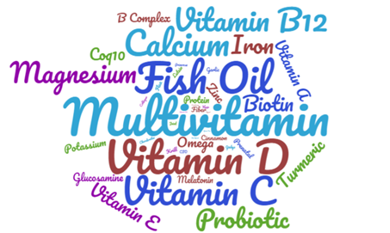
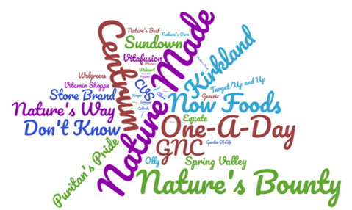
Supplement purchases
They are purchasing a wide range of supplements and brands
Most cited supplements (multivitamins, vitamin D, and fish oil) are top of mind for both Regular & Irregular Supplement Users
They are purchasing a wide range of brands, including private label, but they may not be very loyal to a particular brand
Regular Users are more aware of the brands they are using
Nature Made was most cited by Regular Users while Centrum was cited more by Irregular Users

Slide 8
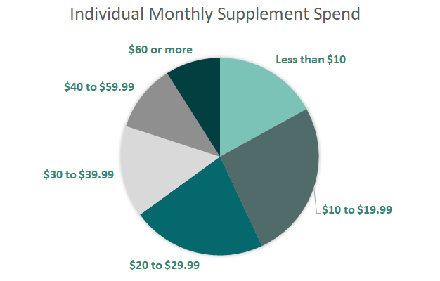
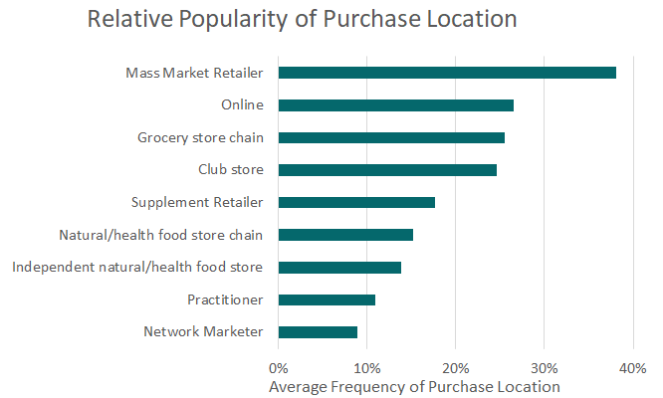
Spending habits
They have a wide range of spending on these supplements, and they are purchasing them in many different locations

Slide 9
General Findings

Slide 10
general Findings
Consumers at all usage levels need to be better educated about what they don’t know
Wide ranging press and consumer education can quickly raise the bar on supplement awareness, knowledge, and usage
  Vitamin D is highlighted as a prime example
  Curcumin/Turmeric is well down this path, but needs a boost to finalize the journey
Regular Users can serve as prime examples of how education and experience leads to loyal customers
  Strong correlation between supplement knowledge, experience of benefits and usage levels – feeling is believing
It is important that usage is increased in conjunction with education in order to better ensure long term usage

Slide 11
Familiarity with usage
Fish Oil, Vitamin D and Probiotics have reached nearly full awareness among supplement users
CoQ10 also remains in the position of needing to improve general knowledge of its existence

Slide 12
Familiarity with usage
While many consumers have never heard of supplements like Astaxanthin, those who have generally feel they have at least moderate familiarity
Regular Users of a particular supplement are generally confident in their knowledge – even if they don’t know everything they should/could
Familiarity levels were slightly up for the average users compared to last year
Glucosamine is well positioned with regard to supplement familiarity

Slide 13
Perceived Effectiveness
A large swath of supplement users have questions or concerns regarding the effectiveness of various supplements
Glucosamine falls behind only Fish Oil, Vitamin D and omega-3s in total perceived effectiveness
Vitamin D highlights how quickly a STRONG CONSUMER EDUCATION CAMPAIGN can quickly elevate consumer understanding

Slide 14
Perceived Effectiveness
Regular Users are far more convinced of all supplement's effectiveness
Irregular Users continue to be more likely to be trusting in effectiveness rather than having experienced benefits
Consumers need to be EDUCATED on the DOSAGES required to experience benefits

Slide 15
Usage Levels
Multivitamins continue to be the #1 supplement choice
Vitamin D has taken the market by storm over the last decade with usage levels almost as strong as multivitamins
The 7 single ingredient supplements that are the study focus continue to be used by a small but important market segment

Slide 16
Change In Usage Levels
Consumers continue to increase usage of all supplement types, even mainstays like multivitamins and calcium as well as the relatively newly ubiquitous Vitamin D
Usage levels of lesser-known supplements are slowly on the rise as well

Slide 17
Change In Usage Levels
Collagen and Protein Powder are the supplements experiencing the most increase in usage, especially with Regular Users
Usage levels are remaining steadier for supplements like Multivitamins and Glucosamine that have more established user bases

Slide 18
Average Monthly Spend
Regular Users tend to spend more per month on supplements
Average monthly spend was up compared to last year

Slide 19
Knowledge of Dosage Levels
There is a significant segment of supplement users that aren’t paying attention to dosages
Regular Users are significantly more likely to be familiar with dosages
Consumers appear to have less dosage knowledge for supplements that are often paired with other ingredients
Consumers need better EDUCATION regarding effective dosages to be informed when choosing supplements

Slide 20
Importance of Sustainability
Overall, sustainability isn’t an important consideration for the majority of supplement users
Consumers for whom Sustainability is frequently or always an influence are:
  Younger (69% under 46 vs. 50% overall)
  More ethnically diverse (47% white, not Hispanic vs. 62% overall)
  Regularly purchase natural and organic foods (65% vs. 52%)
  Less likely to currently say that they have used VMS products to manage their health (77% vs. 83%)
  More likely to have used alternative health care (35% vs. 26%)

Slide 21
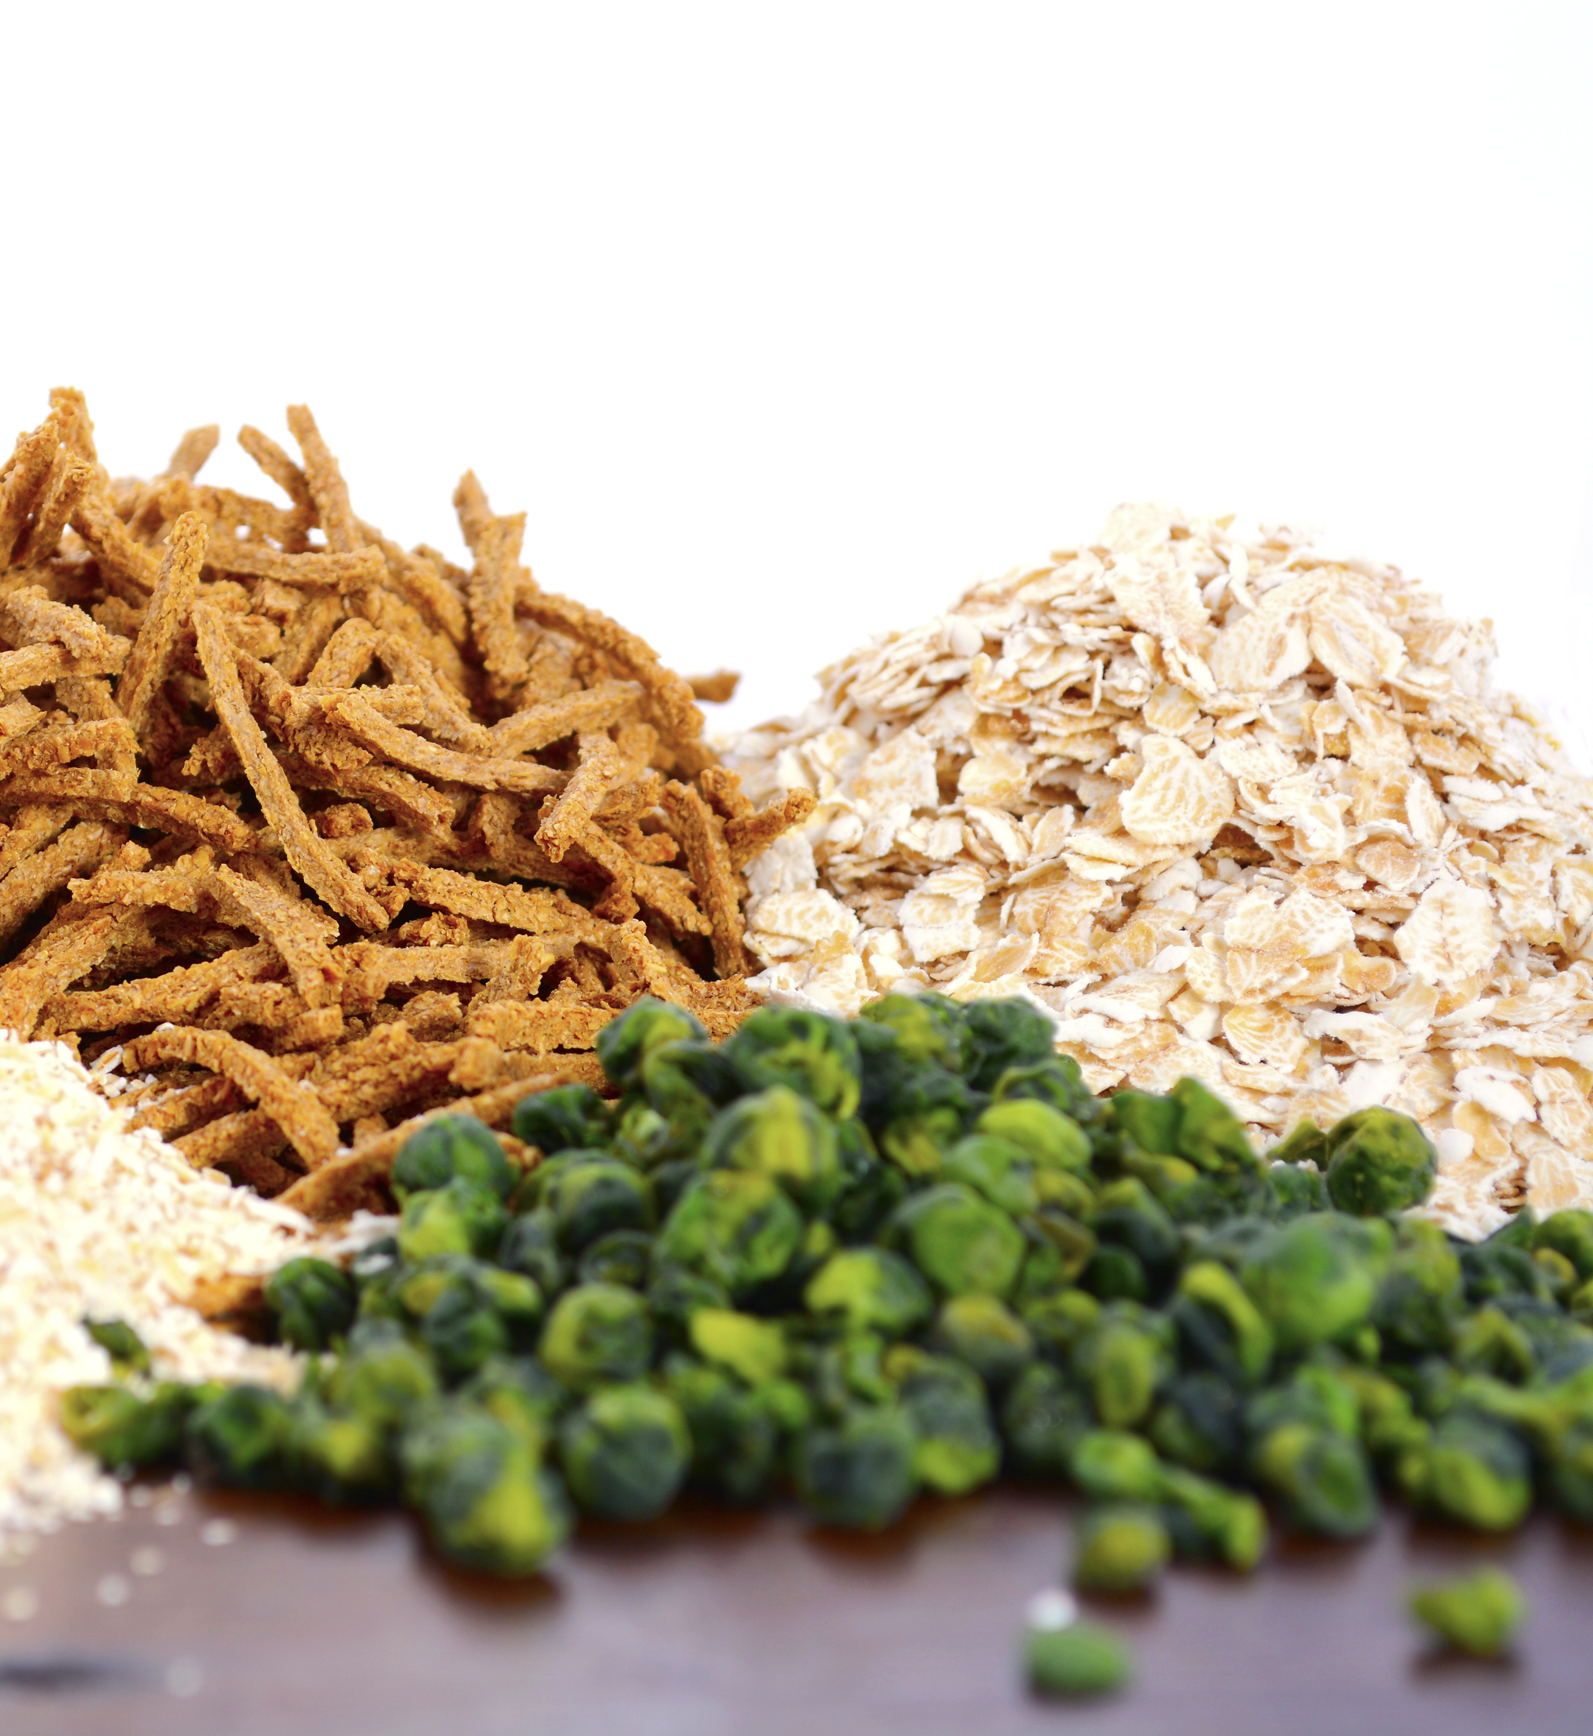
Prebiotics

Slide 22
Familiarity with Prebiotics
80% of supplement users surveyed have heard of Prebiotics (up from 68% last year)
While 73% of Regular Users are very or extremely familiar with its use, most Irregular Users could use more education (49% very or extremely familiar)

Slide 23
Prebiotics Usage
Prebiotics usage appears to be up:
33% of surveyed supplement users are using Prebiotics at some level (up from 23% last year)
39% of Users are REGULAR USERS (4+ times per week), up from 29% last year

Slide 24
Prebiotic Usage CHANGE
38% of Regular Users indicated that they had just started taking or increased their usage in the last year, with 17% indicating “significantly more” usage
27% of Irregular Users indicated that they were using Prebiotics less or had stopped taking in the last year

Slide 25
Monthly Spend on Prebiotics
Users’ spend on prebiotics is slightly above average relative to what supplement users spend on other supplements considered in this survey
Regular Users’ average monthly spend of $23 is about 60% more than what Irregular Users spend, which is above average relative to all supplements considered in this study

Slide 26
Perceived Effectiveness OF Prebiotics
Over half of Regular Users have experienced the benefits of Prebiotics, which is typical of regular users of any supplement
Few consumers have a truly negative opinion of Prebiotics, many just don’t know or have heard conflicting reports
As is true of Irregular Users across supplement types, the biggest group of these users are trusting in the benefits but haven’t experienced them

Slide 27
Benefits of Prebiotics
Gut health clearly remains the most recognized benefit of use
Regular Users are much more likely to recognize the more wide-ranging benefits of prebiotics such as immunity or antioxidant properties
Most non-users aren’t familiar with the benefits of prebiotics, thus highlighting the need for further consumer education

Slide 28
Prebiotics Purchasing Decision
Regular Users are commonly looking for a pro/pre combination, but recognition of the term “synbiotic” remains low
Most users aren’t looking for a high dosage of daily fiber, but they are commonly looking for the “fiber”

Slide 29
Prebiotic Dosages
Prebiotics Irregular Users are especially likely to be less informed about dosage levels
Consumers appear to be taking dosages that are small, especially relative to daily fiber intake needs
Dosage levels have remained fairly steady compared to last year

Slide 30
Profile of Prebiotic User
Regular Users vs. Irregular Users
  More likely to be women (58% vs. 50%)
  Fewer Westerners (20% vs. 29%) and more Northeasterners (25% vs. 17%)
All prebiotic users tend to be
  Younger than average supplement user (67% under 46 vs. 50% overall)
  This year’s prebiotic users were more ethnically diverse, with only 50% white, not Hispanic, vs. 62% overall

Slide 31
Demographics & Psychographics

Slide 32
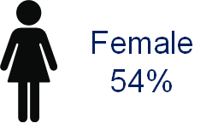
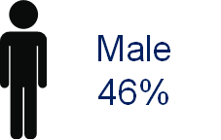
Survey Demographics
Fairly even mix of men and women (no more than 55% women)
Adult consumers, with consumers age 66+ no more than 10% of sample
A diverse balance of all income groups

Slide 33
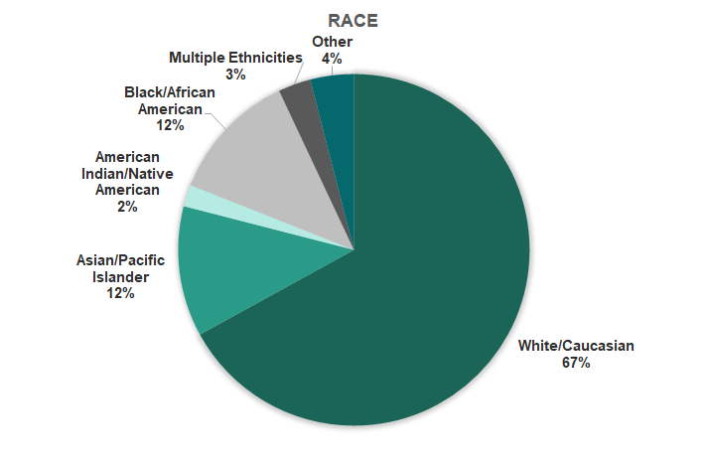
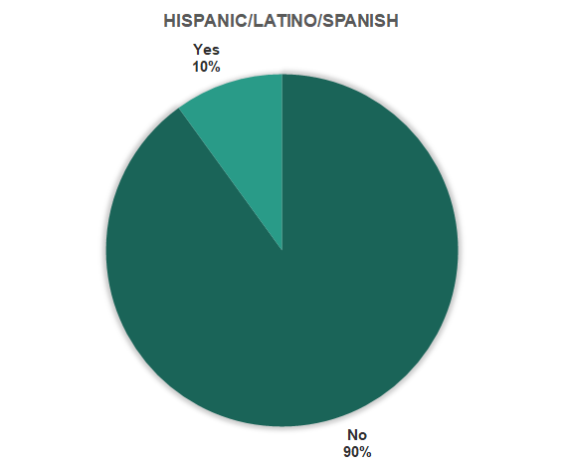
Survey Demographics
Consumers with a diverse ethnic background

Slide 34
Survey Demographics
Consumers living all over the U.S.

Slide 35
For more information or questions, please contact info@prebioticassociation.org
#Ttc2019COnsumerInsights

