Slide 1
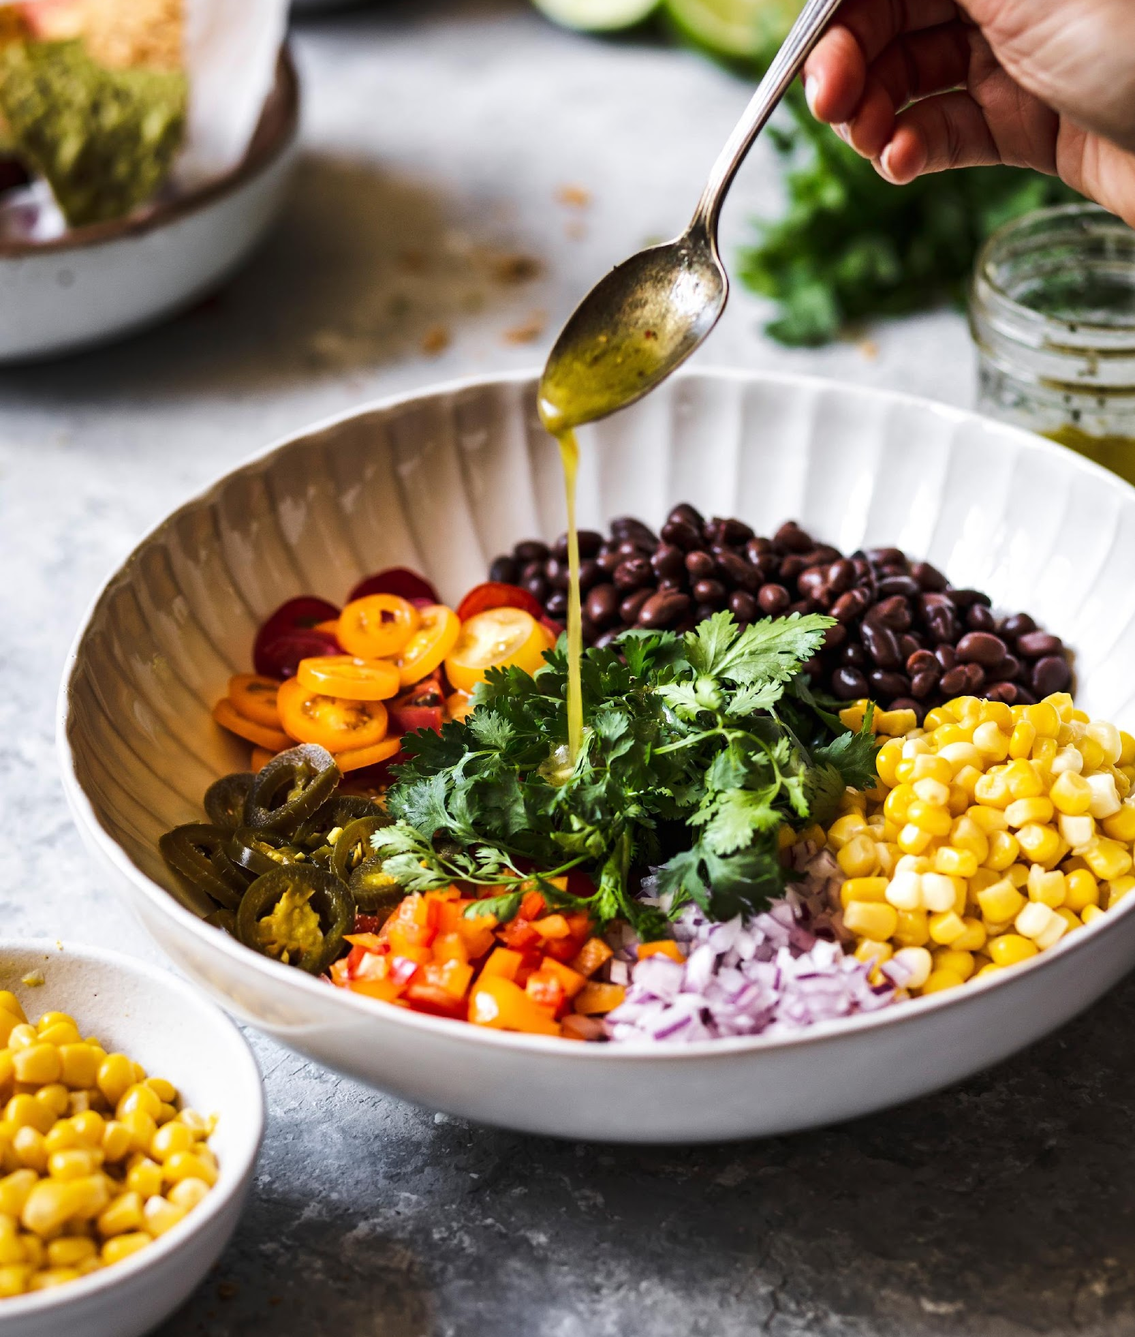

2023 Functional Food and Beverage Survey
GENERAL REPORT

Slide 2

The 2023 ITC Insights Functional Food and Beverage
Survey was fielded from May to June 2023 and analyzed
by the Industry Transparency Center.
The survey includes over 2000 food and beverage
consumers ages 18+ in the US (1000) and UK (1000).
The survey provides insights into functional food and
beverage consumers’ buying behaviors and priorities,
including familiarity, consumption patterns, purchase
drivers, branded ingredients and the importance of values
like trust, transparency and sustainability.
OVERVIEW
The ITC Insights lightbulb indicates there are key takeaways for that slide.

Slide 3

TABLE OF CONTENTS
This table of contents is hyperlinked to the sections. Just click the page number to jump to that section in the deck.
Section | Page Number
Key Takeaways | 4
Demographics | 5
Perceptions About Functional Food and Beverages | 13
Health Concerns and Attitudes | 18
Functional Food & Beverages Usage and Occasions | 22
Shopping Behavior & Patterns | 30
Familiarity & Reasons They Buy | 38
Transparency, Trust & Sustainability | 42
The ITC Insights lightbulb indicates there are key takeaways for that slide.
You can access primary data for charts by right clicking and opening the data in Excel.
Country abbreviations in footers:
United States = US, United Kingdom = UK

Slide 4
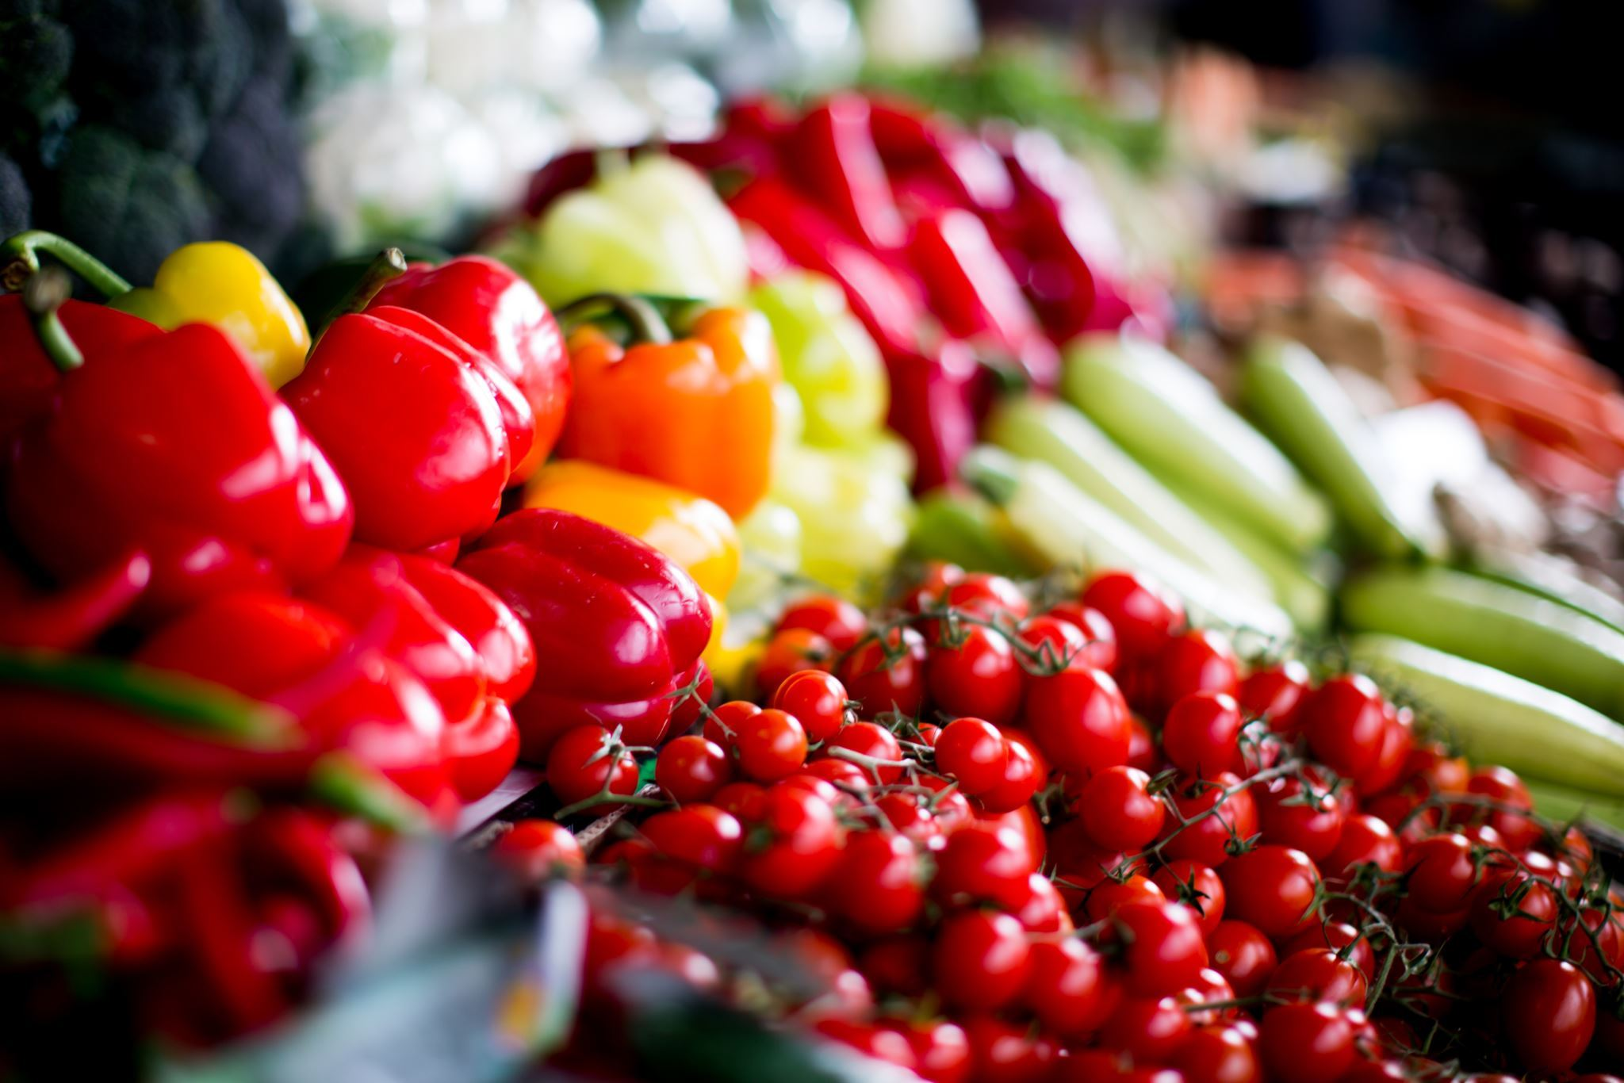
FUNCTIONAL FOOD
& BEVERAGE CONSUMERS KEY TAKEAWAYS
While overall demographics are relatively the same, in the UK, consumers of functional food and beverages skews sharply females at age 18-34, shifting to sharply male for 55+; generally the consumers skew younger (demographics).
When it comes to product format, we see a large gap in the coffee response as a source of functional benefit, where US respondents actually have a high response rate, but not tea; there is a spike for fortified dairy products for females 35-53 and even 55+ (perceptions).
There is significant white space and opportunities as measured by identifying health concerns, mapped against those concerns for which they take functional foods and beverages. While some of this can be accredited to terms such as 'Intuitive functionality', we do see some intuitive gaps that can be filled (health concerns).
Breakfast as a strong preference, followed by lunch (and conspicuously not snacks) were the meal times preferred for functional foods and beverages across all ages and genders (usage and occasions).
In this consumer group, functional foods and beverages are relatively prioritized, at least among 9 lifestyle behaviors, when asking about essential versus willingness to trade out; consumers across the board (behaviors)
When asked how much premium they would pay for healthier options of various product types, for some foods, over 70% said they would pay a premium (more in the US than UK); in all groups measured that number was over 60% in the US (behaviors).

Slide 5

DEMOGRAPHICS
Age, gender and income for all respondents and by individual countries

Slide 6
DEMOGRAPHIC OVERVIEW
Key Insights:
We have an even split between US and UK respondents, as well as close to even for female and male.
Respondent numbers are higher for the 35-54 age group.
Relatively even split with income levels mostly between [$/£]45,000 and [$/£]150,000.
INCOME
 | All Respondents |  | US |  | UK
 | n=2007 |  | n=1002 |  | n=1005
Female | n=1,016 | 51% | n=486 | 49% | n=530 | 53%
Male | n=987 | 49% | n=513 | 51% | n=474 | 47%
Non-binary/prefer to self-describe | n=4 | <1% | n=3 | <1% | n=1 | <1%
18-34 | n=629 | 31% | n=325 | 32% | n=304 | 30%
35-54 | n=809 | 40% | n=403 | 40% | n=406 | 40%
55+ | n=569 | 28% | n=274 | 27% | n=295 | 29%
Note: n=2007 for income.

Slide 7
DEMOGRAPHICS
AGE
INCOME
51%
49%
Even mix of men and women.
Female n=1,016
Male n=987
Non-Binary n=4
We surveyed a well-diversified set of age brackets, in this survey, across all countries/markets
A diverse balance of all income groups was achieved, via individualized country quotas
Note: All Respondents=2007

Slide 8
DEMOGRAPHICS: AGE
18-34
35-54
55+
56%
44%
51%
49%
44%
56%
Note: 18-34 n=629, 35-54 n=809, 55+ n=569.

Slide 9


DEMOGRAPHICS: US
AGE
INCOME
49%
51%
Even mix of men and women.
Female n = 486
Male n = 513
Non-Binary n = 3
Note: US n=1002.

Slide 10
DEMOGRAPHICS: US, AGE & GENDER
18-34
35-54
55+
46%
54%
48%
52%
53%
47%
Note: US 18-34 n=325, 35-54 n=403, 55+ n=274.

Slide 11
DEMOGRAPHICS: UK
AGE
INCOME
53%
47%
Relatively even mix of men and women.
Female n = 530
Male n = 474
Non-Binary n = 1
Note: UK n=1005.

Slide 12
DEMOGRAPHICS: UK, AGE & GENDER
18-34
35-54
55+
66%
33%
55%
45%
36%
64%
Note: UK 18-34 n=304, 35-54 n=406, 55+ n=295.

Slide 13

PERCEPTIONS ABOUT FUNCTIONAL FOODS AND BEVERAGES

Slide 14
SPECIALTY DIETS
Key Insights:
In general US respondents are more likely to be following a specialty diet than their UK counterparts, especially gluten-free and keto.
UK respondents over-indexed for flexitarian and come close to matching the US response rates for vegetarian and Mediterranean but fall behind in all other categories.
Note: US n=1002, UK n=1005, All Respondents n=2007. Question: “Do you currently follow any specialty diets?”

Slide 15
PERSONAL USAGE OF SUPPLEMENTS
Key Insights:
Perhaps unsurprisingly vitamins and multivitamins are the two most popular supplements taken among those surveyed.
US respondents have higher response rates in every supplement category.
Note: US n=1002, UK n=1005, All Respondents n=2007. Question: “Do you take any of the following vitamins/dietary supplements at least once per week?”

Slide 16
SOURCES OF FUNCTIONAL FOOD & BEVERAGE ADVICE
Key Insights:
Family is the number one source of advice for both US and UK respondents.
While a medical doctor is the second highest response in the US, in the UK it comes in 5th, behind family, friends, newspapers, magazines etc. and general nutritionists.
Note: US n=1002, UK n=1005, All Respondents n=2007. Question: “What are the primary sources you use for functional food and/or functional beverage and nutrition advice?”

Slide 17
FOODS & BEVERAGES WITH FUNCTIONAL
BENEFITS
Key Insights:
We see a large gap in the coffee response as a source of functional benefit, where US respondents actually have a higher response rate, but not tea.
The US/UK split was also wide for sports/energy drink.
Most food/beverage categories received responses over 25%, suggesting users are looking for health benefits in most types of foods/beverages.
Note: US n=1002, UK n=1005, All Respondents n=2007. Question: “What are the types of foods/beverages that you look to include a functional benefit?”

Slide 18

HEALTH CONCERNS AND ATTITUDES

Slide 19
HEALTH CONCERNS AND WHAT THEY TAKE FUNCTIONAL FOODS & BEVERAGES FOR
Key Insights:
There is a large gap between reporting health concerns and taking a supplement to treat that health concern in most cases.
This gap as large as 15% for anxiety or stress which is the number one reported health concern and sits at 10% for lack of energy.
Note: n=2007. Results shown for top 10 health concerns.
Health Concerns Question: “Which of the following health conditions or concerns currently impact or impacted you within the past year?”
What They Took Functional Foods & Beverages for Question: “Did you consume functional foods or beverages for any of the following reasons over the past year?”

Slide 20
HEALTH CONCERNS AND WHAT THEY TAKE FUNCTIONAL FOODS & BEVERAGES FOR
Key Insights:
As we move into the next ten top concerns, we do not see the 10%+ gaps as seen with the top 10 health concerns, but do see several at around 5% such as health aging, inflammation, oral health, eye fatigue and memory issues.
Note: n=2007. Results shown for top 11-20 health concerns.
Health Concerns Question: “Which of the following health conditions or concerns currently impact or impacted you within the past year?”
What They Took Functional Foods & Beverages for Question: “Did you consume functional foods or beverages for any of the following reasons over the past year?”

Slide 21
HEALTH CONCERNS AND WHAT THEY TAKE FUNCTIONAL FOODS & BEVERAGES FOR
Key Insights:
There is a large gap between reporting health concerns and taking a supplement to treat that health concern in most cases.
As the health concern reporting rate goes down, so too does the fulfillment gap as seen here the gap for many health concerns is nearing zero.
Note: n=2007. Results shown for top 21-30 health concerns.
Health Concerns Question: “Which of the following health conditions or concerns currently impact or impacted you within the past year?”
What They Took Functional Foods & Beverages for Question: “Did you consume functional foods or beverages for any of the following reasons over the past year?”

Slide 22

FUNCTIONAL FOOD & BEVERAGE USAGE AND OCCASIONS

Slide 23
USAGE FREQUENCY
Key Insight:
US respondents have higher regular usage, as seen by their combined 51% at least four times per week (44% for UK respondents) but both US and UK users have the irregular, 1-3 times per week response as their highest.
Note: US n=1002, UK n=1005, All Respondents n=2007. Question: “How often do you consume functional foods and beverages?”

Slide 24
INGREDIENT USAGE FREQUENCY
Key Insight:
When it comes to ingredient usage, vitamin D tops charts at 37% daily, or 55% at least 4 times per week.
This is followed by calcium at 32/49% and fiber at 30/53%.
Omega3s sit at 22/34% and probiotics at 16/30%.
Note: All Respondents n=1994. Question: “Which of the following best describes how frequently you are consuming the following functional ingredients as part of your regular diet (in foods or beverages, not as dietary supplements)?”

Slide 25
INGREDIENT USAGE FREQUENCY: US
Key Insight:
Vitamin D moves to 40/59% calcium to a solid second in the US at 35/52% with fiber at 30/52%.
Omega-3s in the US sit at 22/35%.
Note: US n=994. Question: “Which of the following best describes how frequently you are consuming the following functional ingredients as part of your regular diet (in foods or beverages, not as dietary supplements)?”

Slide 26
INGREDIENT USAGE FREQUENCY: UK
Key Insight:
Vitamin D and calcium are slightly lower in the US, while omega-3s are about the same. Probiotics are several points less aty 15/27%.
Note: UK n=1000. Question: “Which of the following best describes how frequently you are consuming the following functional ingredients as part of your regular diet (in foods or beverages, not as dietary supplements)?”

Slide 27
WHEN THEY USE
Key Insight:
At almost double the rate of the next closest response, breakfast is overwhelmingly the time when respondents are consuming functional food and/or beverages – in both the US and UK.
Note: US n=1002, UK n=1005, All Respondents n=2007. Question: “When are you most likely to consume a functional food or functional beverage?”

Slide 28
WHO USES FUNCTIONAL FOODS IN THE HOUSEHOLD?
Key Insight:
Overwhelmingly people are buying functional foods & beverages for themselves or for their spouse/significant other.
Note: US n=1002, UK n=1005, All Respondents n=2007. Female 18-34 n=350, Male 18-34 n=276, Female 35-54 n=414, Male 35-54 n=394, Female 55+ n=252, Male 55+ n=317. US Female 18-34 n=148, US Male 18-34 n=175, US Female 35-54 n=192, US Male 35-54 n=210, US Female 55+ n=146, US Male 55+ n=128. UK Female 18-34 n=202, UK Male 18-34 n=101, UK Female 35-54 n=222, UK Male 35-54 n=184, UK Female 55+ n=106, UK Male 55+ n=189. Question: “Who consumes functional foods in your household?”

Slide 29
PREFERRED SWEETENERS
Key Insights:
Honey is the number one preferred sweetener at over 40% for both US and UK respondents, followed by raw sugar, especially in the US.
UK respondents are over-indexed for avoiding sweeteners, and for that reason under-indexed for most every other sweetener.
Note: US n=1002, UK n=1005, All Respondents n=2007. Question: “What are your preferred sweeteners in functional foods and beverages?”

Slide 30

SHOPPING
BEHAVIORS
& PATTERNS

Slide 31
HOUSEHOLD SHOPPING ROLE
Key Insights:
Respondents are overwhelmingly the primary decision-maker in their household when it comes to grocery shopping.
Males over 55 over-index for sharing equal responsibility with others in the household.
Note: US n=1002, UK n=1005, All Respondents n=2007. Female 18-34 n=350, Male 18-34 n=276, Female 35-54 n=414, Male 35-54 n=394, Female 55+ n=252, Male 55+ n=317.US Female 18-34 n=148, US Male 18-34 n=175, US Female 35-54 n=192, US Male 35-54 n=210, US Female 55+ n=146, US Male 55+ n=128. UK Female 18-34 n=202, UK Male 18-34 n=101, UK Female 35-54 n=222, UK Male 35-54 n=184, UK Female 55+ n=106, UK Male 55+ n=189. Question: “Which of the following best describes the role you play in your household's grocery shopping (includes online and/or in-store grocery shopping)?”

Slide 32
MONTHLY GROCERY SPENDING
Key Insight:
Spending in both countries is mostly in the $250 to $500 range with UK responses being slightly higher at and below that range and US responses slightly higher above where they see almost as many responses for spending more than $750 than less than $250 (19% to 21%).
Note: US n=1002, UK n=1005, All Respondents n=2007. Question: “On average, how much does your household spend on groceries each month?”

Slide 33
HOUSEHOLD SIZE
Key Insights:
For both US and UK respondents a household of two is the number one response, and while the US sees more responses of 5 or more, they also see 5% more single persons households.
Females and males over 55 over-index for household size of 2.
Note: US n=1002, UK n=1005, All Respondents n=2007. Female 18-34 n=350, Male 18-34 n=276, Female 35-54 n=414, Male 35-54 n=394, Female 55+ n=252, Male 55+ n=317. US Female 18-34 n=148, US Male 18-34 n=175, US Female 35-54 n=192, US Male 35-54 n=210, US Female 55+ n=146, US Male 55+ n=128. UK Female 18-34 n=202, UK Male 18-34 n=101, UK Female 35-54 n=222, UK Male 35-54 n=184, UK Female 55+ n=106, UK Male 55+ n=189. Question: “How many people are included in your monthly grocery spend?”

Slide 34
PERCENTAGE OF BUDGET FOR FF&B
Key Insights:
Much like spending total, UK respondents are allocating a smaller percentage of their budget to FF&B than their US counterparts.
US respondents have more people budgeting 26 to 50% of their grocery budget to FF&B than under 10%, UK respondents have more than double the other way (35% for under 10% of budget and 16% for 26 to 50% of budget).
Note: US n=1002, UK n=1005, All Respondents n=2007. Question: “What percentage of your monthly grocery spend is on functional foods/beverages?”

Slide 35
PURCHASE LOCATIONS
Key Insight:
Most shopping is perhaps unsurprisingly done at grocery stores and mass market retailers with both respondent groups under 10% for natural health/food stores and UK respondents at only 14% for online and the US 7%.
Note: US n=1002, UK n=1005, All Respondents n=2007. Question: “Where does your household primarily shop for functional foods and beverages?”

Slide 36
PRIORITIZING SPENDING CUTS
Key Insights:
Core vitamins and minerals, functional foods and beverages and over the counter medication all see responses predomin--antly in the essential or change to generic or reduce spending responses.
Gym memberships, physical support and dining out or takeout meals are the only three categories to see a majority number of responses for non-essential from both US and UK respondents.
Note: US n=1002, UK n=1005, All Respondents n=2007. Question: “If you had to cut household spending, how would you prioritize your cuts?”

Slide 37
HEALTHIER ALTERNATIVES PREMIUM
Key Insight:
Apart from popcorn and soda pop, two categories where the highest response rate is no premium, the highest responses come in for the up to 10% price premium.
Higher premiums were mostly in the US, popcorn and cookies at 11-25%, sweet dessert and ice cream at 25-50%,
Note: US n=1002, UK n=1005, All Respondents n=2007. Question: “How much more would you pay for a healthier alternative of a not healthy product you love?”

Slide 38
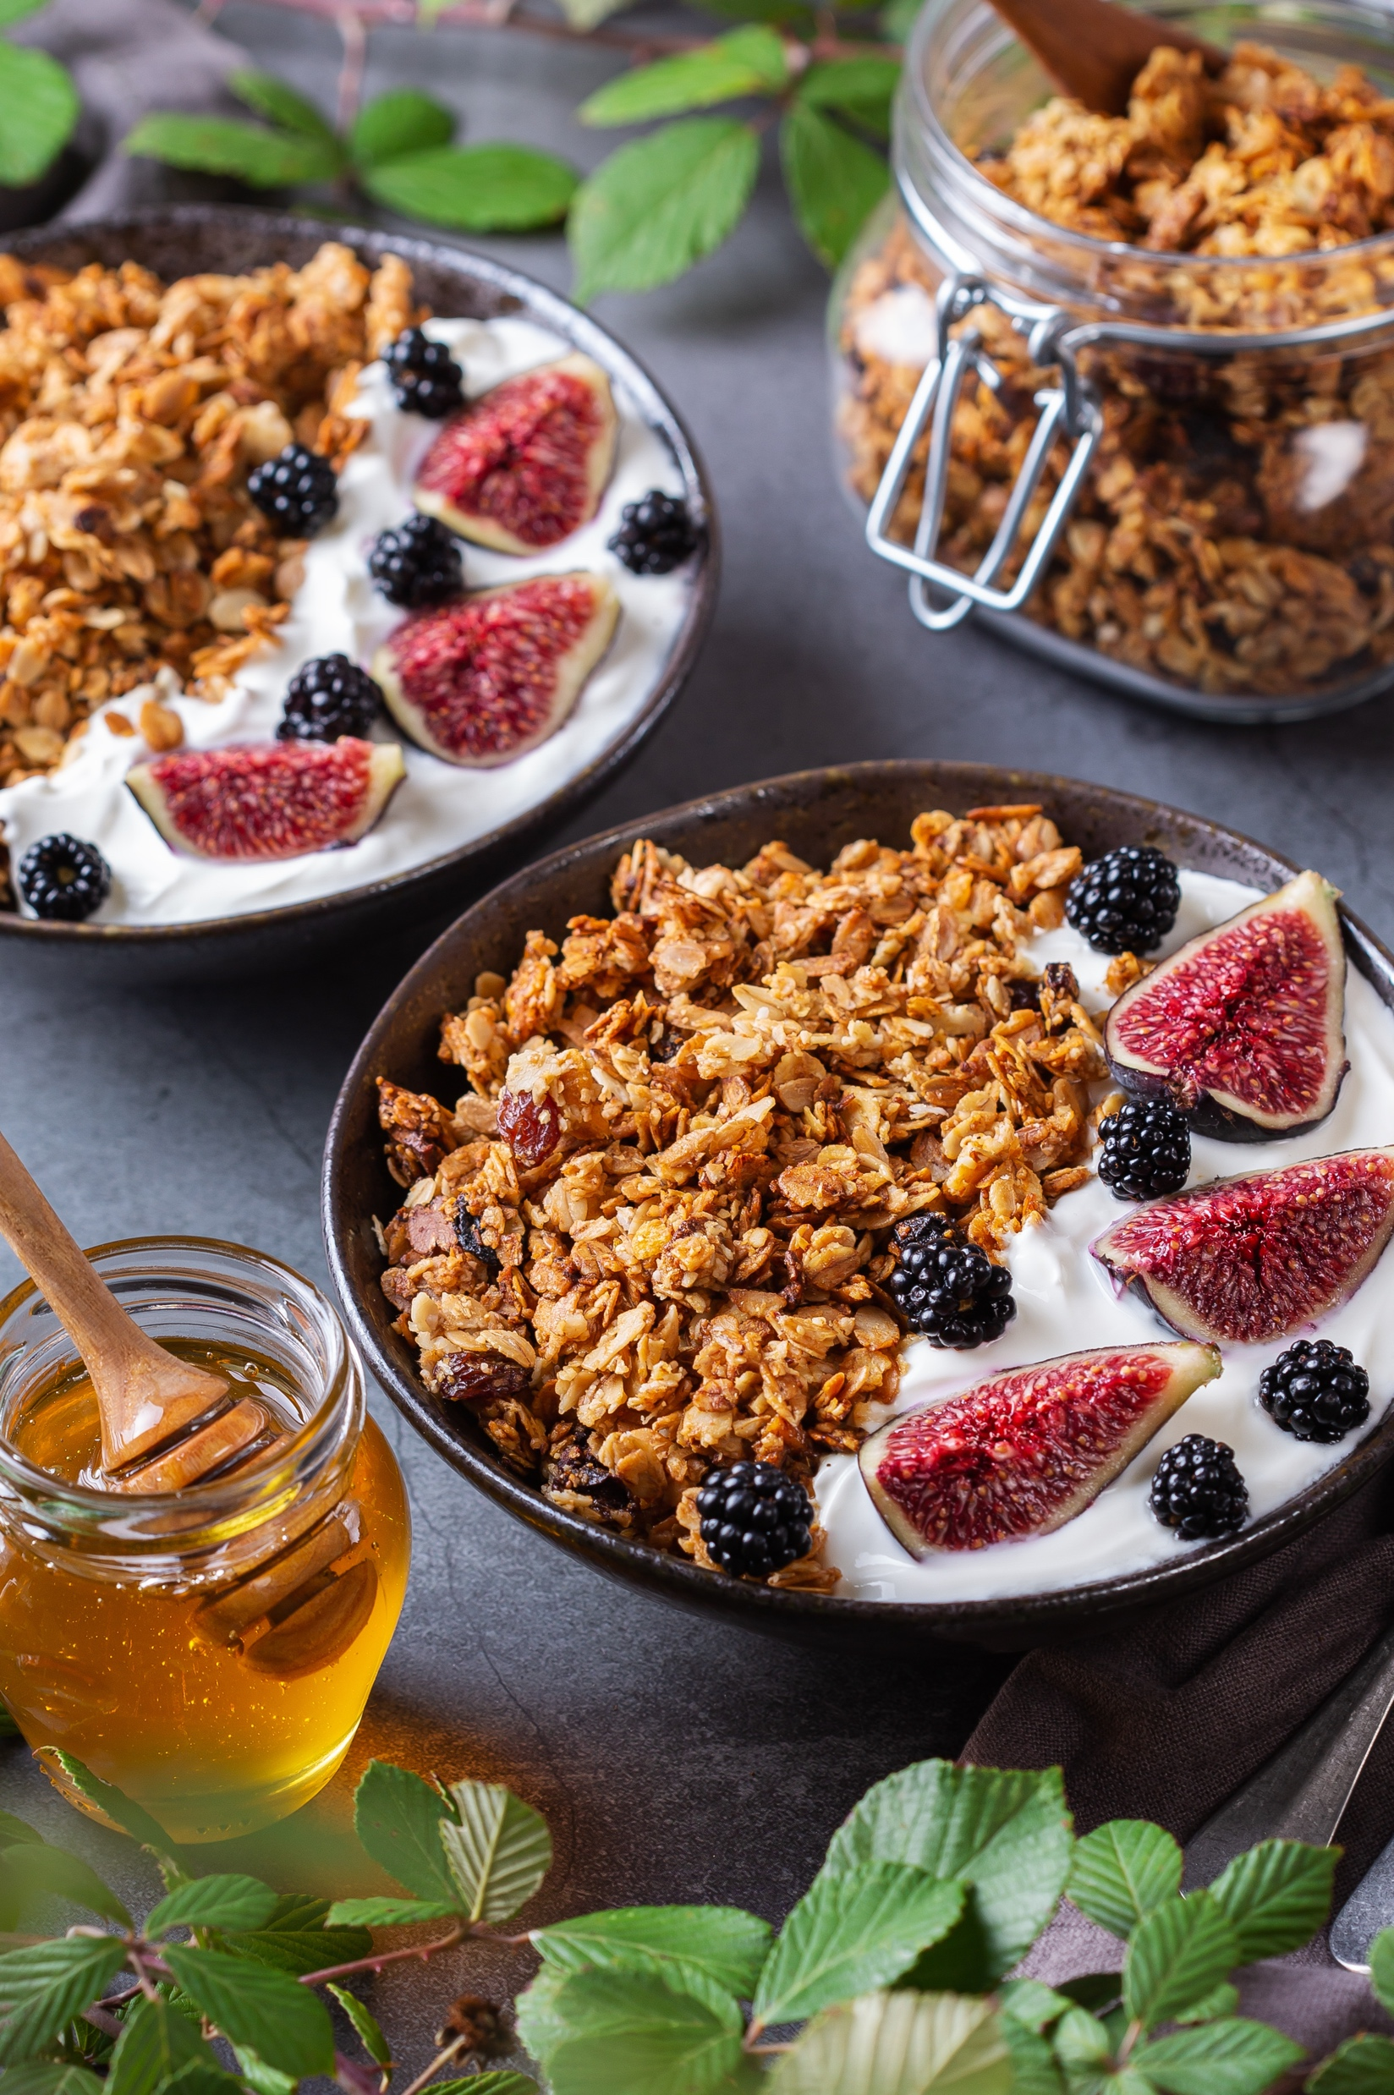
FAMILIARITY & REASONS WHY THEY BUY

Slide 39
FAMILIARITY
Key Insights:
For all but postbiotics and MCT, familiarity levels are above 90%.
Rates in the US and UK are similar but then diverge for postbiotics and MCT.
Prebiotics familiarity levels are lower than probiotics’ but only by a few percentage points, but postbiotics familiarity levels are more than 20% lower.
Note: US n=1002, UK n=1005, All Respondents n=2007. Question: “How familiar would you consider yourself regarding these functional ingredients in foods and/or beverages?” Sum of all responses except “never heard of it”.

Slide 40
PERCEIVED EFFECTIVENESS
Key Insights:
UK perceived effectiveness is higher for omega-3s and to a lesser extent vitamin D and iron; the biggest gap in the favor of US consumers is for collagen.
Perceived effectiveness for all but MCT among UK respondents is over 50%.
Both pre- and postbiotics’ effectiveness levels are more than 10% behind those of probiotics.
Note: n varies by ingredient. Question: “What is your opinion of the effectiveness/benefit of each of these functional food ingredients?” Sum of responses marked “I trust that it is effective, and I have experienced its benefits” and “I trust that it is effective, but I haven’t experienced benefits”.

Slide 41
IMPORTANT CHARACTERISTICS
Key Insights:
The top three most important purchase characteristics are quality of product, price and nutritional profile for both US and UK respondents.
All other categories are under 20% response rate, many near or under 5%.
Note: US n=1002, UK n=1005, All Respondents n=2007. Question: “What characteristics are most important to you when deciding to purchase a functional food or beverage product?”

Slide 42
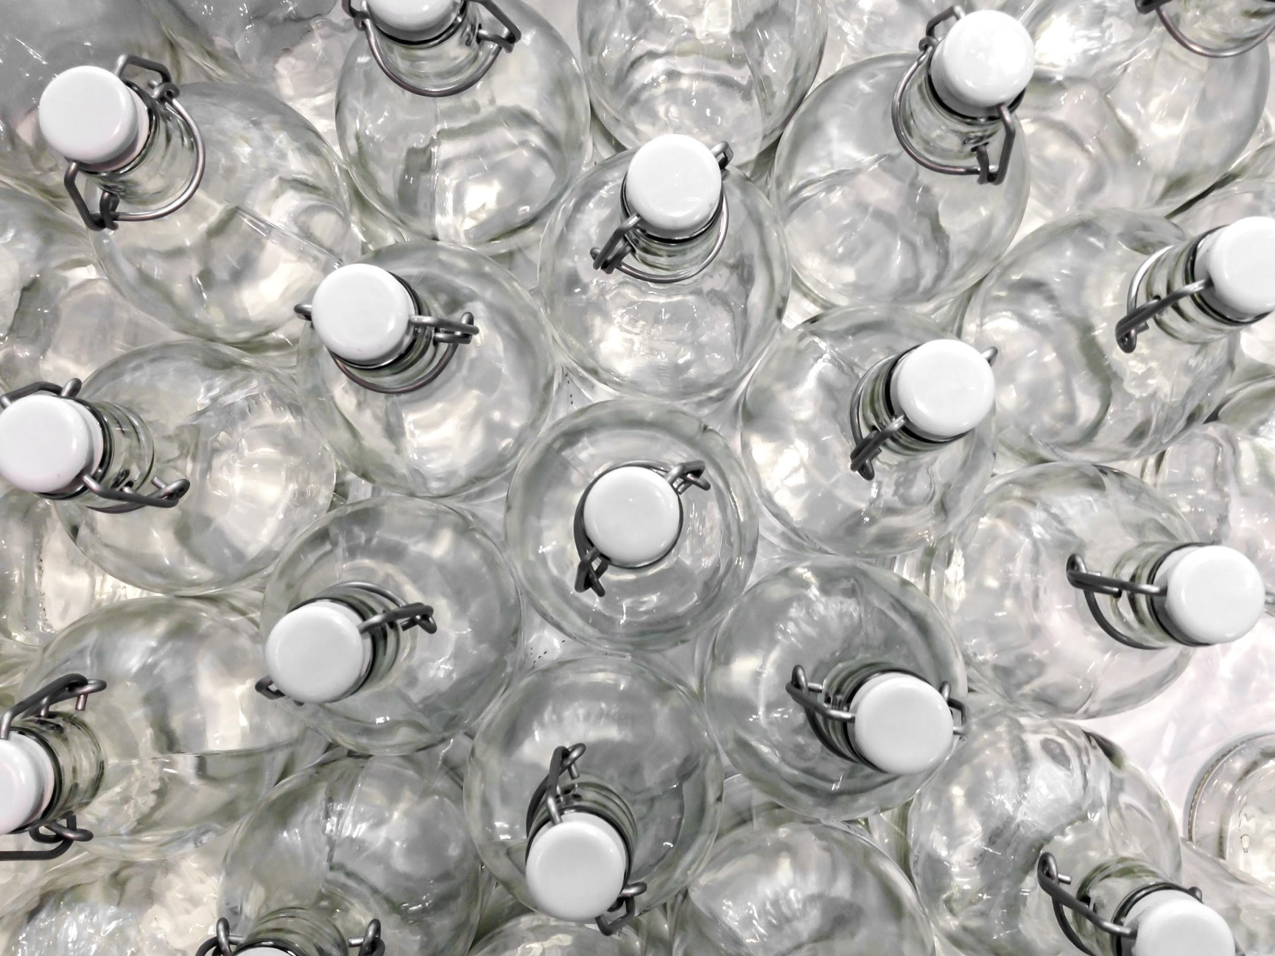
TRANSPARENCY, TRUST & SUSTAINABILITY

Slide 43
LABEL AND WEBSITE TRANSPARENCY
Key Insight:
More than two thirds of responses (67%) come in for either transparency greatly or somewhat increasing someone's purchase chance, the former driven by US consumers at 32%.
Note: US n=1002, UK n=1005, All Respondents n=2007. Question: “How likely are you to purchase functional foods and beverages from a manufacturer that provides transparency information on its label or website?”

Slide 44
SIGNALS OF TRANSPARENCY
Key Insights:
A quality seal on the label is the number one response for both the US and UK, with each at an even 50%.
The UK over-indexes for country of origin as well as QR code.
Both none and I do not believe any brands operate transparently are sitting well below 10% for both respondent groups.
Note: US n=1002, UK n=1005, All Respondents n=2007. Question: “Which of the following are the strongest signals that a food/beverage brand is operating transparently?”

Slide 45
TRUST
Key Insights:
There was not much consensus on what people think of as the most important characteristic for building trust, as seen by most characteristics hovering around the 30 to 40% range. Perhaps signaling a need for brands to have more than one of these characteristics.
There are stark differences between the US and UK, for instance, transparency in supply chain was at the top in the UK, but lowest rank 1 in the US.
Quality certifications and seals was second in the UK, but barely fifth in the US and only if you are looking at rank 1.
US Respondents
UK Respondents
 | Rank 1 | Rank 2 | Rank 3
Consistent product quality | 41% | 32% | 27%
Nutritional profile | 40% | 34% | 26%
Authentic brand story | 37% | 33% | 30%
Long-term use of the brand | 37% | 39% | 24%
Quality certification/seal on label/website | 35% | 30% | 35%
Social media influencers | 34% | 33% | 33%
Brand values align with my own | 34% | 36% | 31%
Friend/family recommends the brand | 33% | 27% | 39%
Values based certification/seal on label/website | 32% | 30% | 37%
Health care professional recommends the brand | 32% | 32% | 36%
Informative website | 29% | 38% | 33%
Other experts recommend the brand | 29% | 34% | 37%
Supports charities/causes | 28% | 31% | 41%
Transparency in supply chain | 27% | 38% | 35%
 | Rank 1 | Rank 2 | Rank 3
Transparency in supply chain | 40% | 29% | 30%
Quality certification/seal on label/website | 40% | 29% | 31%
Health care professional recommends the brand | 38% | 36% | 26%
Long-term use of the brand | 37% | 34% | 30%
Brand values align with my own | 36% | 31% | 33%
Consistent product quality | 36% | 36% | 28%
Social media influencers | 36% | 30% | 34%
Nutritional profile | 35% | 30% | 35%
Informative website | 34% | 33% | 32%
Authentic brand story | 34% | 40% | 26%
Friend/family recommends the brand | 31% | 32% | 37%
Values based certification/seal on label/website | 28% | 36% | 36%
Supports charities/causes | 21% | 34% | 45%
Other experts recommend the brand | 21% | 42% | 38%
Note: n varies. Question: “What characteristics most encourage you to trust a food/beverage brand?”

Slide 46
IMPACT OF SUSTAINABILITY
Key Insights:
Sustainability is more important to US consumers than those in the UK (15% always influences).
The highest response rates come from the sometimes response.
US respondents marked that they were not aware of sustainability issues at the same rate UK respondents marked that those issues always influence their purchase decisions (10%).
Note: US n=1002, UK n=1005, All Respondents n=2007. Question: “Does the sustainability/environmental impact of the nutritional ingredients in your food influence your purchase decisions?”

