Slide 1


2023 Functional Food and Beverage Survey
PREBIOTIC REPORT:
ASSOCIATE LEVEL

Slide 2

The 2023 ITC Insights Consumer Supplement Survey was fielded from February to March 2023 and analyzed by the Industry Transparency Center.
The survey includes over 3500 supplement consumers ages 18+ in 6 countries: US (1000), UK (500), DE (500) IT: 500, KR: 500, AU:500.
The survey provides insights into supplement user buying behaviors and priorities, including familiarity, usage patterns, purchase drivers, branded ingredients and the importance of values like trust, transparency and sustainability.
OVERVIEW
The ITC Insights lightbulb indicates there are key takeaways for that slide.

Slide 3

TABLE OF CONTENTS
This table of contents is hyperlinked to the sections. Just click the page number to jump to that section in the deck.
Section | Page Number
Demographics | 4
Perceptions About Functional Food and Beverages | 12
Health Concerns and Attitudes | 17
Functional Food & Beverages Usage and Occasions | 21
Shopping Behavior & Patterns | 28
Familiarity & Reasons They Buy | 36
Transparency, Trust & Sustainability | 40
Prebiotic Deep Dive | 45
The ITC Insights lightbulb indicates there are key takeaways for that slide.
You can access primary data for charts by right clicking and opening the data in Excel.
Country abbreviations in footers:
United States = US, United Kingdom = UK

Slide 4

DEMOGRAPHICS
Age, gender and income for all respondents and by individual countries

Slide 5
DEMOGRAPHIC OVERVIEW
Key Insights:
We have an even split between US and UK respondents, and slightly more males driven by the US.
Respondent numbers are higher for the 35-54 age group.
Relatively even split with income levels mostly between [$/£]45,000 and [$/£]150,000.
INCOME
 | All Prebiotic Users |  | US |  | UK
 | n=1261 |  | n=651 |  | n=610
Female | n=602 | 48% | n=280 | 43% | n=322 | 53%
Male | n=657 | 52% | n=369 | 57% | n=288 | 47%
Non-binary/prefer to self-describe | n=0 | n/a | n=0 | n/a | n=0 | n/a
18-34 | n=447 | 35% | n=244 | 37% | n=203 | 33%
35-54 | n=541 | 43% | n=275 | 42% | n=266 | 44%
55+ | n=273 | 22% | n=132 | 20% | n=141 | 23%
Note: n=1261 for income.

Slide 6
DEMOGRAPHICS
AGE
INCOME
48%
52%
Even mix of men and women.
Female n=602
Male n=657
We surveyed a well-diversified set of age brackets, in this survey, across all countries/markets
A diverse balance of all income groups was achieved, via individualized country quotas
Note: All Prebiotic Users=1261

Slide 7
DEMOGRAPHICS: AGE & GENDER
18-34
35-54
55+
50%
50%
46%
54%
47%
53%
Note: 18-34 n=447, 35-54 n=541, 55+ n=273.

Slide 8


DEMOGRAPHICS: US
AGE
INCOME
43%
57%
Slightly more men than woman.
Female n = 280
Male n = 369
35-54 age range is most prominent.
Note: US n=651.

Slide 9
DEMOGRAPHICS: US, AGE & GENDER
18-34
35-54
55+
40%
59%
40%
60%
55%
45%
Note: US 18-34 n=244, 35-54 n=275, 55+ n=132.

Slide 10
DEMOGRAPHICS: UK
AGE
INCOME
53%
47%
Slightly more woman than men.
Female n = 322
Male n = 288
35-54 age range is most prominent.
Note: UK n=610.

Slide 11
DEMOGRAPHICS: UK, AGE & GENDER
18-34
35-54
55+
62%
38%
53%
47%
40%
60%
Note: UK 18-34 n=304, 35-54 n=406, 55+ n=295.

Slide 12

PERCEPTIONS ABOUT FUNCTIONAL FOODS AND BEVERAGES

Slide 13
SPECIALTY DIETS
Key Insights:
Prebiotic users sharply over-index, especially in the US, for most of the listed diets, especially gluten-free and plant-based.
In general US respondents are more likely to be following a specialty diet than their UK counterparts.
UK respondents over-index for flexitarian and just barely for Mediterranean and come close to matching the US response rate for vegetarian.
Note: US n=651, UK n=610, All Respondents n=2007. Question: “Do you currently follow any specialty diets?”

Slide 14
PERSONAL USAGE OF SUPPLEMENTS
Key Insights:
Prebiotic users over-index compared to all users for protein, both in the US and UK; in the US, they also over-index in their use of vitamins.
Vitamins and multivitamins are the two most popular supplements taken among those surveyed.
US respondents have higher response rates in every supplement category.
Note: US n=651, UK n=610, All Respondents n=2007. Question: “Do you take any of the following vitamins/dietary supplements at least once per week?”

Slide 15
SOURCES OF FUNCTIONAL FOOD & BEVERAGE ADVICE
Key Insights:
Prebiotic users in the US over-index with medical doctors as an information source; in the UK, the over-indexing of these users is with a general nutritionist.
Family is the number one source of advice for both US and UK respondents.
While a medical doctor is the second highest response in the US, in the UK it comes in 5th, behind family, friends, newspapers, magazines etc. and general nutritionists.
Note: US n=651, UK n=610, All Respondents n=2007. Question: “What are the primary sources you use for functional food and/or functional beverage and nutrition advice?”

Slide 16
FOODS & BEVERAGES WITH FUNCTIONAL
BENEFITS
Key Insights:
Compared to all in the survey, prebiotic consumers over-index in the US for coffee and health drinks;, the strongest over-indexing in the UK is for fortified milk alternatives.
There is a large gap in the coffee response but not tea, where US respondents have a higher response rate.
Most food/beverage categories received responses over 25% with no large category leader, suggesting users are looking for health benefits in most types of foods/beverages.
Note: US n=651, UK n=610, All Respondents n=2007. Question: “What are the types of foods/beverages that you look to include a functional benefit?”

Slide 17

HEALTH CONCERNS AND ATTITUDES

Slide 18
HEALTH CONCERNS AND WHAT THEY TAKE FUNCTIONAL FOODS & BEVERAGES FOR
Key Insights:
There is a large gap between reporting health concerns and taking a supplement to treat that health concern in most cases.
For instance we see a gap as large as 14% for anxiety or stress which is the number one reported health concern.
Note: n=1261. Results shown for top 10 health concerns.
Health Concerns Question: “Which of the following health conditions or concerns currently impact or impacted you within the past year?”
What They Took Functional Foods & Beverages for Question: “Did you consume functional foods or beverages for any of the following reasons over the past year?”

Slide 19
HEALTH CONCERNS AND WHAT THEY TAKE FUNCTIONAL FOODS & BEVERAGES FOR
Key Insights:
There is a large gap between reporting health concerns and taking a supplement to treat that health concern as we move deeper into lesser concerns.
There are not the 10%+ gaps as seen with the top 10 health concerns, with the treatment gap with the next 10 health concerns all at or below 5%.
Note: n=1261. Results shown for top 11-20 health concerns.
Health Concerns Question: “Which of the following health conditions or concerns currently impact or impacted you within the past year?”
What They Took Functional Foods & Beverages for Question: “Did you consume functional foods or beverages for any of the following reasons over the past year?”

Slide 20
HEALTH CONCERNS AND WHAT THEY TAKE FUNCTIONAL FOODS & BEVERAGES FOR
Key Insights:
As the health concern reporting rate goes down, so too does the treatment gap as seen here the gap for many health concerns is nearing zero.
Note: n=1261. Results shown for top 21-30 health concerns.
Health Concerns Question: “Which of the following health conditions or concerns currently impact or impacted you within the past year?”
What They Took Functional Foods & Beverages for Question: “Did you consume functional foods or beverages for any of the following reasons over the past year?”

Slide 21
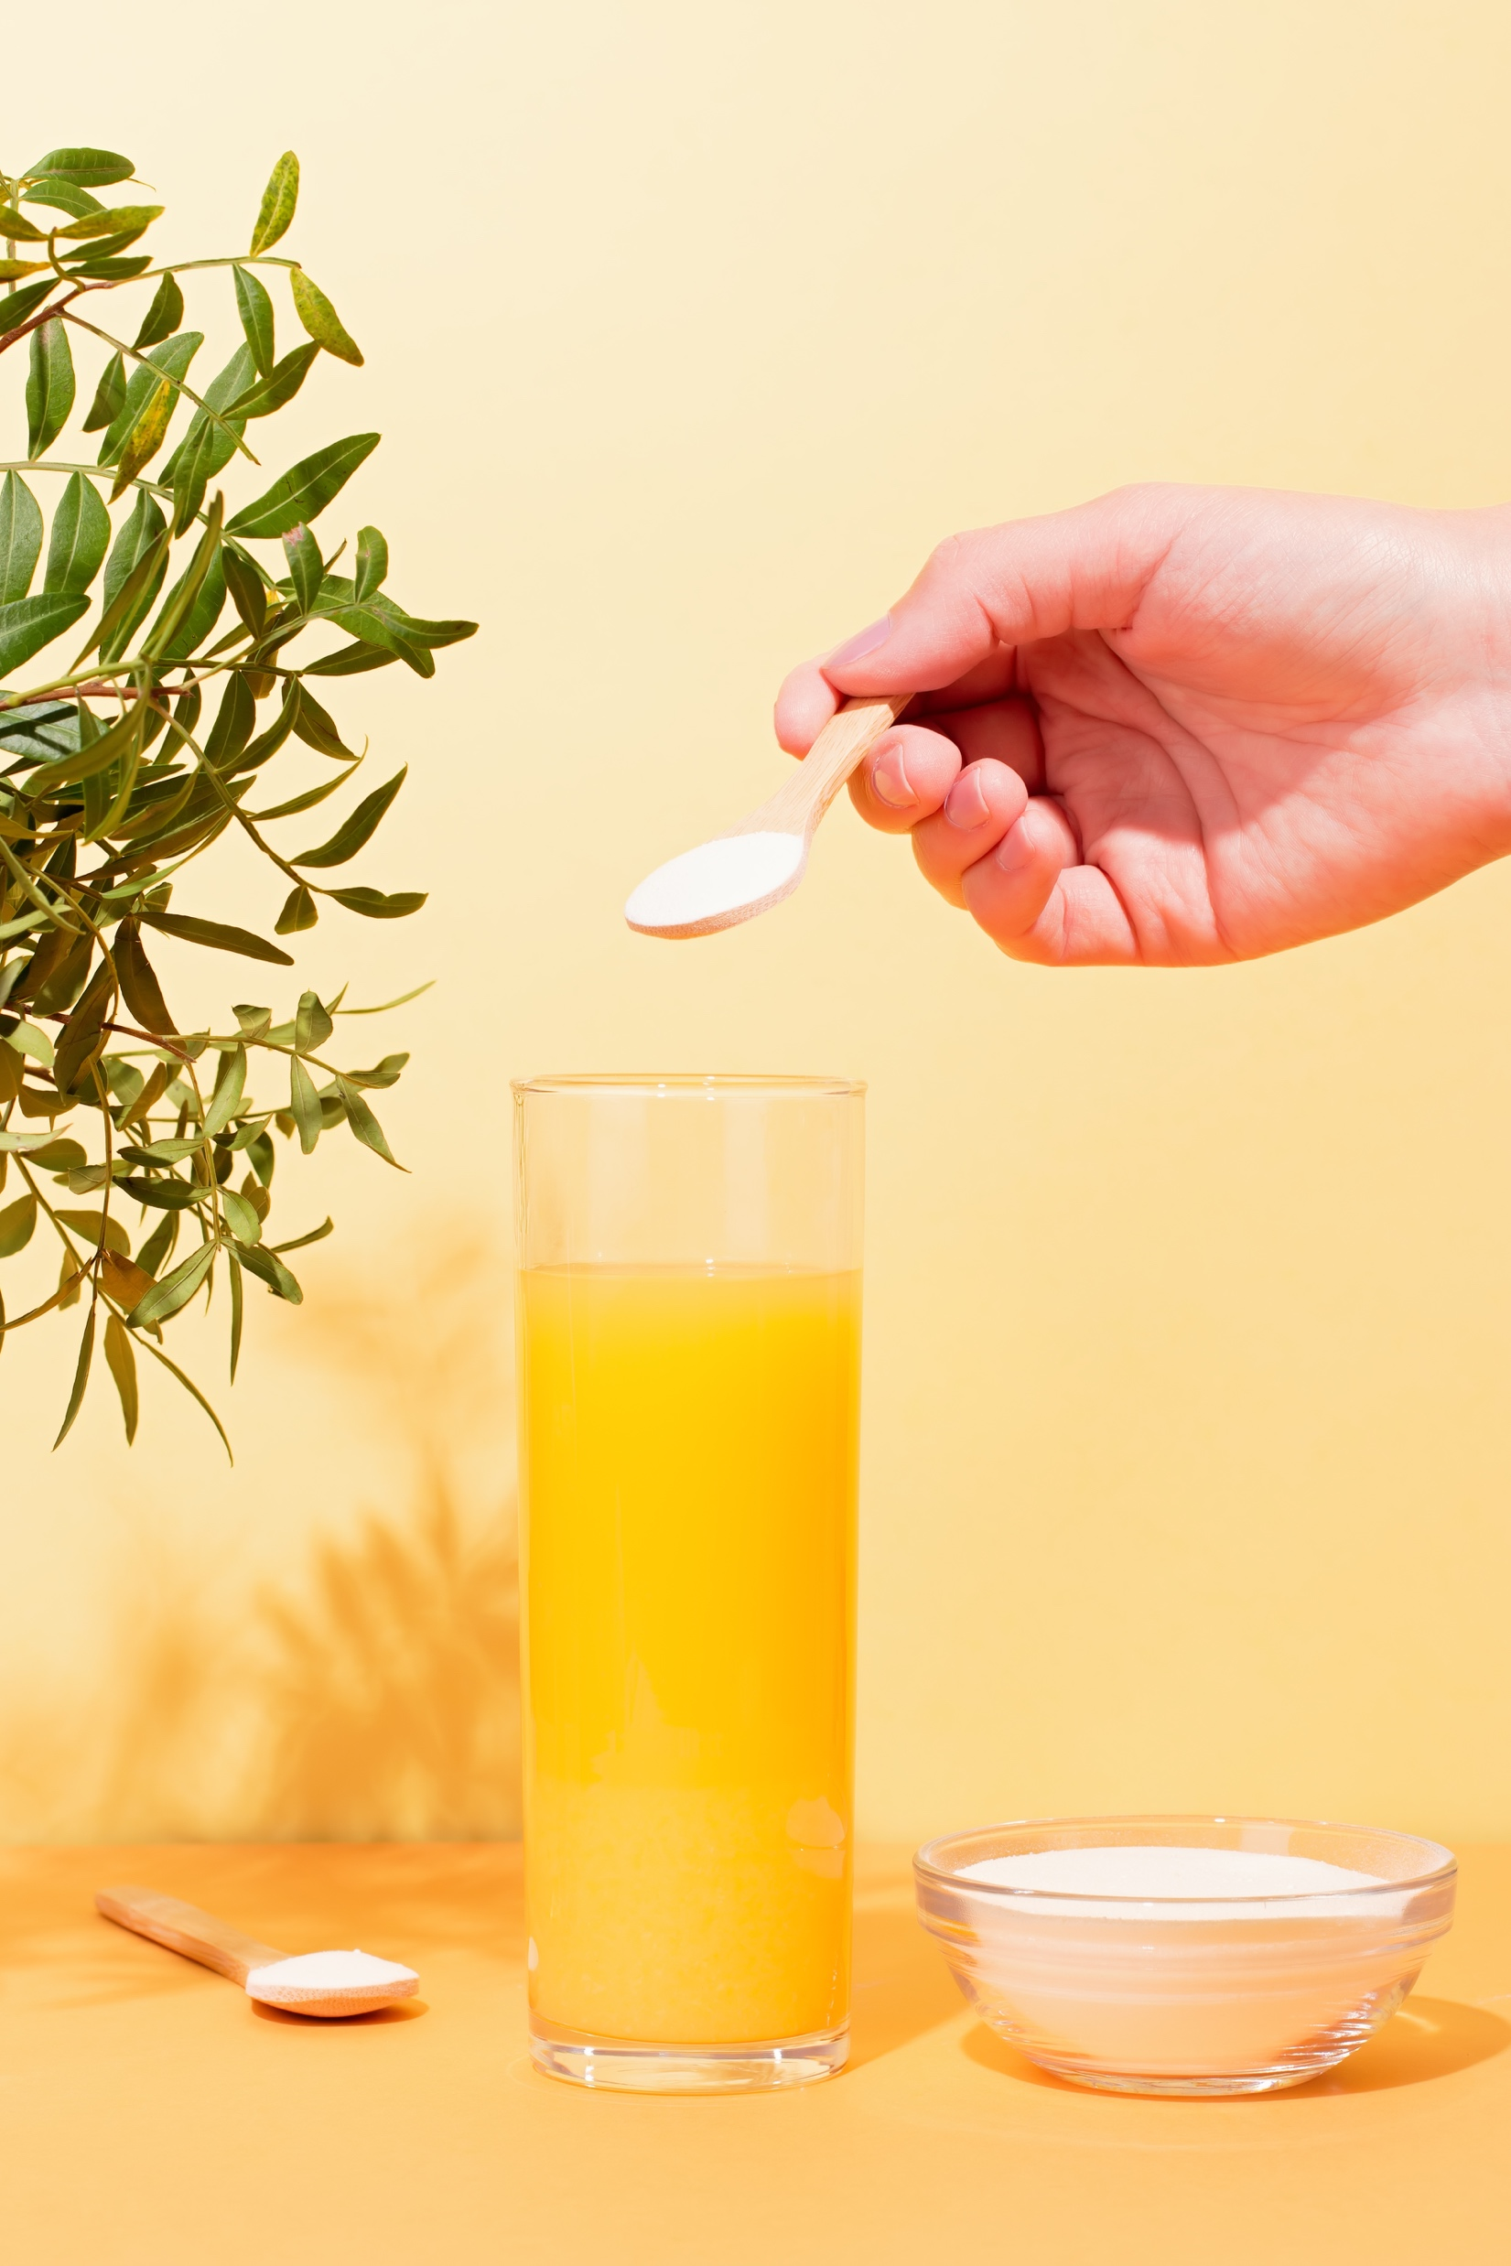
FUNCTIONAL FOOD & BEVERAGE USAGE AND OCCASIONS

Slide 22
USAGE FREQUENCY
Key Insight:
US respondents have the higher regular usage, as seen by their combined 55% in those categories (50% for UK respondents) but both US and UK users have the irregular, 1-3 times per week response as their highest.
Note: US n=651, UK n=610, All Respondents n=2007. Question: “How often do you consume functional foods and beverages?”

Slide 23
INGREDIENT USAGE FREQUENCY: US
Key Insight:
When it comes to functional ingredients consumption for prebiotic users, prebiotics are in the middle of the pack 5% below probiotics.
Interestingly, prebiotics do rank ahead of plant-based protein.
Note: n varies by ingredient. Question: “Which of the following best describes how frequently you are consuming the following functional ingredients as part of your regular diet (in foods or beverages, not as dietary supplements)?”

Slide 24
INGREDIENT USAGE FREQUENCY: UK
Key Insight:
As in the US, probiotics have higher levels of regular use than prebiotics, and in this case, while other ingredient frequency across the board is lower, fiber maintains the exact same level as in the US, and in regular consumption is top ahead of vitamin D.
Note: n varies by ingredient. Question: “Which of the following best describes how frequently you are consuming the following functional ingredients as part of your regular diet (in foods or beverages, not as dietary supplements)?”

Slide 25
WHEN THEY USE
Key Insight:
At almost double the rate of the next closest response, breakfast is overwhelmingly the time when respondents are consuming functional foods and/or beverages, and there is little difference overall between the US and UK.
Note: US n=651, UK n=610, All Respondents n=2007. Question: “When are you most likely to consume a functional food or functional beverage?”

Slide 26
WHO CONSUMES IN THE HOUSEHOLD
Key Insight:
Overwhelmingly people are buying functional foods & beverages for themselves or for their spouse/significant other.
Note: US n=651, UK n=610, All Respondents n=2007. Female 18-34 n=223, Male 18-34 n=222, Female 35-54 n=250, Male 35-54 n=291, Female 55+ n=129, Male 55+ n=144. US Female 18-34 n=98, US Male 18-34 n=144, US Female 35-54 n=110, US Male 35-54 n=165, US Female 55+ n=132, US Male 55+ n=60. UK Female 18-34 n=125, UK Male 18-34 n=78, UK Female 35-54 n=140, UK Male 35-54 n=126, UK Female 55+ n=57, UK Male 55+ n=84. Question: “Who consumes functional foods in your household?”

Slide 27
PREFERRED SWEETENERS
Key Insights:
Honey is the number one preferred sweetener at over almost 50% for both US and UK respondents.
UK respondents over-indexed for avoiding sweeteners, and for that reason under-indexed for most every other sweetener.
Note: US n=651, UK n=610, All Respondents n=2007. Question: “What are your preferred sweeteners in functional foods and beverages?”

Slide 28

SHOPPING
BEHAVIORS & PATTERNS

Slide 29
HOUSEHOLD SHOPPING ROLE
Key Insights:
Respondents are overwhelmingly the primary decision-maker in their household when it comes to grocery shopping.
Males over 55 over-index for sharing equal responsibility with others in the household.
Note: US n=651, UK n=610, All Respondents n=2007. Female 18-34 n=223, Male 18-34 n=222, Female 35-54 n=250, Male 35-54 n=291, Female 55+ n=129, Male 55+ n=144. US Female 18-34 n=98, US Male 18-34 n=144, US Female 35-54 n=110, US Male 35-54 n=165, US Female 55+ n=132, US Male 55+ n=60. UK Female 18-34 n=125, UK Male 18-34 n=78, UK Female 35-54 n=140, UK Male 35-54 n=126, UK Female 55+ n=57, UK Male 55+ n=84. Question: “Which of the following best describes the role you play in your household's grocery shopping (includes online and/or in-store grocery shopping)?”

Slide 30
MONTHLY GROCERY SPENDING
Key Insight:
Spending in both countries is mostly in the $250 to $500 range with UK responses being predominantly at and below that range and US responses more often slightly above where they see more responses for spending more than $750 than less than $250 (23% to 17%).
Note: US n=651, UK n=610, All Respondents n=2007. Question: “On average, how much does your household spend on groceries each month?”

Slide 31
HOUSEHOLD SIZE
Key Insights:
For both US and UK respondents a household of two is the number one response with a household of four coming in just behind.
Females and males over 55 over-index for household size of 2.
Note: US n=651, UK n=610, All Respondents n=2007 Female 18-34 n=223, Male 18-34 n=222, Female 35-54 n=250, Male 35-54 n=291, Female 55+ n=129, Male 55+ n=144. US Female 18-34 n=98, US Male 18-34 n=144, US Female 35-54 n=110, US Male 35-54 n=165, US Female 55+ n=132, US Male 55+ n=60. UK Female 18-34 n=125, UK Male 18-34 n=78, UK Female 35-54 n=140, UK Male 35-54 n=126, UK Female 55+ n=57, UK Male 55+ n=84. Question: “How many people are included in your monthly grocery spend?”

Slide 32
PERCENTAGE OF BUDGET FOR FF&B
Key Insights:
In both countries, prebiotic consumers over-index compared to all consumers; this is manifest in the 26-50% range in the US and the 10-25% range for the UK.
Much like the spending total, UK respondents are allocating a smaller percentage of their budget to FF&B than their US counterparts.
US respondents have more people budgeting 26 to 50% of their grocery budget to FF&B than under 10%.
Note: US n=651, UK n=610, All Respondents n=2007. Question: “What percentage of your monthly grocery spend is on functional foods/beverages?”

Slide 33
PURCHASE LOCATIONS
Key Insight:
Most shopping is done at grocery stores in the UK and grocery stores and mass market retailers in the US.
Note: US n=651, UK n=610, All Respondents n=2007. Question: “Where does your household primarily shop for functional foods and beverages?”

Slide 34
SPENDING CUTS
Key Insights:
Core vitamins and minerals, functional foods and beverages and over the counter medication all see responses predominantly in the essential or change to generic or cut spending responses.
Gym memberships, physical support and dining out or takeout meals are the only three categories to see a majority number of responses for non-essential from both US and UK respondents.
Mental health support is close to an even split across all three options.
Note: US n=651, UK n=610, All Respondents n=2007. Question: “If you had to cut household spending, how would you prioritize your cuts?”

Slide 35
HEALTHIER ALTERNATIVES
Key Insight:
Prebiotic consumers consistently over-index in being willing to pay a 26-50% premium; they also over-index in the 11-25% range for healthier cookies and juices. The largest delta at 26-50% is for sweet desserts and snack bars.
Apart from popcorn and soda pop, two categories where the highest response rate is no premium (among UK respondents), the highest responses come in for the up to 10% price premium.
Note: US n=651, UK n=610, All Respondents n=2007. Question: “How much more would you pay for a healthier alternative of a not healthy product you love?”

Slide 36
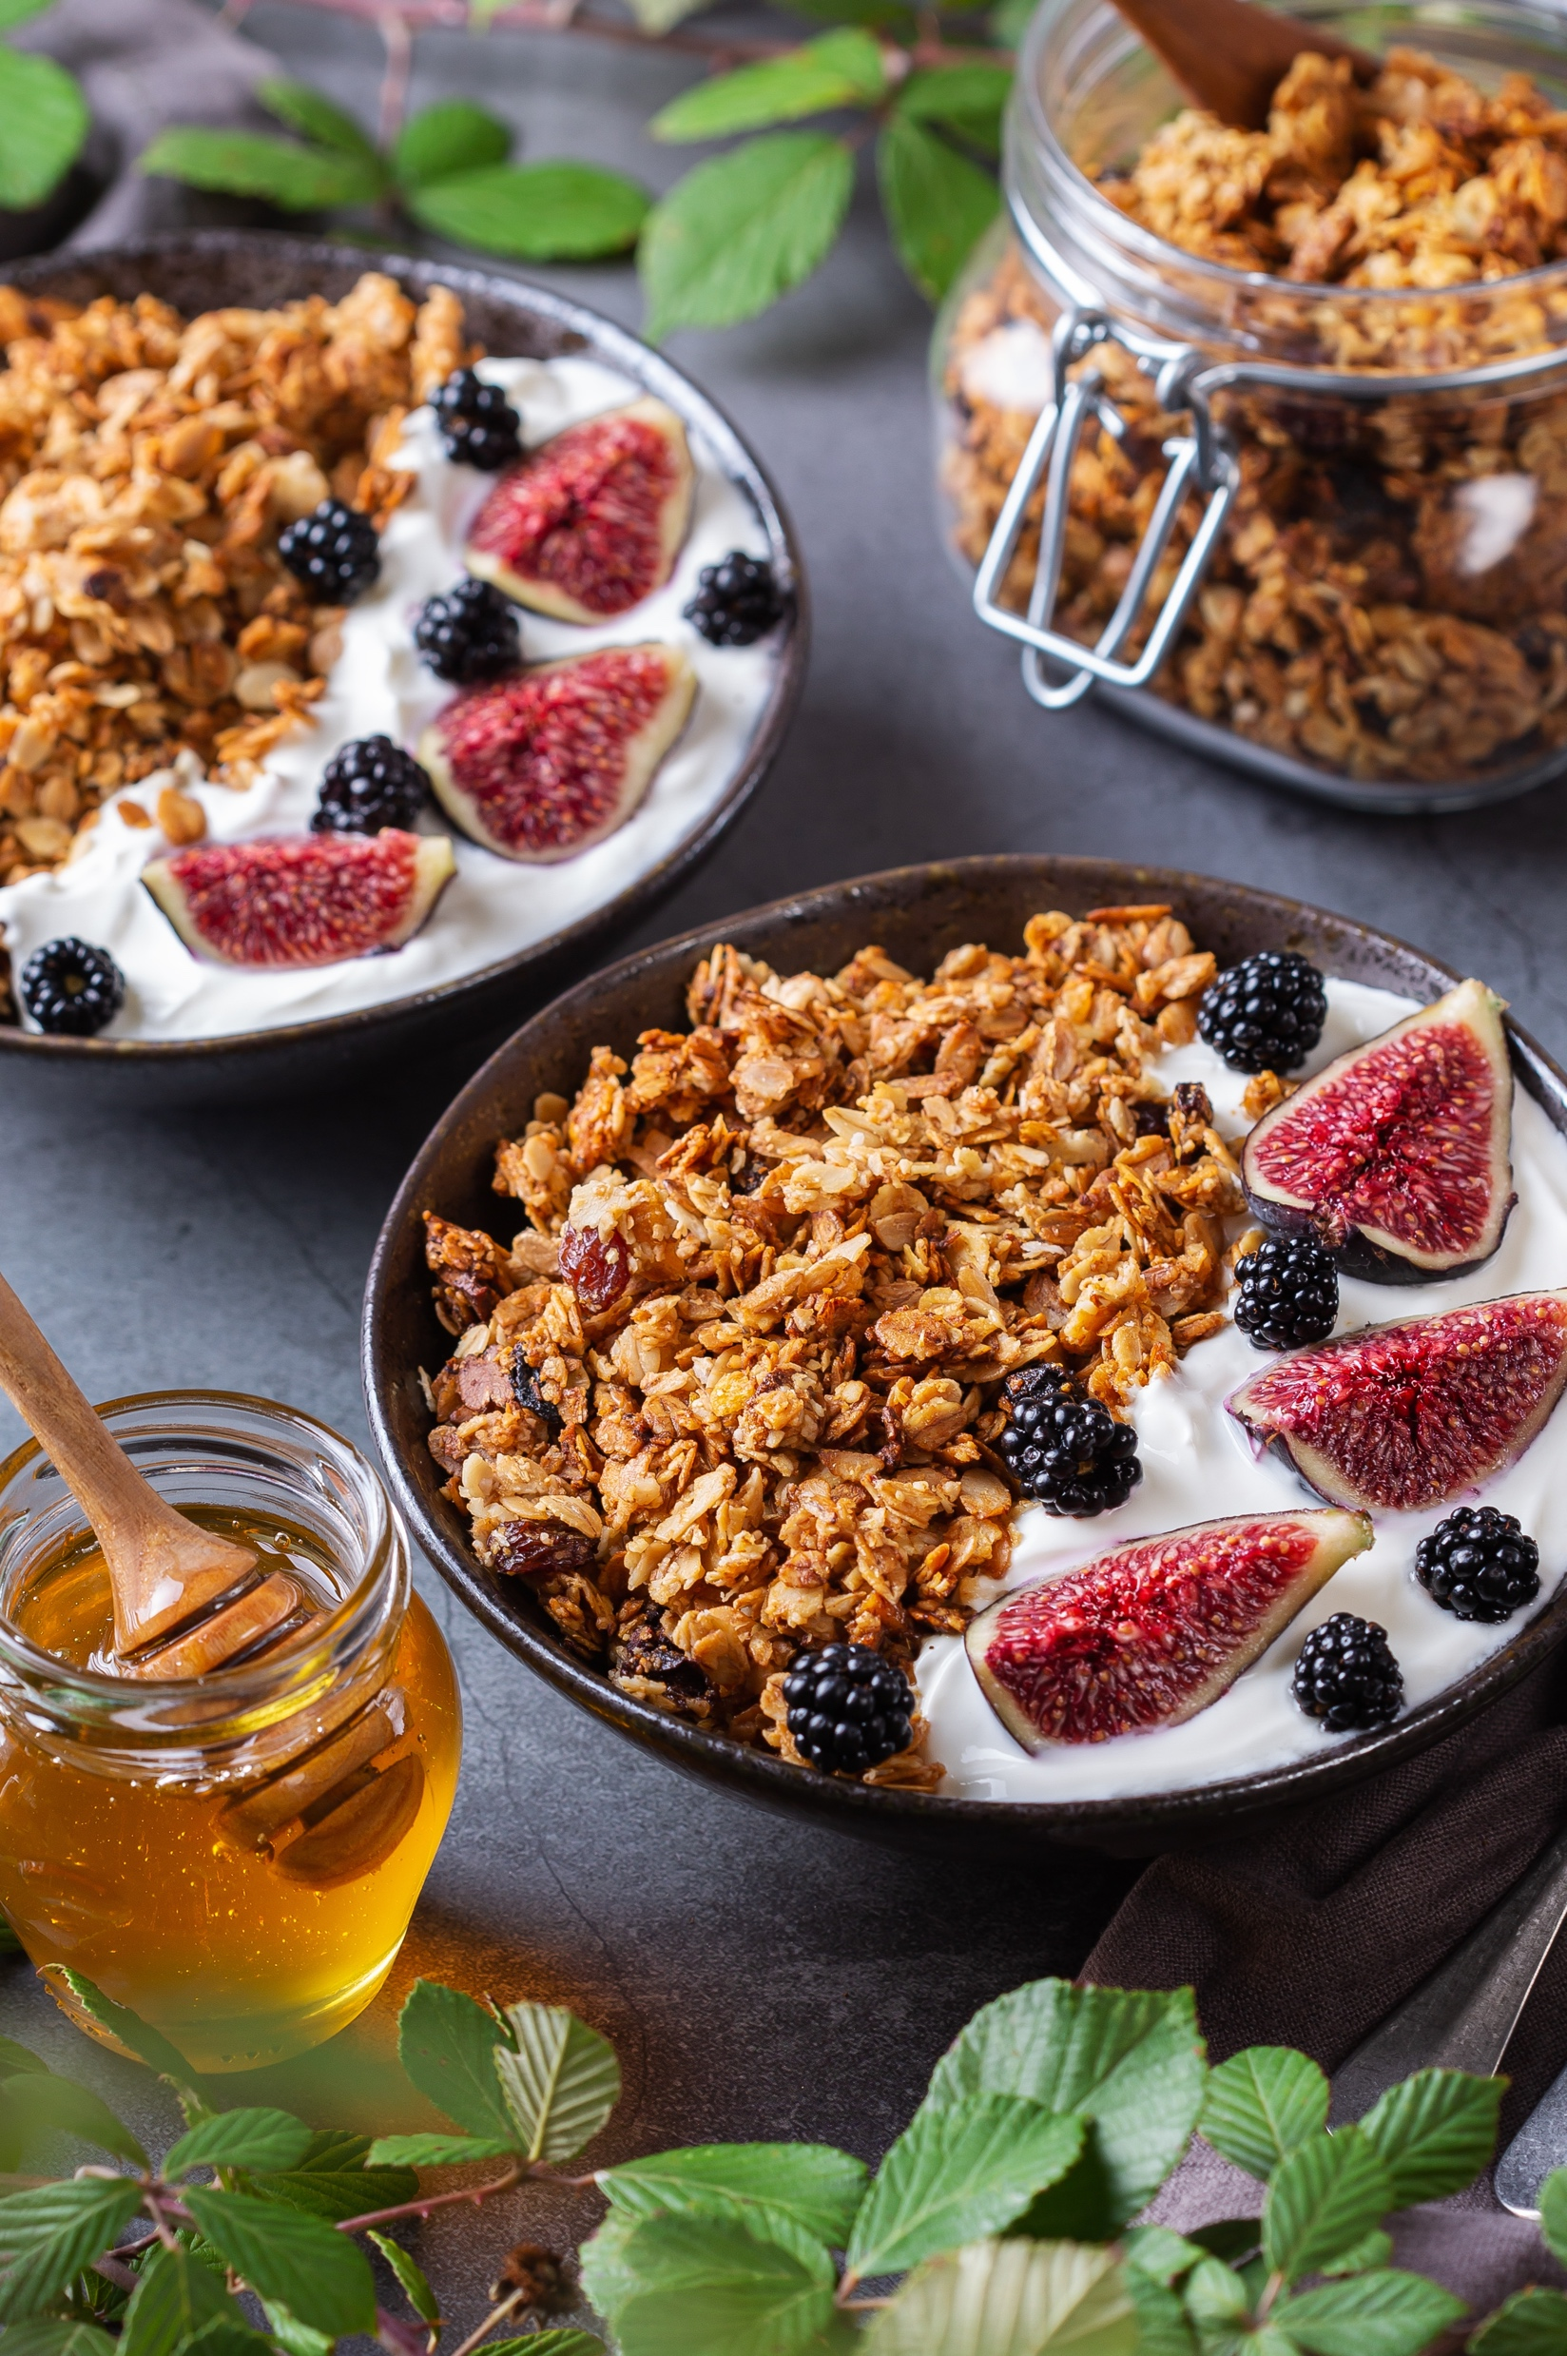
FAMILIARITY &
REASONS THEY
BUY

Slide 37
FAMILIARITY
Key Insight:
For all but postbiotics and MCT, familiarity levels are above 90%.
Familiarity levels are higher among prebiotic users for the lesser familiarity ingredients, postbiotics and MCT when compared to all respondents.
Note: US n=651, UK n=610, All Respondents n=2007. Question: “How familiar would you consider yourself regarding these functional ingredients in foods and/or beverages?” Sum of all responses except “never heard of it”.

Slide 38
PERCEIVED EFFECTIVENESS
Key Insights:
For prebiotic consumers, both pre- and postbiotics’ perception of effectiveness are behind those of probiotics, for the former, about 8% in the US and 5% in the UK.
Perceived effectiveness for all but MCT among UK respondents is over 50%.
Note: n varies. Question: “What is your opinion of the effectiveness/benefit of each of these functional food ingredients?” Sum of responses marked “I trust that it is effective, and I have experienced its benefits” and “I trust that it is effective, but I haven’t experienced benefits”.

Slide 39
IMPORTANT CHARACTERISTICS
Key Insights:
Prebiotic consumers follow an all-consumer pattern when it comes to characteristics driving purchase, under-indexing for price, over-indexing strongly in the UK for calorie content.
The top three most important purchase characteristics are quality of product, price and nutritional profile for both US and UK respondents.
All other categories are under 20% response rate, with many near or under 5%.
Note: US n=651, UK n=610, All Respondents n=2007. Question: “What characteristics are most important to you when deciding to purchase a functional food or beverage product?”

Slide 40
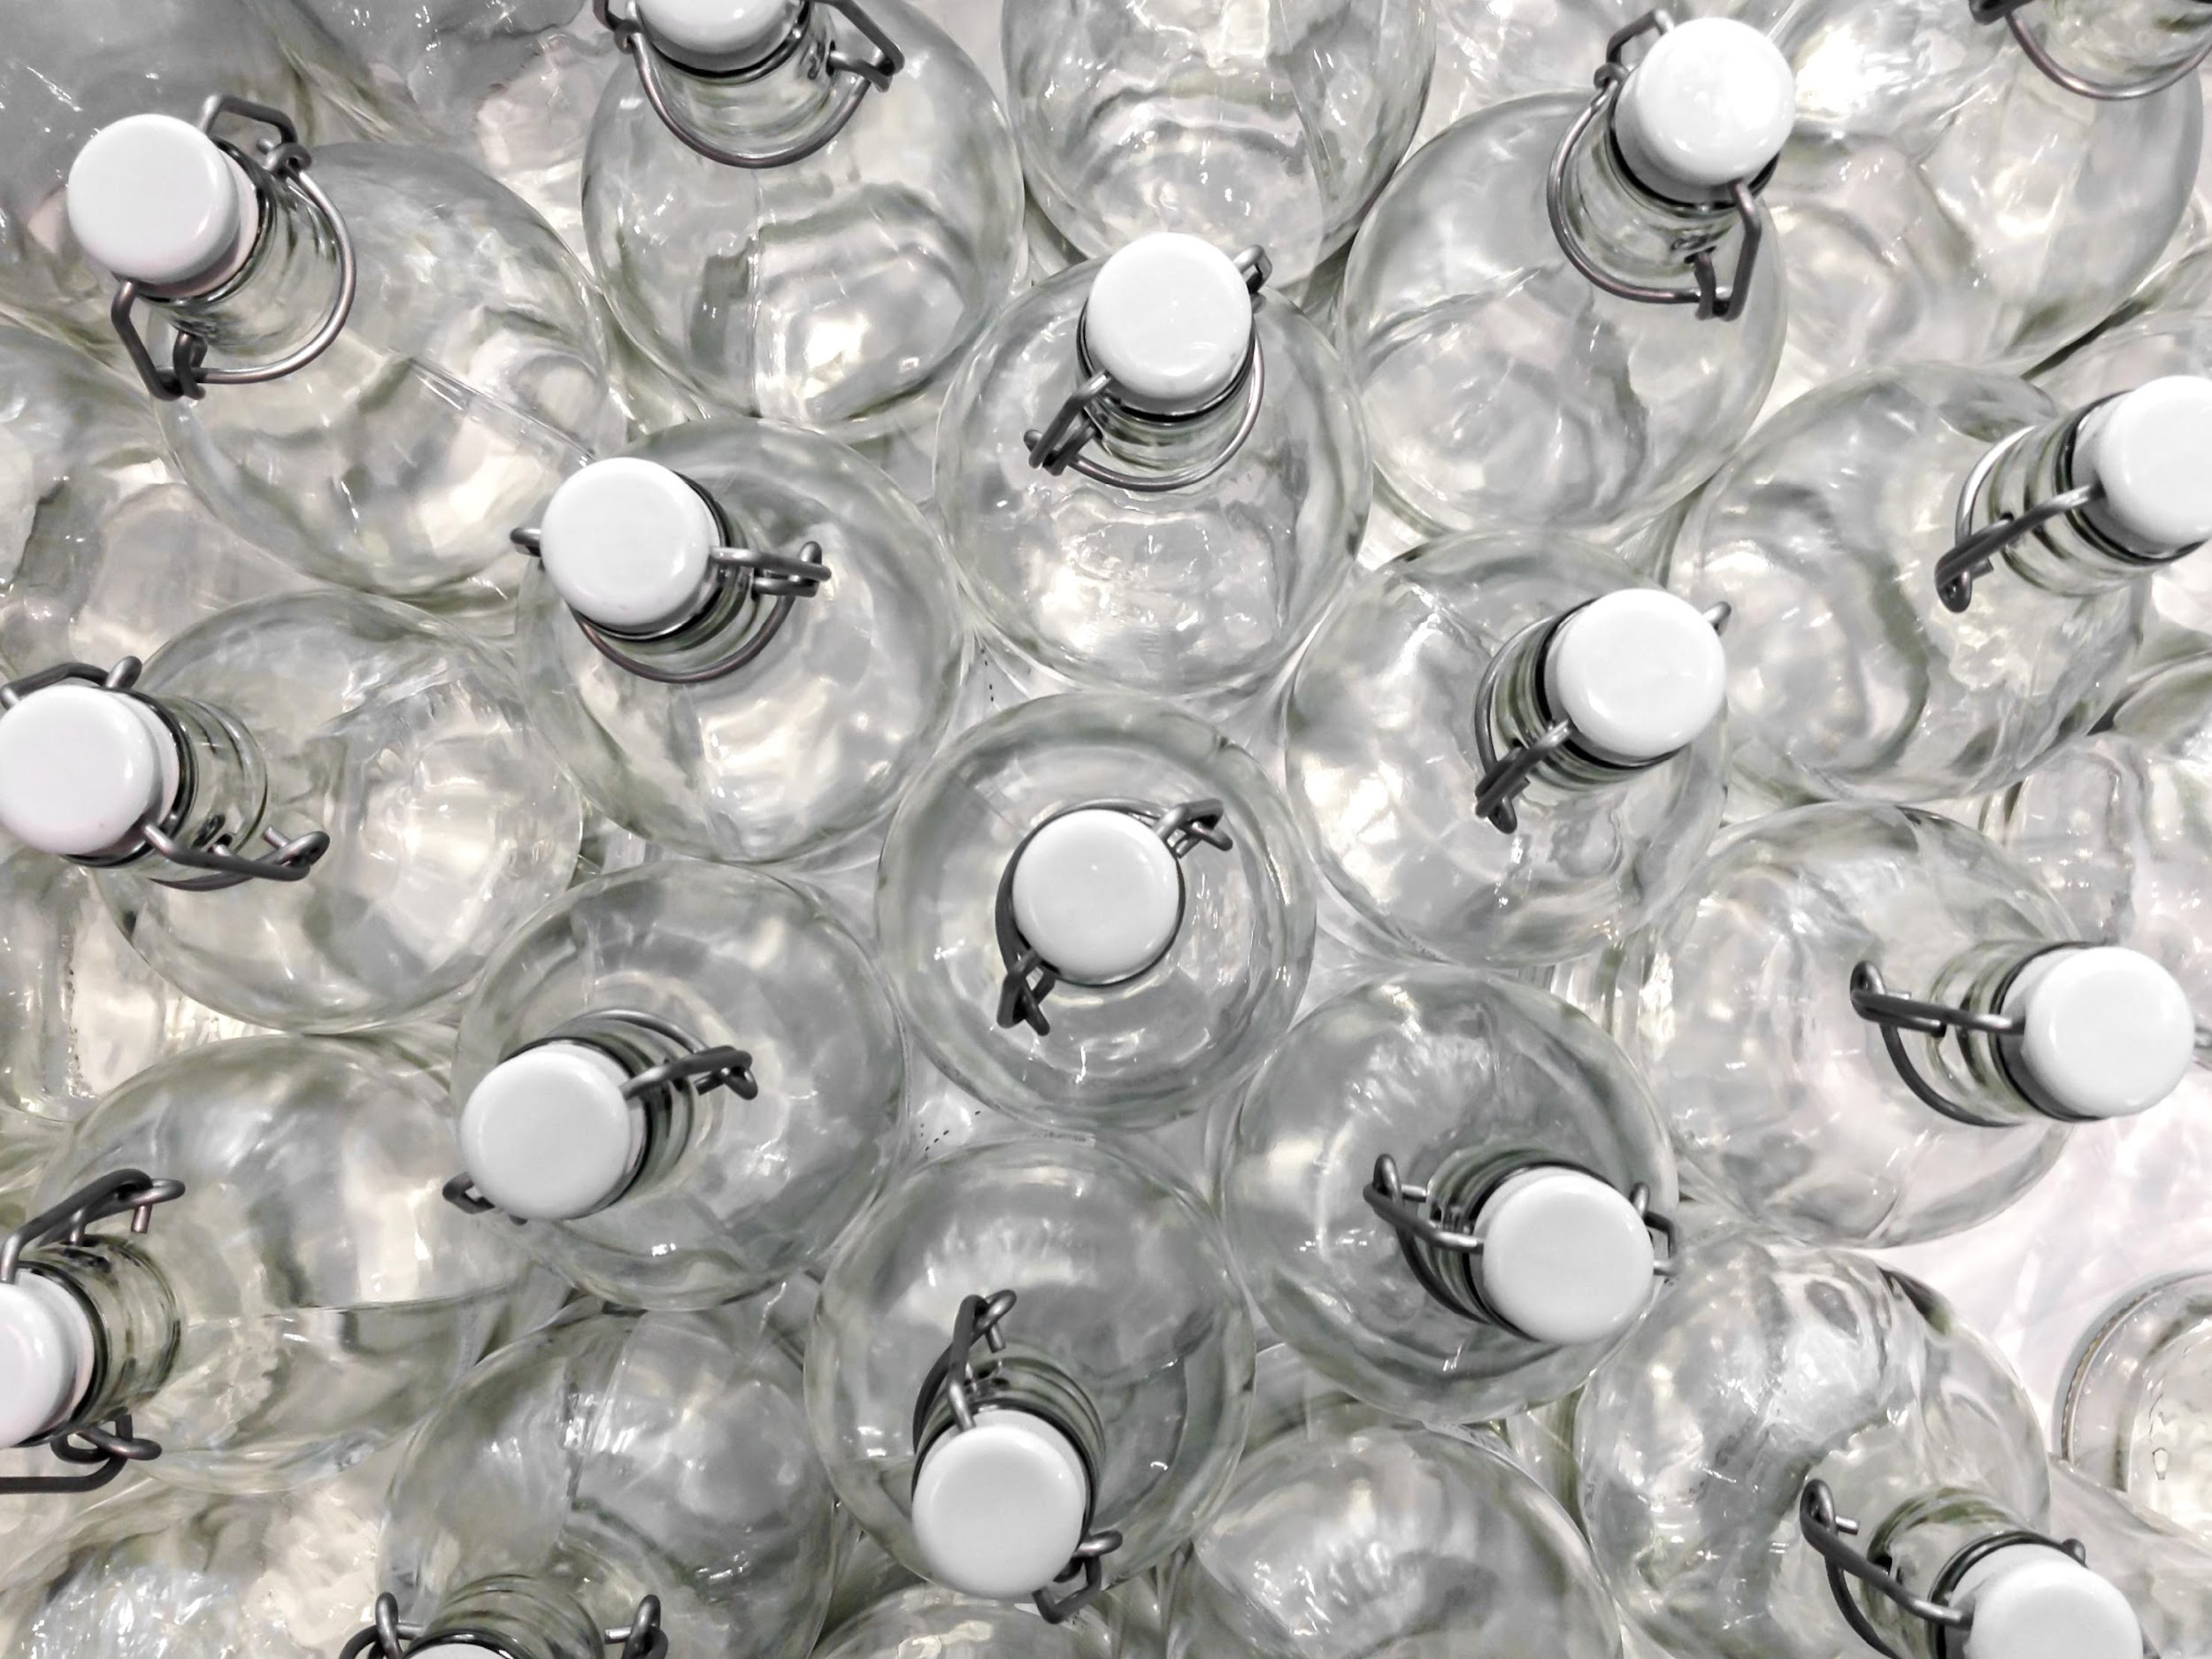
TRANSPARENCY, TRUST & SUSTAINABILITY

Slide 41
IMPACT OF SUSTAINABILITY
Key Insights:
US prebiotic consumers over-indexed sharply for always versus those in the UK as well as all consumers; the frequently response from prebiotic consumers also over-indexed so sustainability is certainly an kissue in this category.
The highest response rates come from the sometimes response.
Note: US n=651, UK n=610, All Respondents n=2007. Question: “Does the sustainability/environmental impact of the nutritional ingredients in your food influence your purchase decisions?”

Slide 42
LABEL AND WEBSITE TRANSPARENCY
Key Insight:
More than two thirds of responses (74% US and 72% UK) come in for either greatly or somewhat increasing someone's purchase chance, with US responses indexing positively compared to all consumers in the greatly influences response.
Note: US n=651, UK n=610, All Respondents n=2007. Question: “How likely are you to purchase functional foods and beverages from a manufacturer that provides transparency information on its label or website?”

Slide 43
SIGNALS OF TRANSPARENCY
Key Insight:
In general, responses over-index for prebiotic consumers, especially for contact information in the US and country of origin in the UK.
A quality seal on the label is the number one response for both the US and UK, both over 50%.
Note: US n=651, UK n=610, All Respondents n=2007. Question: “Which of the following are the strongest signals that a food/beverage brand is operating transparently?”

Slide 44
TRUST
Key Insights:
The highest responses from either the US or UK tops out at 45% (rank 2 – other experts recommend in the UK at 45%, rank 1 – consistent product quality in the US at 44%), with most hovering in the 30 to 40% ranges perhaps signaling a need for brands to have more than one of these characteristics.
US and UK respondents have different top responses with the biggest differences being in consistent product quality (US rank 1, UK rank 12) and transparency in supply chain (UK rank 2, US rank last).
US Respondents
UK Respondents
 | Rank 1 | Rank 2 | Rank 3
Long-term use of the brand | 34% | 40% | 25%
Consistent product quality | 44% | 32% | 25%
Transparency in supply chain | 22% | 38% | 40%
Quality certification/seal on label/website | 33% | 30% | 37%
Values based certification/seal on label/website | 34% | 28% | 38%
Friend/family recommends the brand | 31% | 27% | 42%
Health care professional recommends the brand | 32% | 34% | 34%
Other experts recommend the brand | 34% | 31% | 34%
Brand values align with my own | 32% | 37% | 31%
Authentic brand story | 38% | 32% | 30%
Informative website | 33% | 39% | 28%
Supports charities/causes | 31% | 28% | 41%
Nutritional profile | 38% | 35% | 27%
Social media influencers | 37% | 33% | 30%
 | Rank 1 | Rank 2 | Rank 3
Long-term use of the brand | 34% | 33% | 34%
Consistent product quality | 31% | 37% | 32%
Transparency in supply chain | 39% | 28% | 33%
Quality certification/seal on label/website | 36% | 29% | 35%
Values based certification/seal on label/website | 33% | 34% | 32%
Friend/family recommends the brand | 31% | 33% | 36%
Health care professional recommends the brand | 39% | 39% | 23%
Other experts recommend the brand | 23% | 45% | 32%
Brand values align with my own | 35% | 32% | 33%
Authentic brand story | 33% | 44% | 23%
Informative website | 35% | 35% | 31%
Supports charities/causes | 28% | 33% | 39%
Nutritional profile | 37% | 26% | 36%
Social media influencers | 40% | 28% | 32%
Note: n varies. Question: “What characteristics most encourage you to trust a food/beverage brand?”

Slide 45
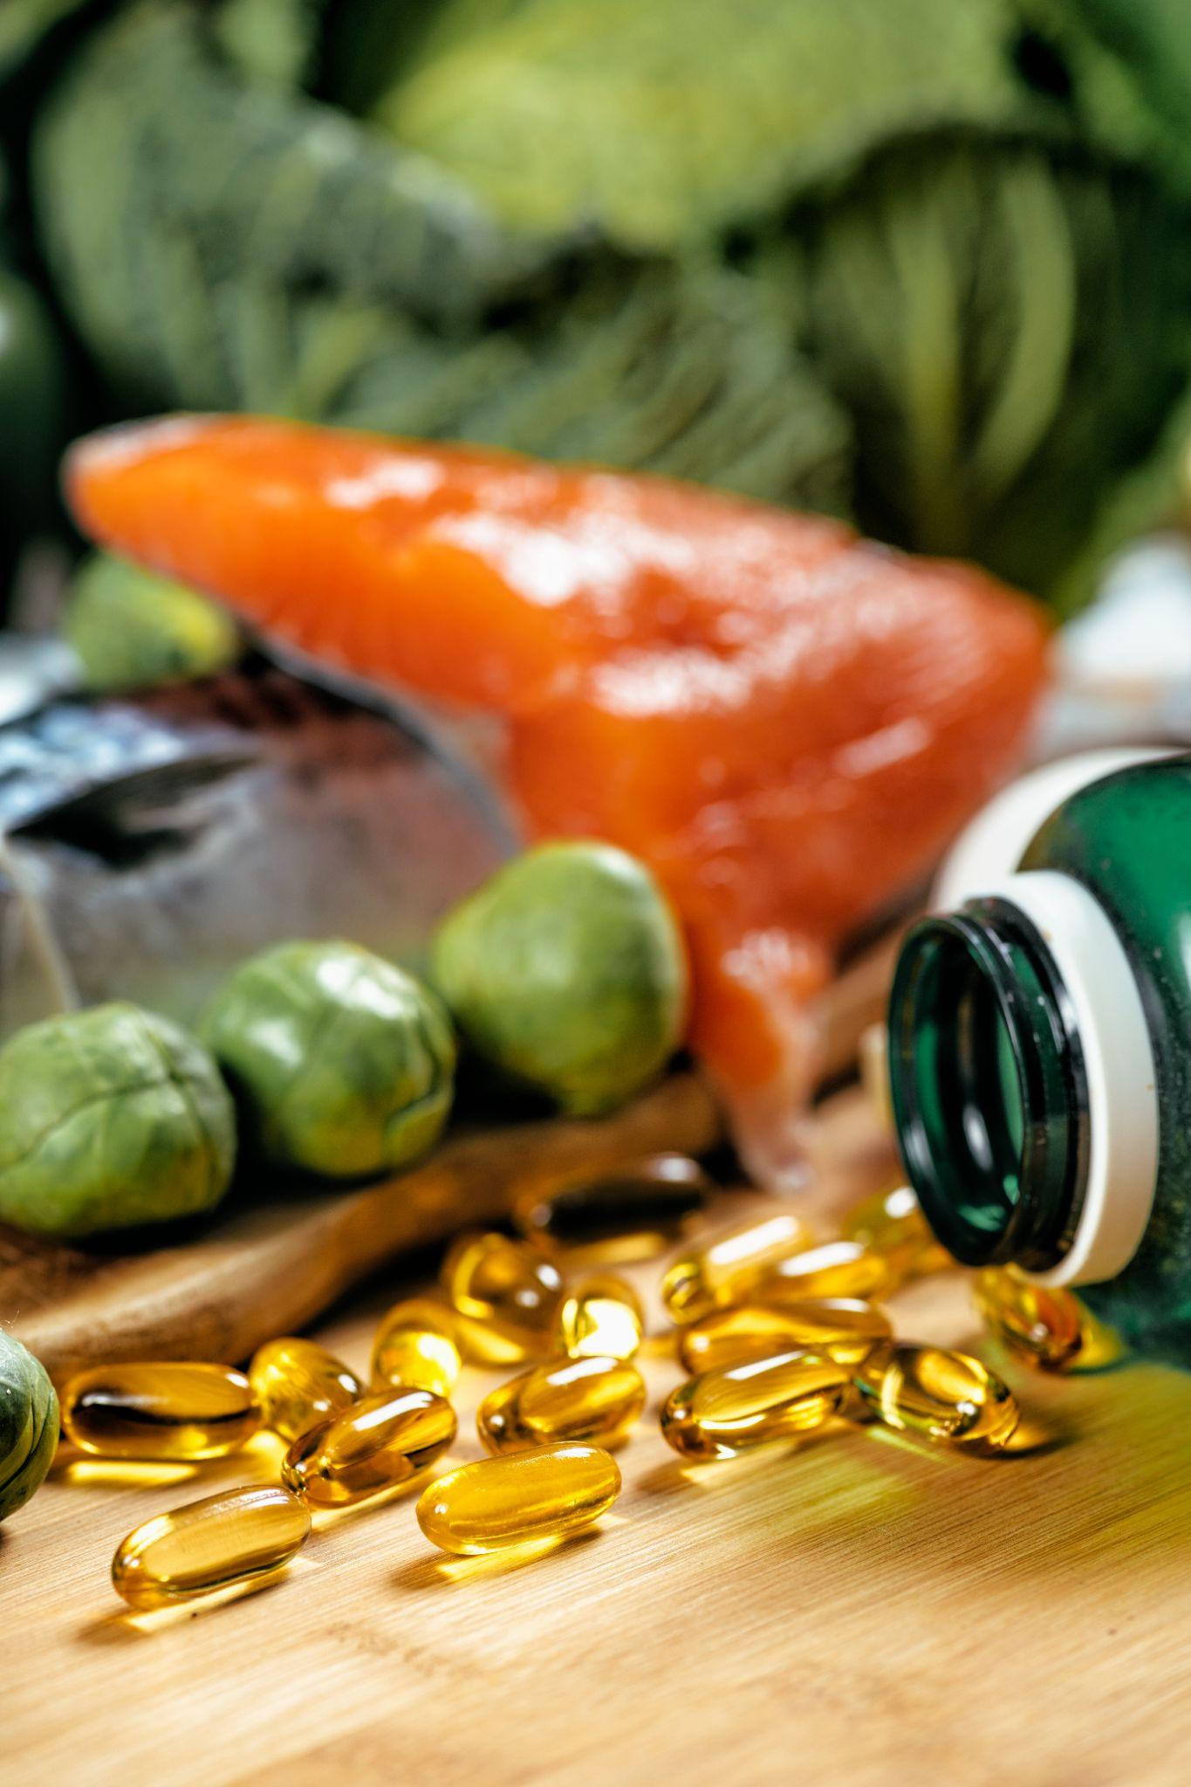
PREBIOTIC
DEEP DIVE

Slide 46
PREBIOTIC SPECIFIC BENEFITS
Key Insights:
Both US and UK respondents mark general gut health as the top benefit they are looking for when consuming foods and/or beverages that contain prebiotics.
It is notable that for the top three responses, US respondents are lower than the UK. This was a multiple response option, so that suggests those in the UK are more likely to seek multiple benefits.
Regularity over-indexes in the US by a wide amount as does to complement a probiotic.
Note: US n=651, UK n=610. Question: “What benefits are you looking for when you choose to consume foods/beverages that contain prebiotics?”

Slide 47
PREBIOTIC FAMILIARITY
Key Insights:
UK respondents under-indexed for every type of prebiotic surveyed with the largest gap being for HMOs and botanicals.
Familiarity levels among US respondents are above 50% for every type of prebiotic surveyed.
Note: US n=640, UK n=601. Question: “How familiar would you consider yourself regarding these prebiotic types?” Sum of all responses except “Never heard of it”.

Slide 48
PREBIOTIC TYPE FAMILIARITY
Key Insights:
The extremely familiar response garners an 8% to 12% response rate for every prebiotic type surveyed, while the never heard of it varies much more, from just 19% on the low end for polyunsaturated fatty acids to 50% on the high end for xylooligosaccharides.
When it comes to Top-2, polyphenols sit at 36%, lactulose at 33% and polyunsaturated fatty acids at 32%. The first and last are confounders as they also sit outside the prebiotic category exclusively.
Note: All Prebiotic Users n=1241. Question: “How familiar would you consider yourself regarding these prebiotic types?”

Slide 49
PREBIOTIC TYPE FAMILIARITY: (US)
Key Insights:
In the US, the extremely familiar responses are slightly higher, ranging from 9% all the way up to 15%.
Polyphenols rise to a Top-2 of 41%.
Likewise, the never heard of it responses are slightly lower, 17% for polyunsaturated fatty acids and 43% for xylooligosaccharides.
Note: US n=640. Question: “How familiar would you consider yourself regarding these prebiotic types?”

Slide 50
PREBIOTIC TYPE FAMILIARITY: (UK)
Key Insights:
UK extremely familiar responses thus are lower (6% to 10%) and their never heard of it responses higher (21% to 56%).
Lactulose sits at a top-2 of 30%, inulin at 25%.
Note: UK n=601. Question: “How familiar would you consider yourself regarding these prebiotic types?”

Slide 51
WHAT THEY LOOK FOR ON LABELS
Key Insight:
Fiber is the number one item looked for on labels in the US and a specific health benefit is sought in the UK.
Made from food ingredients ranked quite high, especially in the US.
Note: US n=640, UK n=601. Question: “What do you look for on the label when choosing a food or beverage containing prebiotics?”

Slide 52
PREFERRED FF&B FORMAT WITH PREBIOTICS
Key Insight:
UK respondents noticeably over-indexed for both yogurt (the top response from both US and UK respondents) and cereals, along with, to a lesser extent, milk alternatives and dairy.
Note: US n=640, UK n=601. Question: “What are your preferred types of functional foods/beverages with prebiotics?”

Slide 53
USAGE DRIVERS
Key Insight:
Responses vary significantly among US and UK respondents with only a recommendation from a health care professional seeing evenly split responses.
The US over-indexes for influencer recommendations and scientific research; the UK over-indexes most sharply for a friend/family recommendation.
Note: n varies. Question: “What would encourage you to start using or to increase your use of functional foods & beverages containing prebiotics?” Percentage of responses marked “Rank 1st”.

Slide 54
SOURCE OF PREBIOTIC KNOWLEDGE
Key Insights:
US respondents have a noticeable top three in health care professional, online research and friend or family, whereas those in the UK have the same top three but in reverse order. Friend or family having the highest response rate, followed by online research and then health care professional.
For all but unpaid media coverage, US respondents have a higher, or equal response rate to those from the UK.
Note: US n=640, UK n=601. Question: “How did you learn about prebiotics?”

