Slide 1
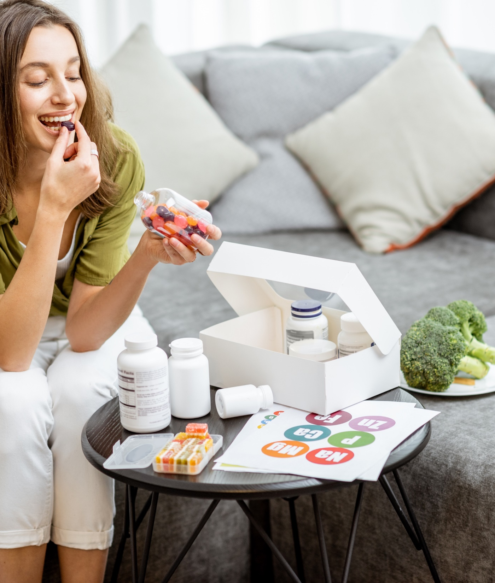

ITC Insights 2023 Consumer Supplement Survey

Slide 2

The 2023 ITC Insights Consumer Supplement Survey was fielded from February to March 2023 and analyzed by the Industry Transparency Center.
The survey includes over 3500 supplement consumers ages 18+ in 6 countries: US (1000), UK (500), DE (500) IT: 500, KR: 500, AU:500.
The survey provides insights into supplement user buying behaviors and priorities, including familiarity, usage patterns, purchase drivers, branded ingredients and the importance of values like trust, transparency and sustainability.
OVERVIEW
The ITC Insights lightbulb indicates there are key takeaways for that slide.

Slide 3


Table of Contents
This table of contents is hyperlinked to the sections. Just click the page number to jump to that section in the deck.
Section | Page Number
Demographics | 4
Health Concerns | 22
Supplement Usage | 25
Familiarity & Reasons They Buy | 30
Shopping Behavior | 38
Branded Ingredients | 43
Values | 49
The ITC Insights lightbulb indicates there are key takeaways for that slide.
You can access primary data for charts by right clicking and opening the data in Excel.
Country abbreviations in footers:
United States = US, United Kingdom = UK, Germany = DE, Italy = IT, South Korea = KR, Australia = AU

Slide 4

DEMOGRAPHICS
Age, gender and income for all respondents and by individual countries

Slide 5
Demographic overview
Key Insights:
Respondents were fairly evenly split across genders with users skewing slightly female in the US, IT and Australia and skewing slightly male in Germany; the biggest split was the US
Quotas were set for the youngest and oldest age groups to ensure equal representation across age groups
 | All Supplement Users |  | US Supplement Users |  | UK Supplement Users |  | DE Supplement Users |  | IT Supplement Users |  | KR Supplement Users |  | AU Supplement Users
 | n=3677 |  | n=1118 |  | n=540 |  | n=518 |  | n=524 |  | n=525 |  | n=522
Female | n=1,916 | 52% | n=615 | 55% | n=269 | 50% | n=249 | 48% | n=271 | 52% | n=263 | 50% | n=279 | 53%
Male | n=1,746 | 47% | n=496 | 44% | n=268 | 50% | n=267 | 52% | n=251 | 48% | n=262 | 50% | n=242 | 46%
Non-binary/prefer to self-describe | n=15 | <1% | n=7 | 1% | n=3 | <1% | n=2 | <1% | n=2 | <1% | n=0 | n/a | n=1 | <1%
18-34 | n=1,175 | 32% | n=369 | 33% | n=145 | 27% | n=159 | 31% | n=171 | 33% | n=175 | 33% | n=176 | 34%
35--54 | n=1,470 | 40% | n=434 | 39% | n=217 | 40% | n=219 | 42% | n=213 | 40% | n=210 | 40% | n=207 | 40%
55+ | n=1,032 | 28% | n=315 | 28% | n=178 | 33% | n=140 | 27% | n=140 | 27% | n=140 | 27% | n=139 | 26%

Slide 6
demographics
AGE
INCOME
52%
47%
Even mix of men and women.
Female n=1,916
Male n=1,746
Non-Binary n=15
We surveyed a well-diversified set of age brackets, in this survey, across all countries/markets
A diverse balance of all income groups was achieved, via individualized country quotas
Note: All supplement users n=3677; n=2639 for income (AU and UK not included)

Slide 7
Demographics: age
18-34
35-54
55+
57%
42%
51%
49%
47%
53%
Note: 18-34 n=860, 35-54 n=1057, 55+ n=722.

Slide 8


DEMOGRAPHICS: US
AGE
INCOME
55%
44%
Even mix of men and women.
Female n = 615
Male n = 496
Non-Binary n = 7
Note: US supplement users n=1110.

Slide 9
DEMOGRAPHICS: US, Age & gender
18-34
35-54
55+
58%
41%
53%
46%
54%
46%
Note: US supplement users 18-34 n=366, 35-54 n=430, 55+ n=314.

Slide 10
DEMOGRAPHICS: UK
AGE
INCOME
50%
50%
Even mix of men and women.
Female n = 269
Male n = 268
Non-Binary n = 3
UK users skew slightly older than the aggregate and US
Note: UK supplement users n=529.

Slide 11
DEMOGRAPHICS: UK, age & gender
18-34
35-54
55+
58%
41%
46%
53%
47%
52%
Note: UK supplement users 18-34 n=142, 35-54 n=212, 55+: n=175.

Slide 12
DEMOGRAPHICS: DE
AGE
INCOME
48%
52%
Even mix of men and women.
Female n = 249
Male n = 267
Non-Binary n=2
Note: DE supplement users n=518.

Slide 13
DEMOGRAPHICS: DE, age & gender
18-34
35-54
55+
54%
44%
49%
51%
41%
59%
Note: DE supplement users 18-34 n=156, 35-54 n=216, 55+ n=136.

Slide 14
DEMOGRAPHICS: IT
AGE
INCOME
52%
48%
Mix of men and women.
Female n = 271
Male n = 251
Non-Binary n=2
We surveyed a well-diversified set of age brackets, in this survey, across the Italy market
A diverse balance of all income groups was achieved
Note: IT supplement users n=510.

Slide 15
DEMOGRAPHICS: IT, age & gender
18-34
35-54
55+
57%
43%
50%
50%
49%
50%
Note: IT supplement users 18-34 n=167, 35-54 n=207, 55+ n=136.

Slide 16
DEMOGRAPHICS: KR
AGE
INCOME
50%
50%
Mix of men and women.
Female n = 255
Male n = 255
We surveyed a well-diversified set of age brackets, in this survey, across the South Korea market
A diverse balance of all income groups was achieved
Note: KR supplement users n=511.

Slide 17
DEMOGRAPHICS: KR, Age & gender
Key Insights:
Note the strong female skew in the youngest age group and the strong male skew in the oldest group making South Korea a unique country for targeting.
18-34
35-54
55+
70%
30%
47%
53%
30%
70%
Note: KR supplement users 18-34 n=171, 35-54 n=204, 55+ n=136.

Slide 18
DEMOGRAPHICS: au
AGE
INCOME
54%
46%
Mix of men and women.
Female n = 275
Male n = 234
We surveyed a well-diversified set of age brackets, in this survey, across the Australia market
A diverse balance of all income groups was achieved
Note: AU supplement users n=509.

Slide 19
DEMOGRAPHICS: au, age & gender
18-34
35-54
55+
47%
53%
60%
40%
53%
47%
Note: AU supplement users18-34 n=173, 35-54 n=201, 55+ n=135.

Slide 20
Why consumers take supplements
Key Insights:
When looking at responses, in total, general health and well-being are overwhelmingly mentioned as reasons for taking health supplements (70%).
Coming in at half of that (35%), supplement users stated that making up for dietary deficiencies was next-most important to them.
Note: All supplement users n=3677. Question GS1: “Why do you take dietary supplements?”

Slide 21
Why consumers take supplements: COUNTRY
Key Insights:
General health and wellbeing was the dominant response in all countries, with making up for dietary deficiencies next (46% in Germany).
Condition-specific health benefits hit 40% in Italy, disease prevention also hit 40% in Germany and 39% in South Korea.
Note: US N=1110, UK n=540, DE n=518, IT n=524, KR n=524, all supplement users n=3677. Question GS1: “Why do you take dietary supplements?”

Slide 22

HEALTH CONCERNS
Deep dive into supplement user health concerns and which ones they take supplements for

Slide 23
Health concerns
Key Insights:
Anxiety or stress and lack of energy ranked highest for overall supplement users driven by supplement consumers in the US and especially Italy. Of note, only 17% of German respondents said anxiety or stress was a concern.
Eye fatigue greatly over-indexes in South Korea where 49% of respondents said it was a concern. This is consistent with our Chinese respondents in 2022, so Asia is a target for eye health.
Lack of energy was an issue in Australia and Italy, with the latter also getting high responses for sleep issues, digestive complaints and eye related issues; joint or other pain was the top response in the UK.
Note: All supplement users US n=1118, UK n=540, DE n=518, IT n=524, KR n=525, AU n=522, all supplement users n=3677. Question D4: “Which of the following health conditions or concerns currently impact or impacted you within the past year?”

Slide 24
Health concerns: what consumers took supplements for
Key Insights:
Overall supplement users said they take supplements to help with lack of energy and that’s largely driven by respondents in Italy and is the top response in Australia as well; anxiety and stress is next in both countries as well as being the top response in the US.
Eye fatigue again over-indexes strongly in South Korea; we saw this in China in 2022.
General health is moving toward the top as a reason all supplement users take supplements.
Note: All supplement users n=3249, US n=971, UK n=462, DE n=437, IT n=490, KR n=471, AU n=468. Question D5: “Did you take supplements for any of the following reasons over the past year?” Only asked of respondents indicating they had the health concern.

Slide 25

SUPPLEMENT USAGE

Slide 26
SUPPLEMENT USAGE FREQUENCY
Key Insights:
60% of respondents are taking supplements 4 times a week or more, thus making them both regular users and key target consumers, although converting irregular users to regular users also boosts categories and positive experiences.
Daily usage is up 4% from 2022 data. It should also be noted that there are fairly large variances among different countries. US supplement-takers came in at the highest end (53%), whereas those in Italy came in as the least-frequent respondents who took them daily (22%). Next on the least frequent side were German users (26%). The three remaining countries came in roughly equal in regard to daily usage.
Note that non-supplement users were disqualified from the survey.
Note: All supplement users n=3677. Question S1: “How often do you take vitamins, minerals, herbs or other dietary supplements (e.g., fish oil, protein powder, probiotics, melatonin, etc.)?”

Slide 27
Supplement use frequency: country
Key Insights:
The US, UK, South Korea and Australia (especially the former) over-index for regular use (4x a week or more) and supplement users in Germany and Italy under-index in their usage.
Note: US n=1104, UK n=526, DE n=504, IT n=510, KR n=511, AU n=508, all supplement users n=3663. Question S1: “How often do you take vitamins, minerals, herbs or other dietary supplements (e.g., fish oil, protein powder, probiotics, melatonin, etc.)?”

Slide 28
Supplement usage
 | All Usage by Those familiar | Daily | 4-6x/week | 1-3x/week | Seasonally/As Needed | It's in another supplement I take | Never
Multivitamin | 89% | 35% | 13% | 16% | 21% | 4% | 11%
Vitamin D | 86% | 28% | 10% | 17% | 23% | 8% | 14%
Magnesium | 75% | 18% | 10% | 16% | 25% | 6% | 25%
Omega-3s | 75% | 23% | 10% | 15% | 23% | 4% | 25%
Calcium | 73% | 18% | 9% | 15% | 23% | 8% | 27%
Probiotics | 69% | 16% | 9% | 15% | 26% | 3% | 31%
Antioxidants | 67% | 13% | 10% | 13% | 26% | 5% | 33%
Alpha-GPC | 63% | 8% | 15% | 16% | 20% | 4% | 37%
Citicoline | 63% | 10% | 14% | 16% | 20% | 3% | 37%
Nootropics | 63% | 8% | 15% | 16% | 20% | 4% | 37%
Vitamin K2 | 60% | 10% | 10% | 12% | 21% | 7% | 40%
Astaxanthin | 59% | 10% | 13% | 16% | 18% | 2% | 41%
Ashwagandha | 58% | 9% | 14% | 14% | 18% | 3% | 42%
Protein Powder | 58% | 10% | 10% | 16% | 20% | 2% | 42%
Lutein | 58% | 12% | 12% | 13% | 17% | 4% | 42%
Prebiotics | 58% | 10% | 9% | 12% | 24% | 3% | 42%
Postbiotics | 57% | 9% | 10% | 13% | 22% | 3% | 43%
Synbiotics | 56% | 8% | 13% | 14% | 19% | 2% | 44%
CoQ10 | 56% | 11% | 10% | 14% | 17% | 4% | 44%
Curcumin/Turmeric | 56% | 10% | 8% | 13% | 22% | 3% | 44%
Glutathione | 56% | 9% | 12% | 14% | 19% | 2% | 44%
Choline | 54% | 6% | 12% | 14% | 17% | 5% | 46%
Collagen | 50% | 10% | 7% | 11% | 18% | 4% | 50%
Glucosamine | 50% | 11% | 8% | 10% | 18% | 3% | 50%
CBD | 45% | 6% | 9% | 11% | 17% | 2% | 55%
Mushrooms (non-psychedelic) | 42% | 5% | 8% | 11% | 16% | 2% | 58%
Key Insights:
Generally, while overall users are regular users of at least one supplement, this use may be inconsistent.
This chart shows that on an individual basis, multivitamins at 48% are followed by vitamin D at 38% when it comes to regular use (more than 4 times per week).
Measuring regular use, even while less overall use, omega-3s do move to third at 33%.
Note: n varies by supplement. Only those familiar with the ingredient were asked about usage. Question: Which of the following best describes how frequently you are taking the following supplements?

Slide 29
Usage change
 | Taking Less | Taking the Same | Taking More | Net change
Vitamin D | 16% | 61% | 20% | 4%
Multivitamin | 18% | 63% | 18% | 0%
Collagen | 24% | 46% | 23% | -1%
Astaxanthin | 26% | 40% | 25% | -1%
Probiotics | 22% | 54% | 19% | -3%
Curcumin/Turmeric | 25% | 47% | 22% | -3%
Lutein | 26% | 45% | 23% | -3%
Vitamin K2 | 24% | 48% | 21% | -3%
Calcium | 21% | 57% | 17% | -4%
CoQ10 | 27% | 42% | 23% | -4%
Choline | 28% | 36% | 23% | -5%
Magnesium | 23% | 55% | 18% | -5%
Protein Powder | 26% | 47% | 21% | -5%
Mushrooms | 28% | 39% | 23% | -5%
Alpha-GPC | 29% | 36% | 23% | -6%
CBD | 31% | 36% | 25% | -6%
Nootropics | 30% | 35% | 24% | -6%
Prebiotics | 25% | 48% | 19% | -6%
Glutathione | 30% | 37% | 24% | -6%
Postbiotics | 28% | 42% | 22% | -6%
Omega-3s | 24% | 55% | 17% | -7%
Synbiotics | 29% | 39% | 22% | -7%
Glucosamine | 25% | 48% | 18% | -7%
Antioxidants | 24% | 53% | 16% | -8%
Citicoline | 31% | 35% | 23% | -8%
Ashwagandha | 34% | 33% | 25% | -9%
Key Insights:
With the exception of vitamin D and multivitamins consumers are reporting taking less, the silver lining is that it offers opportunity for education to increase usage and compliance, focusing on the need for regular use to achieve impact.
Several categories report numbers in the mid-twenties taking more headed by astaxanthin, CBD and ashwagandha at 25%.
Note: n varies by supplement. Only those familiar with the ingredient were asked about usage. Question: Which of the following best describes how your use of each of these supplements compares to your usage 1 year ago?

Slide 30

FAMILIARITY & REASONS THEY BUY

Slide 31
Overall Familiarity with ingredient categories
 | All supplement users | US | UK | DE | IT | KR | AU
Multivitamin | 99% | 98% | 99% | 98% | 98% | 99% | 99%
Vitamin D | 99% | 99% | 99% | 99% | 100% | 99% | 99%
Calcium | 98% | 97% | 99% | 97% | 98% | 99% | 98%
Magnesium | 97% | 96% | 95% | 98% | 99% | 98% | 97%
Omega-3s | 97% | 96% | 98% | 97% | 98% | 99% | 97%
Probiotics | 95% | 96% | 94% | 87% | 96% | 97% | 96%
Antioxidants | 93% | 95% | 95% | 86% | 96% | 91% | 96%
Protein Powder | 92% | 92% | 89% | 91% | 92% | 96% | 90%
Collagen | 91% | 90% | 91% | 83% | 95% | 98% | 91%
Curcumin/Turmeric | 87% | 86% | 89% | 88% | 83% | 78% | 86%
Prebiotics | 81% | 83% | 77% | 70% | 80% | 85% | 84%
Glucosamine | 76% | 80% | 79% | 57% | 67% | 91% | 60%
CBD | 70% | 88% | 81% | 74% | 65% | 34% | 59%
Mushrooms (non-psychedelic) | 66% | 75% | 69% | 50% | 61% | 61% | 69%
Vitamin K2 | 65% | 65% | 62% | 67% | 76% | 64% | 58%
Lutein | 56% | 57% | 46% | 44% | 59% | 96% | 34%
Postbiotics | 54% | 57% | 51% | 45% | 56% | 69% | 43%
CoQ10 | 52% | 65% | 43% | 59% | 47% | 48% | 40%
Glutathione | 46% | 43% | 43% | 38% | 57% | 66% | 32%
Synbiotics | 45% | 43% | 45% | 42% | 51% | 59% | 32%
Choline | 44% | 49% | 45% | 38% | 49% | 41% | 35%
Ashwagandha | 40% | 51% | 32% | 45% | 34% | 27% | 44%
Astaxanthin | 38% | 36% | 33% | 33% | 45% | 59% | 23%
Alpha-GPC | 37% | 40% | 36% | 33% | 42% | 38% | 28%
Nootropics | 36% | 40% | 35% | 28% | 41% | 38% | 30%
Citicoline | 35% | 37% | 33% | 36% | 48% | 31% | 23%
Key Insights:
As one would expect, familiarity with multivitamins and vitamin D tops this chart, with calcium, magnesium and omega-3s not far behind.
Probiotics also have broad familiarity, with the exception of Germany, much of the reason being that the term is not allowed on labels.
There is an interesting comparison between two EU countries, Italy and Germany, the former being more liberal, and this is evident in results for antioxidants and prebiotics (10% difference), mushrooms (11%), choline (11%), collagen (12%), as well as others.
CBD though has higher familiarity in Germany than Italy.
Note: All supplement users n=3676, US n=1118, UK n=540, DE n=518, IT n=524, KR n=524, AU n=522. Question: “How familiar would you consider yourself regarding the use of these supplements?” All responses except ‘never’.

Slide 32
Overall Familiarity: AGE & GENDER
Key Insights:
We see strong awareness among the youngest groups and even the older groups for mainstays like vitamin D, multivitamins and calcium.
Familiarity starts to vary more among the specialty supplements with younger consumers tending to be more familiar than older.
For mushrooms, it's younger males the most familiar, with the same for postbiotics, synbiotics and ashwagandha.
Note: Supplement users female 18-34 n=674, male 18-34 n=487, female 35-54 n=749, male 35-54 n=712, female 55+ n=487, male 55+ n=539, all supplement users n=3677. Question: “How familiar would you consider yourself regarding the use of these supplements?” All responses except ‘never’.

Slide 33
Familiarity:
Key Insights:
Multivitamins and Vitamin D have the familiarity levels all supplements aspire to reach, but omega-3s and now magnesium approach them with probiotics not far behind.
Antioxidants have quite high familiarity and when it comes to Top-2, prebiotics is now well above 30%.
Note: All supplement users n=3663. Question: “How familiar would you consider yourself regarding the use of these supplements?”

Slide 34
Characteristics influencing purchase
Key Insights:
When it comes to physical characteristics, easy to swallow and single pill daily dosage rank top in all countries.
Taste also plays a role.
Gummy preference is increasing, but newer non-pill formats are not currently considered relevant by supplement users—as more become available, we expect this to increase in importance.
 | Total | US | UK | DE | IT | KR | AU
Easy to swallow | 43% | 41% | 49% | 36% | 34% | 43% | 49%
Single pill daily dosage | 42% | 41% | 48% | 36% | 34% | 46% | 49%
Pleasant taste | 21% | 18% | 16% | 31% | 32% | 16% | 17%
Combination formulas | 15% | 13% | 16% | 17% | 23% | 15% | 12%
Gummy format | 12% | 22% | 11% | 4% | 6% | 7% | 8%
Single ingredient formulas | 11% | 12% | 9% | 15% | 6% | 13% | 8%
Pleasant odor or no odor | 9% | 8% | 8% | 9% | 10% | 11% | 9%
Powder format | 9% | 6% | 5% | 12% | 16% | 7% | 8%
Liquid format | 5% | 6% | 4% | 7% | 8% | 2% | 2%
Other non-pill format (i.e., stick pack, chew, effervescent) | 2% | 1% | 1% | 3% | 3% | 2% | 2%
Note: Total n=3676, US n=1110, UK n=540, DE n=518, IT n=524, KR n=524, AU n=522. Question: “Which are the most important purchase considerations for you when choosing which supplement product(s) to purchase?”

Slide 35
Characteristics influencing purchase: country
Key Insights:
The UK and Australia spike for easy to swallow as well as single pill daily dosage.
Germany and Italy respond the highest for pleasant taste; Italy also ranks combination formulas the highest of all countries.
Note: All supplement users n=3677, US n=1110, UK n=540, DE n=518, IT n=524, KR n=525, AU n=522. Question: “Which are the most important purchase considerations for you when choosing which supplement product(s) to purchase?”

Slide 36
Attributes influencing purchase: country
Key Insights:
Personal experience is the most important attribute for consumers in the US,
For those in Italy and Australia, a recommendation from a doctor or health care expert is key.
We also see a spike for online ratings in South Korea.
Note: All supplement users n=3677, US n=1110, UK n=540, DE n=518, IT n=524, KR n=525, AU n=522. Question: What are the most important attributes you look for when purchasing supplements?

Slide 37
quality, safety and regulation concern: country
Key Insights:
False or misleading claims was the biggest concern in all countries except Germany and South korea which ranked undetected contaminants ahead.
Non-declared ingredients tied for the top concern in Italy.
Australia ranked undetected contaminants and non-declared ingredients a close second to false or misleading claims.
Note: All supplement users US n=1110, UK n=540, DE n=518, IT n=524, KR n=525, AU n=522. Question: “Please rate your level of concern surrounding these areas related to the quality, safety and regulation of dietary supplements:”

Slide 38

SHOPPING BEHAVIOR

Slide 39
Supplement Spend
All Supplement Users
KEY ITC INSIGHTS:
UK supplement users spend the least on supplements and Australians spend the most.
Overall, supplement spend is relatively evenly split.
Note: Total n=3677, US n=1110, UK n=540, DE n=518, IT n=524, KR n=524, AU n=522. Question: “On average, how much do you spend monthly on vitamins, minerals, herbals, or other dietary supplements for just yourself?”

Slide 40
Average Monthly Spend: COuntry
Key Insights:
The US over-indexes on spending across all supplements.
Those in Italy tend to spend the least.
There are a few spikes for Australia, notably protein powder, followed by alpha-GPC, nootropics and astaxanthin.
South Korea over-indexes for omega-3s and multivitamins.
Note: Answered only by those that use supplement, n=varies by supplement. Question: “Approximately how much per month do you spend on each of these supplements?”

Slide 41
Purchase locations: country
Key Insights:
Mass market was the top location for those in the US and Australia, but online is critical across all markets, especially South Korea.
Natural food/health stores were most popular in the UK.
Note: US n=1110, UK n=540, DE n=518, IT n=524, KR n=524, AU n=522, all supplement users n=3677. Question: “Where do you primarily purchase your vitamins, minerals, herbals & other dietary supplements?”

Slide 42
PRIORITIZING SPENDING CUTS: COUNTRY
Key Insights:
Consumers in the US put supplements at the top of the list for an area they will not cut, and they over-index in South Korea.
Dining out and gym memberships were the biggest areas consumers will cut.
Note: US n=1110, UK n=540, DE n=518, IT n=524, KR n=525, AU n=522. Question: “If you had to cut household spending, how would you prioritize your cuts?”

Slide 43

BRANDED INGREDIENTS

Slide 44
Branded ingredients: country
Key Insights:
68% of US supplement users appreciate and/or always look for branded ingredients.
Consumers in Australia had the lowest appreciation of branded ingredients.
Note: US n=673, UK n=377, DE n=311, IT n=364, KR n=335, AU n=397, all supplement users n=2417. Question: “When deciding which supplements to purchase, how important is the inclusion of branded or proprietary ingredients?”

Slide 45
branded ingredient value proposition:
US, UK, DE
Key Insights:
Quality is top aspect of branded ingredients in all countries, especially Germany, followed closely by safety.
Germany led the way in many responses, including efficacy.
US
UK
DE
Note: US n=673, UK n=377, DE n=311. Question: “When deciding which supplements to purchase, how important are the following qualities/values related to any branded ingredient?”

Slide 46
branded ingredient value proposition:
IT, KR, AU
Key Insights:
Efficacy was most important to those in South Korea.
Regulatory compliance was important in Italy.
IT
KR
AU
Note: IT n=364, KR n=335, AU n=397. Question: “When deciding which supplements to purchase, how important are the following qualities/values related to any branded ingredient?”

Slide 47
Branded ingredient Price premium: country
Key Insights:
Supplement consumers in South Korea are most willing to pay a price premium for branded ingredients, especially for quality, efficacy and the trust associated with them.
The US is also a market where they are valued, with the premium associated most with quality followed by clinical research and safety.
As a branded ingredient attribute, German users do not value clinical research associated with branded ingredients.
Note: US n=673, UK n=377, DE n=311, IT n=364, KR n=335, AU n=397, all supplement users n=2417. Question: “When deciding which supplements to purchase, how much of a premium would you be willing to pay for the inclusion of a BRANDED INGREDIENT with the following features (versus the cheapest option available)?” Top 2 responses: ’11% to 20% premium’ and ‘More than 20% premium’

Slide 48
Branded ingredient Price premium
Key Insights:
Quality was the attribute global supplement consumers were most willing to pay a premium for with over 10% of respondents willing to pay over a 20% premium.
Clinical studies have increased in importance.
Note: All supplement users n=2417. Question: “When deciding which supplements to purchase, how much of a premium would you be willing to pay for the inclusion of a BRANDED INGREDIENT with the following features (versus the cheapest option available)?”

Slide 49
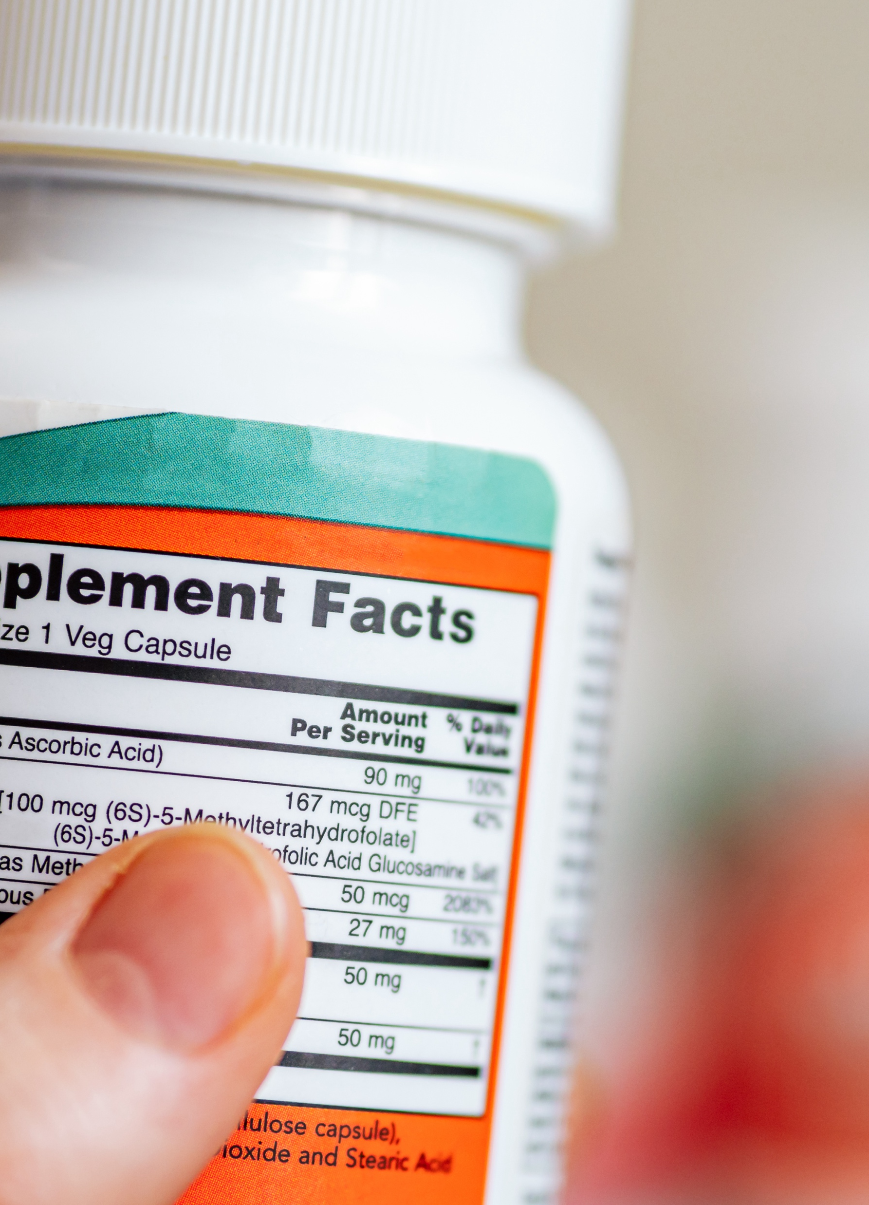
VALUES
Trust, Transparency & Sustainability

Slide 50
Trust: country
Key Insights:
When it comes to trust, Italy looks to a health care professional, as does Australia.
In Germany, clinical research is paramount, while in South Korea, it is a quality certification or seal.
Note: US n=1110, UK n=540, DE n=518, IT n=524, KR n=524, AU n=522, all supplement users n=3677. Question: “What characteristics most encourage you to trust a supplement brand?”

Slide 51
Transparency purchase influence: country
Key Insights:
Transparency is influential in all countries, but those in the US are most likely to say it “greatly influences” the chances they’ll buy.
There is a strong response in South Korea for 'somewhat influences'.
Note: US n=1110, UK n=540, DE n=518, IT n=524, KR n=524, AU n=522, all supplement users n=3677. Question: How likely are you to purchase supplements from a manufacturer that provides transparency information on its label or website?

Slide 52
Signals of brand transparency: country
Key Insights:
Detailed information and proof through quality seals or access to CofAs were the strongest signals of brand transparency for most countries.
Country of origin being listed on the label was especially important to those in South Korea.
Note: US n=1110, UK n=540, DE n=518, IT n=524, KR n=524, AU n=522, all supplement users n=3677. Question: Which of the following items are the strongest signals that a supplement brand is operating transparently?

Slide 53
Sustainability: country
Key Insights:
Sustainability is a purchase influence in all countries, but is most important to those in South Korea and least influential to those in the UK.
Note: US n=1110, UK n=540, DE n=518, IT n=524, KR n=524, AU n=522, all supplement users n=3677. Question: When deciding which supplements to purchase, to what degree does the sustainability/environmental impact of a supplement ingredient influence your purchasing decision?

