Slide 1
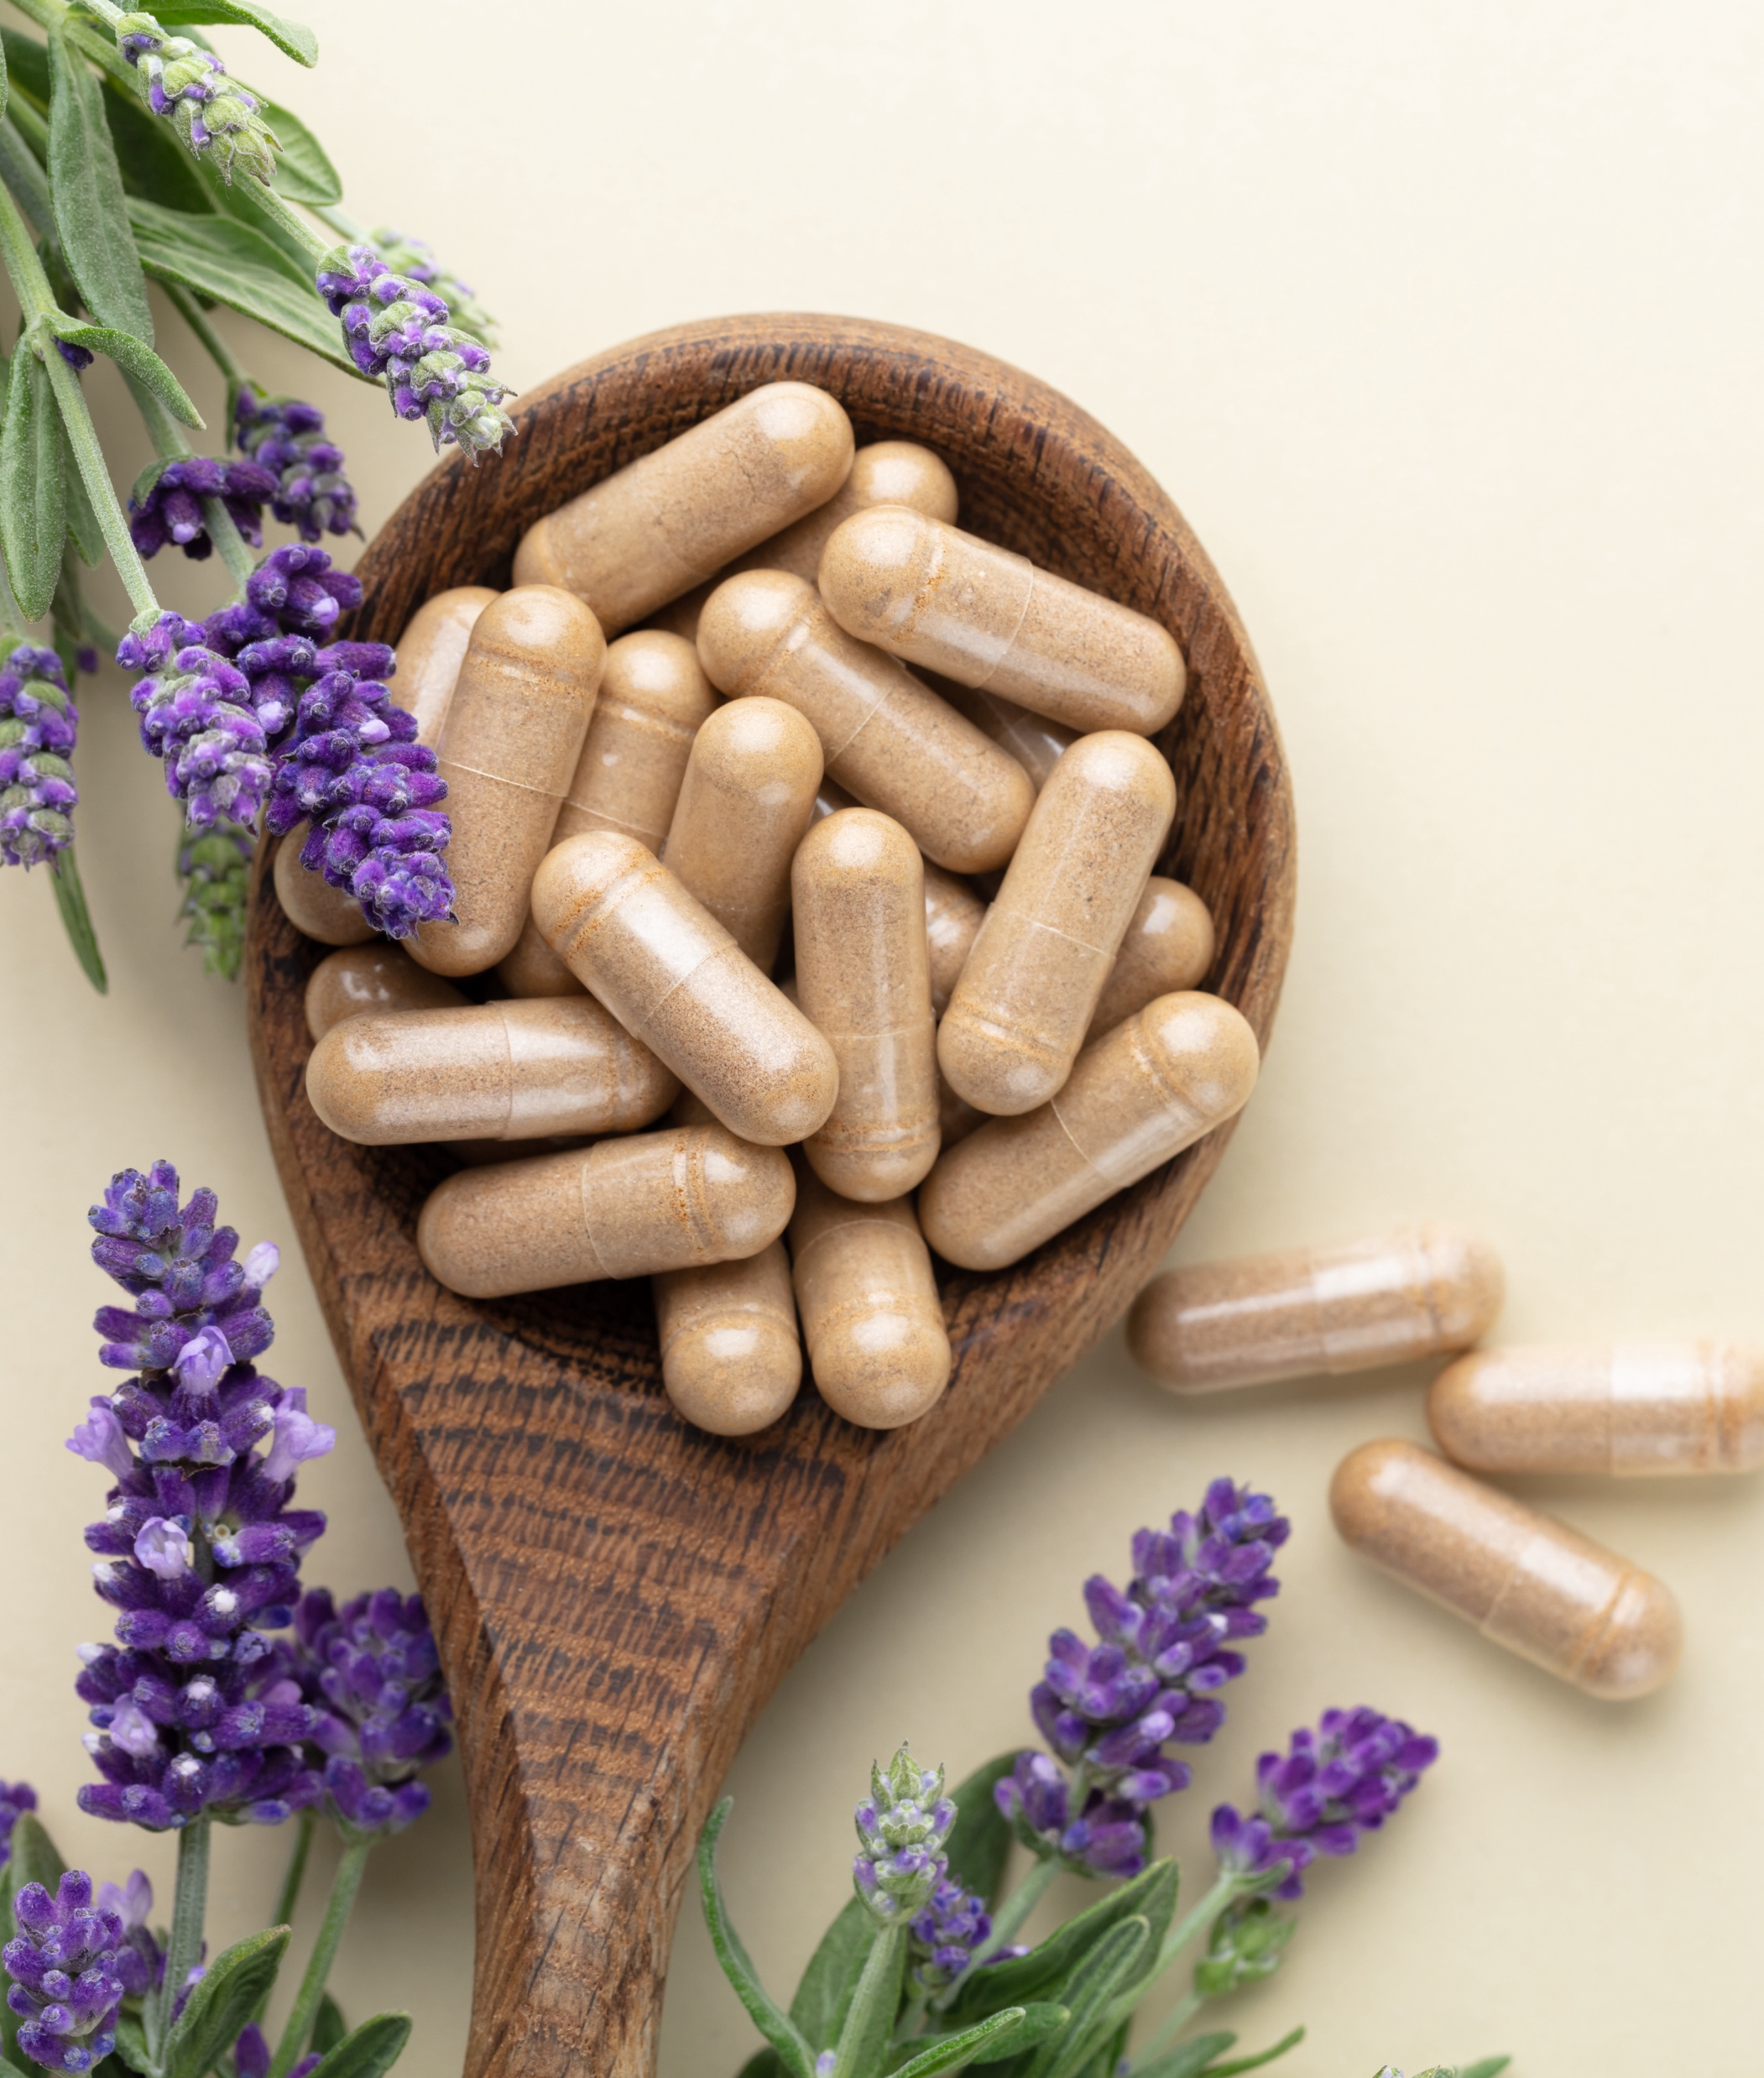

ITC INSIGHTS 2024 CONSUMER SUPPLEMENT SURVEY
PREBIOTIC REPORT

Slide 2


The 2024 ITC Insights Consumer Supplement Survey was fielded from February to March 2024 and analyzed by the Industry Transparency Center.
The overall survey includes over 4000 supplement consumers ages 18+ in 6 countries: US (1000), UK (500), DE (500) IT: (500), KR: (500), AU: (500), IN: (500). Prebiotic users range from 474 in the US, to 367 in India, 316 in South Korea, 247 in Italy, 203 in Germany,197 in Australia and 168 in the UK.
The survey provides insights into supplement user buying behaviors and priorities, including familiarity, usage patterns, purchase drivers, branded ingredients and the importance of values like trust, transparency and sustainability.
OVERVIEW
The ITC Insights lightbulb indicates there are key takeaways for that slide.

Slide 3

Table of Contents
This table of contents is hyperlinked to the sections. Just click the page number to jump to that section in the deck.
Section | Page Number
Demographics | 4
Health Concerns | 30
Supplement Usage | 51
Familiarity & Reasons They Buy | 69
Shopping Behavior | 103
Branded Ingredients | 134
Values | 151
Prebiotic Deep Dive | 168
The ITC Insights lightbulb indicates there are key takeaways for that slide.
You can access primary data for charts by right clicking and opening the data in Excel.
Country abbreviations in footers:
United States = US, United Kingdom = UK, Germany = DE, Italy = IT, South Korea = KR, Australia = AU, India = IN.

Slide 4
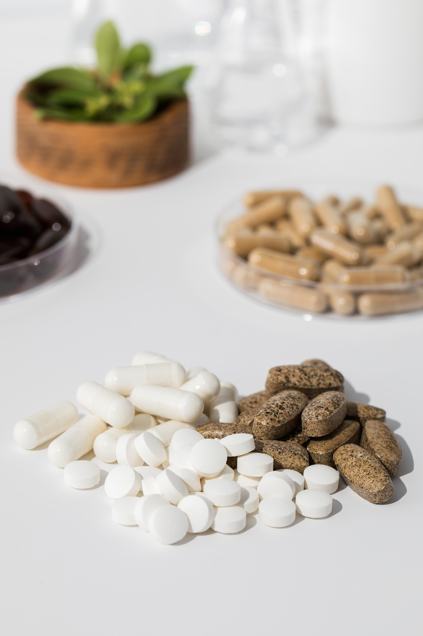
DEMOGRAPHICS
Age, gender and income for all respondents and by individual countries

Slide 5

Demographic overview
Key Insights:
Respondents were fairly evenly split across genders, skewing male overall, driven by the US; with users skewing slightly female in Italy and South Korea, skewing male in the US, UK, Germany and Australia, with an even split in India.
Except for South Korea where the largest group was those 18-34, the 35-54 age range has highest prebiotic users.
 | All Respondents |  | US Prebiotic Users |  | UK Prebiotic Users |  | DE Prebiotic Users |  | IT Prebiotic Users |  | KR Prebiotic Users |  | AU Prebiotic Users |  | IN Prebiotic Users
 | n=4198 |  | n=474 |  | n=168 |  | n=203 |  | n=247 |  | n=316 |  | n=197 |  | n=367
Female | n=2091 | 50% | n=210 | 45% | n=75 | 45% | n=99 | 49% | n=133 | 55% | n=162 | 51% | n=97 | 49% | n=182 | 50%
Male | n=2100 | 50% | n=263 | 55% | n=93 | 55% | n=104 | 51% | n=112 | 45% | n=154 | 49% | n=98 | 50% | n=185 | 50%
Non-binary/prefer to self-describe | n=7 | <1% | n=1 | <1% | n=0 | n/a | n=0 | n/a | n=2 | <1% | n=0 | n/a | n=2 | 1% | n=0 | n/a
18-34 | n=1204 | 29% | n=177 | 37% | n=63 | 38% | n=69 | 34% | n=65 | 26% | n=129 | 41% | n=63 | 32% | n=135 | 37%
35-54 | n=1764 | 42% | n=218 | 46% | n=73 | 43% | n=95 | 47% | n=120 | 49% | n=123 | 39% | n=99 | 50% | n=159 | 43%
55+ | n=1230 | 29% | n=79 | 17% | n=32 | 19% | n=39 | 19% | n=62 | 25% | n=64 | 20% | n=35 | 18% | n=73 | 20%

Slide 6
Demographics
AGE
INCOME
49%
51%
Even mix of men and women.
Female n=958
Male n=1009
Non-Binary n=5
We surveyed a well-diversified set of age brackets, in this survey, across all countries/markets.
A diverse balance of all income groups was achieved, via individualized country quotas.
Note: Prebiotic Users n=1972, Income n=1607 (UK and AU not included).

Slide 7
Demographics: age & gender
18-34
35-54
55+
49%
51%
49%
51%
46%
54%
Note: Gender Split: 18-34 n=701, 35-54 n=887, 55+ n=984, Income: 18-34 n=575, 35-54 n=715, 55+ n=317 (UK and AU not included).

Slide 8
Demographics: us
AGE
INCOME
45%
55%
More men than women.
Female n=210
Male n=263
Non-Binary n=1
We surveyed a well-diversified set of age brackets, in this survey, across the US market, overall.
A diverse balance of all income groups was achieved.
Note: US n=474.

Slide 9
Demographics: US, age & Gender
18-34
35-54
55+
34%
66%
48%
52%
58%
42%
Note: US 18-34 n=177, US 35-54 n=218, US 55+ n=79.

Slide 10
Demographics: uk
AGE
INCOME
45%
55%
More men than women.
Female n=75
Male n=93
We surveyed a well-diversified set of age brackets, in this survey, across the UK market.
We have fewer UK respondents in the £100,000 or more income ranges.
Note: UK n=168.

Slide 11
Demographics: Uk, age & Gender
18-34
35-54
55+
46%
54%
42%
58%
47%
53%
Note: UK 18-34 n=63, UK 35-54 n=73, UK 55+ n=32.

Slide 12
Demographics: de
AGE
INCOME
49%
51%
Slightly more women than men.
Female n=99
Male n=104
We surveyed a well-diversified set of age brackets, in this survey, across the German market.
We have fewer German respondents in the $100,000 or more income ranges.
Note: DE n=203.

Slide 13
Demographics: de, age & Gender
18-34
35-54
55+
52%
48%
47%
53%
46%
54%
Note: DE 18-34 n=69, DE 35-54 n=95, DE 55+ n=39.

Slide 14
Demographics: it
AGE
INCOME
55%
45%
More women than men.
Female n=133
Male n=112
Non-Binary n=2
We surveyed a well-diversified set of age brackets, in this survey, across the Italian market.
We have fewer Italian respondents in the $100,000 or more income ranges.
Note: IT n=247.

Slide 15
Demographics: it, age & Gender
18-34
35-54
55+
65%
34%
49%
50%
52%
48%
Note: IT 18-34 n=65, IT 35-54 n=120, IT 55+ n=62.

Slide 16
Demographics: kr
AGE
INCOME
51%
49%
Slightly more women than men.
Female n=162
Male n=154
We surveyed a well-diversified set of age brackets, in this survey, across the Korean market.
We have fewer Korean respondents in the $100,000 or more income range.
Note: KR n=316.

Slide 17
Demographics: kr, age & Gender
18-34
35-54
55+
64%
36%
50%
50%
30%
70%
Note: KR 18-34 n=129, KR 35-54 n=123, KR 55+ n=64.

Slide 18
Demographics: au
AGE
INCOME
49%
50%
Even mix of men and women.
Female n=97
Male n=98
Non-Binary n=2
We surveyed a well-diversified set of age brackets, in this survey, across the Australian market.
We have significantly more Australian respondents in the $100,000 or more ranges.
Note: AU n=197.

Slide 19
Demographics: au, age & Gender
18-34
35-54
55+
46%
52%
58%
41%
31%
69%
Note: AU 18-34 n=63, AU 35-54 n=99, AU 55+ n=35.

Slide 20
Demographics: in
AGE
INCOME
50%
50%
Even mix of men and women.
Female n=182
Male n=185
We surveyed a well-diversified set of age brackets, in this survey, across the Indian market.
India sees the largest portion of respondents in the under $45,000 ranges.
Note: IN n=367.

Slide 21
Demographics: in, age & Gender
18-34
35-54
55+
51%
49%
50%
50%
47%
53%
Note: IN 18-34 n=135, IN 35-54 n=159, IN 55+ n=73.

Slide 22
Why consumers take supplements
Key Insights:
Prebiotic users are mainly taking supplements for general health & well-being purposes.
Indian respondents over-index for all reasons.
Note: US n=474, UK n=168, DE n=203, IT n=247, KR n=316, AU n=197, IN n=367, All Respondents n=4198. Question: “Why do you take dietary supplements?”

Slide 23
Why consumers take supplements: age & gender
Key Insights:
General health & well-being is far and away the top response from each age & gender group.
Males 18-34 see an over-index for specific performance benefits.
Note: Female 18-34 n=346, Male 18-34 n=352, Female 35-54 n=437, Male 35-54 n=448, Female 55+ n=175, Male 55+ n=209. Question: “Why do you take dietary supplements?”

Slide 24
Why consumers take supplements: us, age & gender
Key Insights:
General health & well-being continues to be the number one reason for taking dietary supplement by a considerable margin, the highest being males 55+ at over 90%.
Both specific performance benefits and a recommendation from a health care professional are significantly skewed by the younger male respondents at over 40%.
Note: US Female 18-34 n=59, US Male 18-34 n=117, US Female 35-54 n=105, US Male 35-54 n=113, US Female 55+ n=46, US Male 55+ n=33. Question: “Why do you take dietary supplements?”

Slide 25
Why consumers take supplements: us, 2023 - 2024
Key Insights:
General health and well-being is still the overwhelmingly number one reason US prebiotic users are taking dietary supplements.
Note: 2023 US n=484, 2024 US n=474. Question: “Why do you take dietary supplements?”

Slide 26
Discussion with a health care professional
Key Insight:
'Situational' is the top response from each country but the US who instead mark ‘always’ as their number one.
Note: US n=474, UK n=168, DE n=203, IT n=247, KR n=316, AU n=197, IN n=367, All Respondents n=4198. Question: “Under which circumstances would you discuss your dietary supplements with your health care professional?”

Slide 27
Discussion with a health care professional: age & gender
Key Insight:
Males 18-34 are the outlier here with a relatively low response rate for situational, and high response rates for always.
Note: Female 18-34 n=346, Male 18-34 n=352, Female 35-54 n=437, Male 35-54 n=448, Female 55+ n=175, Male 55+ n=209. Question: “Under which circumstances would you discuss your dietary supplements with your health care professional?”

Slide 28
Discussion with a health care professional: us, age & gender
Key Insight:
Here we can see the shift in US responses into the always response, being the top response for males 18-34, females 35-54 and both females and males over 55.
Note: US Female 18-34 n=59, US Male 18-34 n=117, US Female 35-54 n=105, US Male 35-54 n=113, US Female 55+ n=46, US Male 55+ n=33. Question: “Under which circumstances would you discuss your dietary supplements with your health care professional?”

Slide 29
Discussion with health care professional: us, 2023 - 2024
Key Insight:
2024 respondents are more pro-active in their talks with a health care professional with the always response up 4%.
Note: 2023 US n=484, 2024 US n=474. Question: “Under which circumstances would you discuss your dietary supplements with your health care professional?”

Slide 30

HEALTH CONCERNS
Deep dive into supplement user health concerns and which ones they take supplements for

Slide 31
Health concerns and what they take supplements for
Key Insight:
There are large fulfillment gaps across the board, but mental health related concerns see some of the largest – across all surveyed countries.
Mood shows an exceedingly large gap, especially for Italy, the UK and Australia.
Note: US n=474, UK n=168, DE n=203, IT n=247, KR n=316, AU n=197, IN n=367. Results shown for top 10 health concerns. Question: “Which of the following health conditions or concerns currently impact or impacted you within the past year?” Entire bar represents total reporting, solid bar represents using supplements for that concern and cross hatch bar represents fulfillment gap.

Slide 32
Health concerns and what they take supplements for – next 10
Key Insights:
Overweight/obese have the largest fulfillment gaps among this grouping, 10% and larger in some cases.
Korean respondents show by far the highest levels of both reporting and addressing with supplements for eye fatigue, doubling the next closest group.
Note: US n=474, UK n=168, DE n=203, IT n=247, KR n=316, AU n=197, IN n=367. Results shown for top 11-20 health concerns. Question: “Which of the following health conditions or concerns currently impact or impacted you within the past year?” Entire bar represents total reporting, solid bar represents using supplements for that concern and cross hatch bar represents fulfillment gap.

Slide 33
Health concerns and what they take supplements for – last 10
Key Insights:
Vision concerns continue to be one of the top concerns for those in South Korea with high reporting and addressing rates for poo/declining vision.
Both Indian and South Korean respondents over-index for immunity concerns, with relatively small fulfillment gaps.
Note: US n=474, UK n=168, DE n=203, IT n=247, KR n=316, AU n=197, IN n=367. Results shown for top 21-32 health concerns. Question: “Which of the following health conditions or concerns currently impact or impacted you within the past year?” Entire bar represents total reporting, solid bar represents using supplements for that concern and cross hatch bar represents fulfillment gap.

Slide 34
Health concerns and what they take supplements for: age & gender
Key Insight:
The mental health related concerns see the highest levels of reporting from the younger age groups, particularly females. The gap for mood for females 35-54 sits at 18%.
Anxiety and stress too sees a large gap for this demographic - 20%.
Note: Female 18-35 n=346, Male 18-35 n=352, Female 35-54 n=437, Male 35-54 n=448, Female 55+ n=175, Male 55+ n=209. Results shown for top 10 health concerns. Question: “Which of the following health conditions or concerns currently impact or impacted you within the past year?” Entire bar represents total reporting, solid bar represents using supplements for that concern and cross hatch bar represents fulfillment gap.

Slide 35
Health concerns and what they take supplements for: age & gender – next 10
Key Insight:
Aging related concerns, joint or other pain and poor/declining vision predictably skewed older, with top responses coming from females over 55. Both have large fulfillment gaps.
Note: Female 18-35 n=346, Male 18-35 n=352, Female 35-54 n=437, Male 35-54 n=448, Female 55+ n=175, Male 55+ n=209. Results shown for top 11-20 health concerns. Question: “Which of the following health conditions or concerns currently impact or impacted you within the past year?” Entire bar represents total reporting, solid bar represents using supplements for that concern and cross hatch bar represents fulfillment gap.

Slide 36
Health concerns and what they take supplements for: age & gender – last 10
Key Insights:
We see more health concerns with a significant older skew in the last 10. High blood pressure and cholesterol both see top responses from males over 55 while healthy aging is driven more by females over 35.
Even among the lesser reported health concerns, we see addressable gaps.
Note: Female 18-35 n=346, Male 18-35 n=352, Female 35-54 n=437, Male 35-54 n=448, Female 55+ n=175, Male 55+ n=209. Results shown for top 21-32 health concerns. Question: “Which of the following health conditions or concerns currently impact or impacted you within the past year?” Entire bar represents total reporting, solid bar represents using supplements for that concern and cross hatch bar represents fulfillment gap.

Slide 37
Health concerns and what they take supplements for: age & gender (US)
Key Insights:
Mental health related concerns tend to have the largest responses, particularly from young females in the US.
Anxiety or stress has the two of the highest reporting rates of any health concern (58% from females 18-34 and 47% from females 35-54).
Energy sees a gap of 18% for females 35-54.
Digestive complaints sees its largest gap for males 55+ at 12%.
Note: US Female 18-35 n=59, US Male 18-35 n=117, US Female 35-54 n=105, US Male 35-54 n=113, US Female 55+ n=46, US Male 55+ n=33. Results shown for top 10 health concerns. Question: “Which of the following health conditions or concerns currently impact or impacted you within the past year?” Entire bar represents total reporting, solid bar represents using supplements for that concern and cross hatch bar represents fulfillment gap.

Slide 38
Health concerns and what they take supplements for: age & gender (US) – NEXT 10
Key Insight:
High blood pressure and joint or other pain are both heavily driven by those over 55, the female over 55 reporting rate for joint or other pain (59%) is the highest among all US respondents.
Note: US Female 18-35 n=59, US Male 18-35 n=117, US Female 35-54 n=105, US Male 35-54 n=113, US Female 55+ n=46, US Male 55+ n=33. Results shown for top 11-20 health concerns. Question: “Which of the following health conditions or concerns currently impact or impacted you within the past year?” Entire bar represents total reporting, solid bar represents using supplements for that concern and cross hatch bar represents fulfillment gap.

Slide 39
Health concerns and what they take supplements for: age & gender (US) – LAST 10
Key Insight:
High cholesterol in the US is mainly driven by those over 55 who have two of the highest reporting rates for this section in the US, 35% for females over 55 and 42% for males over 55. Both have fulfillment gaps of nearly 20%.
Note: US Female 18-35 n=59, US Male 18-35 n=117, US Female 35-54 n=105, US Male 35-54 n=113, US Female 55+ n=46, US Male 55+ n=33. Results shown for top 21-32 health concerns. Question: “Which of the following health conditions or concerns currently impact or impacted you within the past year?” Entire bar represents total reporting, solid bar represents using supplements for that concern and cross hatch bar represents fulfillment gap.

Slide 40
TOP 5 HEALTH CONCERNS:
US, GENDER 2023-2024
Key Insights:
Top health concerns among US respondents remain similar year over year with mental health being a particular area of concern among both females and males, in fact, increasing year over year.
Lack of energy continues to move up the charts – for both females and males
2023 US TOP 5
Anxiety or stress | 36%
Depression | 28%
Lack of energy | 27%
General health | 23%
Joint or other pain | 23%
2023 US Females
Anxiety or stress | 43%
Depression | 32%
Lack of energy | 30%
Insomnia/Sleep problems | 28%
Mood | 26%
2023 US Males
Anxiety or stress | 29%
General health | 25%
High cholesterol | 25%
Depression | 24%
Lack of energy | 24%
2024 US Top 5
Anxiety or stress | 38% ↑
Lack of energy | 29% ↑
Depression | 24% ↓
Joint or other pain | 23% ↔
General health | 23% ↔
2024 US Female Top 5
Anxiety or stress | 46% ↑
Lack of energy | 36% ↑
Joint or other pain | 27% ↑
Insomnia/Sleep problems | 26% ↓
Skin health | 26%↔
2024 US Male Top 5
Anxiety or stress | 32% ↑
Depression | 24%↔
Lack of energy | 24%↔
General health | 23% ↓
Nutrition concerns | 21%↔
Note: 2023 US n=484, 2023 US Female n=239, 2023 US Male n=244, 2024 US n=474, 2024 US Female n=210, 2024 US Male n=263. Question: “Which of the following health conditions or concerns currently impact or impacted you within the past year?”

Slide 41
HEALTH CONCERNS: US, 2019-2024
Key Insight:
Mental health relates concerns, most significantly anxiety or stress and depression have seen large increases since 2019 among prebiotic users in the US.
Note: 2019 US n=333, 2020 US n=300, 2021 US n=342, 2022 US n=503, 2023 US n=484, 2024 US n=474. Question: “Which of the following health conditions or concerns currently impact or impacted you within the past year?”

Slide 42
Willing to take supplements to address concerns
Key Insights:
For the most part, the response rate for a willingness to take a supplement tracks with reporting of a health concern.
Consistently though, there seems to be more of a willingness to consider taking supplements for a reported health concern than actually taking supplements for said concern – suggesting broad opportunities.
Here, smaller gaps are better news for companies targeting those concerns.
Note: US n=474, UK n=168, DE n=203, IT n=247, KR n=316, AU n=197, IN n=367. Question: “Would you consider supplements for any of the following health concerns?” Results shown for top 10 health concerns. Question: “Which of the following health conditions or concerns currently impact or impacted you within the past year?” Entire bar represents total reporting, solid bar represents a willingness to use supplements for that concern, smaller hatch indicates willingness to fulfill.

Slide 43
Willing to take supplements to address concerns – next 10
Key Insights:
Overweight/obese shows some of the largest gaps in this set of concerns.
Many health concerns here see relatively small willingness to fulfillment gaps in this measure.
Of note, digestive concerns in Italy shows a small gap indicating almost all those he the concern are willing to take supplements to address it.
Note: US n=474, UK n=168, DE n=203, IT n=247, KR n=316, AU n=197, IN n=367. Question: “Would you consider supplements for any of the following health concerns?” Results shown for top 11-20 health concerns. Question: “Which of the following health conditions or concerns currently impact or impacted you within the past year?” Entire bar represents total reporting, solid bar represents a willingness to use supplements for that concern, smaller hatch indicates willingness to fulfill.

Slide 44
Willing to take supplements to address concerns – last 10
Key Insights:
Even in these last 10, there is more of a willingness to consider taking supplements for a reported health concern than actually taking supplements for said concern.
Immunity shows well here, especially in Korea.
However, there still exists significant gaps between reporting a concern and a willingness to take a supplement for a concern.
Note: US n=474, UK n=168, DE n=203, IT n=247, KR n=316, AU n=197, IN n=367. Question: “Would you consider supplements for any of the following health concerns?” Results shown for top 21-32 health concerns. Question: “Which of the following health conditions or concerns currently impact or impacted you within the past year?” Entire bar represents total reporting, solid bar represents a willingness to use supplements for that concern, smaller hatch indicates willingness to fulfill.

Slide 45
Willing to take supplements to address concerns: age & gender
Key Insights:
Young females especially and younger males to a lesser extent have some of the largest gaps between reporting and a willingness to take a supplement for things like mood and anxiety or stress.
Lack of energy is a major concern, and generally it ranks high on willingness to address, especially for females 35-54, their highest willingness.
There is also a gap we see for females 55+ for insomnia/sleep problems.
Note: Female 18-35 n=346, Male 18-35 n=352, Female 35-54 n=437, Male 35-54 n=448, Female 55+ n=175, Male 55+ n=209. Question: “Would you consider supplements for any of the following health concerns?” Results shown for top 10 health concerns. Question: “Which of the following health conditions or concerns currently impact or impacted you within the past year?” Entire bar represents total reporting, solid bar represents a willingness to use supplements for that concern, smaller hatch indicates willingness to fulfill.

Slide 46
Willing to take supplements to address concerns: age & gender – next 10
Key Insight:
As we get into the concerns with lower reporting rates, we see the gap between reporting and a willingness to take a supplement shrink as well.
Note: Female 18-35 n=346, Male 18-35 n=352, Female 35-54 n=437, Male 35-54 n=448, Female 55+ n=175, Male 55+ n=209. Question: “Would you consider supplements for any of the following health concerns?” Results shown for top 11-20 health concerns. Question: “Which of the following health conditions or concerns currently impact or impacted you within the past year?” Entire bar represents total reporting, solid bar represents a willingness to use supplements for that concern, smaller hatch indicates willingness to fulfill.

Slide 47
Willing to take supplements to address concerns: age & gender – last 10
Key Insights:
Here again we see a high level of willingness to take a supplement to address concerns.
High blood pressure and cholesterol have relatively large gaps from females and males over 55. Of note here is healthy aging for females 55+.
Note: Female 18-35 n=346, Male 18-35 n=352, Female 35-54 n=437, Male 35-54 n=448, Female 55+ n=175, Male 55+ n=209. Question: “Would you consider supplements for any of the following health concerns?” Results shown for top 21-32 health concerns. Question: “Which of the following health conditions or concerns currently impact or impacted you within the past year?” Entire bar represents total reporting, solid bar represents a willingness to use supplements for that concern, smaller hatch indicates willingness to fulfill.

Slide 48
Willing to take supplements to address concerns: us, age & gender
Key Insight:
Among those in the US, we see smaller gaps, with many at or near zero. Females 18-34 for sexual health, females 35-54 for insomnia/sleep problems, males 35-54 for insomnia/sleep problems as well as both digestive complaints and sexual health, females over 55 for skin health, lack of energy and memory issues and males over 55 for lack of energy, mood and insomnia/sleep problems.
Note: US Female 18-35 n=59, US Male 18-35 n=117, US Female 35-54 n=105, US Male 35-54 n=113, US Female 55+ n=46, US Male 55+ n=33. Question: “Would you consider supplements for any of the following health concerns?” Results shown for top 10 health concerns. Question: “Which of the following health conditions or concerns currently impact or impacted you within the past year?” Entire bar represents total reporting, solid bar represents a willingness to use supplements for that concern, smaller hatch indicates willingness to fulfill.

Slide 49
Willing to take supplements to address concerns: us, age & gender – next 10
Key Insight:
We continue to see small gap from those in the US, with even more at or approaching zero.
Immunity, while not a huge concern, shows zero gap for females 35-54 and 55+.
Note: US Female 18-35 n=59, US Male 18-35 n=117, US Female 35-54 n=105, US Male 35-54 n=113, US Female 55+ n=46, US Male 55+ n=33. Question: “Would you consider supplements for any of the following health concerns?” Results shown for top 11-20 health concerns. Question: “Which of the following health conditions or concerns currently impact or impacted you within the past year?” Entire bar represents total reporting, solid bar represents a willingness to use supplements for that concern, smaller hatch indicates willingness to fulfill.

Slide 50
Willing to take supplements to address concerns: us, age & gender – last 10
Key Insight:
Poor/declining vision and high cholesterol both show relatively high willingness gaps among prebiotic users in the US where we have seen more gaps at or near zero than any other group.
Diabetes/blood sugar management shows significant concern and high willingness especially for males 35-54.
Note: US Female 18-35 n=59, US Male 18-35 n=117, US Female 35-54 n=105, US Male 35-54 n=113, US Female 55+ n=46, US Male 55+ n=33. Question: “Would you consider supplements for any of the following health concerns?” Results shown for top 21-32 health concerns. Question: “Which of the following health conditions or concerns currently impact or impacted you within the past year?” Entire bar represents total reporting, solid bar represents a willingness to use supplements for that concern, smaller hatch indicates willingness to fulfill.

Slide 51
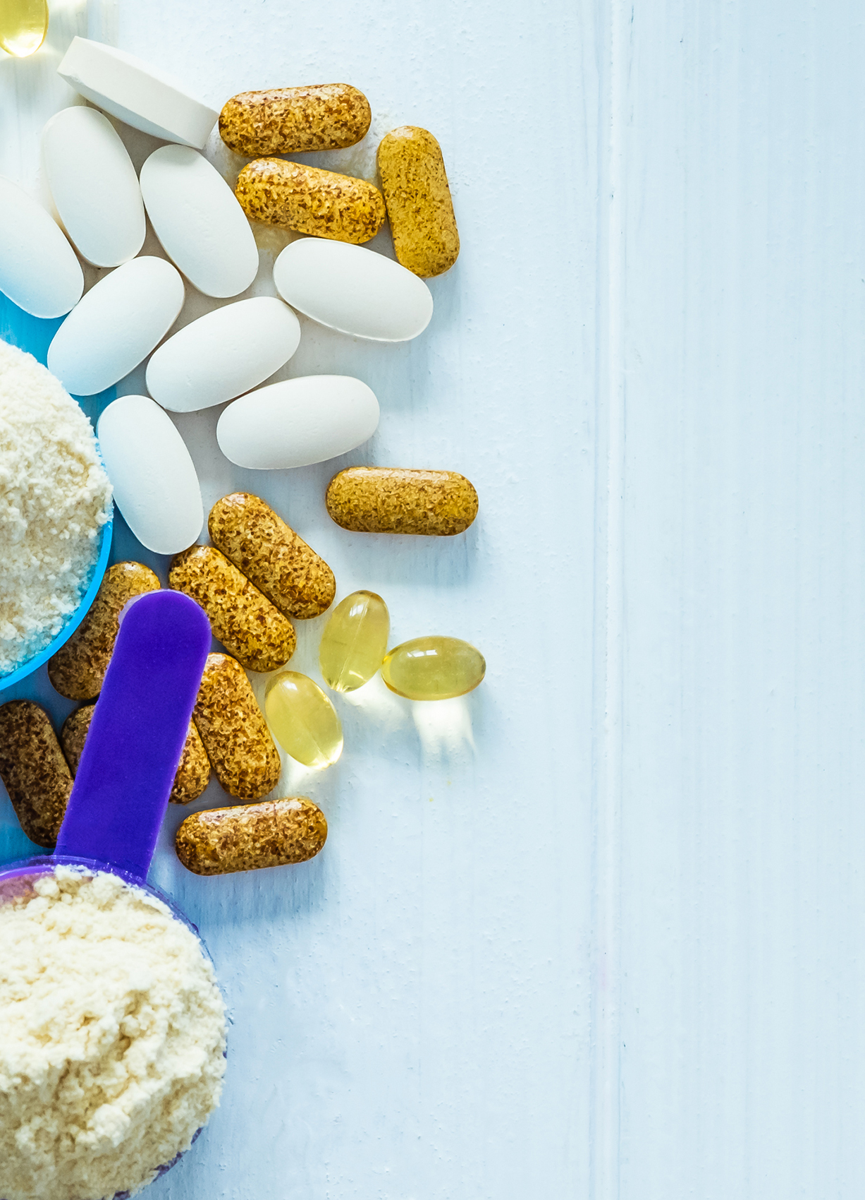
SUPPLEMENT USAGE

Slide 52
Supplement usage frequency
Key Insight:
Daily is the most popular response from each country, but those with relatively low responses there; Germany, Italy and India, have relatively high response rates for as need arises.
Overall, prebiotic users under-index slightly compared to all supplement users.
Note: US n=474, UK n=168, DE n=203, IT n=247, KR n=316, AU n=197, IN n=367, All Respondents n=4198. Question: “How often do you take vitamins, minerals, herbs or other dietary supplements (e.g. fish oil, protein powder, probiotics, melatonin, etc.)?”

Slide 53
Supplement usage frequency: age & gender
Key Insights:
Daily use has as noticeable older female skew.
Young males have relatively high response rates for the irregular use, 1-3 times per week response.
Note: Female 18-34 n=346, Male 18-34 n=352, Female 35-54 n=437, Male 35-54 n=448, Female 55+ n=175, Male 55+ n=209. Question: “How often do you take vitamins, minerals, herbs or other dietary supplements (e.g. fish oil, protein powder, probiotics, melatonin, etc.)?”

Slide 54
Supplement usage frequency: us, age & gender
Key Insights:
In the US, we see over-indexing, with daily also skewed older female, despite the top response from males over 55 there.
It is also the top response from males 18-34 and 35-54, just to a significantly lesser extent, those male age groups have the highest response rates for 4-6 and 1-3 times per week.
Note: US Female 18-34 n=59, US Male 18-34 n=117, US Female 35-54 n=105, US Male 35-54 n=113, US Female 55+ n=46, US Male 55+ n=33. Question: “How often do you take vitamins, minerals, herbs or other dietary supplements (e.g. fish oil, protein powder, probiotics, melatonin, etc.)?”

Slide 55
SUPPLEMENT USAGE FREQUENCY:
US, 2019-2024
Key Insight:
Daily use has seen a steady decline in the US among prebiotic users since 2019.
Note: 2019 US n=333, 2020 US n=300, 2021 US n=342, 2022 US n=503, 2023 US n=484, 2024 n=474. Question: “How often do you take vitamins, minerals, herbs or other dietary supplements (e.g. fish oil, protein powder, probiotics, melatonin, etc.)?”

Slide 56
Supplement usage
Key Insights:
Prebiotic users tend to use supplements more frequently than all users; what this means for instance is that regular use of something like probiotics has gone up 12%.
Prebiotic use itself is mostly irregular, with the highest reported usage rates coming in at 1-3 times per week (24%) and seasonally/as needed (40%).
Daily usage rates for most supplements is above 10%, with the most popular daily usage is supplements like vitamin C and multivitamins seeing daily use of 30% or more.
All supplements have a 65% or more total usage rate among prebiotic users.
 | n |  | All Usage |  | Daily |  | 4-6 times per week |  | 1-3 times per week |  | Seasonally/As needed |  | It's in another supplement I take |  | Never
 | Prebiotic | All | Prebiotic | All | Prebiotic | All | Prebiotic | All | Prebiotic | All | Prebiotic | All | Prebiotic | All | Prebiotic | All
Prebiotics | 1972 | 3548 | 100% | 58% | 16% | 9% | 16% | 9% | 24% | 14% | 40% | 24% | 5% | 3% | 0% | 42%
Vitamin C | 1967 | 4170 | 98% | 91% | 32% | 28% | 18% | 12% | 20% | 16% | 22% | 29% | 6% | 6% | 2% | 9%
Multivitamin | 1961 | 4151 | 97% | 88% | 34% | 32% | 17% | 11% | 22% | 17% | 18% | 24% | 5% | 4% | 3% | 12%
Vitamin D | 1959 | 4147 | 96% | 88% | 28% | 28% | 16% | 10% | 22% | 17% | 22% | 25% | 8% | 8% | 4% | 12%
Probiotics | 1948 | 3953 | 95% | 69% | 19% | 14% | 16% | 9% | 24% | 16% | 32% | 27% | 4% | 3% | 5% | 31%
Magnesium | 1950 | 4070 | 91% | 76% | 18% | 16% | 16% | 10% | 24% | 17% | 28% | 28% | 6% | 6% | 9% | 24%
Omega-3s | 1954 | 4095 | 91% | 78% | 22% | 20% | 16% | 10% | 24% | 18% | 25% | 26% | 4% | 4% | 9% | 22%
Antioxidants | 1932 | 3952 | 91% | 71% | 15% | 11% | 16% | 10% | 23% | 16% | 31% | 29% | 6% | 5% | 9% | 29%
Iron | 1958 | 4137 | 91% | 77% | 22% | 17% | 15% | 9% | 22% | 15% | 26% | 29% | 6% | 7% | 9% | 23%
Calcium | 1959 | 4139 | 90% | 77% | 24% | 20% | 16% | 10% | 22% | 16% | 22% | 24% | 6% | 8% | 10% | 23%
Postbiotics | 1631 | 2567 | 81% | 57% | 11% | 7% | 16% | 10% | 21% | 14% | 31% | 23% | 3% | 2% | 19% | 43%
Protein Powder | 1911 | 3881 | 81% | 62% | 16% | 12% | 16% | 10% | 23% | 18% | 22% | 21% | 3% | 2% | 19% | 38%
Curcumin/ Turmeric | 1901 | 3716 | 79% | 61% | 15% | 11% | 15% | 9% | 20% | 14% | 25% | 23% | 5% | 3% | 21% | 39%
Vitamin K2 | 1748 | 3020 | 77% | 60% | 13% | 10% | 14% | 10% | 20% | 14% | 23% | 21% | 6% | 6% | 23% | 40%
Collagen | 1904 | 3805 | 76% | 52% | 14% | 10% | 15% | 9% | 20% | 12% | 24% | 19% | 4% | 3% | 24% | 48%
Ashwagandha | 1336 | 2072 | 76% | 62% | 13% | 11% | 16% | 11% | 21% | 16% | 22% | 21% | 3% | 3% | 24% | 38%
Biotin | 1766 | 3053 | 76% | 57% | 14% | 11% | 14% | 9% | 18% | 12% | 26% | 20% | 5% | 5% | 24% | 43%
Alpha-GPC | 1299 | 1757 | 76% | 62% | 8% | 6% | 16% | 13% | 22% | 18% | 26% | 22% | 3% | 3% | 24% | 38%
Melatonin | 1874 | 3701 | 75% | 56% | 11% | 9% | 12% | 7% | 19% | 13% | 29% | 25% | 4% | 2% | 25% | 44%
Nootropics | 1221 | 1649 | 75% | 61% | 8% | 7% | 16% | 12% | 20% | 16% | 27% | 23% | 3% | 3% | 25% | 39%
Synbiotics | 1458 | 2118 | 74% | 55% | 9% | 6% | 15% | 11% | 20% | 14% | 27% | 22% | 3% | 3% | 26% | 45%
MSM | 1385 | 1980 | 74% | 58% | 9% | 7% | 15% | 11% | 21% | 15% | 27% | 22% | 3% | 3% | 26% | 42%
Astaxanthin | 1332 | 1791 | 73% | 60% | 9% | 8% | 18% | 14% | 18% | 14% | 25% | 21% | 3% | 3% | 27% | 40%
CoQ10 | 1437 | 2253 | 73% | 56% | 10% | 9% | 16% | 11% | 19% | 13% | 24% | 20% | 4% | 3% | 27% | 44%
Citicoline | 1245 | 1652 | 72% | 60% | 8% | 6% | 17% | 13% | 21% | 16% | 24% | 21% | 3% | 3% | 28% | 40%
Glucosamine | 1802 | 3249 | 72% | 52% | 10% | 8% | 15% | 9% | 17% | 12% | 26% | 20% | 3% | 3% | 28% | 48%
Glutathione | 1489 | 2145 | 72% | 56% | 9% | 7% | 15% | 11% | 20% | 15% | 24% | 21% | 3% | 3% | 28% | 44%
Lutein | 1569 | 2414 | 72% | 57% | 11% | 10% | 16% | 11% | 18% | 14% | 22% | 19% | 3% | 3% | 28% | 43%
Choline | 1388 | 2006 | 70% | 55% | 6% | 5% | 14% | 10% | 20% | 15% | 26% | 21% | 4% | 4% | 30% | 45%
CBD | 1563 | 2893 | 67% | 47% | 9% | 6% | 13% | 8% | 17% | 11% | 25% | 20% | 3% | 2% | 33% | 53%
Mushrooms | 1649 | 2936 | 66% | 46% | 7% | 5% | 14% | 8% | 19% | 13% | 24% | 19% | 2% | 1% | 34% | 54%
Note: n varies by supplement. Question: “Which of the following best describes how frequently you are taking the following supplements?”

Slide 57
Supplement usage: us
Key Insight:
In the US, we see a significant uptick of all supplement frequency of use for prebiotic users. For instance, regular use of probiotics is up 23%.
US prebiotic use is more spread out over each category, with not single category, regular or irregular seeing a usage rate above 28%.
 | n |  | All Usage |  | Daily |  | 4-6 times per week |  | 1-3 times per week |  | Seasonally/As needed |  | It's in another supplement I take |  | Never
 | US | All | US | All | US | All | US | All | US | All | US | All | US | All | US | All
Prebiotics | 474 | 3548 | 100% | 58% | 18% | 9% | 22% | 9% | 26% | 14% | 28% | 24% | 7% | 3% | 0% | 42%
Vitamin C | 472 | 4170 | 97% | 91% | 37% | 28% | 16% | 12% | 19% | 16% | 16% | 29% | 9% | 6% | 3% | 9%
Multivitamin | 471 | 4151 | 97% | 88% | 44% | 32% | 18% | 11% | 18% | 17% | 12% | 24% | 5% | 4% | 3% | 12%
Probiotics | 468 | 3953 | 96% | 69% | 27% | 14% | 19% | 9% | 22% | 16% | 23% | 27% | 4% | 3% | 4% | 31%
Vitamin D | 471 | 4147 | 96% | 88% | 36% | 28% | 18% | 10% | 18% | 17% | 15% | 25% | 9% | 8% | 4% | 12%
Antioxidants | 465 | 3952 | 94% | 71% | 18% | 11% | 21% | 10% | 25% | 16% | 22% | 29% | 8% | 5% | 6% | 29%
Calcium | 469 | 4139 | 92% | 77% | 30% | 20% | 16% | 10% | 20% | 16% | 17% | 24% | 9% | 8% | 8% | 23%
Iron | 469 | 4137 | 89% | 77% | 23% | 17% | 17% | 9% | 20% | 15% | 19% | 29% | 9% | 7% | 11% | 23%
Omega-3s | 465 | 4095 | 89% | 78% | 23% | 20% | 19% | 10% | 22% | 18% | 20% | 26% | 5% | 4% | 11% | 22%
Magnesium | 466 | 4070 | 86% | 76% | 19% | 16% | 15% | 10% | 26% | 17% | 18% | 28% | 8% | 6% | 14% | 24%
Melatonin | 463 | 3701 | 82% | 56% | 14% | 9% | 13% | 7% | 20% | 13% | 31% | 25% | 4% | 2% | 18% | 44%
Protein Powder | 458 | 3881 | 81% | 62% | 16% | 12% | 19% | 10% | 24% | 18% | 19% | 21% | 3% | 2% | 19% | 38%
Postbiotics | 396 | 2567 | 80% | 57% | 12% | 7% | 19% | 10% | 22% | 14% | 22% | 23% | 5% | 2% | 20% | 43%
Curcumin/ Turmeric | 457 | 3716 | 80% | 61% | 18% | 11% | 18% | 9% | 19% | 14% | 21% | 23% | 5% | 3% | 20% | 39%
Alpha-GPC | 313 | 1757 | 79% | 62% | 11% | 6% | 23% | 13% | 21% | 18% | 21% | 22% | 4% | 3% | 21% | 38%
Citicoline | 302 | 1652 | 79% | 60% | 9% | 6% | 23% | 13% | 22% | 16% | 21% | 21% | 5% | 3% | 21% | 40%
Biotin | 448 | 3053 | 79% | 57% | 19% | 11% | 16% | 9% | 19% | 12% | 19% | 20% | 6% | 5% | 21% | 43%
Astaxanthin | 295 | 1791 | 79% | 60% | 7% | 8% | 22% | 14% | 18% | 14% | 25% | 21% | 6% | 3% | 21% | 40%
Vitamin K2 | 425 | 3020 | 78% | 60% | 17% | 10% | 17% | 10% | 18% | 14% | 18% | 21% | 8% | 6% | 22% | 40%
Synbiotics | 336 | 2118 | 78% | 55% | 12% | 6% | 19% | 11% | 21% | 14% | 21% | 22% | 5% | 3% | 22% | 45%
Nootropics | 301 | 1649 | 78% | 61% | 10% | 7% | 18% | 12% | 25% | 16% | 22% | 23% | 4% | 3% | 22% | 39%
MSM | 328 | 1980 | 76% | 58% | 11% | 7% | 19% | 11% | 20% | 15% | 23% | 22% | 4% | 3% | 24% | 42%
CoQ10 | 379 | 2253 | 75% | 56% | 14% | 9% | 16% | 11% | 20% | 13% | 22% | 20% | 3% | 3% | 25% | 44%
Glutathione | 339 | 2145 | 75% | 56% | 10% | 7% | 19% | 11% | 20% | 15% | 23% | 21% | 4% | 3% | 25% | 44%
Collagen | 454 | 3805 | 74% | 52% | 15% | 10% | 17% | 9% | 20% | 12% | 19% | 19% | 4% | 3% | 26% | 48%
Glucosamine | 438 | 3249 | 74% | 52% | 14% | 8% | 15% | 9% | 20% | 12% | 21% | 20% | 4% | 3% | 26% | 48%
Ashwagandha | 349 | 2072 | 72% | 62% | 11% | 11% | 18% | 11% | 20% | 16% | 19% | 21% | 4% | 3% | 28% | 38%
Choline | 354 | 2006 | 70% | 55% | 8% | 5% | 17% | 10% | 21% | 15% | 19% | 21% | 5% | 4% | 30% | 45%
Lutein | 369 | 2414 | 70% | 57% | 8% | 10% | 21% | 11% | 20% | 14% | 17% | 19% | 4% | 3% | 30% | 43%
CBD | 449 | 2893 | 70% | 47% | 11% | 6% | 14% | 8% | 21% | 11% | 21% | 20% | 3% | 2% | 30% | 53%
Mushrooms | 419 | 2936 | 64% | 46% | 8% | 5% | 18% | 8% | 17% | 13% | 19% | 19% | 2% | 1% | 36% | 54%
Note: n varies by supplement. Question: “Which of the following best describes how frequently you are taking the following supplements?”

Slide 58
Supplement usage: UK
Key Insight:
Again, in the UK, we see that prebiotic users also use other supplements more regularly, for jnstance, vitamin D up 13%. Probiotic regular use though is only up 3% for these users
UK prebiotic use is heavily driven by the seasonal/as needed category at 48%, double the next highest, the irregular 1-3 times per week (24%).
 | n |  | All Usage |  | Daily |  | 4-6 times per week |  | 1-3 times per week |  | Seasonally/As needed |  | It's in another supplement I take |  | Never
 | UK | All | UK | All | UK | All | UK | All | UK | All | UK | All | UK | All | UK | All
Prebiotics | 168 | 3548 | 100% | 58% | 12% | 9% | 14% | 9% | 24% | 14% | 48% | 24% | 3% | 3% | 0% | 42%
Vitamin C | 168 | 4170 | 99% | 91% | 40% | 28% | 11% | 12% | 29% | 16% | 11% | 29% | 8% | 6% | 1% | 9%
Vitamin D | 167 | 4147 | 98% | 88% | 36% | 28% | 15% | 10% | 24% | 17% | 14% | 25% | 10% | 8% | 2% | 12%
Multivitamin | 168 | 4151 | 98% | 88% | 41% | 32% | 18% | 11% | 20% | 17% | 14% | 24% | 5% | 4% | 2% | 12%
Iron | 168 | 4137 | 95% | 77% | 26% | 17% | 11% | 9% | 27% | 15% | 20% | 29% | 10% | 7% | 5% | 23%
Omega-3s | 166 | 4095 | 95% | 78% | 28% | 20% | 13% | 10% | 28% | 18% | 20% | 26% | 5% | 4% | 5% | 22%
Probiotics | 166 | 3953 | 93% | 69% | 16% | 14% | 10% | 9% | 27% | 16% | 36% | 27% | 4% | 3% | 7% | 31%
Antioxidants | 167 | 3952 | 92% | 71% | 10% | 11% | 13% | 10% | 26% | 16% | 37% | 29% | 6% | 5% | 8% | 29%
Calcium | 167 | 4139 | 92% | 77% | 26% | 20% | 13% | 10% | 25% | 16% | 21% | 24% | 8% | 8% | 8% | 23%
Magnesium | 166 | 4070 | 89% | 76% | 13% | 16% | 12% | 10% | 27% | 17% | 31% | 28% | 6% | 6% | 11% | 24%
Curcumin/ Turmeric | 161 | 3716 | 81% | 61% | 14% | 11% | 9% | 9% | 22% | 14% | 29% | 23% | 6% | 3% | 19% | 39%
Vitamin K2 | 147 | 3020 | 77% | 60% | 14% | 10% | 14% | 10% | 21% | 14% | 22% | 21% | 5% | 6% | 23% | 40%
Postbiotics | 138 | 2567 | 77% | 57% | 8% | 7% | 12% | 10% | 21% | 14% | 33% | 23% | 3% | 2% | 23% | 43%
Protein Powder | 165 | 3881 | 75% | 62% | 9% | 12% | 13% | 10% | 27% | 18% | 22% | 21% | 4% | 2% | 25% | 38%
Collagen | 163 | 3805 | 74% | 52% | 14% | 10% | 13% | 9% | 19% | 12% | 23% | 19% | 4% | 3% | 26% | 48%
Glucosamine | 156 | 3249 | 72% | 52% | 8% | 8% | 14% | 9% | 19% | 12% | 28% | 20% | 3% | 3% | 28% | 48%
Ashwagandha | 98 | 2072 | 71% | 62% | 5% | 11% | 10% | 11% | 19% | 16% | 34% | 21% | 3% | 3% | 29% | 38%
Nootropics | 103 | 1649 | 71% | 61% | 5% | 7% | 12% | 12% | 17% | 16% | 34% | 23% | 4% | 3% | 29% | 39%
MSM | 120 | 1980 | 70% | 58% | 4% | 7% | 11% | 11% | 15% | 15% | 34% | 22% | 6% | 3% | 30% | 42%
Alpha-GPC | 117 | 1757 | 69% | 62% | 11% | 6% | 9% | 13% | 17% | 18% | 28% | 22% | 3% | 3% | 31% | 38%
Lutein | 113 | 2414 | 68% | 57% | 9% | 10% | 11% | 11% | 19% | 14% | 27% | 19% | 3% | 3% | 32% | 43%
Astaxanthin | 103 | 1791 | 68% | 60% | 8% | 8% | 16% | 14% | 16% | 14% | 25% | 21% | 4% | 3% | 32% | 40%
Biotin | 140 | 3053 | 68% | 57% | 11% | 11% | 12% | 9% | 21% | 12% | 21% | 20% | 4% | 5% | 32% | 43%
Glutathione | 117 | 2145 | 68% | 56% | 4% | 7% | 11% | 11% | 25% | 15% | 26% | 21% | 2% | 3% | 32% | 44%
Synbiotics | 126 | 2118 | 67% | 55% | 6% | 6% | 11% | 11% | 16% | 14% | 31% | 22% | 4% | 3% | 33% | 45%
Melatonin | 154 | 3701 | 66% | 56% | 6% | 9% | 10% | 7% | 17% | 13% | 29% | 25% | 4% | 2% | 34% | 44%
Citicoline | 106 | 1652 | 66% | 60% | 3% | 6% | 15% | 13% | 18% | 16% | 26% | 21% | 4% | 3% | 34% | 40%
Choline | 117 | 2006 | 66% | 55% | 5% | 5% | 14% | 10% | 16% | 15% | 26% | 21% | 5% | 4% | 34% | 45%
CoQ10 | 117 | 2253 | 65% | 56% | 9% | 9% | 14% | 11% | 16% | 13% | 21% | 20% | 6% | 3% | 35% | 44%
CBD | 148 | 2893 | 60% | 47% | 7% | 6% | 6% | 8% | 16% | 11% | 30% | 20% | 1% | 2% | 40% | 53%
Mushrooms | 141 | 2936 | 59% | 46% | 2% | 5% | 11% | 8% | 21% | 13% | 20% | 19% | 5% | 1% | 41% | 54%
Note: n varies by supplement. Question: “Which of the following best describes how frequently you are taking the following supplements?”

Slide 59
Supplement usage: de
Key Insight:
In Germany, for prebiotic users, regular use of magnesium is up 20%, and all probiotic use has gone up 22%.
German respondents also have high usage in the seasonal/as needed category at 40% for prebiotics.
 | n |  | All Usage |  | Daily |  | 4-6 times per week |  | 1-3 times per week |  | Seasonally/As needed |  | It's in another supplement I take |  | Never
 | DE | All | DE | All | DE | All | DE | All | DE | All | DE | All | DE | All | DE | All
Prebiotics | 203 | 3548 | 100% | 58% | 13% | 9% | 15% | 9% | 27% | 14% | 40% | 24% | 4% | 3% | 0% | 42%
Vitamin C | 202 | 4170 | 100% | 91% | 26% | 28% | 24% | 12% | 22% | 16% | 23% | 29% | 4% | 6% | 0% | 9%
Vitamin D | 203 | 4147 | 98% | 88% | 28% | 28% | 16% | 10% | 26% | 17% | 21% | 25% | 8% | 8% | 2% | 12%
Magnesium | 202 | 4070 | 98% | 76% | 27% | 16% | 19% | 10% | 26% | 17% | 21% | 28% | 5% | 6% | 2% | 24%
Multivitamin | 202 | 4151 | 94% | 88% | 23% | 32% | 22% | 11% | 23% | 17% | 19% | 24% | 6% | 4% | 6% | 12%
Iron | 200 | 4137 | 93% | 77% | 20% | 17% | 18% | 9% | 20% | 15% | 29% | 29% | 7% | 7% | 7% | 23%
Omega-3s | 202 | 4095 | 91% | 78% | 21% | 20% | 17% | 10% | 24% | 18% | 25% | 26% | 4% | 4% | 9% | 22%
Probiotics | 198 | 3953 | 91% | 69% | 14% | 14% | 14% | 9% | 23% | 16% | 35% | 27% | 5% | 3% | 9% | 31%
Antioxidants | 193 | 3952 | 90% | 71% | 17% | 11% | 13% | 10% | 24% | 16% | 29% | 29% | 7% | 5% | 10% | 29%
Calcium | 200 | 4139 | 90% | 77% | 14% | 20% | 22% | 10% | 23% | 16% | 25% | 24% | 6% | 8% | 11% | 23%
Curcumin/ Turmeric | 194 | 3716 | 84% | 61% | 11% | 11% | 18% | 9% | 20% | 14% | 30% | 23% | 6% | 3% | 16% | 39%
Postbiotics | 157 | 2567 | 83% | 57% | 10% | 7% | 18% | 10% | 24% | 14% | 29% | 23% | 3% | 2% | 17% | 43%
Biotin | 189 | 3053 | 80% | 57% | 17% | 11% | 15% | 9% | 20% | 12% | 23% | 20% | 5% | 5% | 20% | 43%
Protein Powder | 198 | 3881 | 80% | 62% | 15% | 12% | 15% | 10% | 22% | 18% | 22% | 21% | 7% | 2% | 20% | 38%
Alpha-GPC | 122 | 1757 | 80% | 62% | 5% | 6% | 20% | 13% | 25% | 18% | 23% | 22% | 6% | 3% | 20% | 38%
Astaxanthin | 133 | 1791 | 78% | 60% | 11% | 8% | 18% | 14% | 24% | 14% | 24% | 21% | 2% | 3% | 22% | 40%
CoQ10 | 162 | 2253 | 78% | 56% | 12% | 9% | 17% | 11% | 22% | 13% | 22% | 20% | 5% | 3% | 22% | 44%
Choline | 136 | 2006 | 77% | 55% | 7% | 5% | 18% | 10% | 18% | 15% | 29% | 21% | 4% | 4% | 23% | 45%
Synbiotics | 145 | 2118 | 77% | 55% | 9% | 6% | 16% | 11% | 23% | 14% | 25% | 22% | 3% | 3% | 23% | 45%
Vitamin K2 | 185 | 3020 | 76% | 60% | 16% | 10% | 14% | 10% | 22% | 14% | 17% | 21% | 7% | 6% | 24% | 40%
MSM | 139 | 1980 | 76% | 58% | 8% | 7% | 16% | 11% | 25% | 15% | 26% | 22% | 1% | 3% | 24% | 42%
Nootropics | 116 | 1649 | 75% | 61% | 8% | 7% | 28% | 12% | 14% | 16% | 24% | 23% | 2% | 3% | 25% | 39%
Glutathione | 139 | 2145 | 75% | 56% | 9% | 7% | 18% | 11% | 27% | 15% | 20% | 21% | 1% | 3% | 25% | 44%
Ashwagandha | 146 | 2072 | 73% | 62% | 11% | 11% | 15% | 11% | 25% | 16% | 18% | 21% | 4% | 3% | 27% | 38%
Collagen | 191 | 3805 | 73% | 52% | 15% | 10% | 14% | 9% | 18% | 12% | 21% | 19% | 5% | 3% | 27% | 48%
Mushrooms | 142 | 2936 | 73% | 46% | 12% | 5% | 16% | 8% | 16% | 13% | 26% | 19% | 2% | 1% | 27% | 54%
Melatonin | 194 | 3701 | 72% | 56% | 12% | 9% | 13% | 7% | 19% | 13% | 26% | 25% | 2% | 2% | 28% | 44%
Citicoline | 123 | 1652 | 72% | 60% | 10% | 6% | 14% | 13% | 24% | 16% | 19% | 21% | 5% | 3% | 28% | 40%
CBD | 177 | 2893 | 68% | 47% | 10% | 6% | 15% | 8% | 14% | 11% | 26% | 20% | 3% | 2% | 32% | 53%
Glucosamine | 169 | 3249 | 68% | 52% | 9% | 8% | 18% | 9% | 15% | 12% | 24% | 20% | 3% | 3% | 32% | 48%
Lutein | 156 | 2414 | 68% | 57% | 7% | 10% | 18% | 11% | 18% | 14% | 19% | 19% | 6% | 3% | 32% | 43%
Note: n varies by supplement. Question: “Which of the following best describes how frequently you are taking the following supplements?”

Slide 60
Supplement usage: it
Key Insights:
Italian prebiotic users see the highest irregular usage rates from any group. Prebiotics sit at 78% irregular use.
These users actually under-index, that is they have less regular use than all users for many of the more common supplements (probiotics –3% for instance).
They also have some of the highest response rates for never, with many supplements above 40% there.
 | n |  | All Usage |  | Daily |  | 4-6 times per week |  | 1-3 times per week |  | Seasonally/As needed |  | It's in another supplement I take |  | Never
 | IT | All | IT | All | IT | All | IT | All | IT | All | IT | All | IT | All | IT | All
Prebiotics | 247 | 3548 | 100% | 58% | 8% | 9% | 9% | 9% | 21% | 14% | 57% | 24% | 6% | 3% | 0% | 42%
Vitamin C | 246 | 4170 | 98% | 91% | 17% | 28% | 13% | 12% | 17% | 16% | 46% | 29% | 5% | 6% | 2% | 9%
Multivitamin | 246 | 4151 | 96% | 88% | 16% | 32% | 9% | 11% | 22% | 17% | 43% | 24% | 6% | 4% | 4% | 12%
Probiotics | 245 | 3953 | 96% | 69% | 9% | 14% | 11% | 9% | 22% | 16% | 46% | 27% | 7% | 3% | 4% | 31%
Magnesium | 244 | 4070 | 95% | 76% | 14% | 16% | 11% | 10% | 21% | 17% | 41% | 28% | 7% | 6% | 5% | 24%
Vitamin D | 244 | 4147 | 94% | 88% | 15% | 28% | 9% | 10% | 22% | 17% | 39% | 25% | 9% | 8% | 6% | 12%
Omega-3s | 245 | 4095 | 88% | 78% | 10% | 20% | 12% | 10% | 22% | 18% | 39% | 26% | 4% | 4% | 12% | 22%
Antioxidants | 244 | 3952 | 88% | 71% | 12% | 11% | 10% | 10% | 20% | 16% | 40% | 29% | 5% | 5% | 12% | 29%
Iron | 247 | 4137 | 85% | 77% | 11% | 17% | 10% | 9% | 14% | 15% | 40% | 29% | 9% | 7% | 15% | 23%
Calcium | 246 | 4139 | 85% | 77% | 9% | 20% | 11% | 10% | 21% | 16% | 35% | 24% | 8% | 8% | 15% | 23%
Melatonin | 244 | 3701 | 81% | 56% | 16% | 9% | 7% | 7% | 20% | 13% | 34% | 25% | 5% | 2% | 19% | 44%
Postbiotics | 170 | 2567 | 75% | 57% | 4% | 7% | 10% | 10% | 18% | 14% | 40% | 23% | 2% | 2% | 25% | 43%
Protein Powder | 228 | 3881 | 72% | 62% | 7% | 12% | 13% | 10% | 19% | 18% | 30% | 21% | 4% | 2% | 28% | 38%
Vitamin K2 | 219 | 3020 | 68% | 60% | 8% | 10% | 7% | 10% | 16% | 14% | 30% | 21% | 7% | 6% | 32% | 40%
Collagen | 240 | 3805 | 67% | 52% | 11% | 10% | 8% | 9% | 15% | 12% | 29% | 19% | 5% | 3% | 33% | 48%
Curcumin/ Turmeric | 240 | 3716 | 66% | 61% | 5% | 11% | 8% | 9% | 19% | 14% | 28% | 23% | 6% | 3% | 34% | 39%
Alpha-GPC | 136 | 1757 | 62% | 62% | 4% | 6% | 9% | 13% | 17% | 18% | 28% | 22% | 4% | 3% | 38% | 38%
Biotin | 199 | 3053 | 61% | 57% | 6% | 11% | 7% | 9% | 14% | 12% | 29% | 20% | 6% | 5% | 39% | 43%
Nootropics | 118 | 1649 | 58% | 61% | 4% | 7% | 7% | 12% | 13% | 16% | 30% | 23% | 5% | 3% | 42% | 39%
MSM | 138 | 1980 | 58% | 58% | 4% | 7% | 10% | 11% | 20% | 15% | 22% | 22% | 1% | 3% | 42% | 42%
Synbiotics | 147 | 2118 | 57% | 55% | 3% | 6% | 6% | 11% | 20% | 14% | 26% | 22% | 2% | 3% | 43% | 45%
Glucosamine | 204 | 3249 | 56% | 52% | 4% | 8% | 7% | 9% | 12% | 12% | 29% | 20% | 3% | 3% | 44% | 48%
CoQ10 | 155 | 2253 | 55% | 56% | 3% | 9% | 9% | 11% | 12% | 13% | 26% | 20% | 5% | 3% | 45% | 44%
Choline | 149 | 2006 | 55% | 55% | 3% | 5% | 7% | 10% | 13% | 15% | 29% | 21% | 3% | 4% | 45% | 45%
Astaxanthin | 133 | 1791 | 53% | 60% | 6% | 8% | 10% | 14% | 14% | 14% | 20% | 21% | 2% | 3% | 47% | 40%
Citicoline | 141 | 1652 | 52% | 60% | 6% | 6% | 6% | 13% | 18% | 16% | 20% | 21% | 3% | 3% | 48% | 40%
Ashwagandha | 104 | 2072 | 50% | 62% | 3% | 11% | 11% | 11% | 19% | 16% | 16% | 21% | 1% | 3% | 50% | 38%
Lutein | 183 | 2414 | 49% | 57% | 6% | 10% | 8% | 11% | 13% | 14% | 19% | 19% | 3% | 3% | 51% | 43%
Glutathione | 179 | 2145 | 47% | 56% | 4% | 7% | 7% | 11% | 11% | 15% | 20% | 21% | 5% | 3% | 53% | 44%
CBD | 181 | 2893 | 44% | 47% | 3% | 6% | 7% | 8% | 13% | 11% | 20% | 20% | 2% | 2% | 56% | 53%
Mushrooms | 181 | 2936 | 42% | 46% | 2% | 5% | 7% | 8% | 11% | 13% | 22% | 19% | 1% | 1% | 58% | 54%
Note: n varies by supplement. Question: “Which of the following best describes how frequently you are taking the following supplements?”

Slide 61
Supplement usage: kr
Key Insight:
Prebiotic users in South Korea have a relatively high daily usage rate for prebiotics (28%), the highest among all respondent countries by a decent margin.
Regular use of probiotics goes up 20%, also the same for omega-3s.
 | n |  | All Usage |  | Daily |  | 4-6 times per week |  | 1-3 times per week |  | Seasonally/As needed |  | It's in another supplement I take |  | Never
 | KR | All | KR | All | KR | All | KR | All | KR | All | KR | All | KR | All | KR | All
Prebiotics | 316 | 3548 | 100% | 58% | 28% | 9% | 16% | 9% | 22% | 14% | 31% | 24% | 4% | 3% | 0% | 42%
Vitamin C | 316 | 4170 | 99% | 91% | 38% | 28% | 17% | 12% | 21% | 16% | 18% | 29% | 5% | 6% | 1% | 9%
Multivitamin | 315 | 4151 | 97% | 88% | 41% | 32% | 17% | 11% | 23% | 17% | 12% | 24% | 3% | 4% | 3% | 12%
Probiotics | 313 | 3953 | 96% | 69% | 28% | 14% | 15% | 9% | 28% | 16% | 20% | 27% | 4% | 3% | 4% | 31%
Vitamin D | 314 | 4147 | 94% | 88% | 25% | 28% | 20% | 10% | 20% | 17% | 22% | 25% | 7% | 8% | 6% | 12%
Omega-3s | 314 | 4095 | 93% | 78% | 32% | 20% | 18% | 10% | 21% | 18% | 20% | 26% | 3% | 4% | 7% | 22%
Magnesium | 314 | 4070 | 91% | 76% | 20% | 16% | 15% | 10% | 23% | 17% | 28% | 28% | 4% | 6% | 9% | 24%
Calcium | 314 | 4139 | 89% | 77% | 26% | 20% | 17% | 10% | 23% | 16% | 18% | 24% | 5% | 8% | 11% | 23%
Lutein | 309 | 2414 | 87% | 57% | 28% | 10% | 19% | 11% | 17% | 14% | 20% | 19% | 2% | 3% | 13% | 43%
Iron | 311 | 4137 | 86% | 77% | 19% | 17% | 16% | 9% | 20% | 15% | 28% | 29% | 4% | 7% | 14% | 23%
Antioxidants | 308 | 3952 | 86% | 71% | 17% | 11% | 19% | 10% | 18% | 16% | 28% | 29% | 5% | 5% | 14% | 29%
Postbiotics | 279 | 2567 | 85% | 57% | 18% | 7% | 16% | 10% | 19% | 14% | 29% | 23% | 3% | 2% | 15% | 43%
Collagen | 315 | 3805 | 85% | 52% | 21% | 10% | 19% | 9% | 18% | 12% | 25% | 19% | 2% | 3% | 15% | 48%
Protein Powder | 306 | 3881 | 80% | 62% | 15% | 12% | 15% | 10% | 22% | 18% | 25% | 21% | 2% | 2% | 20% | 38%
Nootropics | 190 | 1649 | 79% | 61% | 11% | 7% | 17% | 12% | 24% | 16% | 24% | 23% | 3% | 3% | 21% | 39%
CBD | 175 | 2893 | 78% | 47% | 14% | 6% | 15% | 8% | 19% | 11% | 25% | 20% | 4% | 2% | 22% | 53%
Synbiotics | 262 | 2118 | 77% | 55% | 12% | 6% | 14% | 11% | 20% | 14% | 27% | 22% | 3% | 3% | 23% | 45%
Alpha-GPC | 201 | 1757 | 76% | 62% | 10% | 6% | 14% | 13% | 25% | 18% | 24% | 22% | 3% | 3% | 24% | 38%
CoQ10 | 223 | 2253 | 75% | 56% | 14% | 9% | 21% | 11% | 16% | 13% | 21% | 20% | 4% | 3% | 25% | 44%
Glucosamine | 309 | 3249 | 75% | 52% | 14% | 8% | 17% | 9% | 17% | 12% | 25% | 20% | 3% | 3% | 25% | 48%
Vitamin K2 | 258 | 3020 | 74% | 60% | 16% | 10% | 17% | 10% | 15% | 14% | 22% | 21% | 5% | 6% | 26% | 40%
Citicoline | 178 | 1652 | 74% | 60% | 12% | 6% | 18% | 13% | 20% | 16% | 22% | 21% | 2% | 3% | 26% | 40%
Ashwagandha | 166 | 2072 | 74% | 62% | 10% | 11% | 19% | 11% | 20% | 16% | 22% | 21% | 3% | 3% | 26% | 38%
Biotin | 295 | 3053 | 74% | 57% | 16% | 11% | 17% | 9% | 15% | 12% | 24% | 20% | 3% | 5% | 26% | 43%
MSM | 240 | 1980 | 74% | 58% | 14% | 7% | 15% | 11% | 21% | 15% | 22% | 22% | 2% | 3% | 26% | 42%
Glutathione | 279 | 2145 | 73% | 56% | 12% | 7% | 16% | 11% | 21% | 15% | 22% | 21% | 2% | 3% | 27% | 44%
Choline | 208 | 2006 | 70% | 55% | 8% | 5% | 17% | 10% | 20% | 15% | 21% | 21% | 4% | 4% | 30% | 45%
Astaxanthin | 277 | 1791 | 69% | 60% | 16% | 8% | 18% | 14% | 15% | 14% | 18% | 21% | 2% | 3% | 31% | 40%
Mushrooms | 245 | 2936 | 69% | 46% | 9% | 5% | 16% | 8% | 16% | 13% | 26% | 19% | 2% | 1% | 31% | 54%
Curcumin/ Turmeric | 298 | 3716 | 68% | 61% | 10% | 11% | 15% | 9% | 17% | 14% | 21% | 23% | 4% | 3% | 32% | 39%
Melatonin | 296 | 3701 | 65% | 56% | 13% | 9% | 12% | 7% | 15% | 13% | 23% | 25% | 2% | 2% | 35% | 44%
Note: n varies by supplement. Question: “Which of the following best describes how frequently you are taking the following supplements?”

Slide 62
Supplement usage: au
Key Insight:
Australian prebiotic users are similar to those in Italy, with high irregular use (73% for prebiotics) and relatively high response rates for never for many supplements.
Regular use of probiotics among these users rises 20%, omega-3s goes up 6%.
 | n |  | All Usage |  | Daily |  | 4-6 times per week |  | 1-3 times per week |  | Seasonally/As needed |  | It's in another supplement I take |  | Never
 | AU | All | AU | All | AU | All | AU | All | AU | All | AU | All | AU | All | AU | All
Prebiotics | 197 | 3548 | 100% | 58% | 14% | 9% | 8% | 9% | 24% | 14% | 49% | 24% | 5% | 3% | 0% | 42%
Probiotics | 196 | 3953 | 97% | 69% | 20% | 14% | 13% | 9% | 26% | 16% | 36% | 27% | 3% | 3% | 3% | 31%
Vitamin C | 197 | 4170 | 95% | 91% | 26% | 28% | 18% | 12% | 17% | 16% | 29% | 29% | 4% | 6% | 5% | 9%
Multivitamin | 196 | 4151 | 93% | 88% | 33% | 32% | 11% | 11% | 26% | 17% | 20% | 24% | 3% | 4% | 7% | 12%
Vitamin D | 193 | 4147 | 91% | 88% | 29% | 28% | 8% | 10% | 23% | 17% | 24% | 25% | 6% | 8% | 9% | 12%
Iron | 197 | 4137 | 87% | 77% | 19% | 17% | 11% | 9% | 24% | 15% | 29% | 29% | 5% | 7% | 13% | 23%
Omega-3s | 195 | 4095 | 86% | 78% | 23% | 20% | 13% | 10% | 18% | 18% | 28% | 26% | 4% | 4% | 14% | 22%
Magnesium | 194 | 4070 | 86% | 76% | 20% | 16% | 13% | 10% | 19% | 17% | 30% | 28% | 5% | 6% | 14% | 24%
Antioxidants | 194 | 3952 | 86% | 71% | 13% | 11% | 9% | 10% | 23% | 16% | 35% | 29% | 5% | 5% | 14% | 29%
Calcium | 197 | 4139 | 80% | 77% | 17% | 20% | 12% | 10% | 20% | 16% | 24% | 24% | 6% | 8% | 20% | 23%
Astaxanthin | 83 | 1791 | 77% | 60% | 6% | 8% | 13% | 14% | 23% | 14% | 30% | 21% | 5% | 3% | 23% | 40%
Protein Powder | 191 | 3881 | 75% | 62% | 13% | 12% | 8% | 10% | 25% | 18% | 27% | 21% | 2% | 2% | 25% | 38%
Curcumin/ Turmeric | 186 | 3716 | 74% | 61% | 11% | 11% | 12% | 9% | 15% | 14% | 33% | 23% | 3% | 3% | 26% | 39%
Postbiotics | 148 | 2567 | 73% | 57% | 9% | 7% | 11% | 10% | 18% | 14% | 32% | 23% | 3% | 2% | 27% | 43%
Collagen | 194 | 3805 | 73% | 52% | 15% | 10% | 12% | 9% | 22% | 12% | 18% | 19% | 5% | 3% | 27% | 48%
Nootropics | 98 | 1649 | 70% | 61% | 8% | 7% | 9% | 12% | 24% | 16% | 27% | 23% | 2% | 3% | 30% | 39%
CoQ10 | 116 | 2253 | 68% | 56% | 8% | 9% | 10% | 11% | 21% | 13% | 28% | 20% | 2% | 3% | 32% | 44%
Alpha-GPC | 87 | 1757 | 68% | 62% | 5% | 6% | 14% | 13% | 18% | 18% | 28% | 22% | 3% | 3% | 32% | 38%
Citicoline | 82 | 1652 | 67% | 60% | 4% | 6% | 12% | 13% | 26% | 16% | 24% | 21% | 1% | 3% | 33% | 40%
MSM | 104 | 1980 | 66% | 58% | 4% | 7% | 11% | 11% | 23% | 15% | 28% | 22% | 1% | 3% | 34% | 42%
Melatonin | 179 | 3701 | 66% | 56% | 10% | 9% | 6% | 7% | 21% | 13% | 27% | 25% | 2% | 2% | 34% | 44%
Glutathione | 108 | 2145 | 65% | 56% | 6% | 7% | 11% | 11% | 22% | 15% | 24% | 21% | 2% | 3% | 35% | 44%
Vitamin K2 | 161 | 3020 | 64% | 60% | 4% | 10% | 10% | 10% | 19% | 14% | 26% | 21% | 6% | 6% | 36% | 40%
Glucosamine | 179 | 3249 | 64% | 52% | 10% | 8% | 8% | 9% | 17% | 12% | 25% | 20% | 4% | 3% | 36% | 48%
Biotin | 143 | 3053 | 63% | 57% | 9% | 11% | 8% | 9% | 16% | 12% | 26% | 20% | 4% | 5% | 37% | 43%
Lutein | 108 | 2414 | 62% | 57% | 3% | 10% | 14% | 11% | 19% | 14% | 22% | 19% | 5% | 3% | 38% | 43%
Synbiotics | 107 | 2118 | 62% | 55% | 4% | 6% | 15% | 11% | 23% | 14% | 20% | 22% | 0% | 3% | 38% | 45%
Ashwagandha | 109 | 2072 | 61% | 62% | 9% | 11% | 7% | 11% | 17% | 16% | 25% | 21% | 3% | 3% | 39% | 38%
Choline | 106 | 2006 | 58% | 55% | 6% | 5% | 8% | 10% | 17% | 15% | 27% | 21% | 1% | 4% | 42% | 45%
CBD | 129 | 2893 | 51% | 47% | 8% | 6% | 6% | 8% | 14% | 11% | 21% | 20% | 2% | 2% | 49% | 53%
Mushrooms | 165 | 2936 | 49% | 46% | 2% | 5% | 8% | 8% | 18% | 13% | 19% | 19% | 1% | 1% | 51% | 54%
Note: n varies by supplement. Question: “Which of the following best describes how frequently you are taking the following supplements?”

Slide 63
Supplement usage: in
Key Insight:
Indian respondents, despite having some of the highest total usage rates, see most of their usage in the irregular categories. Prebiotics have high irregular rates (66%).
Regular use of probiotics among these users does go up by net 9%, but this is with a drop of 2% in those using daily and a rise of 11% by those using 4-6 times per week.
 | n |  | All Usage |  | Daily |  | 4-6 times per week |  | 1-3 times per week |  | Seasonally/As needed |  | It's in another supplement I take |  | Never
 | IN | All | IN | All | IN | All | IN | All | IN | All | IN | All | IN | All | IN | All
Prebiotics | 367 | 3548 | 100% | 58% | 13% | 9% | 17% | 9% | 25% | 14% | 42% | 24% | 4% | 3% | 0% | 42%
Vitamin C | 366 | 4170 | 100% | 91% | 35% | 28% | 23% | 12% | 21% | 16% | 16% | 29% | 4% | 6% | 0% | 9%
Vitamin D | 367 | 4147 | 99% | 88% | 26% | 28% | 22% | 10% | 26% | 17% | 21% | 25% | 5% | 8% | 1% | 12%
Multivitamin | 363 | 4151 | 99% | 88% | 32% | 32% | 23% | 11% | 25% | 17% | 15% | 24% | 4% | 4% | 1% | 12%
Iron | 366 | 4137 | 99% | 77% | 28% | 17% | 19% | 9% | 27% | 15% | 22% | 29% | 4% | 7% | 1% | 23%
Calcium | 366 | 4139 | 99% | 77% | 31% | 20% | 19% | 10% | 26% | 16% | 19% | 24% | 4% | 8% | 1% | 23%
Curcumin/ Turmeric | 365 | 3716 | 97% | 61% | 25% | 11% | 18% | 9% | 26% | 14% | 24% | 23% | 4% | 3% | 3% | 39%
Omega-3s | 367 | 4095 | 97% | 78% | 20% | 20% | 18% | 10% | 32% | 18% | 25% | 26% | 2% | 4% | 3% | 22%
Magnesium | 364 | 4070 | 97% | 76% | 13% | 16% | 20% | 10% | 27% | 17% | 33% | 28% | 4% | 6% | 3% | 24%
Antioxidants | 361 | 3952 | 96% | 71% | 16% | 11% | 20% | 10% | 25% | 16% | 32% | 29% | 2% | 5% | 4% | 29%
Ashwagandha | 364 | 2072 | 95% | 62% | 25% | 11% | 18% | 11% | 24% | 16% | 25% | 21% | 3% | 3% | 5% | 38%
Probiotics | 362 | 3953 | 94% | 69% | 12% | 14% | 20% | 9% | 24% | 16% | 36% | 27% | 2% | 3% | 6% | 31%
Protein Powder | 365 | 3881 | 93% | 62% | 29% | 12% | 22% | 10% | 21% | 18% | 19% | 21% | 4% | 2% | 7% | 38%
Vitamin K2 | 353 | 3020 | 90% | 60% | 14% | 10% | 16% | 10% | 26% | 14% | 30% | 21% | 4% | 6% | 10% | 40%
Mushrooms | 356 | 2936 | 88% | 46% | 11% | 5% | 15% | 8% | 27% | 13% | 33% | 19% | 1% | 1% | 12% | 54%
Biotin | 352 | 3053 | 87% | 57% | 12% | 11% | 16% | 9% | 19% | 12% | 36% | 20% | 4% | 5% | 13% | 43%
Postbiotics | 343 | 2567 | 86% | 57% | 10% | 7% | 16% | 10% | 22% | 14% | 36% | 23% | 2% | 2% | 14% | 43%
Collagen | 347 | 3805 | 84% | 52% | 9% | 10% | 18% | 9% | 23% | 12% | 30% | 19% | 4% | 3% | 16% | 48%
Glutathione | 328 | 2145 | 83% | 56% | 10% | 7% | 17% | 11% | 20% | 15% | 32% | 21% | 3% | 3% | 17% | 44%
Synbiotics | 335 | 2118 | 81% | 55% | 7% | 6% | 17% | 11% | 17% | 14% | 37% | 22% | 3% | 3% | 19% | 45%
Alpha-GPC | 323 | 1757 | 81% | 62% | 7% | 6% | 15% | 13% | 27% | 18% | 31% | 22% | 2% | 3% | 19% | 38%
Glucosamine | 347 | 3249 | 81% | 52% | 6% | 8% | 19% | 9% | 19% | 12% | 33% | 20% | 4% | 3% | 19% | 48%
Melatonin | 344 | 3701 | 81% | 56% | 7% | 9% | 16% | 7% | 22% | 13% | 32% | 25% | 4% | 2% | 19% | 44%
MSM | 316 | 1980 | 80% | 58% | 7% | 7% | 14% | 11% | 22% | 15% | 34% | 22% | 4% | 3% | 20% | 42%
Astaxanthin | 308 | 1791 | 80% | 60% | 8% | 8% | 18% | 14% | 19% | 14% | 33% | 21% | 2% | 3% | 20% | 40%
Choline | 318 | 2006 | 80% | 55% | 7% | 5% | 14% | 10% | 24% | 15% | 32% | 21% | 3% | 4% | 20% | 45%
CBD | 304 | 2893 | 79% | 47% | 6% | 6% | 18% | 8% | 17% | 11% | 36% | 20% | 3% | 2% | 21% | 53%
CoQ10 | 285 | 2253 | 79% | 56% | 8% | 9% | 16% | 11% | 21% | 13% | 32% | 20% | 2% | 3% | 21% | 44%
Lutein | 331 | 2414 | 78% | 57% | 8% | 10% | 16% | 11% | 21% | 14% | 30% | 19% | 2% | 3% | 22% | 43%
Citicoline | 313 | 1652 | 78% | 60% | 7% | 6% | 18% | 13% | 20% | 16% | 31% | 21% | 2% | 3% | 22% | 40%
Nootropics | 295 | 1649 | 78% | 61% | 8% | 7% | 17% | 12% | 19% | 16% | 32% | 23% | 2% | 3% | 22% | 39%
Note: n varies by supplement. Question: “Which of the following best describes how frequently you are taking the following supplements?”

Slide 64
Supplement usage: age & gender
Key Insights:
For most supplements surveyed, males 18-34 have the highest percentage of total usage.
Female 18-34 and males 35-54 also have high total usage rates.
Those over 55 have the lowest total usage rates across the board.
Note: n varies by supplement. Question: “Which of the following best describes how frequently you are taking the following supplements?” Sum of total usage.

Slide 65
Usage change
Key Insights:
Prebiotic users see a decent amount of supplements with more use this year versus last.
While they have more than half of the surveyed supplements seeing a negative net change, no single supplement saw a “taking less” response of more than 34%, with most under 30% there.
 | n | Taking Less | Taking the Same | Taking More | More vs. Less
Vitamin C | 1935 | 16% | 49% | 35% | 18%
Vitamin D | 1877 | 16% | 49% | 34% | 18%
Multivitamin | 1895 | 18% | 48% | 32% | 14%
Calcium | 1769 | 20% | 47% | 30% | 10%
Protein Powder | 1547 | 26% | 39% | 31% | 5%
Iron | 1776 | 23% | 47% | 27% | 4%
Vitamin K2 | 1347 | 24% | 42% | 27% | 3%
Magnesium | 1783 | 23% | 48% | 25% | 2%
Omega-3s | 1786 | 24% | 47% | 26% | 2%
Curcumin/ Turmeric | 1510 | 25% | 42% | 26% | 1%
Antioxidants | 1753 | 24% | 47% | 24% | 0%
Ashwagandha | 1014 | 27% | 39% | 28% | 0%
Probiotics | 1850 | 26% | 47% | 24% | -1%
Collagen | 1456 | 28% | 41% | 25% | -2%
Melatonin | 1405 | 28% | 40% | 25% | -3%
CoQ10 | 1044 | 29% | 38% | 24% | -5%
Biotin | 1336 | 28% | 42% | 23% | -5%
Astaxanthin | 979 | 31% | 36% | 25% | -6%
Lutein | 1123 | 29% | 41% | 22% | -7%
Glutathione | 1066 | 30% | 37% | 23% | -8%
Mushrooms | 1093 | 32% | 37% | 24% | -9%
CBD | 1044 | 33% | 33% | 24% | -9%
Synbiotics | 1082 | 30% | 38% | 21% | -9%
Prebiotics | 1972 | 29% | 45% | 20% | -9%
Alpha-GPC | 982 | 30% | 38% | 21% | -9%
Citicoline | 900 | 32% | 38% | 22% | -10%
Glucosamine | 1292 | 30% | 40% | 20% | -10%
Choline | 973 | 32% | 37% | 21% | -11%
MSM | 1019 | 33% | 36% | 22% | -11%
Postbiotics | 1322 | 31% | 41% | 19% | -11%
Nootropics | 911 | 34% | 35% | 21% | -13%
Note: n varies by supplement. Question: “Which of the following best describes how your use of each of these supplements compares to your usage 1 year ago?”

Slide 66
Usage change: UK, de, it
Key Insights:
European prebiotic users see most supplements seeing a slight negative impact year over year.
Multivitamins and vitamins C and D are positive in this measure for all 3 European countries.
 | n |  |  | Taking Less |  |  | Taking the Same |  |  | Taking More |  |  | More vs. Less
 | UK | DE | IT | UK | DE | IT | UK | DE | IT | UK | DE | IT | UK | DE | IT
Alpha-GPC | 81 | 97 | 84 | 28% | 33% | 42% | 36% | 38% | 25% | 25% | 20% | 8% | -4% | -13% | -33%
Antioxidants | 154 | 173 | 214 | 23% | 32% | 26% | 47% | 39% | 52% | 26% | 21% | 16% | 3% | -11% | -10%
Ashwagandha | 70 | 107 | 52 | 33% | 34% | 37% | 34% | 36% | 29% | 16% | 22% | 15% | -17% | -11% | -21%
CBD | 89 | 121 | 79 | 34% | 42% | 38% | 31% | 30% | 29% | 22% | 24% | 11% | -11% | -18% | -27%
Choline | 77 | 105 | 82 | 26% | 35% | 40% | 42% | 36% | 28% | 19% | 22% | 10% | -6% | -13% | -30%
Citicoline | 70 | 88 | 74 | 30% | 34% | 34% | 39% | 41% | 35% | 16% | 22% | 12% | -14% | -13% | -22%
Magnesium | 147 | 197 | 233 | 18% | 20% | 25% | 55% | 49% | 51% | 23% | 29% | 23% | 5% | 10% | -2%
Nootropics | 73 | 87 | 69 | 41% | 44% | 39% | 30% | 33% | 22% | 15% | 17% | 13% | -26% | -26% | -26%
Omega-3s | 157 | 184 | 216 | 21% | 27% | 28% | 53% | 45% | 49% | 24% | 26% | 18% | 3% | -1% | -10%
Protein Powder | 124 | 158 | 165 | 27% | 34% | 30% | 38% | 37% | 45% | 28% | 25% | 18% | 2% | -8% | -12%
Multivitamin | 164 | 189 | 237 | 18% | 23% | 21% | 49% | 48% | 54% | 32% | 28% | 24% | 15% | 5% | 3%
Vitamin C | 166 | 201 | 242 | 12% | 19% | 17% | 53% | 52% | 57% | 34% | 29% | 24% | 22% | 10% | 7%
Mushrooms | 83 | 103 | 76 | 40% | 36% | 43% | 41% | 38% | 36% | 16% | 18% | 8% | -24% | -17% | -36%
Postbiotics | 106 | 131 | 127 | 29% | 40% | 39% | 42% | 37% | 44% | 13% | 17% | 7% | -16% | -24% | -31%
Iron | 159 | 186 | 209 | 16% | 28% | 26% | 55% | 51% | 52% | 26% | 20% | 20% | 10% | -9% | -6%
MSM | 84 | 105 | 80 | 35% | 46% | 43% | 35% | 25% | 33% | 17% | 24% | 9% | -18% | -22% | -34%
Prebiotics | 168 | 203 | 247 | 28% | 37% | 30% | 40% | 39% | 53% | 20% | 17% | 10% | -8% | -20% | -19%
Probiotics | 154 | 180 | 235 | 29% | 34% | 24% | 49% | 42% | 52% | 17% | 20% | 19% | -12% | -14% | -6%
Synbiotics | 85 | 111 | 84 | 28% | 40% | 42% | 35% | 37% | 36% | 20% | 15% | 8% | -8% | -24% | -33%
Astaxanthin | 70 | 104 | 70 | 29% | 38% | 37% | 34% | 32% | 34% | 23% | 24% | 17% | -6% | -14% | -20%
Biotin | 95 | 151 | 122 | 27% | 30% | 38% | 42% | 45% | 39% | 24% | 22% | 7% | -3% | -9% | -30%
Calcium | 154 | 179 | 208 | 20% | 23% | 26% | 53% | 51% | 52% | 24% | 23% | 20% | 4% | 0% | -7%
Collagen | 120 | 139 | 160 | 20% | 31% | 39% | 49% | 39% | 36% | 21% | 27% | 19% | 1% | -4% | -19%
CoQ10 | 76 | 126 | 86 | 25% | 30% | 35% | 38% | 42% | 33% | 18% | 24% | 14% | -7% | -6% | -21%
Curcumin/ Turmeric | 130 | 163 | 159 | 22% | 32% | 35% | 47% | 40% | 42% | 24% | 25% | 14% | 2% | -7% | -21%
Glucosamine | 113 | 115 | 114 | 30% | 39% | 43% | 41% | 35% | 29% | 19% | 17% | 10% | -12% | -22% | -33%
Glutathione | 79 | 104 | 85 | 34% | 40% | 47% | 24% | 30% | 35% | 27% | 22% | 7% | -8% | -18% | -40%
Lutein | 77 | 106 | 89 | 36% | 32% | 44% | 34% | 34% | 35% | 18% | 27% | 10% | -18% | -5% | -34%
Melatonin | 102 | 140 | 197 | 28% | 26% | 29% | 33% | 41% | 43% | 23% | 29% | 24% | -6% | 3% | -6%
Vitamin D | 164 | 199 | 229 | 12% | 17% | 17% | 53% | 52% | 56% | 33% | 31% | 25% | 21% | 14% | 8%
Vitamin K2 | 113 | 141 | 148 | 18% | 27% | 30% | 51% | 43% | 44% | 22% | 28% | 18% | 4% | 1% | -12%
Note: n varies by supplement. Question: “Which of the following best describes how your use of each of these supplements compares to your usage 1 year ago?”

Slide 67
Usage change: KR, AU, IN
Key Insights:
Australian prebiotic users see the highest levels of negative changes, with many supplements seeing 20% negative net change and only multivitamins and vitamin D showing a positive net change.
Indian prebiotic users see some of the highest positive net changes, with protein powder, multivitamins, vitamins C and D and calcium usage up over 20% year over year.
Multivitamins and vitamin D are the only two supplements that see a net positive change among each country shown here.
 | n |  |  | Taking Less |  |  | Taking the Same |  |  | Taking More |  |  | More vs. Less
 | KR | AU | IN | KR | AU | IN | KR | AU | IN | KR | AU | IN | KR | AU | IN
Alpha-GPC | 152 | 59 | 261 | 28% | 42% | 34% | 36% | 34% | 39% | 24% | 14% | 19% | -3% | -29% | -16%
Antioxidants | 264 | 166 | 346 | 22% | 23% | 26% | 49% | 56% | 44% | 21% | 16% | 28% | -1% | -8% | 2%
Ashwagandha | 123 | 67 | 345 | 20% | 39% | 24% | 44% | 36% | 41% | 28% | 21% | 34% | 8% | -18% | 10%
CBD | 136 | 66 | 240 | 24% | 30% | 40% | 33% | 47% | 30% | 32% | 15% | 21% | 8% | -15% | -20%
Choline | 145 | 62 | 253 | 30% | 31% | 40% | 35% | 44% | 36% | 23% | 16% | 20% | -7% | -15% | -21%
Citicoline | 132 | 55 | 243 | 27% | 38% | 37% | 42% | 38% | 36% | 24% | 18% | 19% | -3% | -20% | -19%
Magnesium | 285 | 167 | 352 | 25% | 28% | 24% | 48% | 49% | 44% | 23% | 22% | 28% | -2% | -6% | 4%
Nootropics | 150 | 69 | 229 | 28% | 30% | 39% | 40% | 39% | 35% | 23% | 23% | 17% | -5% | -7% | -21%
Omega-3s | 292 | 168 | 355 | 20% | 27% | 24% | 56% | 52% | 41% | 22% | 19% | 33% | 2% | -8% | 9%
Protein Powder | 244 | 143 | 341 | 23% | 36% | 19% | 43% | 36% | 36% | 27% | 25% | 43% | 4% | -11% | 23%
Multivitamin | 305 | 182 | 361 | 16% | 20% | 18% | 50% | 55% | 40% | 31% | 24% | 41% | 16% | 3% | 23%
Vitamin C | 314 | 187 | 366 | 15% | 26% | 15% | 53% | 50% | 35% | 30% | 24% | 49% | 15% | -2% | 34%
Mushrooms | 169 | 81 | 312 | 28% | 43% | 29% | 31% | 36% | 39% | 27% | 16% | 28% | -1% | -27% | -2%
Postbiotics | 237 | 108 | 295 | 26% | 32% | 36% | 41% | 46% | 35% | 23% | 15% | 21% | -3% | -18% | -15%
Iron | 269 | 172 | 363 | 26% | 27% | 21% | 46% | 50% | 41% | 22% | 22% | 37% | -4% | -5% | 16%
MSM | 177 | 69 | 254 | 27% | 35% | 36% | 41% | 39% | 38% | 22% | 14% | 19% | -5% | -20% | -17%
Prebiotics | 316 | 197 | 367 | 24% | 35% | 31% | 50% | 48% | 36% | 21% | 11% | 24% | -3% | -24% | -7%
Probiotics | 302 | 191 | 340 | 20% | 30% | 31% | 49% | 50% | 40% | 26% | 18% | 25% | 7% | -12% | -6%
Synbiotics | 201 | 66 | 272 | 20% | 39% | 34% | 44% | 42% | 36% | 24% | 14% | 21% | 4% | -26% | -13%
Astaxanthin | 192 | 64 | 247 | 25% | 42% | 34% | 43% | 34% | 35% | 24% | 16% | 24% | -1% | -27% | -11%
Biotin | 218 | 90 | 307 | 23% | 40% | 30% | 42% | 38% | 40% | 23% | 16% | 24% | 0% | -24% | -6%
Calcium | 279 | 158 | 361 | 20% | 23% | 17% | 50% | 53% | 39% | 26% | 21% | 43% | 6% | -2% | 26%
Collagen | 267 | 141 | 291 | 27% | 23% | 32% | 45% | 50% | 35% | 22% | 21% | 27% | -6% | -1% | -4%
CoQ10 | 168 | 79 | 225 | 23% | 39% | 33% | 41% | 35% | 36% | 30% | 19% | 23% | 7% | -20% | -10%
Curcumin/ Turmeric | 202 | 137 | 354 | 27% | 30% | 21% | 35% | 49% | 42% | 24% | 15% | 34% | -3% | -15% | 12%
Glucosamine | 232 | 114 | 280 | 24% | 31% | 31% | 45% | 49% | 40% | 22% | 14% | 20% | -2% | -17% | -11%
Glutathione | 203 | 70 | 271 | 21% | 33% | 36% | 42% | 46% | 34% | 23% | 13% | 24% | 1% | -20% | -12%
Lutein | 269 | 67 | 257 | 20% | 31% | 39% | 54% | 42% | 30% | 21% | 18% | 24% | 1% | -13% | -14%
Melatonin | 193 | 118 | 277 | 28% | 34% | 30% | 36% | 45% | 40% | 25% | 14% | 23% | -3% | -20% | -7%
Vitamin D | 295 | 175 | 365 | 20% | 20% | 14% | 55% | 50% | 39% | 22% | 29% | 46% | 3% | 9% | 32%
Vitamin K2 | 192 | 103 | 317 | 25% | 25% | 27% | 39% | 49% | 38% | 24% | 18% | 30% | -1% | -7% | 3%
Note: n varies by supplement. Question: “Which of the following best describes how your use of each of these supplements compares to your usage 1 year ago?”

Slide 68
Usage change: us
Key Insight:
US prebiotic users see by far the most positive net changes, with only mushrooms and prebiotics at net zero.
 | n | Taking Less | Taking the Same | Taking More | More vs. Less
Vitamin D | 450 | 12% | 48% | 39% | 26%
Vitamin C | 459 | 13% | 49% | 38% | 25%
Multivitamin | 457 | 15% | 48% | 35% | 20%
Calcium | 430 | 17% | 44% | 35% | 18%
Vitamin K2 | 333 | 18% | 41% | 35% | 17%
Probiotics | 448 | 19% | 47% | 32% | 13%
Antioxidants | 436 | 19% | 46% | 31% | 12%
Curcumin/ Turmeric | 365 | 21% | 42% | 33% | 12%
Iron | 418 | 21% | 44% | 32% | 11%
Protein Powder | 372 | 23% | 40% | 34% | 10%
Collagen | 338 | 22% | 41% | 31% | 9%
Glutathione | 254 | 20% | 40% | 29% | 9%
Omega-3s | 414 | 23% | 43% | 30% | 7%
MSM | 250 | 24% | 36% | 32% | 7%
Astaxanthin | 232 | 26% | 34% | 32% | 6%
Biotin | 353 | 23% | 45% | 29% | 6%
Melatonin | 378 | 25% | 40% | 31% | 6%
Alpha-GPC | 248 | 20% | 46% | 26% | 6%
Choline | 249 | 22% | 41% | 27% | 5%
Citicoline | 238 | 26% | 37% | 30% | 4%
Magnesium | 402 | 22% | 47% | 26% | 4%
Lutein | 258 | 21% | 47% | 24% | 3%
Ashwagandha | 250 | 26% | 38% | 28% | 3%
CoQ10 | 284 | 25% | 40% | 28% | 2%
Synbiotics | 263 | 25% | 38% | 27% | 2%
Nootropics | 234 | 27% | 36% | 29% | 2%
Postbiotics | 318 | 23% | 45% | 25% | 2%
CBD | 313 | 28% | 35% | 30% | 2%
Glucosamine | 324 | 25% | 37% | 27% | 2%
Mushrooms | 269 | 28% | 38% | 28% | 0%
Prebiotics | 474 | 25% | 46% | 25% | 0%
Note: n varies by supplement. Question: “Which of the following best describes how your use of each of these supplements compares to your usage 1 year ago?”

Slide 69
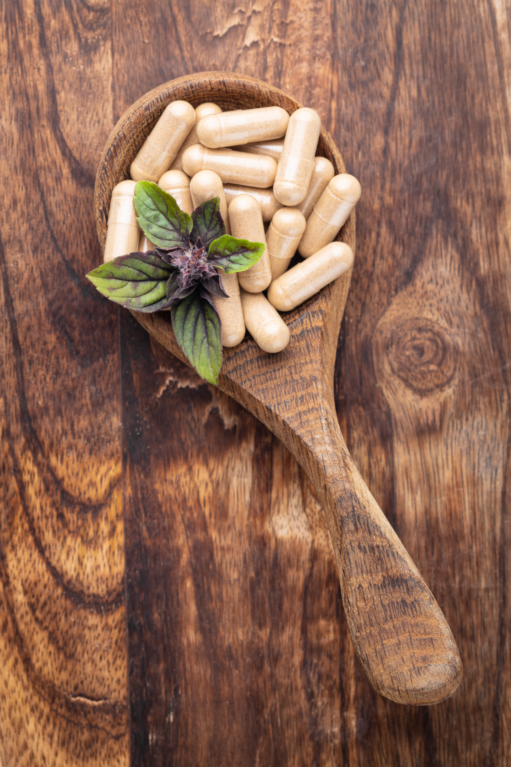
FAMILIARITY & REASONS THEY BUY

Slide 70
Overall familiarity ingredient categories: country
Key Insights:
Prebiotic users have total familiarity levels above 60% for every supplement surveyed and 90% or more for almost half with several supplements seeing 100% familiarity levels across each respondent country.
Familiarity levels in India are significantly higher, CoQ10 has the lowest response rate there at 78%.
 | All Prebiotic Users | US | UK | DE | IT | KR | AU | IN
Prebiotics | 100% | 100% | 100% | 100% | 100% | 100% | 100% | 100%
Vitamin C | 100% | 100% | 100% | 100% | 100% | 100% | 100% | 100%
Multivitamin | 99% | 99% | 100% | 100% | 100% | 100% | 99% | 99%
Vitamin D | 99% | 99% | 99% | 100% | 99% | 99% | 98% | 100%
Calcium | 99% | 99% | 99% | 99% | 100% | 99% | 100% | 100%
Iron | 99% | 99% | 100% | 99% | 100% | 98% | 100% | 100%
Omega-3s | 99% | 98% | 99% | 100% | 99% | 99% | 99% | 100%
Magnesium | 99% | 98% | 99% | 100% | 99% | 99% | 98% | 99%
Probiotics | 99% | 99% | 99% | 98% | 99% | 99% | 99% | 99%
Antioxidants | 98% | 98% | 99% | 95% | 99% | 97% | 98% | 98%
Protein Powder | 97% | 97% | 98% | 98% | 92% | 97% | 97% | 99%
Collagen | 97% | 96% | 97% | 94% | 97% | 100% | 98% | 95%
Curcumin/ Turmeric | 96% | 96% | 96% | 96% | 97% | 94% | 94% | 99%
Melatonin | 95% | 98% | 92% | 96% | 99% | 94% | 91% | 94%
Glucosamine | 91% | 92% | 93% | 83% | 83% | 98% | 91% | 95%
Biotin | 90% | 95% | 83% | 93% | 81% | 93% | 73% | 96%
Vitamin K2 | 89% | 90% | 88% | 91% | 89% | 82% | 82% | 96%
Mushrooms | 84% | 88% | 84% | 70% | 73% | 78% | 84% | 97%
Postbiotics | 83% | 84% | 82% | 77% | 69% | 88% | 75% | 93%
Lutein | 80% | 78% | 67% | 77% | 74% | 98% | 55% | 90%
CBD | 79% | 95% | 88% | 87% | 73% | 55% | 65% | 83%
Glutathione | 76% | 72% | 70% | 68% | 72% | 88% | 55% | 89%
Synbiotics | 74% | 71% | 75% | 71% | 60% | 83% | 54% | 91%
CoQ10 | 73% | 80% | 70% | 80% | 63% | 71% | 59% | 78%
Choline | 70% | 75% | 70% | 67% | 60% | 66% | 54% | 87%
MSM | 70% | 69% | 71% | 68% | 56% | 76% | 53% | 86%
Ashwagandha | 68% | 74% | 58% | 72% | 42% | 53% | 55% | 99%
Astaxanthin | 68% | 62% | 61% | 66% | 54% | 88% | 42% | 84%
Alpha-GPC | 66% | 66% | 70% | 60% | 55% | 64% | 44% | 88%
Citicoline | 63% | 64% | 63% | 61% | 57% | 56% | 42% | 85%
Nootropics | 62% | 64% | 61% | 57% | 48% | 60% | 50% | 80%
Note: All Prebiotic Users n=1972, US n=474, UK n=168, DE n=203, IT n=247, KR n=316, AU n=197, IN n=367. Question: “How familiar would you consider yourself regarding the use of these supplements?” Sum of all responses except “Never heard of it”

Slide 71
Overall familiarity ingredient categories: country
Key Insight:
In the chart display, we see additional points: a spike for several ingredients in India and South Korea are most noticeable.
Note: US n=474, UK n=168, DE n=203, IT n=247, KR n=316, AU n=197, IN n=367, All Respondents n=4198. Question: “How familiar would you consider yourself regarding the use of these supplements?” Sum of all responses except “Never heard of it”

Slide 72
Overall familiarity: age & gender
Key Insights:
Males 18-34 have some of the highest levels of overall familiarity, particularly as you move into some of the “lesser familiar” supplements.
The same can be said of those over 55 and their relatively low overall familiarity levels.
Note: Female 18-34 n=346, Male 18-34 n=352, Female 35-54 n=437, Male 35-54 n=448, Female 55+ n=175, Male 55+ n=209. Question: “How familiar would you consider yourself regarding the use of these supplements?” Sum of all responses except “Never heard of it”

Slide 73
Overall familiarity: us, age & gender
Key Insight:
Males 18-34 and 35-54 in the US see those same high overall familiarity levels as in the global pattern, and this becomes especially evident for ingredients such as mushrooms and synbotics.
Note: US Female 18-34 n=59, US Male 18-34 n=117, US Female 35-54 n=105, US Male 35-54 n=113, US Female 55+ n=46, US Male 55+ n=33. Question: “How familiar would you consider yourself regarding the use of these supplements?” Sum of all responses except “Never heard of it”

Slide 74
Overall familiarity: us, 2019-2024
Key Insight:
Overall familiarity levels remain high and are up and down since 2019 with increases for curcumin/turmeric and slight decreases for vitamin K2 and CoQ10.
Note: 2019 US n=333, 2020 US n=300, 2021 US n=342, 2022 US n=503, 2023 US n=484, 2024 US n=474. Question: “How familiar would you consider yourself regarding the use of these supplements?” Sum of all responses except “Never heard of it”

Slide 75
FAMILIARITY: ALL USERS
Key Insight:
For all supplement users, prebiotic familiarity is in the middle of the pack, sitting at 13% top familiarity and 35% top-2.
Note: All Respondents n=4198. Question: “How familiar would you consider yourself regarding the use of these supplements?”

Slide 76
FAMILIARITY: prebiotic USERS
Key Insights:
Top-2 responses from prebiotic users are generally higher than responses from general supplement users.
Prebiotic familiarity levels are high, 24% top and 58% top-2/
Note: All Prebiotic Users n=1972. Question: “How familiar would you consider yourself regarding the use of these supplements?”

Slide 77
Familiarity: US
Key Insight:
Prebiotic familiarity sits at 26% top and 64% top-2, some of the highest among prebiotic users.
Note: US n=474. Question: “How familiar would you consider yourself regarding the use of these supplements?”

Slide 78
Familiarity: Uk
Key Insights:
While responses for the popular supplements like vitamins D and C are high, top-2 responses in the UK are slightly lower compared to the US.
Prebiotics sit at 21% top and 51% top-2.
Note: UK n=168. Question: “How familiar would you consider yourself regarding the use of these supplements?”

Slide 79
Familiarity: de
Key Insight:
In Germany, prebiotic familiarity sits is relatively low, 18% top and just 47% top-2.
Note: DE n=203. Question: “How familiar would you consider yourself regarding the use of these supplements?”

Slide 80
Familiarity: it
Key Insights:
Italian top familiarity responses, like those from the UK are relatively low.
Prebiotic familiarity is 26% top and 56% top-2.
Note: IT n=247. Question: “How familiar would you consider yourself regarding the use of these supplements?”

Slide 81
Familiarity: kr
Key Insights:
Korean responses show relatively low top familiarity levels, but also some of the lowest responses for minimally familiar.
Prebiotics are 23% top and 57% top-2.
Note: KR n=316. Question: “How familiar would you consider yourself regarding the use of these supplements?”

Slide 82
Familiarity: au
Key Insights:
Australians have some of the largest response rates for “Never heard of it”, and lowest top familiarity responses.
Prebiotics sit at 22% top and 53% top-2.
Note: AU n=197. Question: “How familiar would you consider yourself regarding the use of these supplements?”

Slide 83
Familiarity: in
Key Insights:
Top-2 responses in India are significantly higher than in any other country, with all supplements having 20%+ top response and most over 30%, and the top supplements seeing top-2 responses above 80%.
Prebiotics sit at 25% top and 63% top-2.
Note: IN n=367. Question: “How familiar would you consider yourself regarding the use of these supplements?”

Slide 84
Perceived effectiveness: country
Key Insights:
As with familiarity, Indian respondents significantly over-index for most of the supplements surveyed, especially for those herbs of Indian origin.
US responses are also quite high.
Note: n varies. Question: “What is your opinion of the effectiveness/benefit of each of these supplements?” Sum of top 2 responses marked “I trust that it is effective, and I have experienced its benefits” and “I trust that it is effective, but I haven't experienced benefits”

Slide 85
Perceived effectiveness: age & gender
Key Insights:
Many supplements skew older in terms of perceived effectiveness among prebiotic users.
Prebiotics skew older and female in this regard.
Note: n varies. Question: “What is your opinion of the effectiveness/benefit of each of these supplements?” Sum of top 2 responses marked “I trust that it is effective, and I have experienced its benefits” and “I trust that it is effective, but I haven't experienced benefits”

Slide 86
Perceived effectiveness: us, age & gender
Key Insights:
The US sees a similar older skew to many supplements in terms of perceived effectiveness.
Prebiotics is also skewed older and female in the US.
Note: n varies. Question: “What is your opinion of the effectiveness/benefit of each of these supplements?” Sum of top 2 responses marked “I trust that it is effective, and I have experienced its benefits” and “I trust that it is effective, but I haven't experienced benefits”

Slide 87
PERCEIVED EFFECTIVENESS: ALL USERS
Key Insights:
Top 2 responses for each ingredient are all over 40%; Lutein sits at 74% top-2.
The two not effective responses have by far the lowest response rates across the board with no single response for “I know it’s not effective” above 4%.
Note: n varies. Question: “What is your opinion of the effectiveness/benefit of each of these supplements?”

Slide 88
Perceived effectiveness: us
Key Insights:
US respondents have almost all supplements over 60% top-2
Prebiotics rank 9th in terms of top response at 47% and 7th top-2 at 81%.
Note: n varies. Question: “What is your opinion of the effectiveness/benefit of each of these supplements?”

Slide 89
Perceived effectiveness: uk
Key Insight:
Prebiotics are 9th top response in the UK at 40%, also 9th top-2 at 79%.
Note: n varies. Question: “What is your opinion of the effectiveness/benefit of each of these supplements?”

Slide 90
Perceived effectiveness: de
Key Insight:
Top responses for prebiotics fall in Germany, sitting outside the top 10 at 27% top response and 70% top-2.
Note: n varies. Question: “What is your opinion of the effectiveness/benefit of each of these supplements?”

Slide 91
Perceived effectiveness: it
Key Insights:
We see a strong top grouping in Italy, with a sharp drop off in responses after prebiotics.
Prebiotic responses are at 43% top and 76% top-2.
Note: n varies. Question: “What is your opinion of the effectiveness/benefit of each of these supplements?”

Slide 92
Perceived effectiveness: kr
Key Insights:
As with familiarity, Korean responses are more in the middle ground, with relatively low top and bottom responses.
Prebiotics are 7th at 30% top response and 58% top-2.
Note: n varies. Question: “What is your opinion of the effectiveness/benefit of each of these supplements?”

Slide 93
Perceived effectiveness: au
Key Insight:
Prebiotics are top 10 in Australia, 38% top response and 72% top-2 response.
Note: n varies. Question: “What is your opinion of the effectiveness/benefit of each of these supplements?”

Slide 94
Perceived effectiveness: in
Key Insights:
As with familiarity, Indian respondents have by far the highest response rates for this question with top-2 responses for all supplements over 60% and many over 80%.
Prebiotic responses are middle of the pack for India, but high overall at 44% top and 81% top-2.
Note: n varies. Question: “What is your opinion of the effectiveness/benefit of each of these supplements?”

Slide 95
attributes influencing purchase
Key Insights:
Italian and Indian respondents noticeably over-index for a recommendation from a health care professional.
We see over-indexing for proof of safety and containing branded ingredients from South Korea.
Note: US n=474, UK n=168, DE n=203, IT n=247, KR n=316, AU n=197, IN n=367, All Respondents n=4198. Question: “What are the most important attributes you look for when purchasing supplements?”

Slide 96
attributes influencing purchase: age & gender
Key Insights:
A recommendation from a health care professional is the top response for all but females 18-34 who instead mark proof of safety as their number one.
Addressing a specific concern skews older and female.
Note: Female 18-34 n=346, Male 18-34 n=352, Female 35-54 n=437, Male 35-54 n=448, Female 55+ n=175, Male 55+ n=209. Question: “What are the most important attributes you look for when purchasing supplements?”

Slide 97
attributes influencing purchase: us, age & gender
Key Insight:
Natural source and detailed ingredient information see higher responses among those in the US. Natural source has a noticeable younger male skew.
Note: US Female 18-34 n=59, US Male 18-34 n=117, US Female 35-54 n=105, US Male 35-54 n=113, US Female 55+ n=46, US Male 55+ n=33. Question: “What are the most important attributes you look for when purchasing supplements?”

Slide 98
Attributes influencing purchase: us, 2022-2024
Key Insights:
Responses are up and down year over year.
Addressing a specific concern sees the largest increase since 2022.
Note: 2022 US n=503, 2023 US n=484, 2024 US n=474. Question: “What are the most important attributes you look for when purchasing supplements?”

Slide 99
Quality, safety and regulation concern: country
Key Insight:
Major concern tends to be the top response in each category with only a few exceptions, mostly among German respondents.
Note: US n=474, UK n=168, DE n=203, IT n=247, KR n=316, AU n=197, IN n=367. Question: “Please rate your level of concern surrounding these areas related to the quality, safety and regulation of dietary supplements:”

Slide 100
Quality, safety and regulation concern: age & gender
Key Insight:
Older users generally express a higher level of concerns regarding these issues with females feeling this more than males.
Note: Female 18-34 n=346, Male 18-34 n=352, Female 35-54 n=437, Male 35-54 n=448, Female 55+ n=175, Male 55+ n=209. Question: “Please rate your level of concern surrounding these areas related to the quality, safety and regulation of dietary supplements:”

Slide 101
Quality, safety and regulation concern: us, age & gender
Key Insight:
The US has a similar older and female skew in each category for major concern.
Note: US Female 18-34 n=59, US Male 18-34 n=117, US Female 35-54 n=105, US Male 35-54 n=113, US Female 55+ n=46, US Male 55+ n=33. Question: “Please rate your level of concern surrounding these areas related to the quality, safety and regulation of dietary supplements:”

Slide 102
Quality, safety and regulation concern: us, 2023-2024
Key Insight:
Each category sees an increase in responses for major concern, the highest year over year increases are for unclear description of benefits at 11%.
Note: 2023 US n=766, 2024 US n=474. Question: “Please rate your level of concern surrounding these areas related to the quality, safety and regulation of dietary supplements:”

Slide 103

SHOPPING BEHAVIOR

Slide 104
Supplement spend: country
Key Insights:
UK respondents are spending less than any other respondent group with most of their responses coming in the under $30 spending ranges.
US, Korean and Indian respondents tend to have the high response rates in the higher spending ranges.
Note: US n=474, UK n=168, DE n=203, IT n=247, KR n=316, AU n=197, IN n=367, All Respondents n=4198. Question: “On average, how much do you spend monthly on vitamins, minerals, herbals, or other dietary supplements for just yourself?”

Slide 105
Supplement spend: age & gender
Key Insights:
Both under $20 ranges are heavily skewed older and female.
The higher spending ranges are slightly skewed younger, with females and males 18-34 posting high response rates for those higher spending ranges.
Note: Female 18-34 n=346, Male 18-34 n=352, Female 35-54 n=437, Male 35-54 n=448, Female 55+ n=175, Male 55+ n=209. Question: “On average, how much do you spend monthly on vitamins, minerals, herbals, or other dietary supplements for just yourself?”

Slide 106
Supplement spend: us, age & gender
Key Insights:
Most spending the US is in the $20 to $60 dollar ranges.
Females18-34 over-index for the three under $30 ranges and the $80-$89.99 range.
Note: US Female 18-34 n=59, US Male 18-34 n=117, US Female 35-54 n=105, US Male 35-54 n=113, US Female 55+ n=46, US Male 55+ n=33. Question: “On average, how much do you spend monthly on vitamins, minerals, herbals, or other dietary supplements for just yourself?”

Slide 107
Supplement spend: us, 2019-2024
Key Insight:
Spending has shifted away from the under $30 ranges and toward the higher spending ranges since 2019.
Note: 2019 US n=333, 2020 US n=300, 2021 US n=342, 2022 US n=503, 2023 US n=484, 2024 US n=474. Question: “On average, how much do you spend monthly on vitamins, minerals, herbals, or other dietary supplements for just yourself?”

Slide 108
Monthly Supplement spend: country
Key Insights:
Indian respondents consistently have the highest spend per supplement with most seeing spending around $25/month. Prebiotic pend follows this pattern.
US, South Korean and Australian respondents tend to have the next highest dollar amounts.
Prebiotic spending falls in the bottom quarter for most countries.
Note: n varies. Question: “Approximately how much per month do you spend for yourself on EACH of these supplements?” Dollar value is an approximation based on spending ranges.

Slide 109
Monthly Supplement spend: age & gender
Key Insights:
Spending is significantly skewed younger with males 18-34 topping almost every supplement in terms of dollars spent per month followed closely by females 18-34 and then males 35-54.
Prebiotic spending is mainly driven by those under 55.
Note: n varies. Question: “Approximately how much per month do you spend for yourself on EACH of these supplements?” Dollar value is an approximation based on spending ranges.

Slide 110
Monthly Supplement spend: us, age & gender
Key Insights:
We also see a younger skew in the US, with males 18-34 showing the highest spend per month for most supplements.
Males over 55 have the highest rate for this question for nootropics at $29.25 per month, they also noticeably over-index for synbiotics and choline.
Prebiotic spending is driven by males under 55 and females 35-54.
Note: n varies. Question: “Approximately how much per month do you spend for yourself on EACH of these supplements?” Dollar value is an approximation based on spending ranges.

Slide 111
Purchase location: country
Key Insight:
Online is the number one purchase location for all but those in the UK and Australia. The UK marks natural/health food stores number one and Australia marks mass market retailer number one.
Note: US n=474, UK n=168, DE n=203, IT n=247, KR n=316, AU n=197, IN n=367, All Respondents n=4198. Question: “Where do you primarily purchase your vitamins, minerals, herbals & other dietary supplements?”

Slide 112
Purchase location: age & gender
Key Insight:
Online is the number one response from all age & gender groups despite a noticeable younger skew.
Note: Female 18-34 n=346, Male 18-34 n=352, Female 35-54 n=437, Male 35-54 n=448, Female 55+ n=175, Male 55+ n=209. Question: “Where do you primarily purchase your vitamins, minerals, herbals & other dietary supplements?”

Slide 113
Purchase location: us, age & gender
Key Insights:
Online is not the overwhelmingly number one response in the US, with mass market retailer and natural/health food store gaining ground.
In the US, mass market retailer (the overall number two response) is significantly skewed older and female.
Note: US Female 18-34 n=59, US Male 18-34 n=117, US Female 35-54 n=105, US Male 35-54 n=113, US Female 55+ n=46, US Male 55+ n=33. Question: “Where do you primarily purchase your vitamins, minerals, herbals & other dietary supplements?”

Slide 114
Purchase location: US, 2022-2024
Key Insight:
The only major change year over year is a 5% increase for natural/health food store in 2024 compared to 2023.
Note: 2022 US n=503, 2023 US n=484, 2024 US n=474. Question: “Where do you primarily purchase your vitamins, minerals, herbals & other dietary supplements?”

Slide 115
Preferred format: country
Key Insights:
Either tablet or pill is the top response from each country, the former exceptionally strong in both Australia and India.
Indian respondents over-index for powder, liquid and vegetarian capsule.
Gummy format is heavily driven by the US.
Note: US n=474, UK n=168, DE n=203, IT n=247, KR n=316, AU n=197, IN n=367, All Respondents n=4198. Question: “In which format do you prefer your supplements?”

Slide 116
Preferred format: age & gender
Key Insights:
Both tablet, pill and gelatin capsule skew older.
Gummy, powder, liquid and chew are skewed younger, with powder and liquid driven by males.
The preference for vegetarian versus gelatin capsules is almost equal for females 18-34 and is equal for males that age.
Note: Female 18-34 n=346, Male 18-34 n=352, Female 35-54 n=437, Male 35-54 n=448, Female 55+ n=175, Male 55+ n=209. Question: “In which format do you prefer your supplements?”

Slide 117
Preferred format: us, age & gender
Key Insights:
Gummy takes over as the number one format for females and males 18-34 in the US, nearly the number one for each female group, falling just behind softgel among females over 55 (41% versus 43%).
Liquid is very popular among males 18-54.
Softgel, as a format, is skewed older and female.
Note: US Female 18-34 n=59, US Male 18-34 n=117, US Female 35-54 n=105, US Male 35-54 n=113, US Female 55+ n=46, US Male 55+ n=33. Question: “In which format do you prefer your supplements?”

Slide 118
Format characteristics: country
Key Insights:
Easy to swallow is the number one response for all groups, particularly in the UK and Australia.
Indian respondents over-index for pleasant taste, combination formulas, multi-pack, single ingredient formulas and bioavailable.
Note: US n=474, UK n=168, DE n=203, IT n=247, KR n=316, AU n=197, IN n=367, All Respondents n=4198. Question: “What do you like about these formats?”

Slide 119
Format characteristics: age & gender
Key Insights:
Easy to swallow is the number one for each age & gender group, showing a slight older skew.
Pleasant taste is skewed younger, most likely because of the popularity of the gummy format among the younger age groups.
Note: Female 18-34 n=346, Male 18-34 n=352, Female 35-54 n=437, Male 35-54 n=448, Female 55+ n=175, Male 55+ n=209. Question: “What do you like about these formats?”

Slide 120
Format characteristics : us, age & gender
Key Insight:
Easy to swallow is also the number one in the US, showing an older female skew.
Note: US Female 18-34 n=59, US Male 18-34 n=117, US Female 35-54 n=105, US Male 35-54 n=113, US Female 55+ n=46, US Male 55+ n=33. Question: “What do you like about these formats?”

Slide 121
Prioritizing spending cuts: essentiality, country
Key Insights:
For all but over the counter medication, Indian respondents over-index significantly, showing the highest essential responses.
Korean respondents come close to matching them for essentiality of core vitamins and minerals (58% compared to 59% from India).
Note: US n=474, UK n=168, DE n=203, IT n=247, KR n=316, AU n=197, IN n=367, All Respondents n=4198. Question: “If you had to cut household spending, how would you prioritize your cuts?” Percentage of responses marked “Essential”

Slide 122
Prioritizing spending cuts: essentiality, age & gender
Key Insights:
Essentiality for core and specialty supplements is skewed older whereas mental health support is skewed younger.
Males 18-34 over-index for purchase of natural/organic foods, physical support, gym membership and dining out.
Note: Female 18-34 n=346, Male 18-34 n=352, Female 35-54 n=437, Male 35-54 n=448, Female 55+ n=175, Male 55+ n=209. Question: “If you had to cut household spending, how would you prioritize your cuts?” Percentage of responses marked “Essential”

Slide 123
Prioritizing spending cuts: essentiality, US age & gender
Key Insight:
For these users, mental health support among young respondents in the US is even more pronounced, with essential responses for all but males over 55 higher for mental health than specialty supplements and females 18-34 mental health essentiality higher than even core vitamins and minerals.
Note: US Female 18-34 n=59, US Male 18-34 n=117, US Female 35-54 n=105, US Male 35-54 n=113, US Female 55+ n=46, US Male 55+ n=33. Question: “If you had to cut household spending, how would you prioritize your cuts?” Percentage of responses marked “Essential”

Slide 124
Prioritizing spending cuts: US
Key Insights:
Core vitamins and minerals have the largest essential response, as well as the lowest response for non-essential.
Mental health support has the most extreme responses with high essentiality as well as high non-essential with relatively few middle responses..
Note: US n=474. Question: “If you had to cut household spending, how would you prioritize your cuts?”

Slide 125
Prioritizing spending cuts: uk
Key Insight:
UK responses see mental health support fall being specialty supplements in terms of essentiality.
Note: UK n=168. Question: “If you had to cut household spending, how would you prioritize your cuts?”

Slide 126
Prioritizing spending cuts: DE
Key Insight:
German respondents are the only group to not have core supplements as their top essential response; in this case it is actually specialty supplements.
Note: DE n=203. Question: “If you had to cut household spending, how would you prioritize your cuts?”

Slide 127
Prioritizing spending cuts: it
Key Insight:
Like in the US, Italian respondents have a high regard for mental health support, marking it second behind just core supplements and more essential than specialty supplements.
Note: IT n=247. Question: “If you had to cut household spending, how would you prioritize your cuts?”

Slide 128
Prioritizing spending cuts: kr
Key Insight:
The Korean essential response for core supplements is particularly high at 58%.
Note: KR n=316. Question: “If you had to cut household spending, how would you prioritize your cuts?”

Slide 129
Prioritizing spending cuts: au
Key Insight:
Australian respondents are the only group to not rank any category above 40% for essentiality, with only core supplements and over the counter medication over 30%.
Note: AU n=197. Question: “If you had to cut household spending, how would you prioritize your cuts?”

Slide 130
Prioritizing spending cuts: in
Key Insight:
Indian essential responses are the highest of this group and they have by far the highest essential responses for the purchase of natural/organic foods at 57%.
Note: IN n=367. Question: “If you had to cut household spending, how would you prioritize your cuts?”

Slide 131
Source of ingredient information: country
Key Insights:
A general web search is the number one response in the US, Germany and South Korea; a health care professional is the number one response for Italian, Australian and Indian respondents while those in the UK have brand website.
India also over-indexes for each category response.
Note: US n=474, UK n=168, DE n=203, IT n=247, KR n=316, AU n=197, IN n=367, All Respondents n=4198. Question: “When considering supplements to purchase, where do you go for ingredient information?”

Slide 132
Source of ingredient information: age & gender
Key Insights:
When sorting by age & gender, we see a health care professional is the number one response from all but females 35-54.
Web based responses are three of the four top responses.
Males 18-34 over-index for health app/wearable and online influencer.
Note: Female 18-34 n=346, Male 18-34 n=352, Female 35-54 n=437, Male 35-54 n=448, Female 55+ n=175, Male 55+ n=209. Question: “When considering supplements to purchase, where do you go for ingredient information?”

Slide 133
Source of ingredient information: us, age & gender
Key Insights:
In the US, a health care professional falls behind brand website for most groups.
Surprisingly, health care professional sees relatively high responses from those 18-34 and both brand website and general web search sees relatively high response from those over 55.
Note: US Female 18-34 n=59, US Male 18-34 n=117, US Female 35-54 n=105, US Male 35-54 n=113, US Female 55+ n=46, US Male 55+ n=33. Question: “When considering supplements to purchase, where do you go for ingredient information?”

Slide 134
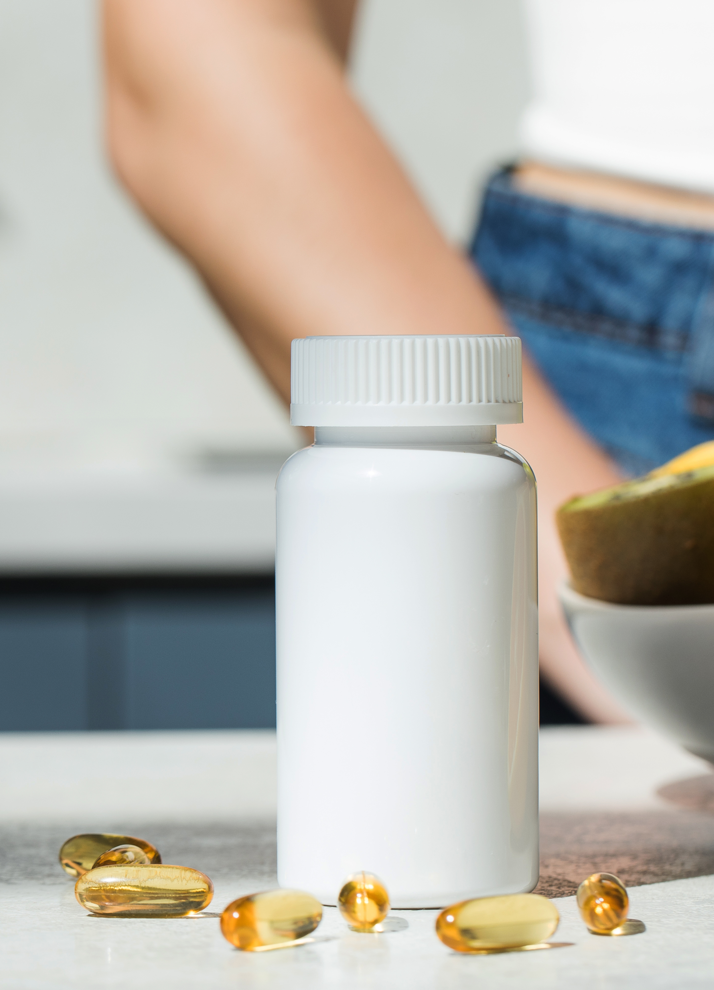
BRANDED INGREDIENTS

Slide 135
Branded ingredients: country
Key Insights:
Indian respondents massively over-index for always looking for branded ingredients; their 62% for that response is almost 30% higher than the next group (US at 38%, who also mark that response as their top).
All other countries have “I appreciate branded ingredients when I find them” as their top response (each hovering around 30-40%).
As in last year's survey, respondents, in order to access this section, had to go a screening in which they were asked to note the label or site that did not contain a branded ingredient. The number of survey respondents that “passed” this screening is located in the footer, typically sitting at between 60% and 75% of users.
Note: US n=308, UK n=113, DE n=109, IT n=181, KR n=184, AU n=138, IN n=293, All Respondents n=2863. Question: “When deciding which supplements to purchase, how important is the inclusion of branded or proprietary ingredients?”

Slide 136
Branded ingredients: age & gender
Key Insight:
When sorting by age & gender, most responses are in the either always looking for branded ingredient or appreciating them when they can find them, with males 18-34 significantly over-indexing for the former.
As in last year's survey, respondents, in order to access this section, had to go a screening in which they were asked to note the label or site that did not contain a branded ingredient. The number of survey respondents that “passed” this screening is located in the footer, typically sitting at between 60% and 75% of users.
Note: Female 18-34 n=214, Male 18-34 n=243, Female 35-54 n=292, Male 35-54 n=315, Female 55+ n=107, Male 55+ n=152. Question: “When deciding which supplements to purchase, how important is the inclusion of branded or proprietary ingredients?”

Slide 137
Branded ingredients: us, age & gender
Key Insights:
US respondents see more extreme differences with age related responses as well as higher responses for not caring about branded ingredients from males over 35 and females over 55.
In this case, we see many males 35-54 joining their younger male and female counterparts in always looking for branded ingredients and willing to pay a premium.
As in last year's survey, respondents, in order to access this section, had to go a screening in which they were asked to note the label or site that did not contain a branded ingredient. The number of survey respondents that “passed” this screening is located in the footer, typically sitting at between 60% and 75% of users.
Note: US Female 18-34 n=35, US Male 18-34 n=85, US Female 35-54 n=69, US Male 35-54 n=70, US Female 55+ n=26, US Male 55+ n=22. Question: “When deciding which supplements to purchase, how important is the inclusion of branded or proprietary ingredients?”

Slide 138
Branded ingredients: us, 2023-2024
Key Insight:
2024 has seen a 6% increase in responses for “I always look for branded ingredients, and I am willing to pay a premium”.
Note: 2023 US n=281, 2024 US n=308. Question: “When deciding which supplements to purchase, how important is the inclusion of branded or proprietary ingredients?”

Slide 139
Branded ingredients: us age, 2023-2024
Key Insight:
Particularly among those under 55, there is more of a willingness to pay a price premium for branded ingredients in 2024.
Note: 2023 US 18-34 n=118, 2023 US 35-54 n=125, 2023 US 55+ n=38, 2024 US 18-34 n=121, 2024 US 35-54 n=139, US 2024 55+ n=48. Question: “When deciding which supplements to purchase, how important is the inclusion of branded or proprietary ingredients?”

Slide 140
Branded ingredients: us gender, 2023-2024
Key Insight:
A willingness to pay a price premium is up for both genders as well, most significantly among females who see a 6% increase.
Note: 2023 US Female n=129, 2023 US Male n=151, 2024 US Female n=130, 2024 US Male n=177. Question: “When deciding which supplements to purchase, how important is the inclusion of branded or proprietary ingredients?”

Slide 141
Branded ingredients: us age & gender, 2023-2024
Key Insight:
Again, we can see the increase in a willingness to pay a price premium is driven by the younger respondent groups.
Note: 2023 US Female 18-34 n=55, 2023 US Male 18-34 n=62, 2023 US Female 35-54 n=54, 2023 US Male 35-54 n=71, 2023 US Female 55+ n=20, 2023 US Male 55+ n=18, 2024 US Female 18-34 n=35, 2024 US Male 18-34 n=85, 2024 US Female 35-54 n=69, 2024 US Male 35-54 n=70, 2024 US Female 55+ n=26, 2024 US Male 55+ n=22. Question: “When deciding which supplements to purchase, how important is the inclusion of branded or proprietary ingredients?”

Slide 142
Branded ingredient value proposition: country
Key Insights:
India over-indexed for all branded ingredient categories, in some cases by more than 30%, confirming that they are putting more weight into branded ingredients when looking to buy supplements, at least, according to this survey.
There is a noticeable drop off in responses from each country past efficacy/efficacious dose as a contributing aspect of the branded ingredient proposition.
Note: US n=308, UK n=113, DE n=109, IT n=181, KR n=184, AU n=138, IN n=293, All Respondents n=2863. Question: “When deciding which supplements to purchase, how important are the following qualities/values related to any branded ingredient?” Percentage of responses marked “Extremely Important”

Slide 143
Branded ingredient value proposition: Age & gender
Key Insights:
Quality is the number one response from each age & gender group.
Regulatory/legal compliance is significantly skewed female.
We see the same drop off in response rate after efficacy/efficacious dose as is evident on a by country breakout.
Note: Female 18-34 n=214, Male 18-34 n=243, Female 35-54 n=292, Male 35-54 n=315, Female 55+ n=107, Male 55+ n=152. Question: “When deciding which supplements to purchase, how important are the following qualities/values related to any branded ingredient?” Percentage of responses marked “Extremely Important”

Slide 144
Branded ingredient value proposition: us, Age & gender
Key Insights:
Quality is also number one or tied for number one from each group in the US.
US respondents are putting more weight toward established safety, which now emerges as the second highest value for most demographic groups, particularly females.
Young females and males in the US have relatively high response rates for traditional media and social media coverage.
Note: US Female 18-34 n=35, US Male 18-34 n=85, US Female 35-54 n=69, US Male 35-54 n=70, US Female 55+ n=26, US Male 55+ n=22. Question: “When deciding which supplements to purchase, how important are the following qualities/values related to any branded ingredient?” Percentage of responses marked “Extremely Important”

Slide 145
Branded ingredient value proposition: us, 2021-2024
Key Insight:
Responses are higher in 2024 and 2023 for all categories.
Note: 2021 US n=289, 2022 US n=412, 2023 US n=281, 2024 US n=308. Question: “When deciding which supplements to purchase, how important are the following qualities/values related to any branded ingredient?” Percentage of responses marked “Extremely Important”

Slide 146
Branded ingredient price premium: country
Key Insights:
US and most significantly Indian respondents over-index for each category with Korean responses close behind.
Quality ranks as the top premium element in all countries.
Note: US n=308, UK n=113, DE n=109, IT n=181, KR n=184, AU n=138, IN n=293, All Respondents n=2863. Question: “When deciding which supplements to purchase, how much of a premium would you be willing to pay for the inclusion of a BRANDED INGREDIENT with the following features (versus the cheapest option available)?” Sum of top two responses marked “11% to 20% premium” and “More than 20% premium”

Slide 147
Branded ingredient price premium: age & gender
Key Insight:
Each aspect of the branded ingredient value proposition as being valued is skewed younger, with females and males 18-34 showing the most willingness to spend 11% or more for branded ingredients.
Note: Female 18-34 n=214, Male 18-34 n=243, Female 35-54 n=292, Male 35-54 n=315, Female 55+ n=107, Male 55+ n=152. Question: “When deciding which supplements to purchase, how much of a premium would you be willing to pay for the inclusion of a BRANDED INGREDIENT with the following features (versus the cheapest option available)?” Sum of top two responses marked “11% to 20% premium” and “More than 20% premium”

Slide 148
Branded ingredient price premium: us, age & gender
Key Insight:
US respondents have very similar response rates with females and males 18-34, especially the latter, over-indexing in each aspect.
Note: US Female 18-34 n=35, US Male 18-34 n=85, US Female 35-54 n=69, US Male 35-54 n=70, US Female 55+ n=26, US Male 55+ n=22. Question: “When deciding which supplements to purchase, how much of a premium would you be willing to pay for the inclusion of a BRANDED INGREDIENT with the following features (versus the cheapest option available)?” Sum of top two responses marked “11% to 20% premium” and “More than 20% premium”

Slide 149
Branded ingredient price premium
Key Insights:
Quality is the number one characteristic no matter how you look at these responses.
Trust has high responses for the higher premium ranges but also has a relatively high no premium response.
Note: All Prebiotic Users n=1326. Question: “When deciding which supplements to purchase, how much of a premium would you be willing to pay for the inclusion of a BRANDED INGREDIENT with the following features (versus the cheapest option available)?”

Slide 150
Branded ingredient price premium: us
Key Insight:
Top 2 responses are high in the US with most categories receiving top 2 responses above 30% willing to pay at least a 10% premium for the feature.
Note: US n=308. Question: “When deciding which supplements to purchase, how much of a premium would you be willing to pay for the inclusion of a BRANDED INGREDIENT with the following features (versus the cheapest option available)?”

Slide 151
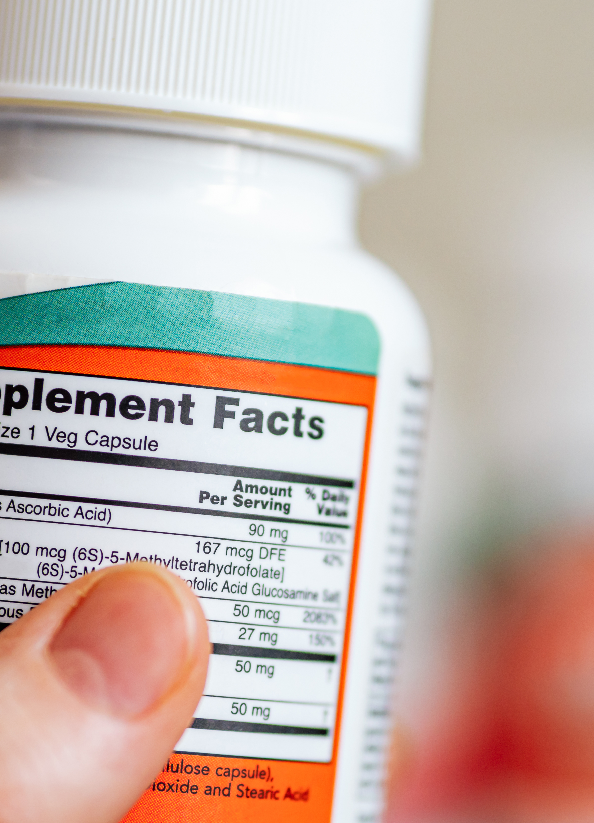
VALUES
Trust, Transparency & Sustainability

Slide 152
Trust: country
Key Insights:
A recommendation from a health care professional is the top trust driver from all countries apart from Germany who mark clinical research on the ingredient number one.
Korean and Indian respondents over-index for contains branded ingredients, consistent with other responses on that topic.
Note: US n=474, UK n=168, DE n=203, IT n=247, KR n=316, AU n=197, IN n=367, All Respondents n=4198. Question: “What characteristics most encourage you to trust a supplement brand?”

Slide 153
Trust: age & gender
Key Insight:
When sorting by age & gender a recommendation from a health care professional is the top response by a decent margin, especially for females 18-34 and females and males over 55.
Note: Female 18-34 n=346, Male 18-34 n=352, Female 35-54 n=437, Male 35-54 n=448, Female 55+ n=175, Male 55+ n=209. Question: “What characteristics most encourage you to trust a supplement brand?”

Slide 154
Trust: US, age & gender
Key Insights:
Among US respondents, we see noticeable over-indexing from females over 55 for a recommendation from a health care professional.
Consistent product quality makes up significant ground on a recommendation from a health care professional, the top two trust builders among US prebiotic users.
Note: US Female 18-34 n=59, US Male 18-34 n=117, US Female 35-54 n=105, US Male 35-54 n=113, US Female 55+ n=46, US Male 55+ n=33. Question: “What characteristics most encourage you to trust a supplement brand?”

Slide 155
Trust: us, 2020-2024
Key Insight:
Many trust builders have seen a steady decline in response rate since 2020 before seeing a slight uptick again in 2024.
Note: 2020 US n=300, 2021 US n=342, 2022 US n=503, 2023 US n=484, 2024 US n=474. Question: “What characteristics most encourage you to trust a supplement brand?”

Slide 156
Transparency purchase influence: country
Key Insights:
Most responses come in for the two responses marking transparency positively influencing a purchase decision.
US and Indian respondents over-index for greatly, South Korea less so.
Note: US n=474, UK n=168, DE n=203, IT n=247, KR n=316, AU n=197, IN n=367, All Respondents n=4198. Question: “How likely are you to purchase supplements from a manufacturer that provides transparency information on its label or website?”

Slide 157
Transparency purchase influence: age & gender
Key Insight:
We see most responses marking transparency positively influencing a purchase decision.
Note: Female 18-34 n=346, Male 18-34 n=352, Female 35-54 n=437, Male 35-54 n=448, Female 55+ n=175, Male 55+ n=209. Question: “How likely are you to purchase supplements from a manufacturer that provides transparency information on its label or website?”

Slide 158
Transparency purchase influence: us, age & gender
Key Insight:
US responses are slightly more shifted towards the greatly response with several groups, including females 55+ approaching 70%, and males 18-34 and 35-54 approaching 60% for that response.
Note: US Female 18-34 n=59, US Male 18-34 n=117, US Female 35-54 n=105, US Male 35-54 n=113, US Female 55+ n=46, US Male 55+ n=33. Question: “How likely are you to purchase supplements from a manufacturer that provides transparency information on its label or website?”

Slide 159
Transparency purchase influence: us, 2020-2024
Key Insights:
Greatly has seen a steady increase year over year since 2020.
2024 sits at 53% for greatly, 14% higher than the 2020 response.
Note: 2020 US n=300, 2021 US n=342, 2022 US n=503, 2023 US n=484, 2024 US n=474. Question: “How likely are you to purchase supplements from a manufacturer that provides transparency information on its label or website?”

Slide 160
Signals of brand transparency: country
Key Insights:
'Detailed ingredient information is readily available' is the top response from each respondent country, especially the UK.
Indian respondents significantly over-index for most categories.
Note: US n=474, UK n=168, DE n=203, IT n=247, KR n=316, AU n=197, IN n=367, All Respondents n=4198. Question: “Which of the following items are the strongest signals that a supplement brand is operating transparently?”

Slide 161
Signals of brand transparency: age & gender
Key Insights:
Detailed ingredient information is readily available is the top response from each age & gender group, especially females 55+.
Most of the categories see a slight younger skew.
Note: Female 18-34 n=346, Male 18-34 n=352, Female 35-54 n=437, Male 35-54 n=448, Female 55+ n=175, Male 55+ n=209. Question: “Which of the following items are the strongest signals that a supplement brand is operating transparently?”

Slide 162
Signals of brand transparency: us, age & gender
Key Insights:
US age & gender responses level out slightly but have more sharp outliers, such as females over 55 for detailed ingredient information.
All but country of origin information skews younger.
Note: US Female 18-34 n=59, US Male 18-34 n=117, US Female 35-54 n=105, US Male 35-54 n=113, US Female 55+ n=46, US Male 55+ n=33. Question: “Which of the following items are the strongest signals that a supplement brand is operating transparently?”

Slide 163
Signals of brand transparency: us, 2020-2024
Key Insight:
Overall, responses have been increasing since 2020, most noticeably with detailed ingredient information and access to a certificate of analysis.
Note: 2020 US n=300, 2021 US n=342, 2022 US n=503, 2023 US n=484, 2024 US n=474. Question: “Which of the following items are the strongest signals that a supplement brand is operating transparently?”

Slide 164
Sustainability: country
Key Insight:
Most responses for sustainability importance are in sometimes and frequently but Indian respondents significantly over-index for always, their 43% is nearly 20% higher than the next closest response (US at 26%).
Note: US n=474, UK n=168, DE n=203, IT n=247, KR n=316, AU n=197, IN n=367, All Respondents n=4198. Question: “When deciding which supplements to purchase, to what degree does the sustainability/environmental impact of a supplement ingredient influence your purchasing decision?”

Slide 165
Sustainability: age & gender
Key Insights:
The influence responses are skewed younger, 'never' is significantly skewed older.
The strongest response was for males 18-34 with a combined total of 63% responding with always or frequently, followed by females 18-34 (57% top-2).
Note: Female 18-34 n=346, Male 18-34 n=352, Female 35-54 n=437, Male 35-54 n=448, Female 55+ n=175, Male 55+ n=209. Question: “When deciding which supplements to purchase, to what degree does the sustainability/environmental impact of a supplement ingredient influence your purchasing decision?”

Slide 166
Sustainability: us, age & gender
Key Insights:
US age & gender responses are more severe, with young females and males over-indexing for always and those over 55 for never.
Not being aware of an issue is skewed female and older.
Note: US Female 18-34 n=59, US Male 18-34 n=117, US Female 35-54 n=105, US Male 35-54 n=113, US Female 55+ n=46, US Male 55+ n=33. Question: “When deciding which supplements to purchase, to what degree does the sustainability/environmental impact of a supplement ingredient influence your purchasing decision?”

Slide 167
Sustainability: us, 2020-2024
Key Insight:
We see a shift away from sometimes influences, and into the more frequent influence responses since 2020.
Note: 2020 US n=300, 2021 US n=342, 2022 US n=503, 2023 US n=484, 2024 US n=474. Question: “When deciding which supplements to purchase, to what degree does the sustainability/environmental impact of a supplement ingredient influence your purchasing decision?”

Slide 168
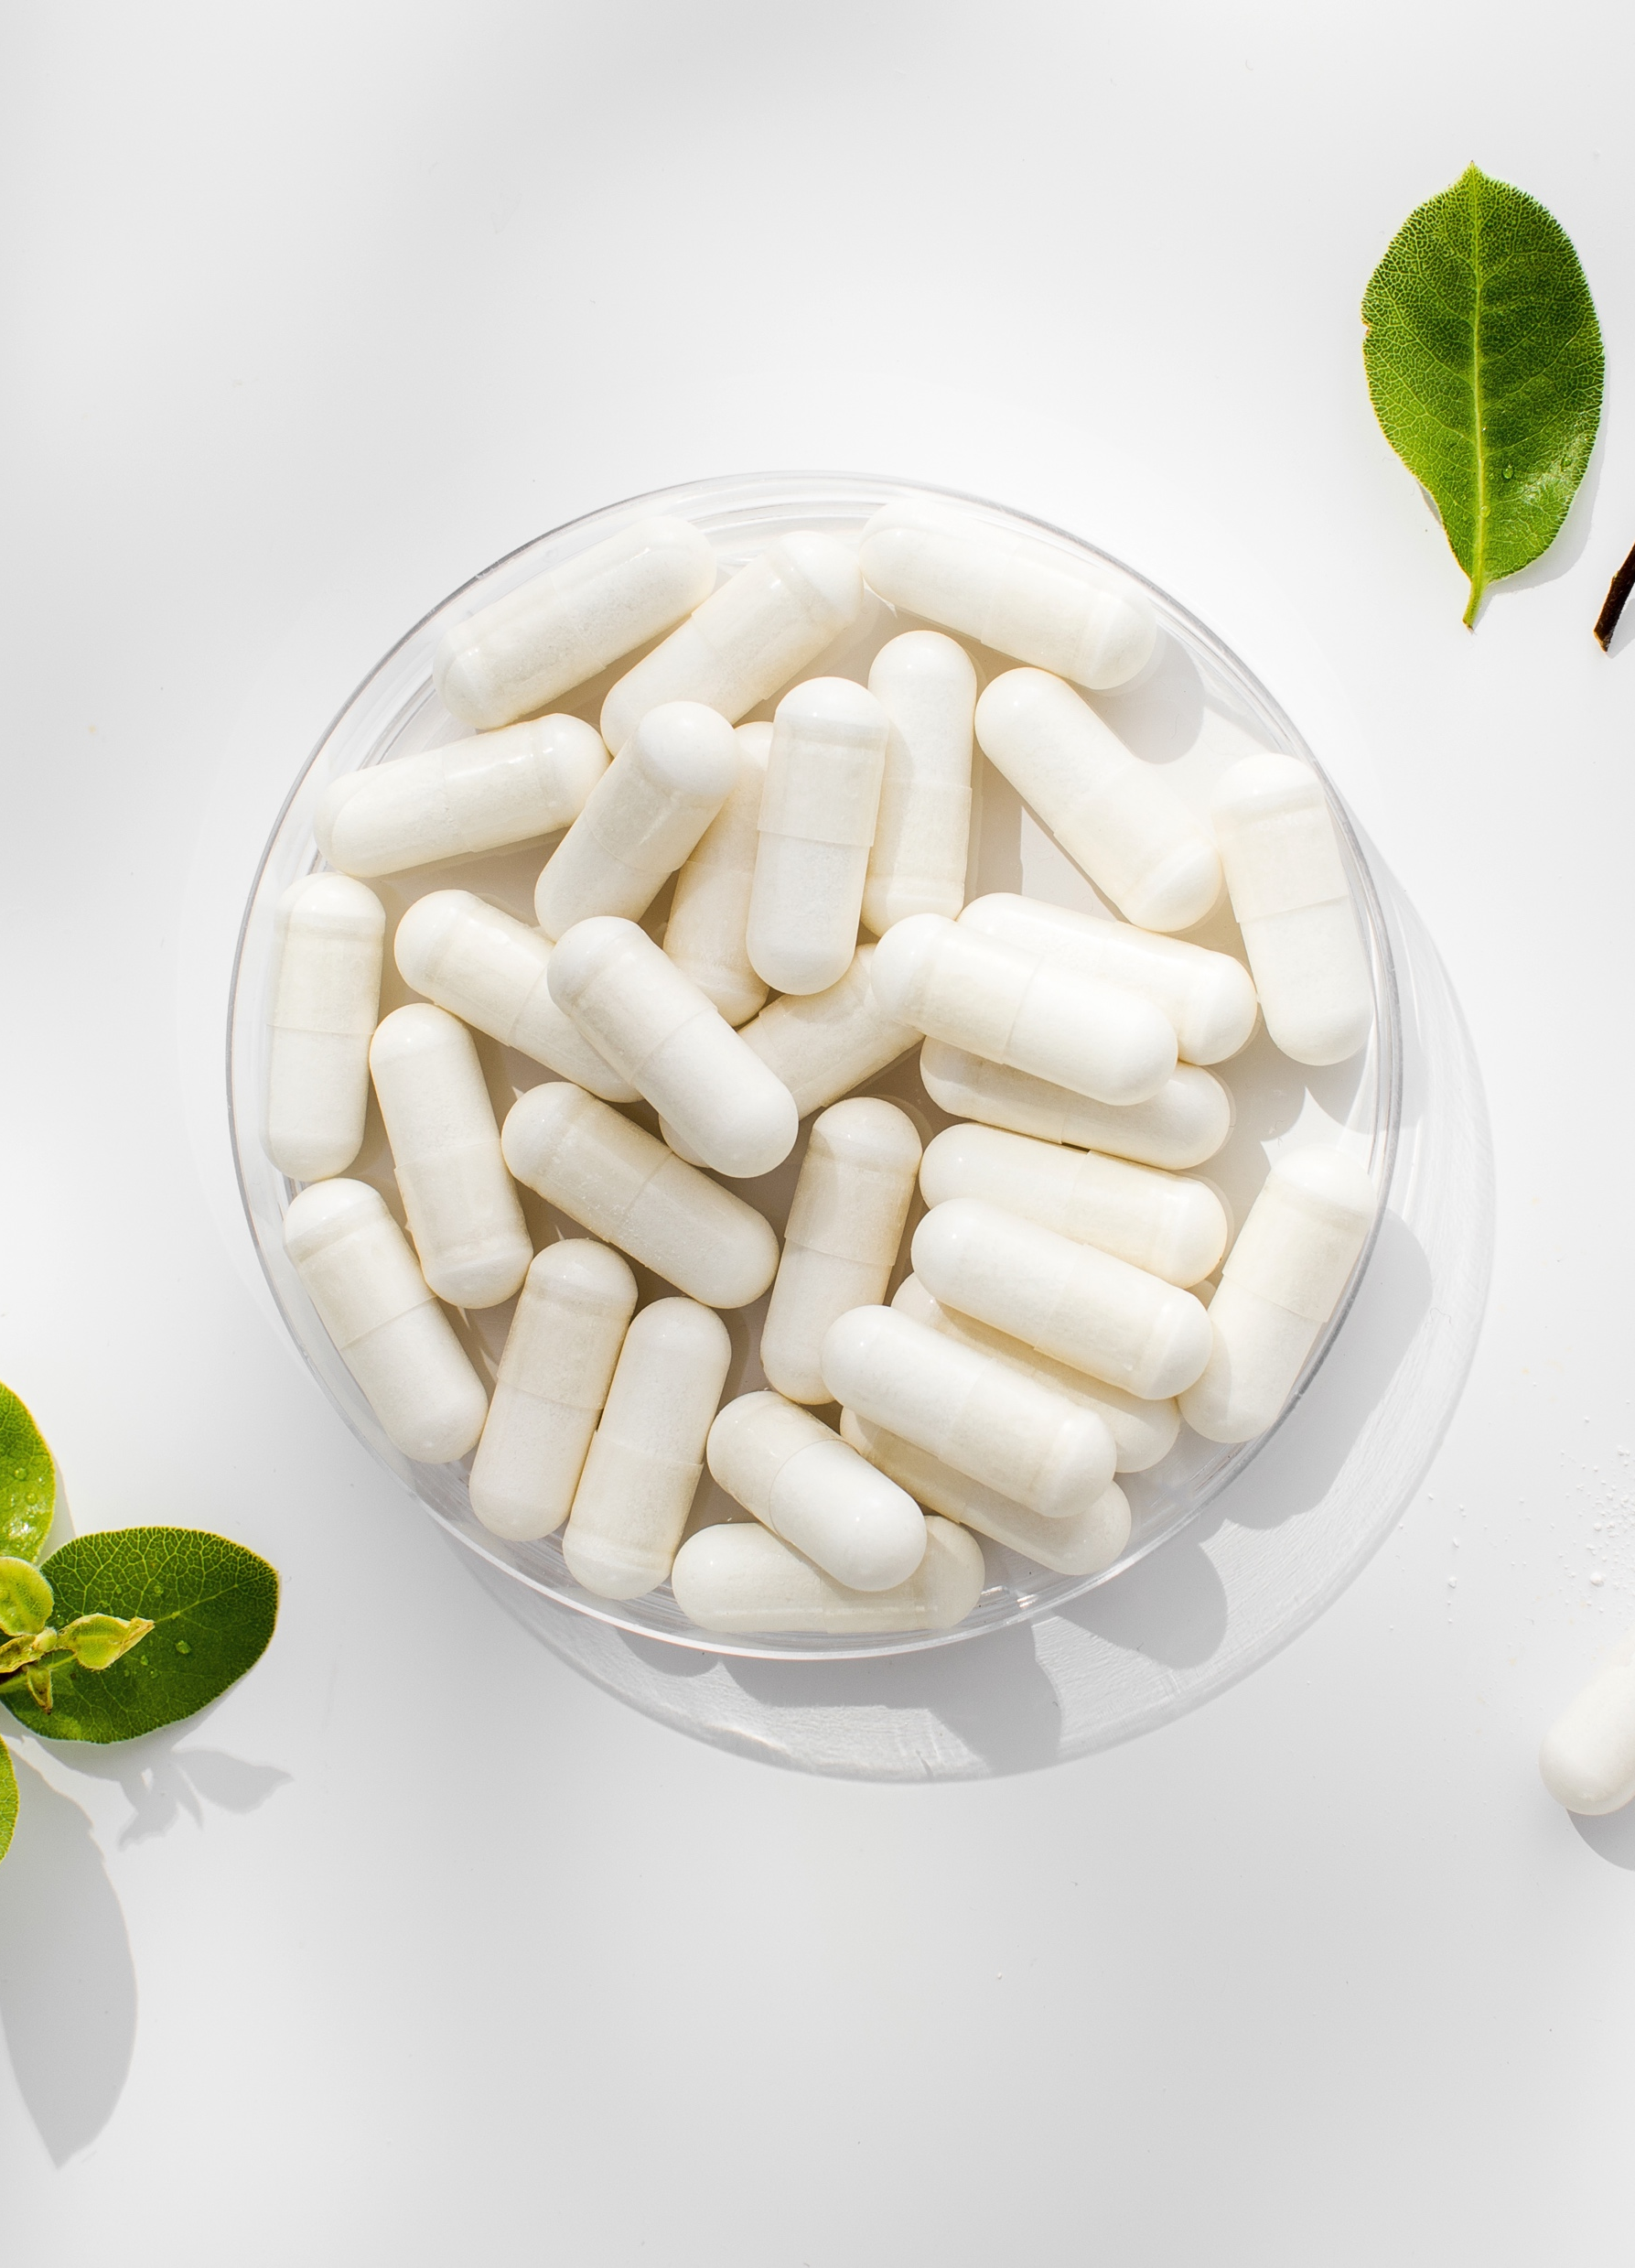
PREBIOTIC:
DEEP DIVE

Slide 169
Why they take prebiotics: country
Key Insights:
Gut health/digestion and immunity health are the top two responses by a decent margin, the former being the top response from all but Indian respondents who instead mark immunity number one.
Indian respondents, as seen with most survey questions, tend to have some of the highest response rates.
Note: US n=474, UK n=168, DE n=203, IT n=247, KR n=316, AU n=197, IN n=367. Question: “Why do you take a prebiotic supplement?”

Slide 170
Why they take prebiotics: age & gender
Key Insights:
When sorting by age & gender we see immunity health is the reason that resonates with everyone, whereas gut health/digestion is significantly skewed older and female.
Males 18-34 over-index for stress/mood, a response that is skewed younger and male.
Metabolic health sits third for many groups, and is another 'all user response'.
Note: Female 18-34 n=346, Male 18-34 n=352, Female 35-54 n=437, Male 35-54 n=448, Female 55+ n=175, Male 55+ n=209. Question: “Why do you take a prebiotic supplement?”

Slide 171
Why they take prebiotics: us, age & gender
Key Insight:
Among those in the US, immunity responses fall more in line with the likes of regularity and metabolic health and gut health/digestion is even more heavily skewed older female. The 63% response from females over 55 there is the highest single response for this question.
Note: US Female 18-34 n=59, US Male 18-34 n=117, US Female 35-54 n=105, US Male 35-54 n=113, US Female 55+ n=46, US Male 55+ n=33. Question: “Why do you take a prebiotic supplement?”

Slide 172
Why they take prebiotics: us, 2019-2024
Key Insight:
While gut health/digestion is still the overall number one response in the US, since 2019 the US there has been a slight shift away from gut health/digestion and solidifying of immunity health as the second response.
Note: 2019 US n=333, 2020 US n=300, 2021 US n=342, 2022 US n=503, 2023 US n=484, 2024 US n=474. Question: “Why do you take a prebiotic supplement?”

Slide 173
Important label characteristics: country
Key Insights
Responses are varied with a noticeable top 4 or 5 and as usual, Indian respondents over-indexing across the board.
The top response is from Korean respondents for specific activity or action on gut microbiota at 40%; that is also the top response from Italy.
Note: US n=474, UK n=168, DE n=203, IT n=247, KR n=316, AU n=197, IN n=367. Question: “When you select what prebiotic to purchase, what characteristics do you look for on the label?”

Slide 174
Important label characteristics: age & gender
Key Insight:
Several of the top responses (labeled as a prebiotic, pro/pre-biotic combo and prebiotic fiber) show an older skew.
Note: Female 18-34 n=346, Male 18-34 n=352, Female 35-54 n=437, Male 35-54 n=448, Female 55+ n=175, Male 55+ n=209. Question: “When you select what prebiotic to purchase, what characteristics do you look for on the label?”

Slide 175
Important label characteristics: us, age & gender
Key Insights:
Simply being labeled as a prebiotic resonates most with those over 55 in the US.
Many of the top responses in the US resonate more with the older age groups.
Prebiotic fiber resonates more strongly with older females.
Note: US Female 18-34 n=59, US Male 18-34 n=117, US Female 35-54 n=105, US Male 35-54 n=113, US Female 55+ n=46, US Male 55+ n=33. Question: “When you select what prebiotic to purchase, what characteristics do you look for on the label?”

Slide 176
Important label characteristics: us, 2019-2024
Key Insights:
Simply being labeled as a prebiotic has seen a steady and stark decline in importance in the US since 2019 as the market matures.
While not being a valid response until 2022, a values-based seal or certification as been one of the top responses since 2022.
Note: 2019 US n=333, 2020 US n=300, 2021 US n=342, 2022 US n=503, 2023 US n=484, 2024 US n=474. Question: “When you select what prebiotic to purchase, what characteristics do you look for on the label?”

Slide 177
Preferred prebiotic formats: country
Key Insights:
Pill and capsules are the top two preferred formats by a decent margin.
Gummy is mostly a US format.
Indian respondents over-index for both beverage and powder, the latter sees the over-indexing from South Korea as well.
Note: US n=474, UK n=168, DE n=203, IT n=247, KR n=316, AU n=197, IN n=367. Question: “How do you prefer to consume your prebiotics?”

Slide 178
Preferred prebiotic formats: age & gender
Key Insights:
For each age & gender group capsules is the number one response.
Powder is the number two response from females 18-34, it is pills for all other groups.
The gummy format is heavily driven by females and males 18-34.
Note: Female 18-34 n=346, Male 18-34 n=352, Female 35-54 n=437, Male 35-54 n=448, Female 55+ n=175, Male 55+ n=209. Question: “How do you prefer to consume your prebiotics?”

Slide 179
Preferred prebiotic formats: us, age & gender
Key Insights:
Age & gender results in the US show a significant younger skew to the gummy format, being the top response from females 18-34, and the top response overall at 46%.
Pills also show a younger (and male) skew while capsules are driven by those over 55.
Note: US Female 18-34 n=59, US Male 18-34 n=117, US Female 35-54 n=105, US Male 35-54 n=113, US Female 55+ n=46, US Male 55+ n=33. Question: “How do you prefer to consume your prebiotics?”

Slide 180
Preferred prebiotic formats: us, 2022-2024
Key Insight:
Responses are up and down year over year, with US prebiotic users shifting away from some of the “lesser” popular formats.
Note: 2022 US n=503, 2023 US n=484, 2024 US n=474. Question: “How do you prefer to consume your prebiotics?”

Slide 181
Prebiotic usage drivers: country
Key Insight:
We have a clear top 3 here with one of either, a recommendation from a health care professional, more information on benefits or more scientific research proving those benefits being the top response from each respondent country.
Note: US n=474, UK n=168, DE n=203, IT n=247, KR n=316, AU n=197, IN n=367. Question: “What would encourage you to start using or to increase your use of prebiotics?”

Slide 182
Prebiotic usage drivers: age & gender
Key Insight:
When sorting by age & gender, a health care professional recommendation is heavily driven by those over 55 while most other responses have either relatively level responses or a sight younger skew.
Note: Female 18-34 n=346, Male 18-34 n=352, Female 35-54 n=437, Male 35-54 n=448, Female 55+ n=175, Male 55+ n=209. Question: “What would encourage you to start using or to increase your use of prebiotics?”

Slide 183
Prebiotic usage drivers: us, age & gender
Key Insight:
US age & gender respondents show a younger skew to most responses with the exception of the health care practitioner.
Note: US Female 18-34 n=59, US Male 18-34 n=117, US Female 35-54 n=105, US Male 35-54 n=113, US Female 55+ n=46, US Male 55+ n=33. Question: “What would encourage you to start using or to increase your use of prebiotics?”

Slide 184
Prebiotic usage drivers: us, 2022-2024
Key Insight:
More information on benefits and more scientific research proving those benefits see the largest increases since 2022.
Note: 2022 US n=503, 2023 US n=484, 2024 US n=474. Question: “What would encourage you to start using or to increase your use of prebiotics?”

Slide 185
Source of prebiotic knowledge: country
Key Insights:
A health care professional is the number one response for all but the UK (online research on health conditions) and South Korea (health TV show).
As with most other areas in this survey, Indian respondents over-index almost across the board.
Note: US n=474, UK n=168, DE n=203, IT n=247, KR n=316, AU n=197, IN n=367. Question: “How did you learn about prebiotics?”

Slide 186
Source of prebiotic knowledge: age & gender
Key Insights:
Although it has the highest responses from those over 55, a health care professional is far and away the number one response from each age & gender group.
Many of the “lesser” popular responses have a younger skew, most noticeably for saw it on the store shelf, health app/wearable, influencer recommendation and retail employee.
Note: Female 18-34 n=346, Male 18-34 n=352, Female 35-54 n=437, Male 35-54 n=448, Female 55+ n=175, Male 55+ n=209. Question: “How did you learn about prebiotics?”

Slide 187
Source of prebiotic knowledge: us, age & gender
Key Insight:
A health care professional is not the overwhelmingly number one response in the US with a top 4 emerging, friend or family, health TV show and online research.
Note: US Female 18-34 n=59, US Male 18-34 n=117, US Female 35-54 n=105, US Male 35-54 n=113, US Female 55+ n=46, US Male 55+ n=33. Question: “How did you learn about prebiotics?”

Slide 188
Source of prebiotic knowledge: us, 2023-2024
Key Insight:
Responses are up and down year over year, with the largest deltas being a 5% increase for both health care professional and health TV show a 4% decrease for friend or family.
Note: 2023 US n=484, 2024 US n=474. Question: “How did you learn about prebiotics?”

Slide 189
Prebiotic branded ingredient familiarity: country
Key Insight:
According to survey responses, Indian respondents have by far the highest familiarity levels, US and Korean respondents tend to have the higher levels among the rest of the respondent countries.
Note: US n=308, UK n=113, DE n=109, IT n=181, KR n=184, AU n=138, IN n=293. Question: “How familiar would you consider yourself regarding the use of these prebiotic branded ingredients?” Sum of all responses except “Never heard of it”

Slide 190
Prebiotic branded ingredient familiarity: age & gender
Key Insight:
When sorting by age & gender each branded ingredient is heavily skewed younger, with top responses from males 18-54 and females 18-34.
Note: Female 18-34 n=214, Male 18-34 n=243, Female 35-54 n=292, Male 35-54 n=315, Female 55+ n=107, Male 55+ n=152. Question: “How familiar would you consider yourself regarding the use of these prebiotic branded ingredients?” Sum of all responses except “Never heard of it”

Slide 191
Prebiotic branded ingredient familiarity: us, age & gender
Key Insight:
The US sees a similar younger skew to each branded ingredient, led by males 35-54, followed by males 18-34 and females 18-34.
Note: US Female 18-34 n=5, US Male 18-34 n=21, US Female 35-54 n=19, US Male 35-54 n=16, US Female 55+ n=10, US Male 55+ n=12. Question: “How familiar would you consider yourself regarding the use of these prebiotic branded ingredients?” Sum of all responses except “Never heard of it”

Slide 192
Prebiotic branded ingredient familiarity: us, 2023-2024
Key Insight:
Familiarity levels are up and down year over year, with no change over 4%,
Note: 2023 US n=301, 2024 US n=308. Question: “How familiar would you consider yourself regarding the use of these prebiotic branded ingredients?” Sum of all responses except “Never heard of it”

Slide 193
Prebiotic branded ingredient familiarity: us
Key Insight:
US prebiotic users have some of the highest familiarity levels, with all but Bimuno® over 10% “I take it” and over 30% top-2.
Note: US n=308. Question: “How familiar would you consider yourself regarding the use of these prebiotic branded ingredients?”

Slide 194
Prebiotic branded ingredient familiarity: UK
Key Insight:
Top-2 familiarity levels are all over 20% in the UK.
Note: UK n=113. Question: “How familiar would you consider yourself regarding the use of these prebiotic branded ingredients?”

Slide 195
Prebiotic branded ingredient familiarity: DE
Key Insights:
Familiarity levels for Actizin® and Orafti® are high among German prebiotic users, showing top familiarity levels over 10% and top-2 over 30%.
Top-2 familiarity levels are generally high in Germany.
Note: DE n=109. Question: “How familiar would you consider yourself regarding the use of these prebiotic branded ingredients?”

Slide 196
Prebiotic branded ingredient familiarity: it
Key Insight:
Italian familiarity levels are relatively low, with most under 20% top-2.
Note: IT n=181. Question: “How familiar would you consider yourself regarding the use of these prebiotic branded ingredients?”

Slide 197
Prebiotic branded ingredient familiarity: KR
Key Insight:
Korean top-2 familiarity levels are also relatively low, with only a few branded ingredients seeing top-2 above 20%.
Note: KR n=184. Question: “How familiar would you consider yourself regarding the use of these prebiotic branded ingredients?”

Slide 198
Prebiotic branded ingredient familiarity: AU
Key Insight:
Australian prebiotic users have the lowest familiarity levels as well as the highest response rates for “Never heard or it”.
Note: AU n=138. Question: “How familiar would you consider yourself regarding the use of these prebiotic branded ingredients?”

Slide 199
Prebiotic branded ingredient familiarity: IN
Key Insight:
Indian prebiotic users have by far the highest familiarity levels, with all but Solnul™ over 40% top-2.
Note: IN n=293. Question: “How familiar would you consider yourself regarding the use of these prebiotic branded ingredients?”

Slide 200
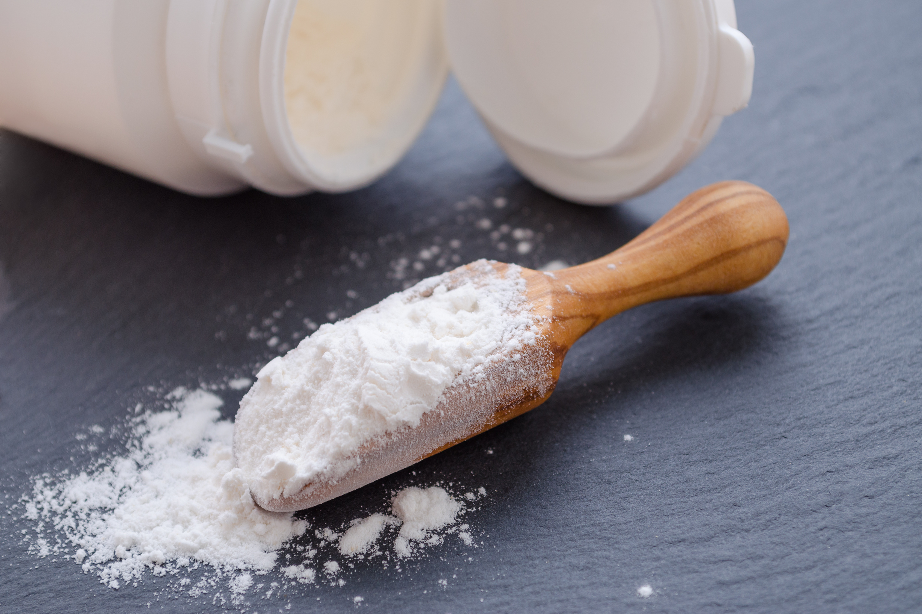
QUESTIONS?
+1 (303) 746-9555
len@itcstrategy.com
itcstrategy.com
#itcinsights
#itcinsights

Slide 201

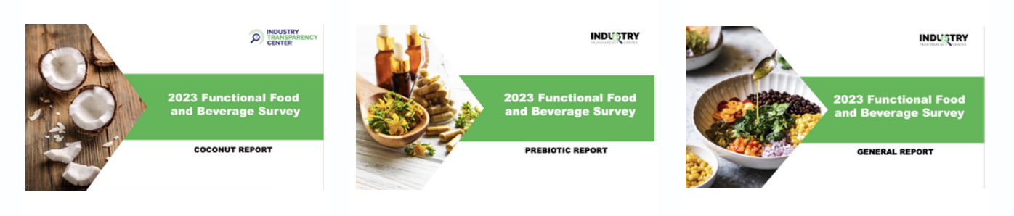

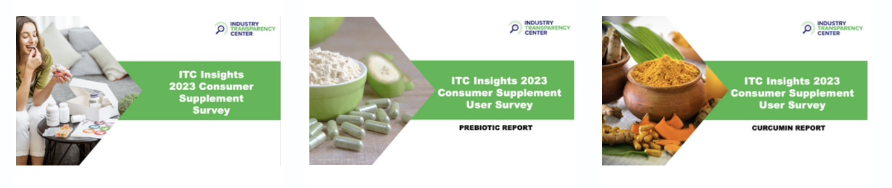
Unlock the power of
our data-driven insights today!
Visit our data-driven insights page to discover
actionable knowledge that can transform your decision-making.

