Slide 1
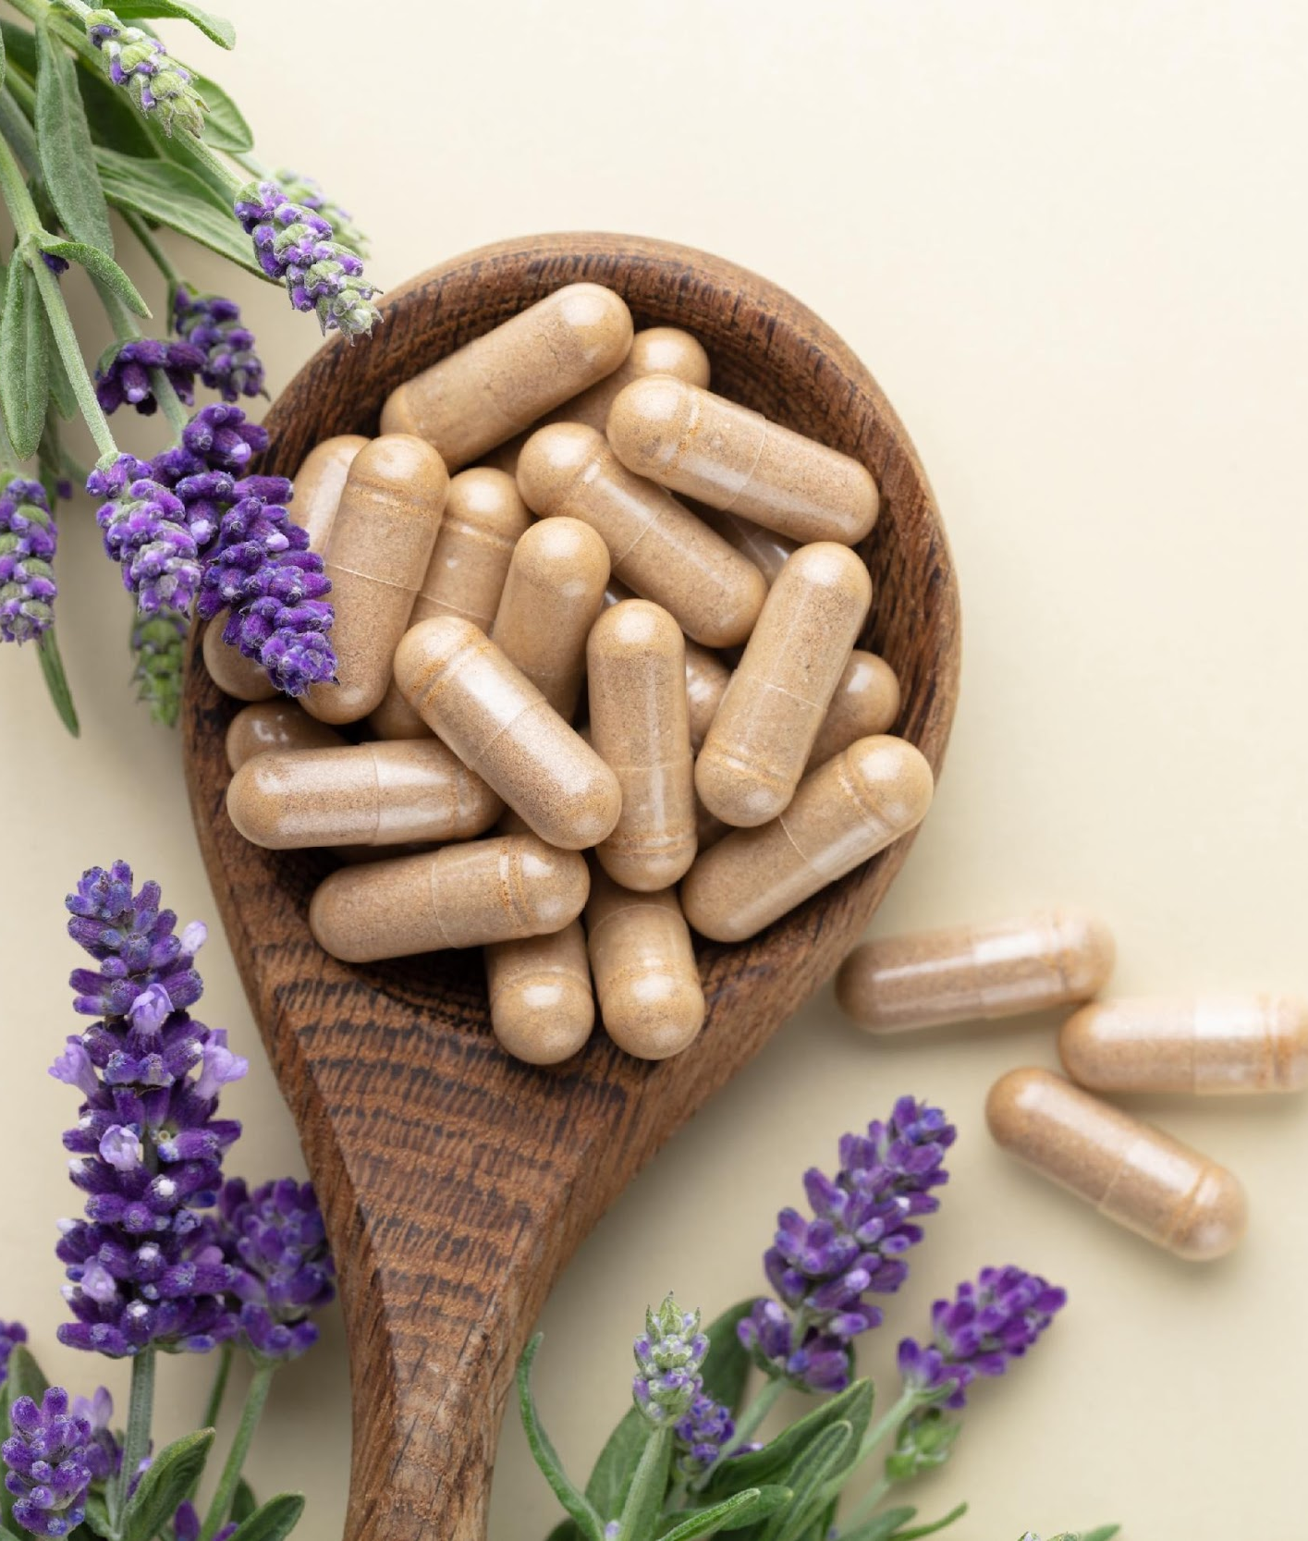

ITC INSIGHTS 2024 CONSUMER SUPPLEMENT SURVEY
PREBIOTIC REPORT:
ASSOCIATE LEVEL

Slide 2


The 2024 ITC Insights Consumer Supplement Survey was fielded from February to March 2024 and analyzed by the Industry Transparency Center.
The overall survey includes over 4000 supplement consumers ages 18+ in 6 countries: US (1000), UK (500), DE (500) IT: (500), KR: (500), AU: (500), IN: (500). Prebiotic users range from 474 in the US, to 367 in India, 316 in South Korea, 247 in Italy, 203 in Germany,197 in Australia and 168 in the UK.
The survey provides insights into supplement user buying behaviors and priorities, including familiarity, usage patterns, purchase drivers, branded ingredients and the importance of values like trust, transparency and sustainability.
OVERVIEW
The ITC Insights lightbulb indicates there are key takeaways for that slide.

Slide 3

TABLE OF CONTENTS
This table of contents is hyperlinked to the sections. Just click the page number to jump to that section in the deck.
Section | Page Number
Demographics | 4
Health Concerns | 24
Supplement Usage | 31
Familiarity & Reasons They Buy | 41
Shopping Behavior | 64
Branded Ingredients | 79
Values | 85
Prebiotic Deep Dive | 90
The ITC Insights lightbulb indicates there are key takeaways for that slide.
You can access primary data for charts by right clicking and opening the data in Excel.
Country abbreviations in footers:
United States = US, United Kingdom = UK, Germany = DE, Italy = IT, South Korea = KR, Australia = AU, India = IN.

Slide 4
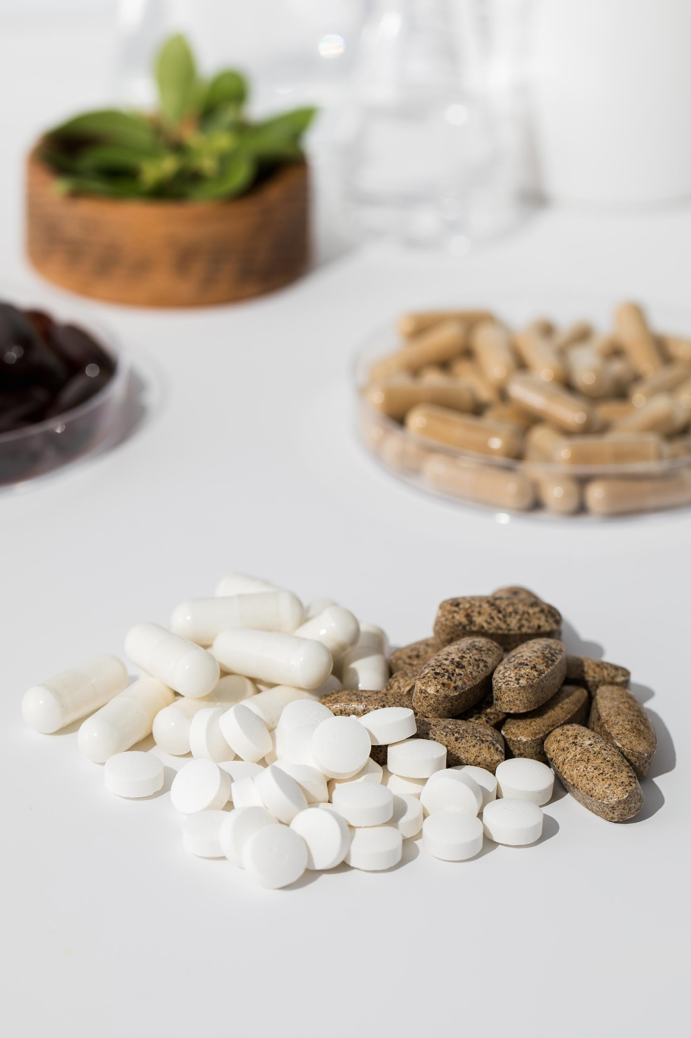
DEMOGRAPHICS
Age, gender and income for all respondents and by individual countries

Slide 5

DEMOGRAPHIC OVERVIEW
Key Insights:
Respondents were fairly evenly split across genders, skewing male overall, driven by the US; with users skewing slightly female in Italy and South Korea, skewing male in the US, UK, Germany and Australia, with an even split in India.
Except for South Korea where the largest group was those 18-34, the 35-54 age range has highest prebiotic users.
 | All Respondents |  | US Prebiotic Users |  | UK Prebiotic Users |  | DE Prebiotic Users |  | IT Prebiotic Users |  | KR Prebiotic Users |  | AU Prebiotic Users |  | IN Prebiotic Users
 | n=4198 |  | n=474 |  | n=168 |  | n=203 |  | n=247 |  | n=316 |  | n=197 |  | n=367
Female | n=2091 | 50% | n=210 | 45% | n=75 | 45% | n=99 | 49% | n=133 | 55% | n=162 | 51% | n=97 | 49% | n=182 | 50%
Male | n=2100 | 50% | n=263 | 55% | n=93 | 55% | n=104 | 51% | n=112 | 45% | n=154 | 49% | n=98 | 50% | n=185 | 50%
Non-binary/prefer to self-describe | n=7 | <1% | n=1 | <1% | n=0 | n/a | n=0 | n/a | n=2 | <1% | n=0 | n/a | n=2 | 1% | n=0 | n/a
18-34 | n=1204 | 29% | n=177 | 37% | n=63 | 38% | n=69 | 34% | n=65 | 26% | n=129 | 41% | n=63 | 32% | n=135 | 37%
35-54 | n=1764 | 42% | n=218 | 46% | n=73 | 43% | n=95 | 47% | n=120 | 49% | n=123 | 39% | n=99 | 50% | n=159 | 43%
55+ | n=1230 | 29% | n=79 | 17% | n=32 | 19% | n=39 | 19% | n=62 | 25% | n=64 | 20% | n=35 | 18% | n=73 | 20%

Slide 6
DEMOGRAPHICS
AGE
INCOME
49%
51%
Even mix of men and women.
Female n=958
Male n=1009
Non-Binary n=5
We surveyed a well-diversified set of age brackets, in this survey, across all countries/markets.
A diverse balance of all income groups was achieved, via individualized country quotas.
Note: Prebiotic Users n=1972, Income n=1607 (UK and AU not included).

Slide 7
DEMOGRAPHICS: AGE & GENDER
18-34
35-54
55+
49%
51%
49%
51%
46%
54%
Note: Gender Split: 18-34 n=701, 35-54 n=887, 55+ n=984, Income: 18-34 n=575, 35-54 n=715, 55+ n=317 (UK and AU not included).

Slide 8
DEMOGRAPHICS: US
AGE
INCOME
45%
55%
More men than women.
Female n=210
Male n=263
Non-Binary n=1
We surveyed a well-diversified set of age brackets, in this survey, across the US market, overall.
A diverse balance of all income groups was achieved.
Note: US n=474.

Slide 9
DEMOGRAPHICS: US, AGE & GENDER
18-34
35-54
55+
34%
66%
48%
52%
58%
42%
Note: US 18-34 n=177, US 35-54 n=218, US 55+ n=79.

Slide 10
DEMOGRAPHICS: UK
AGE
INCOME
45%
55%
More men than women.
Female n=75
Male n=93
We surveyed a well-diversified set of age brackets, in this survey, across the UK market.
We have fewer UK respondents in the £100,000 or more income ranges.
Note: UK n=168.

Slide 11
DEMOGRAPHICS: UK, AGE & GENDER
18-34
35-54
55+
46%
54%
42%
58%
47%
53%
Note: UK 18-34 n=63, UK 35-54 n=73, UK 55+ n=32.

Slide 12
DEMOGRAPHICS: DE
AGE
INCOME
49%
51%
Slightly more women than men.
Female n=99
Male n=104
We surveyed a well-diversified set of age brackets, in this survey, across the German market.
We have fewer German respondents in the $100,000 or more income ranges.
Note: DE n=203.

Slide 13
DEMOGRAPHICS: DE, AGE & GENDER
18-34
35-54
55+
52%
48%
47%
53%
46%
54%
Note: DE 18-34 n=69, DE 35-54 n=95, DE 55+ n=39.

Slide 14
DEMOGRAPHICS: IT
AGE
INCOME
55%
45%
More women than men.
Female n=133
Male n=112
Non-Binary n=2
We surveyed a well-diversified set of age brackets, in this survey, across the Italian market.
We have fewer Italian respondents in the $100,000 or more income ranges.
Note: IT n=247.

Slide 15
DEMOGRAPHICS: IT, AGE & GENDER
18-34
35-54
55+
65%
34%
49%
50%
52%
48%
Note: IT 18-34 n=65, IT 35-54 n=120, IT 55+ n=62.

Slide 16
DEMOGRAPHICS: KR
AGE
INCOME
51%
49%
Slightly more women than men.
Female n=162
Male n=154
We surveyed a well-diversified set of age brackets, in this survey, across the Korean market.
We have fewer Korean respondents in the $100,000 or more income range.
Note: KR n=316.

Slide 17
DEMOGRAPHICS: KR, AGE & GENDER
18-34
35-54
55+
64%
36%
50%
50%
30%
70%
Note: KR 18-34 n=129, KR 35-54 n=123, KR 55+ n=64.

Slide 18
DEMOGRAPHICS: AU
AGE
INCOME
49%
50%
Even mix of men and women.
Female n=97
Male n=98
Non-Binary n=2
We surveyed a well-diversified set of age brackets, in this survey, across the Australian market.
We have significantly more Australian respondents in the $100,000 or more ranges.
Note: AU n=197.

Slide 19
DEMOGRAPHICS: AU, AGE & GENDER
18-34
35-54
55+
46%
52%
58%
41%
31%
69%
Note: AU 18-34 n=63, AU 35-54 n=99, AU 55+ n=35.

Slide 20
DEMOGRAPHICS: IN
AGE
INCOME
50%
50%
Even mix of men and women.
Female n=182
Male n=185
We surveyed a well-diversified set of age brackets, in this survey, across the Indian market.
India sees the largest portion of respondents in the under $45,000 ranges.
Note: IN n=367.

Slide 21
DEMOGRAPHICS: IN, AGE & GENDER
18-34
35-54
55+
51%
49%
50%
50%
47%
53%
Note: IN 18-34 n=135, IN 35-54 n=159, IN 55+ n=73.

Slide 22
WHY CONSUMERS TAKE SUPPLEMENTS
Key Insights:
Prebiotic users are mainly taking supplements for general health & well-being purposes.
Indian respondents over-index for all reasons.
Note: US n=474, UK n=168, DE n=203, IT n=247, KR n=316, AU n=197, IN n=367, All Respondents n=4198. Question: “Why do you take dietary supplements?”

Slide 23
DISCUSSION WITH A HEALTH CARE
PROFESSIONAL
Key Insight:
'Situational' is the top response from each country but the US who instead mark ‘always’ as their number one.
Note: US n=474, UK n=168, DE n=203, IT n=247, KR n=316, AU n=197, IN n=367, All Respondents n=4198. Question: “Under which circumstances would you discuss your dietary supplements with your health care professional?”

Slide 24

HEALTH CONCERNS
Deep dive into supplement user health concerns and which ones they take supplements for

Slide 25
HEALTH CONCERNS AND WHAT THEY TAKE SUPPLEMENTS FOR
Key Insight:
There are large fulfillment gaps across the board, but mental health related concerns see some of the largest – across all surveyed countries.
Mood shows an exceedingly large gap, especially for Italy, the UK and Australia.
Note: US n=474, UK n=168, DE n=203, IT n=247, KR n=316, AU n=197, IN n=367. Results shown for top 10 health concerns. Question: “Which of the following health conditions or concerns currently impact or impacted you within the past year?” Entire bar represents total reporting, solid bar represents using supplements for that concern and cross hatch bar represents fulfillment gap.

Slide 26
HEALTH CONCERNS AND WHAT THEY TAKE SUPPLEMENTS FOR – NEXT 10
Key Insights:
Overweight/obese have the largest fulfillment gaps among this grouping, 10% and larger in some cases.
Korean respondents show by far the highest levels of both reporting and addressing with supplements for eye fatigue, doubling the next closest group.
Note: US n=474, UK n=168, DE n=203, IT n=247, KR n=316, AU n=197, IN n=367. Results shown for top 11-20 health concerns. Question: “Which of the following health conditions or concerns currently impact or impacted you within the past year?” Entire bar represents total reporting, solid bar represents using supplements for that concern and cross hatch bar represents fulfillment gap.

Slide 27
HEALTH CONCERNS AND WHAT THEY TAKE SUPPLEMENTS FOR – LAST 10
Key Insights:
Vision concerns continue to be one of the top concerns for those in South Korea with high reporting and addressing rates for poo/declining vision.
Both Indian and South Korean respondents over-index for immunity concerns, with relatively small fulfillment gaps.
Note: US n=474, UK n=168, DE n=203, IT n=247, KR n=316, AU n=197, IN n=367. Results shown for top 21-32 health concerns. Question: “Which of the following health conditions or concerns currently impact or impacted you within the past year?” Entire bar represents total reporting, solid bar represents using supplements for that concern and cross hatch bar represents fulfillment gap.

Slide 28
WILLING TO TAKE SUPPLEMENTS TO
ADDRESS CONCERNS
Key Insights:
For the most part, the response rate for a willingness to take a supplement tracks with reporting of a health concern.
Consistently though, there seems to be more of a willingness to consider taking supplements for a reported health concern than actually taking supplements for said concern – suggesting broad opportunities.
Here, smaller gaps are better news for companies targeting those concerns.
Note: US n=474, UK n=168, DE n=203, IT n=247, KR n=316, AU n=197, IN n=367. Question: “Would you consider supplements for any of the following health concerns?” Results shown for top 10 health concerns. Question: “Which of the following health conditions or concerns currently impact or impacted you within the past year?” Entire bar represents total reporting, solid bar represents a willingness to use supplements for that concern, smaller hatch indicates willingness to fulfill.

Slide 29
WILLING TO TAKE SUPPLEMENTS TO
ADDRESS CONCERNS – NEXT 10
Key Insights:
Overweight/obese shows some of the largest gaps in this set of concerns.
Many health concerns here see relatively small willingness to fulfillment gaps in this measure.
Of note, digestive concerns in Italy shows a small gap indicating almost all those he the concern are willing to take supplements to address it.
Note: US n=474, UK n=168, DE n=203, IT n=247, KR n=316, AU n=197, IN n=367. Question: “Would you consider supplements for any of the following health concerns?” Results shown for top 11-20 health concerns. Question: “Which of the following health conditions or concerns currently impact or impacted you within the past year?” Entire bar represents total reporting, solid bar represents a willingness to use supplements for that concern, smaller hatch indicates willingness to fulfill.

Slide 30
WILLING TO TAKE SUPPLEMENTS TO
ADDRESS CONCERNS – LAST 10
Key Insights:
Even in these last 10, there is more of a willingness to consider taking supplements for a reported health concern than actually taking supplements for said concern.
Immunity shows well here, especially in Korea.
However, there still exists significant gaps between reporting a concern and a willingness to take a supplement for a concern.
Note: US n=474, UK n=168, DE n=203, IT n=247, KR n=316, AU n=197, IN n=367. Question: “Would you consider supplements for any of the following health concerns?” Results shown for top 21-32 health concerns. Question: “Which of the following health conditions or concerns currently impact or impacted you within the past year?” Entire bar represents total reporting, solid bar represents a willingness to use supplements for that concern, smaller hatch indicates willingness to fulfill.

Slide 31
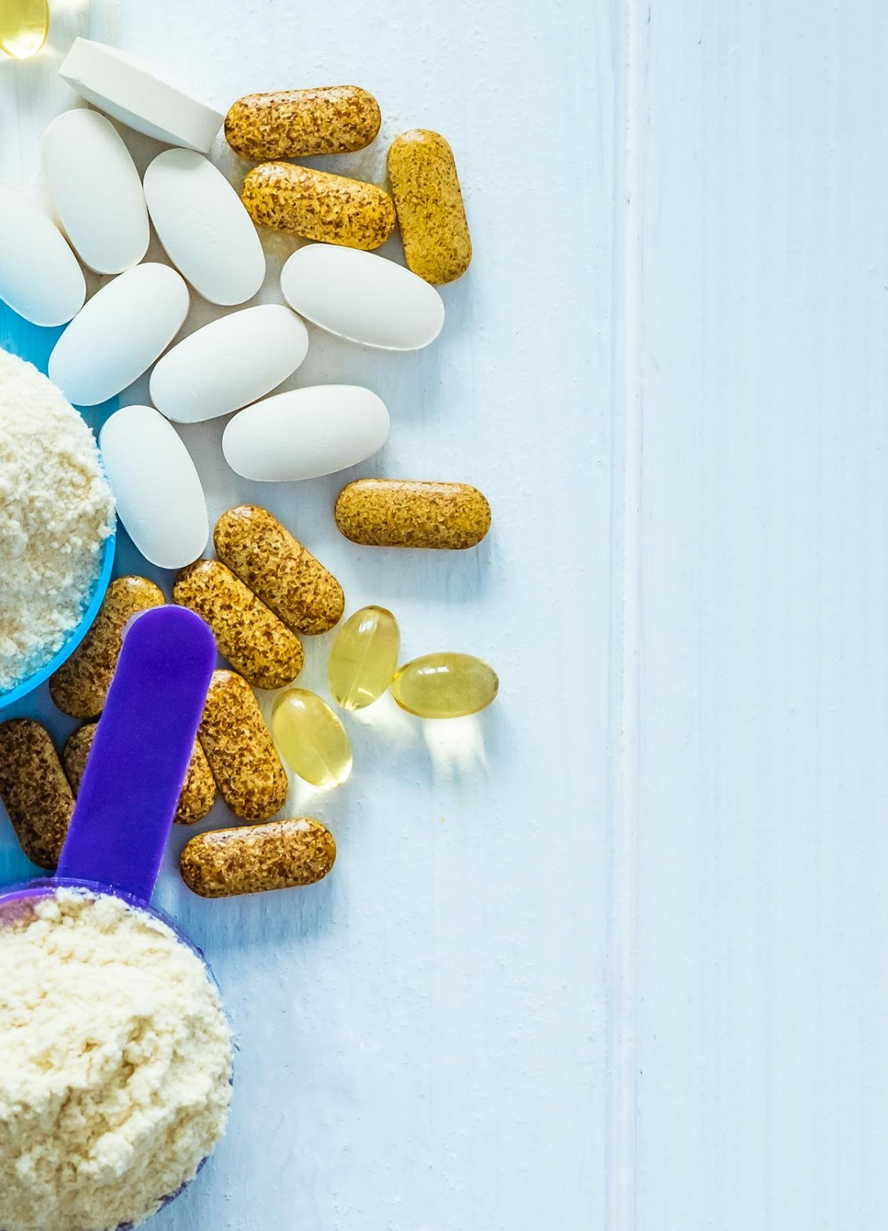
SUPPLEMENT USAGE

Slide 32
SUPPLEMENT USAGE FREQUENCY
Key Insight:
Daily is the most popular response from each country, but those with relatively low responses there; Germany, Italy and India, have relatively high response rates for as need arises.
Overall, prebiotic users under-index slightly compared to all supplement users.
Note: US n=474, UK n=168, DE n=203, IT n=247, KR n=316, AU n=197, IN n=367, All Respondents n=4198. Question: “How often do you take vitamins, minerals, herbs or other dietary supplements (e.g. fish oil, protein powder, probiotics, melatonin, etc.)?”

Slide 33
SUPPLEMENT USAGE
Key Insights:
Prebiotic users tend to use supplements more frequently than all users; what this means for instance is that regular use of something like probiotics has gone up 12%.
Prebiotic use itself is mostly irregular, with the highest reported usage rates coming in at 1-3 times per week (24%) and seasonally/as needed (40%).
Daily usage rates for most supplements is above 10%, with the most popular daily usage is supplements like vitamin C and multivitamins seeing daily use of 30% or more.
All supplements have a 65% or more total usage rate among prebiotic users.
 | n |  | All Usage |  | Daily |  | 4-6 times per week |  | 1-3 times per week |  | Seasonally/As needed |  | It's in another supplement I take |  | Never
 | Prebiotic | All | Prebiotic | All | Prebiotic | All | Prebiotic | All | Prebiotic | All | Prebiotic | All | Prebiotic | All | Prebiotic | All
Prebiotics | 1972 | 3548 | 100% | 58% | 16% | 9% | 16% | 9% | 24% | 14% | 40% | 24% | 5% | 3% | 0% | 42%
Vitamin C | 1967 | 4170 | 98% | 91% | 32% | 28% | 18% | 12% | 20% | 16% | 22% | 29% | 6% | 6% | 2% | 9%
Multivitamin | 1961 | 4151 | 97% | 88% | 34% | 32% | 17% | 11% | 22% | 17% | 18% | 24% | 5% | 4% | 3% | 12%
Vitamin D | 1959 | 4147 | 96% | 88% | 28% | 28% | 16% | 10% | 22% | 17% | 22% | 25% | 8% | 8% | 4% | 12%
Probiotics | 1948 | 3953 | 95% | 69% | 19% | 14% | 16% | 9% | 24% | 16% | 32% | 27% | 4% | 3% | 5% | 31%
Magnesium | 1950 | 4070 | 91% | 76% | 18% | 16% | 16% | 10% | 24% | 17% | 28% | 28% | 6% | 6% | 9% | 24%
Omega-3s | 1954 | 4095 | 91% | 78% | 22% | 20% | 16% | 10% | 24% | 18% | 25% | 26% | 4% | 4% | 9% | 22%
Antioxidants | 1932 | 3952 | 91% | 71% | 15% | 11% | 16% | 10% | 23% | 16% | 31% | 29% | 6% | 5% | 9% | 29%
Iron | 1958 | 4137 | 91% | 77% | 22% | 17% | 15% | 9% | 22% | 15% | 26% | 29% | 6% | 7% | 9% | 23%
Calcium | 1959 | 4139 | 90% | 77% | 24% | 20% | 16% | 10% | 22% | 16% | 22% | 24% | 6% | 8% | 10% | 23%
Postbiotics | 1631 | 2567 | 81% | 57% | 11% | 7% | 16% | 10% | 21% | 14% | 31% | 23% | 3% | 2% | 19% | 43%
Protein Powder | 1911 | 3881 | 81% | 62% | 16% | 12% | 16% | 10% | 23% | 18% | 22% | 21% | 3% | 2% | 19% | 38%
Curcumin/ Turmeric | 1901 | 3716 | 79% | 61% | 15% | 11% | 15% | 9% | 20% | 14% | 25% | 23% | 5% | 3% | 21% | 39%
Vitamin K2 | 1748 | 3020 | 77% | 60% | 13% | 10% | 14% | 10% | 20% | 14% | 23% | 21% | 6% | 6% | 23% | 40%
Collagen | 1904 | 3805 | 76% | 52% | 14% | 10% | 15% | 9% | 20% | 12% | 24% | 19% | 4% | 3% | 24% | 48%
Ashwagandha | 1336 | 2072 | 76% | 62% | 13% | 11% | 16% | 11% | 21% | 16% | 22% | 21% | 3% | 3% | 24% | 38%
Biotin | 1766 | 3053 | 76% | 57% | 14% | 11% | 14% | 9% | 18% | 12% | 26% | 20% | 5% | 5% | 24% | 43%
Alpha-GPC | 1299 | 1757 | 76% | 62% | 8% | 6% | 16% | 13% | 22% | 18% | 26% | 22% | 3% | 3% | 24% | 38%
Melatonin | 1874 | 3701 | 75% | 56% | 11% | 9% | 12% | 7% | 19% | 13% | 29% | 25% | 4% | 2% | 25% | 44%
Nootropics | 1221 | 1649 | 75% | 61% | 8% | 7% | 16% | 12% | 20% | 16% | 27% | 23% | 3% | 3% | 25% | 39%
Synbiotics | 1458 | 2118 | 74% | 55% | 9% | 6% | 15% | 11% | 20% | 14% | 27% | 22% | 3% | 3% | 26% | 45%
MSM | 1385 | 1980 | 74% | 58% | 9% | 7% | 15% | 11% | 21% | 15% | 27% | 22% | 3% | 3% | 26% | 42%
Astaxanthin | 1332 | 1791 | 73% | 60% | 9% | 8% | 18% | 14% | 18% | 14% | 25% | 21% | 3% | 3% | 27% | 40%
CoQ10 | 1437 | 2253 | 73% | 56% | 10% | 9% | 16% | 11% | 19% | 13% | 24% | 20% | 4% | 3% | 27% | 44%
Citicoline | 1245 | 1652 | 72% | 60% | 8% | 6% | 17% | 13% | 21% | 16% | 24% | 21% | 3% | 3% | 28% | 40%
Glucosamine | 1802 | 3249 | 72% | 52% | 10% | 8% | 15% | 9% | 17% | 12% | 26% | 20% | 3% | 3% | 28% | 48%
Glutathione | 1489 | 2145 | 72% | 56% | 9% | 7% | 15% | 11% | 20% | 15% | 24% | 21% | 3% | 3% | 28% | 44%
Lutein | 1569 | 2414 | 72% | 57% | 11% | 10% | 16% | 11% | 18% | 14% | 22% | 19% | 3% | 3% | 28% | 43%
Choline | 1388 | 2006 | 70% | 55% | 6% | 5% | 14% | 10% | 20% | 15% | 26% | 21% | 4% | 4% | 30% | 45%
CBD | 1563 | 2893 | 67% | 47% | 9% | 6% | 13% | 8% | 17% | 11% | 25% | 20% | 3% | 2% | 33% | 53%
Mushrooms | 1649 | 2936 | 66% | 46% | 7% | 5% | 14% | 8% | 19% | 13% | 24% | 19% | 2% | 1% | 34% | 54%
Note: n varies by supplement. Question: “Which of the following best describes how frequently you are taking the following supplements?”

Slide 34
SUPPLEMENT USAGE: US
Key Insight:
In the US, we see a significant uptick of all supplement frequency of use for prebiotic users. For instance, regular use of probiotics is up 23%.
US prebiotic use is more spread out over each category, with not single category, regular or irregular seeing a usage rate above 28%.
 | n |  | All Usage |  | Daily |  | 4-6 times per week |  | 1-3 times per week |  | Seasonally/As needed |  | It's in another supplement I take |  | Never
 | US | All | US | All | US | All | US | All | US | All | US | All | US | All | US | All
Prebiotics | 474 | 3548 | 100% | 58% | 18% | 9% | 22% | 9% | 26% | 14% | 28% | 24% | 7% | 3% | 0% | 42%
Vitamin C | 472 | 4170 | 97% | 91% | 37% | 28% | 16% | 12% | 19% | 16% | 16% | 29% | 9% | 6% | 3% | 9%
Multivitamin | 471 | 4151 | 97% | 88% | 44% | 32% | 18% | 11% | 18% | 17% | 12% | 24% | 5% | 4% | 3% | 12%
Probiotics | 468 | 3953 | 96% | 69% | 27% | 14% | 19% | 9% | 22% | 16% | 23% | 27% | 4% | 3% | 4% | 31%
Vitamin D | 471 | 4147 | 96% | 88% | 36% | 28% | 18% | 10% | 18% | 17% | 15% | 25% | 9% | 8% | 4% | 12%
Antioxidants | 465 | 3952 | 94% | 71% | 18% | 11% | 21% | 10% | 25% | 16% | 22% | 29% | 8% | 5% | 6% | 29%
Calcium | 469 | 4139 | 92% | 77% | 30% | 20% | 16% | 10% | 20% | 16% | 17% | 24% | 9% | 8% | 8% | 23%
Iron | 469 | 4137 | 89% | 77% | 23% | 17% | 17% | 9% | 20% | 15% | 19% | 29% | 9% | 7% | 11% | 23%
Omega-3s | 465 | 4095 | 89% | 78% | 23% | 20% | 19% | 10% | 22% | 18% | 20% | 26% | 5% | 4% | 11% | 22%
Magnesium | 466 | 4070 | 86% | 76% | 19% | 16% | 15% | 10% | 26% | 17% | 18% | 28% | 8% | 6% | 14% | 24%
Melatonin | 463 | 3701 | 82% | 56% | 14% | 9% | 13% | 7% | 20% | 13% | 31% | 25% | 4% | 2% | 18% | 44%
Protein Powder | 458 | 3881 | 81% | 62% | 16% | 12% | 19% | 10% | 24% | 18% | 19% | 21% | 3% | 2% | 19% | 38%
Postbiotics | 396 | 2567 | 80% | 57% | 12% | 7% | 19% | 10% | 22% | 14% | 22% | 23% | 5% | 2% | 20% | 43%
Curcumin/ Turmeric | 457 | 3716 | 80% | 61% | 18% | 11% | 18% | 9% | 19% | 14% | 21% | 23% | 5% | 3% | 20% | 39%
Alpha-GPC | 313 | 1757 | 79% | 62% | 11% | 6% | 23% | 13% | 21% | 18% | 21% | 22% | 4% | 3% | 21% | 38%
Citicoline | 302 | 1652 | 79% | 60% | 9% | 6% | 23% | 13% | 22% | 16% | 21% | 21% | 5% | 3% | 21% | 40%
Biotin | 448 | 3053 | 79% | 57% | 19% | 11% | 16% | 9% | 19% | 12% | 19% | 20% | 6% | 5% | 21% | 43%
Astaxanthin | 295 | 1791 | 79% | 60% | 7% | 8% | 22% | 14% | 18% | 14% | 25% | 21% | 6% | 3% | 21% | 40%
Vitamin K2 | 425 | 3020 | 78% | 60% | 17% | 10% | 17% | 10% | 18% | 14% | 18% | 21% | 8% | 6% | 22% | 40%
Synbiotics | 336 | 2118 | 78% | 55% | 12% | 6% | 19% | 11% | 21% | 14% | 21% | 22% | 5% | 3% | 22% | 45%
Nootropics | 301 | 1649 | 78% | 61% | 10% | 7% | 18% | 12% | 25% | 16% | 22% | 23% | 4% | 3% | 22% | 39%
MSM | 328 | 1980 | 76% | 58% | 11% | 7% | 19% | 11% | 20% | 15% | 23% | 22% | 4% | 3% | 24% | 42%
CoQ10 | 379 | 2253 | 75% | 56% | 14% | 9% | 16% | 11% | 20% | 13% | 22% | 20% | 3% | 3% | 25% | 44%
Glutathione | 339 | 2145 | 75% | 56% | 10% | 7% | 19% | 11% | 20% | 15% | 23% | 21% | 4% | 3% | 25% | 44%
Collagen | 454 | 3805 | 74% | 52% | 15% | 10% | 17% | 9% | 20% | 12% | 19% | 19% | 4% | 3% | 26% | 48%
Glucosamine | 438 | 3249 | 74% | 52% | 14% | 8% | 15% | 9% | 20% | 12% | 21% | 20% | 4% | 3% | 26% | 48%
Ashwagandha | 349 | 2072 | 72% | 62% | 11% | 11% | 18% | 11% | 20% | 16% | 19% | 21% | 4% | 3% | 28% | 38%
Choline | 354 | 2006 | 70% | 55% | 8% | 5% | 17% | 10% | 21% | 15% | 19% | 21% | 5% | 4% | 30% | 45%
Lutein | 369 | 2414 | 70% | 57% | 8% | 10% | 21% | 11% | 20% | 14% | 17% | 19% | 4% | 3% | 30% | 43%
CBD | 449 | 2893 | 70% | 47% | 11% | 6% | 14% | 8% | 21% | 11% | 21% | 20% | 3% | 2% | 30% | 53%
Mushrooms | 419 | 2936 | 64% | 46% | 8% | 5% | 18% | 8% | 17% | 13% | 19% | 19% | 2% | 1% | 36% | 54%
Note: n varies by supplement. Question: “Which of the following best describes how frequently you are taking the following supplements?”

Slide 35
SUPPLEMENT USAGE: UK
Key Insight:
Again, in the UK, we see that prebiotic users also use other supplements more regularly, for jnstance, vitamin D up 13%. Probiotic regular use though is only up 3% for these users
UK prebiotic use is heavily driven by the seasonal/as needed category at 48%, double the next highest, the irregular 1-3 times per week (24%).
 | n |  | All Usage |  | Daily |  | 4-6 times per week |  | 1-3 times per week |  | Seasonally/As needed |  | It's in another supplement I take |  | Never
 | UK | All | UK | All | UK | All | UK | All | UK | All | UK | All | UK | All | UK | All
Prebiotics | 168 | 3548 | 100% | 58% | 12% | 9% | 14% | 9% | 24% | 14% | 48% | 24% | 3% | 3% | 0% | 42%
Vitamin C | 168 | 4170 | 99% | 91% | 40% | 28% | 11% | 12% | 29% | 16% | 11% | 29% | 8% | 6% | 1% | 9%
Vitamin D | 167 | 4147 | 98% | 88% | 36% | 28% | 15% | 10% | 24% | 17% | 14% | 25% | 10% | 8% | 2% | 12%
Multivitamin | 168 | 4151 | 98% | 88% | 41% | 32% | 18% | 11% | 20% | 17% | 14% | 24% | 5% | 4% | 2% | 12%
Iron | 168 | 4137 | 95% | 77% | 26% | 17% | 11% | 9% | 27% | 15% | 20% | 29% | 10% | 7% | 5% | 23%
Omega-3s | 166 | 4095 | 95% | 78% | 28% | 20% | 13% | 10% | 28% | 18% | 20% | 26% | 5% | 4% | 5% | 22%
Probiotics | 166 | 3953 | 93% | 69% | 16% | 14% | 10% | 9% | 27% | 16% | 36% | 27% | 4% | 3% | 7% | 31%
Antioxidants | 167 | 3952 | 92% | 71% | 10% | 11% | 13% | 10% | 26% | 16% | 37% | 29% | 6% | 5% | 8% | 29%
Calcium | 167 | 4139 | 92% | 77% | 26% | 20% | 13% | 10% | 25% | 16% | 21% | 24% | 8% | 8% | 8% | 23%
Magnesium | 166 | 4070 | 89% | 76% | 13% | 16% | 12% | 10% | 27% | 17% | 31% | 28% | 6% | 6% | 11% | 24%
Curcumin/ Turmeric | 161 | 3716 | 81% | 61% | 14% | 11% | 9% | 9% | 22% | 14% | 29% | 23% | 6% | 3% | 19% | 39%
Vitamin K2 | 147 | 3020 | 77% | 60% | 14% | 10% | 14% | 10% | 21% | 14% | 22% | 21% | 5% | 6% | 23% | 40%
Postbiotics | 138 | 2567 | 77% | 57% | 8% | 7% | 12% | 10% | 21% | 14% | 33% | 23% | 3% | 2% | 23% | 43%
Protein Powder | 165 | 3881 | 75% | 62% | 9% | 12% | 13% | 10% | 27% | 18% | 22% | 21% | 4% | 2% | 25% | 38%
Collagen | 163 | 3805 | 74% | 52% | 14% | 10% | 13% | 9% | 19% | 12% | 23% | 19% | 4% | 3% | 26% | 48%
Glucosamine | 156 | 3249 | 72% | 52% | 8% | 8% | 14% | 9% | 19% | 12% | 28% | 20% | 3% | 3% | 28% | 48%
Ashwagandha | 98 | 2072 | 71% | 62% | 5% | 11% | 10% | 11% | 19% | 16% | 34% | 21% | 3% | 3% | 29% | 38%
Nootropics | 103 | 1649 | 71% | 61% | 5% | 7% | 12% | 12% | 17% | 16% | 34% | 23% | 4% | 3% | 29% | 39%
MSM | 120 | 1980 | 70% | 58% | 4% | 7% | 11% | 11% | 15% | 15% | 34% | 22% | 6% | 3% | 30% | 42%
Alpha-GPC | 117 | 1757 | 69% | 62% | 11% | 6% | 9% | 13% | 17% | 18% | 28% | 22% | 3% | 3% | 31% | 38%
Lutein | 113 | 2414 | 68% | 57% | 9% | 10% | 11% | 11% | 19% | 14% | 27% | 19% | 3% | 3% | 32% | 43%
Astaxanthin | 103 | 1791 | 68% | 60% | 8% | 8% | 16% | 14% | 16% | 14% | 25% | 21% | 4% | 3% | 32% | 40%
Biotin | 140 | 3053 | 68% | 57% | 11% | 11% | 12% | 9% | 21% | 12% | 21% | 20% | 4% | 5% | 32% | 43%
Glutathione | 117 | 2145 | 68% | 56% | 4% | 7% | 11% | 11% | 25% | 15% | 26% | 21% | 2% | 3% | 32% | 44%
Synbiotics | 126 | 2118 | 67% | 55% | 6% | 6% | 11% | 11% | 16% | 14% | 31% | 22% | 4% | 3% | 33% | 45%
Melatonin | 154 | 3701 | 66% | 56% | 6% | 9% | 10% | 7% | 17% | 13% | 29% | 25% | 4% | 2% | 34% | 44%
Citicoline | 106 | 1652 | 66% | 60% | 3% | 6% | 15% | 13% | 18% | 16% | 26% | 21% | 4% | 3% | 34% | 40%
Choline | 117 | 2006 | 66% | 55% | 5% | 5% | 14% | 10% | 16% | 15% | 26% | 21% | 5% | 4% | 34% | 45%
CoQ10 | 117 | 2253 | 65% | 56% | 9% | 9% | 14% | 11% | 16% | 13% | 21% | 20% | 6% | 3% | 35% | 44%
CBD | 148 | 2893 | 60% | 47% | 7% | 6% | 6% | 8% | 16% | 11% | 30% | 20% | 1% | 2% | 40% | 53%
Mushrooms | 141 | 2936 | 59% | 46% | 2% | 5% | 11% | 8% | 21% | 13% | 20% | 19% | 5% | 1% | 41% | 54%
Note: n varies by supplement. Question: “Which of the following best describes how frequently you are taking the following supplements?”

Slide 36
SUPPLEMENT USAGE: DE
Key Insight:
In Germany, for prebiotic users, regular use of magnesium is up 20%, and all probiotic use has gone up 22%.
German respondents also have high usage in the seasonal/as needed category at 40% for prebiotics.
 | n |  | All Usage |  | Daily |  | 4-6 times per week |  | 1-3 times per week |  | Seasonally/As needed |  | It's in another supplement I take |  | Never
 | DE | All | DE | All | DE | All | DE | All | DE | All | DE | All | DE | All | DE | All
Prebiotics | 203 | 3548 | 100% | 58% | 13% | 9% | 15% | 9% | 27% | 14% | 40% | 24% | 4% | 3% | 0% | 42%
Vitamin C | 202 | 4170 | 100% | 91% | 26% | 28% | 24% | 12% | 22% | 16% | 23% | 29% | 4% | 6% | 0% | 9%
Vitamin D | 203 | 4147 | 98% | 88% | 28% | 28% | 16% | 10% | 26% | 17% | 21% | 25% | 8% | 8% | 2% | 12%
Magnesium | 202 | 4070 | 98% | 76% | 27% | 16% | 19% | 10% | 26% | 17% | 21% | 28% | 5% | 6% | 2% | 24%
Multivitamin | 202 | 4151 | 94% | 88% | 23% | 32% | 22% | 11% | 23% | 17% | 19% | 24% | 6% | 4% | 6% | 12%
Iron | 200 | 4137 | 93% | 77% | 20% | 17% | 18% | 9% | 20% | 15% | 29% | 29% | 7% | 7% | 7% | 23%
Omega-3s | 202 | 4095 | 91% | 78% | 21% | 20% | 17% | 10% | 24% | 18% | 25% | 26% | 4% | 4% | 9% | 22%
Probiotics | 198 | 3953 | 91% | 69% | 14% | 14% | 14% | 9% | 23% | 16% | 35% | 27% | 5% | 3% | 9% | 31%
Antioxidants | 193 | 3952 | 90% | 71% | 17% | 11% | 13% | 10% | 24% | 16% | 29% | 29% | 7% | 5% | 10% | 29%
Calcium | 200 | 4139 | 90% | 77% | 14% | 20% | 22% | 10% | 23% | 16% | 25% | 24% | 6% | 8% | 11% | 23%
Curcumin/ Turmeric | 194 | 3716 | 84% | 61% | 11% | 11% | 18% | 9% | 20% | 14% | 30% | 23% | 6% | 3% | 16% | 39%
Postbiotics | 157 | 2567 | 83% | 57% | 10% | 7% | 18% | 10% | 24% | 14% | 29% | 23% | 3% | 2% | 17% | 43%
Biotin | 189 | 3053 | 80% | 57% | 17% | 11% | 15% | 9% | 20% | 12% | 23% | 20% | 5% | 5% | 20% | 43%
Protein Powder | 198 | 3881 | 80% | 62% | 15% | 12% | 15% | 10% | 22% | 18% | 22% | 21% | 7% | 2% | 20% | 38%
Alpha-GPC | 122 | 1757 | 80% | 62% | 5% | 6% | 20% | 13% | 25% | 18% | 23% | 22% | 6% | 3% | 20% | 38%
Astaxanthin | 133 | 1791 | 78% | 60% | 11% | 8% | 18% | 14% | 24% | 14% | 24% | 21% | 2% | 3% | 22% | 40%
CoQ10 | 162 | 2253 | 78% | 56% | 12% | 9% | 17% | 11% | 22% | 13% | 22% | 20% | 5% | 3% | 22% | 44%
Choline | 136 | 2006 | 77% | 55% | 7% | 5% | 18% | 10% | 18% | 15% | 29% | 21% | 4% | 4% | 23% | 45%
Synbiotics | 145 | 2118 | 77% | 55% | 9% | 6% | 16% | 11% | 23% | 14% | 25% | 22% | 3% | 3% | 23% | 45%
Vitamin K2 | 185 | 3020 | 76% | 60% | 16% | 10% | 14% | 10% | 22% | 14% | 17% | 21% | 7% | 6% | 24% | 40%
MSM | 139 | 1980 | 76% | 58% | 8% | 7% | 16% | 11% | 25% | 15% | 26% | 22% | 1% | 3% | 24% | 42%
Nootropics | 116 | 1649 | 75% | 61% | 8% | 7% | 28% | 12% | 14% | 16% | 24% | 23% | 2% | 3% | 25% | 39%
Glutathione | 139 | 2145 | 75% | 56% | 9% | 7% | 18% | 11% | 27% | 15% | 20% | 21% | 1% | 3% | 25% | 44%
Ashwagandha | 146 | 2072 | 73% | 62% | 11% | 11% | 15% | 11% | 25% | 16% | 18% | 21% | 4% | 3% | 27% | 38%
Collagen | 191 | 3805 | 73% | 52% | 15% | 10% | 14% | 9% | 18% | 12% | 21% | 19% | 5% | 3% | 27% | 48%
Mushrooms | 142 | 2936 | 73% | 46% | 12% | 5% | 16% | 8% | 16% | 13% | 26% | 19% | 2% | 1% | 27% | 54%
Melatonin | 194 | 3701 | 72% | 56% | 12% | 9% | 13% | 7% | 19% | 13% | 26% | 25% | 2% | 2% | 28% | 44%
Citicoline | 123 | 1652 | 72% | 60% | 10% | 6% | 14% | 13% | 24% | 16% | 19% | 21% | 5% | 3% | 28% | 40%
CBD | 177 | 2893 | 68% | 47% | 10% | 6% | 15% | 8% | 14% | 11% | 26% | 20% | 3% | 2% | 32% | 53%
Glucosamine | 169 | 3249 | 68% | 52% | 9% | 8% | 18% | 9% | 15% | 12% | 24% | 20% | 3% | 3% | 32% | 48%
Lutein | 156 | 2414 | 68% | 57% | 7% | 10% | 18% | 11% | 18% | 14% | 19% | 19% | 6% | 3% | 32% | 43%
Note: n varies by supplement. Question: “Which of the following best describes how frequently you are taking the following supplements?”

Slide 37
SUPPLEMENT USAGE: IT
Key Insights:
Italian prebiotic users see the highest irregular usage rates from any group. Prebiotics sit at 78% irregular use.
These users actually under-index, that is they have less regular use than all users for many of the more common supplements (probiotics –3% for instance).
They also have some of the highest response rates for never, with many supplements above 40% there.
 | n |  | All Usage |  | Daily |  | 4-6 times per week |  | 1-3 times per week |  | Seasonally/As needed |  | It's in another supplement I take |  | Never
 | IT | All | IT | All | IT | All | IT | All | IT | All | IT | All | IT | All | IT | All
Prebiotics | 247 | 3548 | 100% | 58% | 8% | 9% | 9% | 9% | 21% | 14% | 57% | 24% | 6% | 3% | 0% | 42%
Vitamin C | 246 | 4170 | 98% | 91% | 17% | 28% | 13% | 12% | 17% | 16% | 46% | 29% | 5% | 6% | 2% | 9%
Multivitamin | 246 | 4151 | 96% | 88% | 16% | 32% | 9% | 11% | 22% | 17% | 43% | 24% | 6% | 4% | 4% | 12%
Probiotics | 245 | 3953 | 96% | 69% | 9% | 14% | 11% | 9% | 22% | 16% | 46% | 27% | 7% | 3% | 4% | 31%
Magnesium | 244 | 4070 | 95% | 76% | 14% | 16% | 11% | 10% | 21% | 17% | 41% | 28% | 7% | 6% | 5% | 24%
Vitamin D | 244 | 4147 | 94% | 88% | 15% | 28% | 9% | 10% | 22% | 17% | 39% | 25% | 9% | 8% | 6% | 12%
Omega-3s | 245 | 4095 | 88% | 78% | 10% | 20% | 12% | 10% | 22% | 18% | 39% | 26% | 4% | 4% | 12% | 22%
Antioxidants | 244 | 3952 | 88% | 71% | 12% | 11% | 10% | 10% | 20% | 16% | 40% | 29% | 5% | 5% | 12% | 29%
Iron | 247 | 4137 | 85% | 77% | 11% | 17% | 10% | 9% | 14% | 15% | 40% | 29% | 9% | 7% | 15% | 23%
Calcium | 246 | 4139 | 85% | 77% | 9% | 20% | 11% | 10% | 21% | 16% | 35% | 24% | 8% | 8% | 15% | 23%
Melatonin | 244 | 3701 | 81% | 56% | 16% | 9% | 7% | 7% | 20% | 13% | 34% | 25% | 5% | 2% | 19% | 44%
Postbiotics | 170 | 2567 | 75% | 57% | 4% | 7% | 10% | 10% | 18% | 14% | 40% | 23% | 2% | 2% | 25% | 43%
Protein Powder | 228 | 3881 | 72% | 62% | 7% | 12% | 13% | 10% | 19% | 18% | 30% | 21% | 4% | 2% | 28% | 38%
Vitamin K2 | 219 | 3020 | 68% | 60% | 8% | 10% | 7% | 10% | 16% | 14% | 30% | 21% | 7% | 6% | 32% | 40%
Collagen | 240 | 3805 | 67% | 52% | 11% | 10% | 8% | 9% | 15% | 12% | 29% | 19% | 5% | 3% | 33% | 48%
Curcumin/ Turmeric | 240 | 3716 | 66% | 61% | 5% | 11% | 8% | 9% | 19% | 14% | 28% | 23% | 6% | 3% | 34% | 39%
Alpha-GPC | 136 | 1757 | 62% | 62% | 4% | 6% | 9% | 13% | 17% | 18% | 28% | 22% | 4% | 3% | 38% | 38%
Biotin | 199 | 3053 | 61% | 57% | 6% | 11% | 7% | 9% | 14% | 12% | 29% | 20% | 6% | 5% | 39% | 43%
Nootropics | 118 | 1649 | 58% | 61% | 4% | 7% | 7% | 12% | 13% | 16% | 30% | 23% | 5% | 3% | 42% | 39%
MSM | 138 | 1980 | 58% | 58% | 4% | 7% | 10% | 11% | 20% | 15% | 22% | 22% | 1% | 3% | 42% | 42%
Synbiotics | 147 | 2118 | 57% | 55% | 3% | 6% | 6% | 11% | 20% | 14% | 26% | 22% | 2% | 3% | 43% | 45%
Glucosamine | 204 | 3249 | 56% | 52% | 4% | 8% | 7% | 9% | 12% | 12% | 29% | 20% | 3% | 3% | 44% | 48%
CoQ10 | 155 | 2253 | 55% | 56% | 3% | 9% | 9% | 11% | 12% | 13% | 26% | 20% | 5% | 3% | 45% | 44%
Choline | 149 | 2006 | 55% | 55% | 3% | 5% | 7% | 10% | 13% | 15% | 29% | 21% | 3% | 4% | 45% | 45%
Astaxanthin | 133 | 1791 | 53% | 60% | 6% | 8% | 10% | 14% | 14% | 14% | 20% | 21% | 2% | 3% | 47% | 40%
Citicoline | 141 | 1652 | 52% | 60% | 6% | 6% | 6% | 13% | 18% | 16% | 20% | 21% | 3% | 3% | 48% | 40%
Ashwagandha | 104 | 2072 | 50% | 62% | 3% | 11% | 11% | 11% | 19% | 16% | 16% | 21% | 1% | 3% | 50% | 38%
Lutein | 183 | 2414 | 49% | 57% | 6% | 10% | 8% | 11% | 13% | 14% | 19% | 19% | 3% | 3% | 51% | 43%
Glutathione | 179 | 2145 | 47% | 56% | 4% | 7% | 7% | 11% | 11% | 15% | 20% | 21% | 5% | 3% | 53% | 44%
CBD | 181 | 2893 | 44% | 47% | 3% | 6% | 7% | 8% | 13% | 11% | 20% | 20% | 2% | 2% | 56% | 53%
Mushrooms | 181 | 2936 | 42% | 46% | 2% | 5% | 7% | 8% | 11% | 13% | 22% | 19% | 1% | 1% | 58% | 54%
Note: n varies by supplement. Question: “Which of the following best describes how frequently you are taking the following supplements?”

Slide 38
SUPPLEMENT USAGE: KR
Key Insight:
Prebiotic users in South Korea have a relatively high daily usage rate for prebiotics (28%), the highest among all respondent countries by a decent margin.
Regular use of probiotics goes up 20%, also the same for omega-3s.
 | n |  | All Usage |  | Daily |  | 4-6 times per week |  | 1-3 times per week |  | Seasonally/As needed |  | It's in another supplement I take |  | Never
 | KR | All | KR | All | KR | All | KR | All | KR | All | KR | All | KR | All | KR | All
Prebiotics | 316 | 3548 | 100% | 58% | 28% | 9% | 16% | 9% | 22% | 14% | 31% | 24% | 4% | 3% | 0% | 42%
Vitamin C | 316 | 4170 | 99% | 91% | 38% | 28% | 17% | 12% | 21% | 16% | 18% | 29% | 5% | 6% | 1% | 9%
Multivitamin | 315 | 4151 | 97% | 88% | 41% | 32% | 17% | 11% | 23% | 17% | 12% | 24% | 3% | 4% | 3% | 12%
Probiotics | 313 | 3953 | 96% | 69% | 28% | 14% | 15% | 9% | 28% | 16% | 20% | 27% | 4% | 3% | 4% | 31%
Vitamin D | 314 | 4147 | 94% | 88% | 25% | 28% | 20% | 10% | 20% | 17% | 22% | 25% | 7% | 8% | 6% | 12%
Omega-3s | 314 | 4095 | 93% | 78% | 32% | 20% | 18% | 10% | 21% | 18% | 20% | 26% | 3% | 4% | 7% | 22%
Magnesium | 314 | 4070 | 91% | 76% | 20% | 16% | 15% | 10% | 23% | 17% | 28% | 28% | 4% | 6% | 9% | 24%
Calcium | 314 | 4139 | 89% | 77% | 26% | 20% | 17% | 10% | 23% | 16% | 18% | 24% | 5% | 8% | 11% | 23%
Lutein | 309 | 2414 | 87% | 57% | 28% | 10% | 19% | 11% | 17% | 14% | 20% | 19% | 2% | 3% | 13% | 43%
Iron | 311 | 4137 | 86% | 77% | 19% | 17% | 16% | 9% | 20% | 15% | 28% | 29% | 4% | 7% | 14% | 23%
Antioxidants | 308 | 3952 | 86% | 71% | 17% | 11% | 19% | 10% | 18% | 16% | 28% | 29% | 5% | 5% | 14% | 29%
Postbiotics | 279 | 2567 | 85% | 57% | 18% | 7% | 16% | 10% | 19% | 14% | 29% | 23% | 3% | 2% | 15% | 43%
Collagen | 315 | 3805 | 85% | 52% | 21% | 10% | 19% | 9% | 18% | 12% | 25% | 19% | 2% | 3% | 15% | 48%
Protein Powder | 306 | 3881 | 80% | 62% | 15% | 12% | 15% | 10% | 22% | 18% | 25% | 21% | 2% | 2% | 20% | 38%
Nootropics | 190 | 1649 | 79% | 61% | 11% | 7% | 17% | 12% | 24% | 16% | 24% | 23% | 3% | 3% | 21% | 39%
CBD | 175 | 2893 | 78% | 47% | 14% | 6% | 15% | 8% | 19% | 11% | 25% | 20% | 4% | 2% | 22% | 53%
Synbiotics | 262 | 2118 | 77% | 55% | 12% | 6% | 14% | 11% | 20% | 14% | 27% | 22% | 3% | 3% | 23% | 45%
Alpha-GPC | 201 | 1757 | 76% | 62% | 10% | 6% | 14% | 13% | 25% | 18% | 24% | 22% | 3% | 3% | 24% | 38%
CoQ10 | 223 | 2253 | 75% | 56% | 14% | 9% | 21% | 11% | 16% | 13% | 21% | 20% | 4% | 3% | 25% | 44%
Glucosamine | 309 | 3249 | 75% | 52% | 14% | 8% | 17% | 9% | 17% | 12% | 25% | 20% | 3% | 3% | 25% | 48%
Vitamin K2 | 258 | 3020 | 74% | 60% | 16% | 10% | 17% | 10% | 15% | 14% | 22% | 21% | 5% | 6% | 26% | 40%
Citicoline | 178 | 1652 | 74% | 60% | 12% | 6% | 18% | 13% | 20% | 16% | 22% | 21% | 2% | 3% | 26% | 40%
Ashwagandha | 166 | 2072 | 74% | 62% | 10% | 11% | 19% | 11% | 20% | 16% | 22% | 21% | 3% | 3% | 26% | 38%
Biotin | 295 | 3053 | 74% | 57% | 16% | 11% | 17% | 9% | 15% | 12% | 24% | 20% | 3% | 5% | 26% | 43%
MSM | 240 | 1980 | 74% | 58% | 14% | 7% | 15% | 11% | 21% | 15% | 22% | 22% | 2% | 3% | 26% | 42%
Glutathione | 279 | 2145 | 73% | 56% | 12% | 7% | 16% | 11% | 21% | 15% | 22% | 21% | 2% | 3% | 27% | 44%
Choline | 208 | 2006 | 70% | 55% | 8% | 5% | 17% | 10% | 20% | 15% | 21% | 21% | 4% | 4% | 30% | 45%
Astaxanthin | 277 | 1791 | 69% | 60% | 16% | 8% | 18% | 14% | 15% | 14% | 18% | 21% | 2% | 3% | 31% | 40%
Mushrooms | 245 | 2936 | 69% | 46% | 9% | 5% | 16% | 8% | 16% | 13% | 26% | 19% | 2% | 1% | 31% | 54%
Curcumin/ Turmeric | 298 | 3716 | 68% | 61% | 10% | 11% | 15% | 9% | 17% | 14% | 21% | 23% | 4% | 3% | 32% | 39%
Melatonin | 296 | 3701 | 65% | 56% | 13% | 9% | 12% | 7% | 15% | 13% | 23% | 25% | 2% | 2% | 35% | 44%
Note: n varies by supplement. Question: “Which of the following best describes how frequently you are taking the following supplements?”

Slide 39
SUPPLEMENT USAGE: AU
Key Insight:
Australian prebiotic users are similar to those in Italy, with high irregular use (73% for prebiotics) and relatively high response rates for never for many supplements.
Regular use of probiotics among these users rises 20%, omega-3s goes up 6%.
 | n |  | All Usage |  | Daily |  | 4-6 times per week |  | 1-3 times per week |  | Seasonally/As needed |  | It's in another supplement I take |  | Never
 | AU | All | AU | All | AU | All | AU | All | AU | All | AU | All | AU | All | AU | All
Prebiotics | 197 | 3548 | 100% | 58% | 14% | 9% | 8% | 9% | 24% | 14% | 49% | 24% | 5% | 3% | 0% | 42%
Probiotics | 196 | 3953 | 97% | 69% | 20% | 14% | 13% | 9% | 26% | 16% | 36% | 27% | 3% | 3% | 3% | 31%
Vitamin C | 197 | 4170 | 95% | 91% | 26% | 28% | 18% | 12% | 17% | 16% | 29% | 29% | 4% | 6% | 5% | 9%
Multivitamin | 196 | 4151 | 93% | 88% | 33% | 32% | 11% | 11% | 26% | 17% | 20% | 24% | 3% | 4% | 7% | 12%
Vitamin D | 193 | 4147 | 91% | 88% | 29% | 28% | 8% | 10% | 23% | 17% | 24% | 25% | 6% | 8% | 9% | 12%
Iron | 197 | 4137 | 87% | 77% | 19% | 17% | 11% | 9% | 24% | 15% | 29% | 29% | 5% | 7% | 13% | 23%
Omega-3s | 195 | 4095 | 86% | 78% | 23% | 20% | 13% | 10% | 18% | 18% | 28% | 26% | 4% | 4% | 14% | 22%
Magnesium | 194 | 4070 | 86% | 76% | 20% | 16% | 13% | 10% | 19% | 17% | 30% | 28% | 5% | 6% | 14% | 24%
Antioxidants | 194 | 3952 | 86% | 71% | 13% | 11% | 9% | 10% | 23% | 16% | 35% | 29% | 5% | 5% | 14% | 29%
Calcium | 197 | 4139 | 80% | 77% | 17% | 20% | 12% | 10% | 20% | 16% | 24% | 24% | 6% | 8% | 20% | 23%
Astaxanthin | 83 | 1791 | 77% | 60% | 6% | 8% | 13% | 14% | 23% | 14% | 30% | 21% | 5% | 3% | 23% | 40%
Protein Powder | 191 | 3881 | 75% | 62% | 13% | 12% | 8% | 10% | 25% | 18% | 27% | 21% | 2% | 2% | 25% | 38%
Curcumin/ Turmeric | 186 | 3716 | 74% | 61% | 11% | 11% | 12% | 9% | 15% | 14% | 33% | 23% | 3% | 3% | 26% | 39%
Postbiotics | 148 | 2567 | 73% | 57% | 9% | 7% | 11% | 10% | 18% | 14% | 32% | 23% | 3% | 2% | 27% | 43%
Collagen | 194 | 3805 | 73% | 52% | 15% | 10% | 12% | 9% | 22% | 12% | 18% | 19% | 5% | 3% | 27% | 48%
Nootropics | 98 | 1649 | 70% | 61% | 8% | 7% | 9% | 12% | 24% | 16% | 27% | 23% | 2% | 3% | 30% | 39%
CoQ10 | 116 | 2253 | 68% | 56% | 8% | 9% | 10% | 11% | 21% | 13% | 28% | 20% | 2% | 3% | 32% | 44%
Alpha-GPC | 87 | 1757 | 68% | 62% | 5% | 6% | 14% | 13% | 18% | 18% | 28% | 22% | 3% | 3% | 32% | 38%
Citicoline | 82 | 1652 | 67% | 60% | 4% | 6% | 12% | 13% | 26% | 16% | 24% | 21% | 1% | 3% | 33% | 40%
MSM | 104 | 1980 | 66% | 58% | 4% | 7% | 11% | 11% | 23% | 15% | 28% | 22% | 1% | 3% | 34% | 42%
Melatonin | 179 | 3701 | 66% | 56% | 10% | 9% | 6% | 7% | 21% | 13% | 27% | 25% | 2% | 2% | 34% | 44%
Glutathione | 108 | 2145 | 65% | 56% | 6% | 7% | 11% | 11% | 22% | 15% | 24% | 21% | 2% | 3% | 35% | 44%
Vitamin K2 | 161 | 3020 | 64% | 60% | 4% | 10% | 10% | 10% | 19% | 14% | 26% | 21% | 6% | 6% | 36% | 40%
Glucosamine | 179 | 3249 | 64% | 52% | 10% | 8% | 8% | 9% | 17% | 12% | 25% | 20% | 4% | 3% | 36% | 48%
Biotin | 143 | 3053 | 63% | 57% | 9% | 11% | 8% | 9% | 16% | 12% | 26% | 20% | 4% | 5% | 37% | 43%
Lutein | 108 | 2414 | 62% | 57% | 3% | 10% | 14% | 11% | 19% | 14% | 22% | 19% | 5% | 3% | 38% | 43%
Synbiotics | 107 | 2118 | 62% | 55% | 4% | 6% | 15% | 11% | 23% | 14% | 20% | 22% | 0% | 3% | 38% | 45%
Ashwagandha | 109 | 2072 | 61% | 62% | 9% | 11% | 7% | 11% | 17% | 16% | 25% | 21% | 3% | 3% | 39% | 38%
Choline | 106 | 2006 | 58% | 55% | 6% | 5% | 8% | 10% | 17% | 15% | 27% | 21% | 1% | 4% | 42% | 45%
CBD | 129 | 2893 | 51% | 47% | 8% | 6% | 6% | 8% | 14% | 11% | 21% | 20% | 2% | 2% | 49% | 53%
Mushrooms | 165 | 2936 | 49% | 46% | 2% | 5% | 8% | 8% | 18% | 13% | 19% | 19% | 1% | 1% | 51% | 54%
Note: n varies by supplement. Question: “Which of the following best describes how frequently you are taking the following supplements?”

Slide 40
SUPPLEMENT USAGE: IN
Key Insight:
Indian respondents, despite having some of the highest total usage rates, see most of their usage in the irregular categories. Prebiotics have high irregular rates (66%).
Regular use of probiotics among these users does go up by net 9%, but this is with a drop of 2% in those using daily and a rise of 11% by those using 4-6 times per week.
 | n |  | All Usage |  | Daily |  | 4-6 times per week |  | 1-3 times per week |  | Seasonally/As needed |  | It's in another supplement I take |  | Never
 | IN | All | IN | All | IN | All | IN | All | IN | All | IN | All | IN | All | IN | All
Prebiotics | 367 | 3548 | 100% | 58% | 13% | 9% | 17% | 9% | 25% | 14% | 42% | 24% | 4% | 3% | 0% | 42%
Vitamin C | 366 | 4170 | 100% | 91% | 35% | 28% | 23% | 12% | 21% | 16% | 16% | 29% | 4% | 6% | 0% | 9%
Vitamin D | 367 | 4147 | 99% | 88% | 26% | 28% | 22% | 10% | 26% | 17% | 21% | 25% | 5% | 8% | 1% | 12%
Multivitamin | 363 | 4151 | 99% | 88% | 32% | 32% | 23% | 11% | 25% | 17% | 15% | 24% | 4% | 4% | 1% | 12%
Iron | 366 | 4137 | 99% | 77% | 28% | 17% | 19% | 9% | 27% | 15% | 22% | 29% | 4% | 7% | 1% | 23%
Calcium | 366 | 4139 | 99% | 77% | 31% | 20% | 19% | 10% | 26% | 16% | 19% | 24% | 4% | 8% | 1% | 23%
Curcumin/ Turmeric | 365 | 3716 | 97% | 61% | 25% | 11% | 18% | 9% | 26% | 14% | 24% | 23% | 4% | 3% | 3% | 39%
Omega-3s | 367 | 4095 | 97% | 78% | 20% | 20% | 18% | 10% | 32% | 18% | 25% | 26% | 2% | 4% | 3% | 22%
Magnesium | 364 | 4070 | 97% | 76% | 13% | 16% | 20% | 10% | 27% | 17% | 33% | 28% | 4% | 6% | 3% | 24%
Antioxidants | 361 | 3952 | 96% | 71% | 16% | 11% | 20% | 10% | 25% | 16% | 32% | 29% | 2% | 5% | 4% | 29%
Ashwagandha | 364 | 2072 | 95% | 62% | 25% | 11% | 18% | 11% | 24% | 16% | 25% | 21% | 3% | 3% | 5% | 38%
Probiotics | 362 | 3953 | 94% | 69% | 12% | 14% | 20% | 9% | 24% | 16% | 36% | 27% | 2% | 3% | 6% | 31%
Protein Powder | 365 | 3881 | 93% | 62% | 29% | 12% | 22% | 10% | 21% | 18% | 19% | 21% | 4% | 2% | 7% | 38%
Vitamin K2 | 353 | 3020 | 90% | 60% | 14% | 10% | 16% | 10% | 26% | 14% | 30% | 21% | 4% | 6% | 10% | 40%
Mushrooms | 356 | 2936 | 88% | 46% | 11% | 5% | 15% | 8% | 27% | 13% | 33% | 19% | 1% | 1% | 12% | 54%
Biotin | 352 | 3053 | 87% | 57% | 12% | 11% | 16% | 9% | 19% | 12% | 36% | 20% | 4% | 5% | 13% | 43%
Postbiotics | 343 | 2567 | 86% | 57% | 10% | 7% | 16% | 10% | 22% | 14% | 36% | 23% | 2% | 2% | 14% | 43%
Collagen | 347 | 3805 | 84% | 52% | 9% | 10% | 18% | 9% | 23% | 12% | 30% | 19% | 4% | 3% | 16% | 48%
Glutathione | 328 | 2145 | 83% | 56% | 10% | 7% | 17% | 11% | 20% | 15% | 32% | 21% | 3% | 3% | 17% | 44%
Synbiotics | 335 | 2118 | 81% | 55% | 7% | 6% | 17% | 11% | 17% | 14% | 37% | 22% | 3% | 3% | 19% | 45%
Alpha-GPC | 323 | 1757 | 81% | 62% | 7% | 6% | 15% | 13% | 27% | 18% | 31% | 22% | 2% | 3% | 19% | 38%
Glucosamine | 347 | 3249 | 81% | 52% | 6% | 8% | 19% | 9% | 19% | 12% | 33% | 20% | 4% | 3% | 19% | 48%
Melatonin | 344 | 3701 | 81% | 56% | 7% | 9% | 16% | 7% | 22% | 13% | 32% | 25% | 4% | 2% | 19% | 44%
MSM | 316 | 1980 | 80% | 58% | 7% | 7% | 14% | 11% | 22% | 15% | 34% | 22% | 4% | 3% | 20% | 42%
Astaxanthin | 308 | 1791 | 80% | 60% | 8% | 8% | 18% | 14% | 19% | 14% | 33% | 21% | 2% | 3% | 20% | 40%
Choline | 318 | 2006 | 80% | 55% | 7% | 5% | 14% | 10% | 24% | 15% | 32% | 21% | 3% | 4% | 20% | 45%
CBD | 304 | 2893 | 79% | 47% | 6% | 6% | 18% | 8% | 17% | 11% | 36% | 20% | 3% | 2% | 21% | 53%
CoQ10 | 285 | 2253 | 79% | 56% | 8% | 9% | 16% | 11% | 21% | 13% | 32% | 20% | 2% | 3% | 21% | 44%
Lutein | 331 | 2414 | 78% | 57% | 8% | 10% | 16% | 11% | 21% | 14% | 30% | 19% | 2% | 3% | 22% | 43%
Citicoline | 313 | 1652 | 78% | 60% | 7% | 6% | 18% | 13% | 20% | 16% | 31% | 21% | 2% | 3% | 22% | 40%
Nootropics | 295 | 1649 | 78% | 61% | 8% | 7% | 17% | 12% | 19% | 16% | 32% | 23% | 2% | 3% | 22% | 39%
Note: n varies by supplement. Question: “Which of the following best describes how frequently you are taking the following supplements?”

Slide 41
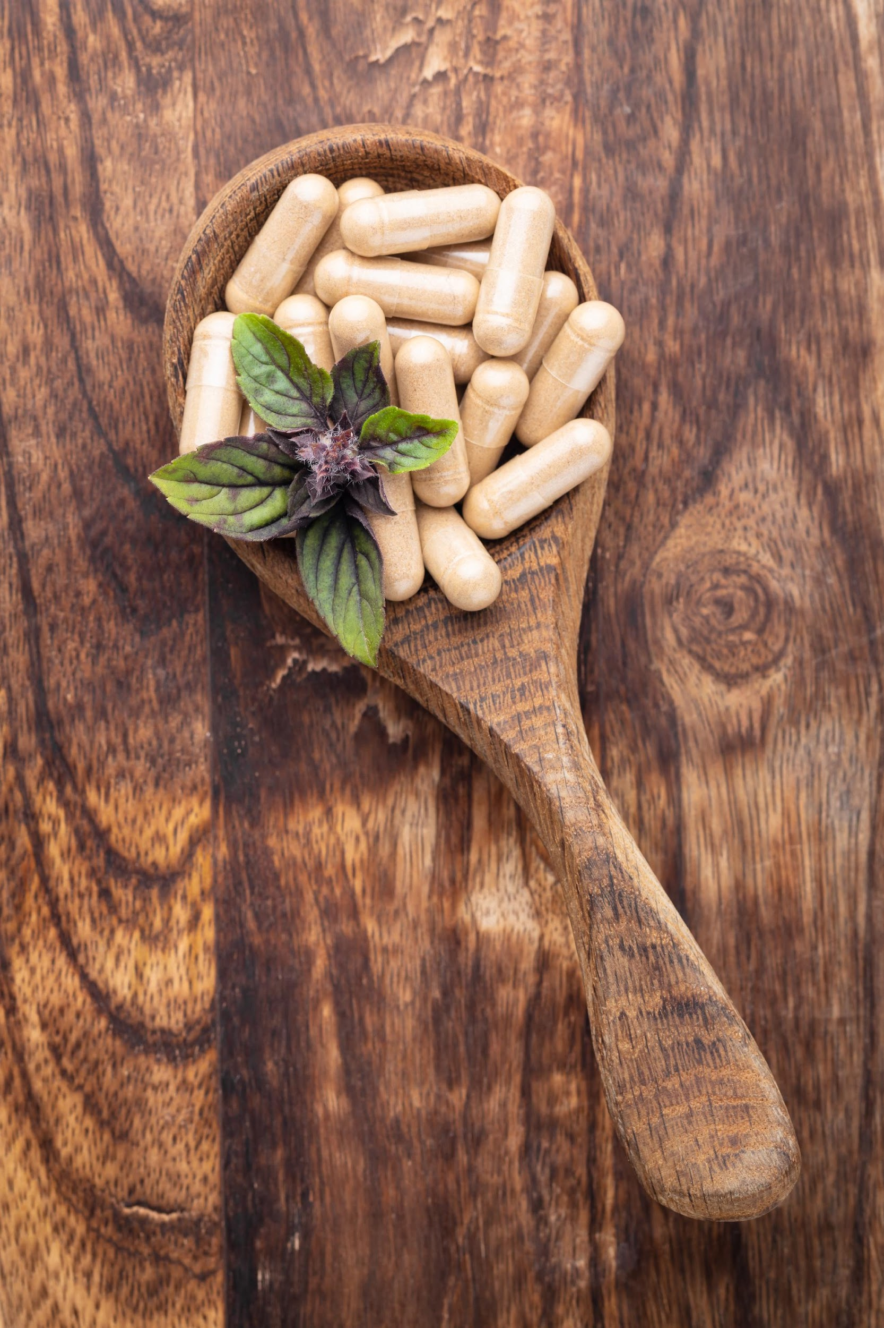
FAMILIARITY & REASONS THEY BUY

Slide 42
OVERALL FAMILIARITY INGREDIENT
CATEGORIES: COUNTRY
Key Insights:
Prebiotic users have total familiarity levels above 60% for every supplement surveyed and 90% or more for almost half with several supplements seeing 100% familiarity levels across each respondent country.
Familiarity levels in India are significantly higher, CoQ10 has the lowest response rate there at 78%.
 | All Prebiotic Users | US | UK | DE | IT | KR | AU | IN
Prebiotics | 100% | 100% | 100% | 100% | 100% | 100% | 100% | 100%
Vitamin C | 100% | 100% | 100% | 100% | 100% | 100% | 100% | 100%
Multivitamin | 99% | 99% | 100% | 100% | 100% | 100% | 99% | 99%
Vitamin D | 99% | 99% | 99% | 100% | 99% | 99% | 98% | 100%
Calcium | 99% | 99% | 99% | 99% | 100% | 99% | 100% | 100%
Iron | 99% | 99% | 100% | 99% | 100% | 98% | 100% | 100%
Omega-3s | 99% | 98% | 99% | 100% | 99% | 99% | 99% | 100%
Magnesium | 99% | 98% | 99% | 100% | 99% | 99% | 98% | 99%
Probiotics | 99% | 99% | 99% | 98% | 99% | 99% | 99% | 99%
Antioxidants | 98% | 98% | 99% | 95% | 99% | 97% | 98% | 98%
Protein Powder | 97% | 97% | 98% | 98% | 92% | 97% | 97% | 99%
Collagen | 97% | 96% | 97% | 94% | 97% | 100% | 98% | 95%
Curcumin/ Turmeric | 96% | 96% | 96% | 96% | 97% | 94% | 94% | 99%
Melatonin | 95% | 98% | 92% | 96% | 99% | 94% | 91% | 94%
Glucosamine | 91% | 92% | 93% | 83% | 83% | 98% | 91% | 95%
Biotin | 90% | 95% | 83% | 93% | 81% | 93% | 73% | 96%
Vitamin K2 | 89% | 90% | 88% | 91% | 89% | 82% | 82% | 96%
Mushrooms | 84% | 88% | 84% | 70% | 73% | 78% | 84% | 97%
Postbiotics | 83% | 84% | 82% | 77% | 69% | 88% | 75% | 93%
Lutein | 80% | 78% | 67% | 77% | 74% | 98% | 55% | 90%
CBD | 79% | 95% | 88% | 87% | 73% | 55% | 65% | 83%
Glutathione | 76% | 72% | 70% | 68% | 72% | 88% | 55% | 89%
Synbiotics | 74% | 71% | 75% | 71% | 60% | 83% | 54% | 91%
CoQ10 | 73% | 80% | 70% | 80% | 63% | 71% | 59% | 78%
Choline | 70% | 75% | 70% | 67% | 60% | 66% | 54% | 87%
MSM | 70% | 69% | 71% | 68% | 56% | 76% | 53% | 86%
Ashwagandha | 68% | 74% | 58% | 72% | 42% | 53% | 55% | 99%
Astaxanthin | 68% | 62% | 61% | 66% | 54% | 88% | 42% | 84%
Alpha-GPC | 66% | 66% | 70% | 60% | 55% | 64% | 44% | 88%
Citicoline | 63% | 64% | 63% | 61% | 57% | 56% | 42% | 85%
Nootropics | 62% | 64% | 61% | 57% | 48% | 60% | 50% | 80%
Note: All Prebiotic Users n=1972, US n=474, UK n=168, DE n=203, IT n=247, KR n=316, AU n=197, IN n=367. Question: “How familiar would you consider yourself regarding the use of these supplements?” Sum of all responses except “Never heard of it”

Slide 43
OVERALL FAMILIARITY INGREDIENT
CATEGORIES: COUNTRY
Key Insight:
In the chart display, we see additional points: a spike for several ingredients in India and South Korea are most noticeable.
Note: US n=474, UK n=168, DE n=203, IT n=247, KR n=316, AU n=197, IN n=367, All Respondents n=4198. Question: “How familiar would you consider yourself regarding the use of these supplements?” Sum of all responses except “Never heard of it”

Slide 44
FAMILIARITY: ALL USERS
Key Insight:
For all supplement users, prebiotic familiarity is in the middle of the pack, sitting at 13% top familiarity and 35% top-2.
Note: All Respondents n=4198. Question: “How familiar would you consider yourself regarding the use of these supplements?”

Slide 45
FAMILIARITY: PREBIOTIC USERS
Key Insights:
Top-2 responses from prebiotic users are generally higher than responses from general supplement users.
Prebiotic familiarity levels are high, 24% top and 58% top-2/
Note: All Prebiotic Users n=1972. Question: “How familiar would you consider yourself regarding the use of these supplements?”

Slide 46
FAMILIARITY: US
Key Insight:
Prebiotic familiarity sits at 26% top and 64% top-2, some of the highest among prebiotic users.
Note: US n=474. Question: “How familiar would you consider yourself regarding the use of these supplements?”

Slide 47
FAMILIARITY: UK
Key Insights:
While responses for the popular supplements like vitamins D and C are high, top-2 responses in the UK are slightly lower compared to the US.
Prebiotics sit at 21% top and 51% top-2.
Note: UK n=168. Question: “How familiar would you consider yourself regarding the use of these supplements?”

Slide 48
FAMILIARITY: DE
Key Insight:
In Germany, prebiotic familiarity sits is relatively low, 18% top and just 47% top-2.
Note: DE n=203. Question: “How familiar would you consider yourself regarding the use of these supplements?”

Slide 49
FAMILIARITY: IT
Key Insights:
Italian top familiarity responses, like those from the UK are relatively low.
Prebiotic familiarity is 26% top and 56% top-2.
Note: IT n=247. Question: “How familiar would you consider yourself regarding the use of these supplements?”

Slide 50
FAMILIARITY: KR
Key Insights:
Korean responses show relatively low top familiarity levels, but also some of the lowest responses for minimally familiar.
Prebiotics are 23% top and 57% top-2.
Note: KR n=316. Question: “How familiar would you consider yourself regarding the use of these supplements?”

Slide 51
FAMILIARITY: AU
Key Insights:
Australians have some of the largest response rates for “Never heard of it”, and lowest top familiarity responses.
Prebiotics sit at 22% top and 53% top-2.
Note: AU n=197. Question: “How familiar would you consider yourself regarding the use of these supplements?”

Slide 52
FAMILIARITY: IN
Key Insights:
Top-2 responses in India are significantly higher than in any other country, with all supplements having 20%+ top response and most over 30%, and the top supplements seeing top-2 responses above 80%.
Prebiotics sit at 25% top and 63% top-2.
Note: IN n=367. Question: “How familiar would you consider yourself regarding the use of these supplements?”

Slide 53
PERCEIVED EFFECTIVENESS: COUNTRY
Key Insights:
As with familiarity, Indian respondents significantly over-index for most of the supplements surveyed, especially for those herbs of Indian origin.
US responses are also quite high.
Note: n varies. Question: “What is your opinion of the effectiveness/benefit of each of these supplements?” Sum of top 2 responses marked “I trust that it is effective, and I have experienced its benefits” and “I trust that it is effective, but I haven't experienced benefits”

Slide 54
PERCEIVED EFFECTIVENESS: ALL USERS
Key Insights:
Top 2 responses for each ingredient are all over 40%; Lutein sits at 74% top-2.
The two not effective responses have by far the lowest response rates across the board with no single response for “I know it’s not effective” above 4%.
Note: n varies. Question: “What is your opinion of the effectiveness/benefit of each of these supplements?”

Slide 55
PERCEIVED EFFECTIVENESS: US
Key Insights:
US respondents have almost all supplements over 60% top-2
Prebiotics rank 9th in terms of top response at 47% and 7th top-2 at 81%.
Note: n varies. Question: “What is your opinion of the effectiveness/benefit of each of these supplements?”

Slide 56
PERCEIVED EFFECTIVENESS: UK
Key Insight:
Prebiotics are 9th top response in the UK at 40%, also 9th top-2 at 79%.
Note: n varies. Question: “What is your opinion of the effectiveness/benefit of each of these supplements?”

Slide 57
PERCEIVED EFFECTIVENESS: DE
Key Insight:
Top responses for prebiotics fall in Germany, sitting outside the top 10 at 27% top response and 70% top-2.
Note: n varies. Question: “What is your opinion of the effectiveness/benefit of each of these supplements?”

Slide 58
PERCEIVED EFFECTIVENESS: IT
Key Insights:
We see a strong top grouping in Italy, with a sharp drop off in responses after prebiotics.
Prebiotic responses are at 43% top and 76% top-2.
Note: n varies. Question: “What is your opinion of the effectiveness/benefit of each of these supplements?”

Slide 59
PERCEIVED EFFECTIVENESS: KR
Key Insights:
As with familiarity, Korean responses are more in the middle ground, with relatively low top and bottom responses.
Prebiotics are 7th at 30% top response and 58% top-2.
Note: n varies. Question: “What is your opinion of the effectiveness/benefit of each of these supplements?”

Slide 60
PERCEIVED EFFECTIVENESS: AU
Key Insight:
Prebiotics are top 10 in Australia, 38% top response and 72% top-2 response.
Note: n varies. Question: “What is your opinion of the effectiveness/benefit of each of these supplements?”

Slide 61
PERCEIVED EFFECTIVENESS: IN
Key Insights:
As with familiarity, Indian respondents have by far the highest response rates for this question with top-2 responses for all supplements over 60% and many over 80%.
Prebiotic responses are middle of the pack for India, but high overall at 44% top and 81% top-2.
Note: n varies. Question: “What is your opinion of the effectiveness/benefit of each of these supplements?”

Slide 62
ATTRIBUTES INFLUENCING PURCHASE
Key Insights:
Italian and Indian respondents noticeably over-index for a recommendation from a health care professional.
We see over-indexing for proof of safety and containing branded ingredients from South Korea.
Note: US n=474, UK n=168, DE n=203, IT n=247, KR n=316, AU n=197, IN n=367, All Respondents n=4198. Question: “What are the most important attributes you look for when purchasing supplements?”

Slide 63
QUALITY, SAFETY AND REGULATION
CONCERN: COUNTRY
Key Insight:
Major concern tends to be the top response in each category with only a few exceptions, mostly among German respondents.
Note: US n=474, UK n=168, DE n=203, IT n=247, KR n=316, AU n=197, IN n=367. Question: “Please rate your level of concern surrounding these areas related to the quality, safety and regulation of dietary supplements:”

Slide 64

SHOPPING BEHAVIOR

Slide 65
SUPPLEMENT SPEND: COUNTRY
Key Insights:
UK respondents are spending less than any other respondent group with most of their responses coming in the under $30 spending ranges.
US, Korean and Indian respondents tend to have the high response rates in the higher spending ranges.
Note: US n=474, UK n=168, DE n=203, IT n=247, KR n=316, AU n=197, IN n=367, All Respondents n=4198. Question: “On average, how much do you spend monthly on vitamins, minerals, herbals, or other dietary supplements for just yourself?”

Slide 66
MONTHLY SUPPLEMENT SPEND: COUNTRY
Key Insights:
Indian respondents consistently have the highest spend per supplement with most seeing spending around $25/month. Prebiotic pend follows this pattern.
US, South Korean and Australian respondents tend to have the next highest dollar amounts.
Prebiotic spending falls in the bottom quarter for most countries.
Note: n varies. Question: “Approximately how much per month do you spend for yourself on EACH of these supplements?” Dollar value is an approximation based on spending ranges.

Slide 67
PURCHASE LOCATION: COUNTRY
Key Insight:
Online is the number one purchase location for all but those in the UK and Australia. The UK marks natural/health food stores number one and Australia marks mass market retailer number one.
Note: US n=474, UK n=168, DE n=203, IT n=247, KR n=316, AU n=197, IN n=367, All Respondents n=4198. Question: “Where do you primarily purchase your vitamins, minerals, herbals & other dietary supplements?”

Slide 68
PREFERRED FORMAT: COUNTRY
Key Insights:
Either tablet or pill is the top response from each country, the former exceptionally strong in both Australia and India.
Indian respondents over-index for powder, liquid and vegetarian capsule.
Gummy format is heavily driven by the US.
Note: US n=474, UK n=168, DE n=203, IT n=247, KR n=316, AU n=197, IN n=367, All Respondents n=4198. Question: “In which format do you prefer your supplements?”

Slide 69
FORMAT CHARACTERISTICS: COUNTRY
Key Insights:
Easy to swallow is the number one response for all groups, particularly in the UK and Australia.
Indian respondents over-index for pleasant taste, combination formulas, multi-pack, single ingredient formulas and bioavailable.
Note: US n=474, UK n=168, DE n=203, IT n=247, KR n=316, AU n=197, IN n=367, All Respondents n=4198. Question: “What do you like about these formats?”

Slide 70
PRIORITIZING SPENDING CUTS:
ESSENTIALITY, COUNTRY
Key Insights:
For all but over the counter medication, Indian respondents over-index significantly, showing the highest essential responses.
Korean respondents come close to matching them for essentiality of core vitamins and minerals (58% compared to 59% from India).
Note: US n=474, UK n=168, DE n=203, IT n=247, KR n=316, AU n=197, IN n=367, All Respondents n=4198. Question: “If you had to cut household spending, how would you prioritize your cuts?” Percentage of responses marked “Essential”

Slide 71
PRIORITIZING SPENDING CUTS: US
Key Insights:
Core vitamins and minerals have the largest essential response, as well as the lowest response for non-essential.
Mental health support has the most extreme responses with high essentiality as well as high non-essential with relatively few middle responses..
Note: US n=474. Question: “If you had to cut household spending, how would you prioritize your cuts?”

Slide 72
PRIORITIZING SPENDING CUTS: UK
Key Insight:
UK responses see mental health support fall being specialty supplements in terms of essentiality.
Note: UK n=168. Question: “If you had to cut household spending, how would you prioritize your cuts?”

Slide 73
PRIORITIZING SPENDING CUTS: DE
Key Insight:
German respondents are the only group to not have core supplements as their top essential response; in this case it is actually specialty supplements.
Note: DE n=203. Question: “If you had to cut household spending, how would you prioritize your cuts?”

Slide 74
PRIORITIZING SPENDING CUTS: IT
Key Insight:
Like in the US, Italian respondents have a high regard for mental health support, marking it second behind just core supplements and more essential than specialty supplements.
Note: IT n=247. Question: “If you had to cut household spending, how would you prioritize your cuts?”

Slide 75
PRIORITIZING SPENDING CUTS: KR
Key Insight:
The Korean essential response for core supplements is particularly high at 58%.
Note: KR n=316. Question: “If you had to cut household spending, how would you prioritize your cuts?”

Slide 76
PRIORITIZING SPENDING CUTS: AU
Key Insight:
Australian respondents are the only group to not rank any category above 40% for essentiality, with only core supplements and over the counter medication over 30%.
Note: AU n=197. Question: “If you had to cut household spending, how would you prioritize your cuts?”

Slide 77
PRIORITIZING SPENDING CUTS: IN
Key Insight:
Indian essential responses are the highest of this group and they have by far the highest essential responses for the purchase of natural/organic foods at 57%.
Note: IN n=367. Question: “If you had to cut household spending, how would you prioritize your cuts?”

Slide 78
SOURCE OF INGREDIENT INFORMATION:
COUNTRY
Key Insights:
A general web search is the number one response in the US, Germany and South Korea; a health care professional is the number one response for Italian, Australian and Indian respondents while those in the UK have brand website.
India also over-indexes for each category response.
Note: US n=474, UK n=168, DE n=203, IT n=247, KR n=316, AU n=197, IN n=367, All Respondents n=4198. Question: “When considering supplements to purchase, where do you go for ingredient information?”

Slide 79
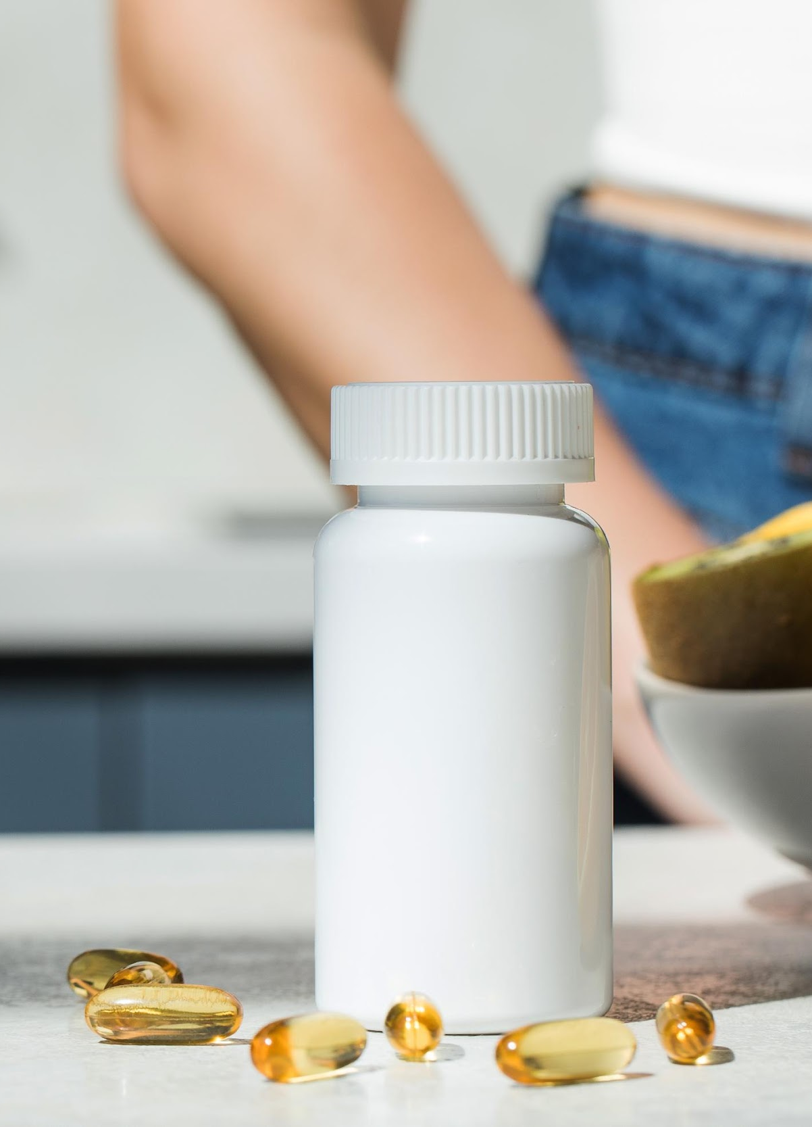
BRANDED INGREDIENTS

Slide 80
BRANDED INGREDIENTS: COUNTRY
Key Insights:
Indian respondents massively over-index for always looking for branded ingredients; their 62% for that response is almost 30% higher than the next group (US at 38%, who also mark that response as their top).
All other countries have “I appreciate branded ingredients when I find them” as their top response (each hovering around 30-40%).
As in last year's survey, respondents, in order to access this section, had to go a screening in which they were asked to note the label or site that did not contain a branded ingredient. The number of survey respondents that “passed” this screening is located in the footer, typically sitting at between 60% and 75% of users.
Note: US n=308, UK n=113, DE n=109, IT n=181, KR n=184, AU n=138, IN n=293, All Respondents n=2863. Question: “When deciding which supplements to purchase, how important is the inclusion of branded or proprietary ingredients?”

Slide 81
BRANDED INGREDIENT
VALUE PROPOSITION: COUNTRY
Key Insights:
India over-indexed for all branded ingredient categories, in some cases by more than 30%, confirming that they are putting more weight into branded ingredients when looking to buy supplements, at least, according to this survey.
There is a noticeable drop off in responses from each country past efficacy/efficacious dose as a contributing aspect of the branded ingredient proposition.
Note: US n=308, UK n=113, DE n=109, IT n=181, KR n=184, AU n=138, IN n=293, All Respondents n=2863. Question: “When deciding which supplements to purchase, how important are the following qualities/values related to any branded ingredient?” Percentage of responses marked “Extremely Important”

Slide 82
BRANDED INGREDIENT PRICE PREMIUM:
COUNTRY
Key Insights:
US and most significantly Indian respondents over-index for each category with Korean responses close behind.
Quality ranks as the top premium element in all countries.
Note: US n=308, UK n=113, DE n=109, IT n=181, KR n=184, AU n=138, IN n=293, All Respondents n=2863. Question: “When deciding which supplements to purchase, how much of a premium would you be willing to pay for the inclusion of a BRANDED INGREDIENT with the following features (versus the cheapest option available)?” Sum of top two responses marked “11% to 20% premium” and “More than 20% premium”

Slide 83
BRANDED INGREDIENT PRICE PREMIUM
Key Insights:
Quality is the number one characteristic no matter how you look at these responses.
Trust has high responses for the higher premium ranges but also has a relatively high no premium response.
Note: All Prebiotic Users n=1326. Question: “When deciding which supplements to purchase, how much of a premium would you be willing to pay for the inclusion of a BRANDED INGREDIENT with the following features (versus the cheapest option available)?”

Slide 84
BRANDED INGREDIENT PRICE PREMIUM: US
Key Insight:
Top 2 responses are high in the US with most categories receiving top 2 responses above 30% willing to pay at least a 10% premium for the feature.
Note: US n=308. Question: “When deciding which supplements to purchase, how much of a premium would you be willing to pay for the inclusion of a BRANDED INGREDIENT with the following features (versus the cheapest option available)?”

Slide 85
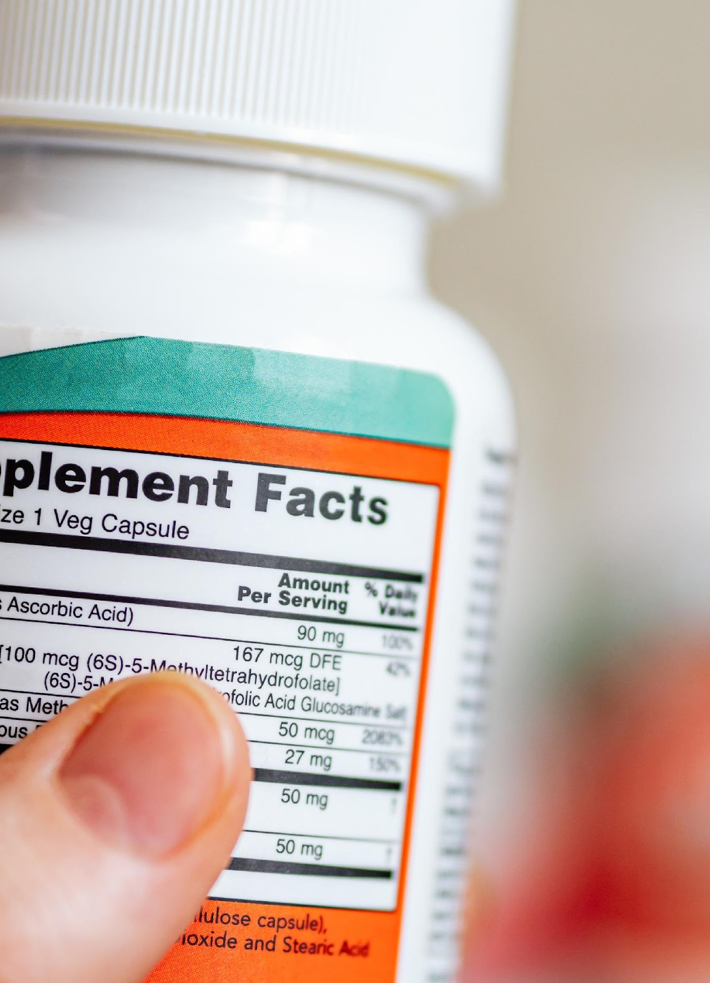
VALUES
Trust, Transparency & Sustainability

Slide 86
TRUST: COUNTRY
Key Insights:
A recommendation from a health care professional is the top trust driver from all countries apart from Germany who mark clinical research on the ingredient number one.
Korean and Indian respondents over-index for contains branded ingredients, consistent with other responses on that topic.
Note: US n=474, UK n=168, DE n=203, IT n=247, KR n=316, AU n=197, IN n=367, All Respondents n=4198. Question: “What characteristics most encourage you to trust a supplement brand?”

Slide 87
TRANSPARENCY PURCHASE INFLUENCE:
COUNTRY
Key Insights:
Most responses come in for the two responses marking transparency positively influencing a purchase decision.
US and Indian respondents over-index for greatly, South Korea less so.
Note: US n=474, UK n=168, DE n=203, IT n=247, KR n=316, AU n=197, IN n=367, All Respondents n=4198. Question: “How likely are you to purchase supplements from a manufacturer that provides transparency information on its label or website?”

Slide 88
SIGNALS OF BRAND TRANSPARENCY:
COUNTRY
Key Insights:
'Detailed ingredient information is readily available' is the top response from each respondent country, especially the UK.
Indian respondents significantly over-index for most categories.
Note: US n=474, UK n=168, DE n=203, IT n=247, KR n=316, AU n=197, IN n=367, All Respondents n=4198. Question: “Which of the following items are the strongest signals that a supplement brand is operating transparently?”

Slide 89
SUSTAINABILITY: COUNTRY
Key Insight:
Most responses for sustainability importance are in sometimes and frequently but Indian respondents significantly over-index for always, their 43% is nearly 20% higher than the next closest response (US at 26%).
Note: US n=474, UK n=168, DE n=203, IT n=247, KR n=316, AU n=197, IN n=367, All Respondents n=4198. Question: “When deciding which supplements to purchase, to what degree does the sustainability/environmental impact of a supplement ingredient influence your purchasing decision?”

Slide 90
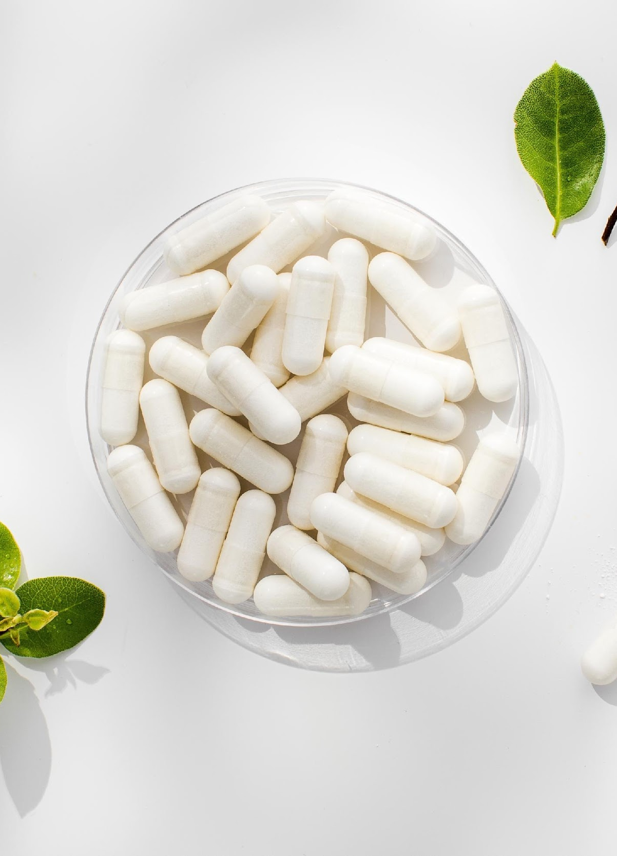
PREBIOTIC:
DEEP DIVE

Slide 91
WHY THEY TAKE PREBIOTICS: COUNTRY
Key Insights:
Gut health/digestion and immunity health are the top two responses by a decent margin, the former being the top response from all but Indian respondents who instead mark immunity number one.
Indian respondents, as seen with most survey questions, tend to have some of the highest response rates.
Note: US n=474, UK n=168, DE n=203, IT n=247, KR n=316, AU n=197, IN n=367. Question: “Why do you take a prebiotic supplement?”

Slide 92
IMPORTANT LABEL CHARACTERISTICS:
COUNTRY
Key Insights
Responses are varied with a noticeable top 4 or 5 and as usual, Indian respondents over-indexing across the board.
The top response is from Korean respondents for specific activity or action on gut microbiota at 40%; that is also the top response from Italy.
Note: US n=474, UK n=168, DE n=203, IT n=247, KR n=316, AU n=197, IN n=367. Question: “When you select what prebiotic to purchase, what characteristics do you look for on the label?”

Slide 93
PREFERRED PREBIOTIC FORMATS: COUNTRY
Key Insights:
Pill and capsules are the top two preferred formats by a decent margin.
Gummy is mostly a US format.
Indian respondents over-index for both beverage and powder, the latter sees the over-indexing from South Korea as well.
Note: US n=474, UK n=168, DE n=203, IT n=247, KR n=316, AU n=197, IN n=367. Question: “How do you prefer to consume your prebiotics?”

Slide 94
PREBIOTIC USAGE DRIVERS: COUNTRY
Key Insight:
We have a clear top 3 here with one of either, a recommendation from a health care professional, more information on benefits or more scientific research proving those benefits being the top response from each respondent country.
Note: US n=474, UK n=168, DE n=203, IT n=247, KR n=316, AU n=197, IN n=367. Question: “What would encourage you to start using or to increase your use of prebiotics?”

Slide 95
SOURCE OF PREBIOTIC KNOWLEDGE:
COUNTRY
Key Insights:
A health care professional is the number one response for all but the UK (online research on health conditions) and South Korea (health TV show).
As with most other areas in this survey, Indian respondents over-index almost across the board.
Note: US n=474, UK n=168, DE n=203, IT n=247, KR n=316, AU n=197, IN n=367. Question: “How did you learn about prebiotics?”

Slide 96
PREBIOTIC BRANDED INGREDIENT
FAMILIARITY: COUNTRY
Key Insight:
According to survey responses, Indian respondents have by far the highest familiarity levels, US and Korean respondents tend to have the higher levels among the rest of the respondent countries.
Note: US n=308, UK n=113, DE n=109, IT n=181, KR n=184, AU n=138, IN n=293. Question: “How familiar would you consider yourself regarding the use of these prebiotic branded ingredients?” Sum of all responses except “Never heard of it”

Slide 97
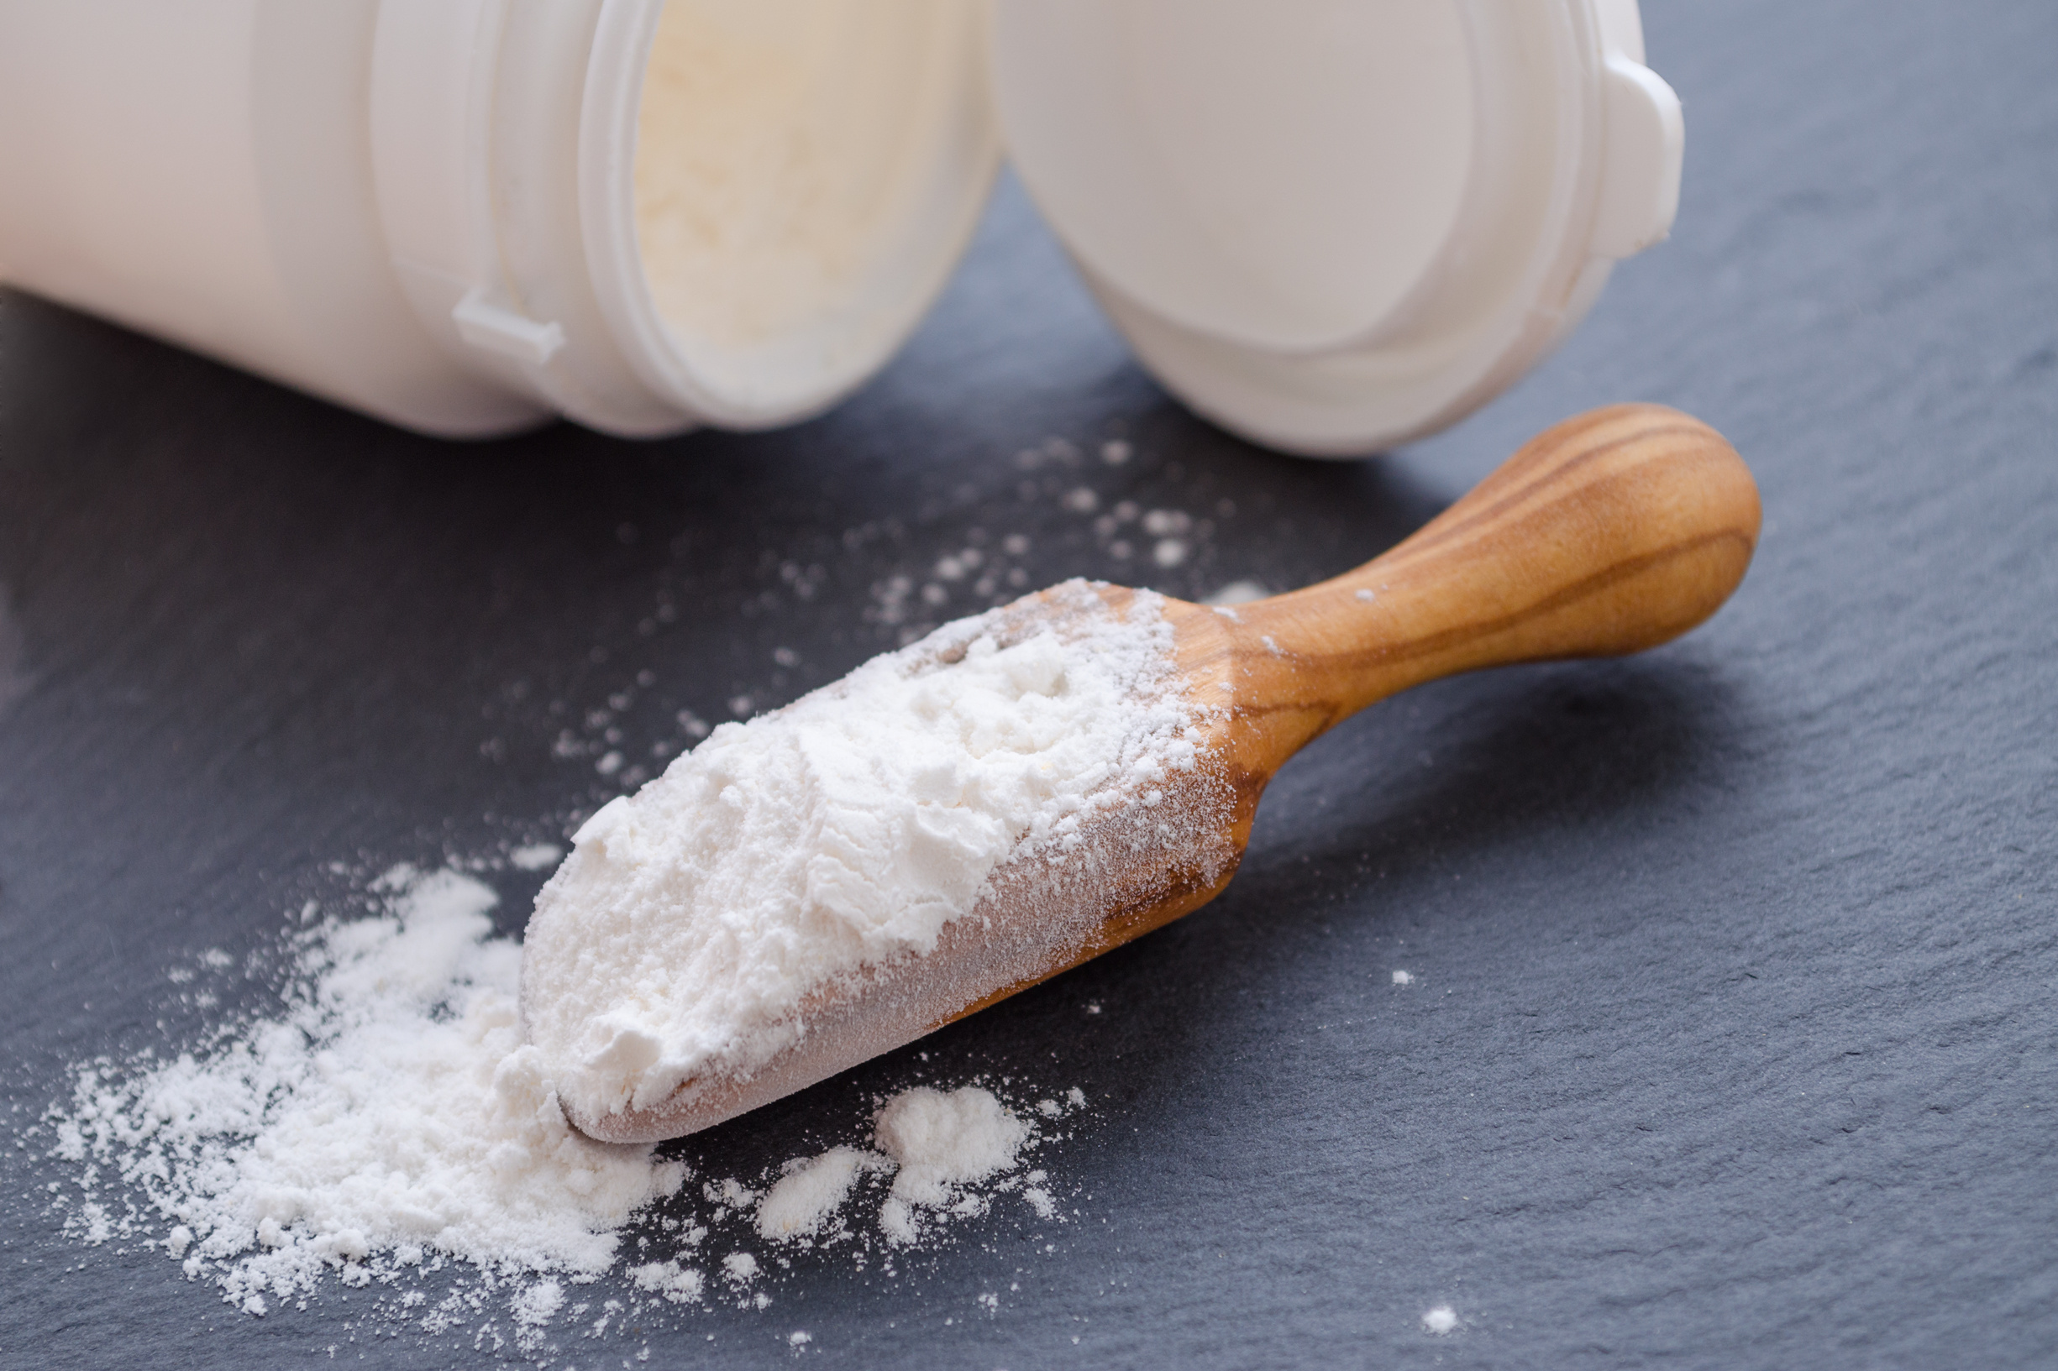
QUESTIONS?
+1 (303) 746-9555
len@itcstrategy.com
itcstrategy.com
#itcinsights
#itcinsights

Slide 98

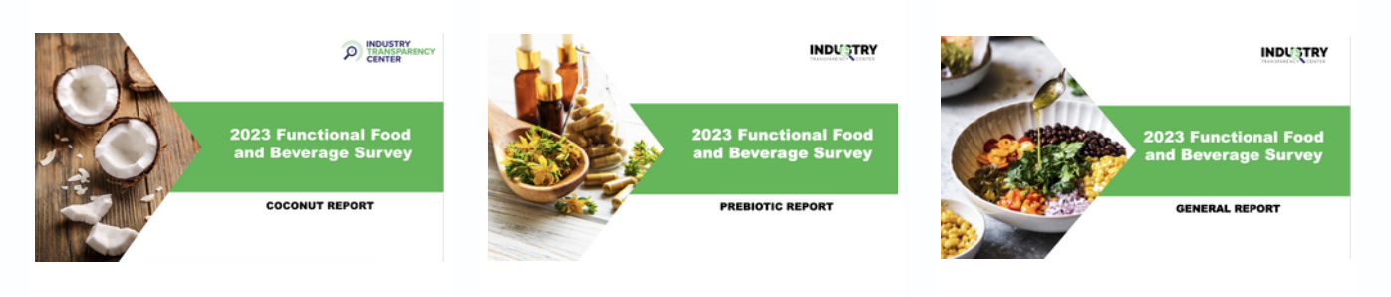

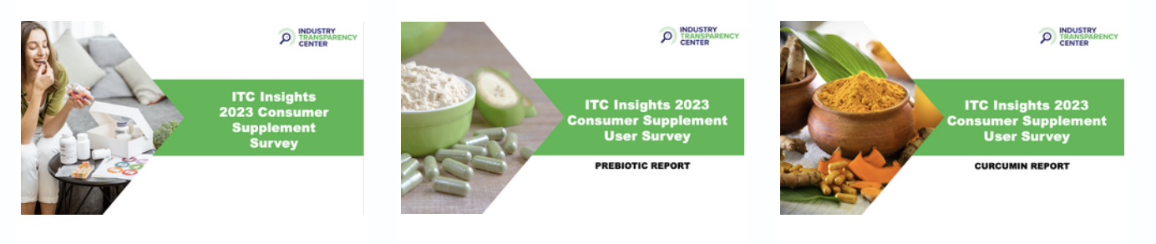
UNLOCK THE POWER OF
OUR DATA-DRIVEN INSIGHTS TODAY!
Visit our data-driven insights page to discover
actionable knowledge that can transform your decision-making.

