Slide 1
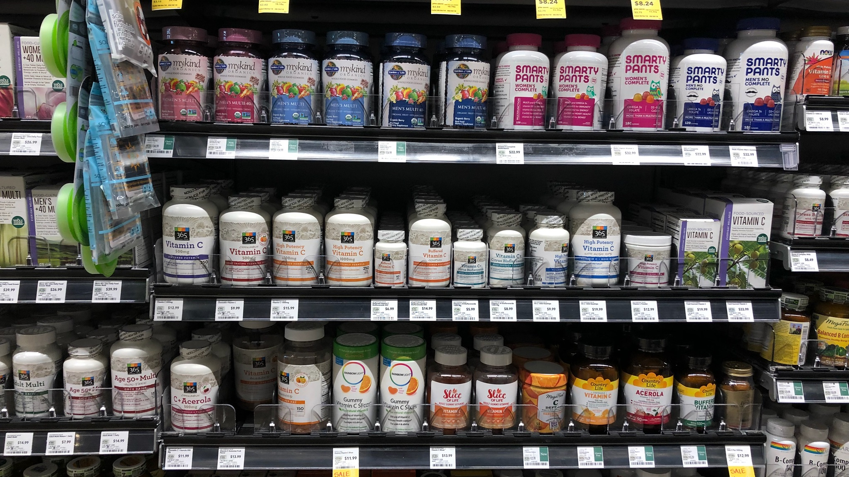
ITC INSIGHTS:
SUPPLEMENT
CONSUMER
SURVEY 2020
PREBIOTIC CATEGORY
ENHANCED REPORT

Slide 2

What is the ITC 2020 Survey?
Ingredient Transparency Center recently concluded its third annual consumer survey, involving 2000 consumers from the US, UK and Germany. Our multi-category insights drive understanding of supplement purchasing behaviors and decisions with an intense focus on emerging and important categories, placed into context by comparing these against more established and broader categories like probiotics, omega-3s, vitamin D and protein.
The emerging categories explored include astaxanthin, coenzyme Q10, collagen, curcumin/turmeric, glucosamine, prebiotics and vitamin K.
This is the first year that multiple countries have been included in our survey, allowing ITC to present comparisons across the US, UK and Germany in all these categories. We’ve also looked at year over year data in the US though some findings have been impacted by COVID which are noted.
EXECUTIVE
SUMMARY

Slide 3
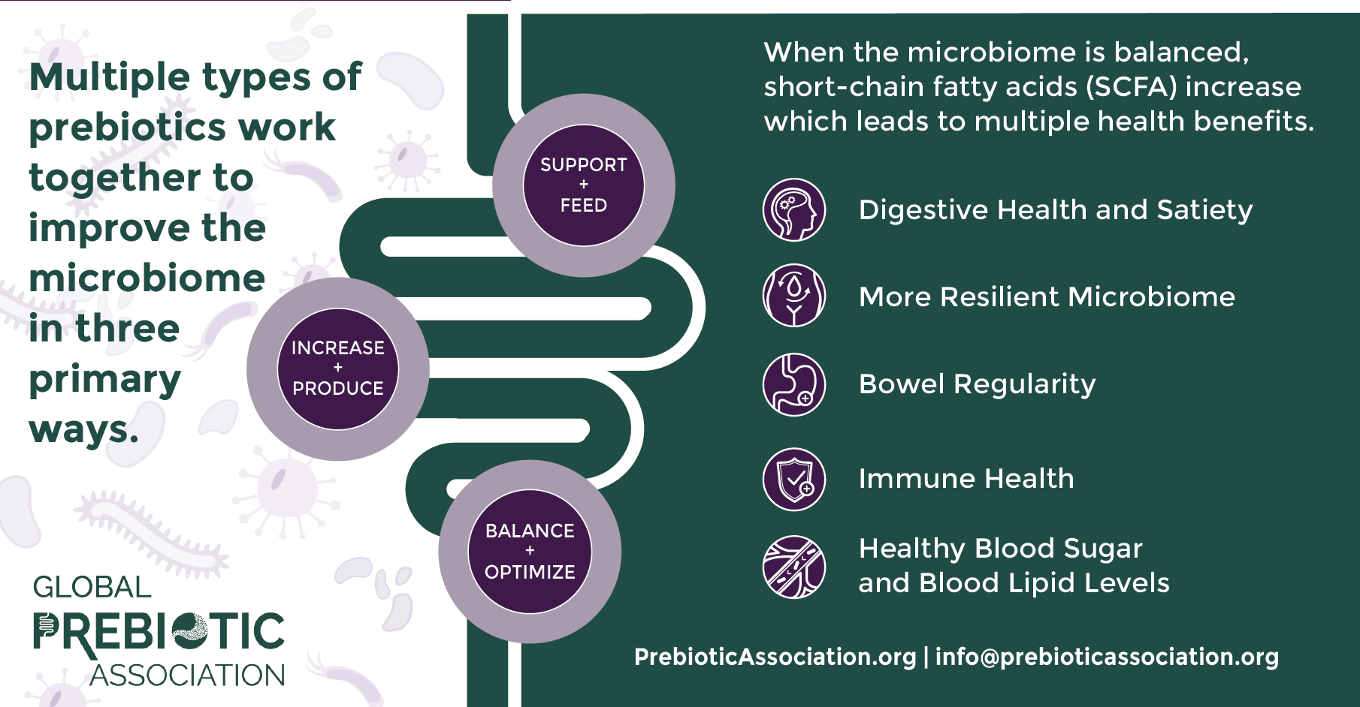
The prebiotic category has seen rapid growth over multiple years moving out of the shadow of probiotics for multiple health conditions and benefits: gut health and digestion; increasingly into overall immunity; and even more in areas such as mood and mental wellness as scientific research expands the prospects.
This acceleration and broadening of perceived and possible health benefits is clearly shown in the insights results as awareness is growing.
In the very early days of the prebiotic category, much of the emphasis was on fiber, with fiber frequently used instead of – or interchangeably with – the term ‘prebiotic’.
Digging into prebiotics:
The Global Prebiotics Association (GPA), ), the non-profit trade association representing the worldwide prebiotics category, defines a prebiotic as a nutritional product or ingredient selected to be utilized in the microbiome producing health benefits.
There are several known mechanisms by which prebiotics act to confer health benefits, with new science allowing us to track what is happening even at receptor level within the microbiome. In simple terms, prebiotics act either chemically or physically, often but not always by interacting with gut microbes and generally serve to: support and feed, increase and produce and balance and optimize – all within the microbiome.
TOP 5 BENEFITS

Slide 4
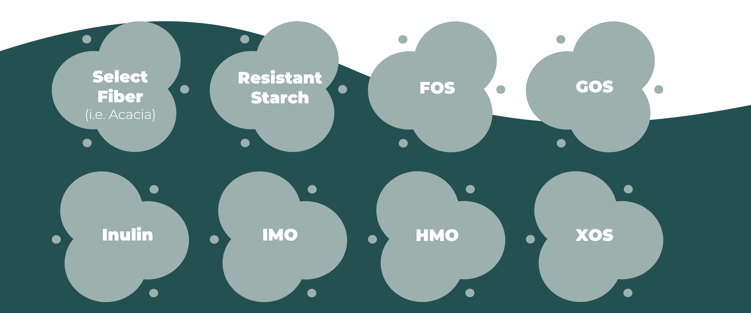
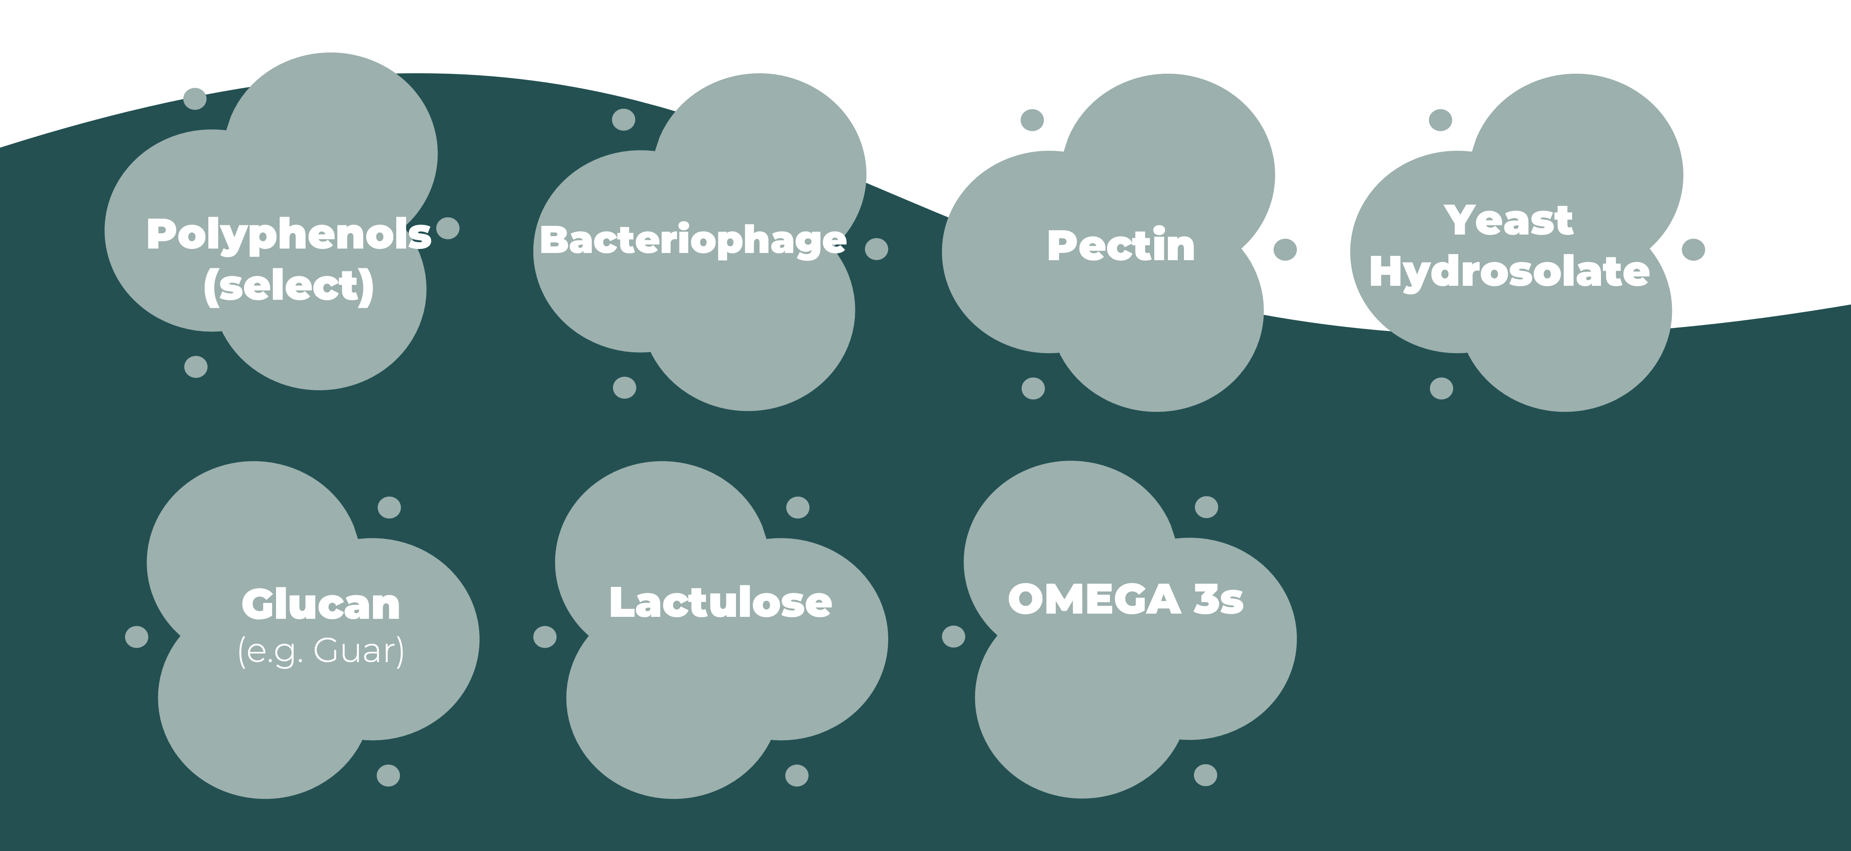
PREBIOTIC TYPES
Consumers in all three countries surveyed (US, UK and Germany) are increasingly knowledgeable and discerning – illustrated by what they look for when buying prebiotic products.
This matches ITCs analysis of the marketplace, as product developers look to formulate with multiple prebiotic sources and new or emerging prebiotic ingredients like (XOS) xylo-oligosaccharides, pectin oligosaccharides, acacia fiber, arabinoxylan and beta-glucans , while the science base has broadened for well-documented ingredients such as resistant starch.
Most common
What Prebiotic Consumers Look For
Look that it is labelled as a prebiotic | 39%
Look for a probiotic/prebiotic combination | 31%
Look for fiber | 30%
In the very early days of the prebiotic category, much of the emphasis was on fiber, with fiber frequently used instead of – or interchangeably with – the term ‘prebiotic’.
However, it is important to note that not all fibers are prebiotic – and there are many more food constituents shown to exhibit prebiotic activity than simple fiber sources.
While it remains true that many prebiotics are fibers, other prebiotic ingredients such as selected polyphenols and bacteriophages have been shown to be effective at relatively low doses, meaning product developers can more effectively create products in multiple delivery formats, including traditional dietary supplements formats such as tablets and capsules as well as functional foods and beverages. These lower dosages can also help to overcome the negative consequences of higher dose ingredients, whether that be gastric distress or taste issues.
Emerging types
It should be noted, that while current ITC Insights work only surveys supplement consumers, rather than foods and beverage users, many of the findings do translate across all markets of functional food and drinks.
Overall awareness of prebiotics, in addition to what prebiotic consumers look for on product labels – such as a combination of a probiotic with a prebiotic (symbiotic) – clearly gives insights into broader consumer understanding and marketing tactics.

Slide 5
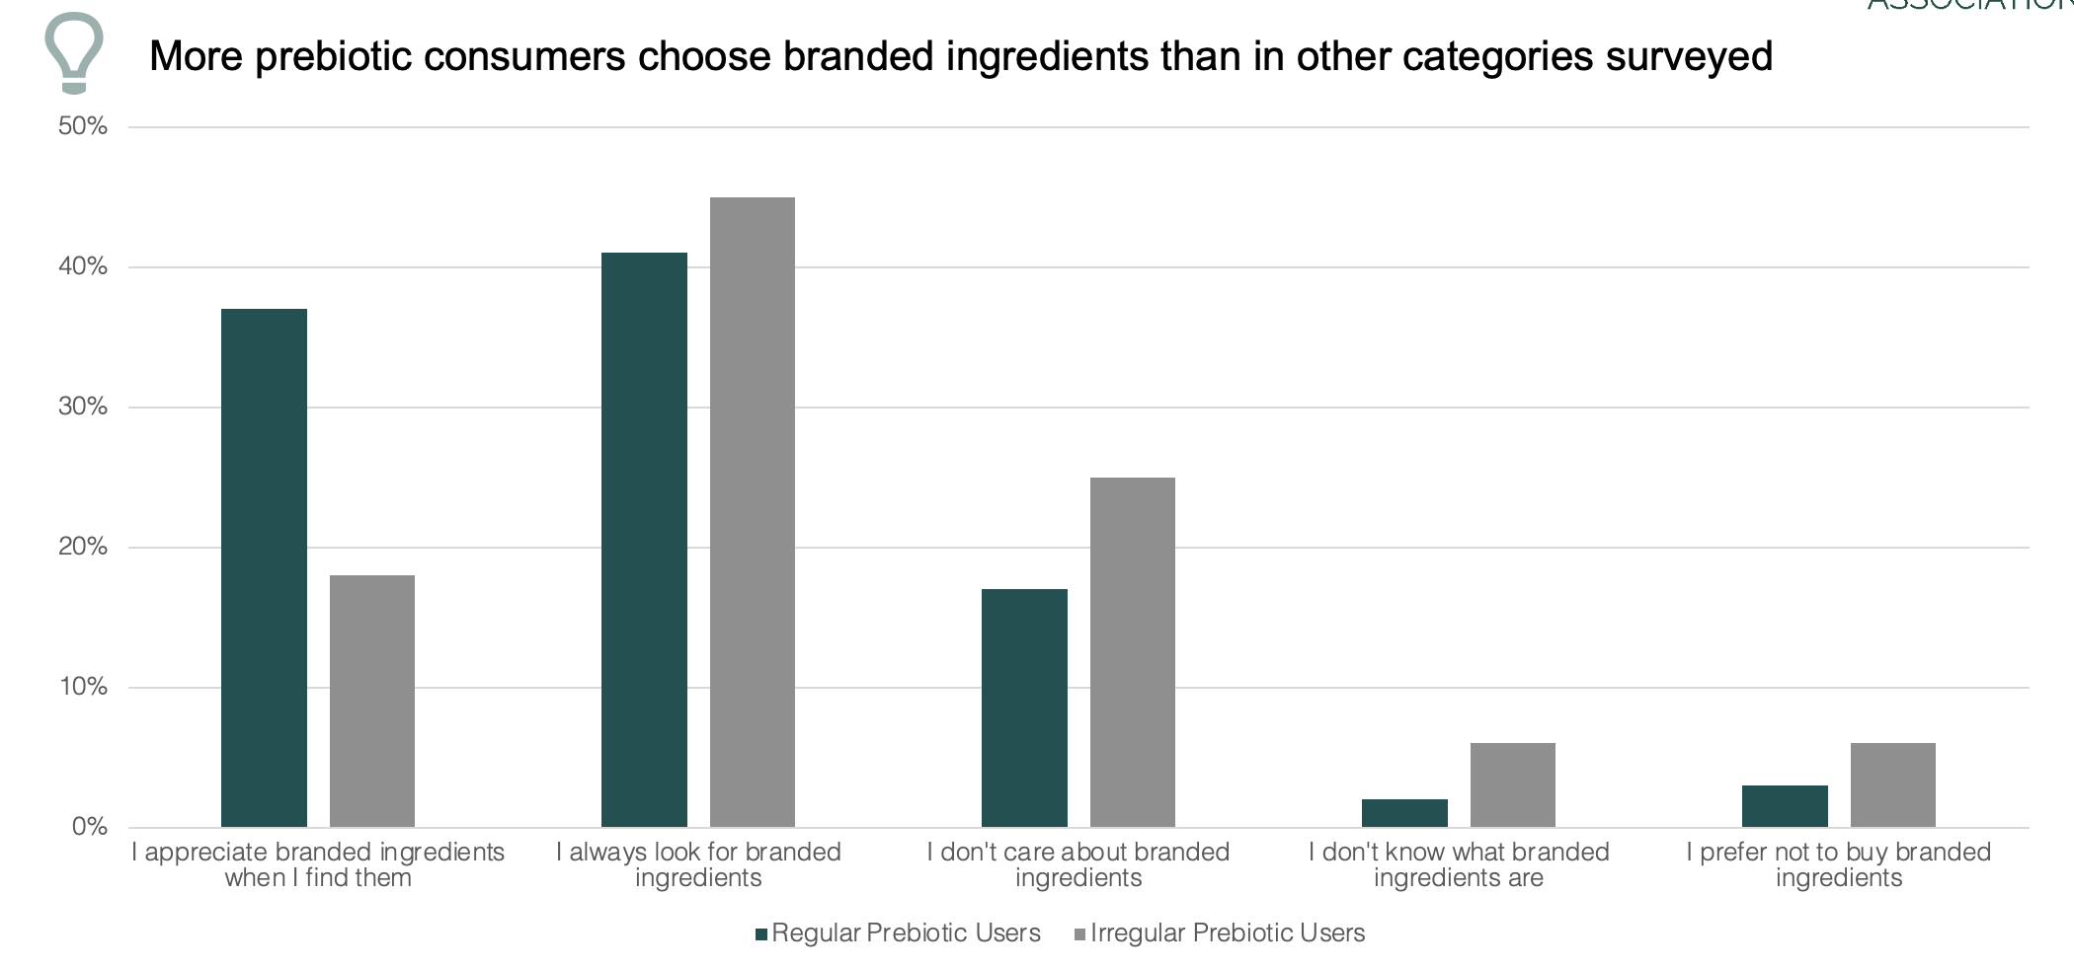
A growing value proposition
Across the natural products industry, core consumer ‘values’ drive much of their behavior and prebiotics are a perfect example – they can provide a food-based clean label functional or even multi-functional component such as ‘gut health’ along with moderate sweetening. Prebiotics also benefit from a gluten-free proposition, and can be a substitute for yeast.
Compared to other categories monitored by ITC Insights, prebiotic users also over-index on monthly spend and are more interested in sustainable solutions and offerings from their brands. Prebiotic users also pay more attention to labels than most other consumers, seeking signals of trust and identifiers of transparency.
In particular, the high interest of prebiotic users in sustainable solutions and transparent supply chains can be of benefit to brands and suppliers who may be able to use story-telling around strong supply chains and sustainable sources, given for example that many prebiotics are developed out of agricultural by-product streams.
Lastly, branded ingredients also
impact the buying behaviors of
these supplement consumers,
with a strong recognition and
appreciation of branded ingredients
in the prebiotic space.
Emerging microbiome research is revealing roles for prebiotics in satiety, sleep, stress, inflammation and even new gut function mechanisms of action are coming to light.
This new research offers potential for product development across a variety of formats and for numerous conditions. Terms like the ‘gut-brain axis’ and ‘skin microbiome’ are quickly moving into the public realm, and with them nutrients like prebiotics that can make a difference.
To put market size in context, the current global human-use prebiotics market is worth approximately $3.5bn, according to market estimates, with the US market worth around one third of this. These numbers include fiber-based prebiotics across food, beverages and supplements, of which chicory root-sourced inulin remains the dominant prebiotic and major suppliers like Beneo, Sensus and Galam are all in the midst of output-boosting investments to meet rising demand, including for organic inulin.
The above numbers also include established and emerging ingredients such as alpha-amylase resistant starch, psyllium and other fiber/inulin positioned food-type offerings like fructo-oligosaccharides (FOS), galacto-oligosaaccharides (GOS), human milk oligosaccharide (HMOs), AXOS, chito-oligosaccharides, neoagaro-oligosaccharides, polyphenols and others, for uses in foods, beverages and supplements.
While conversations around fiber remain important in the wider context, it is important to note that a fiber-based, food-centric, market positioning of prebiotic ingredients is increasingly giving way to the use of more specific and specialist terms, in addition to greater use of the term prebiotic itself, and growing conversations around microbiome modulation.
Recent developments in life-stage nutrition have also seen prebiotics become increasingly important in infant and toddler nutrition, as well as in product development for active and aging populations.
Future drivers of the category are expected to include broad education, learned from categories such as omega-3’s, probiotics and even to a certain extent, vitamin D. Meanwhile, the continued rise of synbiotics and holistic ‘microbiome solutions’ and ‘personalization’ all support ongoing category potential.

Slide 6
Overall Supplement User Data
Core Demographics
General Overview
Page 8
Page 12
Shopping Behavior
Drivers
Familiarity
Usage & Spend
Table
Of
contents
Page 25
Page 33
Page 46
Prebiotic Supplement User Data
Prebotic User:
Benefits, Familiarity and Usage
Prebotic User: Demographics
Page 61
Page 67
Prebiotic User:
Trust, Transparency and Sustainability
Prebiotic User:
Shopping Behavior
Page 82
Page 93

Slide 7


ITC INSIGHTS
CONSUMER SURVEY 2020
Fielded June-July 2020
  Fielded online by Dynata
  Analyzed by Ooyen Research & Trust Transparency Center
Surveyed opinions and habits of 2,004 consumers
  USA - 1,000 consumers
  UK - 501 consumers
  Germany (DE) - 503 consumers
General Criteria for Participation
  Supplement users, with sporadic users no more than 7% of sample (vs. the 5% limit in previous years)
  Disqualified poor quality responses and respondents who did not fit survey consumer profile parameters
The information in this presentation is for the recipient only and should not be share in its entirety. You may share components of this survey data with attribution:
Trust Transparency Center ITC Insights – Consumer Survey 2020

Slide 8


CORE DEMOGRAPHICS

Slide 9
GEOGRAPHIC Overview
Northeast
210
Midwest
190
UK
501
Total Respondents: 2,004
West
260
South
340
Germany
503
Total US: 1,000 respondents
ITC Insights – 2020 Consumer Survey

Slide 10
Demographics
GENDER
AGE
INCOME
49%
51%
Even mix of men and women (USA limited to no more than 55% women, while UK 45% women and Germany 50% women fell out naturally from respondent pool)
Adult consumers, with consumers age 66+ no more than 10% of sample (German respondents younger with 28% 35 or younger)
A diverse balance of all income groups. UK & Germany pushing average income lower than in previous years, with 30% under $45,000 per year vs. 23% in USA
*Converted to USD from original national currency

Slide 11
ETHNIC BACKGROUND
Consumers had a diverse ethnic background over the three countries surveyed
US respondents were limited to no more than 70% white to ensure diversity in responses
UK respondents were more diverse, with only 56% white
A lack of diversity in the Germany survey sample required acceptance of 89% white respondents
American Indian option only available in USA, Arab in UK and Germany

Slide 12

CONSUMER SUPPLEMENT DATA:
GENERAL OVERVIEW

Slide 13
Supplement Usage Levels
KEY ITC INSIGHT: Most consuming supplements do so daily
All Respondents
By Country
In Germany, fewer regular supplement users consume daily. While still the most popular, more also take supplements between 1 and 6 times per week
Question: “How often do you take vitamins, minerals, herbs or other dietary supplements?”

Slide 14
HEALTH CONCERNS: BY USAGE LEVEL
KEY ITC INSIGHT: Most are experiencing a variety of health issues
KEY ITC INSIGHT: Regular supplement users are more likely to be suffering from chronic health issues
Question: “Which of the following health conditions impact you currently or have impacted you within the past year?”

Slide 15






Health concerns: BY USAGE LEVEL
Regular
Supplement Users
Joint or other pain
High blood pressure
Insomnia/Sleep problems
All Respondents
Joint or other pain
High blood pressure
Anxiety or stress
KEY ITC INSIGHT: Mental wellbeing, include stress and sleep issues, are leading health concerns for Irregular Users
Irregular Supplement Users
Anxiety or stress
Joint or other pain
Insomnia/Sleep problems
Question: “Which of the following health conditions impact you currently or have impacted you within the past year?”

Slide 16
Health Concerns: BY COUNTRY
Question: “Which of the following health conditions impact you currently or have impacted you within the past year?” All Respondents

Slide 17
Health Concerns: BY COUNTRY
KEY ITC INSIGHTS
Medicalized issues relating to blood pressure and cholesterol dominate US consumer concerns
Concerns about lack of energy and mental well-being are high in the UK
Concerns for joint pain remain high in all three countries, but are top priority in Europe
US Top 3 Health Concerns
High Blood Pressure High Cholesterol Anxiety or Stress & Joint or Other Pain
UK Top 3 Health Concerns
Joint or Other Pain Anxiety or Stress Lack of Energy
Germany Top 3 Health Concerns
Joint or Other Pain Insomnia/ Sleep Problems High Blood Pressure
Question: “Which of the following health conditions impact you currently or have impacted you within the past year?” All Respondents

Slide 18
Health concerns: 2018-2020 (US Data)
Question: “Which of the following health conditions impact you currently or have impacted you within the past year?”

Slide 19
Health attitudes
KEY ITC INSIGHTS
I use/have used vitamins, minerals, herbs or other dietary supplements to help manage my health
I believe that eating good food is important to maintaining good health
I exercise for 30 minutes at least 3 times per week
I am proactive about my health and take steps to lower health risks
I regularly purchase at least some natural & organic foods
20%
They are using supplements & other means to better manage their health
German and UK consumers are much more proactive about managing their health, purchasing natural & organic food, and reading health articles than are USA consumers. The UK consumers are also exercising more
Taking supplements, eating good food, exercising, and being proactive about health are all important to Regular Supplement Users
19%
16%
15%
12%
*Info based on All Respondents

Slide 20
what supplements they take
(Unaided Responses)
KEY ITC INSIGHTS:
While multivitamins are at the top of the UK and US lists as expected, they are under indexed in
B Vitamins top the list in Germany and are high in all three countries
UK consumers are above average users of fish oil and glucosamine
German consumers are above average users of Magnesium
US Top 7 Supplements
Multivitamins | 52.4%
Vitamin D | 28.1%
Vitamin C | 22.5%
B Vitamins | 15.2%
Omegas | 17.6%
Calcium | 10.8%
Probiotics | 7.4%
UK Top 7 Supplements
Multivitamin | 32.7%
Vitamin D | 31.9%
Omegas | 25.9%
B Vitamins | 9.8%
Calcium | 5.2%
Glucosamine | 5.0%
Magnesium | 4.2%
Germany Top 7 Supplements
Magnesium | 31.3%
B Vitamins | 26.2%
Vitamin D | 22.3%
Vitamin C | 20%
Multivitamin | 17.7%
Omegas | 9.3%
Calcium | 8.3%

Slide 21






Supplement spend
KEY ITC INSIGHTS
More than half of users (51%) spend less than $19.99 per month on supplements
The average spend in the US remains similar year-on-year
A small but significant part is willing to spend $40 or more on supplements
9%
9%
13%
18%
22%
29%
Less than $10
$10-$19.99
$20-$29.99
$30-$39.99
$40-$59.99
$60 or more
Individual Monthly Supplement Spend: All Respondents
*Converted to USD from original national currency
Question: “On average, how much do you spend monthly on vitamins, minerals, herbals, or other dietary supplements for just yourself?”

Slide 22
PURCHASE LOCATION
KEY ITC INSIGHTS
Supplement users purchase at a diverse set of retail and online locations, with great variations by country
The German market differs significantly from the US and UK markets, with greater online purchases and a focus on pharmacy channels
US Top 3 Channels
Mass Market Retailer Club Store Drugstore/ Pharmacy
UK Top 3 Channels
Grocery Store Chain Drugstore/Pharmacy Natural/Health Food Store
Germany Top 3 Channels
Online Independent Pharmacy Drugstore/Pharmacy
Note: Purchase locations and examples varied by country. “Independent Pharmacy” & “Other Retail” option not available to US respondents, “Mass Market Retailer” & “Supplement Retailer” not shown for UK.

Slide 23
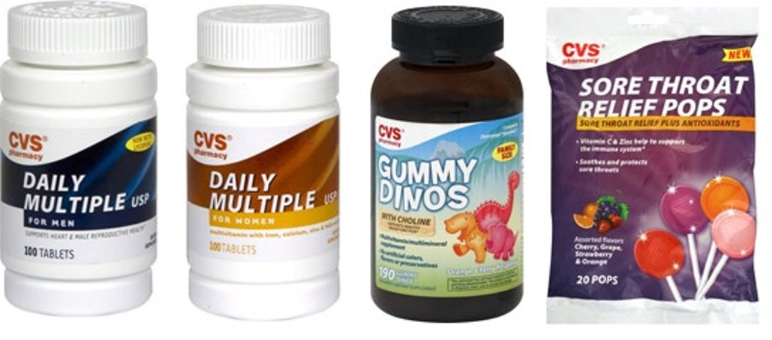
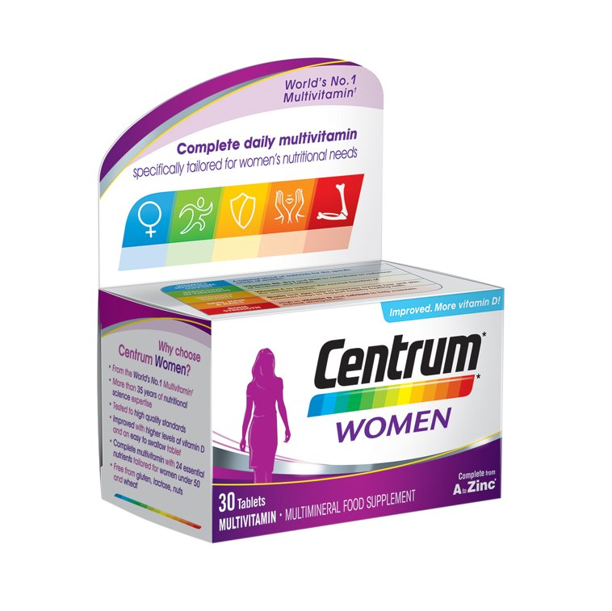
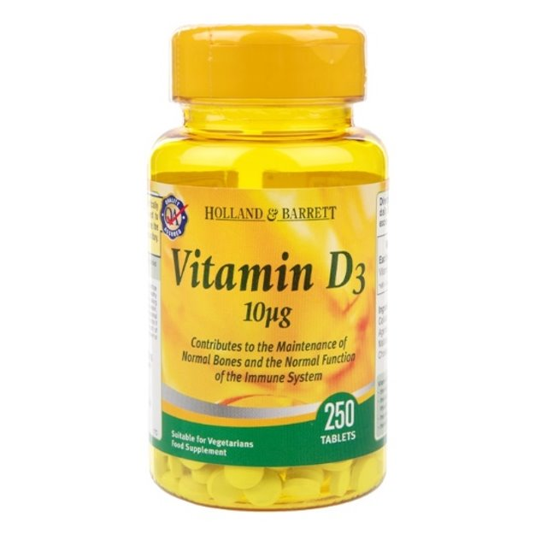
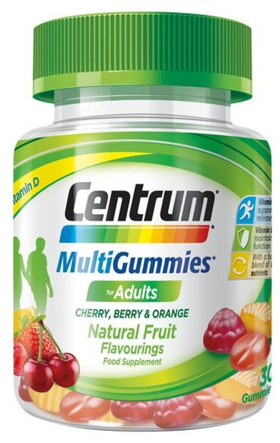

What brands do people buy?
KEY ITC INSIGHTS
In all countries, supplement users purchase a wide range of brands, including private label and supermarket own-brand​
Many users may not be loyal to one specific brand​
UK consumers may be the most brand loyal, with only 7% suggesting they have no brand preference (10% US and 11% Germany)​
In all countries store brands are often purchased, with brands owned by retailers Holland & Barrett and Boots the most popular in the UK, and CVS store brands ranking in the US consumer top 10
Only Pfizer owned brand Centrum is present in the top 10 for all three countries​
Note: Unaided list of brands they purchase. Question: “What three (3) brand names are you most likely to look for when purchasing a supplement?”

Slide 24

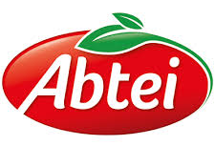


















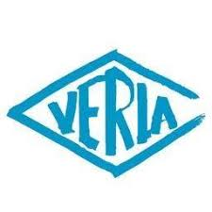







What brands DO PEOPLE BUY?

Slide 25
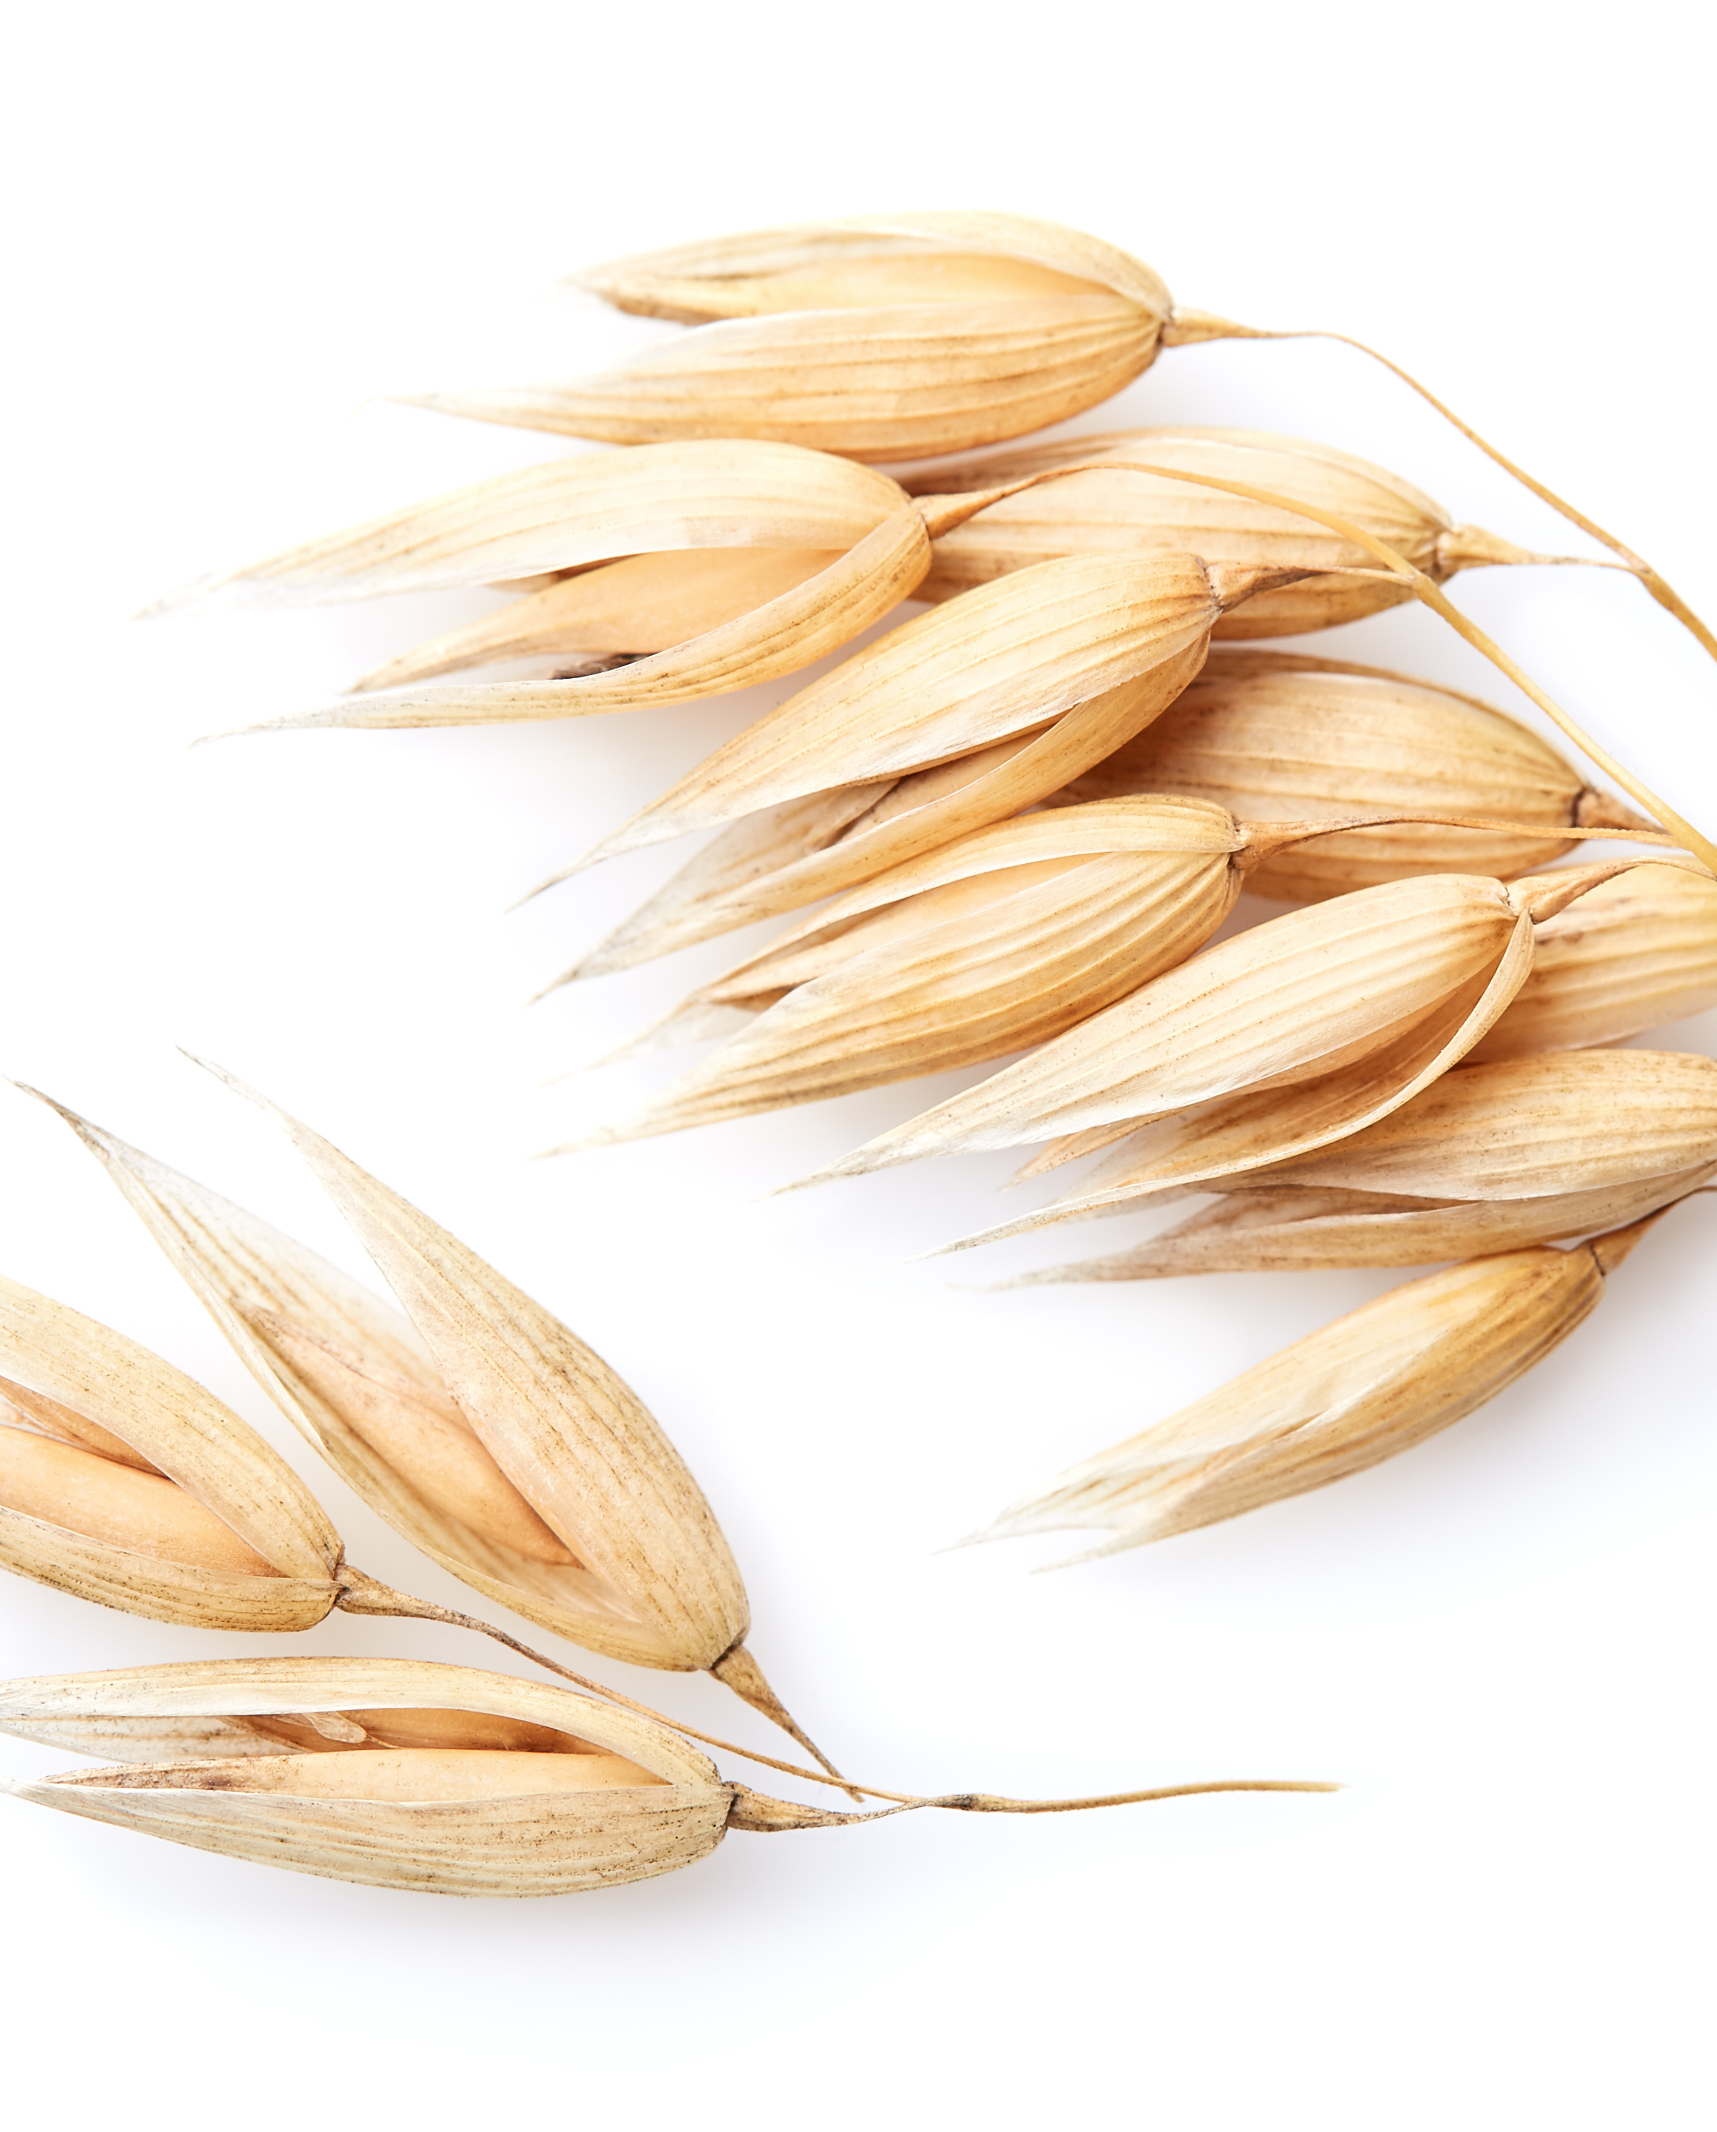
CONSUMER SUPPLEMENT DATA:
FAMILIARITY

Slide 26
Familiarity with usage
KEY ITC INSIGHTS:​
Familiarity of supplement categories across US, UK and Germany is similar for most​
Vitamin D, Probiotics and Omegas have reached the high level of penetration that all supplements wish for​
There is a notable drop in familiarity with glucosamine in Germany​
Familiarity for Astaxanthin and CoQ10 differs between all three countries, with German consumers most familiar for Astaxanthin and US for CoQ10
Top 3
Vitamin D
Omegas
Probiotics
Question: “How familiar would you consider yourself regarding the use of these supplements?”. Respondents who did not answer “Never Heard of It”

Slide 27
Differences emerge when excluding the top 3 supplement types
US
Question: “How familiar would you consider yourself regarding the use of these supplements?” Respondents who did not answer “Never Heard of It”

Slide 28
Familiarity with usage
KEY ITC INSIGHTS
Regular Users of a supplement are generally confident in their knowledge – even if they don’t know everything they should/could
Consumers feel most confident in their knowledge of the most widely used supplements – Vitamin D, Omegas, and Probiotics
While many consumers have never heard of supplements like Astaxanthin, those who have generally feel they have good familiarity with it
Note: Regular Users of specific supplement indicated using supplement at least 4 times per week. Question: “How familiar would you consider yourself regarding the use of these supplements?”

Slide 29
Familiarity: 2018-2020 (US Data)
*2-year data sets available
Note: US Regular Users of specific supplement indicated using supplement at least 4 times per week. Question: “How familiar would you consider yourself regarding the use of these supplements?”

Slide 30
Perceived Effectiveness
KEY ITC INSIGHTS
Many supplement users have concerns over the effectiveness of supplements
Perceived effectiveness is closely tied to familiarity with usage
Omegas
Note: Only consumers who had heard of the supplement answered this question for each specific supplement. Question: “What is your opinion of the effectiveness/benefit of each of these supplements?”

Slide 31


Perceived Effectiveness
Top 3 in each category
I've experienced its benefits - I'm a believer
I've heard good & bad - I'm not sure
I know it's not effective - I'm a non-believer
Vitamin D
Omegas
Probiotics
Astaxanthin
Collagen
Prebiotics
Astaxanthin
Collagen
Glucosamine
*Info based on All Respondents

Slide 32
Perceived Effectiveness
KEY ITC INSIGHTS:​
Regular Users are far more convinced of all supplements’ effectiveness (or more likely those who are convinced of supplement effectiveness become Regular Users)​
Irregular Users are likely to be trusting in effectiveness rather than having experienced benefits​
There is a clear need for consumer education on dosages required to experience benefits
Believer
11.11%
10.74%
9.93%
7.30%
13.04%
11.87%
9.55%
7.35%
5.73%
Effective
4.18%
Not Sure
Not Effective
Note: Regular Users of each supplement indicated using supplement at least 4 times per week. Question: “What is your opinion of the effectiveness/benefit of each of these supplements?”
Notes:
5 I've experienced its benefits - I'm a believer 4 I trust that it is effective, but I haven't experienced benefits 3 I've heard good & bad - I'm not sure 2 I think it might not be effective, I haven't experienced benefits 1 I know it's not effective - I'm a non-believer 0 I don't know

Slide 33
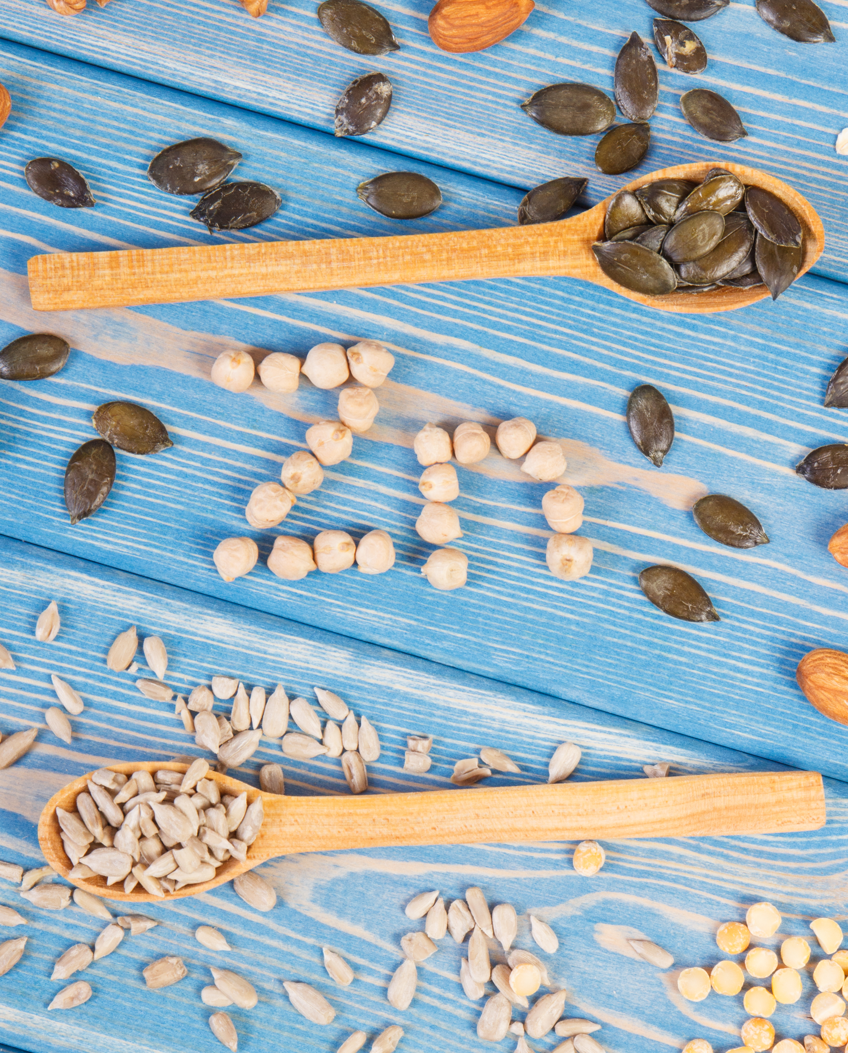
CONSUMER SUPPLEMENT DATA:
USAGE & SPEND

Slide 34

#1
Multivitamins continue to be the top supplement taken overall and most regularly
Top 5 Most Frequently Taken Supplements
43%
Multivitamin
41%
Vitamin D
Vitamin D has taken the market by storm over the last decade with usage levels now similar to multivitamins
Calcium
28%
Omegas
26%
25%
Magnesium
Note: All Users used for this data. Question “Which of the following best describes how frequently you are taking the following supplements?”

Slide 35
Usage Levels
Note: Regular Users of each individual supplement indicated using supplement at least 4 times per week. Question “Which of the following best describes how frequently you are taking the following supplements?”

Slide 36
USAGE LEVELS: 2018-2020 (US DATA)
KEY ITC INSIGHTS:
Usage of popular supplements including multivitamins and vitamin D continue to fall each year
Use of certain ‘hot’ supplements including Turmeric, Prebiotics and Collagen continues to grow (albeit from lower bases)
*2-year data sets available
Question “Which of the following best describes how frequently you are taking the following supplements?” Info based on All US Respondents.

Slide 37
USAGE LEVELS BY COUNTRY
KEY ITC INSIGHTS
UK consumers are above average users of omegas and glucosamine
German consumers are above average users of multiple supplement types, including Vitamin D, Calcium, Vitamin K, Collagen, Turmeric and Magnesium – with the use of Magnesium especially high compared to other countries
US Top 3 Supplements
Multivitamin Vitamin D Calcium
UK Top 3 Supplements
Vitamin D Multivitamin Omegas
Germany Top 3 Supplements
Magnesium Vitamin D Multivitamin
Note: Regular Users of each individual supplement indicated using supplement at least 4 times per week. Question “Which of the following best describes how frequently you are taking the following supplements?”

Slide 38




Change In Usage Levels
KEY ITC INSIGHTS:
Most usage changes were consistent across countries
A small but significant number of consumers are taking significantly more supplements – across all categories, including mainstays like multivitamins, vitamin D and calcium
Usage levels of lesser-known supplements are rising more rapidly than mainstays
Increased Use: Top 3
Vitamin D 12%
Multivitamin 8%
Omegas 7%
Stayed the Same: Top 3
Multivitamin 52%
Vitamin D 50%
Calcium 42%
Decreased Use: Top 3
Multivitamin 11%
Omegas 11%
Protein Powder 10%
Info based on All Respondents. Question “Which of the following best describes how your use of each of these supplements compares to your usage 1 year ago?”
Increased use: sum of “Just Started Taking” and “Significantly More”, Decreased use: sum of “ Significantly Less” and “Stopped Taking.”

Slide 39

Change In Usage Levels
Many supplements are seeing increases in usage, especially among Regular Users
Usage levels are remaining steadier for supplements like Multivitamins and Omegas that have more established user bases
Prebiotics and Collagen are recognized “hot” ingredients and increased usage follows this trend
Note: Regular Users of each individual supplement indicated using supplement at least 4 times per week. Question “Which of the following best describes how your use of each of these supplements compares to your usage 1 year ago?”

Slide 40
Change In Usage Levels: 2 YEAR TREND
KEY ITC INSIGHT: Vitamin D, Multivitamins, and calcium are among the supplements people are taking significantly more
US All Respondents, 2019 + 2020. Question “Which of the following best describes how your use of each of these supplements compares to your usage 1 year ago?”

Slide 41
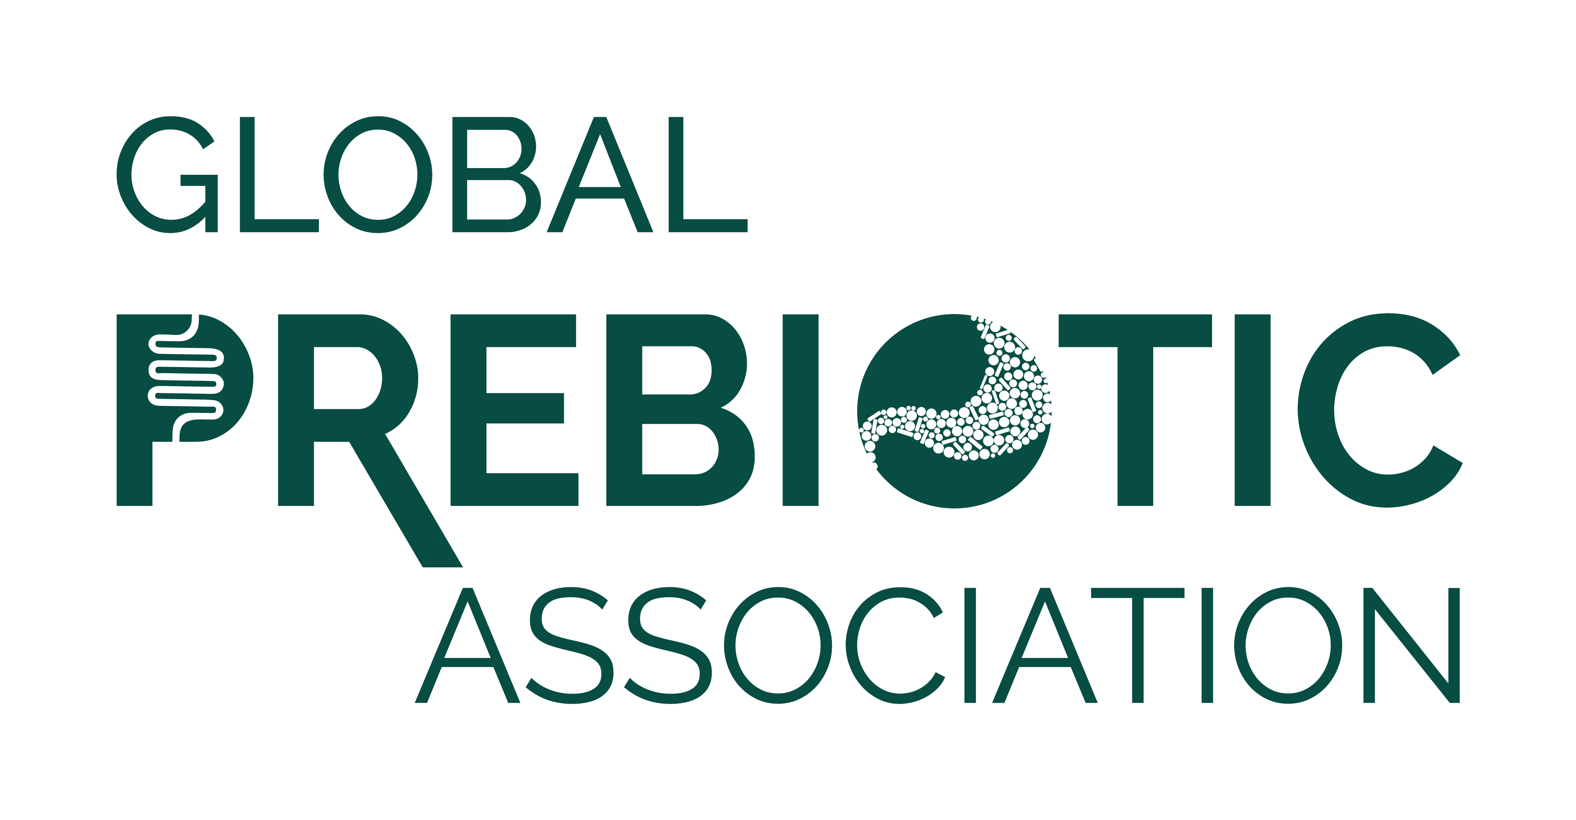
KEY ITC INSIGHT: covid-19 is driving increased use
Many of the supplements are on the rise during Covid-19
Vitamin D saw significant increases across the board
(US 10%, UK 18%, Germany 14%)
28%
consumers increased supplement usage as COVID-19 became a major health concern
Increases in Vitamin K usage were double
the US rate (2%) in
Europe (UK 4% / Germany 5%)

Slide 42
Change DUE TO COVID-19
US Top 3 Supplements
Vitamin D Multivitamin Omegas
UK Top 3 Supplements
Vitamin D Multivitamin Omegas
Germany Top 3 Supplements
Vitamin D Multivitamin Magnesium
Question: “Have you increased your usage of any of these supplements due to COVID-19 (coronavirus) concerns?”

Slide 43
Average Monthly Spend
KEY ITC INSIGHTS
Regular Users spend more per month on supplements than Irregular Users (46% more on average)
Protein powders are widely used and have high average monthly spend
While astaxanthin and collagen are used at lower rates, consumers are willing to spend significant amounts on them
Protein powders, Vitamin K, and Prebiotics see the biggest change in spend between Regular and Irregular users.
Biggest Change Between Users
 | All Users | Regular Users
Protein Powder | $17.90 | $23.50 (+$5.59)
Vitamin K | $13.86 | $19.34 (+$5.48)
Prebiotics | $15.58 | $20.15 (+$4.58)
*Converted to USD from original national currency
Note: Regular Users of each individual supplement indicated using supplement at least 4 times per week. Question “Approximately how much per month do you spend on each of these supplements?”

Slide 44
Average Monthly Spend
KEY ITC INSIGHTS:
Regular Users spend more per month on supplements than Irregular Users (46% more on average)
Protein powders are widely used and have high average monthly spend
While astaxanthin and collagen are used at lower rates, consumers are willing to spend significant amounts on them
Protein powders, vitamin K, and prebiotics see the biggest change in spend between Regular and Irregular users.
Biggest Change Between Users
 | All Users | Regular Users ($) | Percent Increase
Protein Powder | $17.90 | $23.50 (+$5.59) | 31.2%
Vitamin K | $13.86 | $19.34 (+$5.48) | 39.5%
Prebiotics | $15.58 | $20.15 (+$4.58) | 29.4%
Astaxanthin | $19.37 | $23.29 (+$3.92) | 20.2%
Probiotics | $14.57 | $18.28 (+$3.70) | 25.4%
Collagen | $17.07 | $20.79 (+3.71) | 21.7%
Note: Regular Users of each individual supplement indicated using supplement at least 4 times per week. Question “Approximately how much per month do you spend on each of these supplements?”

Slide 45
Average Monthly Spend
KEY ITC INSIGHT:
Almost all monthly supplement spending went down in 2020, except for magnesium, calcium, and vitamin D
Note: Regular US Users of each individual supplement indicated using supplement at least 4 times per week. Question “Approximately how much per month do you spend on each of these supplements?”
Glucosamine and Collagen do not have 2018 data.

Slide 46
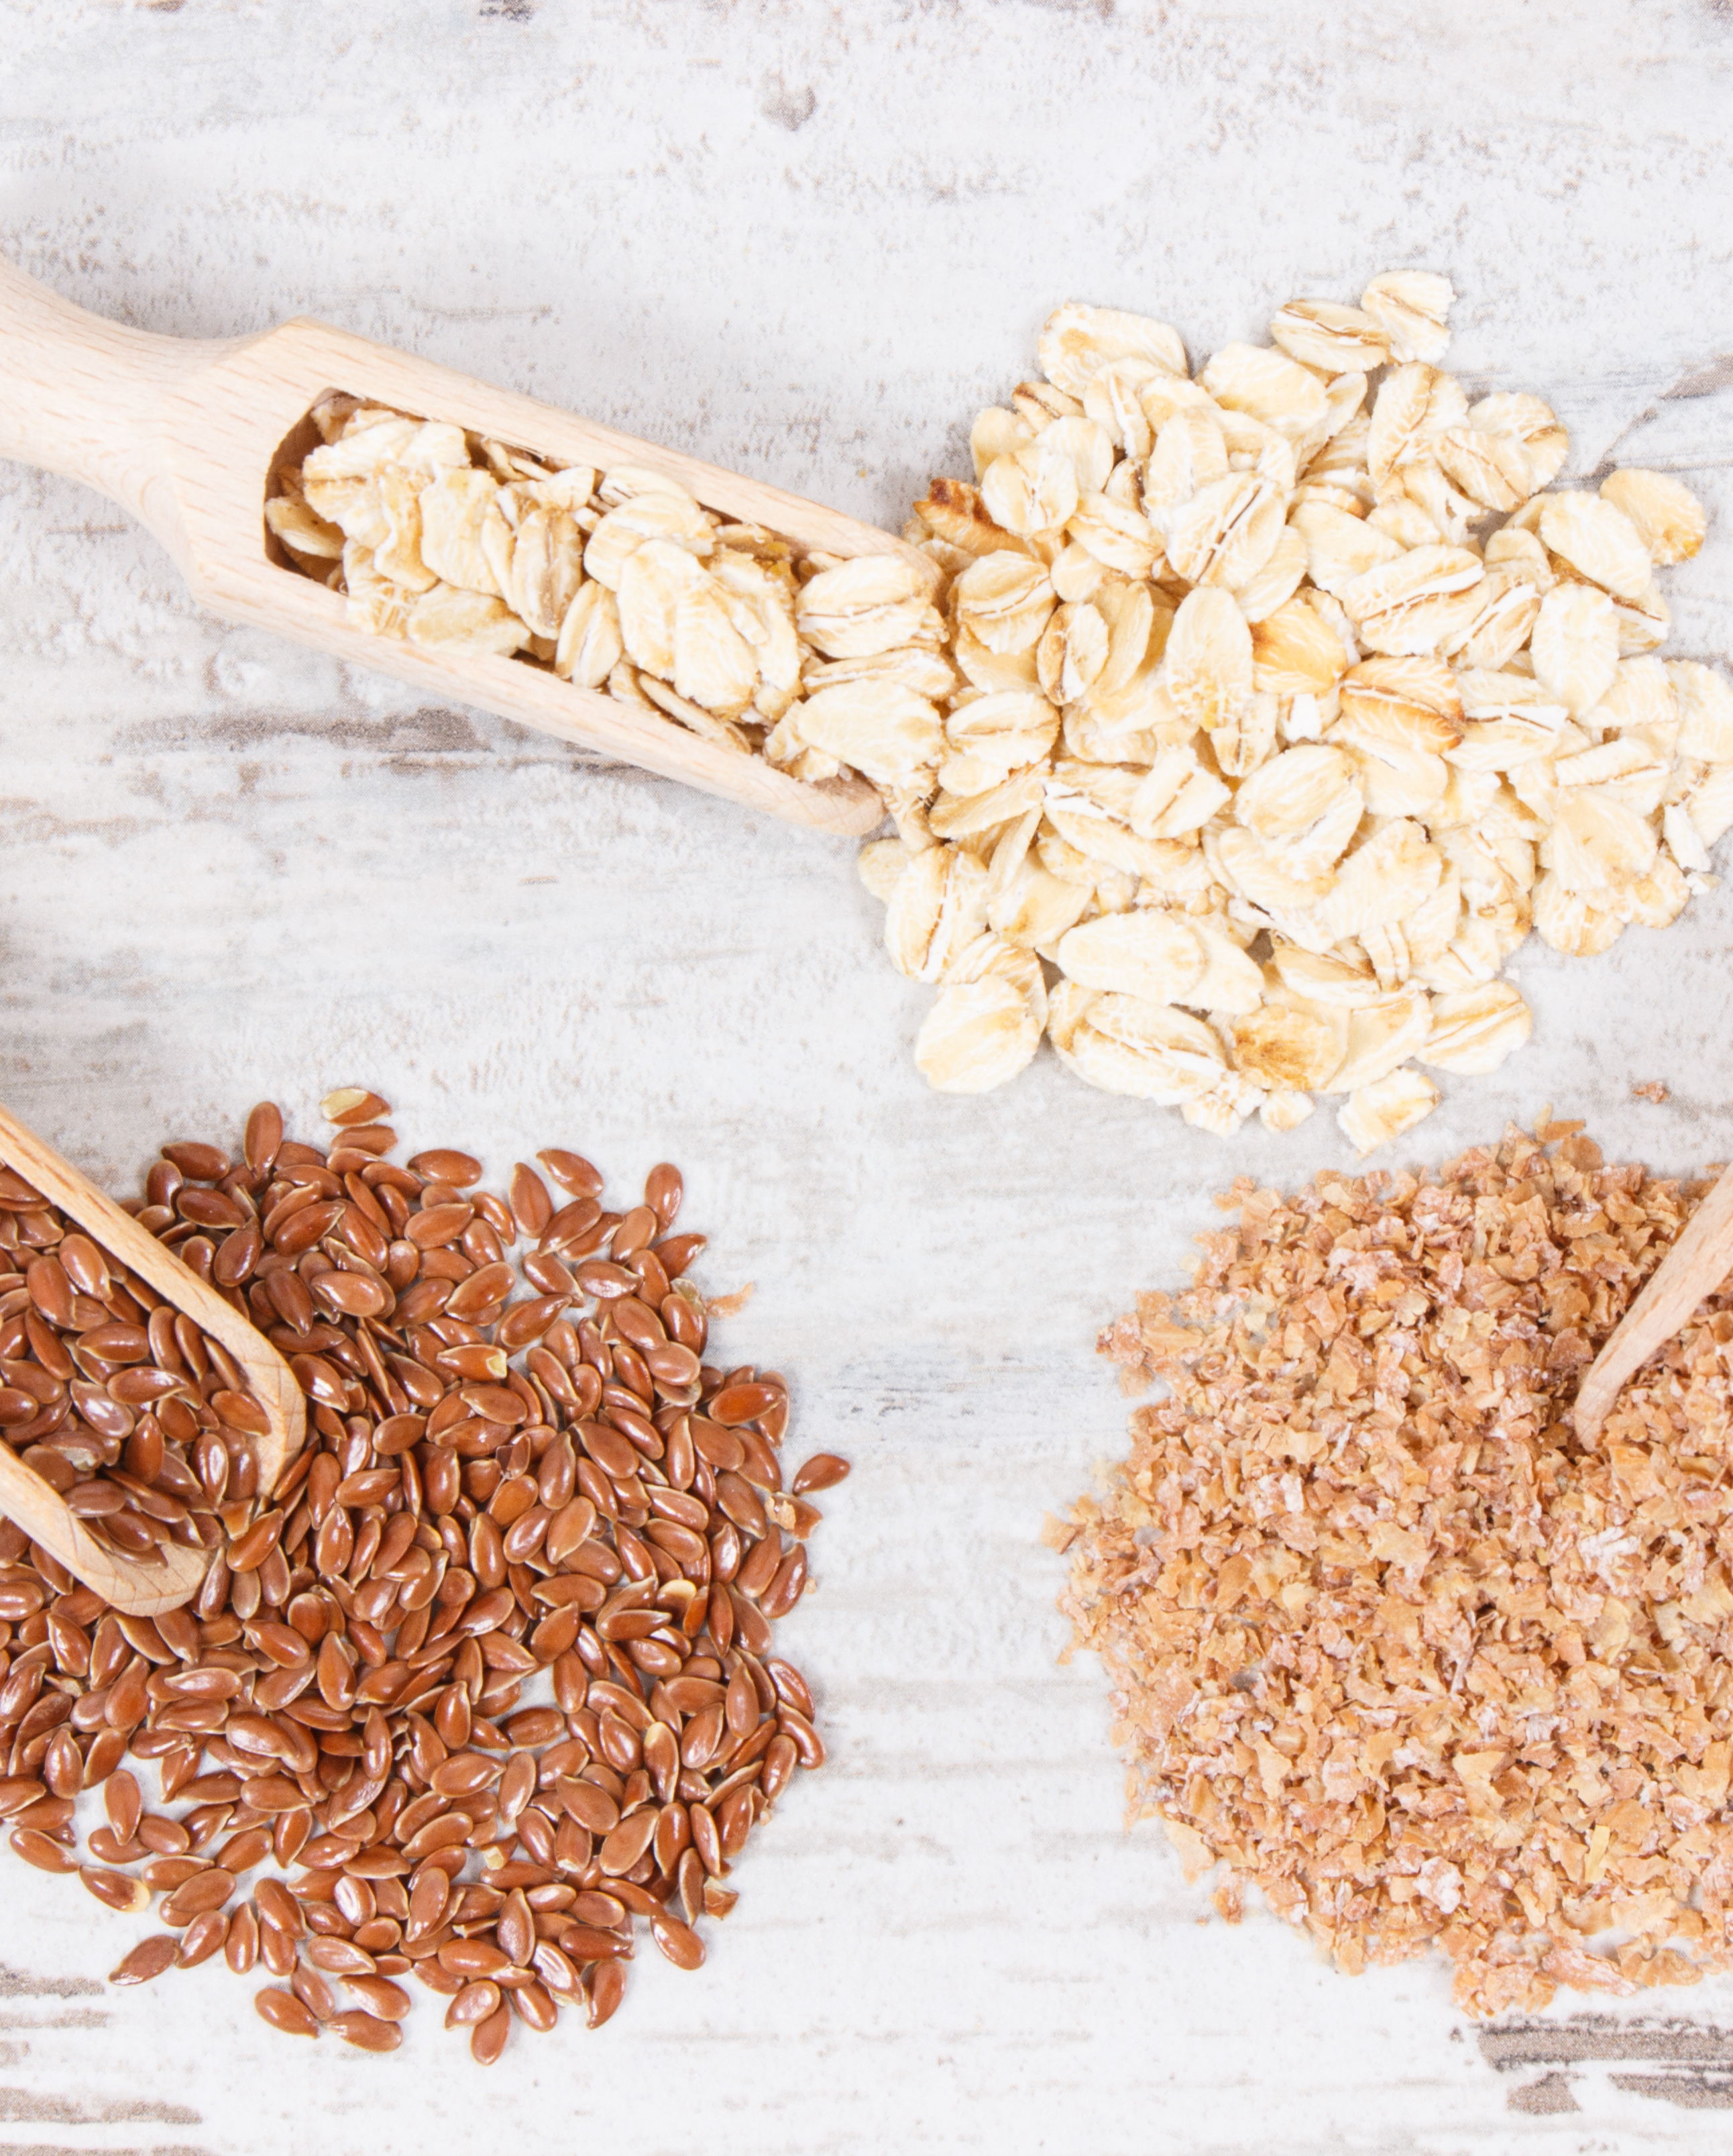
Consumer supplement data:
Shopping Behavior Drivers

Slide 47
Importance of Sustainability
KEY ITC INSIGHTS
Sustainability is not considered an important consideration for most supplement users
Many are unaware that supplements have sustainability issues
Sustainability is a bigger consideration for Irregular users
Regular users may be more loyal to specific brands and therefore may not consider sustainability as a driver of purchase
Note: Regular Users indicated using supplements in general at least 4 times per week. Question: “When deciding which supplements to purchase, to what degree does the sustainability/environmental impact of a supplement ingredient influence your purchasing decision?”

Slide 48
Importance of Sustainability
KEY ITC INSIGHTS:
US consumers are less aware of sustainability issues related to supplements
German consumers are the most influenced by sustainability issues
US Top 3
Wasn’t aware 27% Never influences 22% Sometimes influences 20%
UK Top 3
Sometimes influences 22% Never influences 20% Wasn’t aware 20%
Germany Top 3
Frequently influences 20% Sometimes influences 18% Often influences 18%
Question: “When deciding which supplements to purchase, to what degree does the sustainability/environmental impact of a supplement ingredient influence your purchasing decision?”

Slide 49
Importance of Sustainability
More German consumers are influenced by sustainability (50%) vs. USA (31%) or UK (38%)
Consumers who are impacted by sustainability are more likely to have used alternative health care (39% vs. 26%)
Younger consumers are more influenced by sustainability (60% under 46 vs.
46% overall)
Consumers who are more focused on sustainability regularly purchase natural and organic foods (68% vs. 54%)
Consumers concerned about sustainability frequently or always read articles about health & wellness (59% vs. 45%)

Slide 50
Signals of Brand Transparency
KEY ITC INSIGHTS
Quality seals on the label are clearly important to all consumers
Regular Users in Germany are most appreciative of transparency signals, with USA consumers least excited, and UK falling in the middle
Ingredient supplier information is especially appreciated by Regular Users in the UK (40%)
Note: Regular Users indicated using supplements in general at least 4 times per week. Question: “Which of the following items are the strongest signals that a supplement brand is operating transparently?”

Slide 51
Transparency Purchase Influence
KEY ITC INSIGHTS
Transparency clearly encourages consumers to purchase a brand (especially Regular Users)
44% of Regular Users in Germany say transparency would greatly increase the chances of buying a brand (vs. 28% UK and 31% US)
Question: How likely are you to purchase supplements from a manufacturer that provides transparency information on its label or website?

Slide 52
Reasons for Trust
Consistent product quality is the biggest driver of trust, especially for Regular Users (42%)
The top 4 drivers of trust are the same across countries
German Regular Users appreciate quality certifications and seals (39%) more than those in UK (29%) and USA (31%)
Note: Regular Users indicated using supplements in general at least 4 times per week. Question: “What characteristics most encourage you to trust a supplement brand?”

Slide 53
Supplement Selection Criteria
KEY ITC INSIGHTS
Single pill daily dosage, proof of efficacy, easy to swallow, and natural source are all top characteristics
There is no one characteristic that is important to all supplement users, and importance doesn’t change much for Regular vs. Irregular Users
Note: Regular Users indicated using supplements in general at least 4 times per week. Question: “Which of the following characteristics are most important when choosing which supplement product to purchase?”

Slide 54




SUPPLEMENT FORMAT PREFERENCES
Regular Users Preference
Single Pill 32%
Gummy 9%
Powder 4%
Liquid 3%
Irregular Users Preference
Single Pill 23%
Gummy 11%
Liquid 8%
Powder 7%
VS.
*Info based on All Respondents

Slide 55
Important Supplement Characteristics
KEY ITC INSIGHTS:
Drivers of purchase differ greatly between country
Proof of efficacy is most important to German users (43%) along with a focus on natural sources (38%)
Single dose and easy to swallow pills are the top characteristics for UK and US users
US Top 3
Single pill dose Easy to swallow Proof it works
UK Top 3
Easy to swallow Single pill dose Natural source
Germany Top 3
Proof it works Natural Source Detailed ingredient info (transparency)
Question: “Which of the following characteristics are most important when choosing which supplement product to purchase?”

Slide 56

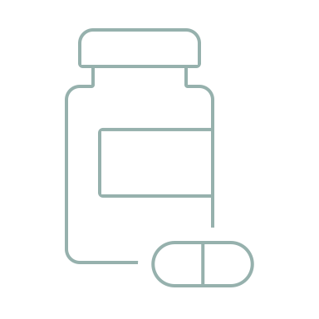

Discouraging Purchase
Note: Regular Users indicated using supplements in general at least 4 times per week. Question: “Which of these characteristics are most likely to discourage you from purchasing/repurchasing a supplement product or brand?”

Slide 57
Discouraging Purchase
KEY ITC INSIGHTs:
Bad tastes and smells can be the most off-putting characteristics of supplements
Regular Users in UK and USA care much more about odor (45% and 40%) than those in Germany (33%)
US Top 3
Smell/ odor Size Aftertaste
UK Top 3
Aftertaste Smell/ Odor Size
Germany Top 3
Bad initial taste Aftertaste Size
Question: “Which of these characteristics are most likely to discourage you from purchasing/repurchasing a supplement product or brand?”

Slide 58
Importance of branded Ingredients
KEY ITC INSIGHTS:
Knowledge that branded ingredients exist is strong (very few do not know what a branded ingredient is)
Most general supplement users aren’t searching out branded ingredients, but many do appreciate them when they find them
Note: Regular Users indicated using supplements in general at least 4 times per week. Question: “When deciding which supplements to purchase, how important is the inclusion of branded or proprietary ingredients?”

Slide 59
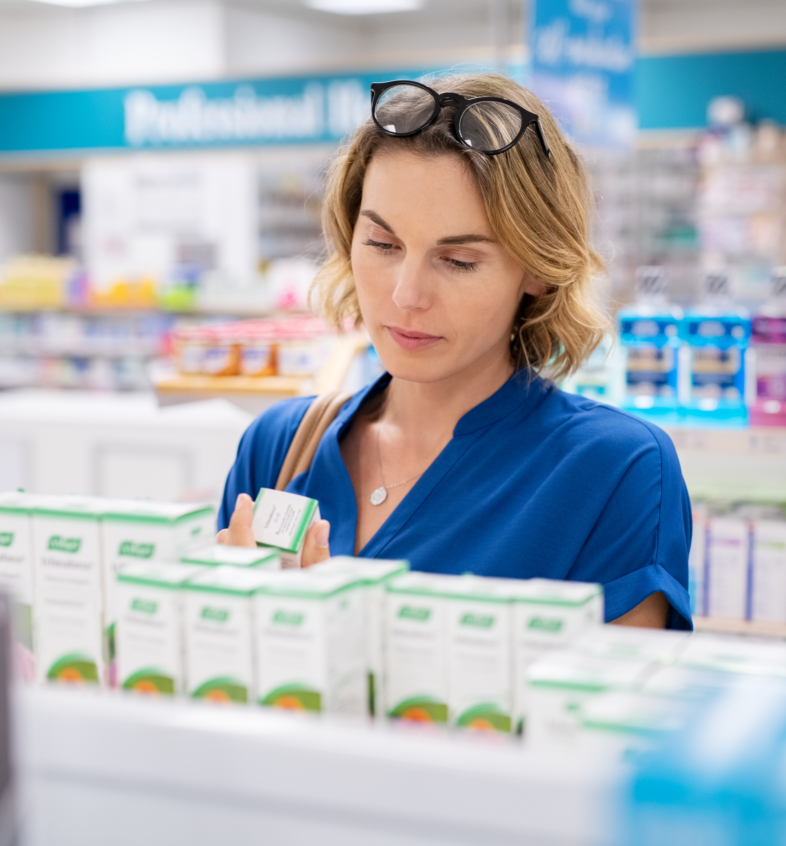
ITC TRENDS RECAP: EDUCATION NEED
2020 data shows consumer usage trends between the USA, UK, and Germany are often quite similar, however we see important differences in ‘reason for use’ – suggesting different drivers and understanding of benefits
There is a clear need for better consumer education at all usage levels
Differences in the perceived benefits of supplement types across countries highlights the importance of consumer education, which clearly drives higher usage for a wide array of reasons
Media coverage and consumer education can quickly raise the bar on supplement awareness, knowledge, and usage;
  Vitamin D is a poster child in this area
  Turmeric & curcumin are on the journey
  Categories like astaxanthin have a long way to go
Regular Users can serve as prime examples of how education and experience leads to loyal customers; there is a strong correlation between supplement knowledge, experience of benefits and usage levels – feeling is believing
It is important that usage is increased in conjunction with education in order to better ensure long term usage

Slide 60
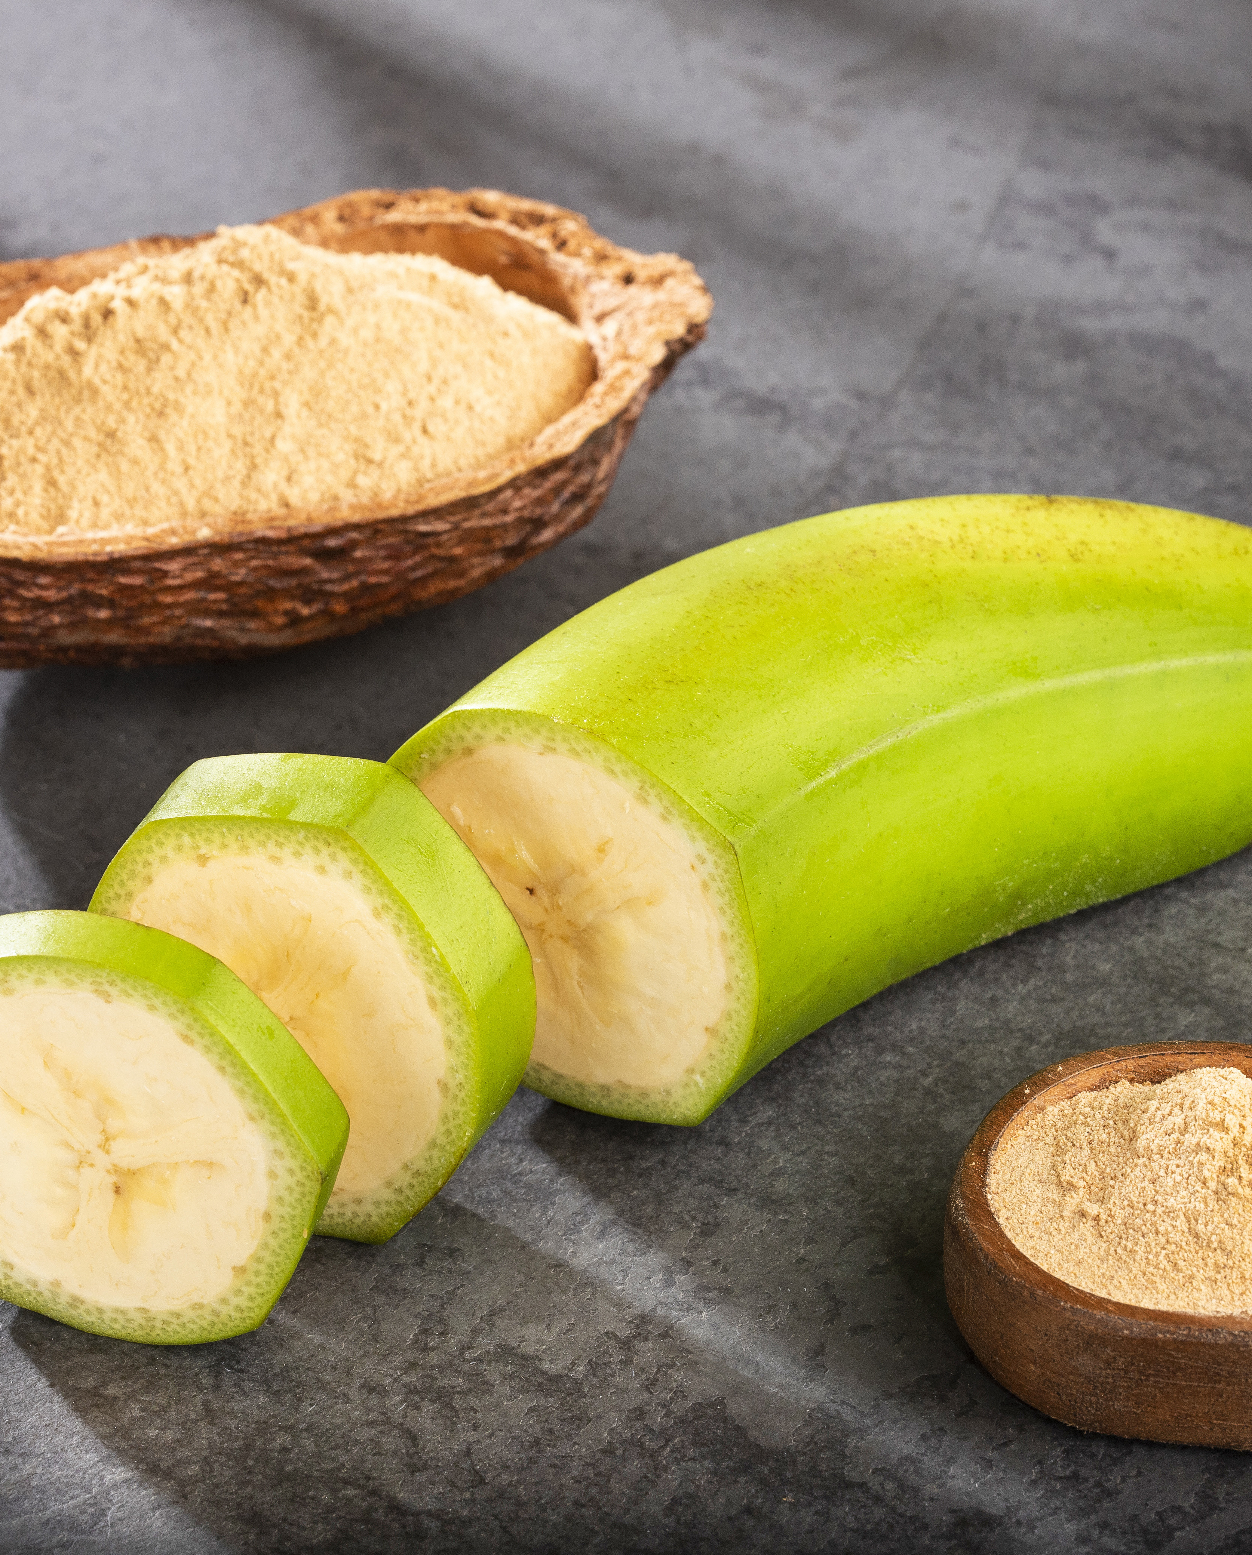
PREBIOTICS SURVEY DATA

Slide 61
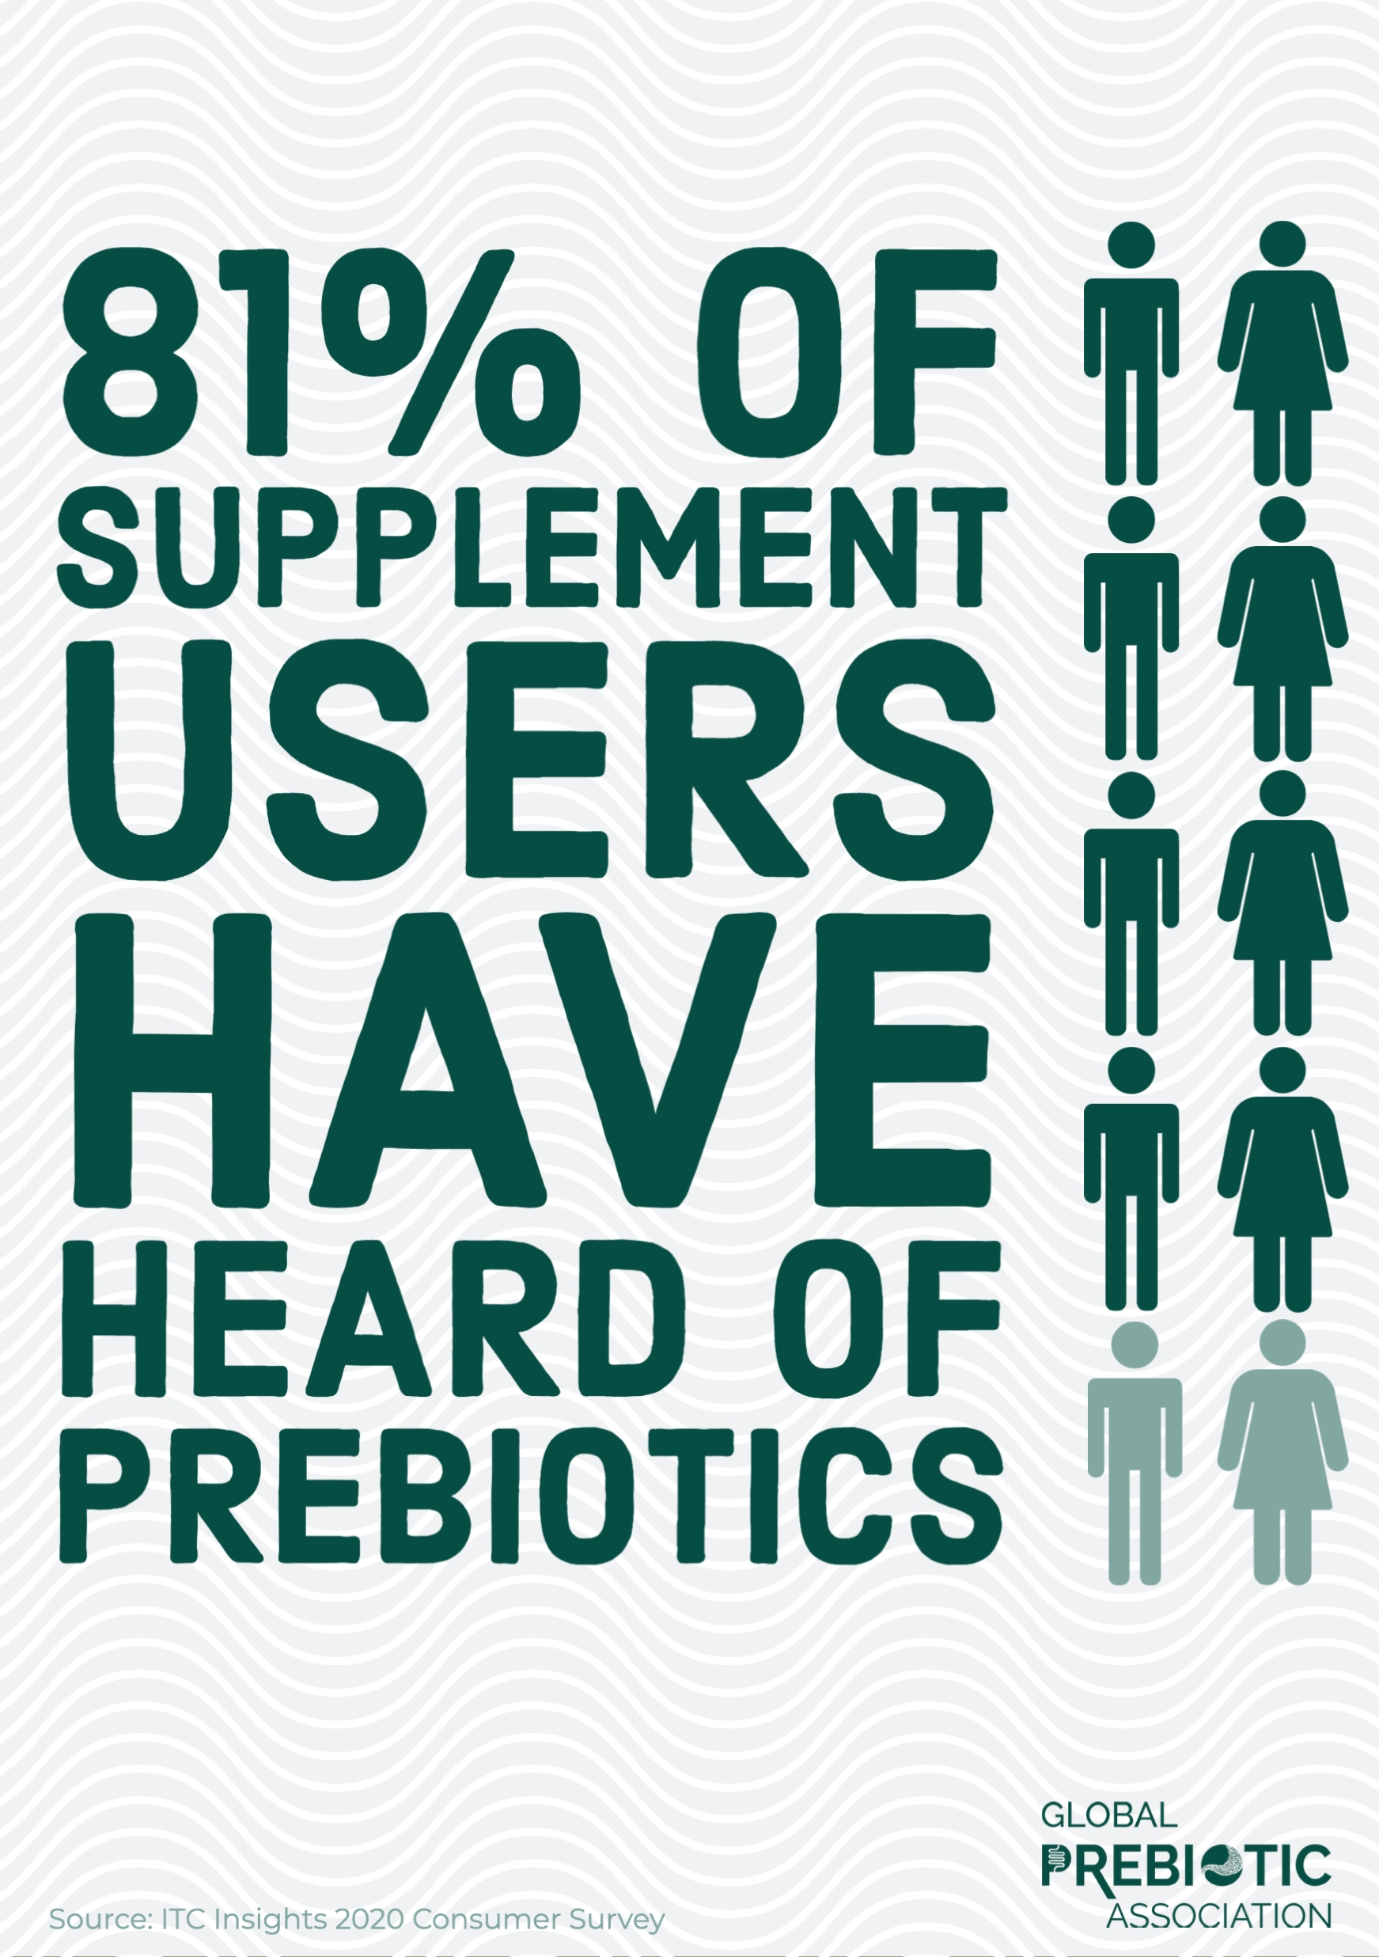

Prebiotic USER general Demographics
51%
49%
GENDER
AGE
INCOME
*Converted to USD from original national currency
Regular Users vs. Irregular Users - similar across age, gender and income
Take prebiotics at all, N=701
61

Slide 62
Gender Demographics: by country
Note: Take prebiotics at all= regular and irregular users. US N=297, UK N=194, DE N=210. Question: “How do you identify your gender?”

Slide 63
Age demographics: by country
ITC KEY INSIGHT: All prebiotic users tend to be younger than average supplement user (62% under 46 vs. 46% overall)
Note: Take prebiotics at all= regular and irregular users. US N=297, UK N=194, DE N=210. Question: “How old are you?”

Slide 64
Ethnic background: by country
Note: Take prebiotics at all= regular and irregular users. US N=297, UK N=194, DE N=210. Question: “How do you identify your primary ethnicity origin/race?”

Slide 65
Health CONCERNS: PREBIOTICS USERS By country
Note: Regular Users indicated using supplement at least 4 times per week. US N=115, UK N=61, DE N=65. Question: Which of the following health conditions impact you currently or have impacted you within the past year?

Slide 66
Top 3 Health Concerns 2020
US Top 3 Health Concerns
High Blood Pressure High Cholesterol Anxiety or Stress & Joint or Other Pain
UK Top 3 Health Concerns
Joint or Other Pain Anxiety or Stress Lack of Energy
Germany Top 3 Health Concerns
Joint or Other Pain Insomnia/ Sleep Problems High Blood Pressure
All Those Who Take Supplements
US Top 3 Health Concerns
High Cholesterol Anxiety or stress Diabetes
UK Top 3 Health Concerns
Lack of Energy Joint or other pain Anxiety or stress
Germany Top 3 Health Concerns
Joint or other pain Insomnia/ Sleep problems High Blood Pressure
Regular Prebiotic Users
All respondents vs. All reg prebiotic users. All Question: Which of the following health conditions impact you currently or have impacted you within the past year?

Slide 67
BENEFITS, FAMILIARITY AND USAGE

Slide 68
Benefits of Prebiotics
Gut health clearly remains a top benefit, with microbiome health also showing strong recognition
Immunity health has seen a steady gain and is now clearly recognized as a benefit
Regular Users are much more likely to recognize the more wide-ranging benefits of prebiotics such as fiber source or bone health
Many non-users aren’t familiar with the benefits of prebiotics, thus highlighting the need for further consumer education
Note: Regular Users indicated using supplement at least 4 times per week. N=241 for Prebiotics Regular Users, N=460 for Prebiotics Irregular Users. Question: “Why are you taking/What have you heard are the benefits of taking a prebiotic supplement?”

Slide 69
Benefits of Prebiotics: Top 5
Gut and immunity are the top reasons across all ages and income levels.
Note: Regular Users indicated using supplement at least 4 times per week. N=241 for Prebiotics Regular Users, N=460 for Prebiotics Irregular Users. Question: “Why are you taking/What have you heard are the benefits of taking a prebiotic supplement?”

Slide 70
WHY THEY TAKE PREBIOTICS: BENEFITS BY COUNTRY
US Regular Users
Gut health/digestion | 36%
Immunity health | 29%
Source of fiber | 21%
Regularity | 20%
Inflammation/autoimmune | 18%
UK Regular Users
Microbiome health | 34%
Immunity health | 28%
Source of fiber | 26%
Gut health/digestion | 26%
Bone health | 25%
Germany Regular Users
Immunity health | 26%
Gut health/digestion | 25%
Regularity | 25%
Microbiome health | 22%
Athletic performance | 22%
Varies by geography, but there are patterns that emerge…
Note: Regular Users indicated using supplement at least 4 times per week. N=115 for USA, N=61 for UK, N=65 for Germany. *Note small sample sizes for individual countries due to low usage. Question: “Why are you taking/What have you heard are the benefits of taking a prebiotic supplement?”

Slide 71
PREBIOTIC USER FAMILIARITY LEVELS
Regular Prebiotic Users in the USA and UK are most likely to be very/extremely familiar with use, while Germans are less sure

Slide 72
Familiarity by Age and income
*Converted to USD from original national currency
All prebiotic users. Under 46 N=921, 46+ N=1083, Income <70 N= 930, Income 70+ N=1074. Question: “How familiar would you consider yourself regarding the use of prebiotics?”

Slide 73
Familiarity: 2018-2020 (US DATA)
Note: US, take prebiotic at all. Question: “How familiar would you consider yourself regarding the use of these supplements?”

Slide 74
Prebiotics Usage: By Country
35% of surveyed supplement users are using Prebiotics at some level
Prebiotics usage is stronger globally than in US: 30% of USA supplement users are using Prebiotics vs. 39% in UK & 42% in Germany
34% of Prebiotic Users are Regular Users(4+ times per week), including 39% in the US and 31% in UK & Germany
Note: All Respondents. Question: “Which of the following best describes how frequently you are taking the following supplement?”

Slide 75
Prebiotics Usage: 2018-2020 (US DATA)
All US respondents, 2020 N=1000, 2019 N=1004, 2019 N=993. Question: “Which of the following best describes how frequently you are taking the following supplements?”

Slide 76
Prebiotic Usage CHANGE
KEY ITC INSIGHTS
42% of Regular Prebiotic Users indicated that they have just started taking or increased their usage in the last year, with 20% indicating “significantly more” usage
30% of Irregular Prebiotic Users indicated that they are using prebiotics less or have stopped taking in the last year
Changes in usage are similar across countries
Note: Regular Users indicated using supplement at least 4 times per week. N=241 for Prebiotics Regular Users, N=460 for Prebiotics Irregular Users. Question: “Which of the following best describes how your use of each of this supplement compares to your usage 1 year ago?” Global Responses

Slide 77
Change in Usage Levels: By Country
25% of German regular prebiotic users are taking significantly more vs. US and UK (both 18%)
9% of German regular prebiotic users are taking significantly less vs. US (7%) and UK (5%)
Note: Take prebiotics regularly, US N=115, UK N=61, Germany N=65. . Question: “Which of the following best describes how your use of each of these supplements compares to your usage 1 year ago?”

Slide 78
Perceived Effectiveness OF Prebiotics
41% of Regular Prebiotic Users have experienced the benefits of Prebiotics, which is typical of regular users of any supplement
As is true of Irregular Users across supplement types, the biggest group of these users are trusting in the benefits but haven’t experienced them
Note: Regular Users indicated using supplement at least 4 times per week. N=241 for Prebiotics Regular Users, N=460 for Prebiotics Irregular Users. Question: “What is your opinion of the effectiveness/benefit of this supplement?”

Slide 79
Effectiveness: 2018-2020 (Us DATA)
Question: “What is your opinion of the effectiveness/benefit of each of these supplements?” US users, combined regular and irregular users.

Slide 80
Effectiveness: By Country
Among Regular Users, those in the USA are most likely to have experienced benefits (47%) vs. UK (36%) & Germany (37%)
UK Irregular Users are the most skeptical, with 32% reporting that they’ve heard good & bad
Note: Take prebiotics regularly, US N=115, UK N=61, Germany N=65. Question: “What is your opinion of the effectiveness/benefit of each of these supplements?”

Slide 81
Prebiotic Dosages
Strong indication that education is needed surrounding efficacious dosage
Note: Regular Users indicated using supplement at least 4 times per week. Question: “Approximately what dosage of Prebiotics do you take per serving?”

Slide 82
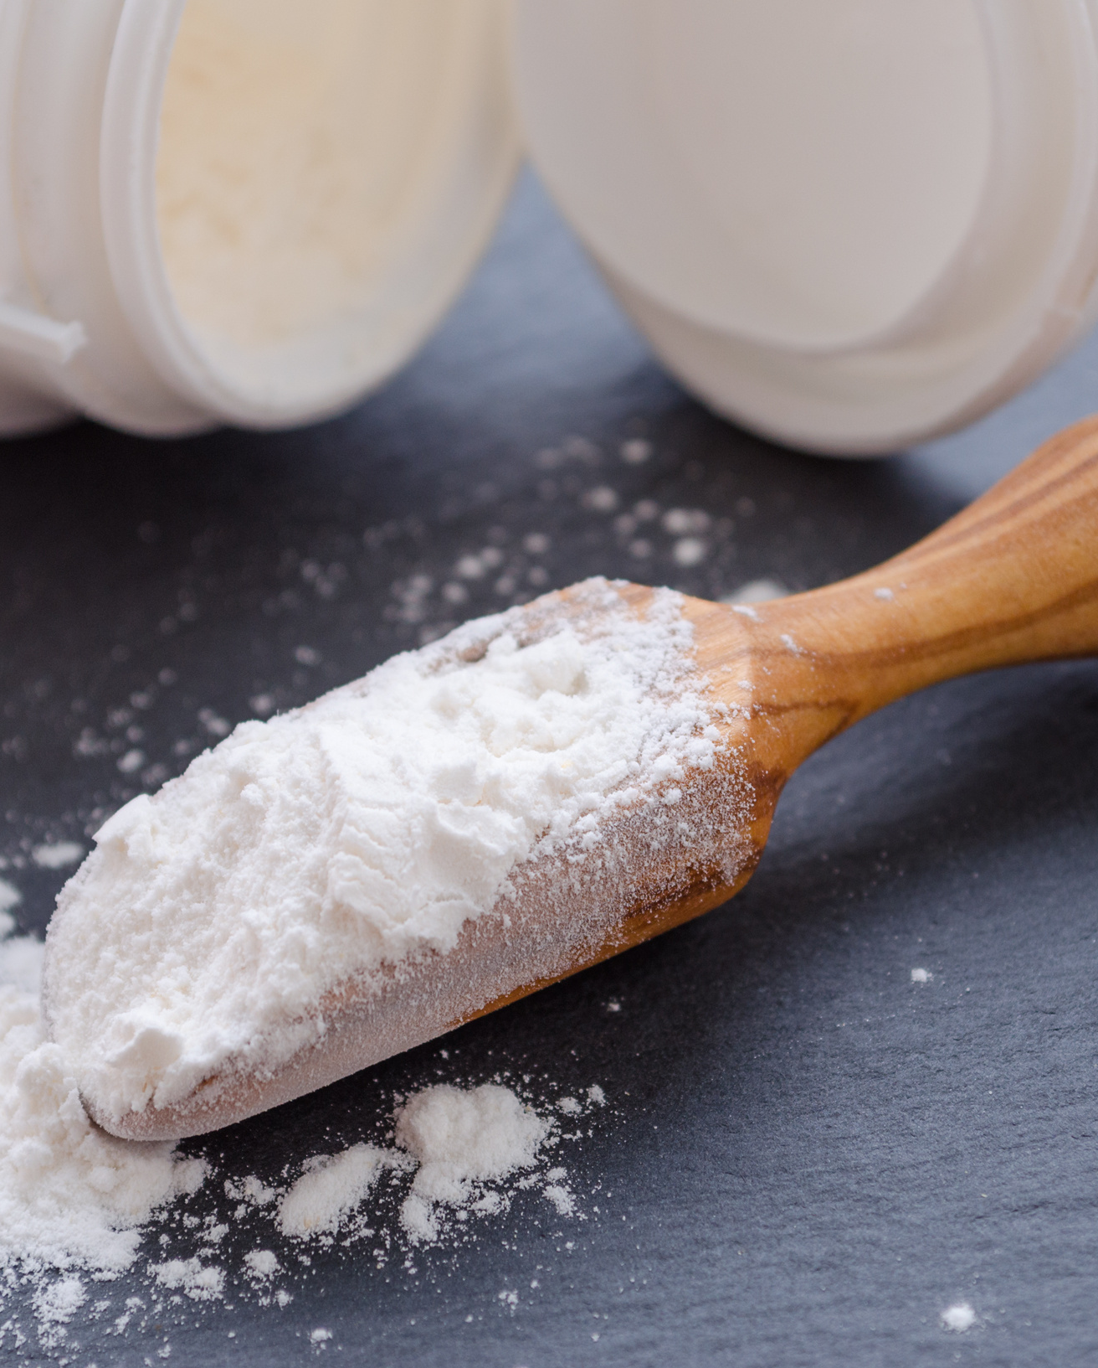
PREBIOTIC USER SHOPPING BEHAVIOR

Slide 83
Prebiotics Purchasing Decisions
Going beyond the basics, Regular Users are commonly looking for fiber along with a pro/pre combination (29%), but recognition of the term “synbiotic” remains low (17%).
Most users aren’t looking for a high dosage of daily fiber, but they are commonly looking for the term “fiber”
Note: Regular Users indicated using supplement at least 4 times per week. N=241 for Prebiotics Regular Users, N=460 for Prebiotics Irregular Users. Question: “When you select what prebiotic to purchase, do you look for any of these specific characteristics?”

Slide 84
Prebiotics Purchasing Decision:
By Country
37% of Regular Users in the USA are looking for a pro/pre combination, vs 30% in UK & 17% in Germany
28% of UK Regular Users are looking for specific prebiotics such as inulin vs. only 18% in USA & Germany
Gut health benefits are most recognized by USA Regular Users while those in UK have stronger connection to microbiome health benefits
Regularity, along with gut health & immunity, is a leading benefit in Germany
Bone health benefits are most noted by UK Regular Users
Note: Regular Users indicated using supplement at least 4 times per week, US N=115, UK N=61, Germany N=65. Question: “When you select what prebiotic to purchase, do you look for any of these specific characteristics?”

Slide 85

Prebiotics Purchasing Decision:
2018-2020 (US Data)
2020 dropped 12% from the previous two years in “ look that it is labelled as a prebiotic.”
Looking for fiber in a prebiotic supplement has declined.
No data for 2018
Note: Regular Users indicated using supplement at least 4 times per week. Question: “When you select what prebiotic to purchase, do you look for any of these specific characteristics?”

Slide 86



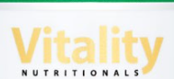
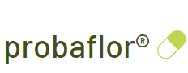





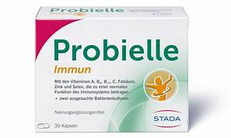
PREBIOTIC BRANDS
Many consumers aren’t aware of the prebiotic brands that they are taking or may be confused with probiotic brands – approximately 1 in 5 said they didn’t know
US
UK
Germany
Question: “What brand of prebiotics do you take?”

Slide 87
What do prebiotics users spend?
Monthly spend ranks 6 of 14 supplements surveyed
Individual Monthly Prebiotic Spend
Based on All Prebiotic Users
3%
19%
9%
35%
25%
Less than $10
$10-$19
$20-$29
$30-$49
$50 or more
Note: Take prebiotics at all is a combination of irregular and regular users, N=701. Question: “Approximately how much per month do you spend on this supplement?”

Slide 88
Monthly Spend on Prebiotics:
By Country
Average spend- US $19.61, UK $20.23, Germany $21.05
UK and Germans are more likely to spend more on Prebiotics than US, but largely all countries will likely spend less than $30 monthly
Regular Users’ average spending is similar across countries, but USA Irregular Users are spending more than UK and German counterparts
Note: Regular Users indicated using supplement at least 4 times per week. US N=115, UK N=61, Germany N=65. Question: “Approximately how much per month do you spend on this supplement?”

Slide 89
Spend Comparison vs other Supplements
Users who take prebiotics are more likely to spend in the higher price categories.
Note: Take supplement at all. Prebiotic N=701, Probiotic N= 1065, Fish oil N=1018, Multivitamin= 1599. Question: “On average, how much do you spend monthly on vitamins, minerals, herbals, or other dietary supplements for just yourself?”

Slide 90
Prebiotics user Yearly Spend:
2018-2020 (US DATA)
US, take prebiotics at all. Question: On average, how much do you spend monthly on vitamins, minerals, herbals, or other dietary supplements for just yourself?

Slide 91
Branded Ingredients
More prebiotic consumers choose branded ingredients than in other categories surveyed
Note: Regular Users indicated using supplement at least 4 times per week. N=241 for Prebiotics Regular Users, N=460 for Prebiotics Irregular Users. Question: “When deciding which supplements to purchase, how important is the inclusion of branded or proprietary ingredients?”

Slide 92
Branded Ingredients: comparison between supplements
Take supplement regularly. Question: “When deciding which supplements to purchase, how important is the inclusion of branded or proprietary ingredients?”

Slide 93
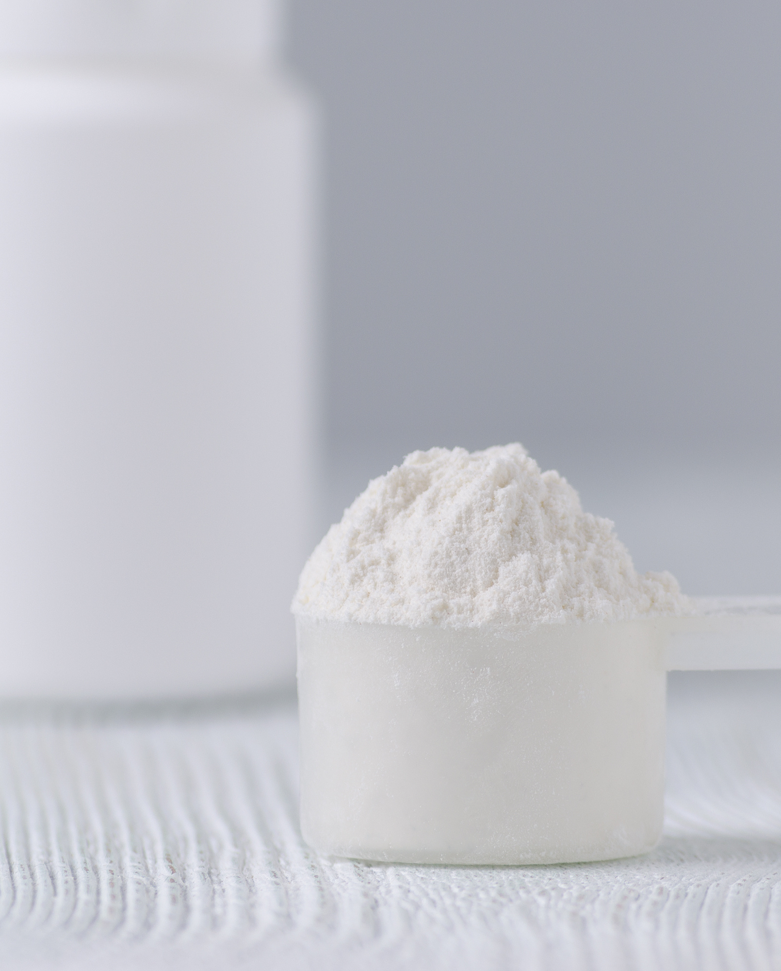
TRUST, TRANSPARENCY
AND SUSTAINABILITY
INFLUENCE ON PREBIOTIC
PURCHASING BEHAVIOR​

Slide 94
Trust
Irregular prebiotic users care more about seals/ certs and an informative website than Regular users.
Note: Regular Users indicated using supplement at least 4 times per week. N=241 for Prebiotics Regular Users, N=460 for Prebiotics Irregular Users. Question: “What characteristics most encourage you to trust a supplement brand?”

Slide 95
Trusting in Supplements:
Prebiotics vs other categories
Take supplement regularly. Question: “What characteristics most encourage you to trust a supplement brand?”

Slide 96
Trust: all responses VS. Prebiotic users
Prebiotic users tend to care more about values, causes and stories than other supplement users.
All responses to survey N=2004, take prebiotics regularly N=241. Question: “What characteristics most encourage you to trust a supplement brand?”

Slide 97
Trust: by country FOR PREBIOTIC USERS
US Top 3
Health care professional Consistent product quality Certs & Seals
UK Top 3
Consistent product quality Health care professional Transparency in supply chain
Germany Top 3
Certs & Seals Brand values align Consistent product quality & Health care professional
Note: Regular Users indicated using supplement at least 4 times per week. US N=115, UK N= 61, Germany N=65. Question: “What characteristics most encourage you to trust a supplement brand?”

Slide 98
Transparency signals
Quality seals are important for all supplement consumers
Country of origin is more important to prebiotic users than other supplement categories
Note: Regular Users indicated using supplement at least 4 times per week. N=241 for Prebiotics Regular Users, N=460 for Prebiotics Irregular Users. Question: “Which of the following items are the strongest signals that a supplement brand is operating transparently?”
Notes:
Question 10c

Slide 99
Transparency Purchase influence
Transparency strongly influences purchase decision
Note: Regular Users indicated using supplement at least 4 times per week. N=241 for Prebiotics Regular Users, N=460 for Prebiotics Irregular Users. Question: “How likely are you to purchase supplements from a manufacturer that provides transparency information on its label or website?”

Slide 100
Sustainability impact
An ingredient’s sustainability/environmental impact has a significant impact on purchase decision among prebiotic users compared to other categories
There was no significant variation by country
Note: Regular Users indicated using supplement at least 4 times per week. N=241 for Prebiotics Regular Users, N=460 for Prebiotics Irregular Users. Question: “When deciding which supplements to purchase, to what degree does the sustainability/environmental impact of a supplement ingredient influence your purchasing decision?”

Slide 101
Sustainability: Across Supplements
Question: “When deciding which supplements to purchase, to what degree does the sustainability/environmental impact of a supplement ingredient influence your purchasing decision?”

Slide 102

Len Monheit
Executive Director
len@trusttransparency.com
Questions?
Traci Kantowski
Communications Director
traci@trusttransparency.com
/prebioticassociation
@PrebioticAssoc
PrebioticAssociation.org

