Slide 1
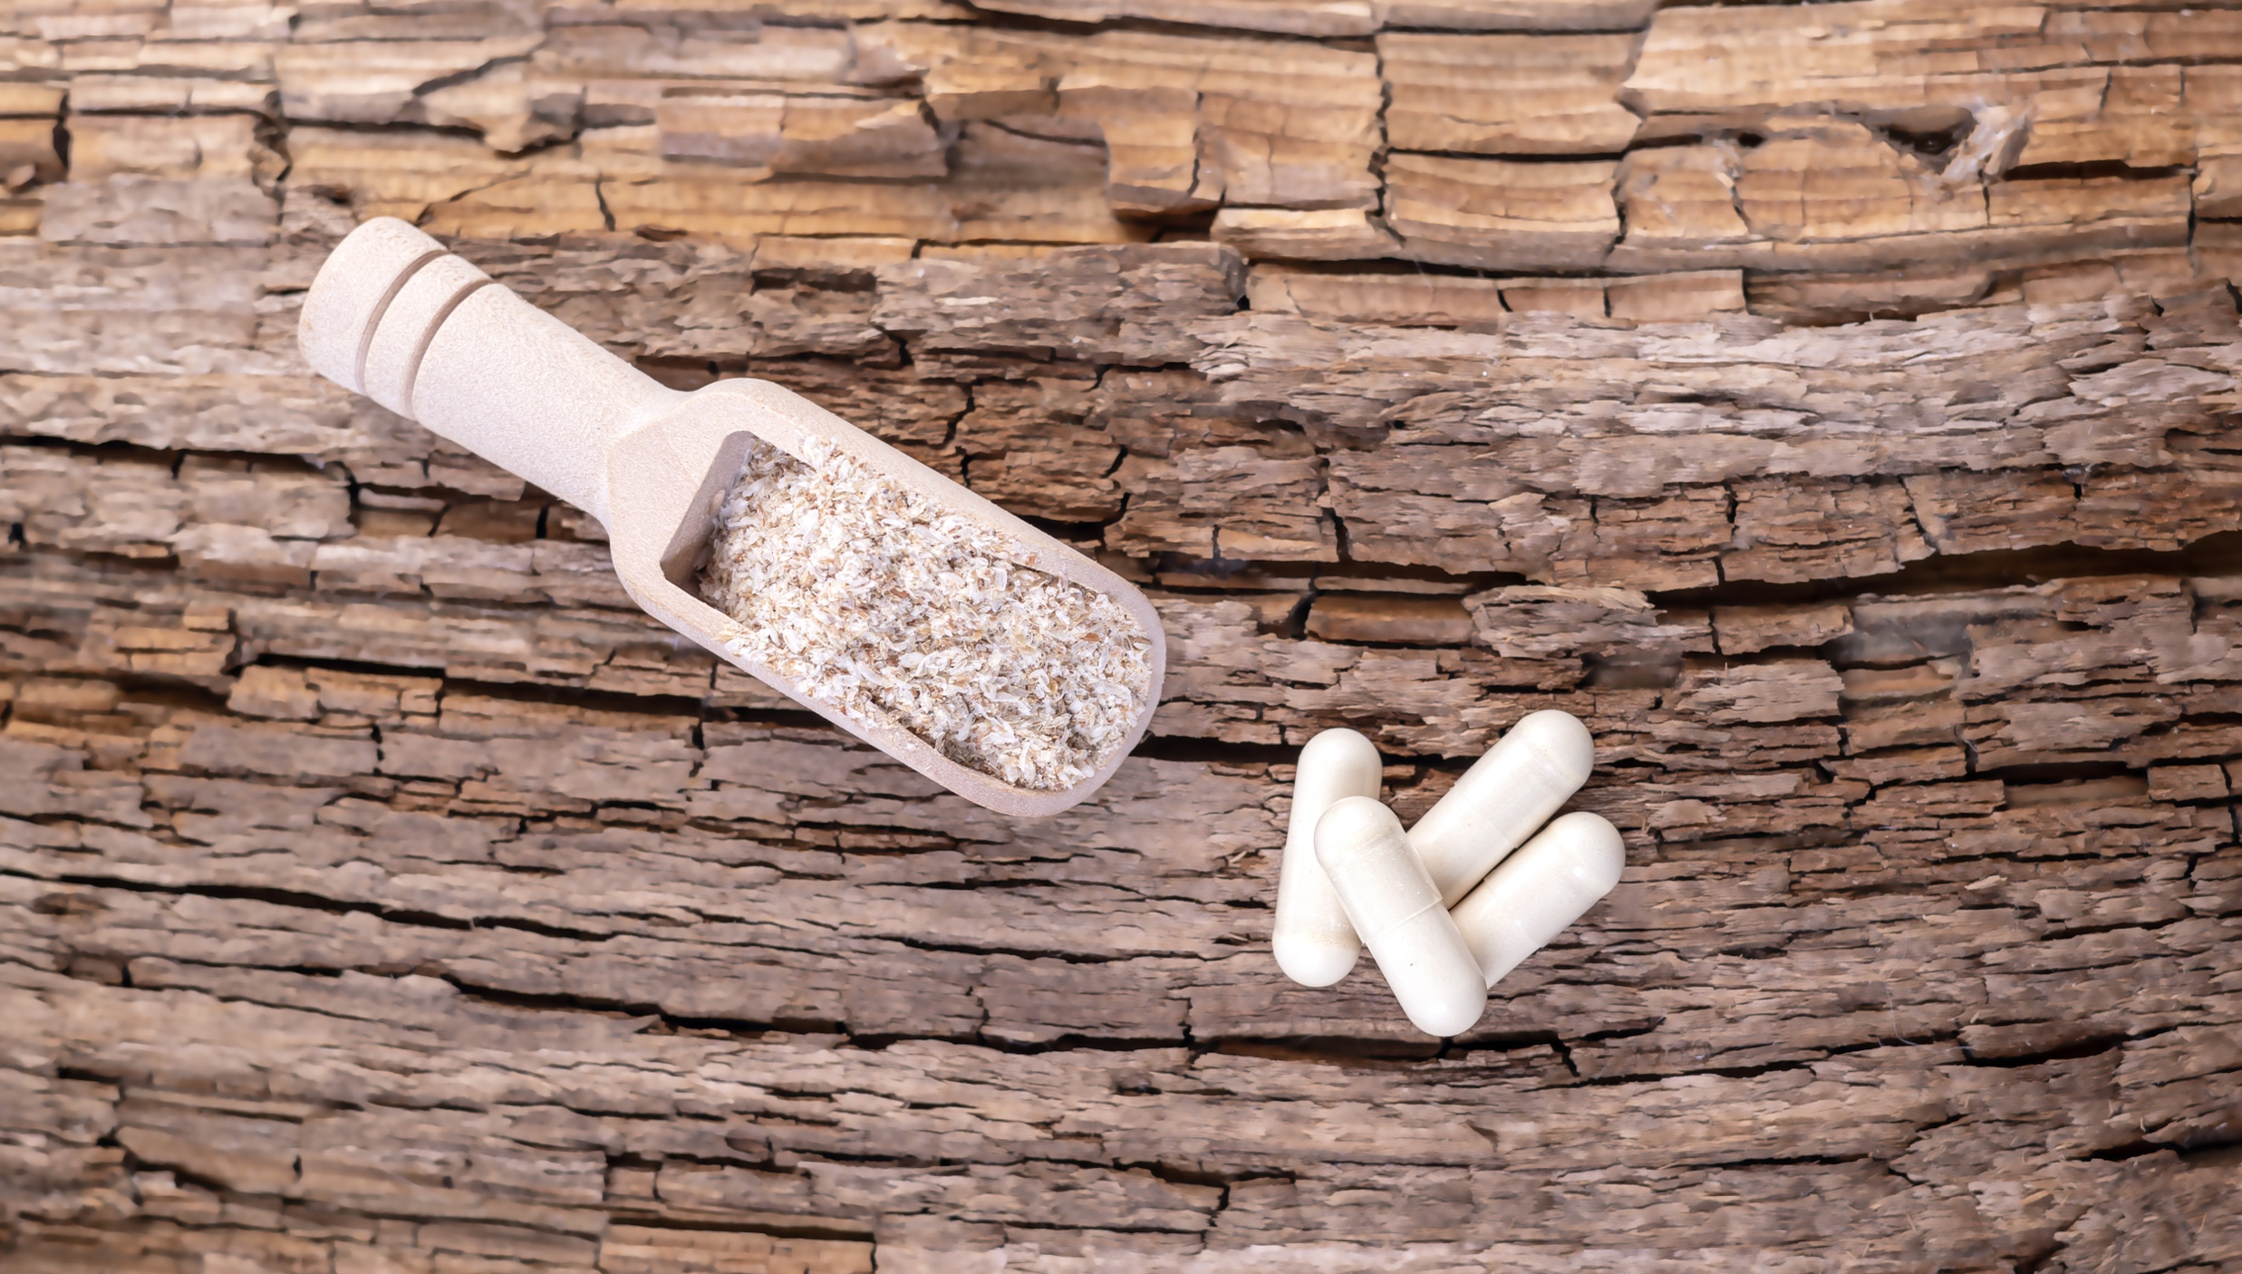
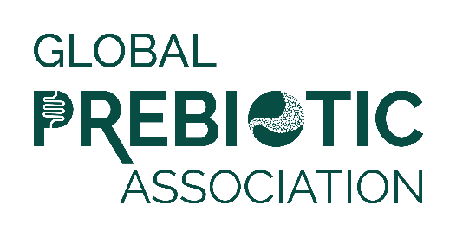
Media Insights Report
Q1 2024

Slide 2
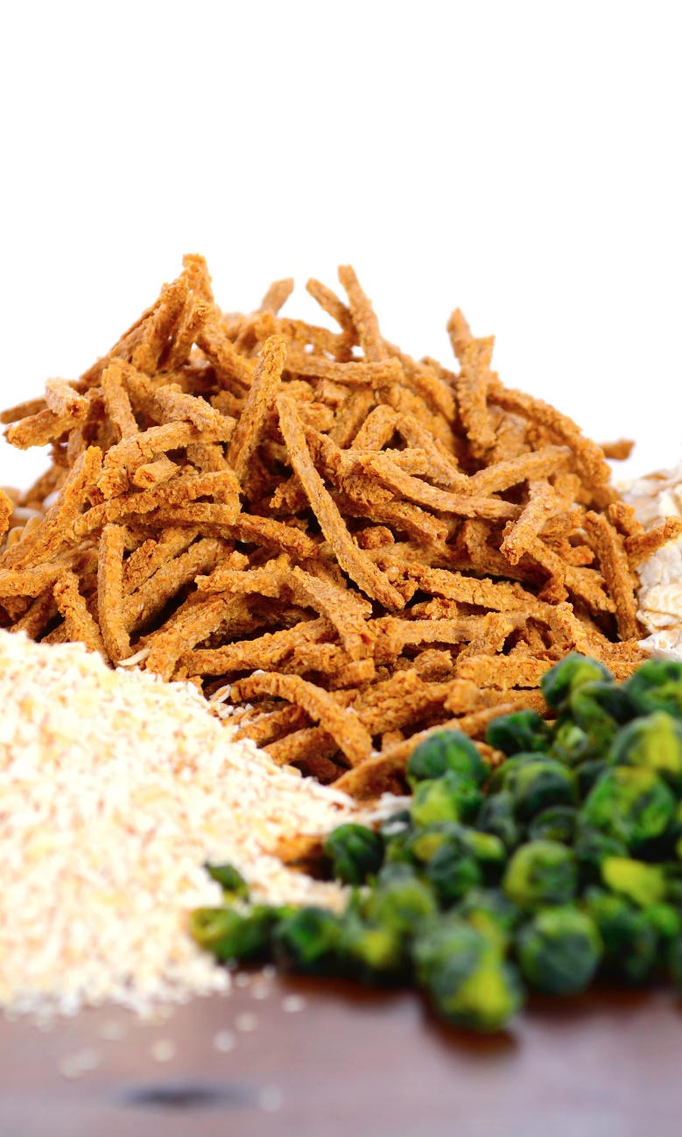
Data Summary
Data was pulled from Muck Rack insights for the period of January 1 to March 31, 2024.
Reports looked at traditional media and social media, with a heavy emphasis on consumer-reaching media.
Trade coverage and new product launches are also included.
Full text of articles may be accessed by clicking the article image on each slide.

Slide 3
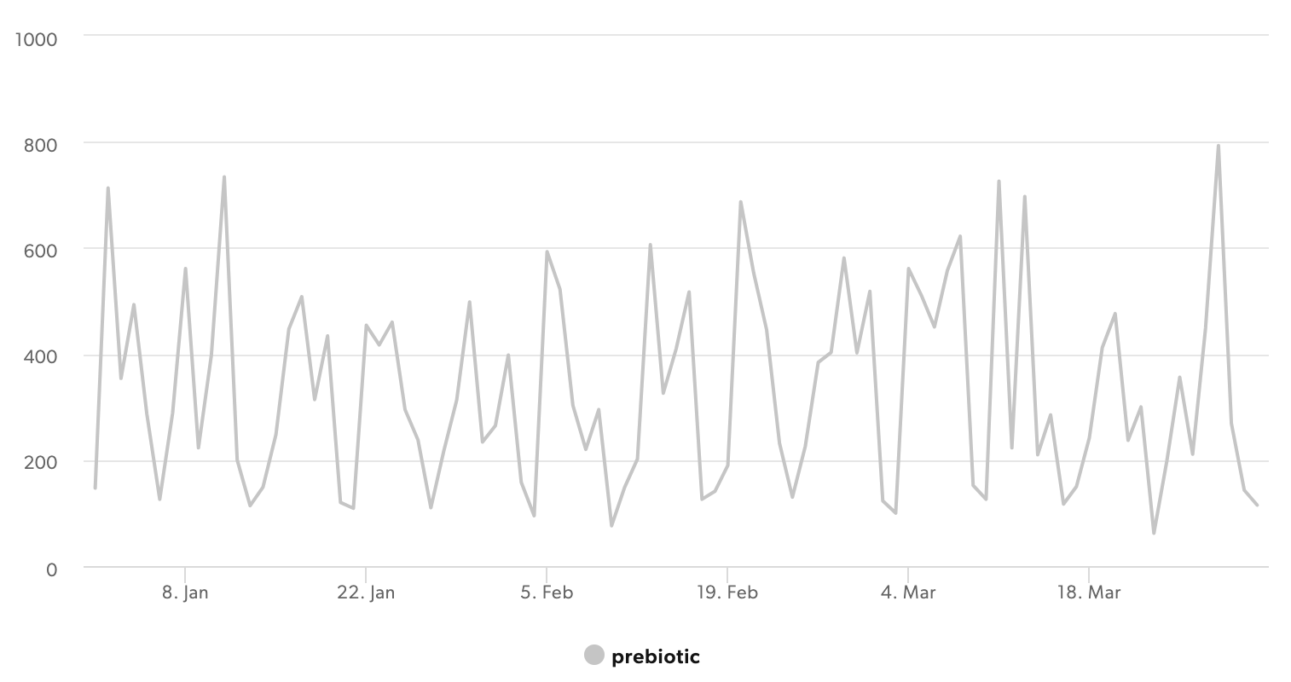
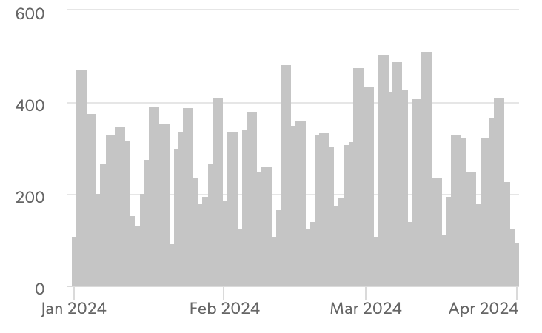
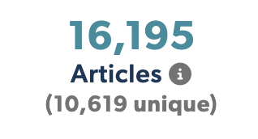
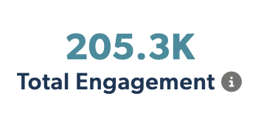


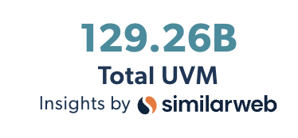
Articles Over Time
Unique Outlets
Coverage drivers are listed on the following slides.

Slide 4
Research Expansion
Skin Microbiome
Synbiotics & Combination Products
Mental Health & Wellness
Health Care Innovations
Soda /Pop
Animal / Pet Health
Functional Beverages
New Formulas
Trending Topics
Vegan & Plant Based
Anti-Disease
Anti-Aging / Longevity
Imbalance
New & Novel Prebiotics

Slide 5
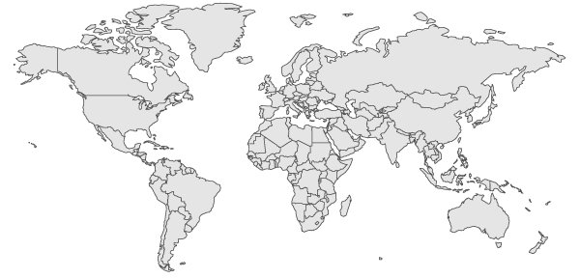
Top Countries/Regions
Canada
3%
UK
8%
USA
46%
Europe
12%
Asia
7%
India
8%
South America
& Mexico
4%
Africa
2%
Australia & New Zealand
3%

Slide 6
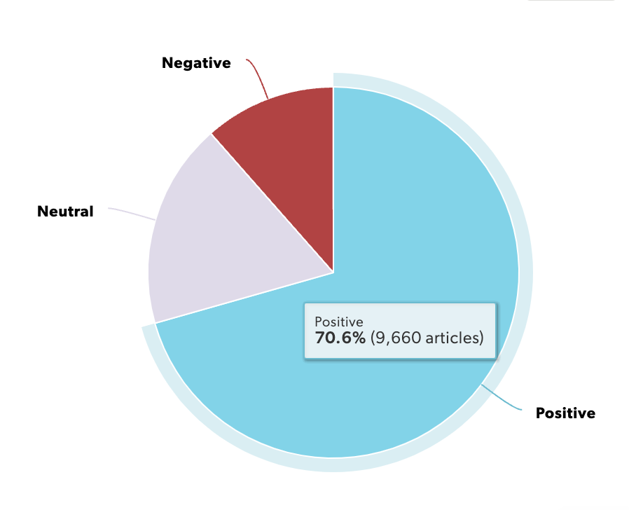
Sentiment
Coverage is positive overall, with more media coverage and study growing.

Slide 7
Experts & Influencers
The Best Products For Treating Psoriasis, According To Dermatologists
To get lean and healthy Dr. Stork’s way, consider a prebiotic supplement and begin building meals and snacks around fiber-rich plant foods. Emphasize prebiotic superstars like asparagus, onion, garlic, greens, beans, tomato, banana and berries.
Constantly bloated? This is what nutritionists want you to know…Jordan Hill, RD, nutritionist, Top Nutrition Coaching. Courtney Schuchmann, RD, nutritionist, University of Chicago Medicine. Molly Kimball, RD, CSSD, founder and director, Ochsner Eat Fit nonprofit initiative in New Orleans and host, FUELED podcast. Kim Kulp, RD, nutritionist and gut health nutrition expert based in California. Michael D. Brown, MD, is a gastroenterologist at Rush University Medical Group…
Impact of synbiotic supplements on the gut microbiome and overall health of penguins… Advancing research on this front, Professor Takumi Tochio and Dr. Tadashi Fujii from the Department of Medical Research on Prebiotics and Probiotics, Fujita Health University, Aichi, Japan.

Slide 8
Product Launches
Beech-Nut introduces prebiotic offerings and new snacks for infants… a range of new smoothie, yogurt and snack products.
Bubbies to Release World’s First - and Only - Fermented Pickle Chip…The new Kosher Dill Pickle Chips will have the prebiotics and probiotics, fiber and nutrients that are only present in a fully fermented pickle.
Ombre Revolutionizes Gut Health Market with Launch of Innovative Symbiotic and Green Prebiotic Products at Expo West
Beyoncé’s haircare brand Cécred is now live: Products and other details explored…Cécred's entire range features three essential components: bioactive keratin, a prebiotic ferment, and 'Beyhive' honey.
Biotiful unveils ambient meal boosters to enhance gut health… The meal boosters contain billions of live cultures, prebiotic fibres, oats, fruits, seeds and spices.

Slide 9
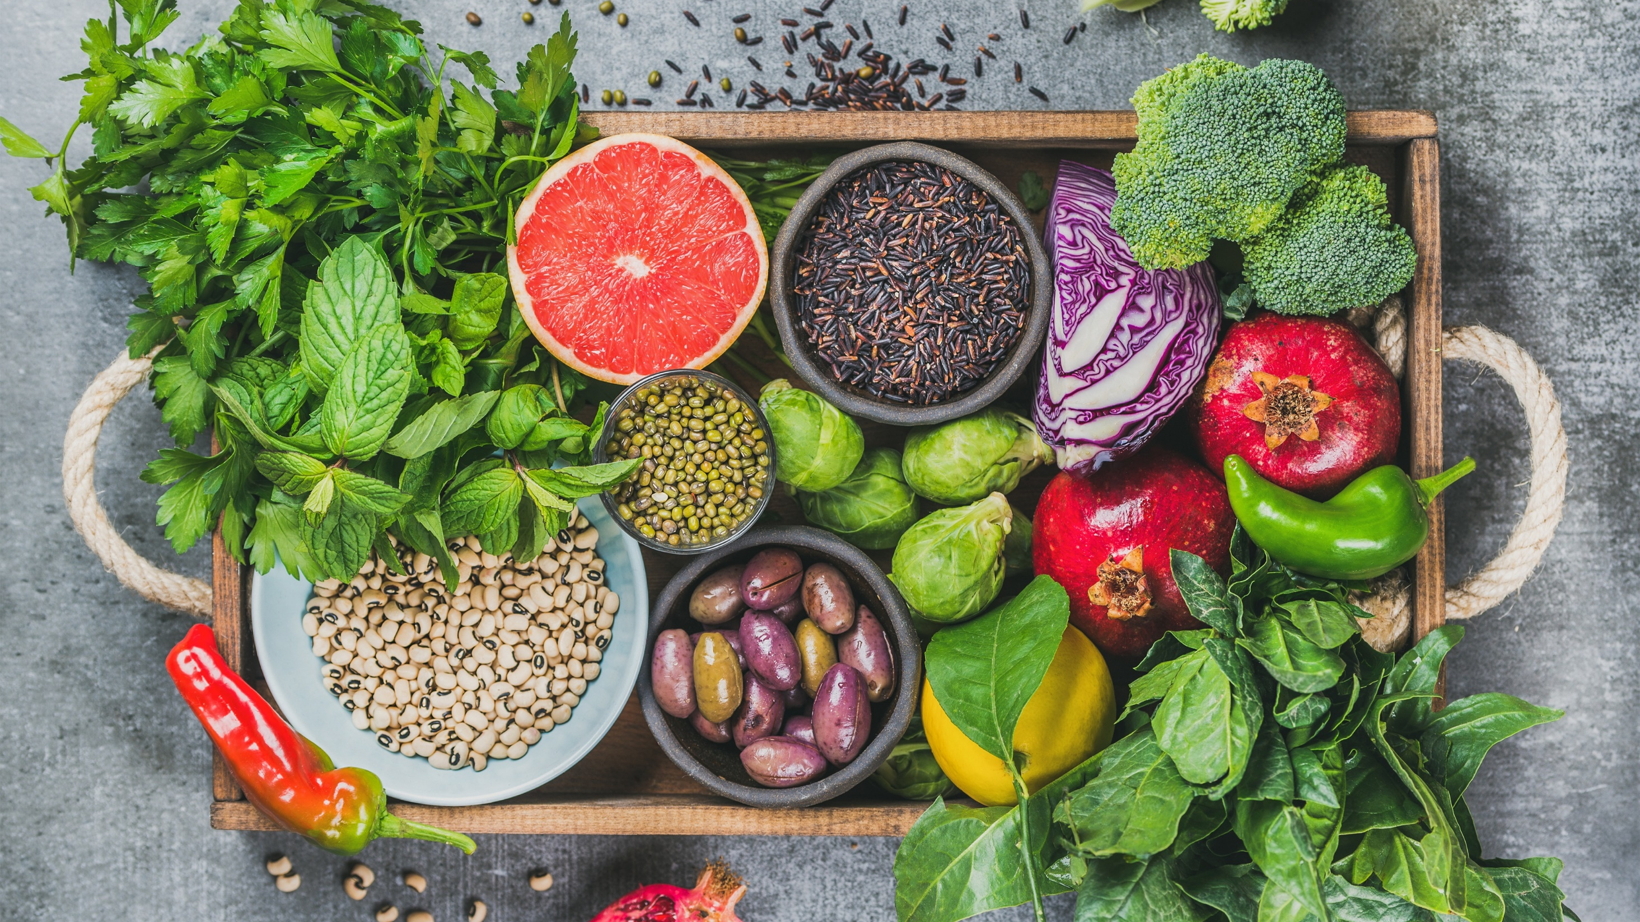
Media
Coverage
Highlights

Slide 10
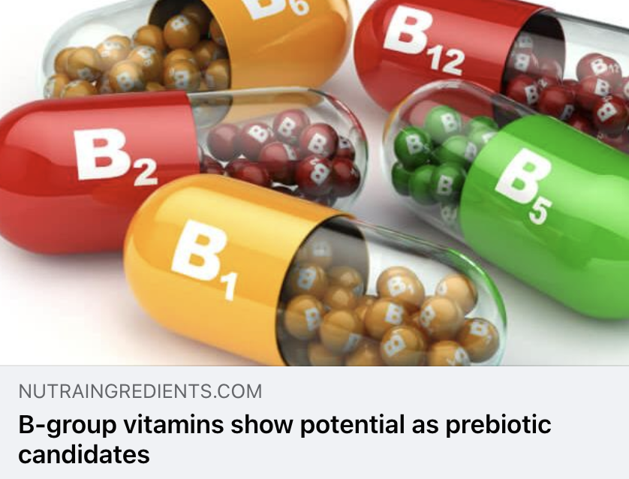
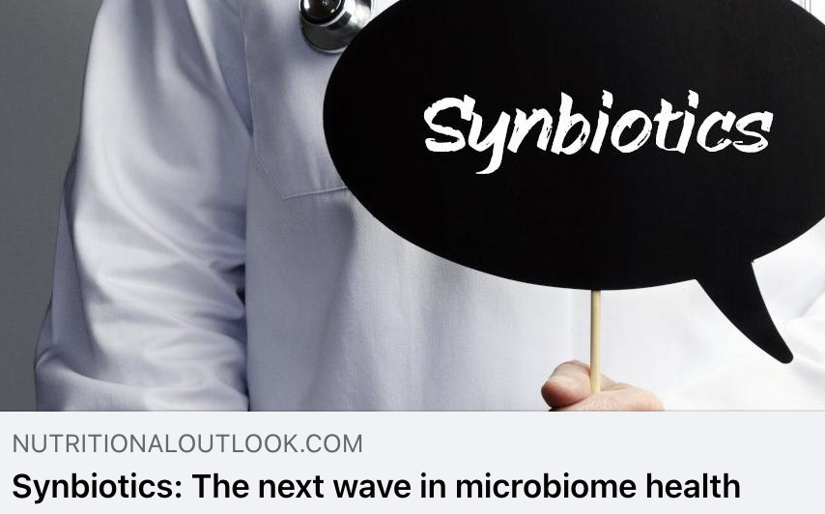
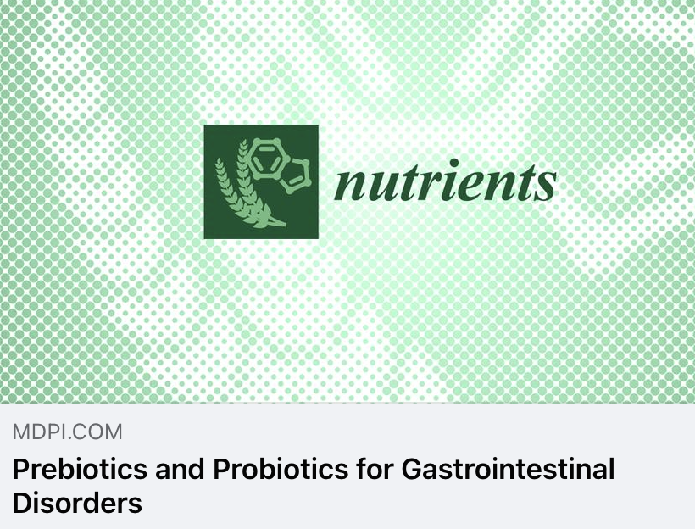
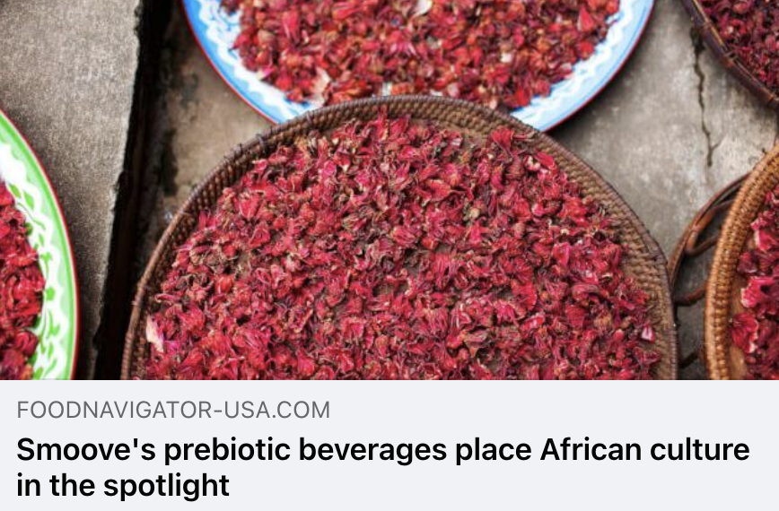
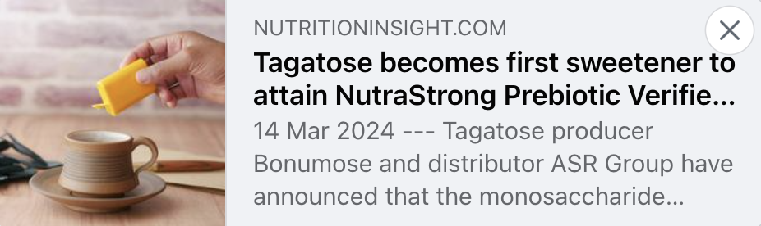
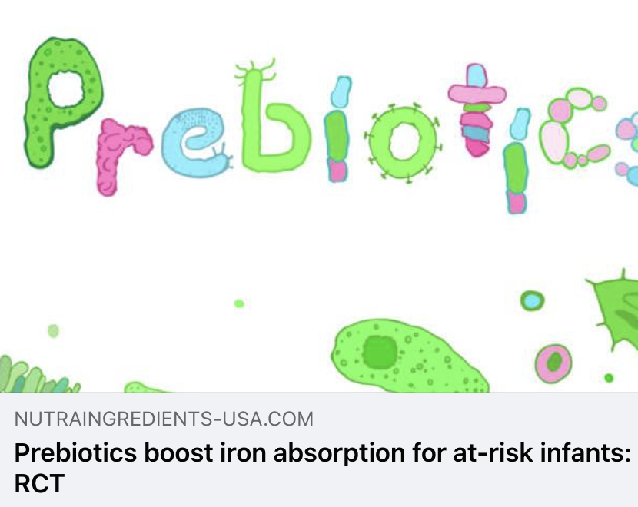
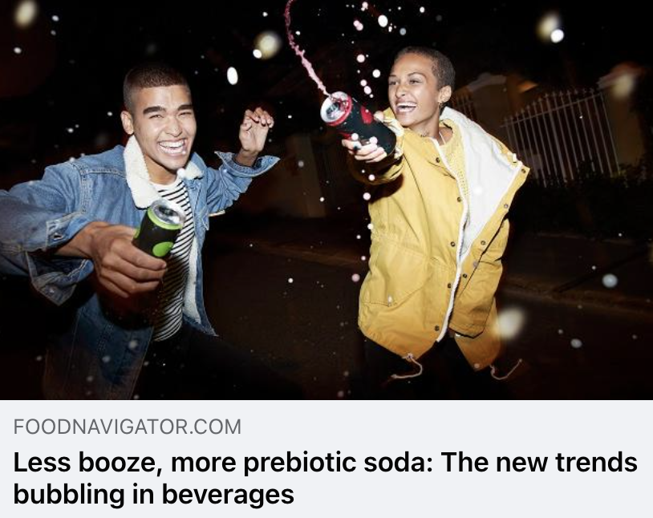
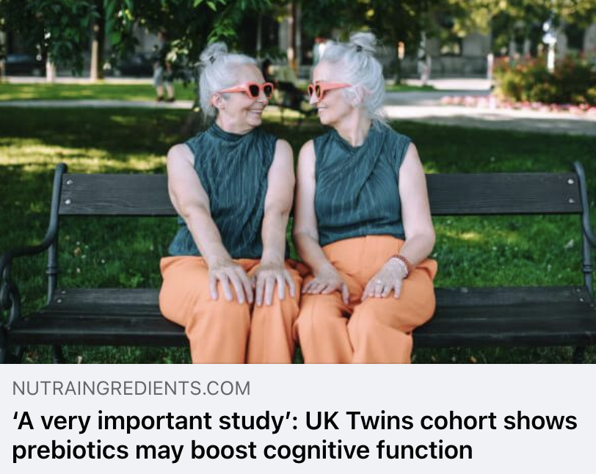

Trade Coverage

Slide 11
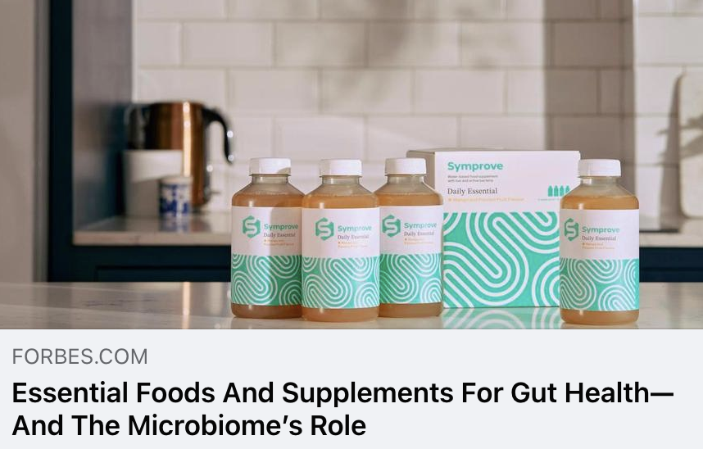
Forbes
UVM 81,472,794
Why is a healthy gut microbiome so important? According to the National Health Service UK, with an estimated 13 million people suffering from gut issues, including IBS and 10-15% worldwide, it’s no surprise that there’s an appetite to learn why and how to best manage symptoms. The microbiome consists of trillions of living bacteria, viruses, fungi and other microbes inside your gut that play essential roles in digestion, immune system regulation and overall health.

Slide 12
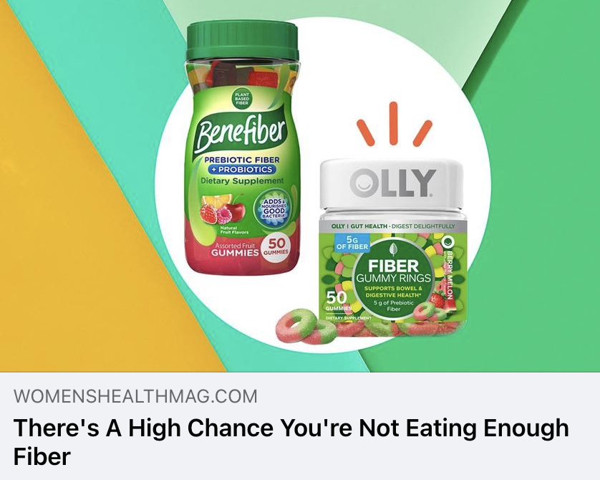
Women’s Health
UVM 18,587,241
If you heard about a super-nutrient that could help protect against chronic diseases, improve your gut health, and help keep your digestion running at a healthy pace, you'd almost certainly want in. There's good news and bad news. First, the good news: This nutrient exists, and it's easy to access—fiber. The bad news: According to a recent report by the American Society for Nutrition, only seven percent of American adults are consuming their daily recommended intake of fiber.

Slide 13
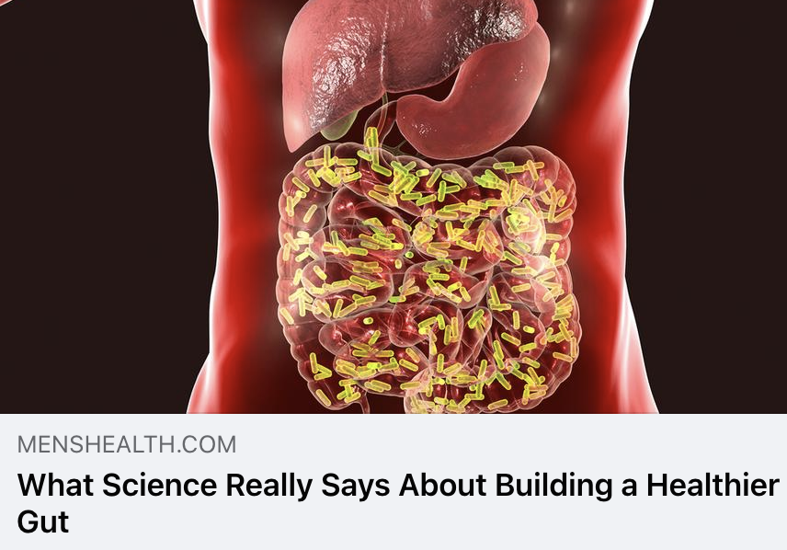
Men’s Health
UVM 21,414,233
"Our bodies are quite clever,” says Jack Gilbert, Ph.D., a microbiologist at UC San Diego and the director of the Microbiome and Metagenomics Center. Enzymes our bodies make help us digest what we’re able to, then we rely on microbes—mainly bacteria in the colon—to digest the rest. Like you, microbes “poop” out by-products they can’t process. Depending on what they’re eating, these by-products can cause gas and other issues, or their “waste” can be useful things like vitamins B and K. An out-of-whack microbial mix is linked to common digestive ailments as well as Crohn’s disease and ulcerative colitis.

Slide 14
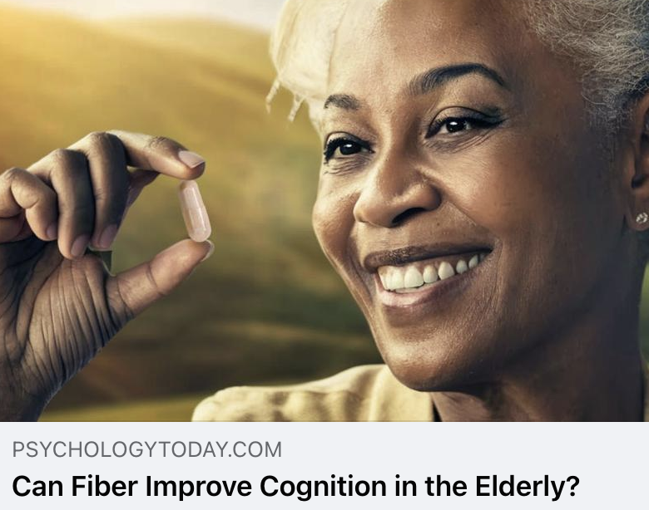
Psychology Today
UVM 14,075,557
A new study has found that a simple prebiotic could boost beneficial bacteria in the gut and improve scores on a cognitive test in people over 65. This could be fantastic news to those worried about the seemingly inevitable descent into dementia as we age. The study, conducted by Clare Steves, Mary Ní Lochlainn, Kevin Whelan, and colleagues at King’s College, London, found that the people taking a prebiotic fiber had significantly better scores on a test called the paired associates learning test. This visual-memory test is often used to detect early signs of Alzheimer's.

Slide 15
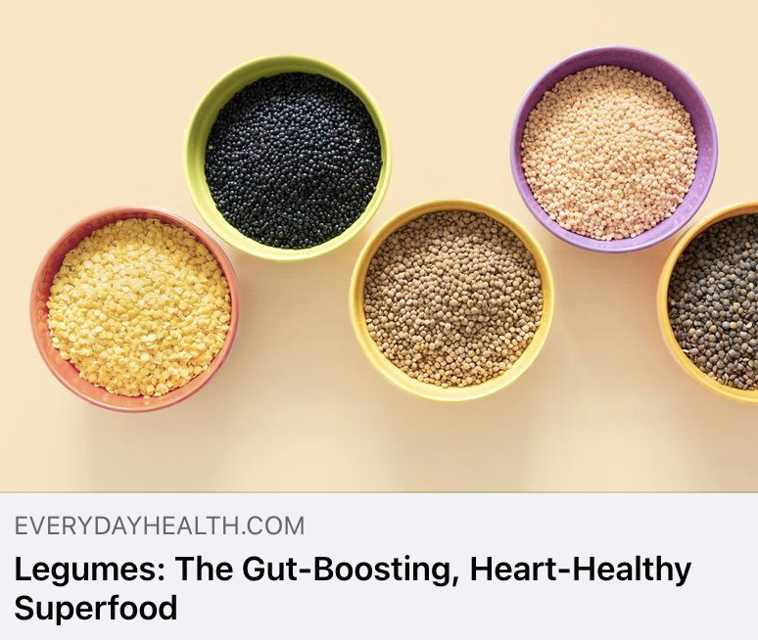
Everyday Health
UVM 7,886,838
Legumes — such as beans, lentils, and peas — are packed with nutrients that are beneficial for the body. Not only are they loaded with complex carbohydrates, fiber, minerals, and vitamins, they’re also a rich source of protein — minus the saturated fat and cholesterol common in many animal proteins. The American Heart Association recommends beans and other legumes as part of a healthy eating plan. Studies even say that a legume-heavy diet may reduce cholesterol, lower blood pressure, and improve diabetes risk. When it comes to the gut, fiber-rich legumes overall promote regular bowel movements and encourage beneficial gut bacteria for a healthy digestive tract. But digesting beans can be difficult for some, leading to discomfort, such as bloating, gas, and other intestinal problems.

Slide 16
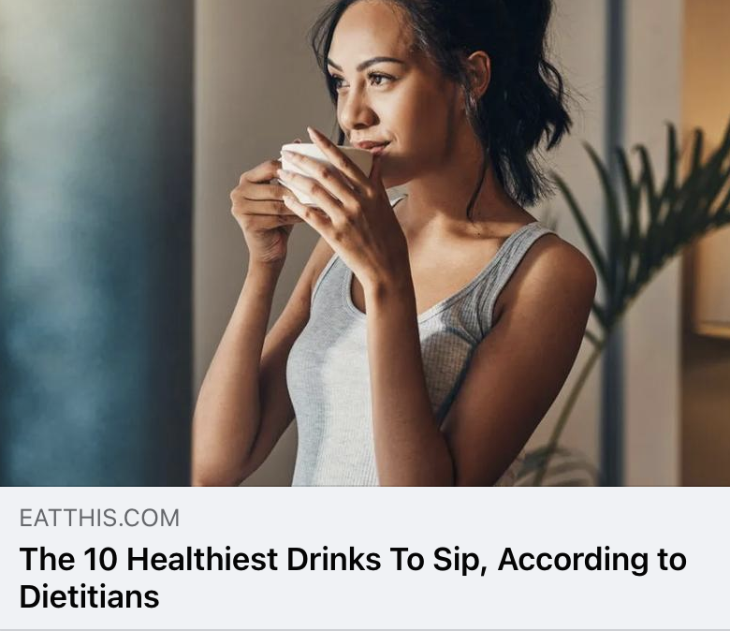
Eat This, Not That
UVM 7,541,711
Staying hydrated is one of the most important things you can do to support your overall health, but choosing the right drinks to sip is key. Some drinks can bolster your well-being whereas others can do the complete opposite. While water should be your go-to for hydration, there's a whole world of healthy beverages out there that can add valuable nutrients to your day, serve as a meal or snack, and boost your hydration all at once.
The healthiest drinks will promote health with their extra nutrients like vitamins, minerals, antioxidants, protein, and fiber without causing undesirable effects like sugar rushes or caffeine-induced jitters.

Slide 17

MindBodyGreen
UVM 4,499,606
So, the researchers of this study recruited 36 pairs of twins (72 individuals) over the age of 60. Twins were randomly divided to receive either a placebo or a prebiotic fiber supplement. While fiber is a broad term used to describe nondigestible carbohydrates, prebiotics are a specific type of carbohydrate that only nourish the good bacteria in your gut.*
The prebiotic supplement used in this study provided 7.5 grams of a mixture of fructooligosaccharides and inulin—both well-researched and readily available fiber supplements. Everyone was also given a protein supplement and instructions for weekly resistance exercises.

Slide 18

Beauty Bay
UVM 1,577,227
Your haircare routine needn’t end as soon as you’re out of the shower. Just as you’d moisturize your skin after cleansing, now’s the time to calm and rehydrate your scalp with a soothing tonic. By BEAUTY BAY’s Soothe + Calm Scalp Tonic contains oat, glycerin, and prebiotics, so it simultaneously helps to add moisture, strengthen your scalp’s skin barrier, and calm any irritation, all while continuing to gently exfoliate away dry skin and dandruff (thanks to salicylic acid).

Slide 19
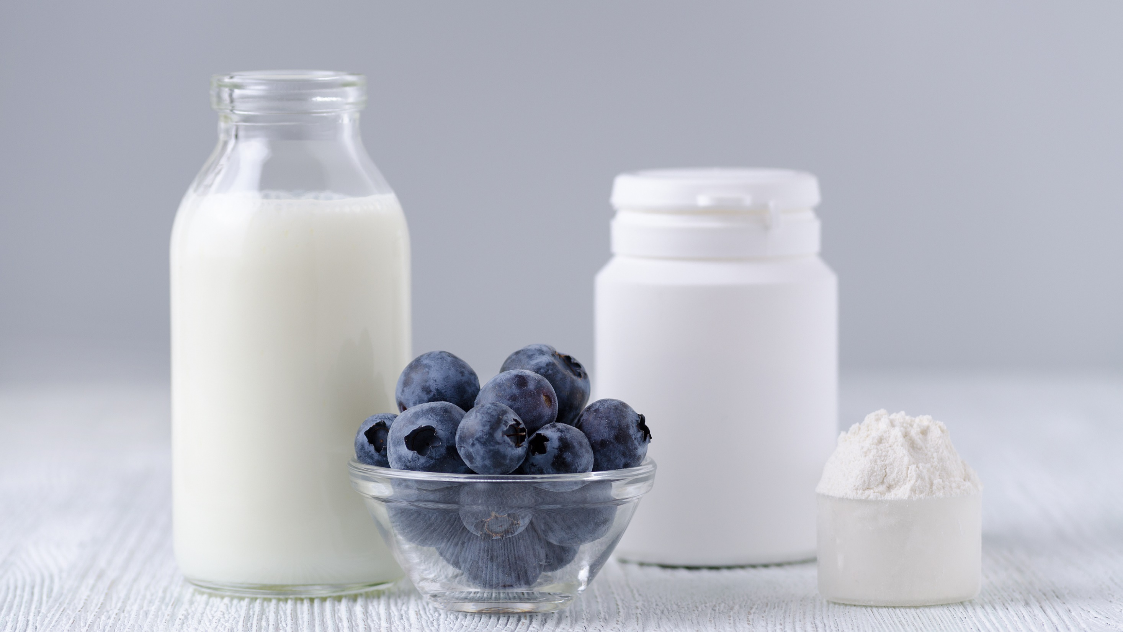
Questions?
Morgan Johnston
Communications Director
Global Prebiotic Association
morgan@itcstrategy.com
Tim Mizones
Project Specialist
Global Prebiotic Association
tim@itcstrategy.com

