Slide 1
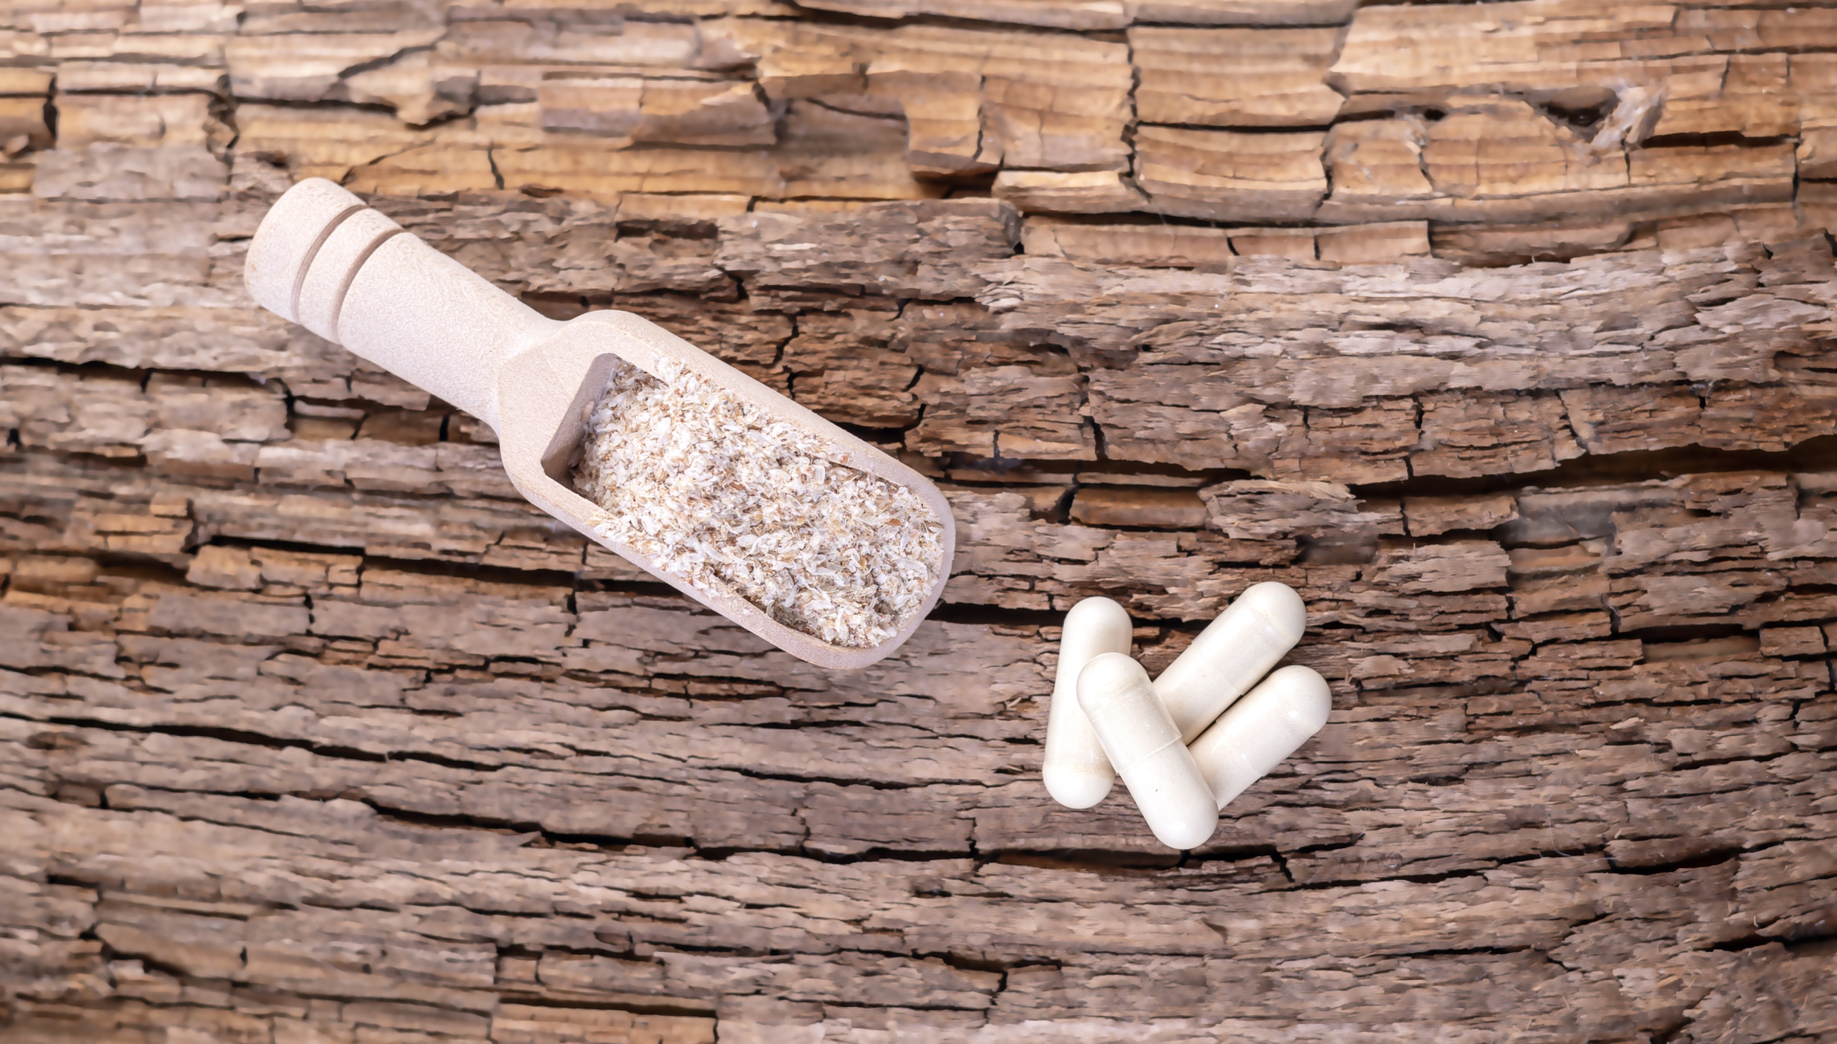
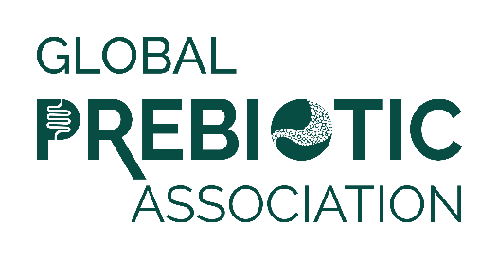
Media Insights Report
Q1 2023

Slide 2
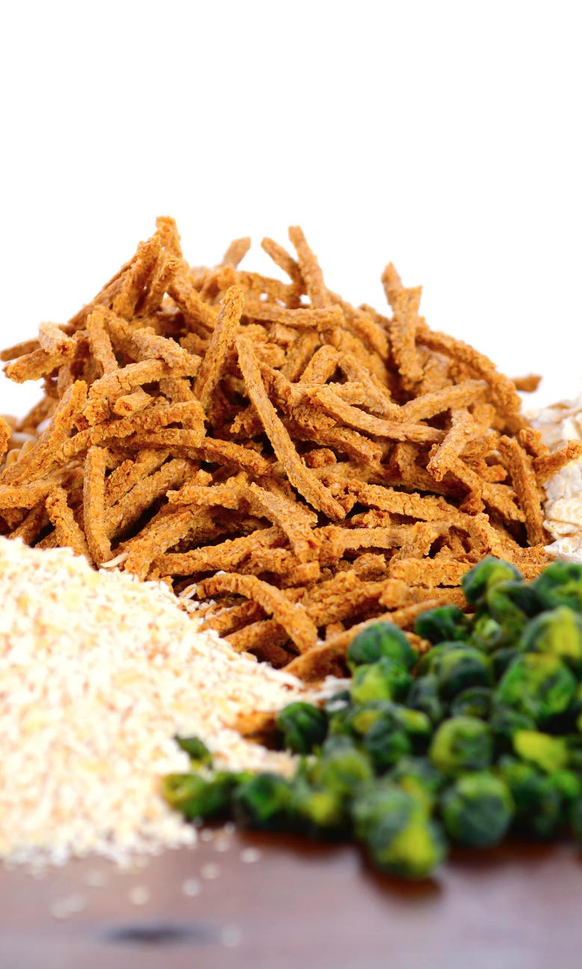
Data Summary
Data was pulled from Muck Rack insights for the period of January 1 to March 31, 2023.
Reports looked at traditional media and social media, with a heavy emphasis on consumer-reaching media.
Trade coverage and new product launches are also included.
Full text of articles may be accessed by clicking the article image on each slide.

Slide 3
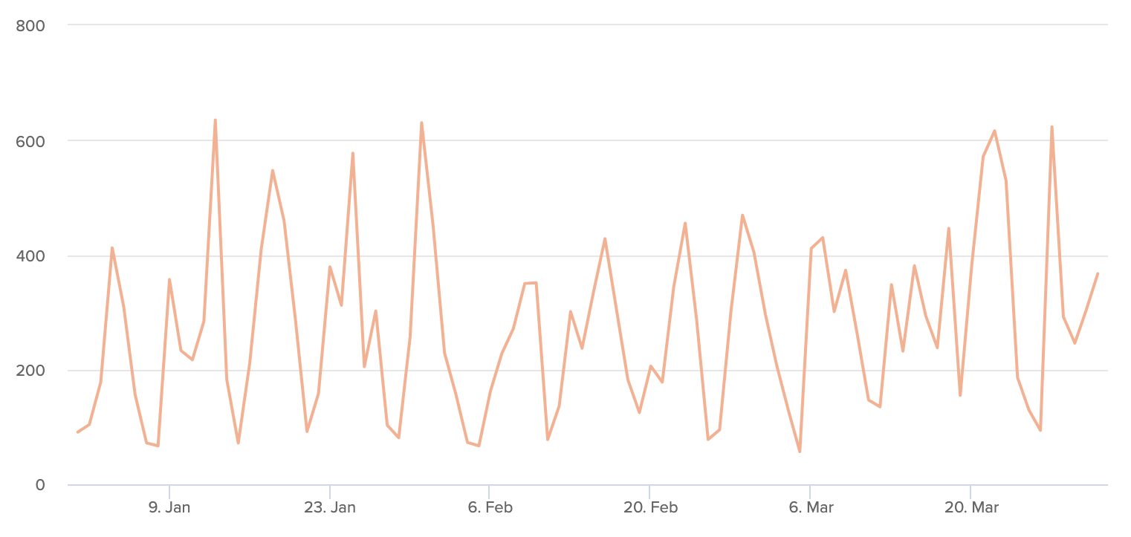
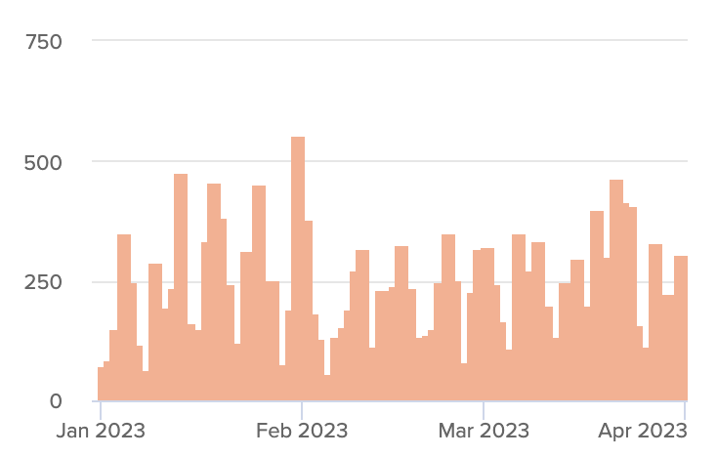

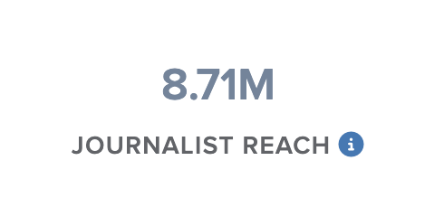
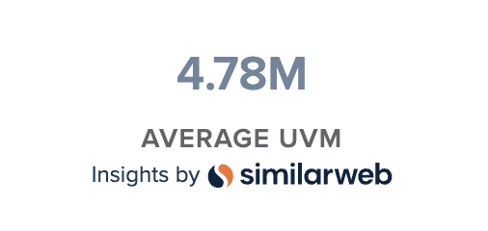
Articles Over Time
Unique Outlets
Coverage drivers are listed on the following slides.

Slide 4
Product Launches
Jarrow Formulas Launches Immune Booster - formulated with PreforPro, a prebiotic that helps balance the gut microbiota
FHIRST launches gut-healthy Living Soda line
As the UK Prebiotics market itself is rapidly growing, MOJU has expanded the Prebiotic Range with our latest launch Tropical Prebiotic.
Beech-Nut® Nutrition Company, an award-winning baby and toddler food manufacturer, launched Dino Biscuits with Hidden Veggies and Dino Biscuits with Prebiotics last week
Beyond Better Foods-owned brand Enlightened has expanded its better-for-you snacks portfolio with the launch of the new frozen Greek yogurt bars
Arcaea today launched its first ingredient technology, ScentARC™, designed to target specific underarm microbes…
Restorative Botanicals Launches New Functional Mushroom Product Line

Slide 5
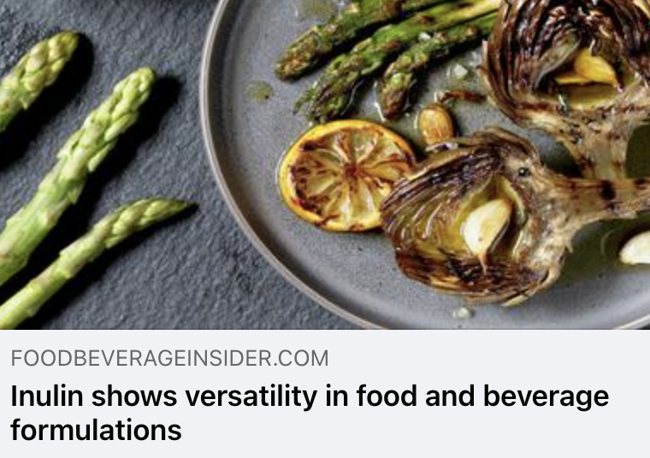
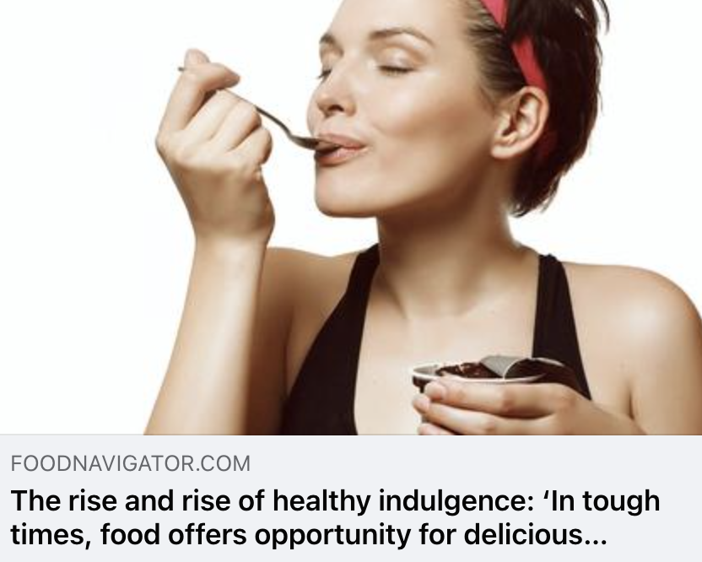
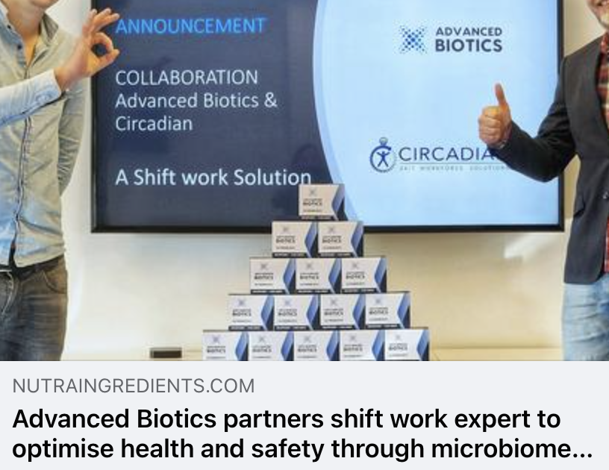
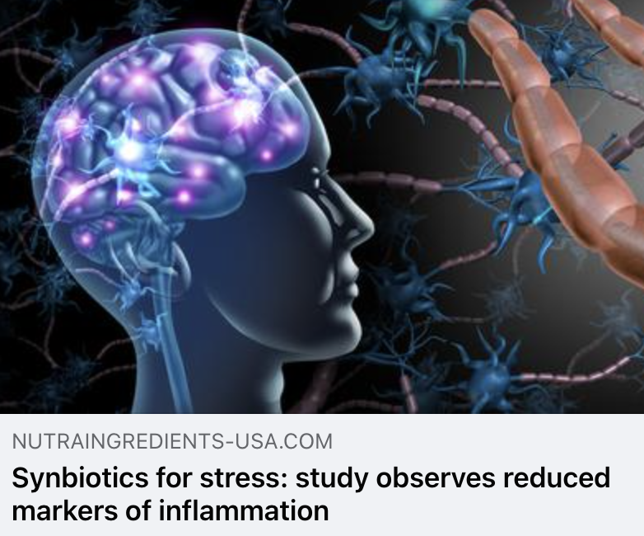
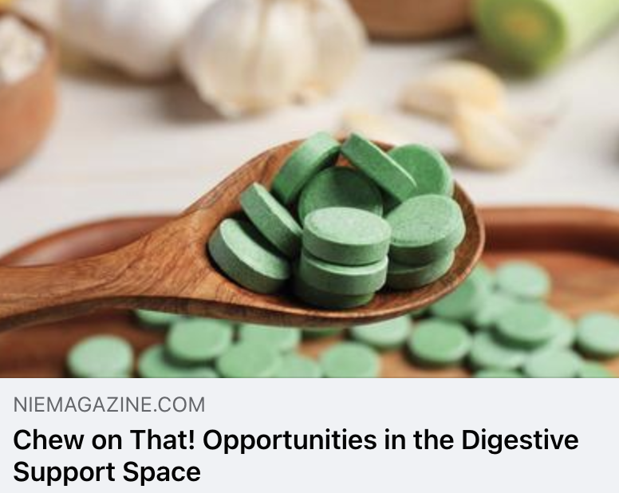
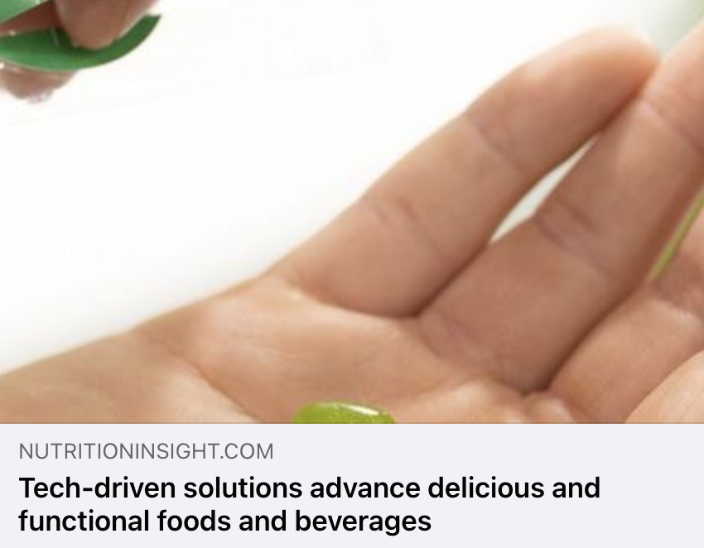
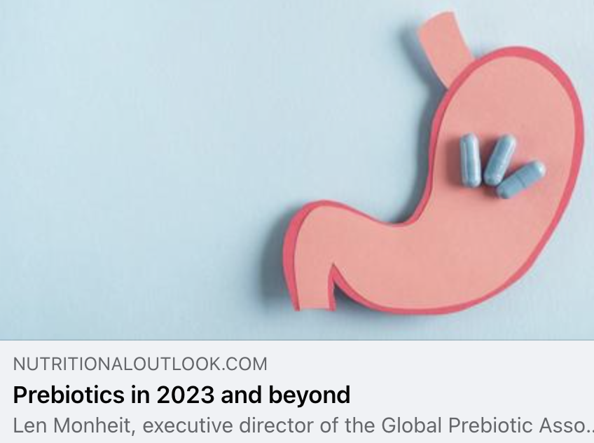
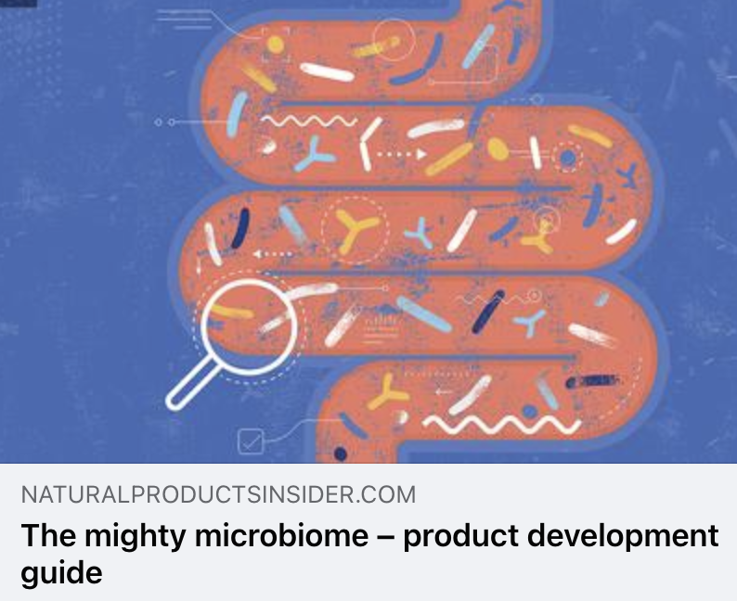
Trade Coverage

Slide 6
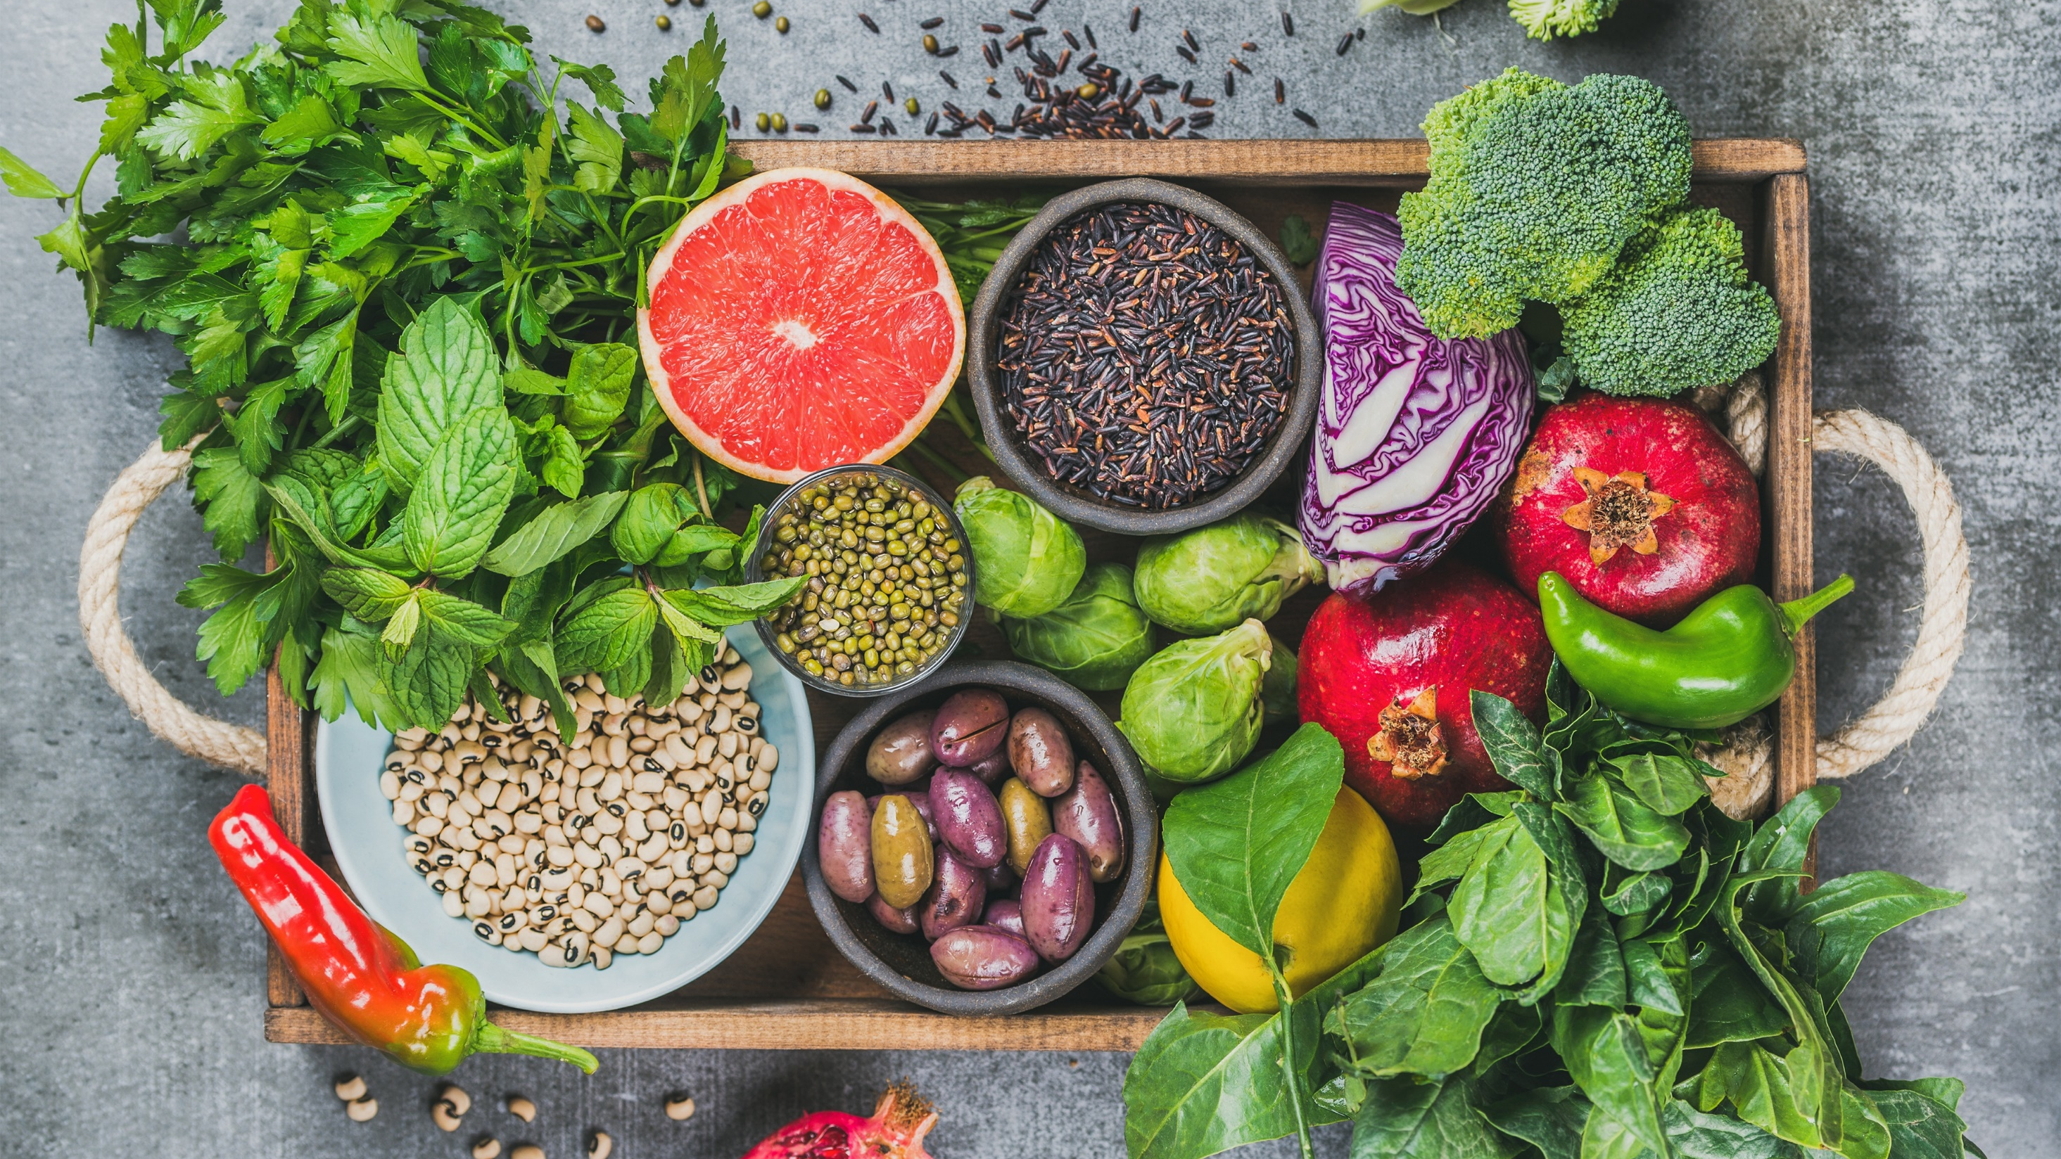
Media
Coverage

Slide 7
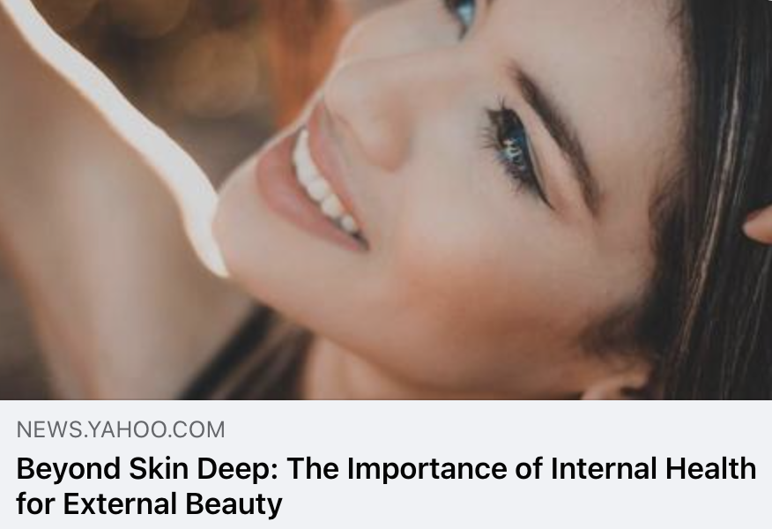
Yahoo!
UVM 411,180,653
The latest beverage revolution is riding the wave of better-for-you junk foods. The health and wellness of consumers is a priority for up-and-coming companies. Olipop is a refreshing healthy soda that mimics the taste of traditional sodas. Each can provide 32% of your daily fiber needs, no artificial sweeteners, and prebiotics to support digestive health. When it comes to beauty and wellness, gut health is everything. The good news is that you can now drink soda more healthily.

Slide 8
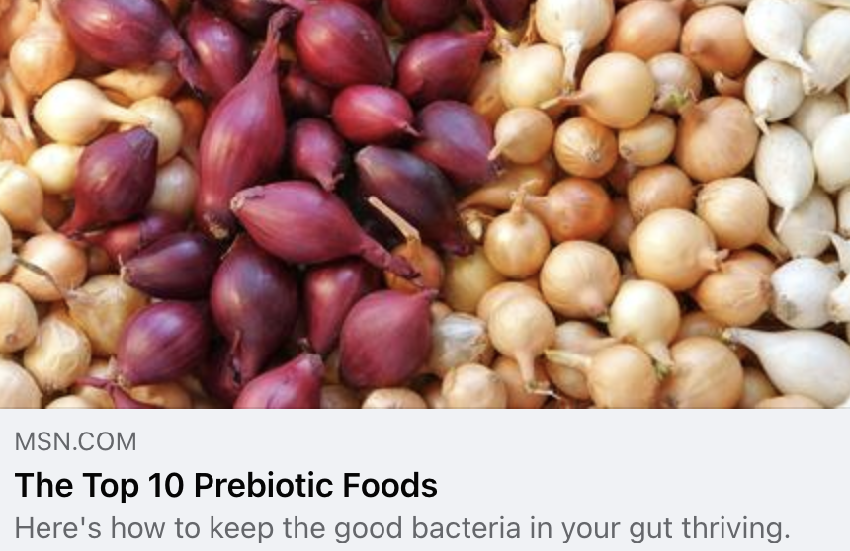
MSN
UVM 177,956,931
There are different types of prebiotics," adds Nour Zibdeh, M.S, R.D.N., a functional dietitian specializing in digestive disorders. The prebiotics that are commonly highlighted are oligosaccharides, which are a type of carbohydrate naturally found in a variety of plant foods. Others include fructans, inulin and pectin. When "good" bacteria probiotics ferment prebiotics, they produce "postbiotics," which are healthy, beneficial byproducts that are "heart-protective and help prevent diabetes," says Zibdeh. You’re probably already eating prebiotics, especially if you’re consuming a variety of high-fiber rich foods, but it might be time to take it up a notch to ensure you reap the benefits. Here are some of the top prebiotic foods worth adding to your diet.

Slide 9
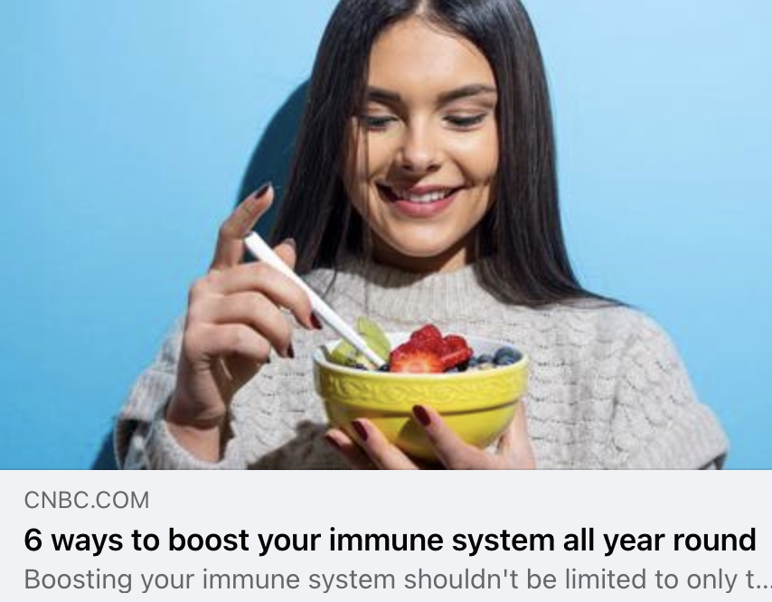
CNBC
UVM 57,504,218
Miller encourages you to implement these behaviors throughout the year to increase your immune resilience:
Eat foods high in fiber like berries and avocados, or take probiotics/prebiotics: gut health can greatly impact your immune system
Reduce sugar intake
Exercise regularly
Get sufficient hours of sleep
Lower alcohol intake
Don’t smoke or consume drugs (that aren’t prescribed to you for medical reasons), as these activities can weaken your immune system

Slide 10

Women’s Health
UVM 29,481,781
Prebiotics are non-digestible carbohydrates that your good gut bacteria love, Dandrea-Russert says. Prebiotic-rich foods include leeks, garlic, onions, oats, sweet potatoes, asparagus, and flaxseeds. Aim to eat one or more servings of these foods daily, but you may want to increase slowly over time to help your body adjust smoothly.

Slide 11
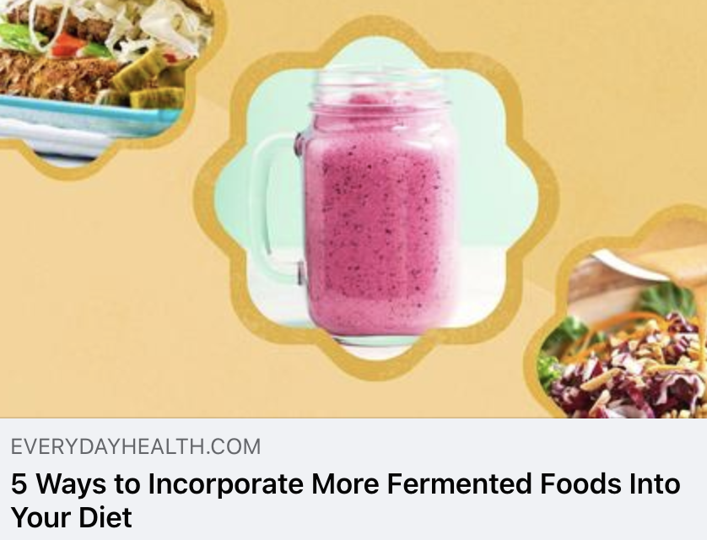
Everyday Health
UVM 14,095,360
Fermented foods like yogurt, kimchi, and sauerkraut have become increasingly popular in recent years, but they are certainly not new. Fermented foods have been a staple in the human diet all across the world for millennia, and for good reason. Research published in the June 2022 issue of Microorganisms showed that regular consumption of fermented foods can improve the health of your gut microbiome, combat inflammation, and even help you absorb more nutrients from food. Additionally, fermented foods add depth of flavor to a variety of dishes, and it's easier than you might think to make them a part of your diet.

Slide 12
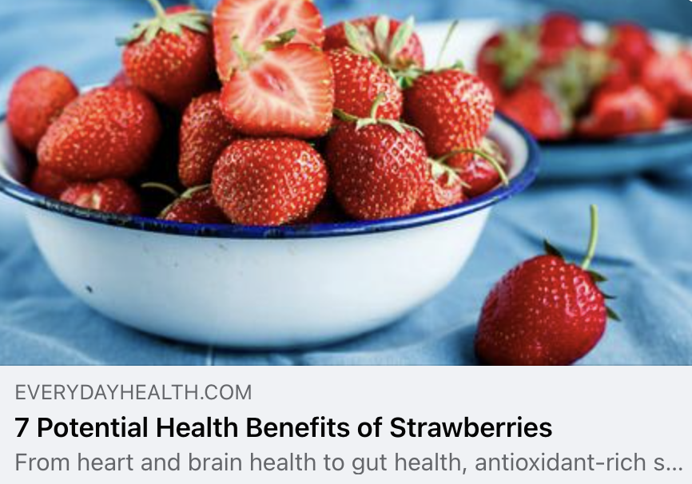
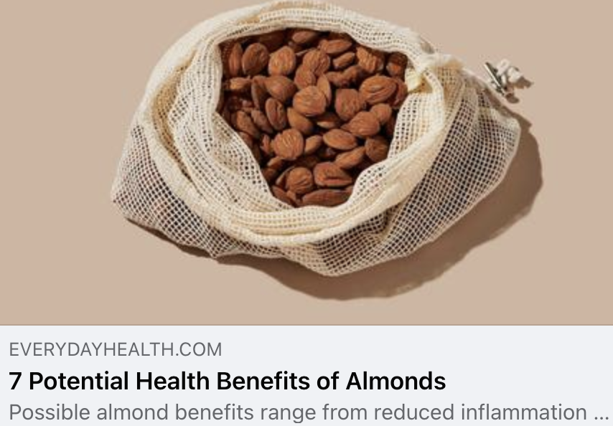
Everyday Health
UVM 14,095,360
“While strawberries are most well known for their vitamin C and antioxidant levels, newer research is now also suggesting that strawberries have potent prebiotic activity in the gut,” Volpe says. For example, an animal study in the April 2019 Journal of Nutritional Biochemistry found that strawberry supplementation increased beneficial gut bacteria in mice. “This suggests that the polyphenols in strawberries likely have prebiotic activity, which means they help to boost the growth of beneficial probiotic microbes such as Bifidobacterium in the gut,” Volpe explains.
Full of fiber, almonds are also a good source of prebiotics, which help feed a healthy gut microbiome, says Volpe. A healthy gut microbiome supports a healthy immune system and weight management, and prebiotics and probiotics help the balance of beneficial microorganisms flourish, according to the Mayo Clinic Health System. “Almonds, most notably their skins, are a natural food source of prebiotics, which feed and support the healthy growth of probiotics in the gut,” Volpe explains. A small study found that almonds and almond skins have potential prebiotic properties.

Slide 13
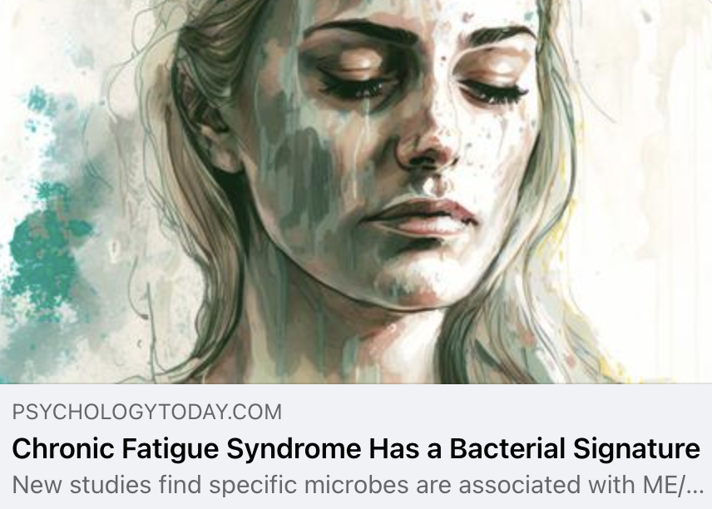
Psychology Today
UVM 15,979,355
There are a few things that people with ME/CFS can do to improve their microbiota. These include:
Eat a healthy diet that is rich in fiber (prebiotics) and probiotics.
Avoid antibiotics, if possible.
Get sufficient sleep on a regular basis.
These changes will help to improve the health of the microbiota and may reduce the symptoms of ME/CFS. More studies are needed, but this research is a wonderful start for the millions of sufferers who are finally being heard.

Slide 14
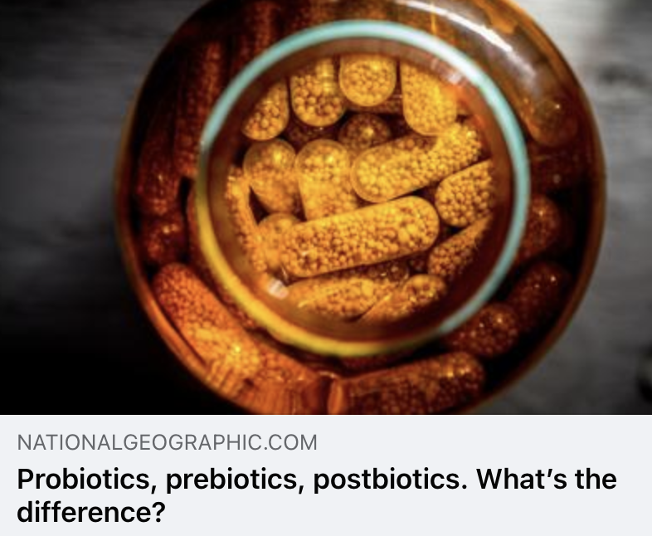
National Geographic
UVM 10,694,000
The words probiotics, prebiotics, and postbiotics may sound like variations of the same thing, but what a difference a prefix makes. The first is a category of health-promoting microbes. The latter two groups are types of beneficial molecules. But all three biotics are critical for supporting the community of microscopic organisms that live in the gastrointestinal tract, known as the gut microbiome. With both beneficial and harmful bacteria living in the human body, these diet-related factors—the biotics—help tip the balance in the positive direction. It’s important to understand their differences, as you’ll see, because each of these factors serves a distinct purpose, even as they work together.

Slide 15
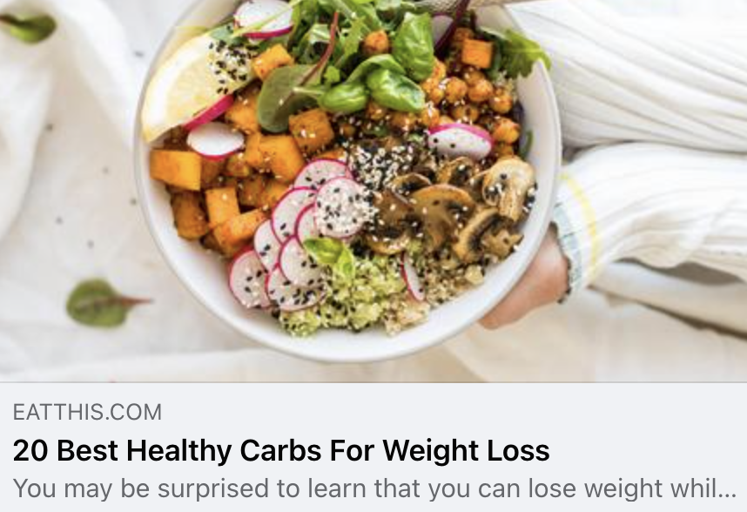
Eat This, Not That
UVM 13,564,830
If you want to lose weight, don't wait for your bananas to totally ripen before eating them!
"[Underripe bananas are] rich in gut-healthy resistant starch, a prebiotic fiber that has been shown to slow digestion, reduce belly fat, and assist in weight loss," The Nutrition Twins explain. Resistant starch also acts as an appetite suppressant.

Slide 16
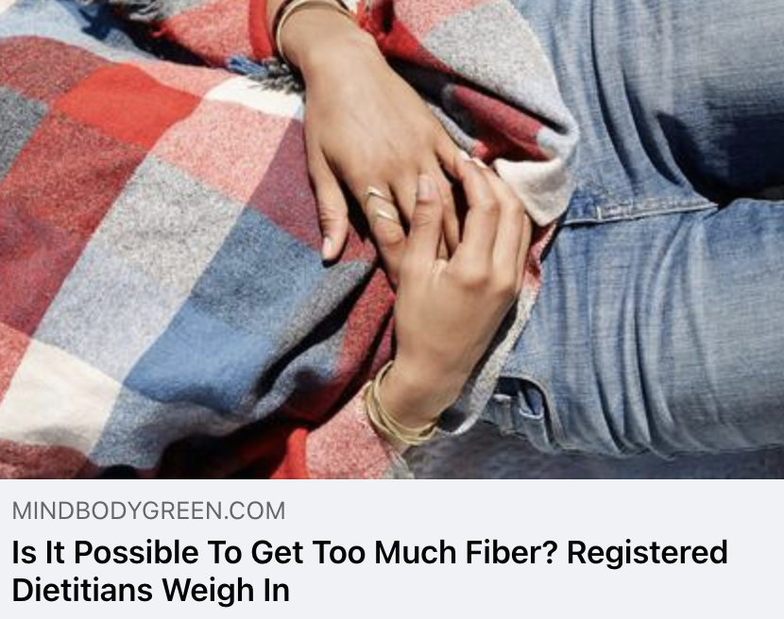
Mind Body Green
UVM 9,939,635
If you decide to leverage a high-quality fiber supplement to meet your daily fiber goals, consider mindbodygreen's organic fiber potency+. It offers 6 grams of soluble, insoluble, and prebiotic fiber in each scoop from advanced fiber sources (organic guar bean, organic kiwifruit, and a trio of organic mushrooms) to promote satiety4, regularity5, holistic gut health, and more.
Up to 80% of your immune cells7 are in your GI tract, per a 2021 Nutrients review, and prebiotic fibers (along with probiotics) help sustain a healthy gut-immune function by promoting the integrity of the gut lining and supporting the diversity of your gut microbiome.

Slide 17
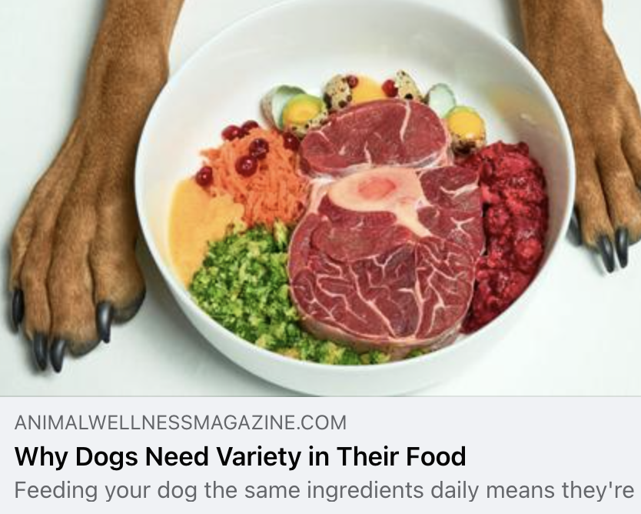
Animal Wellness
UVM 64,697
Besides well-researched, quality ingredients, NutriSource also includes nutrients beneficial to your dog’s stomach that help with easy transition from one protein and carbohydrate source to another. The innovative Good 4 Life system supplies all the prebiotics and probiotics your dog needs to build a healthy gut that easily shifts from food to food.
“The probiotics and prebiotics help with mineral absorption and support your dog’s immunity by producing natural antibiotics and antifungals in the gut for optimal health,” Adam says.

Slide 18

Insights

Slide 19
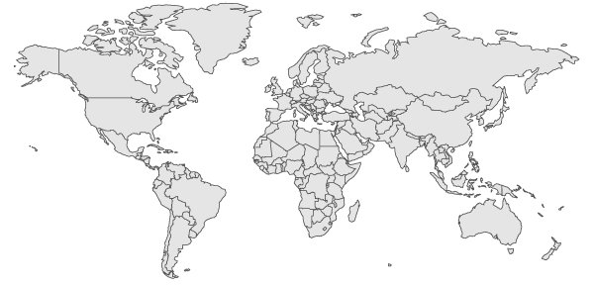
Top Countries/Regions
Canada
3%
Germany
4%
UK
6%
USA
57%
Italy & France
3%
Asia
13%
India
8%
South America
& Mexico
1%
Africa
2%
Australia & New Zealand
2%

Slide 20
In/Out of Balance
Beverages & Snacks
Synbiotics
&
Postbiotic
Skin Microbiome
Microbiome Health
Stress
Gut-Brain Axis
Pet Health
Whole Foods
Trending Topics
Wellness
Diet
Fatigue
Diversity
Mushrooms

Slide 21

Sentiment
Positive
%
Neutral
%
Negative
%
Coverage continues to be positive overall, but we do continue to see prebiotics referred to as only food for probiotics or fiber.

Slide 22
Experts & Influencers
Gut microbiome researcher Nathan Price, PhD, Chief Scientific Officer at Thorne, gets right into things, saying it’s not truly possible to have stellar digestion if you don’t have a healthy gut
Dr. Zeeshan Afzal, MD…said that eating more garlic every day can help boost metabolism, lower blood pressure, and improve digestion and gut health
Jeffrey Bland, PhD, a clinical biochemist, the “father of functional medicine,” and president of Big Bold Health, discusses: Tips for Eating for Longevity
New Gut Health Research: Fiber, Prebiotics, and Butyrate, with Dr. Ruscio
Liping Zhao, PhD, professor of applied microbiology at Rutgers University in New Brunswick, New Jersey, recommends a healthy dose of skepticism when looking at yogurt
Serena Poon, CN, CHC, CHN, certified nutritionist and celebrity chef adds that aside from possibly getting too much fiber—which can lead to digestive discomfort—it’s hard to overdo fruits and veggies

Slide 23
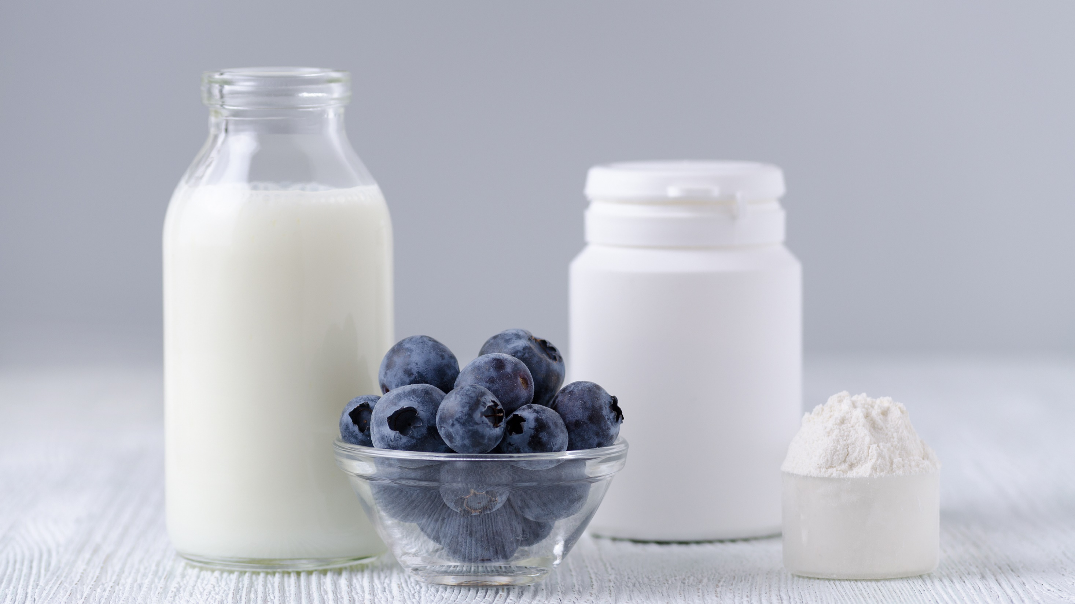
Questions?
Traci Kantowski
Communications Director
Global Prebiotic Association
+1 630.923.0211
traci@prebioticassociation.org

