Slide 1
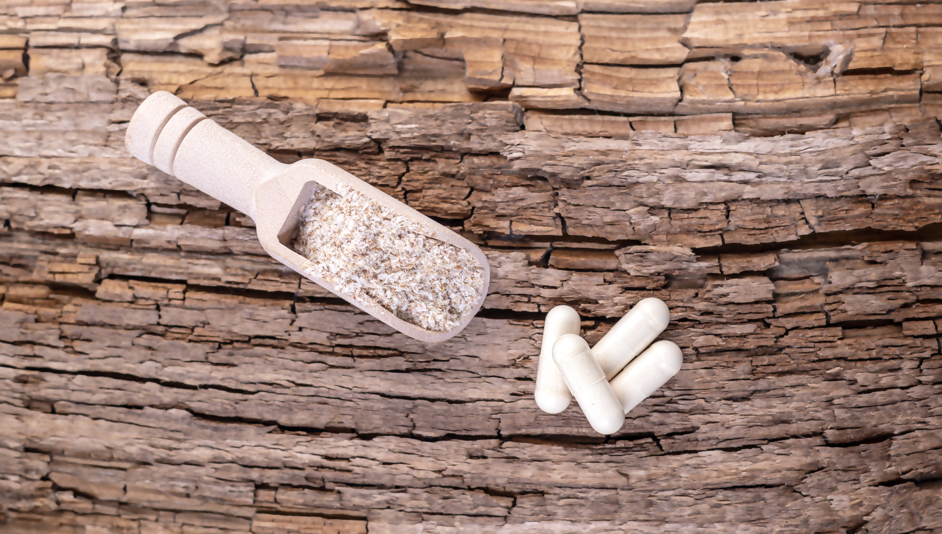
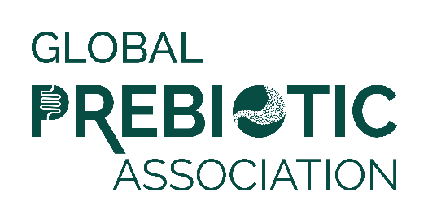
Media Insights Report
Q2 2024

Slide 2
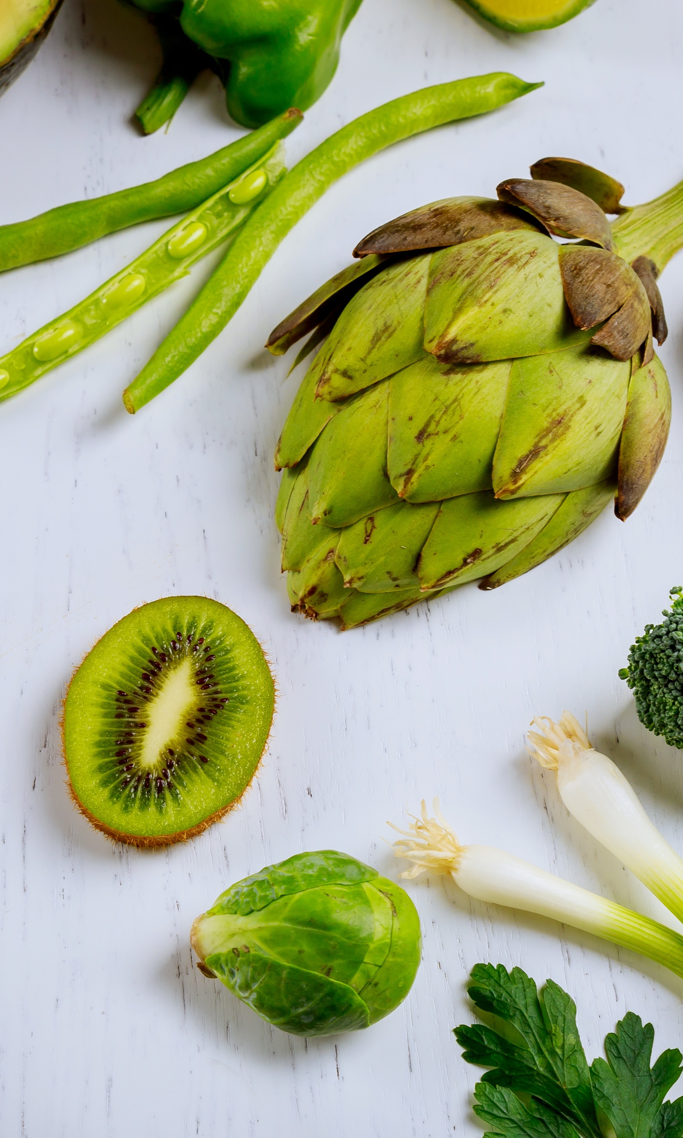
Data Summary
Data was pulled from Muck Rack insights for the period of April 1, 2024 to June 30, 2024.
Reports looked at traditional media and social media, with a heavy emphasis on consumer-reaching media.
Trade coverage and new product launches are also included.
Full text of articles may be accessed by clicking the article image on each slide.

Slide 3
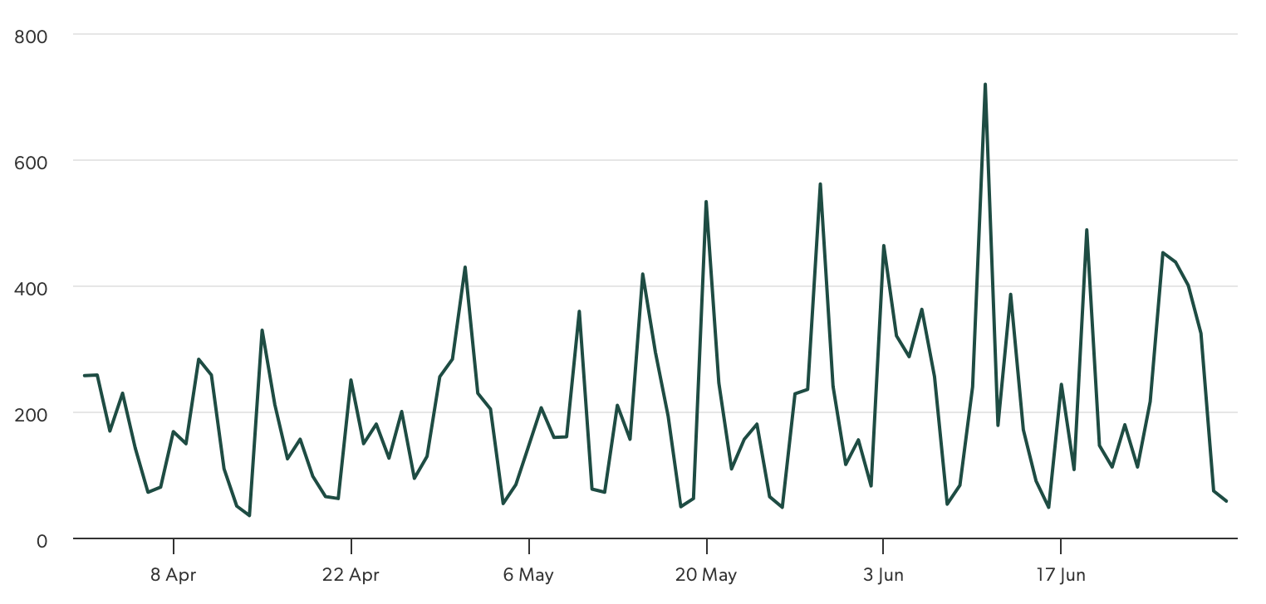
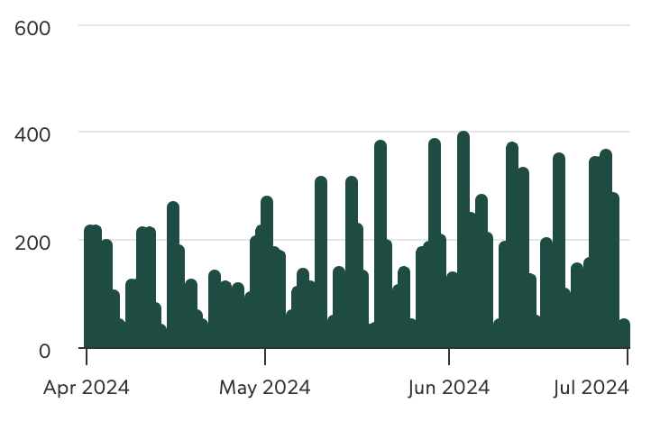
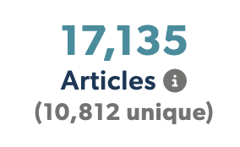
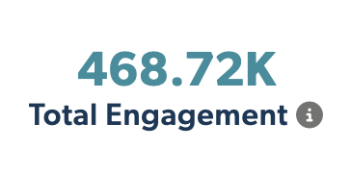


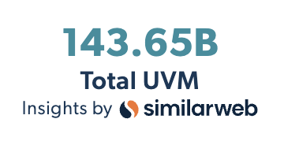
Articles Over Time
Unique Outlets
Coverage drivers are listed on the following slides.

Slide 4

Functional Foods and Beverages
Gut-Brain Axis
Immune Function
Prebiotic Soda
Sports Nutrition
Trending Topics:
Plant-Based Diet
Personalized Nutrition
Product Development
Sugar Reduction
Mental Health and Wellness
Fermented Foods
Infant Formula
Regulatory Challenges

Slide 5
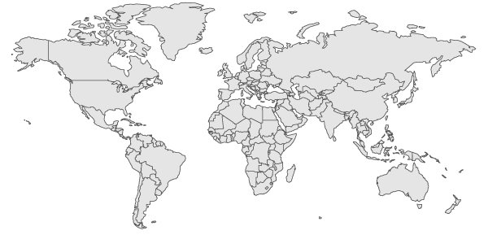
Top Countries/Regions
Canada
1.7%
UK
5.1%
USA
42%
Europe
14%
Asia
6.2%
India
5.8%
South America
& Mexico
3.4%
Africa
.5%
Australia & New Zealand
1.6%

Slide 6
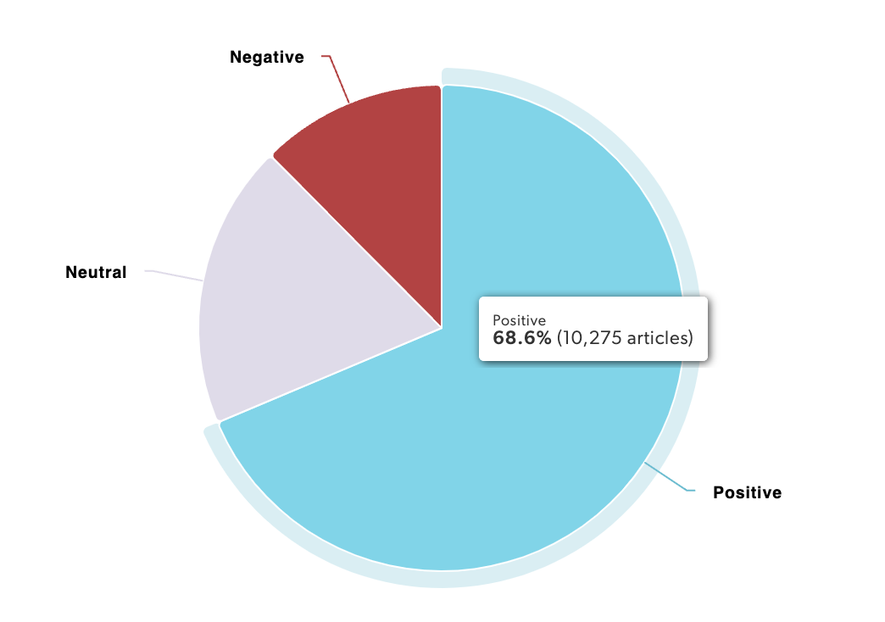
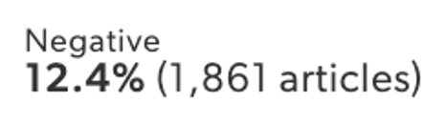
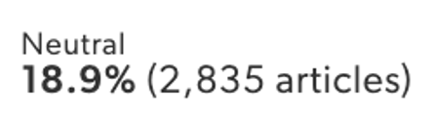
Sentiment
Coverage is positive overall, with more media coverage and study growing.

Slide 7
Experts & Influencers
Some Say This Childhood Treat Is Great for Gut Health—Here’s What Gastroenterologist Dr. Supriya Rao, MD Wants You to Know
Sick Of Bloating? Add These 7 Gut-Healthy Fermented Foods To Your Diet… We spoke with Sarah Anderson, NP, Lisa Richards, nutritionist at The Candida Diet, and Samantha Cassetty, MS, RD, to find out about seven fermented foods that can help beat bloating.
Nutritionist Deepsikha Jain shares that sourdough bread is great for your gut health because it undergoes a very slow and long fermentation process. This increases beneficial bacteria and yeast which is great for your gut health and also makes it a prebiotic.
Luckily, there’s no shortage of fiber-loaded foods to add to your diet as you work towards your health goals. To shed some light on a few of the best options out there, we spoke to health experts Dr. Sarah Mathis , a board-certified physician, Dana Ellis Hunnes , PhD, MPH, RD, Clara Lawson, RDN Alanna Kate Derrick , sports nutrition coach, and Dr. Mrinal Pandit , a registered dietitian, clinical nutritionist, and certified nutritional counselor.
One study published in BMC Complementary Medicine and Therapies found that sea moss had a prebiotic effect on rats when consumed. Specifically, it increased the number of fatty acids and good bacteria in the colon, while eliminating bad gut bacteria.

Slide 8
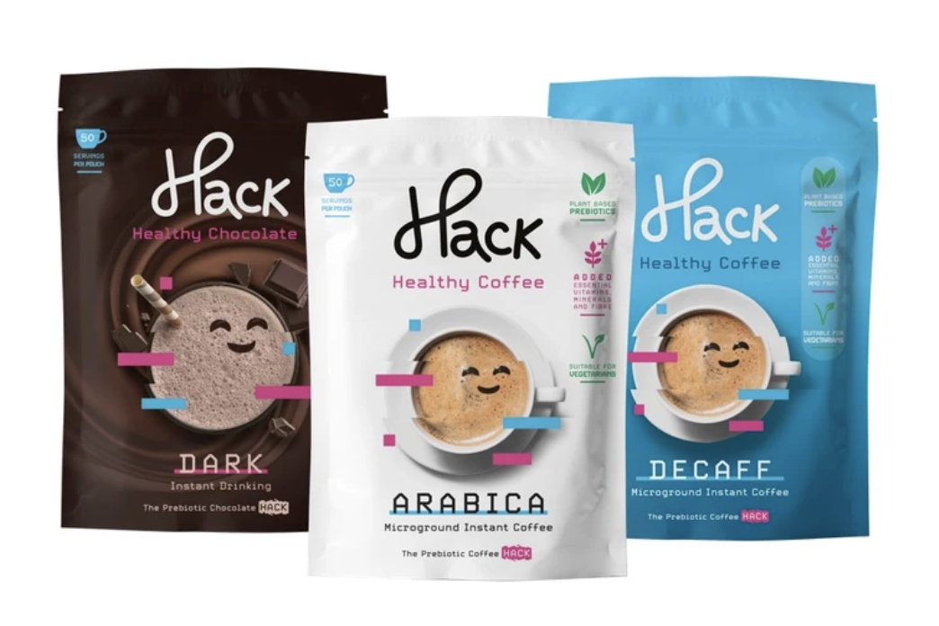
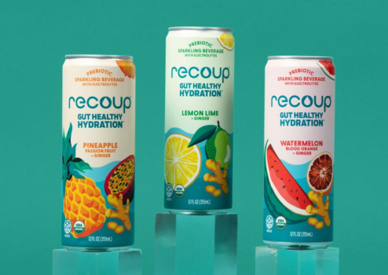
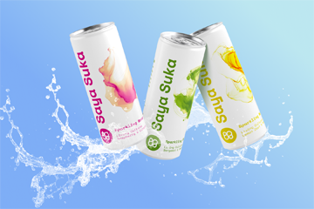
Product Launches
Love Eat Inc. announced the launch of Hack Coffee, an innovative blend that combines the rich, aromatic profile of premium Arabica coffee with essential vitamins, minerals, and prebiotics. This groundbreaking product, created in collaboration with renowned researcher Dr. Julia Jones, aims to revolutionize the daily coffee ritual by providing a delicious and nutritious alternative to traditional coffee.
Recoup®, is shaking up the beverage aisle with the launch of its new line of Organic prebiotic sparkling beverages for “Gut Healthy Hydration™.” This innovative drink is the first to combine a powerful dose of gut-health focused ingredients, including prebiotic fiber and real ginger, with essential electrolytes to support hydration and digestive wellness.
Clasado Biosciences announced the debut of Saya Suka, a synbiotic water range launched by Zurich-based beverage business, Kefinova AG.
The functional beverage features Clasado’s Bimuno GOS as the prebiotic element, while the probiotic, Weizmannia Coagulans GX-1, is supplied by probiotic specialist Probi AB.

Slide 9
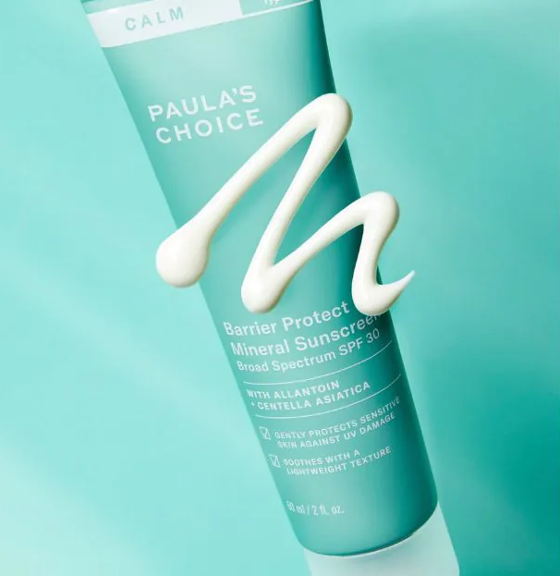
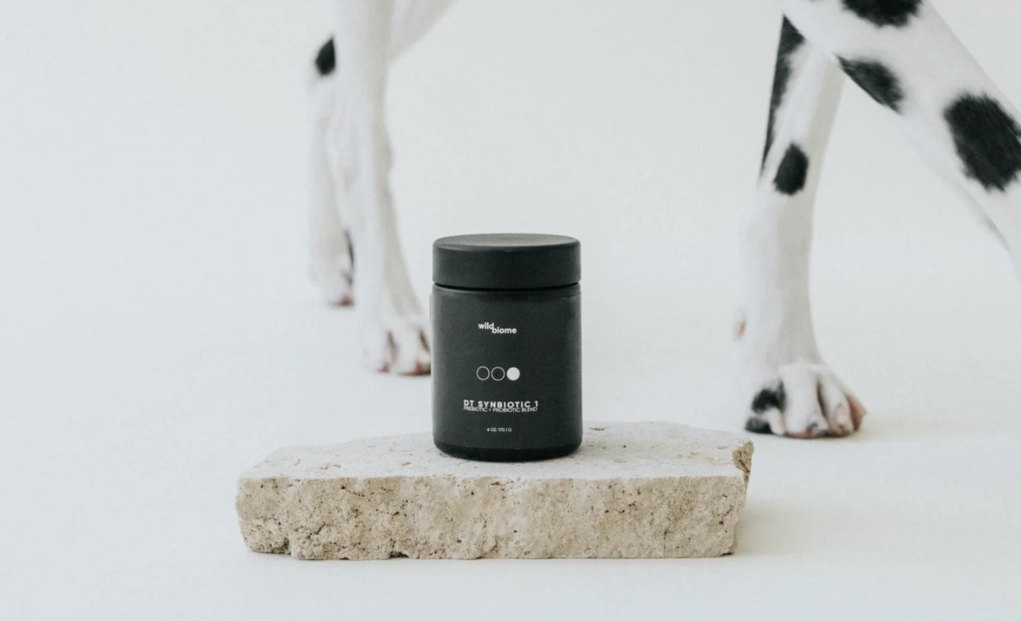
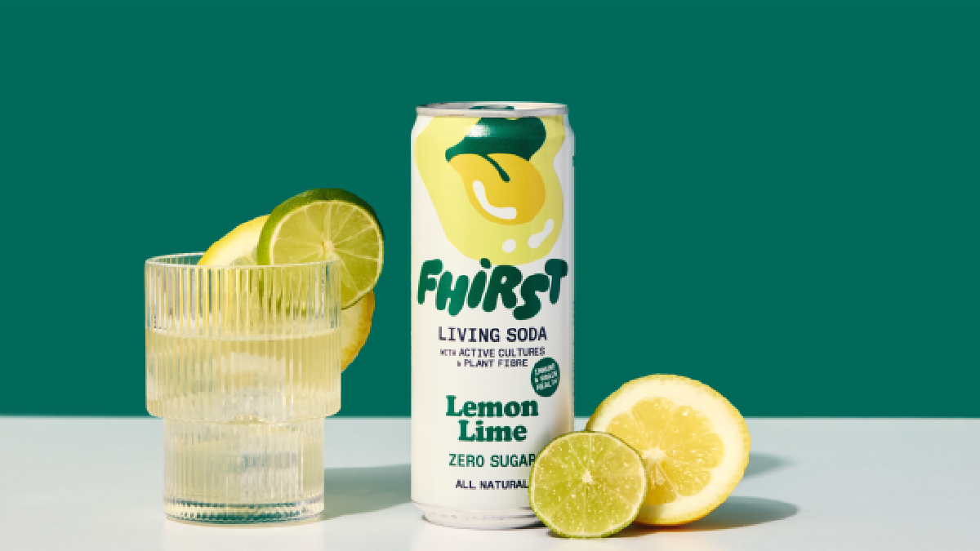
Product Launches
The new CALM Barrier Protect Mineral Sunscreen SPF 30 helps to visibly reduce redness and signs of irritation while being suitable for all skin types, including those experiencing rosacea.
Formulated to go beyond traditional sun protection, it contains a calming blend of Allantoin, Centella Asiatica, and Prebiotics to help soothe, hydrate, and fortify the skin’s barrier and microbiome.
Wild Biome, a new company dedicated to canine wellness through innovative gut health solutions, today announces the launch of its two-part supplement system designed to combat leaky gut syndrome and its associated issues in dogs.
Functional drinks brand Fhirst is adding a Lemon Lime variety to its range of zero-sugar sodas. The new addition joins Fhirst’s Cherry Vanilla, Ginger Mandarin and Passion Fruit varieties, which first launched this January.
Like the rest of the Fhirst range, it contains probiotics and prebiotics to aid in gut health, alongside added zinc and no added sugars or sweeteners.

Slide 10
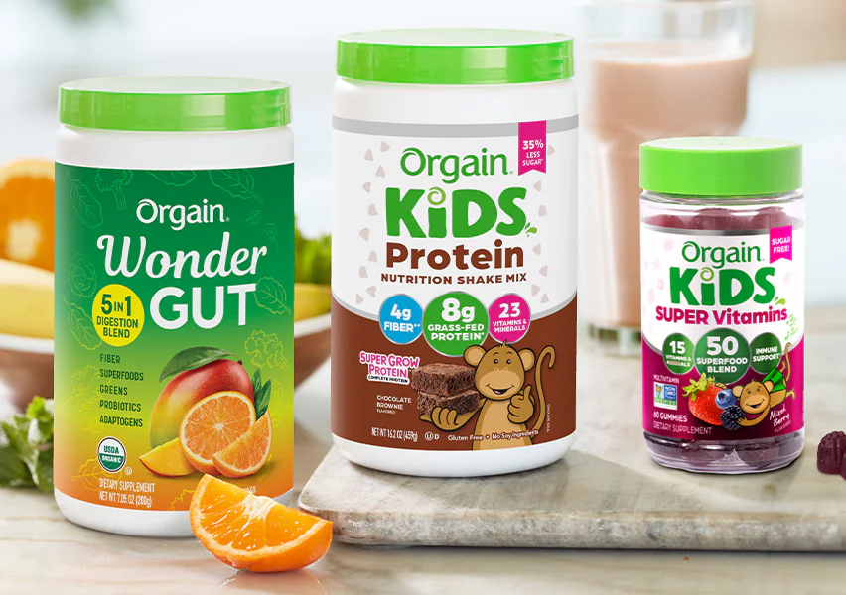
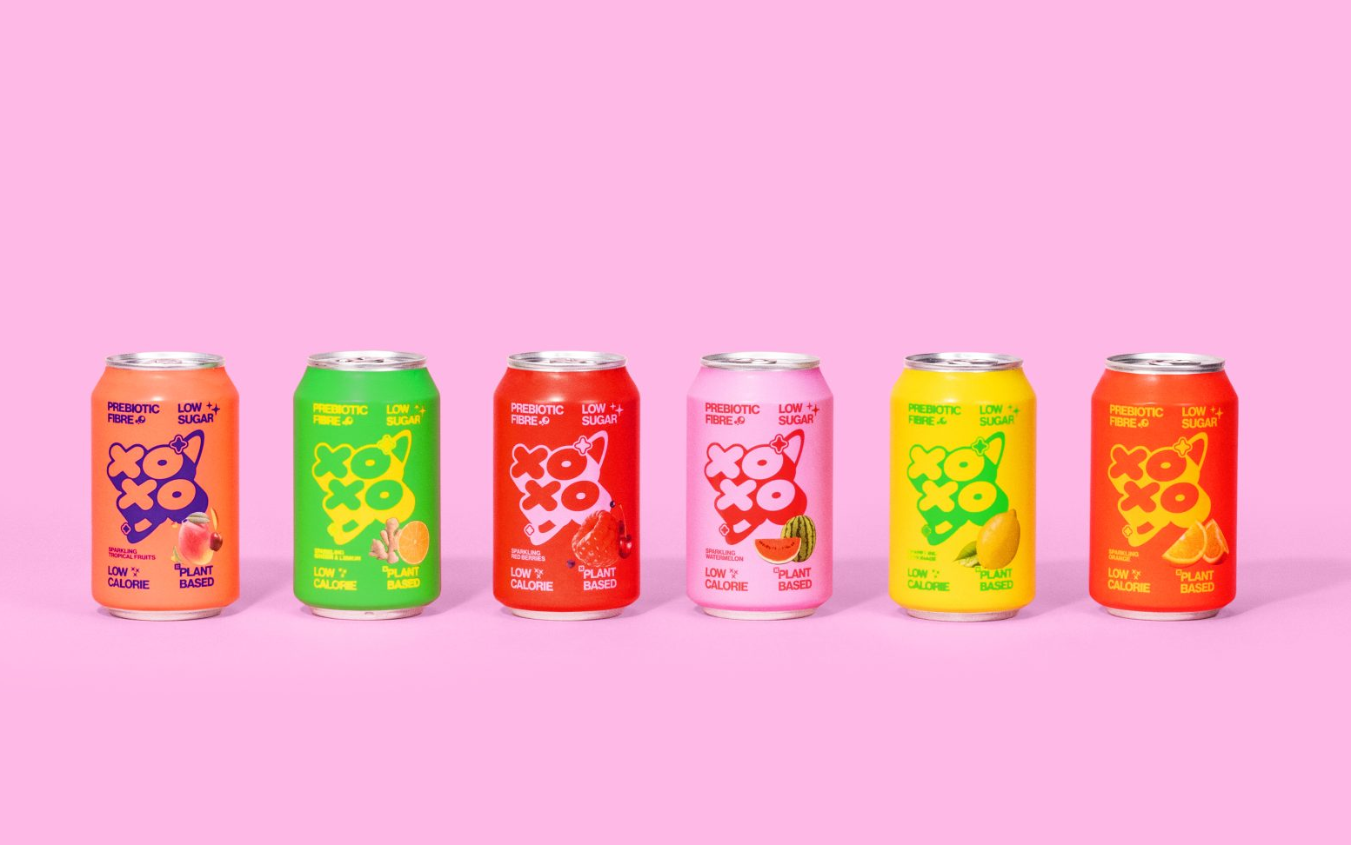
Product Launches
Orgain unveils its latest in good clean nutrition including its 5-in-1 greens powder, kids sugar free multivitamin gummies and kids nutrition powders. Each serving of the Wonder Gut greens powder contains a good source (5g) of fiber to support digestion**, 1 billion probiotics + enzymes to support gut health**, and adaptogens including ashwagandha, reishi, and lion’s mane to support overall wellness**.
Officially launched in May 2023, XOXO Soda’s is a disrupter in this market, creating the first shelf-stable prebiotic soda. Following a rigorous testing period, which saw the creation of over 50 iterations in the space of two years, the team – comprised of the world’s leading food and ingredients experts – settled on three core ingredients that combine to form the UK’s best prebiotic soda.

Slide 11
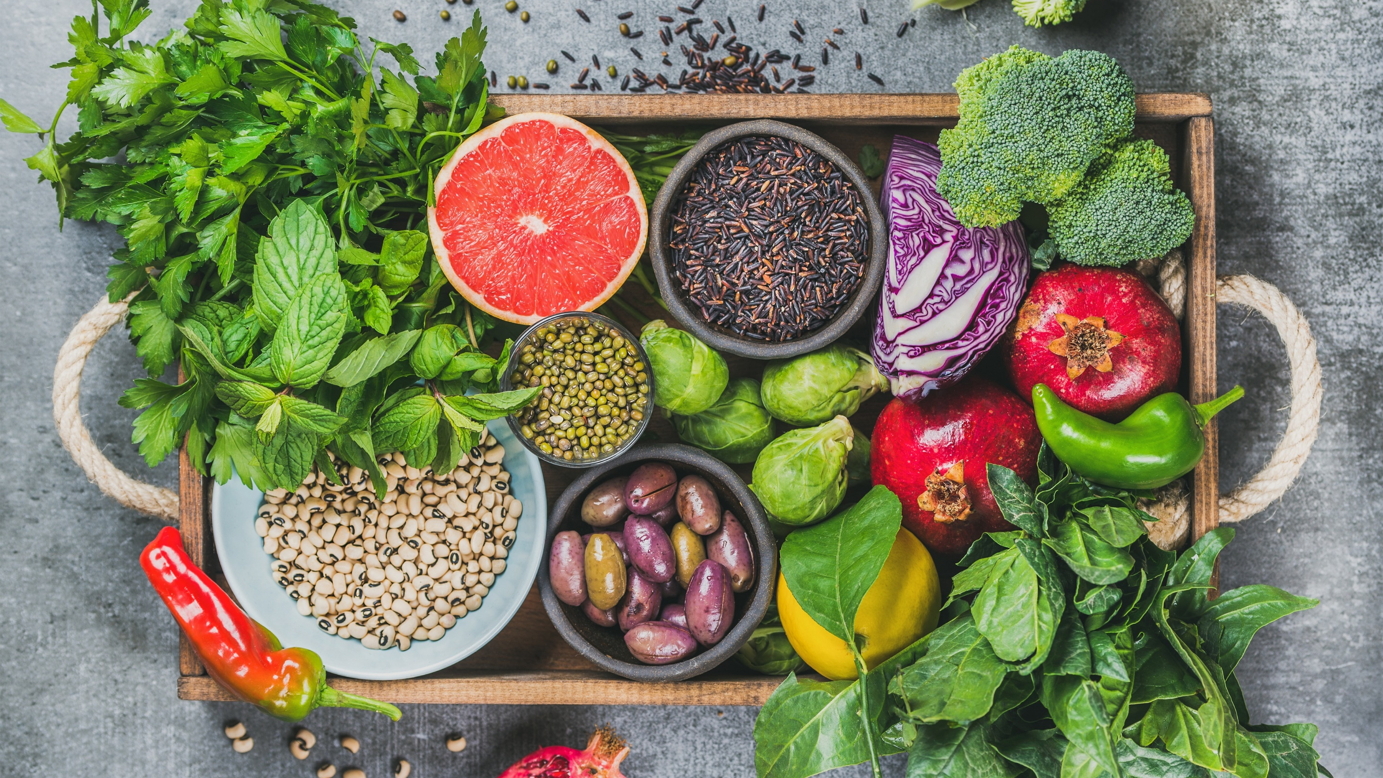
Media
Coverage
Highlights

Slide 12

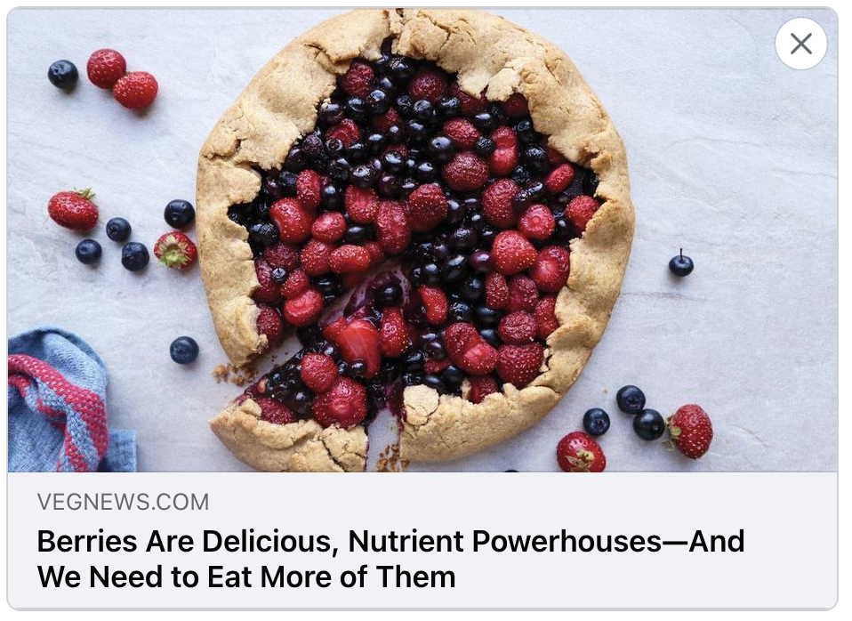

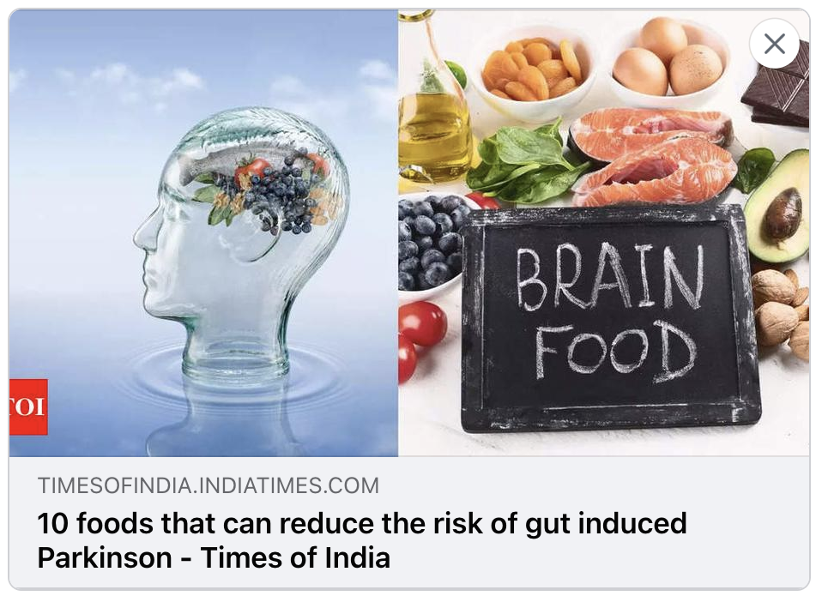
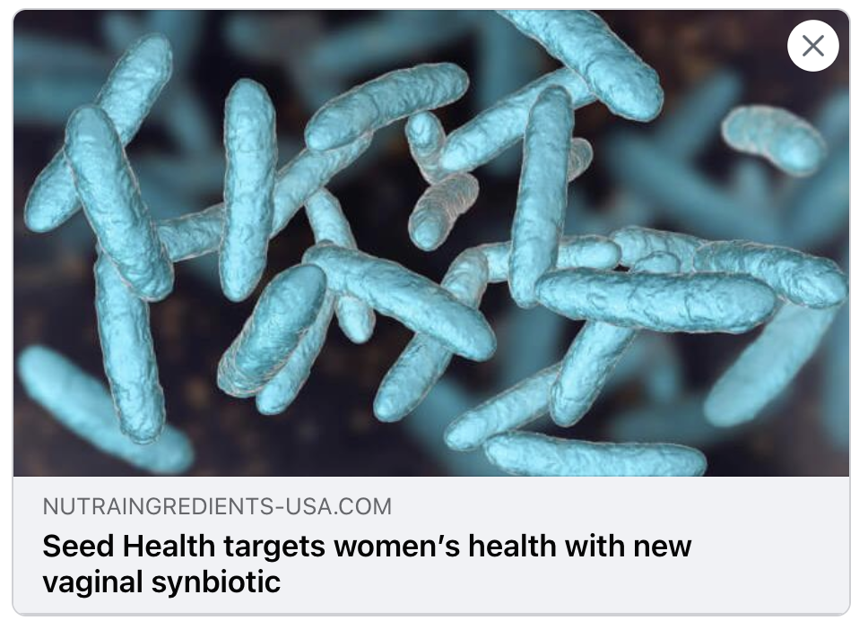
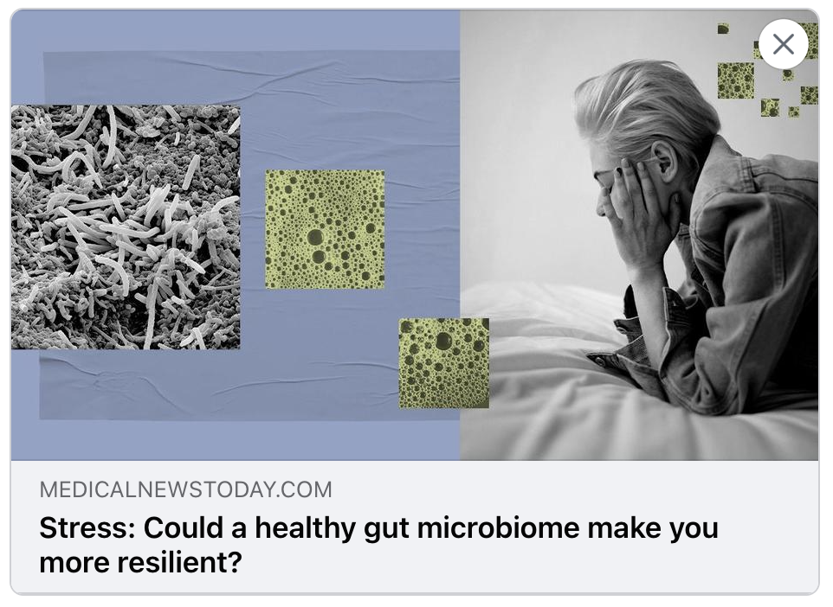
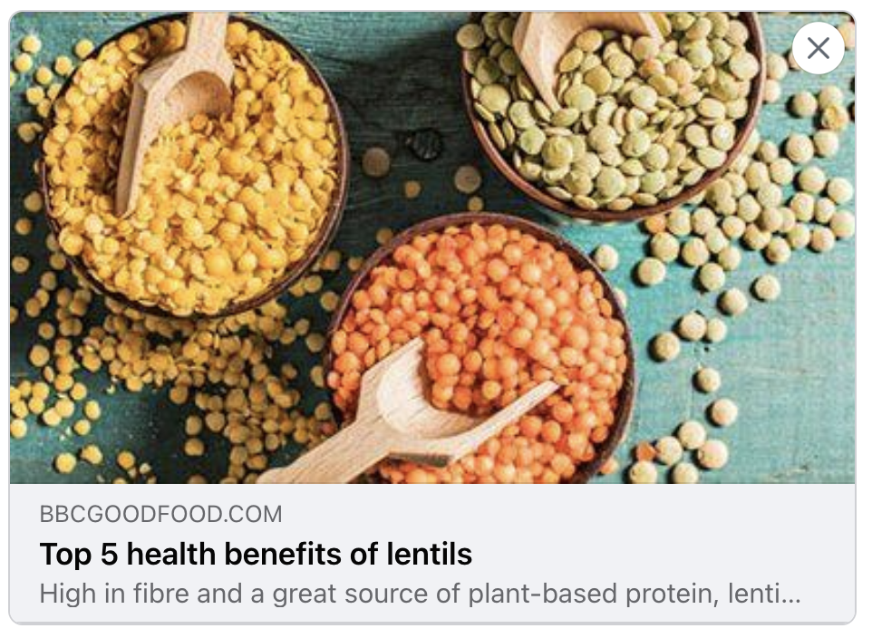

Trade Coverage

Slide 13
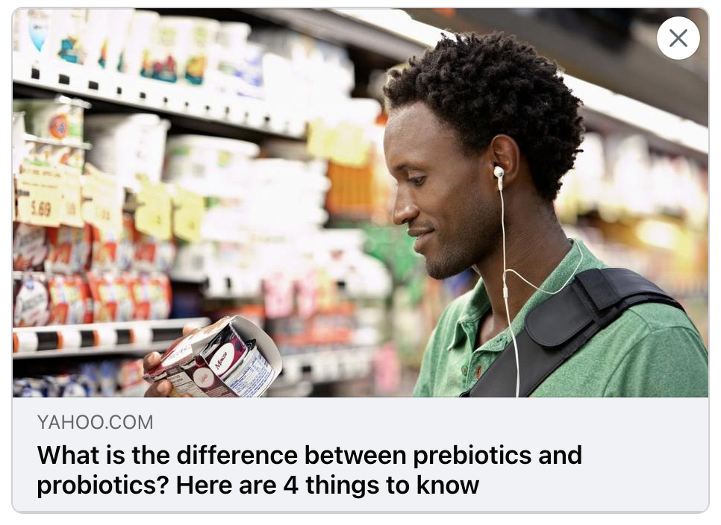
Yahoo Life
UVM 432,976,146
It’s always best to consume nutrients naturally from a good diet. Unfortunately, many eat a diet overloaded with sugar and saturated fat, which provides limited nutritional value, and the odds are good that the vast majority of Americans suffer from a lack of prebiotics and probiotics. This raises the question of supplements, and it’s not a simple question to answer.

Slide 14

Only My Health
UVM 4,107,612
Incorporating plant protein into your diet can be a strategic move to alleviate bloating issues. The lower fat content, high fibre, easier digestibility, anti-inflammatory properties, and prebiotic benefits of plant proteins make them a valuable addition to a bloating-friendly diet. By diversifying your sources, preparing foods properly, and introducing them gradually, you can harness the benefits of plant protein while maintaining a healthy and comfortable digestive system.

Slide 15
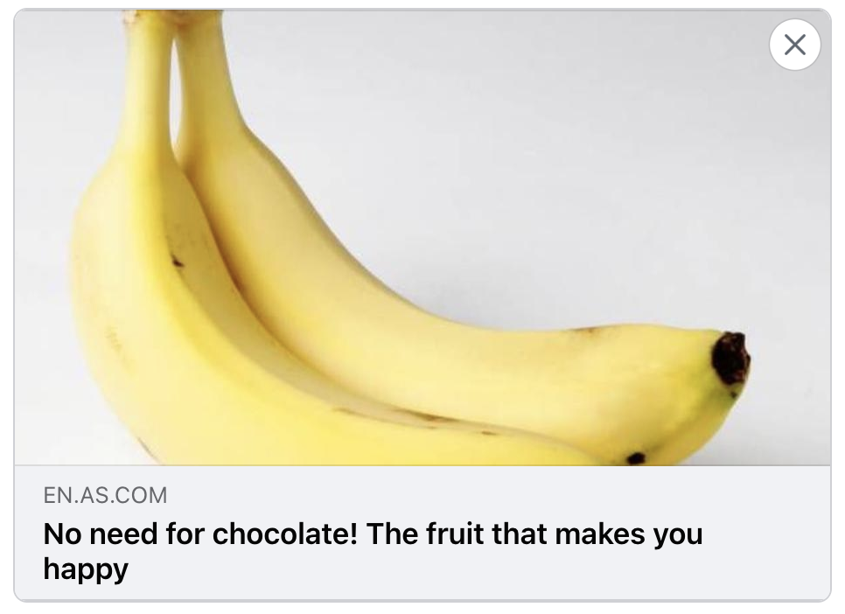
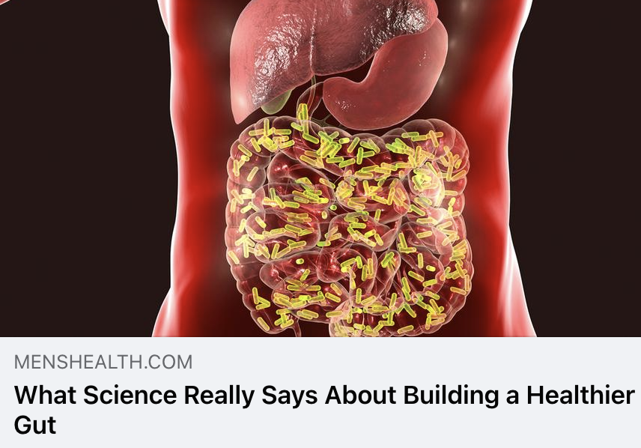
Diario AS
UVM 39,921,063
The benefits of this fruit found in nearly every supermarket and fruit stand in the world don’t stop there either. Healthline points out that bananas are an excellent source of prebiotics, especially when there is still a little green showing on the peel. This particular type of fiber is ideal fodder to help keep your gut bacteria healthy.

Slide 16
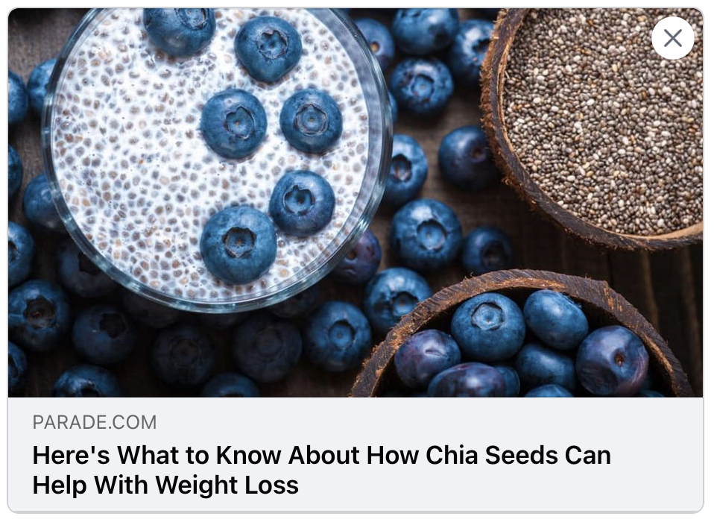
Parade Magazine
UVM 22,458,760
The soluble fiber found in chia seeds is a prebiotic that feeds the healthy bacteria in the gut. These bacteria produce short-chain fatty acids (SCFA) that help nourish the gut's cells and fight off harmful bacteria, Kirschner explains.

Slide 17
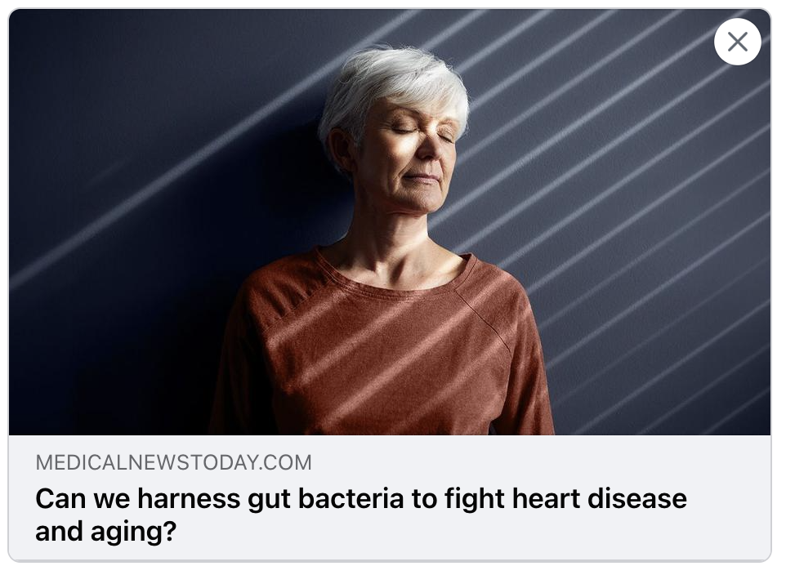
Medical News Today
UVM 56,178,445
“While there is some merit to the idea that microbiome health can correlate effectively with someone’s biological age, our gut microbiomes are also highly changeable through prebiotic and probiotic supplementation and potentially even more extreme measures like fecal transplantation,” says Catherine Rall, RDN, a registered dietitian based in Denver, CO, and certified nutritionist at Happy V.

Slide 18
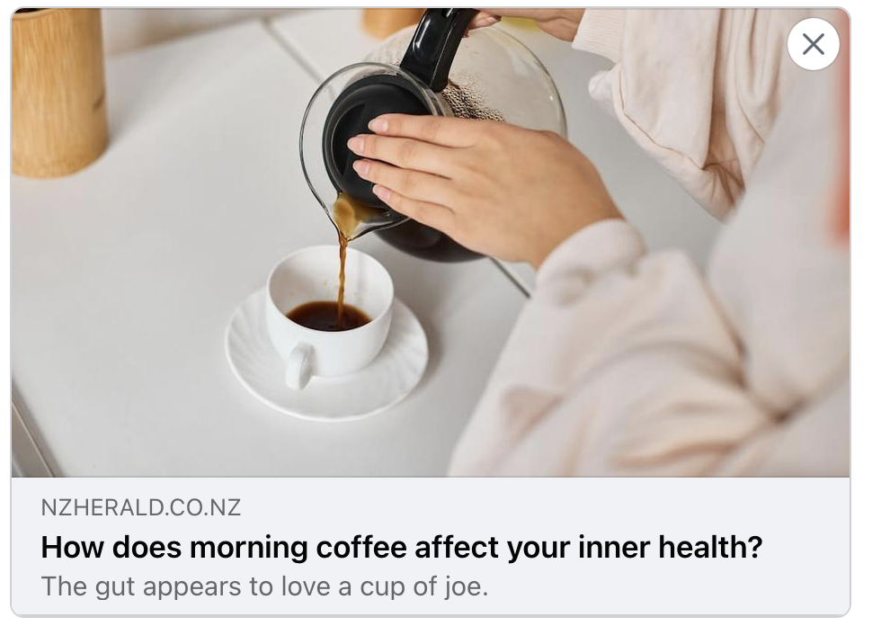
The NZ Herald
UVM 6,484,091
That morning cup of coffee doesn’t just wake you up for the day, it also gives a boost to billions of friendly microbes residing in your digestive system. Because, according to a growing body of research, there is evidence that your espresso may positively influence your microbiome – gut bacteria – leading to better overall health and even a longer life.

Slide 19
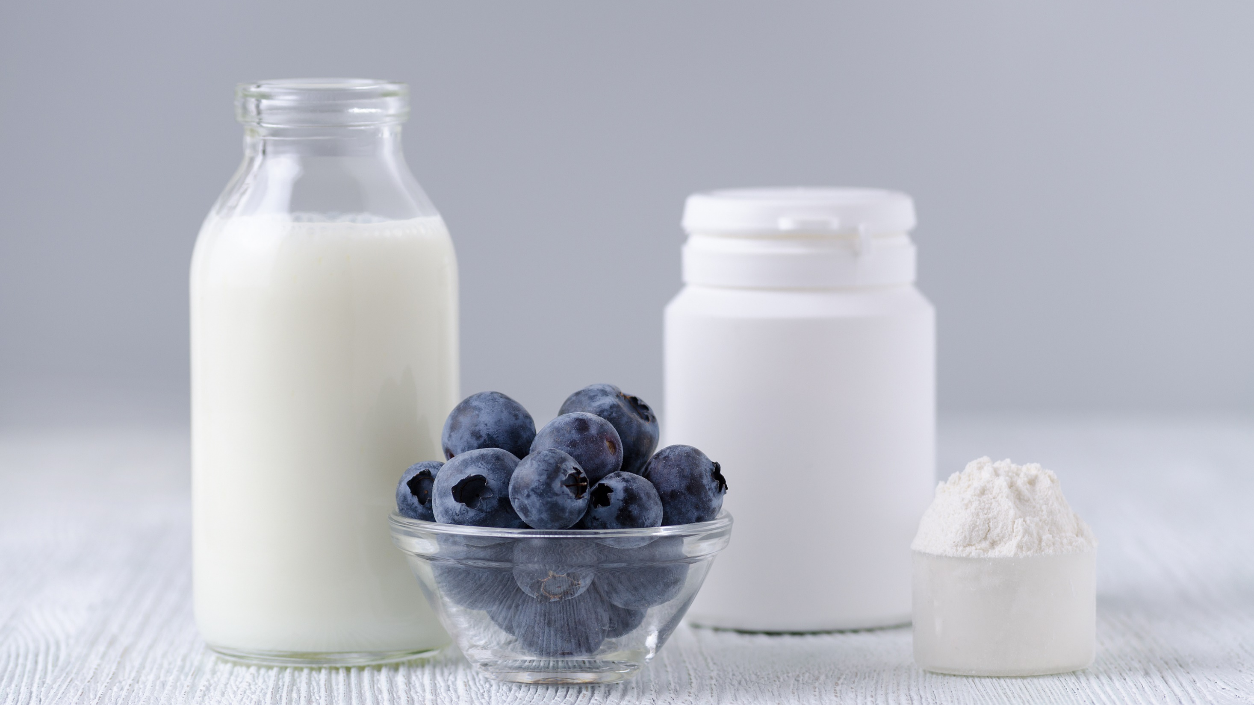
Questions?
Liz Smith
Communications Director
Global Prebiotic Association
liz@itcstrategy.com
Maggie Feikes
Project Specialist
Global Prebiotic Association
maggie@itcstrategy.com

