Slide 1
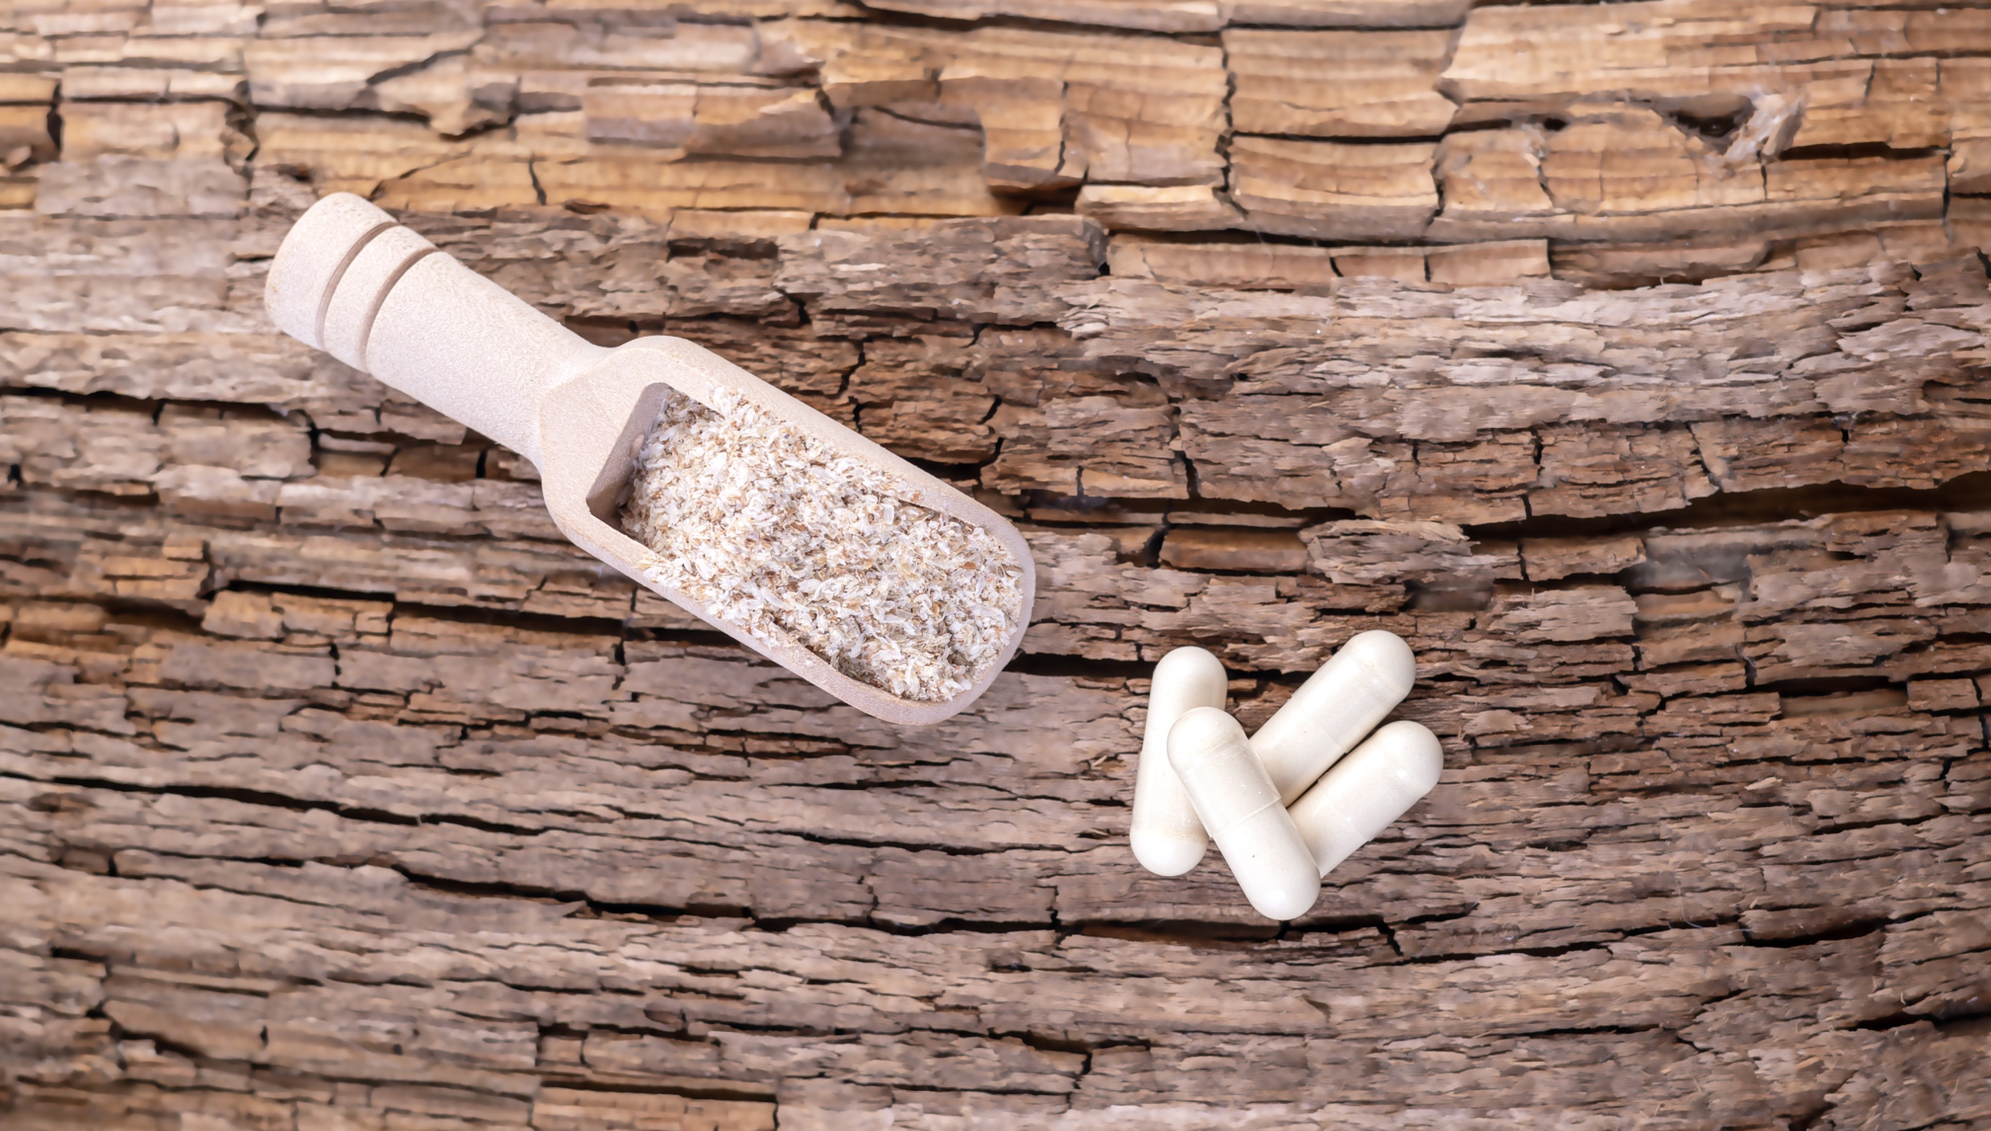
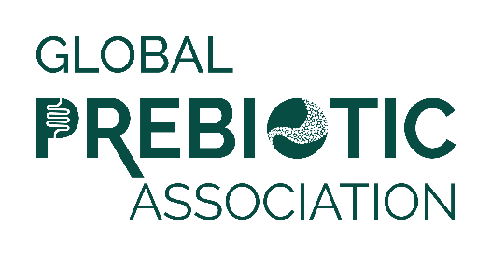
Media Insights Report
Q2 2022

Slide 2
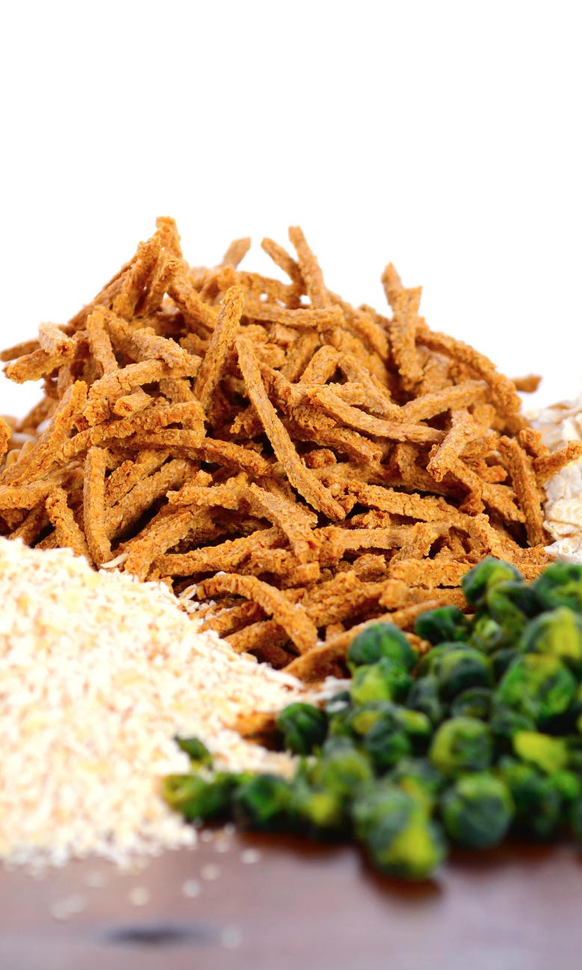
Data Summary
Data was pulled from Muck Rack insights for the period of April 1 to June 30, 2022.
Reports looked at traditional media and social media, with a heavy emphasis on consumer-reaching media.
Trade coverage and new product launches are also included.
Full text of articles may be accessed by clicking the article image on each slide.

Slide 3
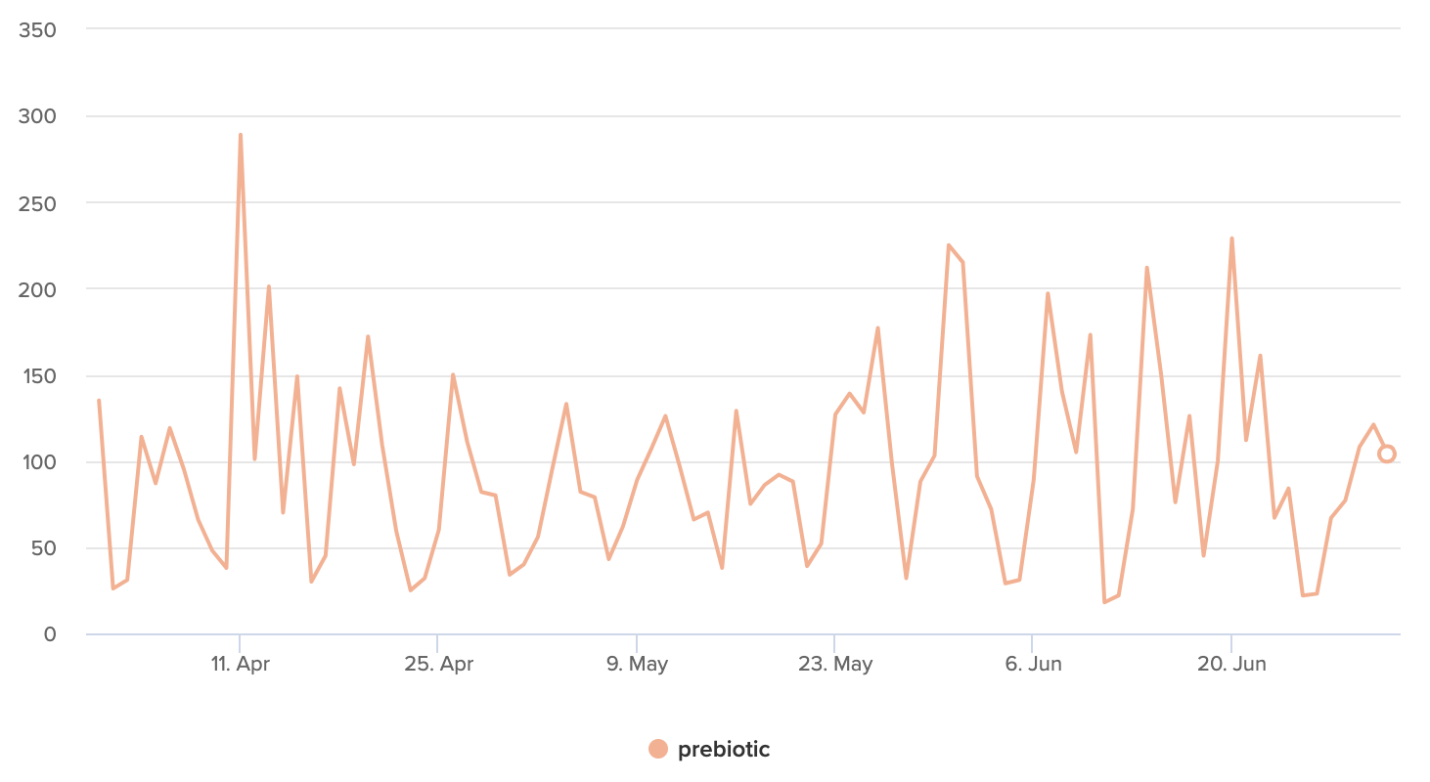
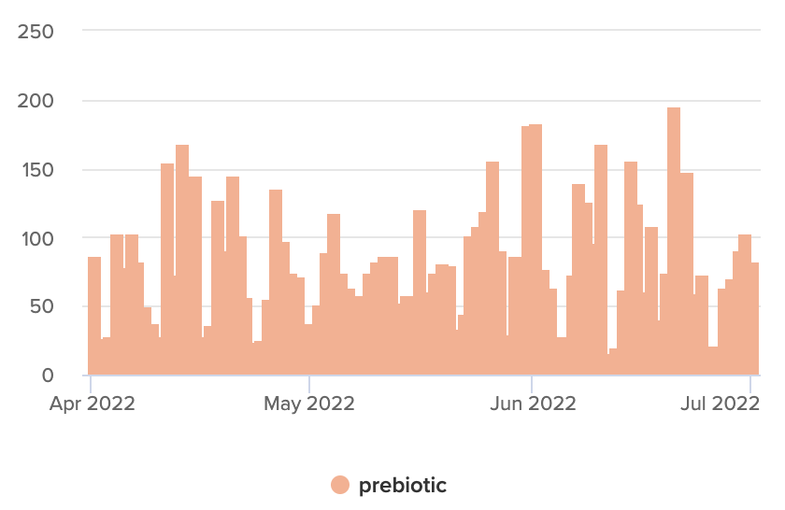

Articles Over Time
Unique Outlets
Coverage drivers are listed on the following slides.

Slide 4
Product Launches
HarlanMD Launches its Proprietary Formula for SmartLotion®, the first-ever prebiotic lotion that targets both root causes of eczema
Dermatologist, Dr. Whitney Bowe Beauty, is taking an “outer + inner” approach to skincare with a topical and ingestible product launch
I and love and you has expanded its line of dog food and toppers with the launch of Irresist-A-Bowls, made with farm-raised meat and prebiotics.
With a galacto-oligosaccharide (GOS) content of over 90%, Biotis™ GOS-OP High Purity is FrieslandCampina’s purest prebiotic ingredient
Nutrafol has announced its newest innovation: A patent-pending, physician-formulated suite of products designed to balance the scalp microbiome
Better Choice Company, announces the launch of Halo Elevate, a new super-premium, natural pet food backed by science
Nexba, Australia’s naturally sugar-free soft drinks brand has launched Nexba Natural Energy, Designed to enhance everyday energy and improve gut health with zero caffeine and prebiotics

Slide 5
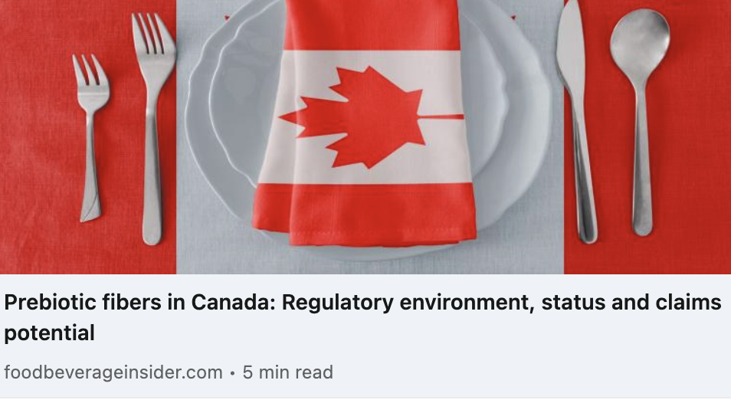
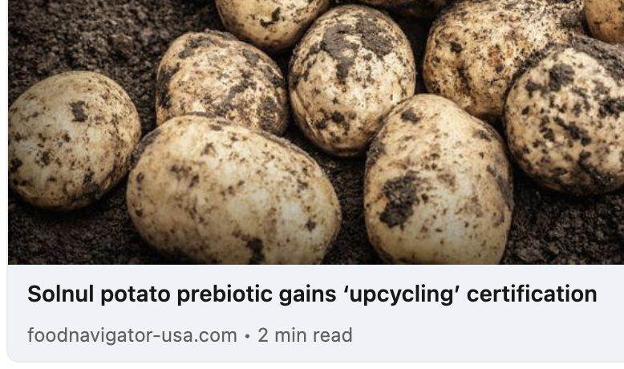
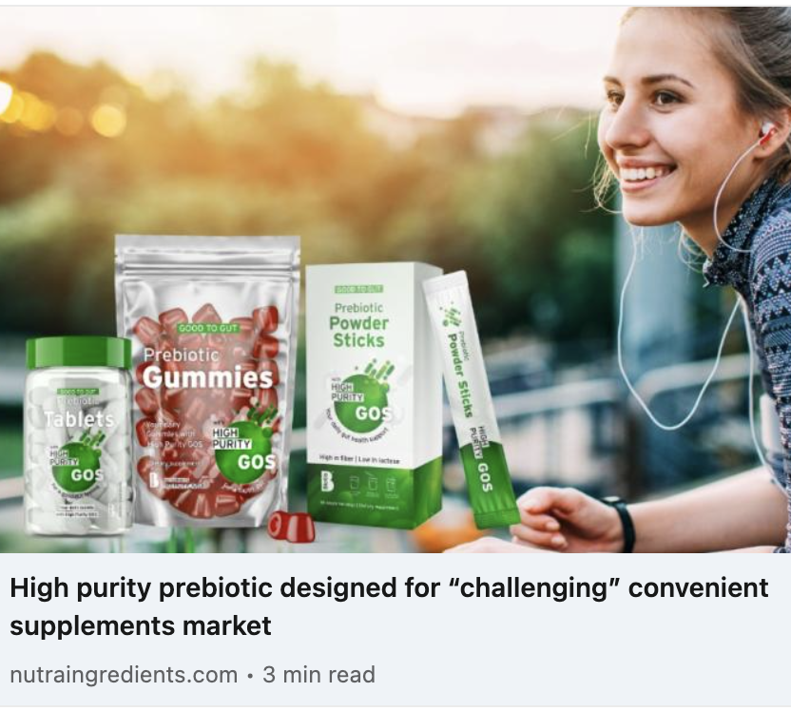
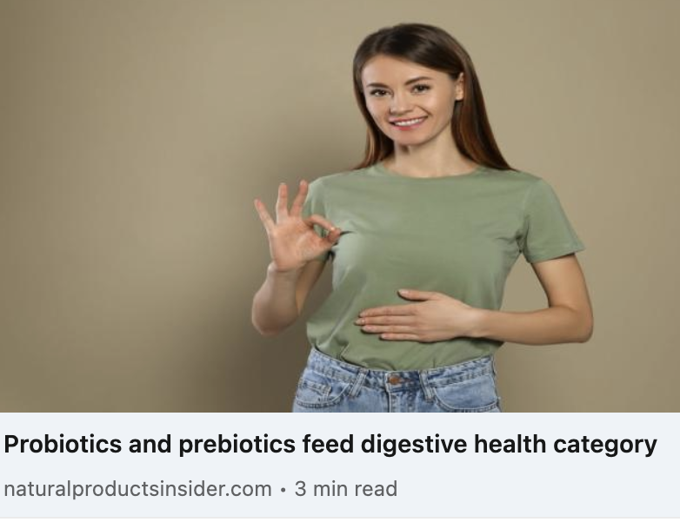
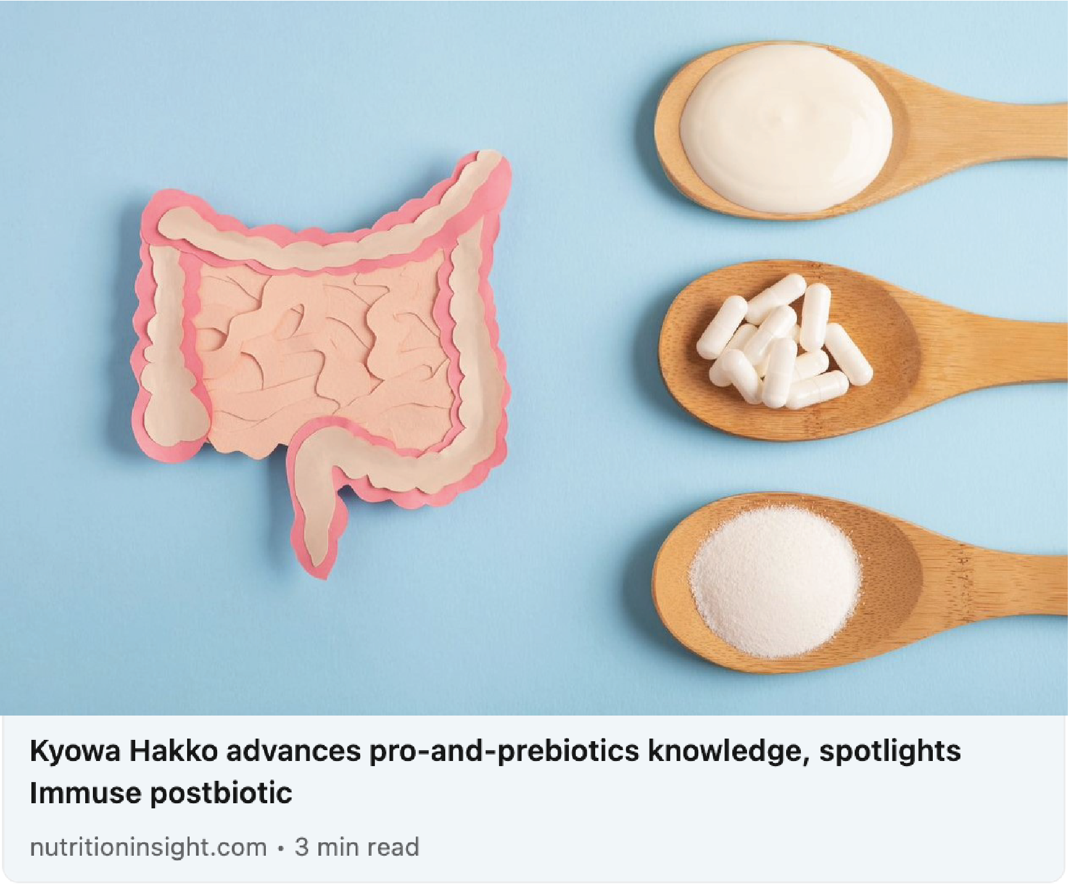
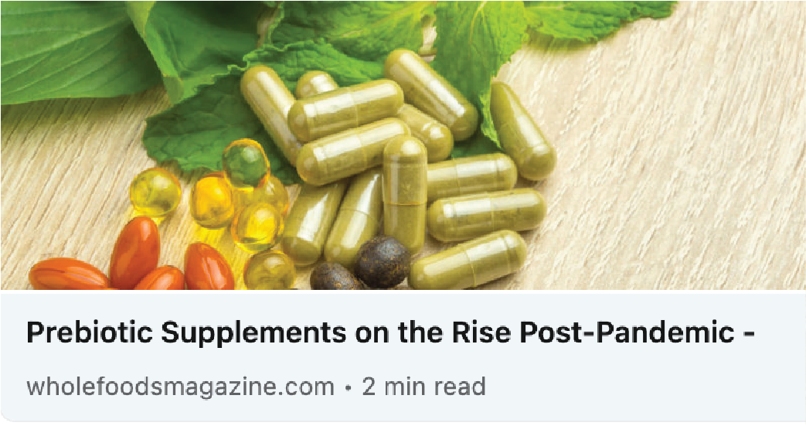
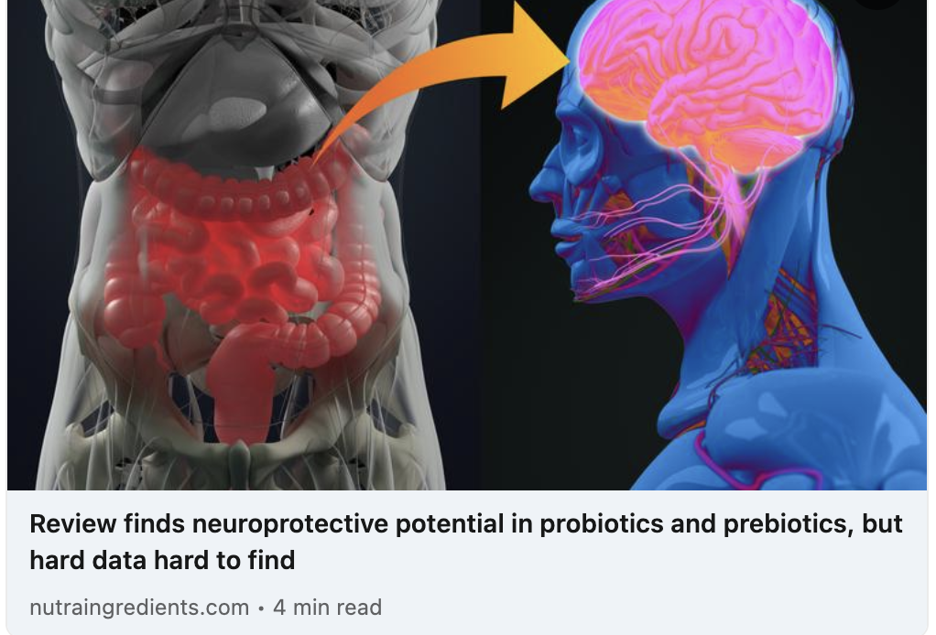
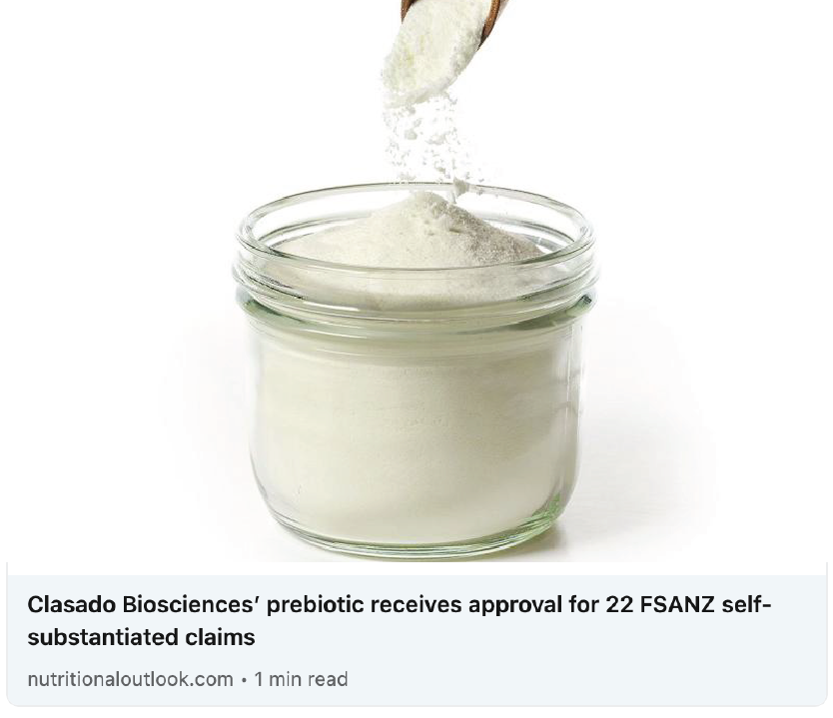
Trade Coverage

Slide 6
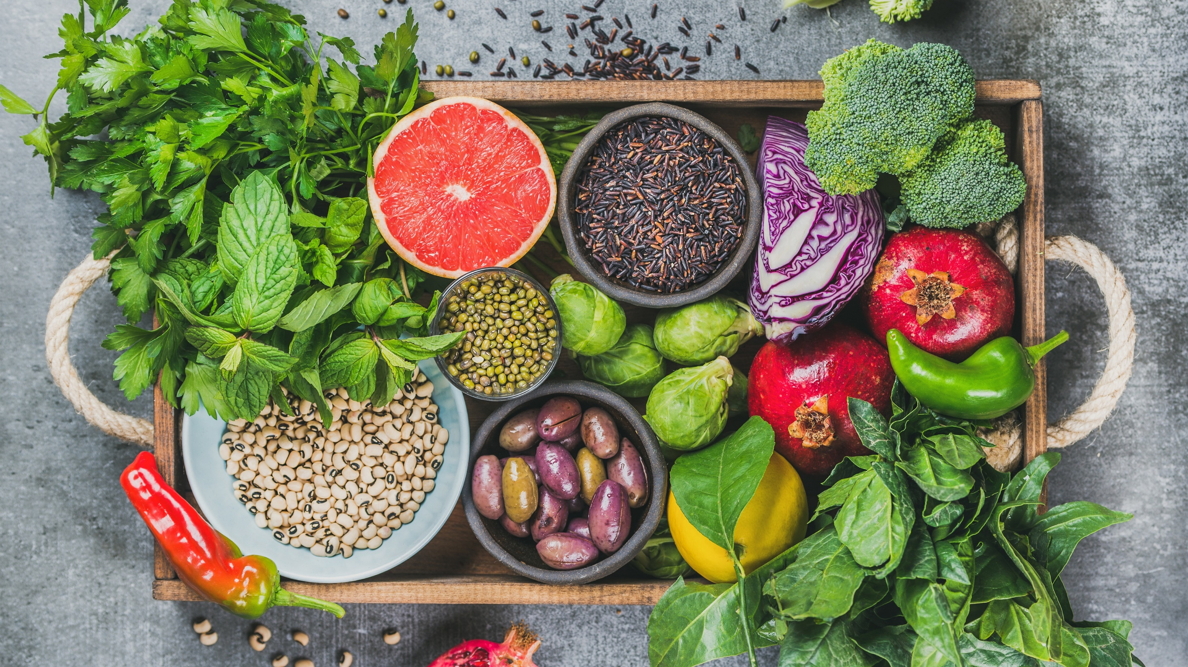
Media
Coverage

Slide 7
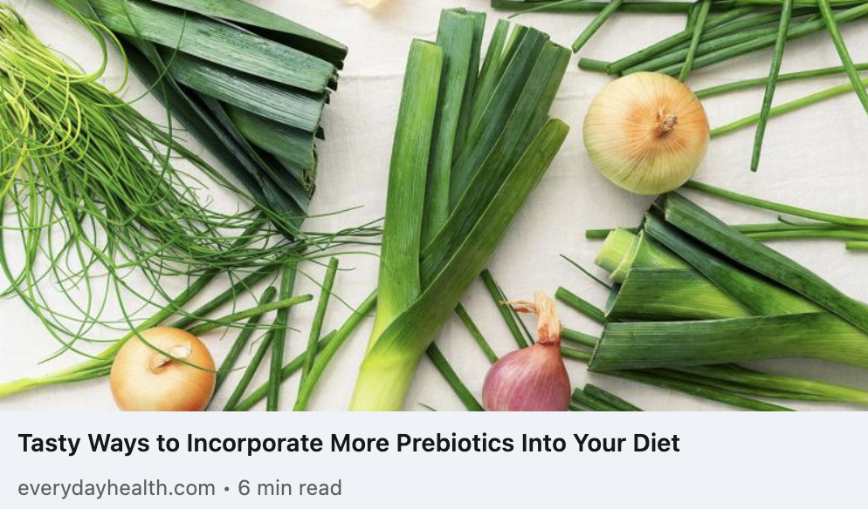
Everyday Health
UVM 11,185,632
Incorporating a variety of prebiotics into your diet helps prevent bad bacteria from taking over and encourages good bacteria to produce anti-inflammatory compounds, called short-chain fatty acids, which nourish the cells lining the colon. If our gut microbiome were a garden, prebiotics would be the fertilizer. Fortunately, there are many prebiotic-rich foods to choose from that suit a variety of dietary needs and taste preferences. With a little extra thought and planning, you can easily incorporate prebiotic-rich foods into every meal to promote the growth of healthy gut bacteria.

Slide 8
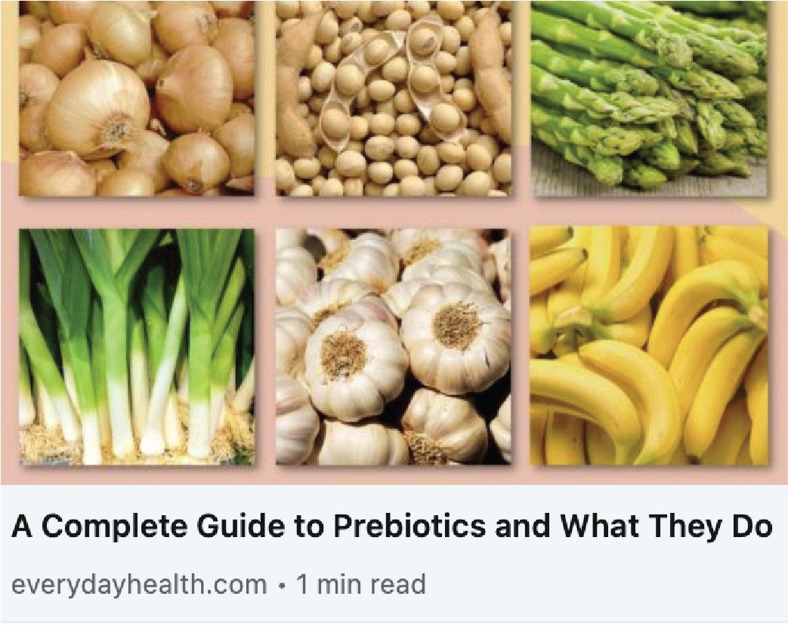
Everyday Health
UVM 11,185,632
To understand prebiotics, we need to understand the microbiome, the community of microorganisms, including bacteria, fungi, and viruses living on and in the human body. This collection of microorganisms is located primarily in the gut, and they work together to protect you from infections and other health risks.
The good bacteria in your gut are called probiotics. They occur there naturally, but you can increase their numbers by eating fermented foods or taking probiotic supplements. These bacteria eat the food you eat: Nutrients that humans can’t digest are consumed by the bacteria, helping them to thrive. Those nutrients are called prebiotics

Slide 9
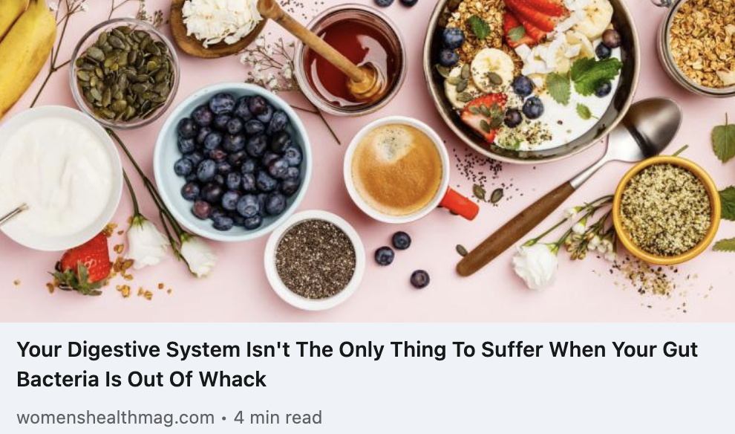
Women’s Health
UVM 22,549,321
For probiotics, their partner in keeping your gut happy are prebiotics. Prebiotic foods contain fibers that promote the growth of healthy bacteria in the gut, notes Matone, and they help make sure the probiotics in that kombucha you drank don’t get flushed out right away. The two work together to make sure that the microorganisms in your gut are living their best lives.

Slide 10
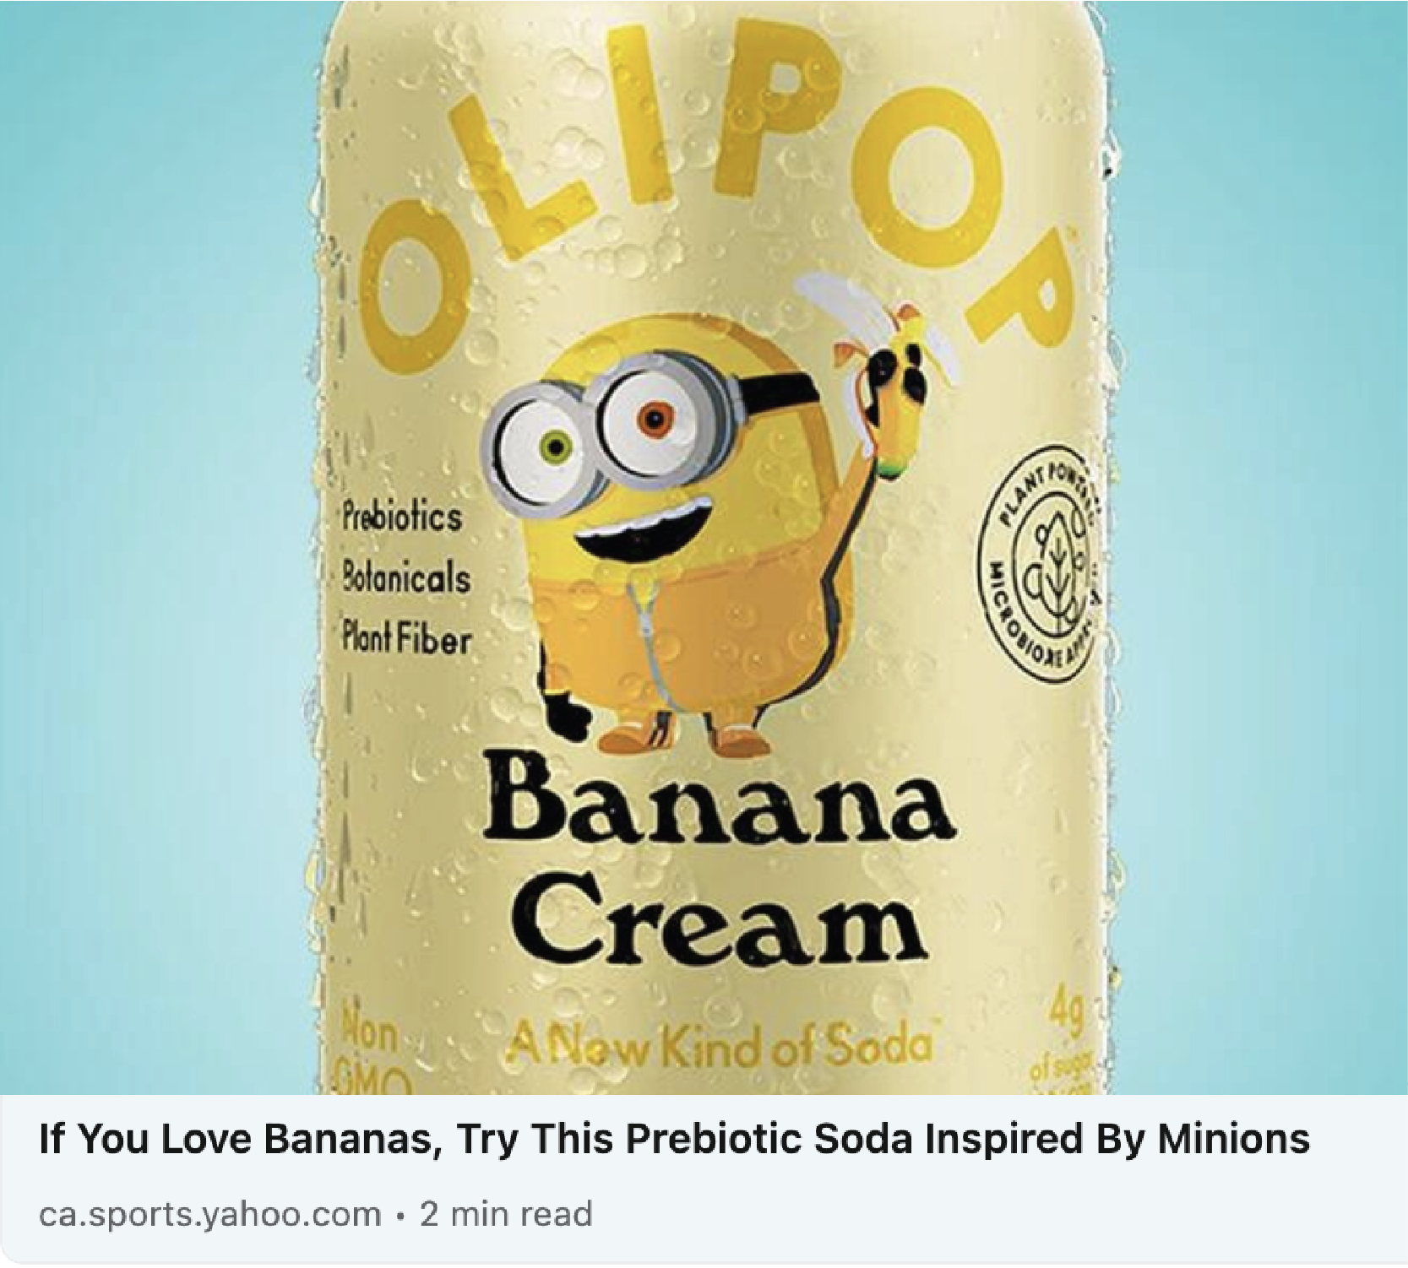
Yahoo!
UVM 456,238,592
According to the brand’s team of microbiome researchers, Olipop soda features research-backed ingredients that can improve gut health. Each can has 35 to 45 calories and contains 2 to 5 grams of natural sugar, and the main ingredient is Olismart, a proprietary blend of botanicals, plant fibers, and prebiotics. Olipop describes the banana cream flavor as “a work of evil genius,” which is no surprise considering the characters that inspired it.

Slide 11
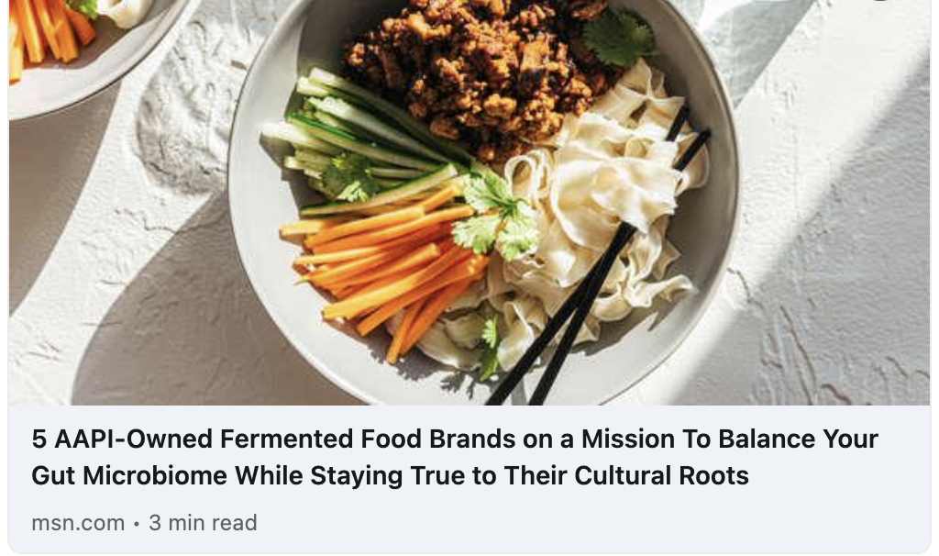
MSN
UVM 193,867,586
The prebiotic and probiotic sparkling drink company Wildwonder was inspired by the healing tonics that founder Rosa Li’s Chinese grandmother would make for her when growing up. According to Li, these herbal-infused beverages would lift her spirits, calm her stomach, and keep her healthy. Later in life, while working a stressful finance job, Li experienced several gastrointestinal issues. After an eye-opening microbiome test revealed the impact stress was playing on her gut health, Li set out to modernize her grandmother’s healing tonics and launched Wildwonder.

Slide 12
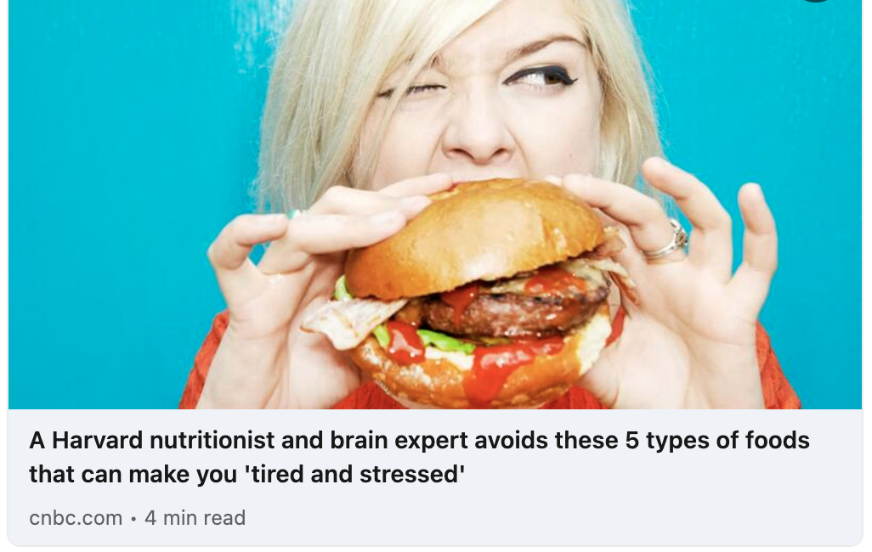
CNBC
UVM 57,164,915
"Here are the foods, vitamins, and nutrients I try to embrace for a happy brain and healthy body; Probiotics: yogurt with active cultures, tempeh, miso, sauerkraut, kefir, kimchi, kombucha and certain cheeses; Prebiotics: beans, oats, bananas, berries, garlic, onions, dandelion greens, asparagus, artichokes and leeks.”

Slide 13
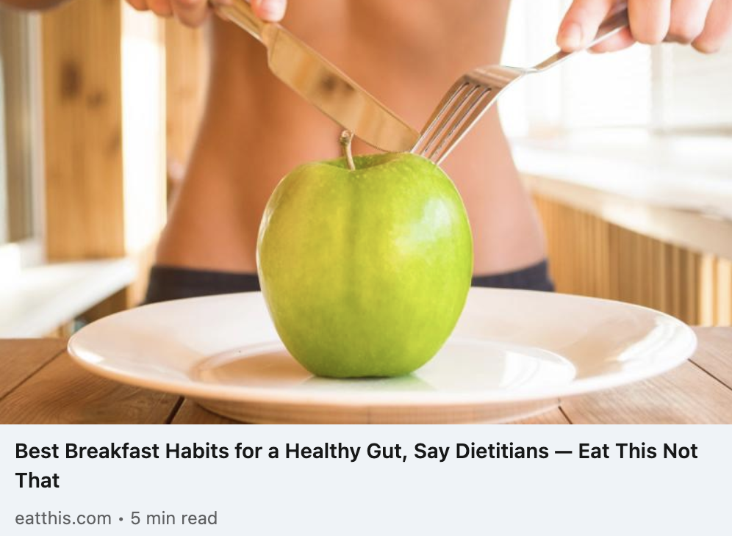
Eat This, Not That
UVM 17,171,546
Apples contain polyphenols-antioxidant and anti-inflammatory properties. The polyphenols have prebiotic characteristics and apply antimicrobial effects against pathogenic gut microflora—meaning they protect your body from harmful bacterial species that promote their own growth and can spread disease throughout the body. They also contain fiber to contribute to lowering cholesterol. "Pears contain prebiotic fiber that helps improve gut health by providing food for good probiotic bacteria," says Dunn. "Bananas contain prebiotics and resistant starch. Resistant starch is resistant to digestion, and bacteria can feed on it as it passes through the large intestines."

Slide 14
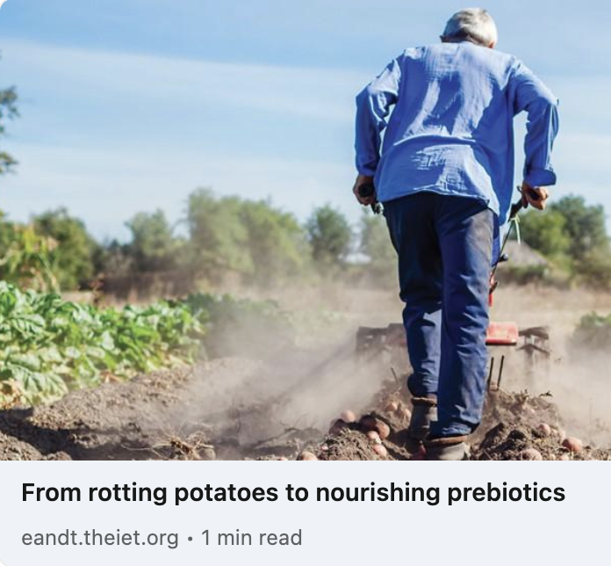
Engineering & Technology
UVM 11,739,503
Engineers and scientists are working on a new way to extract target carbohydrates needed to make prebiotics; a group of non-digestible nutrients – mostly carbohydrates – that are resistant to the acidic conditions found in the human gut and boost the growth of beneficial bacteria.... Currently, experts use enzymes to produce prebiotics on an industrial scale, but they are expensive. Scientists are working on new ways to synthesize nutrients in a more sustainable way, by using enzymes that grow on food waste.

Slide 15
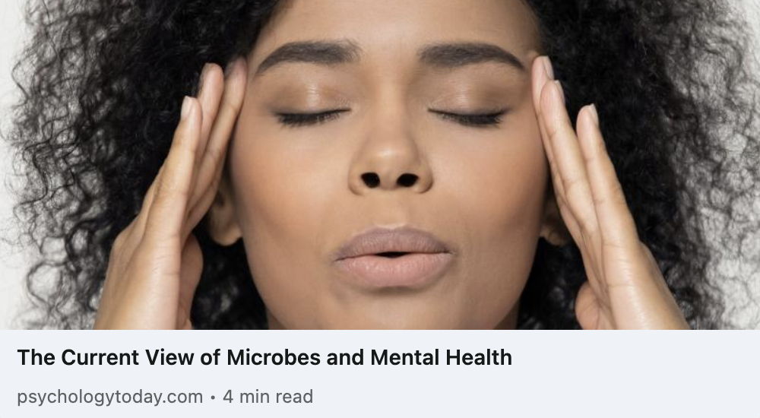
Psychology Today
UVM 11,935,172
The potential benefit of microbiota-targeted therapeutics to treat brain-related disorders has led to an expansion of companies targeting the gut-brain axis. In addition to probiotics and prebiotics, companies are developing live biotherapeutic products to be used, while others are focusing on the molecules produced by microbes as potential therapeutics.

Slide 16
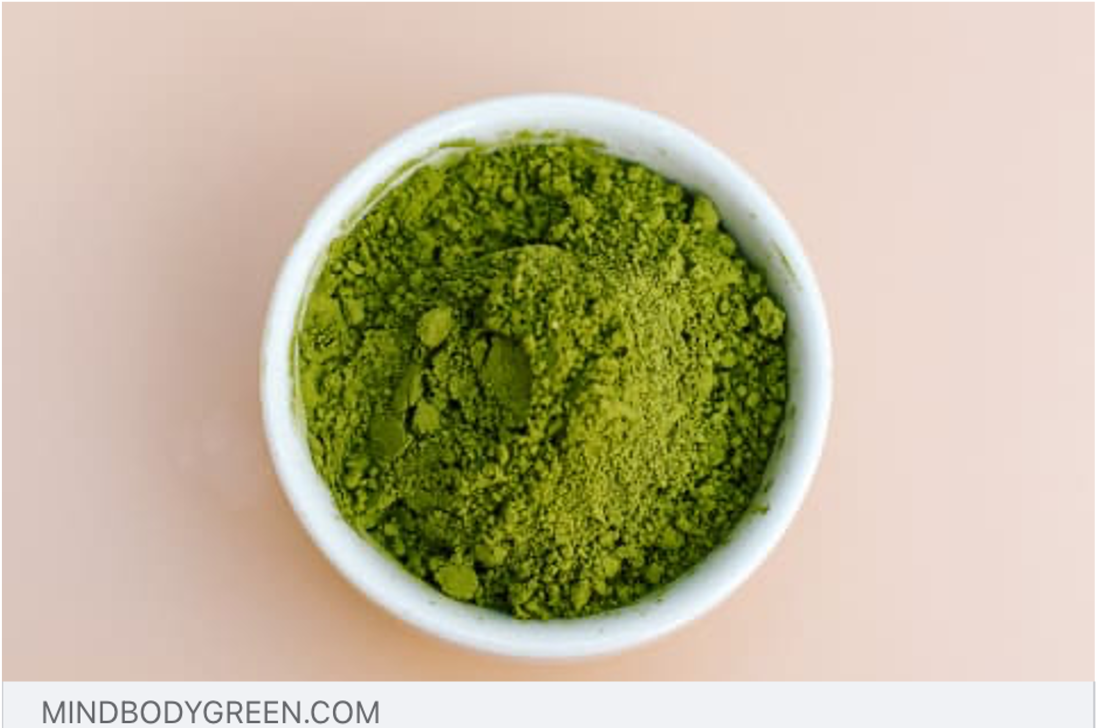
Mind Body Green
UVM 6,436,879
When a superfood powder does double-duty to support digestion, that's a win. Prebiotic fiber, digestive enzymes, and even probiotics (described at the strain level) are all a major plus.
It's always great when your existing diet provides your body with a diverse array of nutrients to thrive; but enhancing your eating habits with a superfood powder can easily slip some extra vitamins, minerals, phytonutrients, fiber, and other healthy ingredients into your day.
15 Best Superfood Powders To Try, According To Nutrition Experts

Slide 17
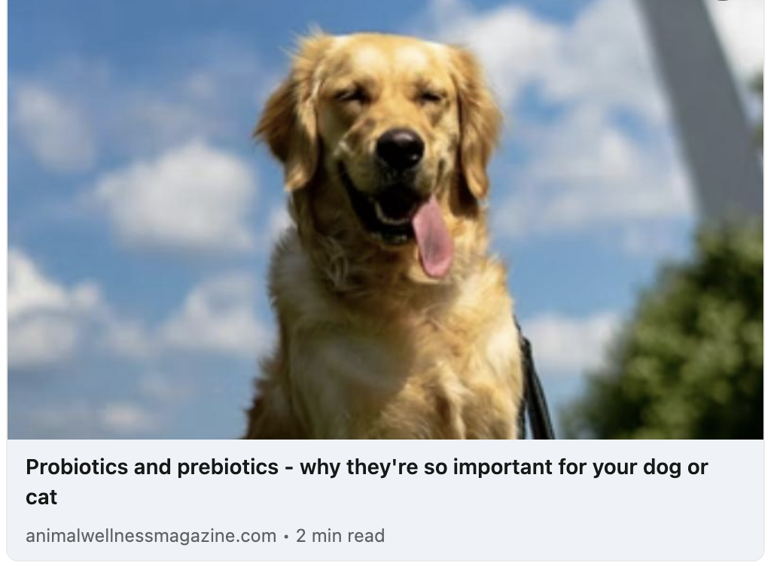
Animal Wellness
UVM 71,517
A balanced microbiome has a positive impact on your dog or cat’s health that goes well beyond digestive function. Probiotics and prebiotics can help achieve and maintain that balance.
A well-balanced and nutritionally adequate diet, supplemented with specific prebiotic fibers and viable probiotics, can help support and maintain a normal microbiome. Feeding the microbiome with prebiotic fibers in the diet helps the commensal bacteria perform their functions, while probiotics provide further reinforcement to that bacteria.

Slide 18

Insights
Insights

Slide 19
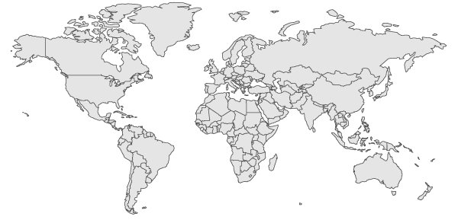
Top Countries Online + Print
Canada
2%
Germany
2%
USA
75%
UK
10%
India
5%
South America
& Mexico
1%
Africa
1%
Australia & New Zealand
4%

Slide 20
Anxiety
Snacks
Synbiotics
Skincare
Microbiome
Pet Food
Gut Health
Balance
Immunity
Trending Topics
Integrity
Super Foods
Mental Health
Postbiotics
Fungi

Slide 21

Sentiment
Positive
92%
Neutral
7%
Negative
1%
Coverage continues to be positive overall, but we do continue to see prebiotics referred to as only food for probiotics or fiber.

Slide 22
Experts & Influencers
Dr. Whitney Bowe holds that there is a founded gut-skin connection — we understand skincare is holistic
Dr. Megan Petty, resident farm veterinarian, on the importance of prebiotics and probiotics "support the microflora in the gut, giving the horse a better baseline for staying healthy…”
Laura Manning, MPH, RDN, a clinical nutrition coordinator, discusses the Crohn’s Disease Exclusion Diet.
Dr. Ruscio devotes a podcast to how your gut health correlates with subclinical hypothyroidism, rheumatoid arthritis, depression, H. Pylori, and more
Dr. Raphael Kellman, a specialist in integrative and functional medicine describes “The microbiome diet can significantly help many patients with both forms of IBS…and the use of probiotics and prebiotics are glaringly missing”

Slide 23
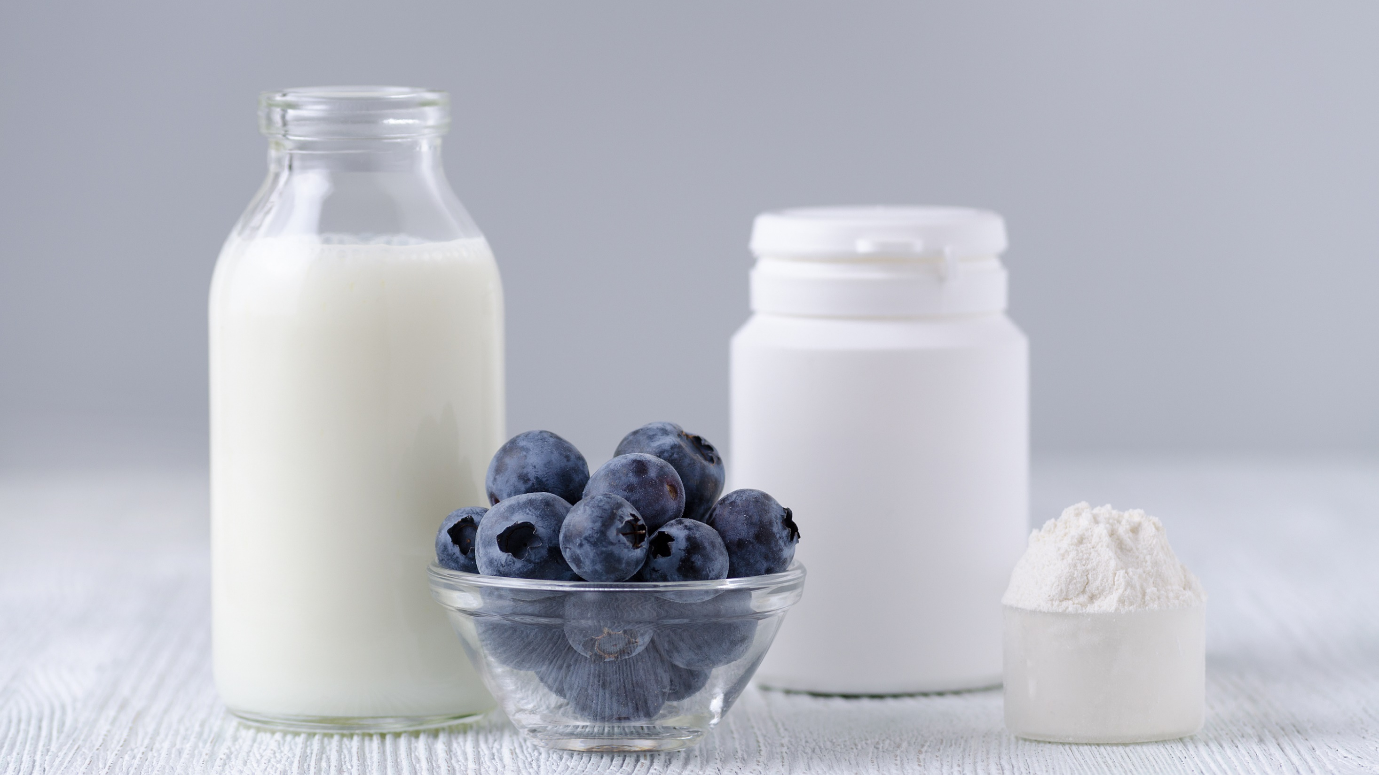
Questions?
Traci Kantowski
Communications Director
Global Prebiotic Association
+1 630.923.0211
traci@prebioticassociation.org

