Slide 1
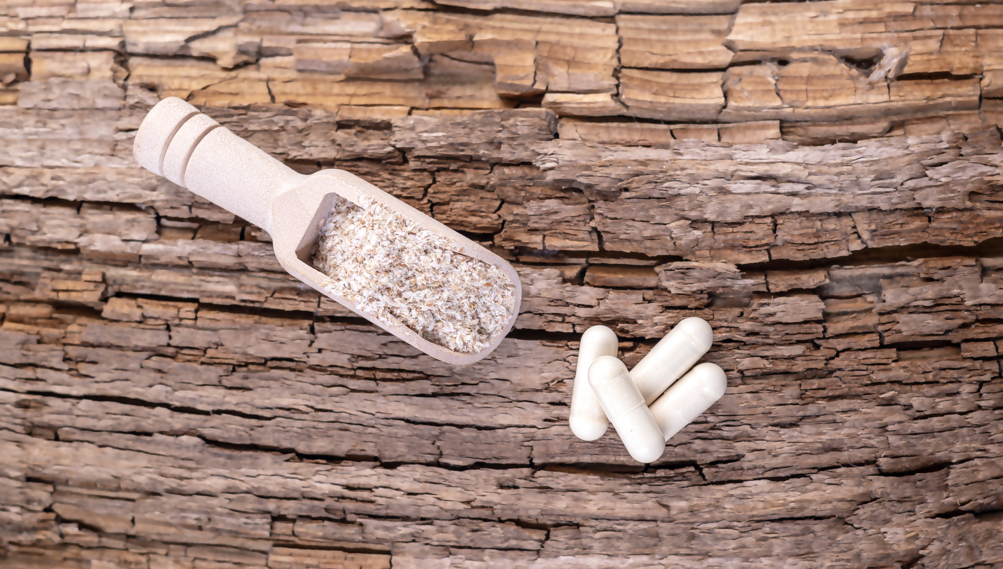
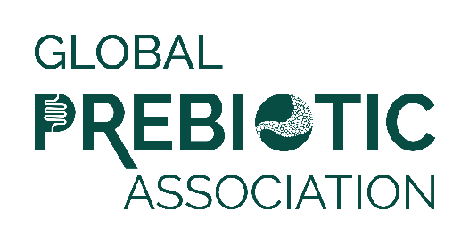
Media Insights Report
Q2 2023

Slide 2
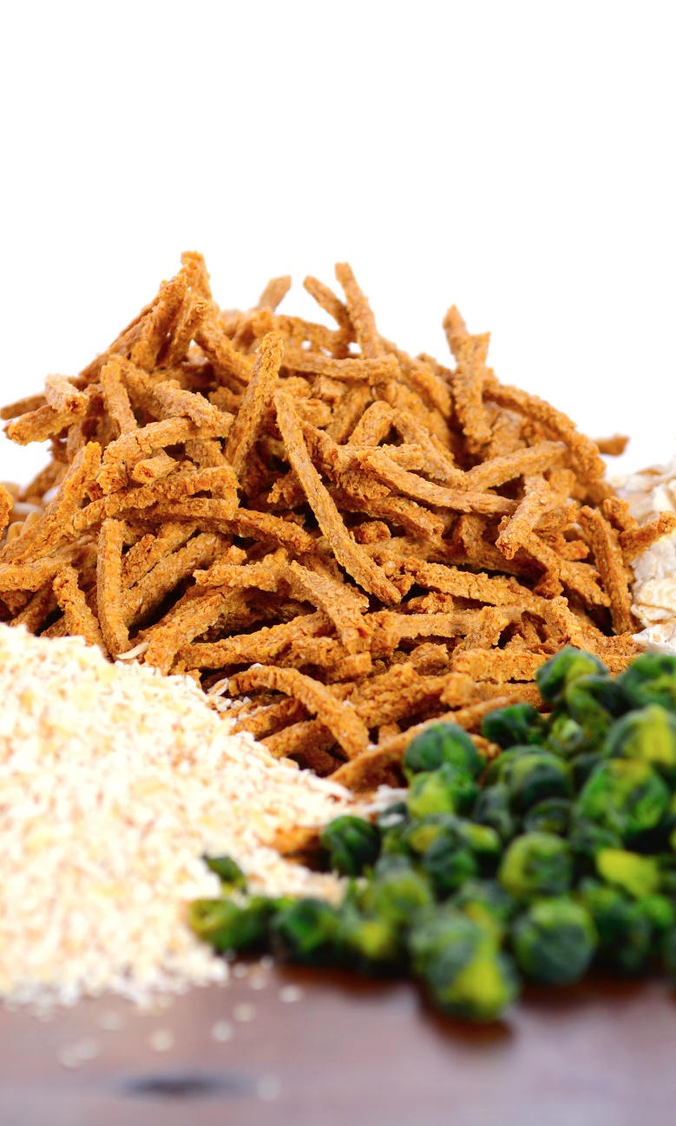
Data Summary
Data was pulled from Muck Rack insights for the period of April 1 to June 30, 2023.
Reports looked at traditional media and social media, with a heavy emphasis on consumer-reaching media.
Trade coverage and new product launches are also included.
Full text of articles may be accessed by clicking the article image on each slide.

Slide 3
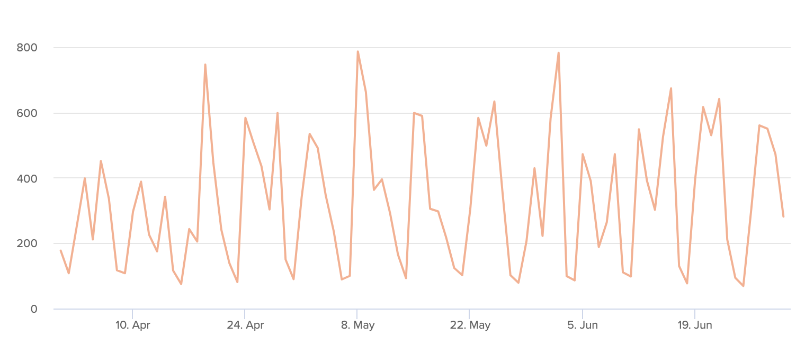
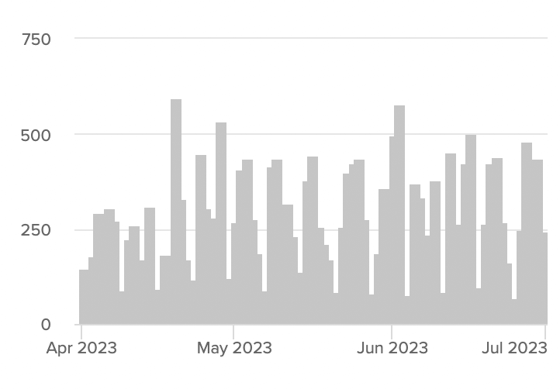
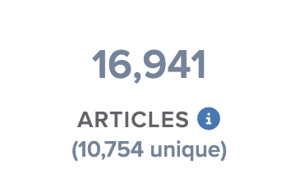

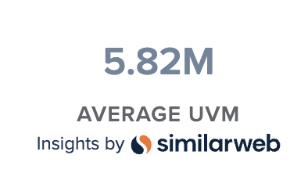
Articles Over Time
Unique Outlets
Coverage drivers are listed on the following slides.

Slide 4
Mycelium / Mushroom
Fermented Foods
Pro, Pre, Syn, Post Combination
Microbiome in Beauty/Skin
Energy & Vitality
Mental Health
Pet Food & Supplement
RTD Beverage - Sodas
Plant-Based
Trending Topics
New Formulations
Dietary Balance
Holistic Wellness
Gut Health
Menstrual & Menopausal Health

Slide 5
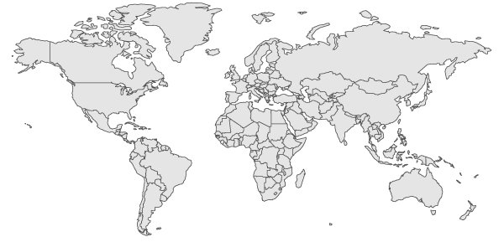
Top Countries/Regions
Canada
4%
Germany
4%
UK
7%
USA
52%
Italy & France
3%
Asia
12%
India
7%
South America
& Mexico
2%
Africa
3%
Australia & New Zealand
4%

Slide 6
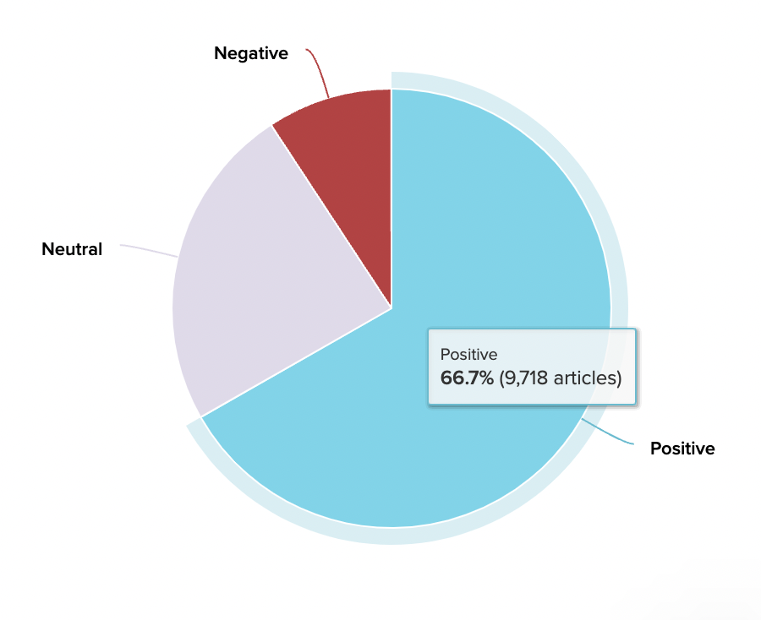
Sentiment
Coverage is positive overall, with more media coverage and study growing. Focus is on building additional understanding and driving increased media coverage.

Slide 7
Experts & Influencers
Registered pharmacist David Foreman examines risks factors for poor skin health and four areas that can affect beauty from within effectively.
Dr. Joanne Aponte, a naturopathic doctor at Lakeside Natural Medicine, discusses - Gut Health for Kids: Clever Strategies for Picky Eaters: “All veggies are beneficial, but ones high in galacto-oligosaccharide (GOS) and fructo-oligosaccharide (FOS) prebiotics help grow and support healthy gut bacteria…”
Dr. Piraye Yurttas Beim, PhD discusses the microbiome and more in: I’m a Women’s Biotech Founder & These Are 8 Ways I Protect My Ovarian Health
The study, "Effects of 24-week prebiotic intervention on self-reported upper respiratory symptoms, gastrointestinal symptoms, and markers of immunity in elite rugby players," published in the European Journal of Sport Science, was conducted by a research team led by Dr. Neil Williams of Nottingham Trent University
Clinical nutritionist and researcher Dr Vincent Candrawinata says gut health is the foundation of overall health and wellness
Dr Caitlin Hall is a gut health dietitian, with a PhD in neurosciences and gut microbiology; Prebiotics are “rocket fuel for your gut microbes.”

Slide 8
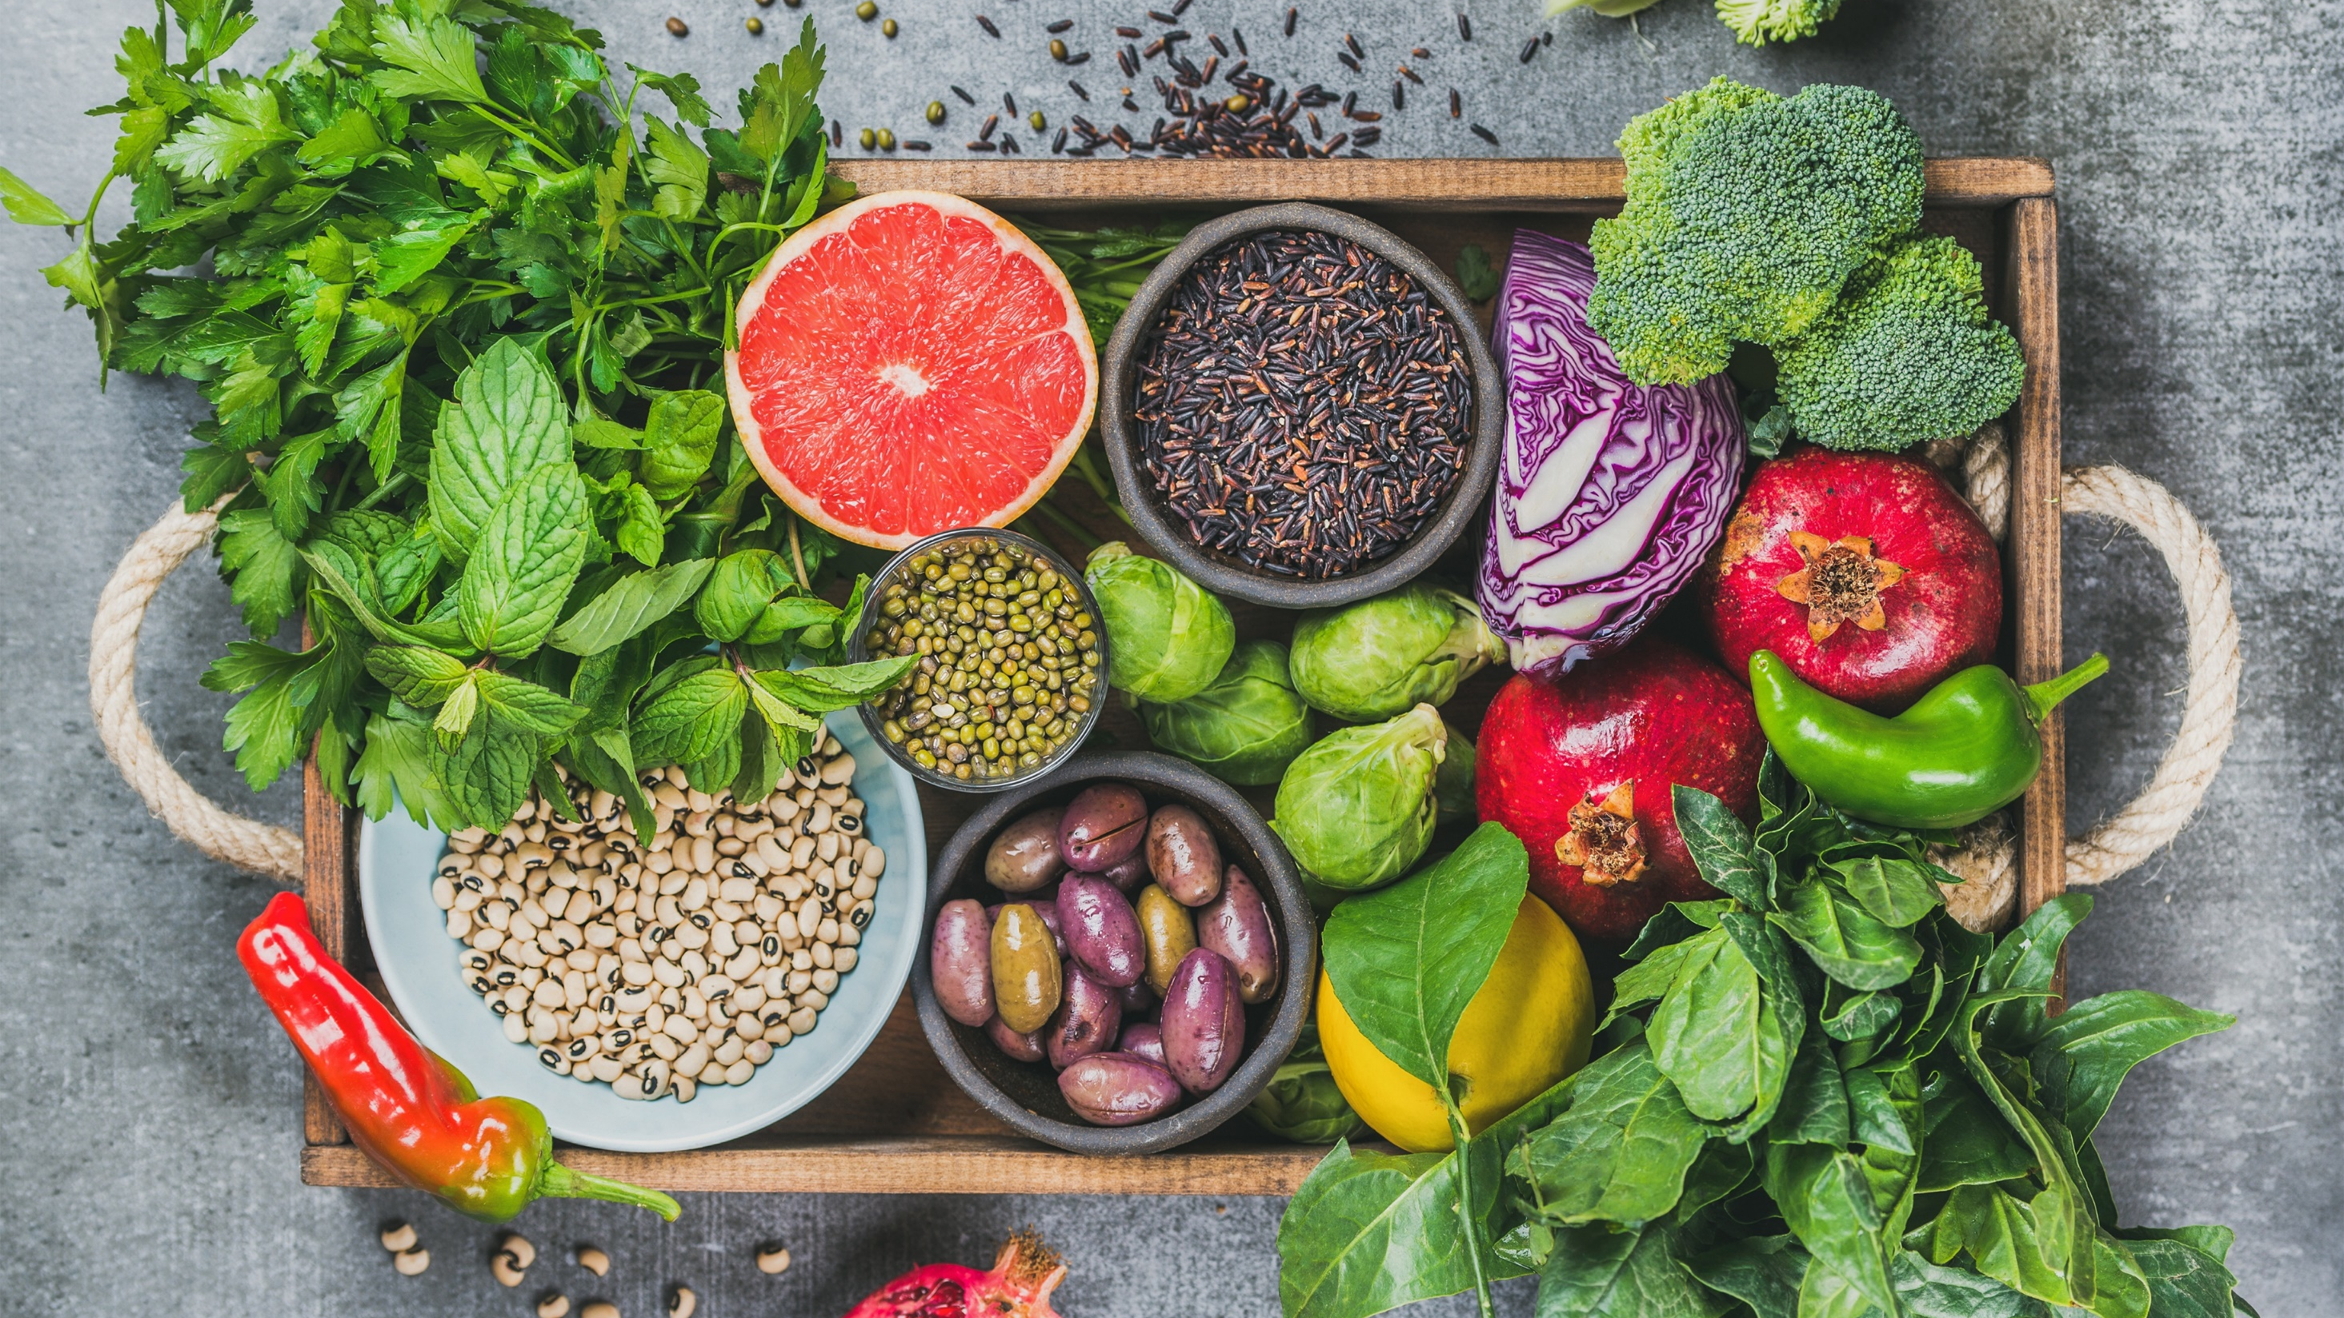
Media
Coverage
Highlights

Slide 9
Product Launches
Human-grade dog food brand PetPlate has announced the launch of FreshBaked™, a new dry formulation of crunchy, gently-baked clusters: “we packed in superfoods as well as prebiotics and postbiotics for extra nutritional and digestive support.”
Plexus announced the launch of Plexus Sleep, a supplement that promotes quality, restorative sleep; contains… melatonin, paired with gut-healthy prebiotic fiber FOS (fructooligosaccharides)
SuperMouth Launches Nationwide, SuperMouth MouthCare Systems are customized by age, risk potential for cavities, and personal preference
Ava Lee, the TikToker behind #JelloSkin, launches ingestible beauty brand ByAva
Skin Federation launches "Intimate Menopause Management Routine": A revolutionary skincare solution for menopausal women
Goode Health announced the launch of The Ultimate Wellness Blend, a customizable smoothie blend packed with four kinds of high-grade plant-based proteins… Including a prebiotic fiber, a unique mix of polyphenol antioxidants…

Slide 10

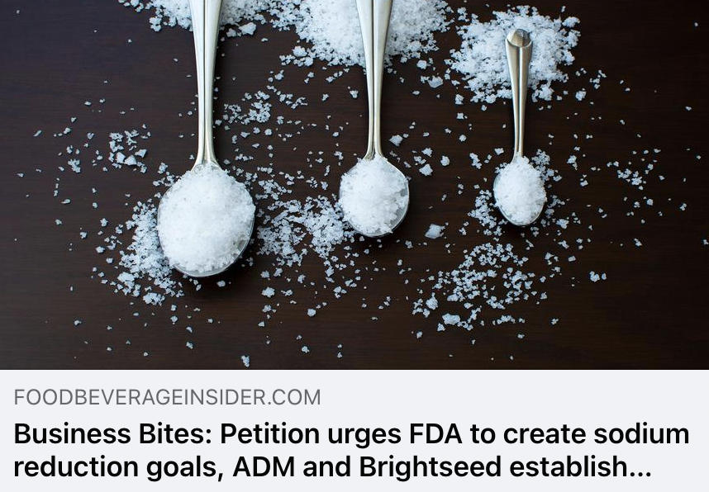
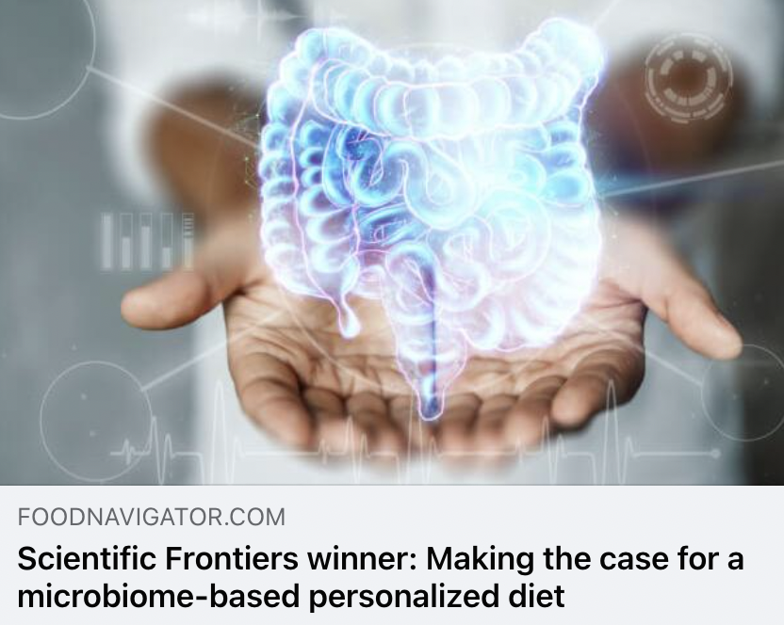
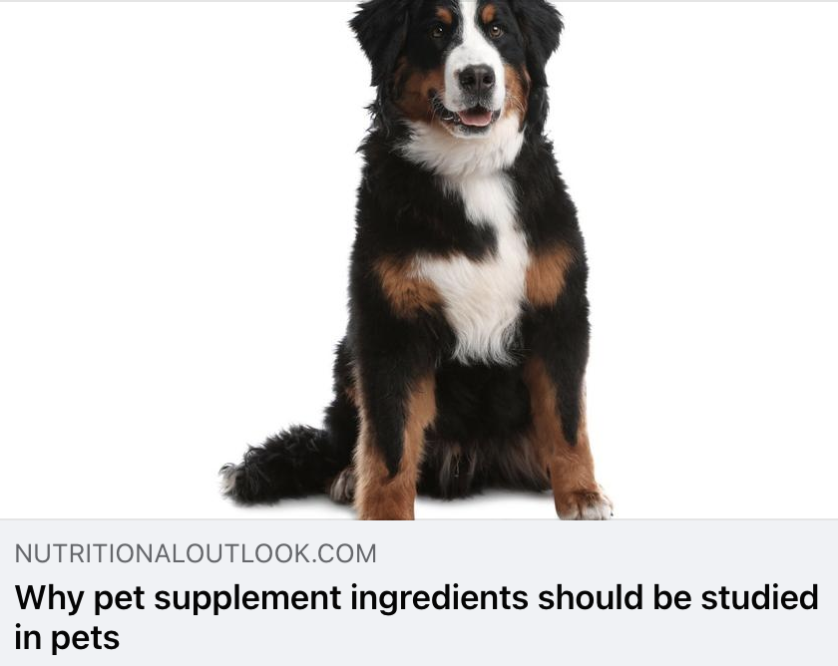
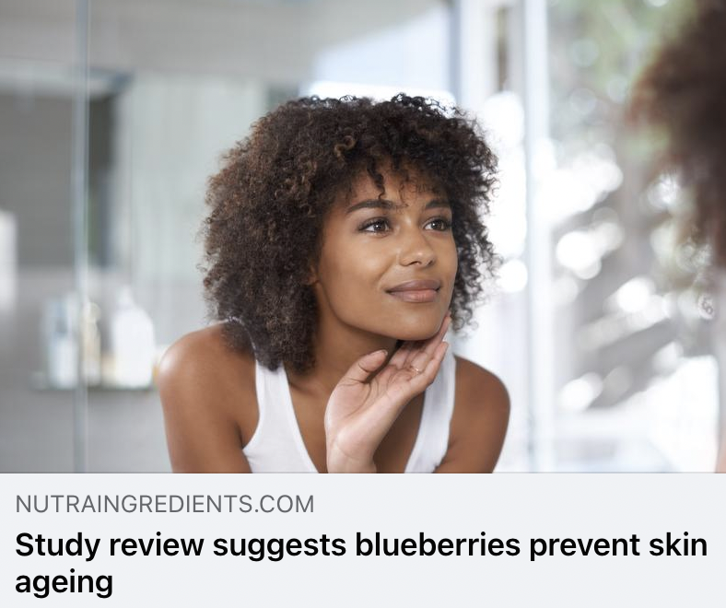
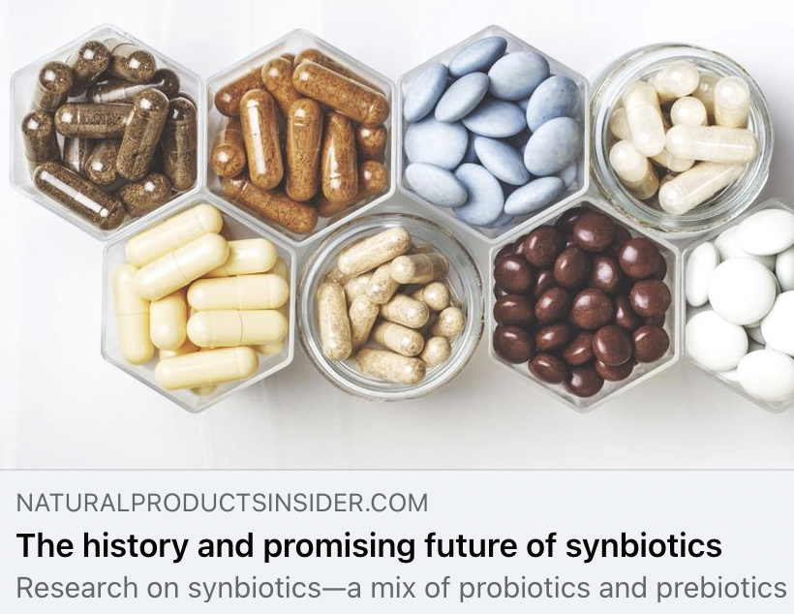
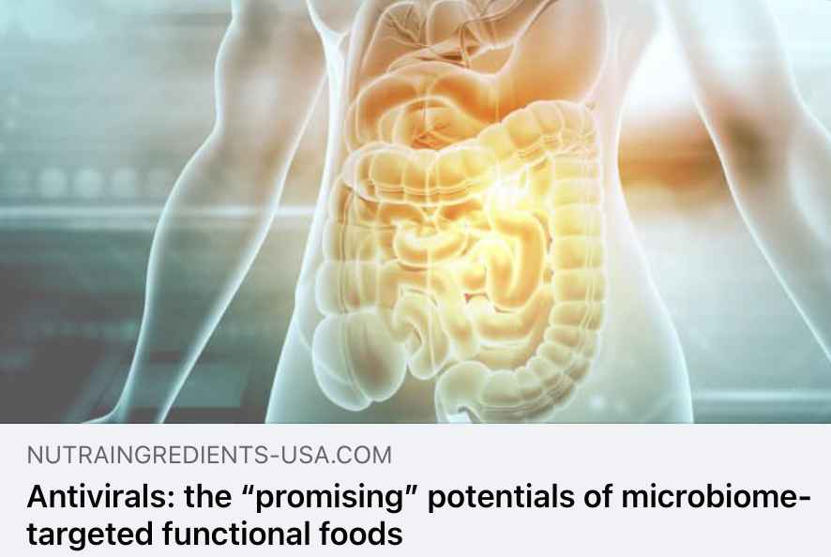
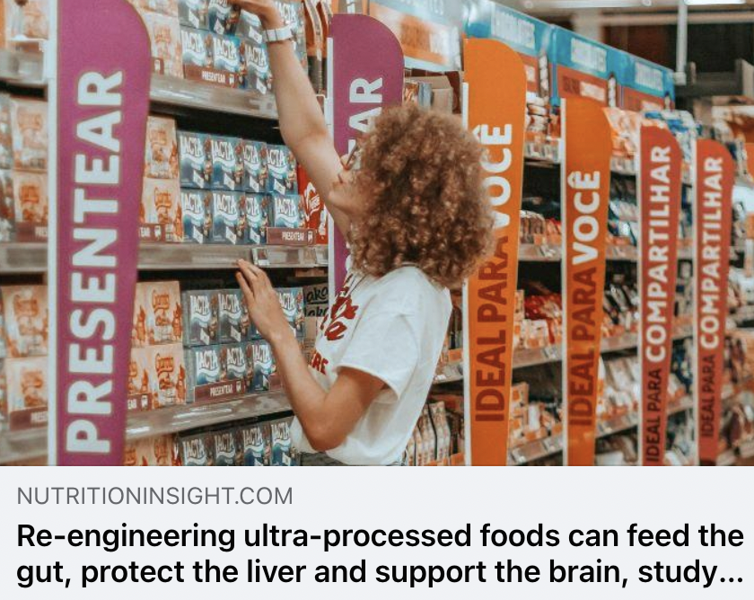
Trade Coverage

Slide 11
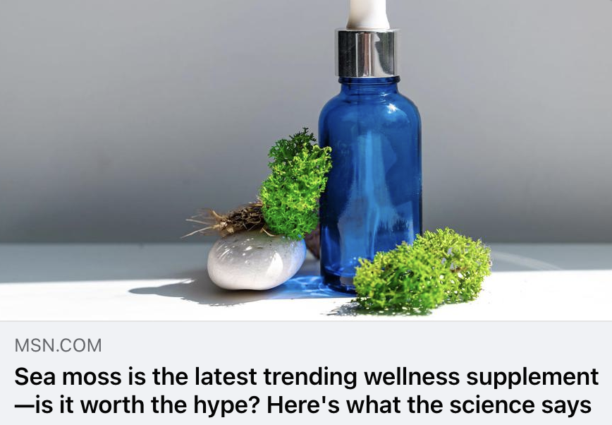
MSN
UVM 168,879,495
"It's rich in antioxidants which could potentially help lower inflammation and decrease your risk of chronic diseases," says Kullab. Support for thyroid function: "Sea moss contains iodine which helps regulate your thyroid function. And iodine is something that our bodies can't produce, so we do have to ingest it." Thyroids release hormones that regulate mood, metabolism and weight, she adds. To prevent adverse effects, you shouldn't exceed one serving of a sea moss supplement a day; its high iodine levels can negatively affect your thyroid if taken in excess, Kullab notes. Regulated gut health: "Sea moss also contains prebiotics which will feed your healthy gut bacteria. [This] could potentially lead to improved digestion [and] again, a boost in your immune system. Good gut health can also improve mental health," she notes.

Slide 12
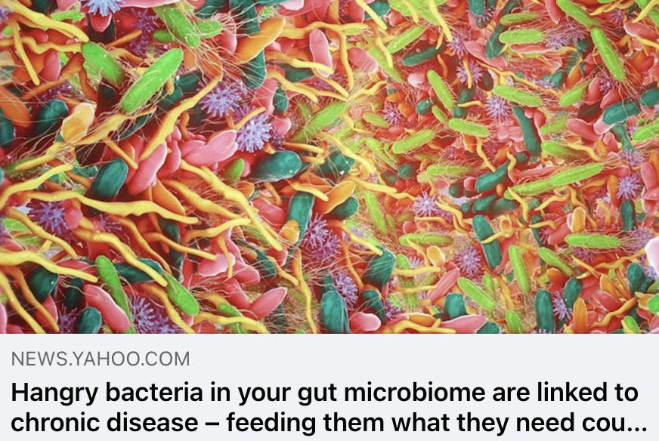
Yahoo!
UVM 409,373,649
Only 5% of the U.S. population gets sufficient fiber, a prebiotic nutrient linked to metabolic, immune and neurologic health. Americans are likely also deficient in phytonutrients, potassium and certain healthy fats linked to lower rates of cardiovascular disease and cancer. Fermentation is nature’s version of processing, creating foods with natural preservatives, flavors and vitamins. Recent research suggests fermented foods can improve gut microbiome diversity and dampen systemic inflammation.

Slide 13
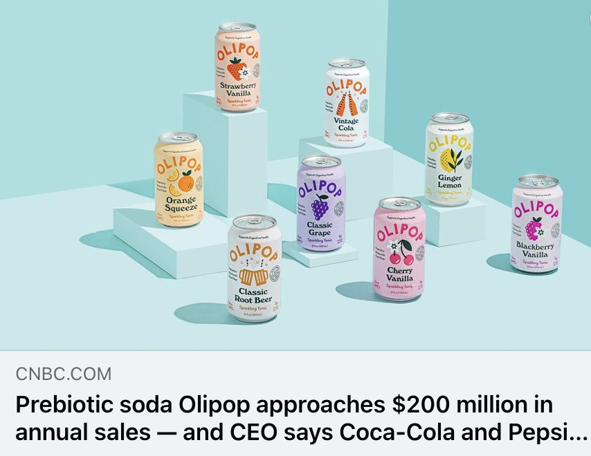
CNBC
UVM 44,530,816
Goodwin estimates that roughly 10% of Olipop drinkers have replaced traditional soda entirely, but the rest swap it into their routines occasionally.
“We really are replacing that soda experience and soda occasion,” Goodwin said.
For roughly two decades, U.S. soda consumption has been falling. Americans have ditched the drinks for bottled water, flavored seltzer and other options that they view as healthier due to concerns about soda’s sugar — or sugar replacements, such as aspartame. Still, Coke and Pepsi aren’t in danger of discontinuing their namesake sodas.
“Consumers are drinking less soft drinks, but they’re still drinking a lot of soft drinks,…”

Slide 14
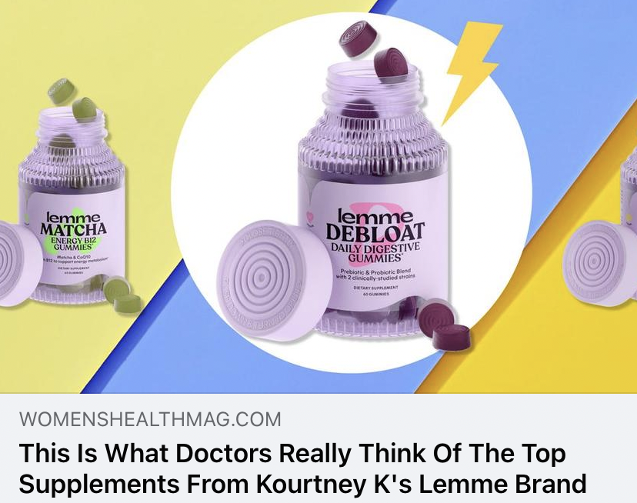
Women’s Health
UVM 28,409,805
If it feels like your social media feed is being run by Lemme, Kourtney Kardashian’s newest line of vitamins and botanical supplements, you're not alone. There’s no doubt Lemme’s trendy branding is appealing (some products even have a waitlist!). But before you click "add to cart" and take the Kardashian’s health advice as gospel, a deeper dive into the ingredients is warranted.
Add probiotic-rich foods—fermented veggies, yogurt, kefir, and kombucha—and prebiotic-rich foods—garlic, onions, bananas, oats, mushrooms, and cabbage—to your nutrition plan to support a healthy gut microbiome, says Guan. She also recommends avoiding highly processed foods.

Slide 15
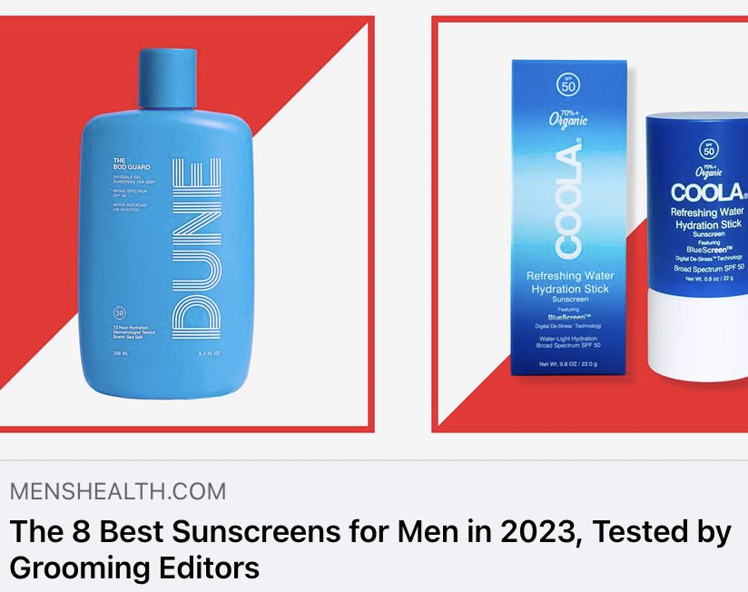
Men’s Health
UVM 26,278,082
In detail, according to Dr. Shirazi, the Anthelios is "formulated with ceramides to support the skin barrier, Niacinamide to help reduce inflammation and discoloration, glycerin to hydrate." Dr. Garshick also adds: "This lightweight sunscreen is easy to apply and fast-absorbing, making it a great option for daily use. It also contains Cell-Ox Shield Technology and antioxidants. It is broad-spectrum and can be used by all skin types."
In addition, the brand’s use of prebiotic thermal spring water also makes it a good choice for those with acne-prone skin. And at this price, it's a no-brainer.

Slide 16
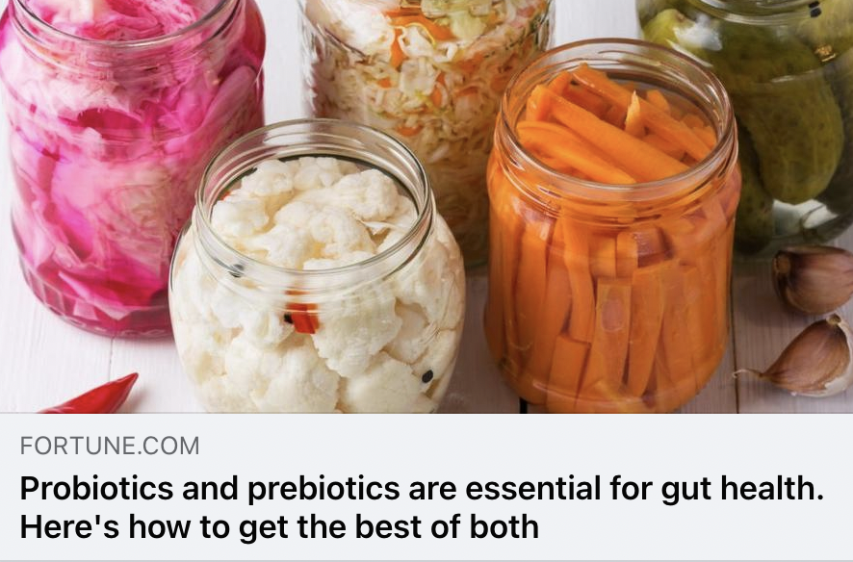
Fortune
UVM 18,657,782
They’re a form of dietary fiber humans can’t digest that acts as food for friendly bacteria. You get them from high-fiber, plant-based foods.
“They’re like the fuel,” says Amy Bragagnini, RD, national spokesperson for the Academy of Nutrition and Dietetics. “It’s basically a fiber that is able to resist the acidity of the GI tract. It doesn’t break down as it goes through your system, and feeds the healthy microbes in our microbiome.” Bragagnini says that even though comparatively, probiotics do the lion’s share of the work of good digestion, prebiotics are the sustenance that make it last.

Slide 17
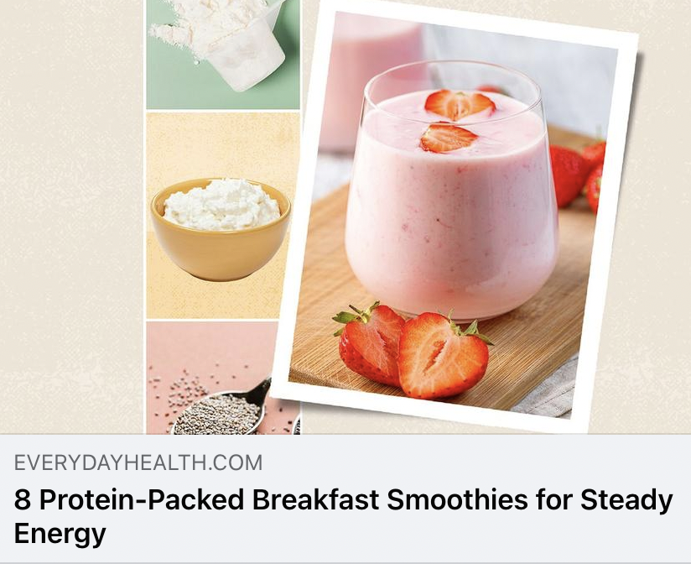
Everyday Health
UVM 14,971,084
A fermented dairy beverage, kefir contains probiotics like yogurt, which aid in digestion and support immune health. One cup of nonfat plain kefir contains 9 g of protein, per U.S. Department of Agriculture (USDA) data. Kefir also contains calcium to support bone health, and is 99 percent lactose-free, so people with a lactose intolerance typically can tolerate it.
Because it is strained, Greek yogurt has more protein than the regular kind, a whopping 25 g per cup of nonfat yogurt, per USDA data. It also contains live and active cultures, which supports gut health. Prebiotics and probiotics work better together, so pair a probiotic like Greek yogurt with a prebiotic like a banana in a smoothie, for a synbiotic effect.

Slide 18

Psychology Today
UVM 15,432,394
Prebiotics are dietary compounds that are utilized by the gut microflora and have an impact on the diversity of the microbiome. Probiotics are living microorganisms that can directly modify the composition of the microbiome. By improving gut microbiota diversity, prebiotic, and probiotic approaches can be used to enhance mental and cognitive health.
Psychobiotics are a novel class of medication used to treat mental disorders, which act on the gut-brain axis to improve mental health. On the other hand, the microbiota signature may be considered a factor that influences not only our physical health but also our decisions and behavior. This is in addition to other factors that shape our personality. Further research is necessary to comprehensively comprehend the intricate correlation between the gut-brain axis and personality.

Slide 19
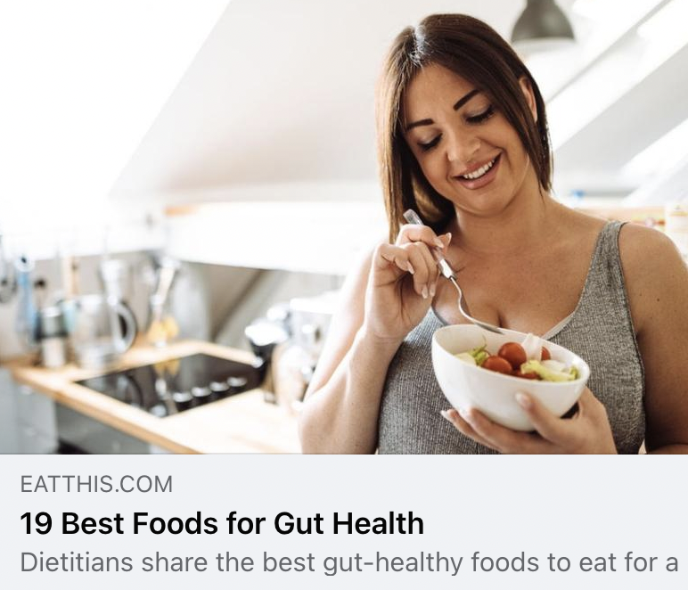
Eat This, Not That
UVM 10,614,232
"If these microbes are ever out of balance, it can cause harm to our gut and increase our risk for developing certain (negative) health conditions," adds Ehsani.
Eating gut-healthy foods is pretty simple. "A balanced diet that includes fruits, vegetables, whole grains, lean proteins, and fermented foods can promote a healthy microbiome leading to better health overall," says Amber Pankonin, MS, RD, registered dietitian and owner of the food blog Stirlist.

Slide 20

Animal Wellness
UVM 49,298
Grass can be a source of vitamins, minerals, and most importantly, fiber, so frequent grass-eating could be a sign of a nutritional deficiency.
You can address nutrient deficiencies by switching to a high-fiber diet or by adding a fiber supplement such as psyllium husk powder into your dog’s food. You can also add a supplement with prebiotics and probiotics such as DoggyBiome S. boulardii + FOS Powder, which improves both gut health and immune functions. Fructooligosaccharides (FOS) are tiny soluble fibers that beneficial gut bacteria love to feed on, so this fosters a re-balancing of good bacteria in the gut.

Slide 21
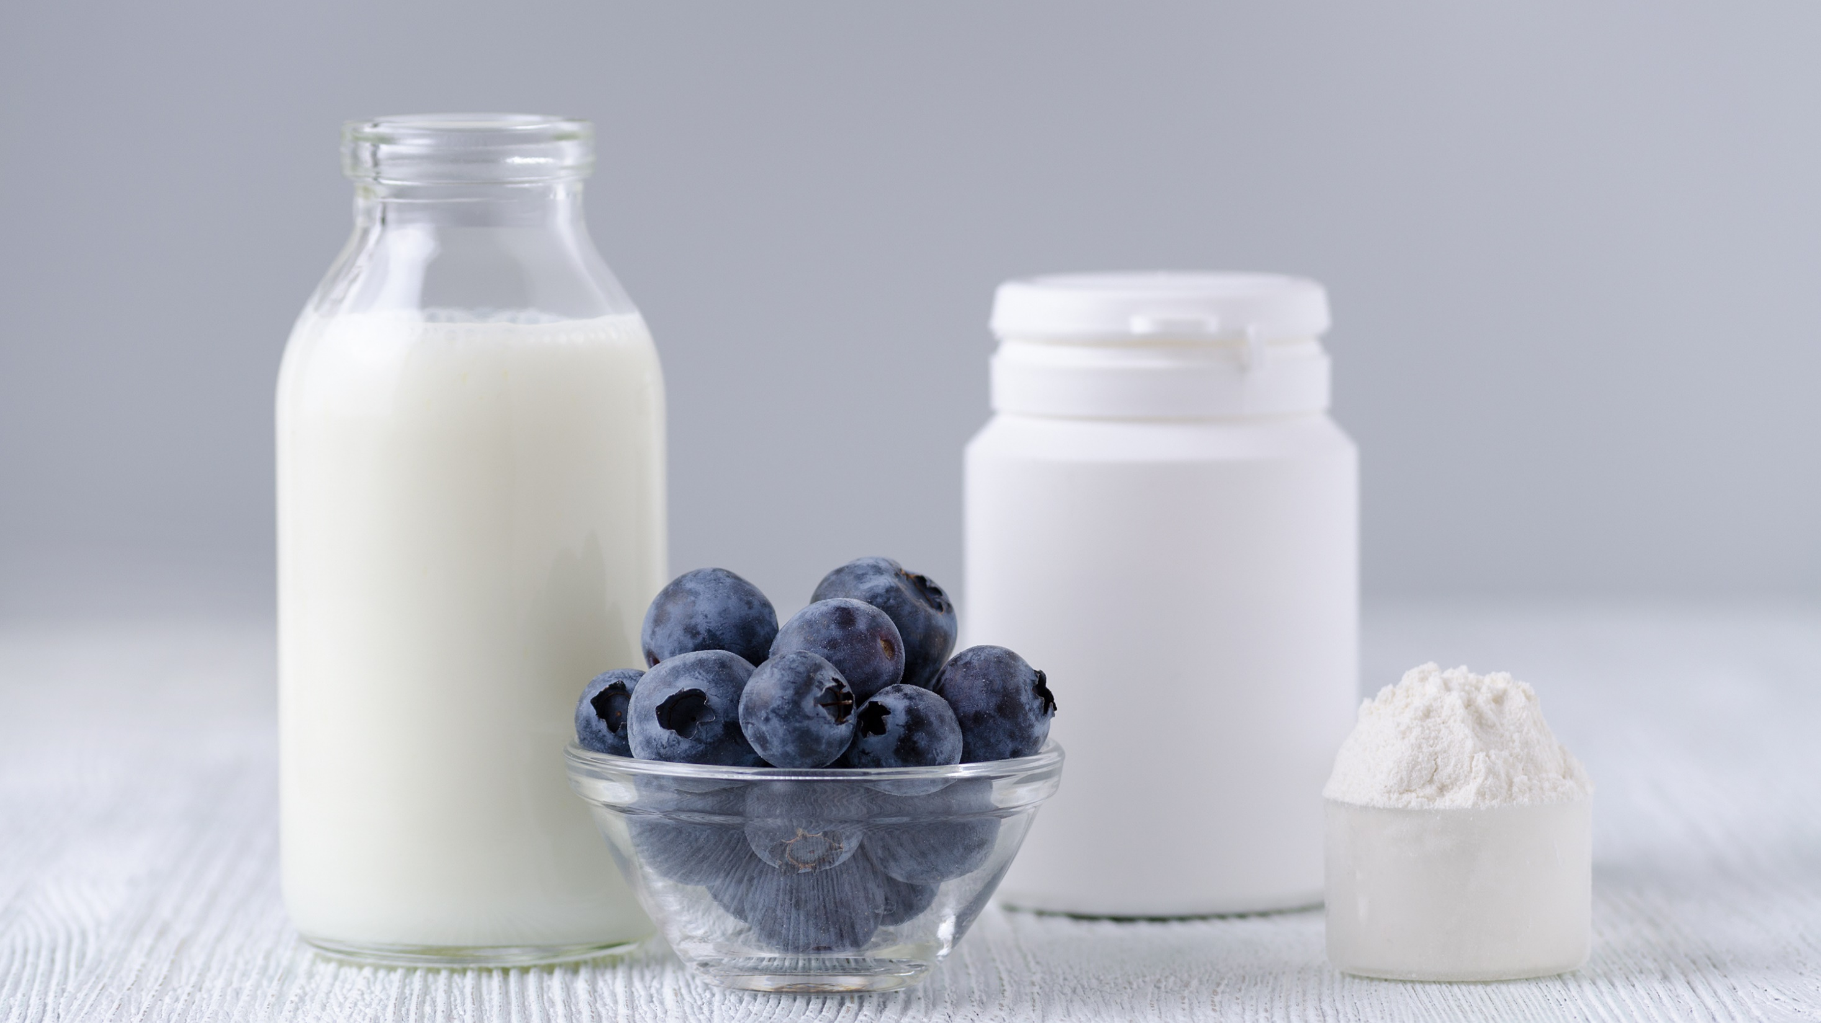
Questions?
Traci Kantowski
Communications Director
Global Prebiotic Association
+1 630.923.0211
traci@prebioticassociation.org

