Slide 1
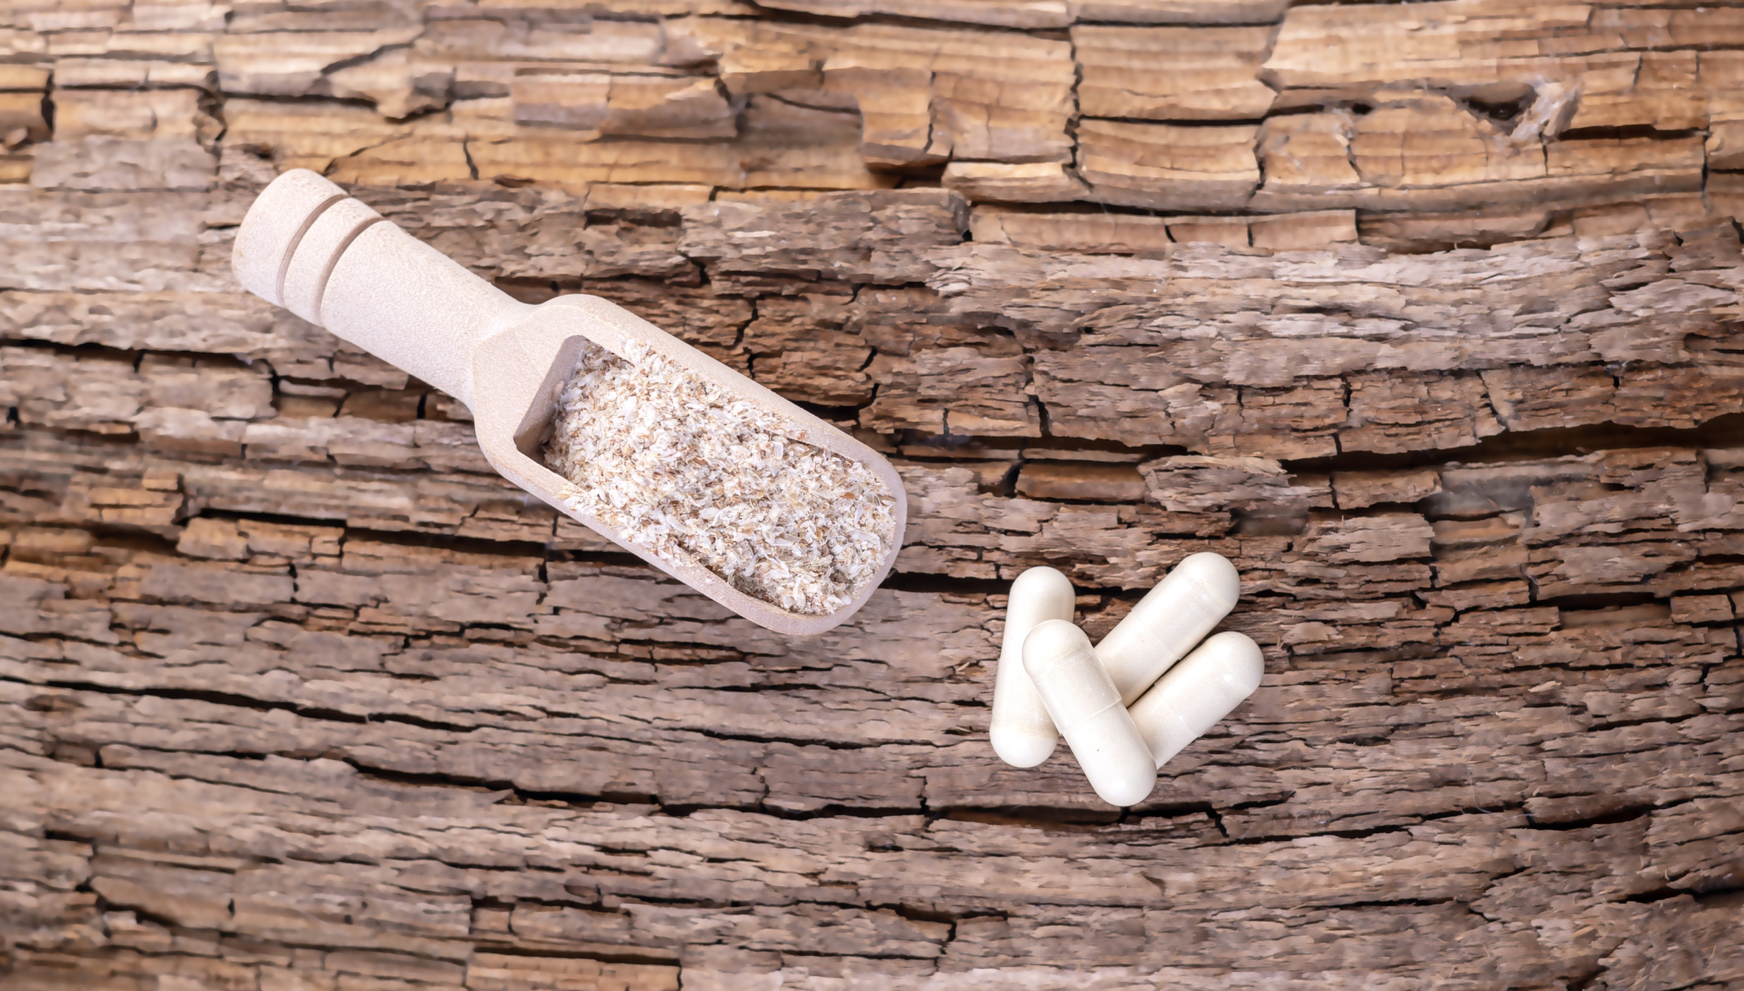
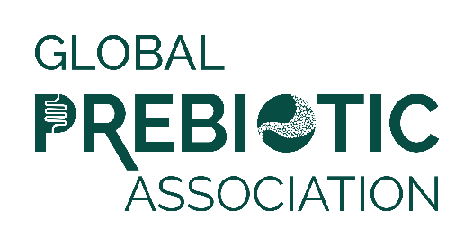
Media Insights Report
Q3 2023

Slide 2
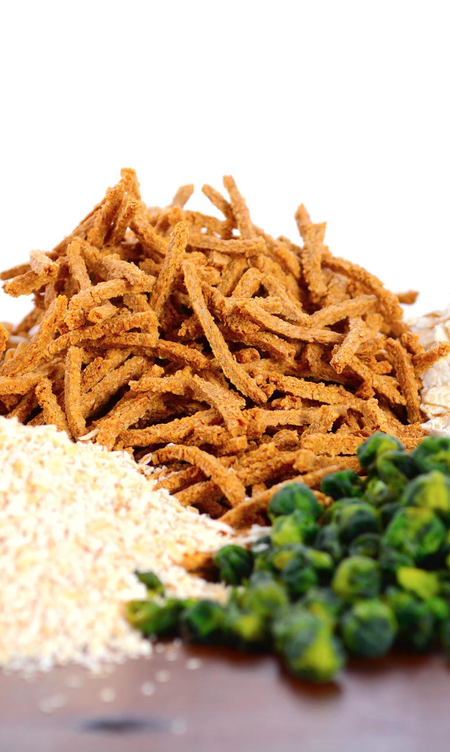
Data Summary
Data was pulled from Muck Rack insights for the period of July 1 to September 30, 2023.
Reports looked at traditional media and social media, with a heavy emphasis on consumer-reaching media.
Trade coverage and new product launches are also included.
Full text of articles may be accessed by clicking the article image on each slide.

Slide 3
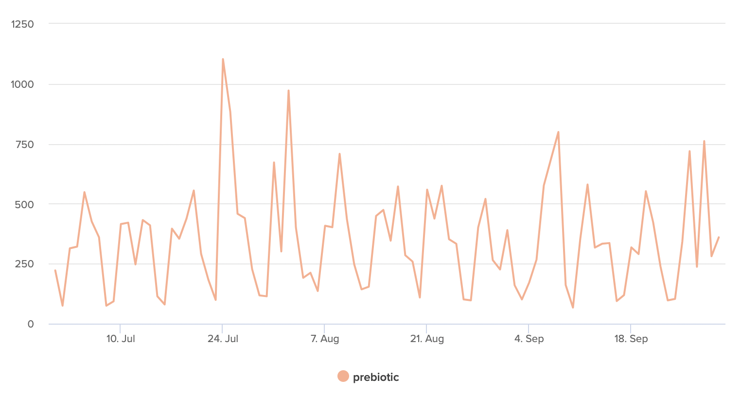
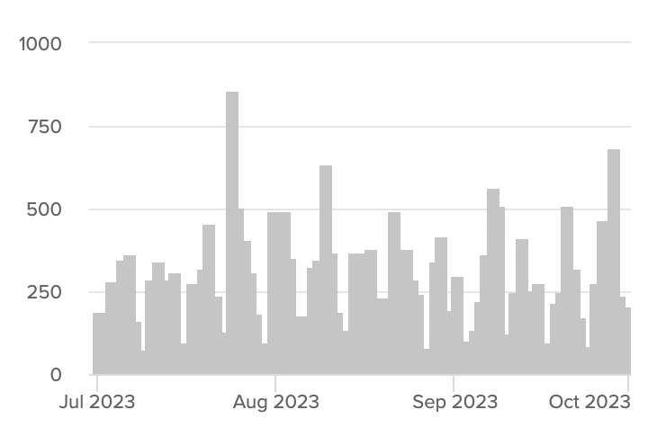
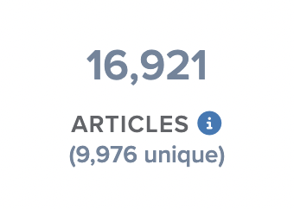
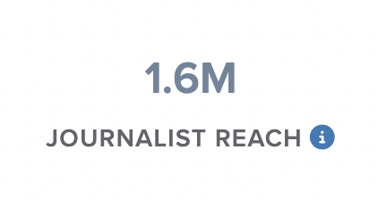
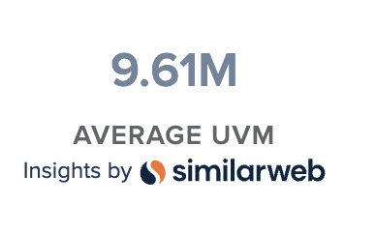
Articles Over Time
Unique Outlets
Coverage drivers are listed on the following slides.

Slide 4
New Research
Pet Health
Synbiotics
Skin Care
Active Aging
Wellness
Mushrooms
Functional Drinks
Vegan
Trending Topics
New Formats
Dietary Balance
Functional Foods & Snacks
Digestive Health
Prebiotic Types

Slide 5
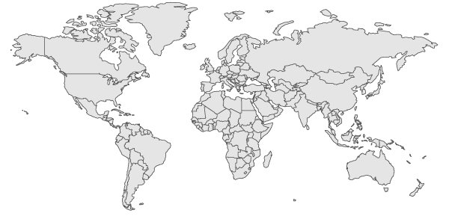
Top Countries/Regions
Canada
4%
Germany
3%
UK
6%
USA
44%
France & Switzerland
4%
Asia
14%
India
9%
South America
& Mexico
3%
Africa
3%
Australia & New Zealand
4%

Slide 6
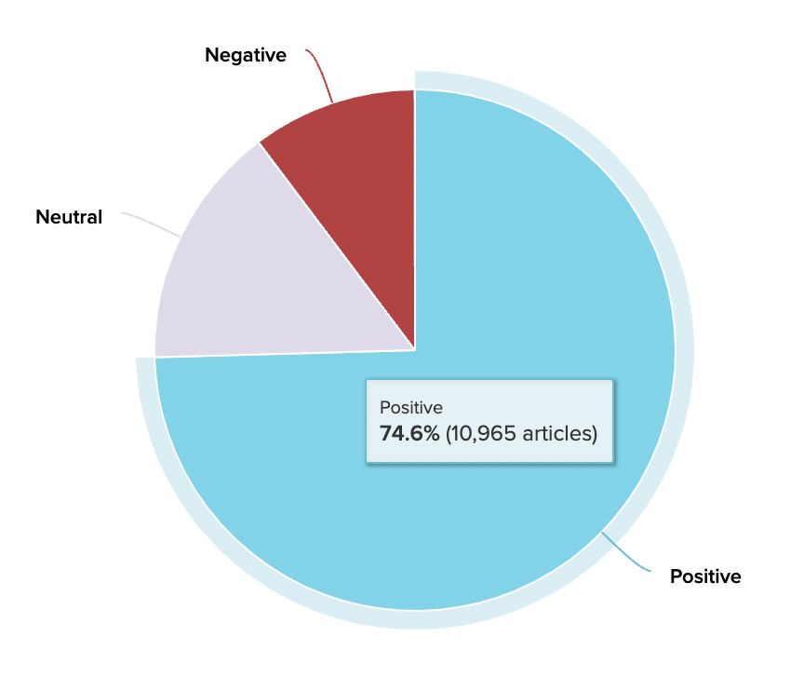
Sentiment
Coverage is positive overall, with more media coverage and study growing. Focus is on building additional understanding and driving increased media coverage.

Slide 7
Experts & Influencers
Dr. Kenneth Brown, a gastroenterologist from Texas, has explained how unhealthy snacking habits can lead to uncomfortable, and frankly unwanted, bloating.
Dr. Thomas Borody, an Australian gastroenterologist, published case reports demonstrating the efficacy of FMT in treating patients with severe and recurring diarrhea…
"Peanuts and peanut butter may have a beneficial effect on the gut microbiota because they are rich in prebiotic fiber and polyphenols," says Dr. Isabella Parilli Moser, first author of the study…
Matt Kopke, the chief executive of Veterinary Nutrition Group which makes personalised homemade diets for dogs and cats, said the global market for pet food supplements was expected to reach $5 billion before the end of the decade.
“The impact of algae on the skin’s microbiome is still an area of ongoing research,” explains Dr. Shokeen Khalsa.
Foods like honey are powerful adjunctive agents that help keep our gut microbiome healthy, says Dr. Fenster

Slide 8
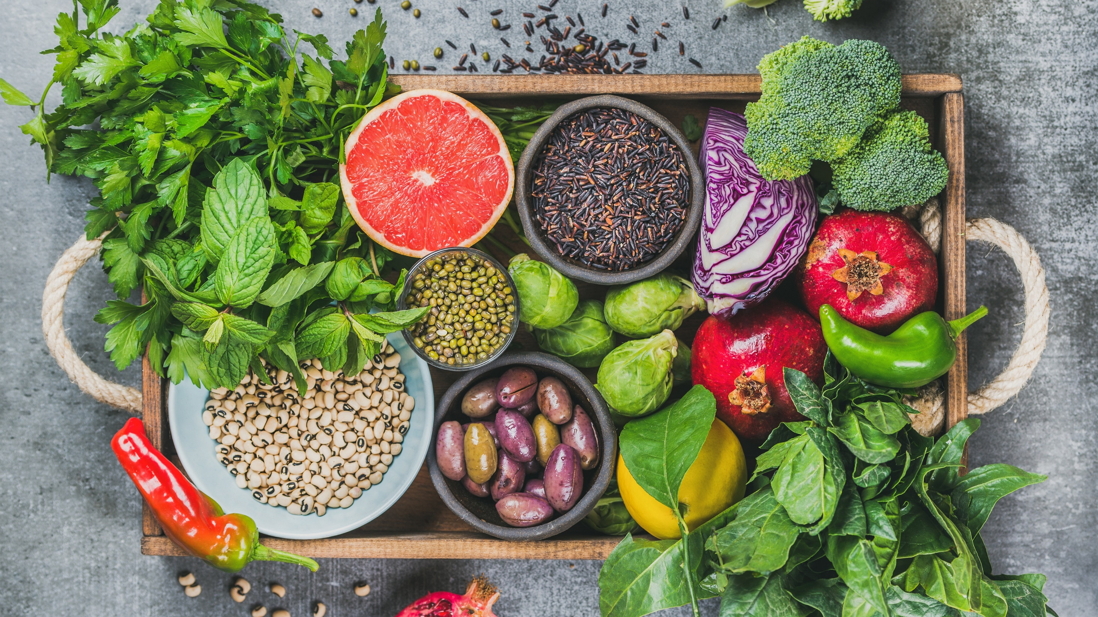
Media
Coverage
Highlights

Slide 9
Product Launches
Deeply, your positive new habit. Deeply® aims to shake up gut health category with new daily prebiotic food.
Shiseido RevitalEssence Skin Glow Foundation... Two key ingredients power the unique medium-coverage formula. The first is fermented kefir+, a potent prebiotic that helps to maintain a healthy microbiome balance.
A Better Treat Pet Brand Focuses on Health, Transparency, Quality Ingredients… This includes using them during times of diarrhea/constipation, adding them as a meal topper or mixer to ease food transition, as a low-calorie training reward (.2 kcal/treat), or simply as a tasty, prebiotic treat…
Just last week, Malaysian-Singaporean actor Lawrence Wong introduced his favourite skin hydration duo that gives him an enviable glow. Bound to boost hydration and skin health, these two products are also new launches of Lawrence’s skincare brand Grail.

Slide 10
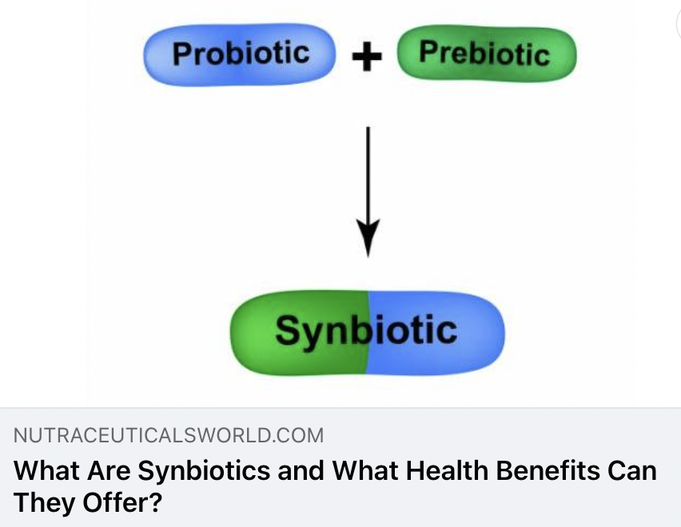
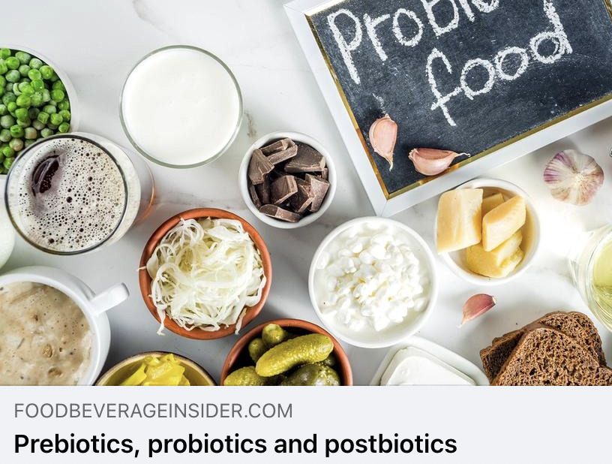
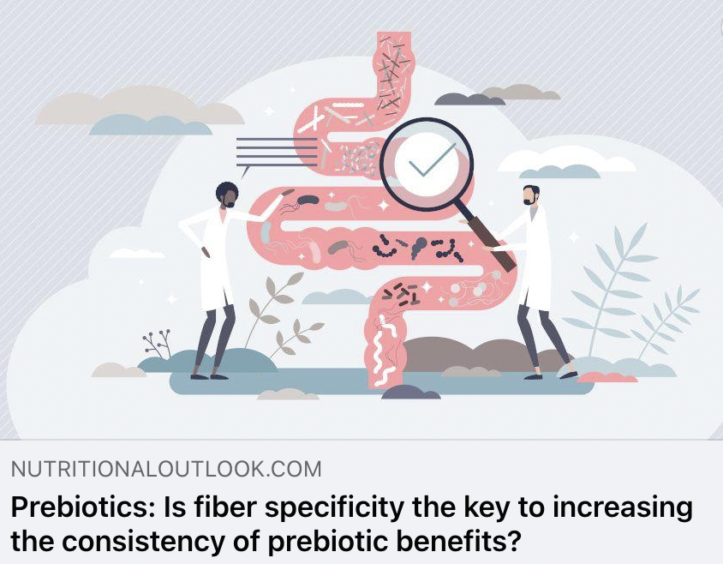
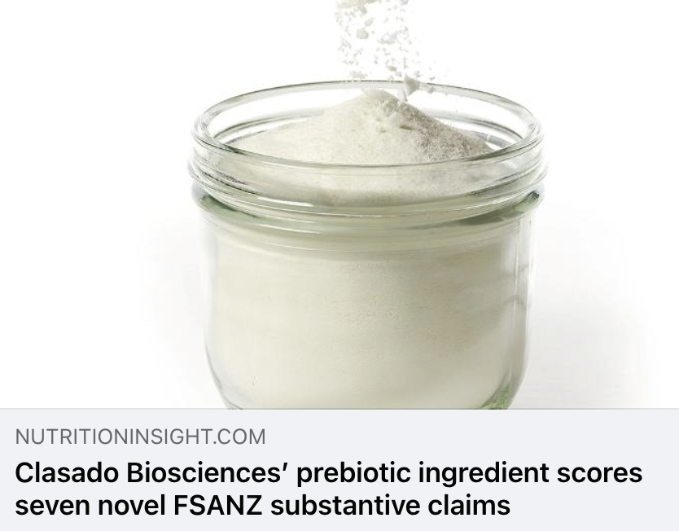
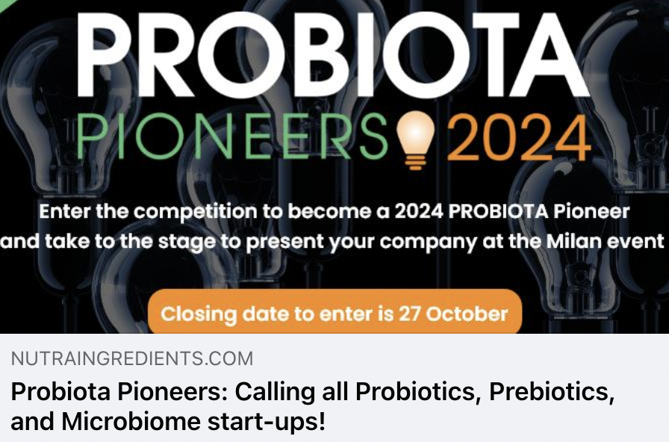
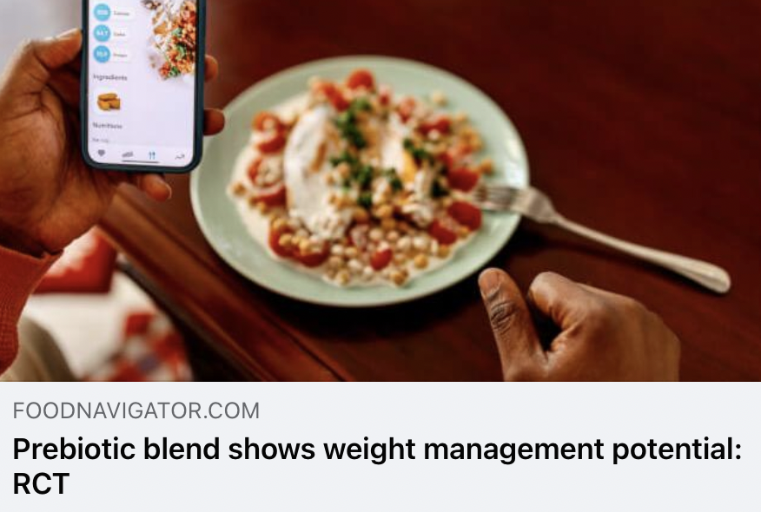
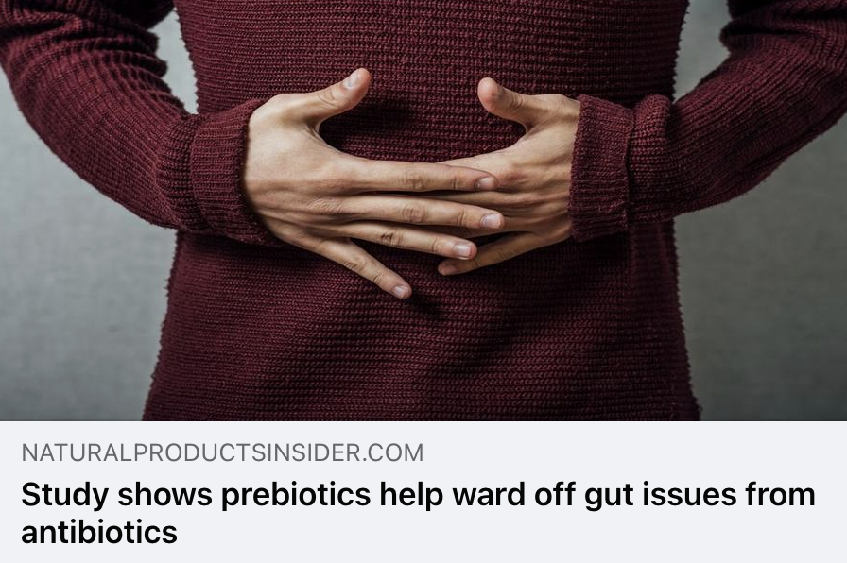
Trade Coverage

Slide 11
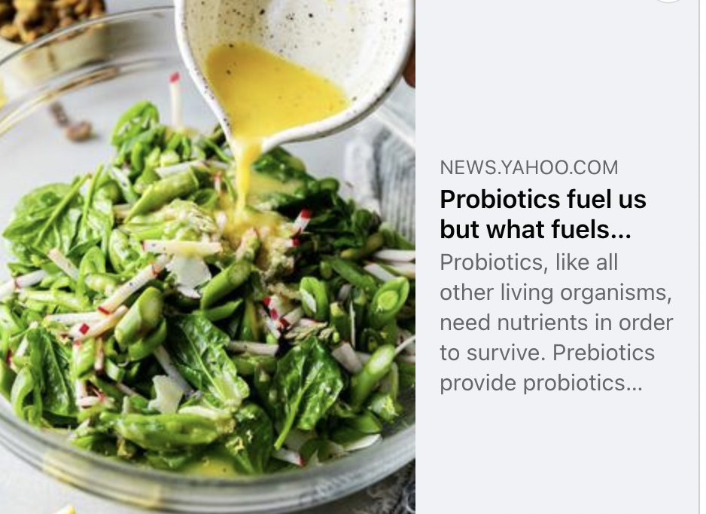
Yahoo!
UVM 422,951,989
“Prebiotics and probiotics make up what is collectively called the gut microbiome. To understand what we need to know about prebiotics, we asked Stephanie Schiff, RDN, CDN, CDCES a registered dietitian and certified diabetes care and education specialist with Huntington Hospital in New York, and Melissa Prest, DCN, RDN a spokesperson for the Academy of Nutrition and Dietetics.”

Slide 12
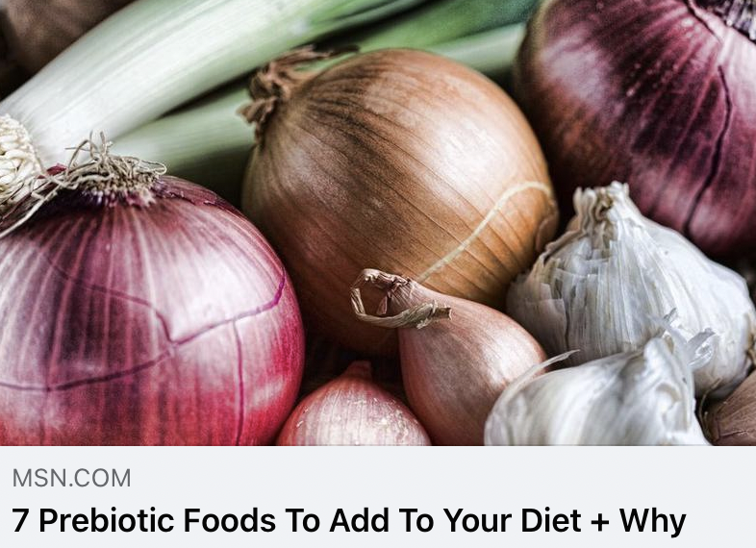
MSN (UK)
UVM 142,877,153
“Sure, your probiotic game is strong: you ferment your own sauerkraut, you down kombucha shots like they’re going out of fashion and there ain't much you won't sprinkle with kefir.
There’s no doubting the good bacteria are booming in your gut, boosting your body’s immunity, weight loss efforts and even mental health. But here’s the big question: are you feeding those guys? Without prebiotics, probably not. And this is where gut health gets really interesting. "I never want to wear any other shoes" - M.A”

Slide 13
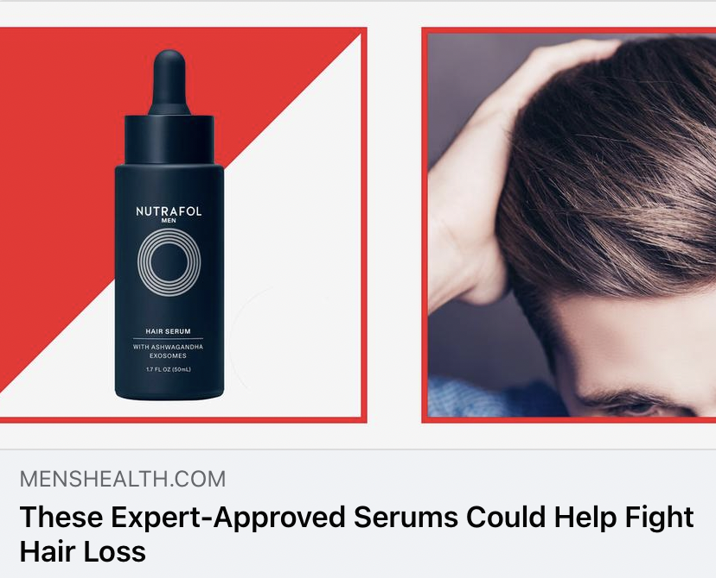
Men’s Health
UVM 26,818,822
A healthy scalp is the key to healthy hair, especially when you're trying to promote new growth. This targeted treatment targets both the hair follicle stem cells and dermal papilla cells, which plays the main role in the regulation of hair growth. At the same time, the prebiotics and probiotics that are infused into the formula help repopulate the scalp’s all-important microbiome, helping hair transition to the anagen phase, which reduces shedding and encourages thicker growth.

Slide 14

Women’s Health
UVM 25,085,933
You may have heard of chia seeds having loads of omega-3s, which can help support brain and heart health and reduce inflammation. And thanks to their high fiber and protein content, also keep you full for longer, therefore making them the perfect grab and go snack for weight loss, says Ehsani. “These squeeze packets are also pre-portioned, so making it handy to just stick to one portion at a time,” she adds.

Slide 15
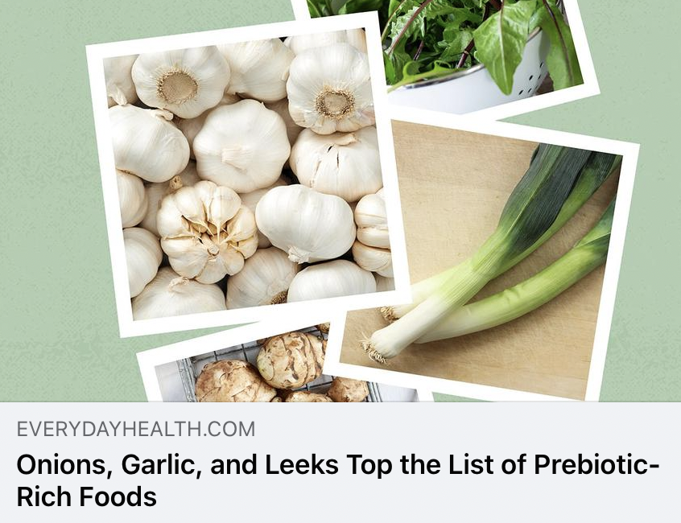
Everyday Health
UVM 14,495,072
If you’re trying to eat a diet that can build and support a healthy gut microbiome, finding which foods contain the right microorganisms and nutrients (probiotics and prebiotics) and in the recommended amounts can be tricky.
Good news: Research presented at Nutrition 2023, the annual meeting of the American Society of Nutrition, performs a lot of the heavy lifting by revealing the foods with the highest amounts of prebiotics.

Slide 16
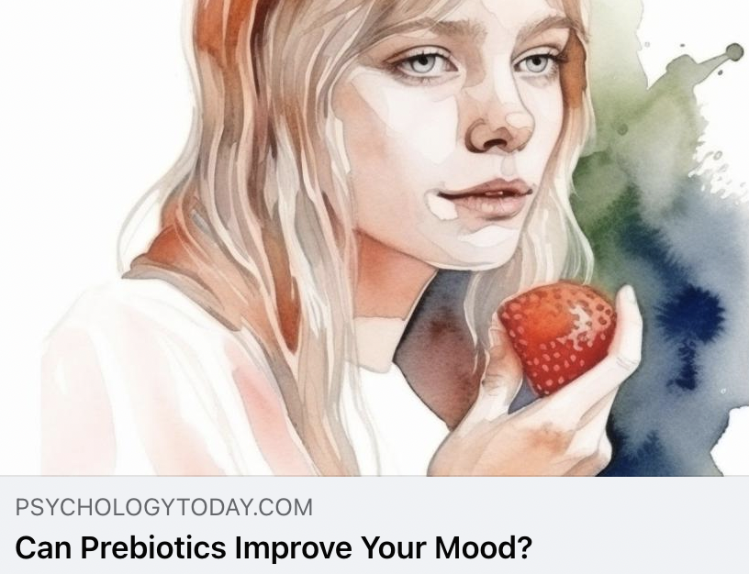
Psychology Today
UVM 14,551,046
The notion that the gut and the brain are somehow connected has presented psychiatry with a new paradigm: Gut microbes may, directly or indirectly, cause or prevent anxiety and depression. This begs the question: As well as treating the mind, should we also be treating the gut?
The basic thesis of the gut–brain axis is that our gut can become unbalanced, with a few unsavory bacteria dominating the mix. This imbalance can lead to a “leaky gut,” allowing toxins and bacteria to enter the bloodstream. From there, they are pumped to every organ in the body, including the brain.

Slide 17
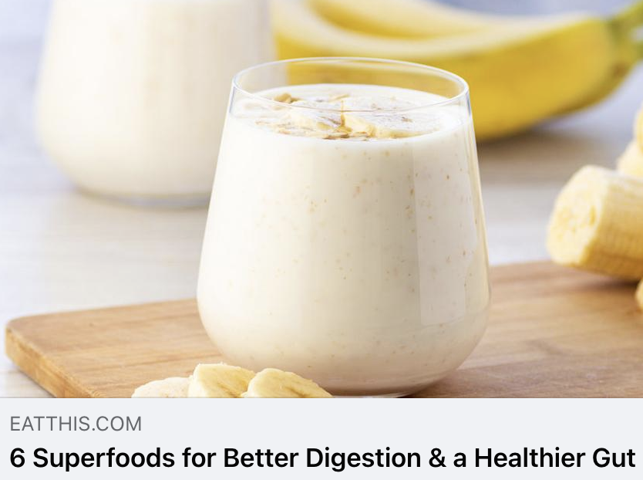
Eat This, Not That
UVM 9,195,905
Like many fruits, bananas are a source of fiber, which is a superfood nutrient that can help support digestion and healthy gut microbiota through regular bowel movements. And if you are a fan of a slightly underripe banana (aka those that have a slightly green peel), know that you are getting a boost of prebiotic fiber when you nosh on this fruit choice. Prebiotics act as "fuel" for the probiotic bacteria, helping support your microbiota health in an important way.

Slide 18
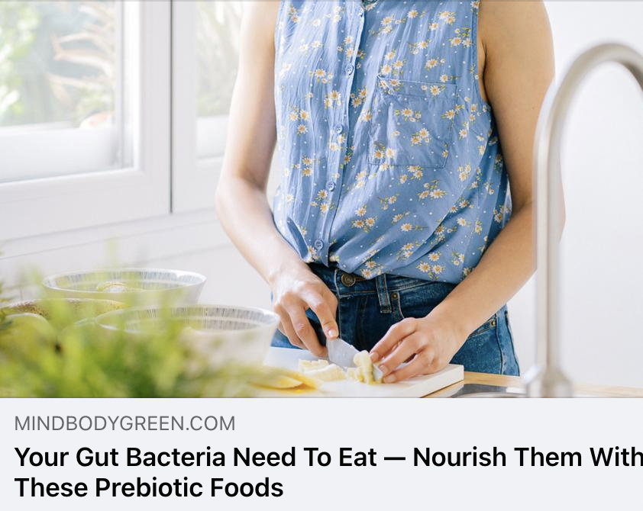
MindBodyGreen
UVM 7,645,365
"With the booming recognition of all things gut health, words like probiotics, prebiotics, synbiotics, and postbiotics (oh boy!) are thrown around like we all have an advanced degree in microbiology. And while we may recognize words ending in biotics as relating to the gut microbiome, each one is distinctly different.
We're going to dive into what you need to know about prebiotics and the foods that contain the highest amount of these beneficial fibers.”

Slide 19
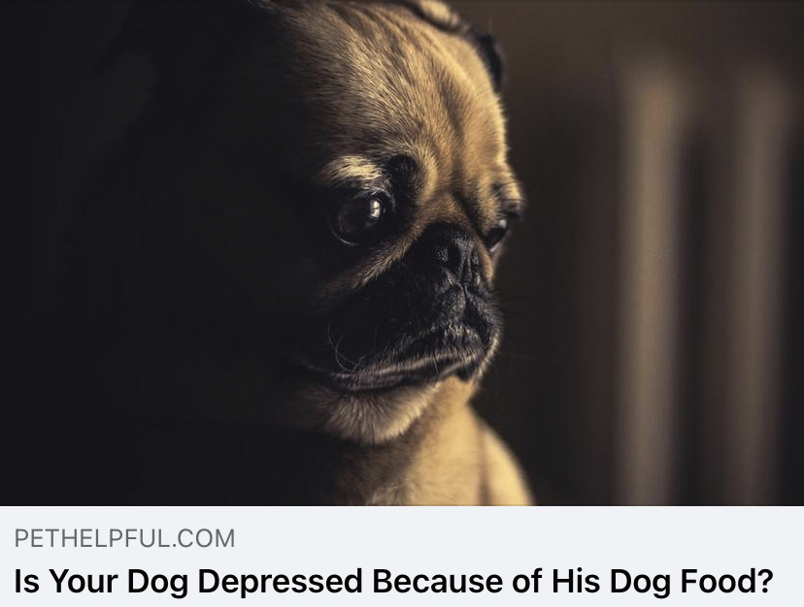
PetHelpful
UVM 4,513,727
Grass can be a source of vitamins, minerals, and most importantly, fiber, so frequent grass-eating could be a sign of a nutritional deficiency.
You can address nutrient deficiencies by switching to a high-fiber diet or by adding a fiber supplement such as psyllium husk powder into your dog’s food. You can also add a supplement with prebiotics and probiotics such as DoggyBiome S. boulardii + FOS Powder, which improves both gut health and immune functions. Fructooligosaccharides (FOS) are tiny soluble fibers that beneficial gut bacteria love to feed on, so this fosters a re-balancing of good bacteria in the gut.

Slide 20
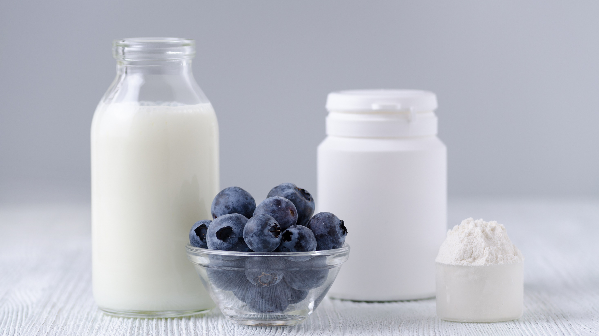
Questions?
Morgan Johnston
Communications Director
Global Prebiotic Association
morgan@itcstrategy.com
Tim Mizones
Project Specialist
Global Prebiotic Association
tim@itcstrategy.com

