Slide 1
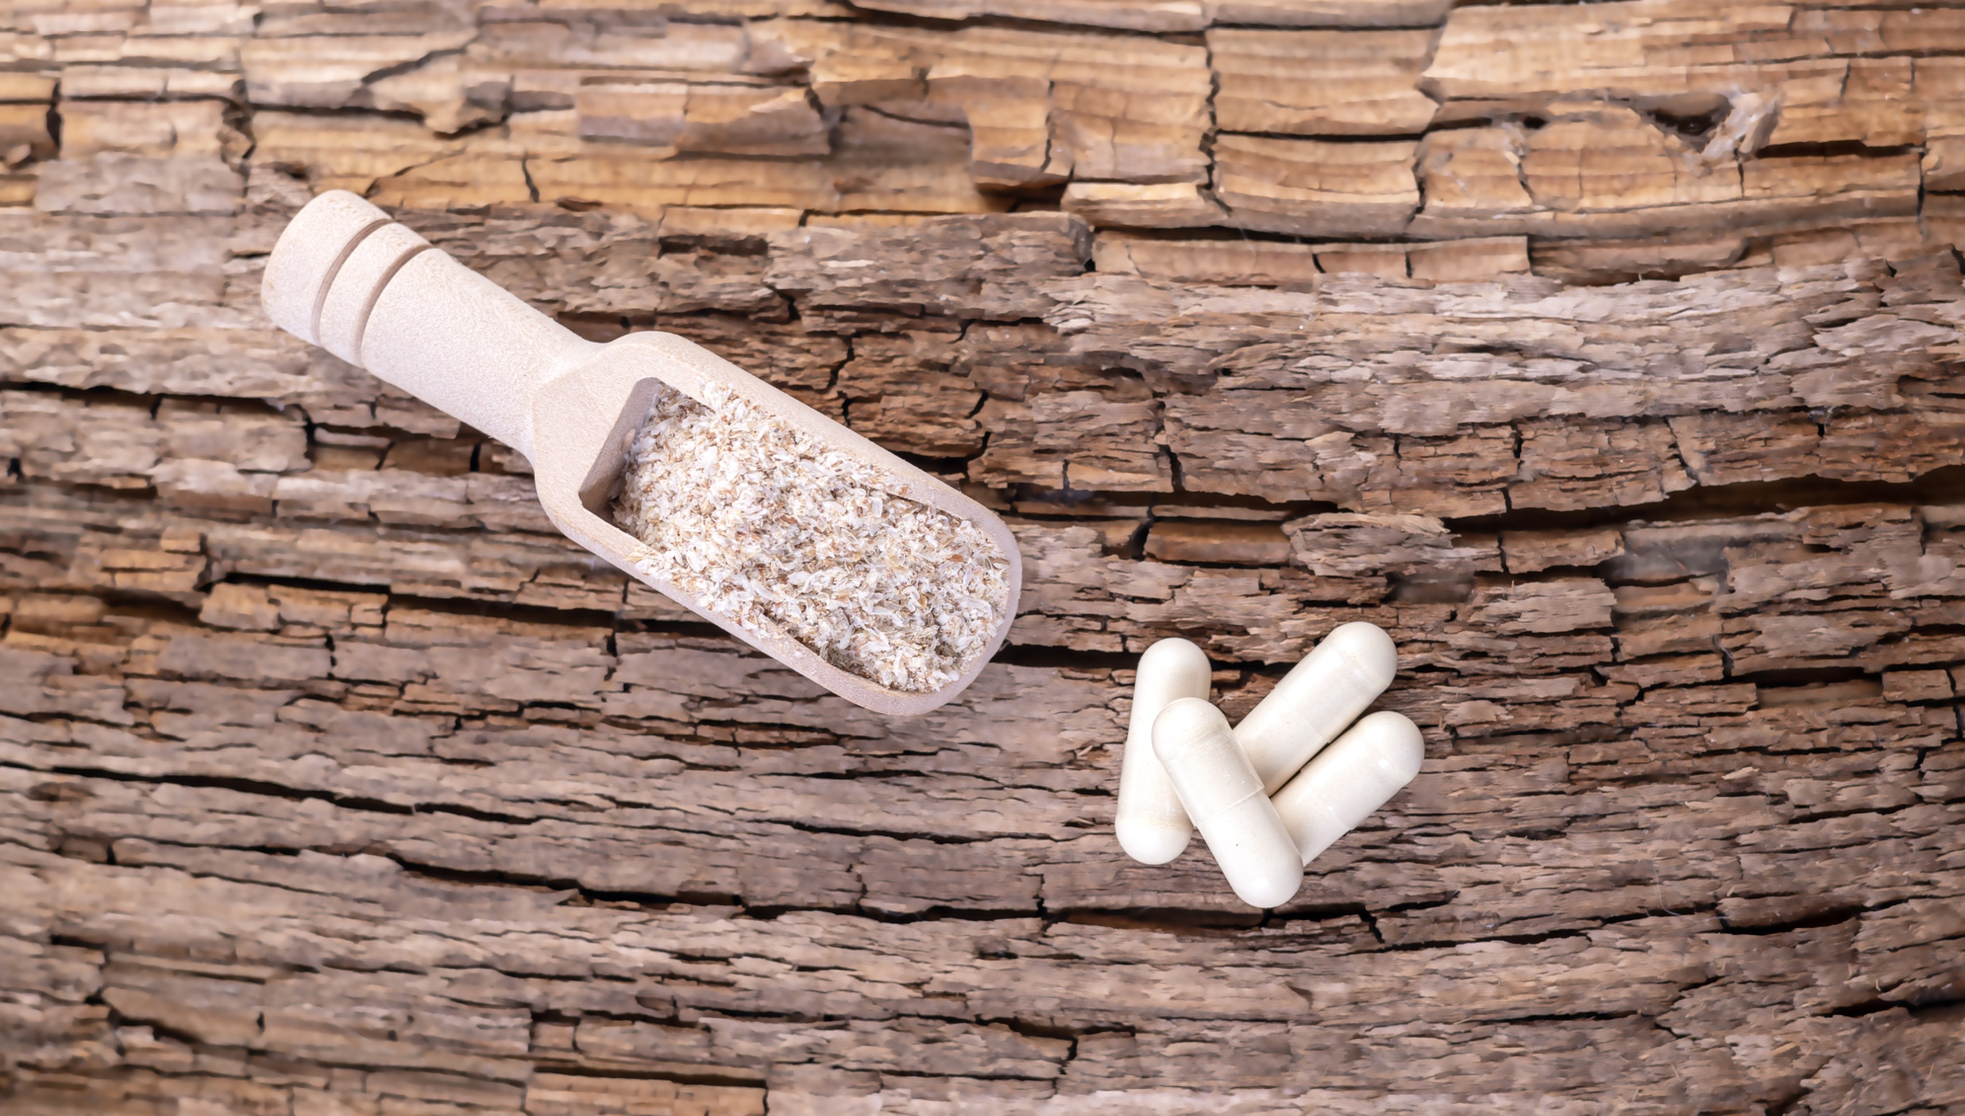
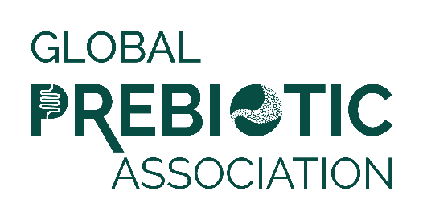
Media Insights Report
Q4 2023

Slide 2
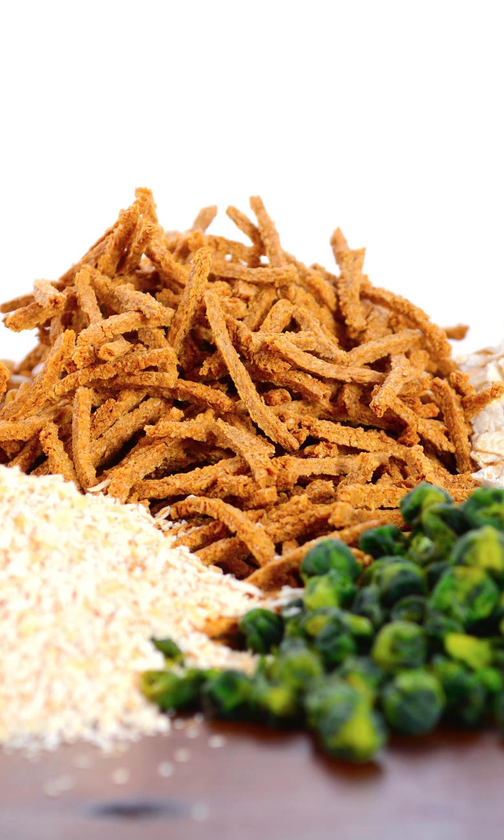
Data Summary
Data was pulled from Muck Rack insights for the period of October 1 to December 31, 2023.
Reports looked at traditional media and social media, with a heavy emphasis on consumer-reaching media.
Trade coverage and new product launches are also included.
Full text of articles may be accessed by clicking the article image on each slide.

Slide 3
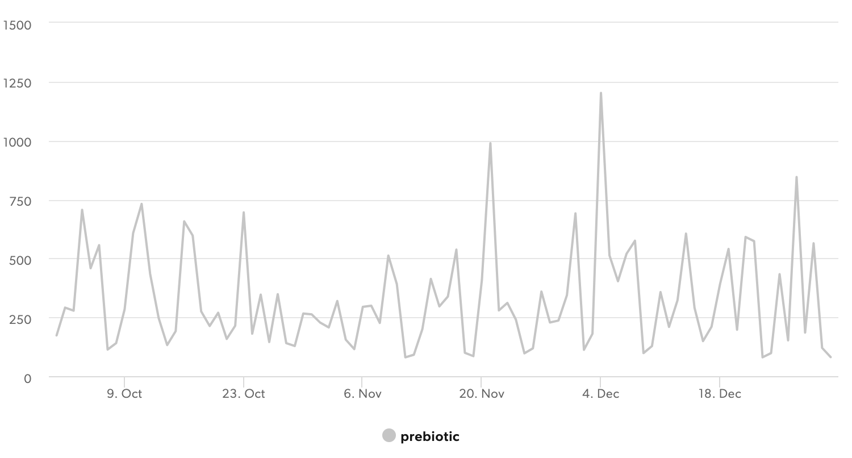
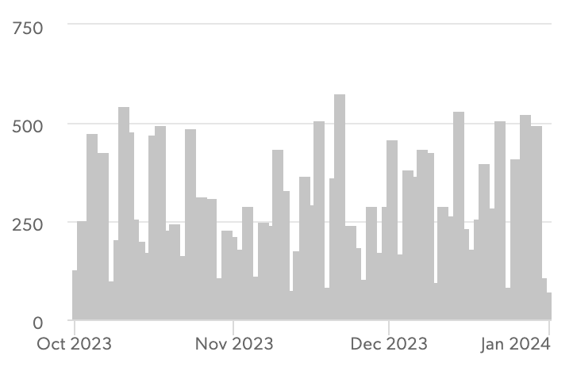
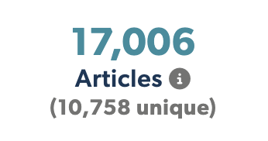



Articles Over Time
Unique Outlets
Coverage drivers are listed on the following slides.

Slide 4
Scientific Reviews
Animal Welfare
Ready to Drink Beverages
Skin Microbiome
All Ages Well Being
Mental Wellness
Gut & Body Axes
Synbiotics
Vegetarian & Vegan Options
Trending Topics
Updated Formulations
Microbiome Balance
Expanding Microbiome Research
Anti-Inflammatory
Mushrooms
& Mycelium

Slide 5
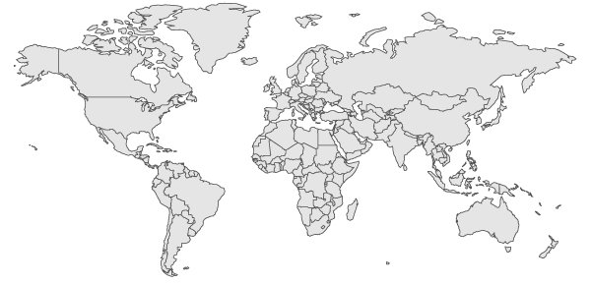
Top Countries/Regions
Canada
5%
Germany
3%
UK
6%
USA
47%
France & Switzerland
8%
Asia
11%
India
8%
South America
& Mexico
2%
Africa
3%
Australia & New Zealand
4%

Slide 6
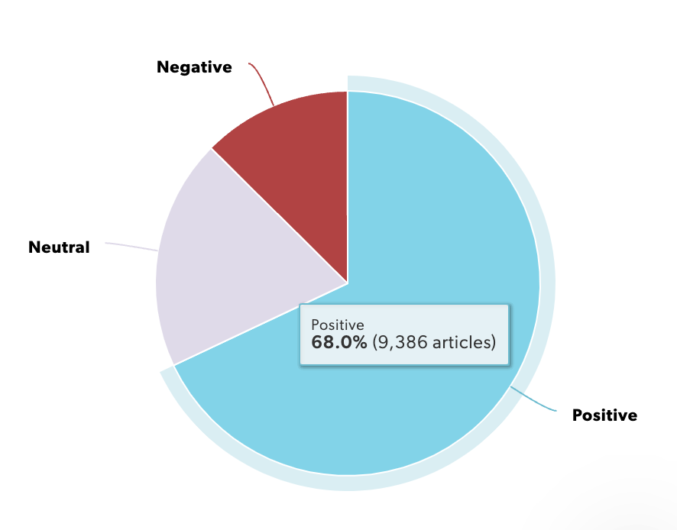
Sentiment
Coverage is positive overall, with more media coverage and study growing. Focus is on building additional understanding and driving increased media coverage.

Slide 7
Experts & Influencers
A healthy gut is a diverse gut, according to Sam Treadway, chief scientific officer at The Functional Gut Clinic
The 5 Prebiotic Foods That Are Highly Recommended in Scientists, As Presented by Dr Jennifer L. Hanseth
Pioneers for small animal medicine, nutrition, and practice: AAHA and Hill’s Pet Nutrition celebrate milestones
Here’s what health experts want you to know. Eat to calm anxiety Dr. Uma Naidoo is a leading expert in nutritional psychiatry and the bestselling author of This Is Your Brain On Food.
Experts say that there are seven key signs of an unhealthy gut, and some are fairly easy to identify, since they're clearly linked with poor digestive function.
Dr. Mickey Mehta’s Guidelines for Gut Health: A Path to Emotional Positivity and Courage

Slide 8
Product Launches
Asiros Nordic Launches Prebiotic Berry Ingredients in the U.S. The Nordic berry specialist is launching a lineup of concentrates, juice powders, berry extracts, and liquid shots.
Stratum, Clasado to launch prebiotic-postbiotic gummy supplement at 2023 SupplySide West show
Snickers launches brand new bar featuring low GI dark chocolate cereal
Sol De Janeiro's New Body Butter Is Like a Beach Vacation for Your Skin…Other key ingredients include hyaluronic acid for both fast-acting and long-lasting hydration, prebiotic hibiscus to nourish the microbiome…
Nestlé develops N3 prebiotic fibre milk for China
UK’s first hangover recovery drink, Bounce Back, secures two national supermarket listings
Prebiotic soda brand Living Things launches in the UK
Ultimate Pet Nutrition Introduces Nutra Complete Infusions Dog Food Line

Slide 9
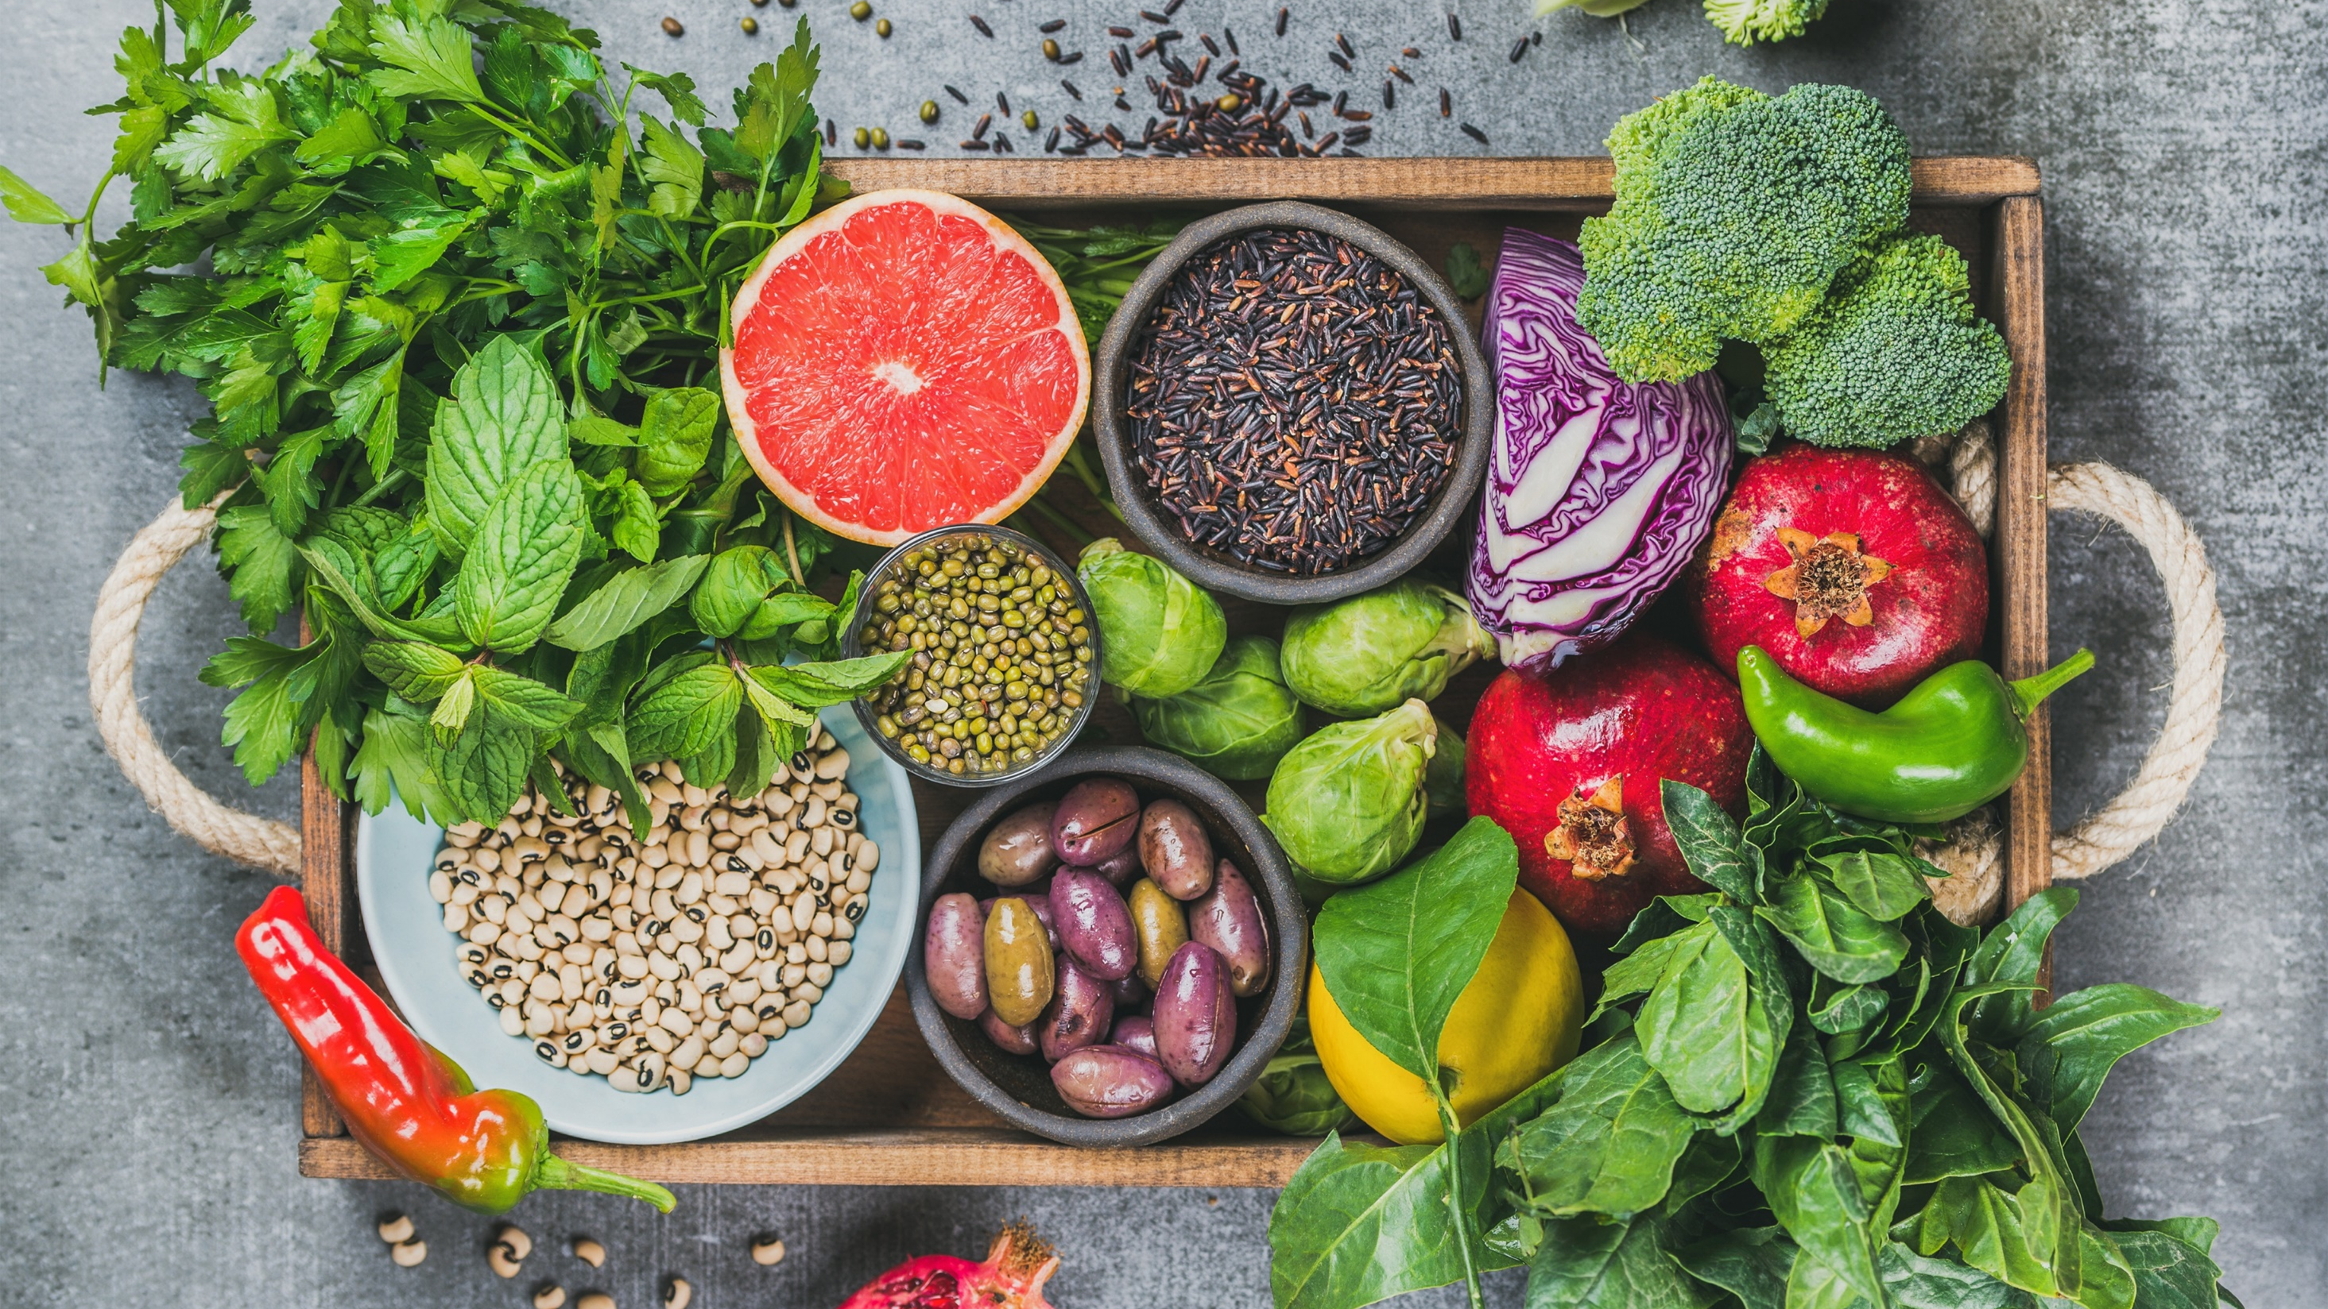
Media
Coverage
Highlights

Slide 10
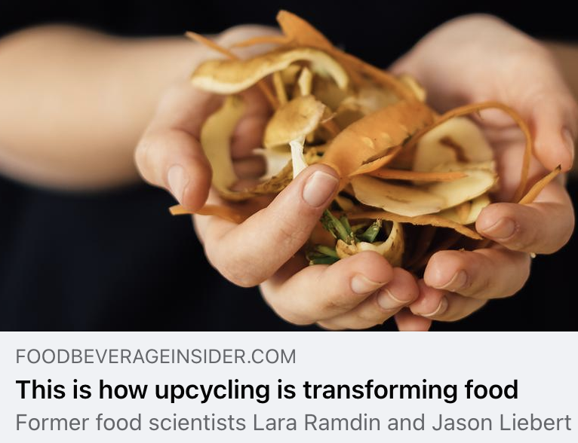
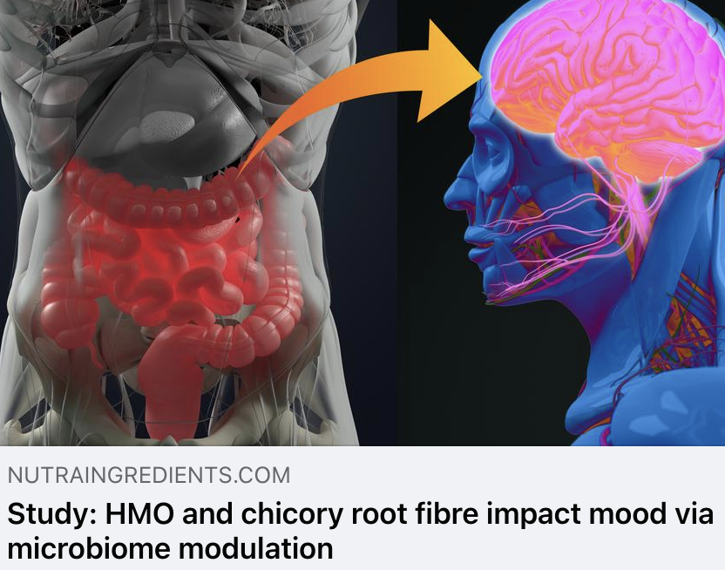
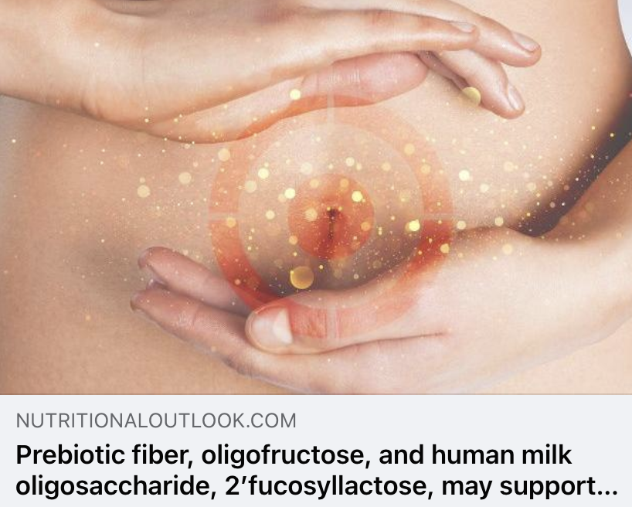
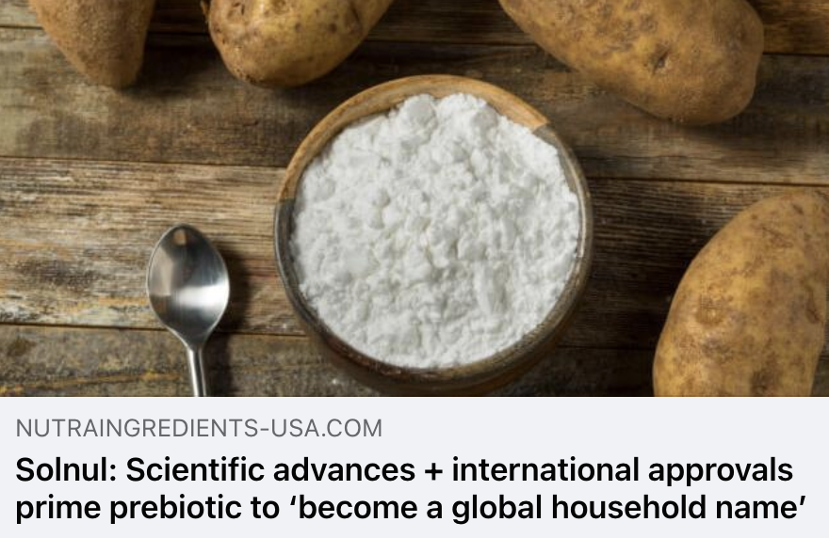
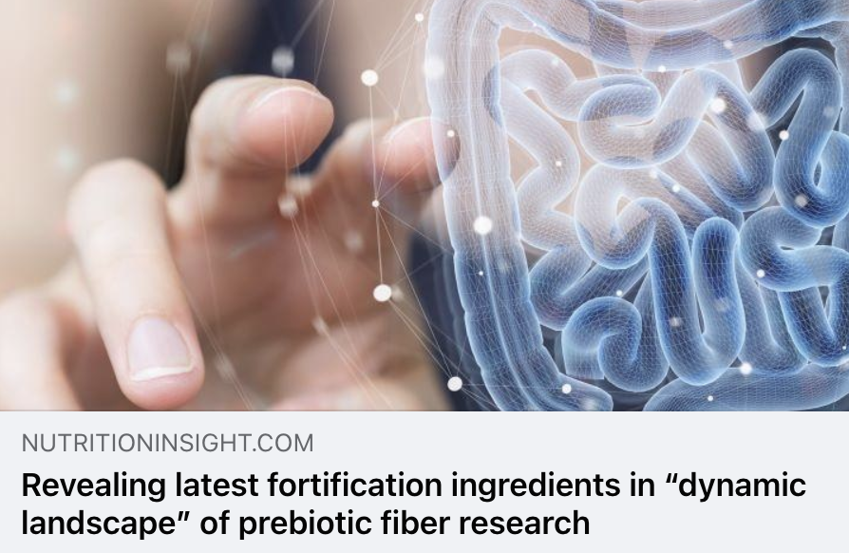
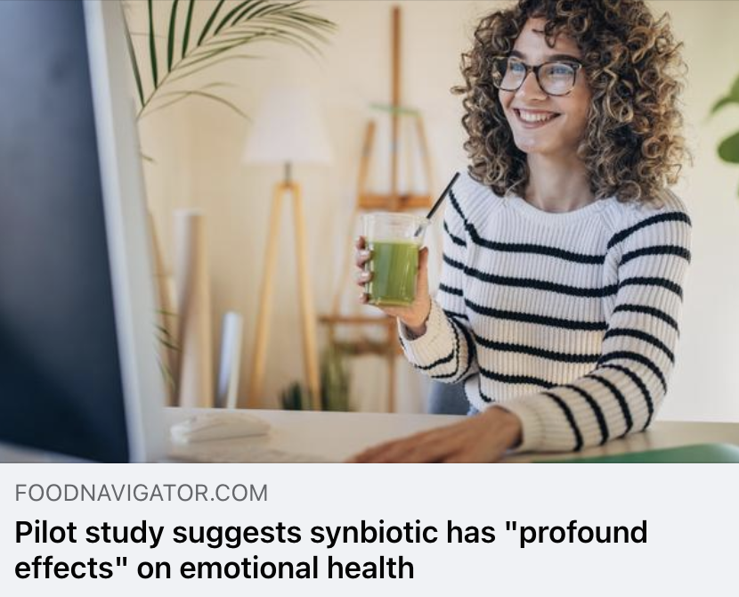
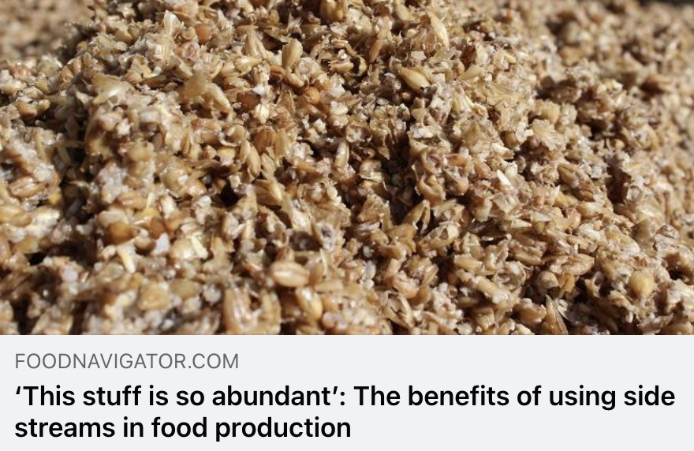
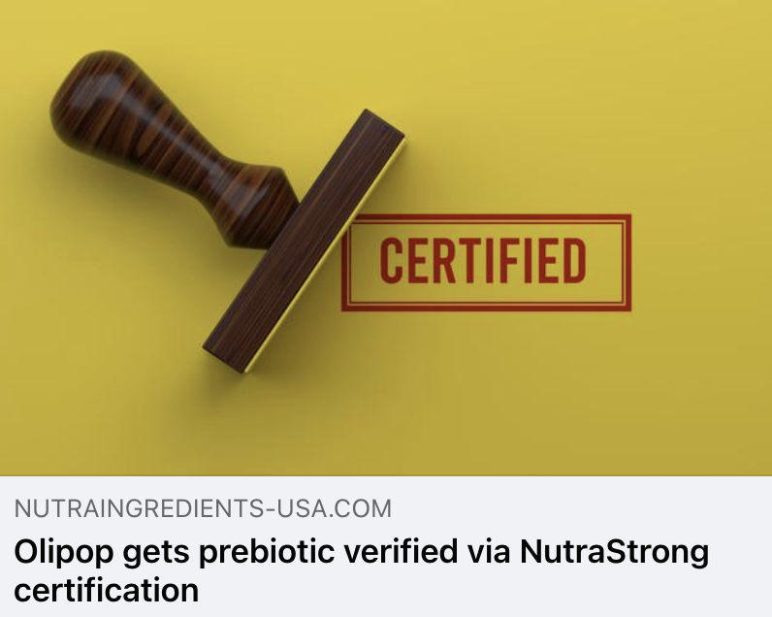
Trade Coverage

Slide 11
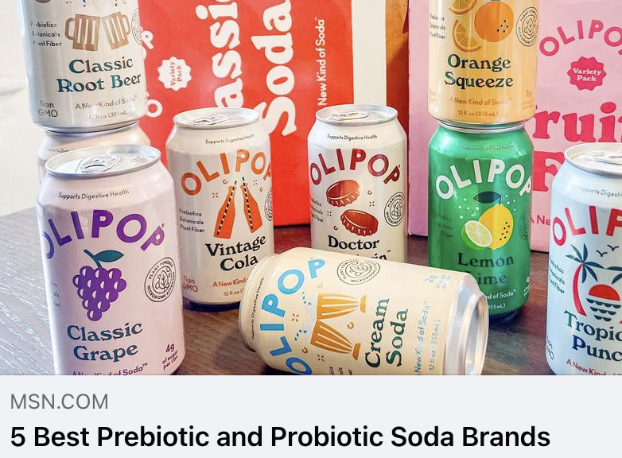
MSN
UVM 135,281,915
During our testing, Olipop really, well, popped. Whether it's the fruity basics such as Classic Grape or Orange Squeeze, or the soda dupes such as Root Beer or Vintage Cola, Olipop succeeds. In fact, we found its Root Beer and Cream Soda to be nearly indistinguishable from the real deal. Plus, the retro branding is an adorable nod to its nostalgic flavors like Strawberry Vanilla and Banana Cream. And, dang, we've only listed seven of the whopping 16 flavors so far! (They're always dropping seasonal faves too!)

Slide 12
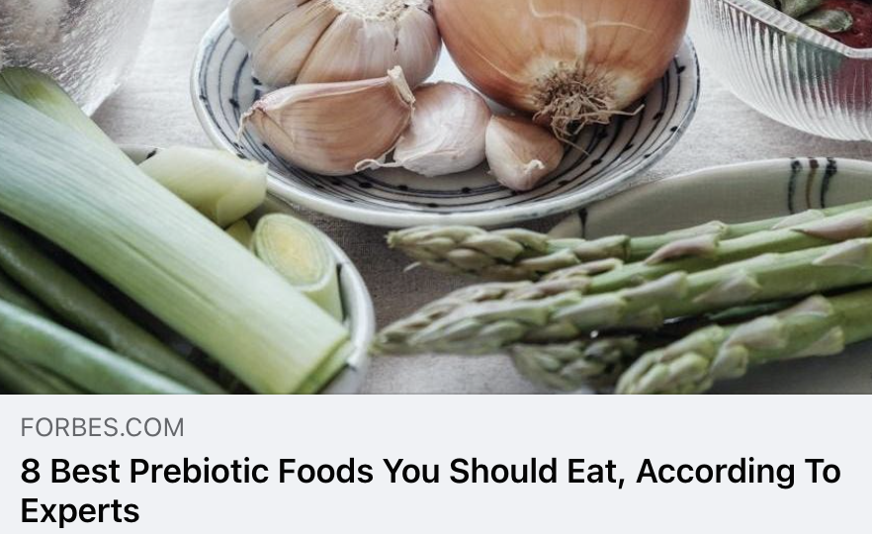
Forbes Health
UVM 73,844,154
Prebiotics are known as a group of nutrients that provide fuel for the beneficial bacteria in the gut. In addition to supporting digestive health, they might also offer other health benefits including improved weight and blood sugar management, enhanced nutrient absorption and more. Plus, though prebiotics can be found in supplements, they’re also naturally available in a wide variety of food sources, making it easy to increase your daily intake.

Slide 13
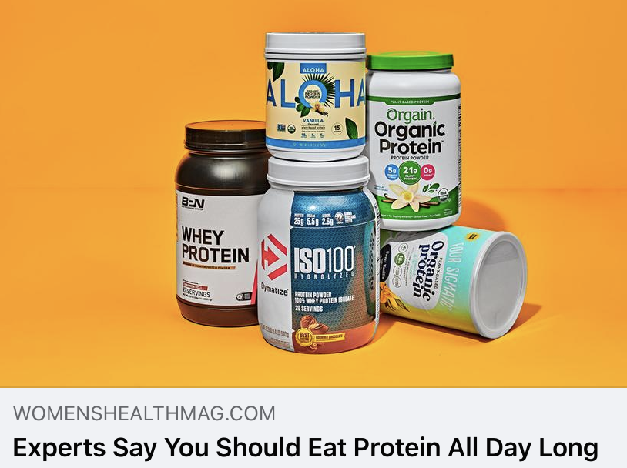
Women’s Health
UVM 22,263,600
Derived from non-rBGH New Zealand grass-fed cows, this supplement supports muscle synthesis and immune health without disrupting digestion. Prebiotics and probiotics make it easy on even sensitive stomachs. Plus a digestive enzyme mix boosts protein absorption. This mix gets White's stamp of approval.

Slide 14
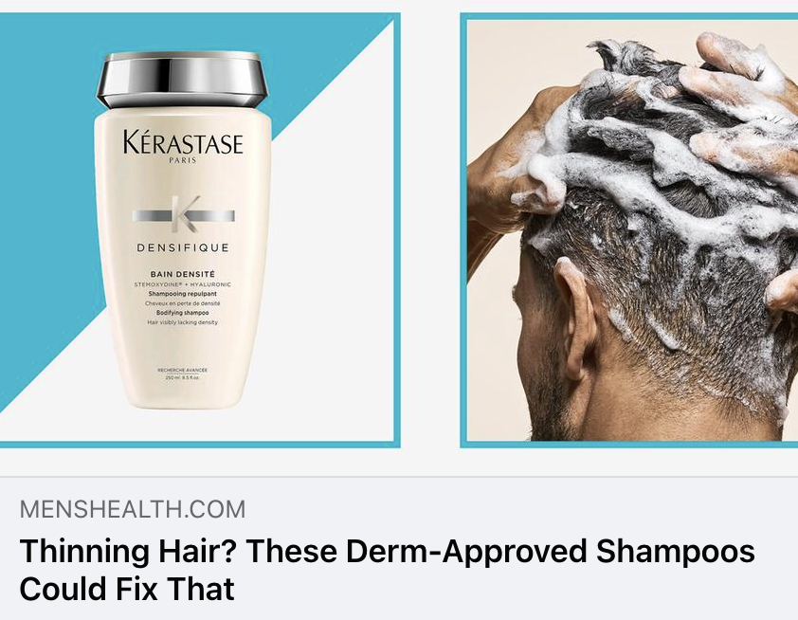
Men’s Health
UVM 26,504,984
This lightweight-yet-hydrating shampoo not only deep cleans your scalp and strands without leaving them dry, but it uses ingredients like microbiome prebiotics to help control oil and volcanic jeju water that’s packed with zinc and iron to promote healthy hair. Oh, and it also helps your hair look thicker.

Slide 15
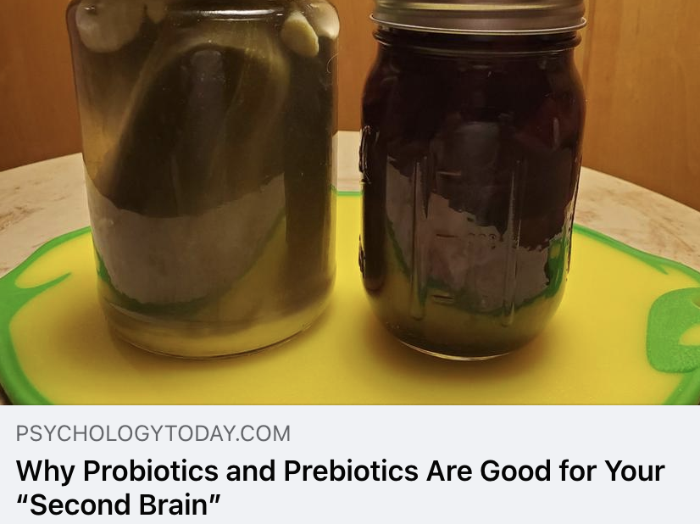
Psychology Today
UVM 13,955,600
Prebiotics are not the same as probiotics. In addition to taking probiotics to increase the amount of good bacteria in the gut, we also need to eat prebiotics (special plant fiber) that are in fermented food because prebiotics are the best food for our good bacteria in the gut. Prebiotics make the good bacteria healthy and happy and this also increases the overall health of the host of the gut, which is you and me. All health food stores now sell fermented foods such as kimchi, sauerkraut, pickled cucumbers and other vegetables, but pickles are easy to prepare at home for a much lower price, take almost no time and they’re delicious. There are many pickled food recipes on the internet, so you can find out some you may like and experiment with them.

Slide 16
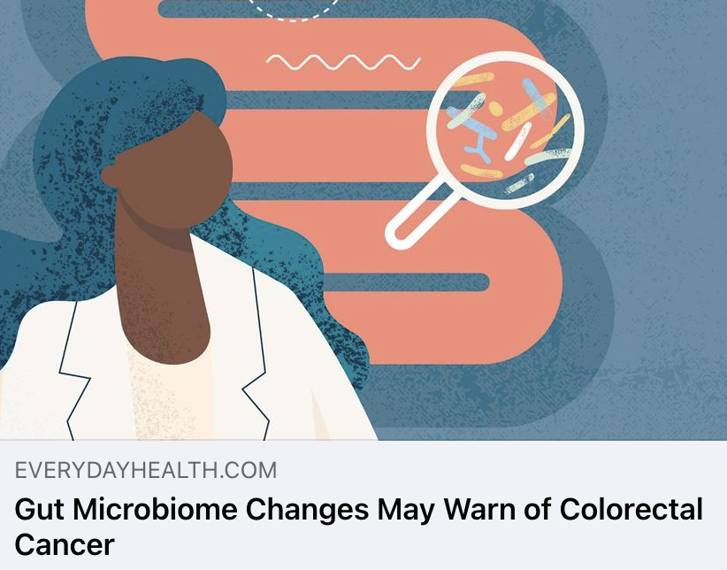
Everyday Health
UVM 10,492,387
If confirmed, these findings could be used to help point the way to microbiome-targeted therapies, such as fecal microbiome transplants and probiotics and prebiotics. “This would require extensive testing to demonstrate that such probiotics have expected effect,” says Gacesca.
The work of creating these therapies is ongoing, and it is likely we will see advances in the near to mid-term future.

Slide 17
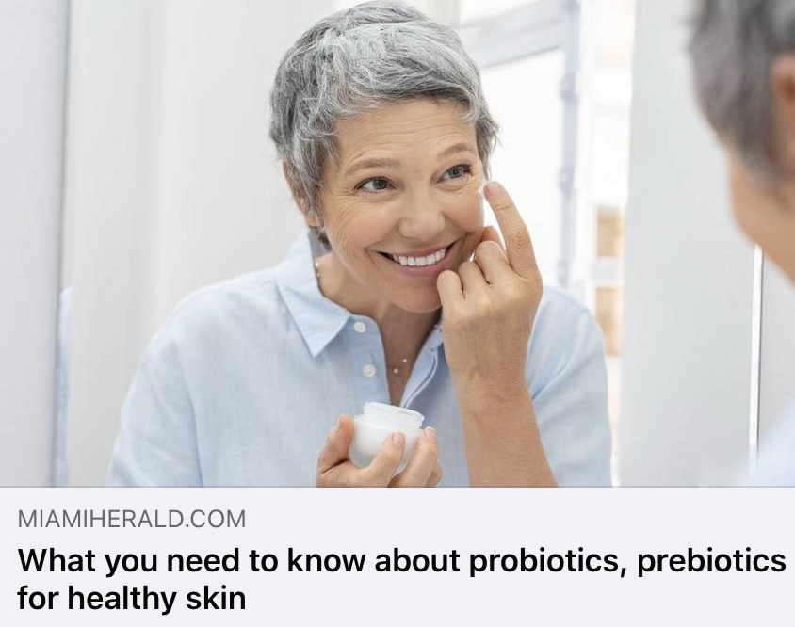
Miami Herald
UVM 5,474,100
The skin microbiome is made up of trillions of microorganisms like bacteria, fungi and viruses. While most of these microorganisms are harmless, an imbalanced microbiome can lead to the growth of bad microorganisms. A balanced microbiome plays a vital role in supporting a healthy skin barrier, fighting off harmful pathogens and maintaining homeostasis within the skin. So how do you promote a healthy skin microbiome? Probiotics and prebiotics play key roles in balancing the microbiome.

Slide 18
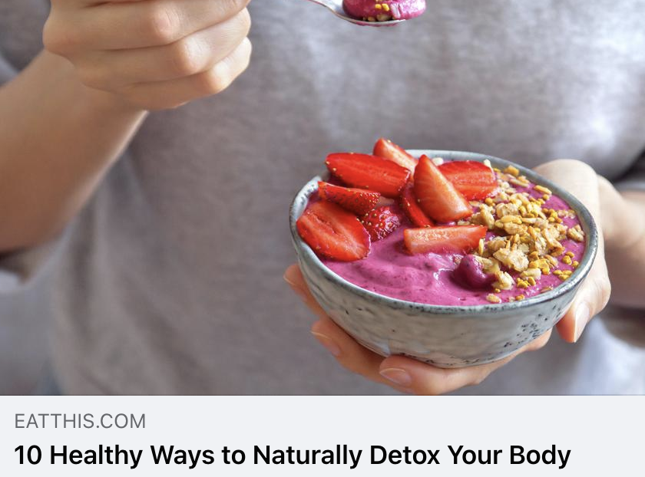
Eat This, Not That
UVM 6,258,323
Fiber serves a few functions when it comes to detoxifying your body. Soluble fiber serves as a prebiotic, which is essentially a food source of the probiotics in your gut. Eating more prebiotics supports the health of probiotics and allows them to fulfill their important functions. Insoluble fiber is the form that supports the digestive tract, adding bulk to your stool and aiding in the timely passage of waste. Additionally, fiber is a very filling nutrient. A diet high in fiber may allow you to feel fuller throughout the day, reducing the likelihood of overeating less nutrient-dense foods. This supports weight loss while also contributing to detoxification.

Slide 19
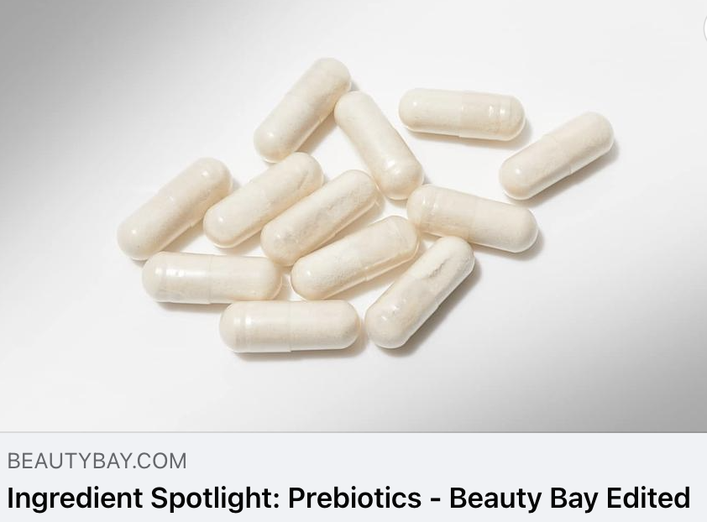
Beauty Bay
UVM 1,964,478
When we hear prebiotics and probiotics, our minds typically go straight to breakfast foods and our gut, right? But what if we told you that the nifty ingredient might be your ticket to happy skin, too. We know, it’s another skincare term to learn, but trust us when we say it’s well worth it. Today, we’re specifically focusing on prebiotics and exploring exactly how they can help keep our skin barrier and skin’s microbiome looking and feeling its best by keeping the bacteria and microorganisms on the top layer of our skin healthy.

Slide 20

MindBodyGreen
UVM 5,124,300
Prioritize a balanced and diverse diet rich in fiber, fruits, vegetables, and whole grains. These foods support a healthy gut microbiome and the production of short-chain fatty acids and other health-promoting compounds like neurotransmitters.
You should also incorporate probiotic-rich foods like yogurt, kefir, sauerkraut, and kimchi, as well as prebiotics such as garlic, onions, leeks, banana, and asparagus, into your diet. These foods nourish beneficial gut bacteria. Probiotic supplements can also help restore a healthy gut microbiota balance.

Slide 21
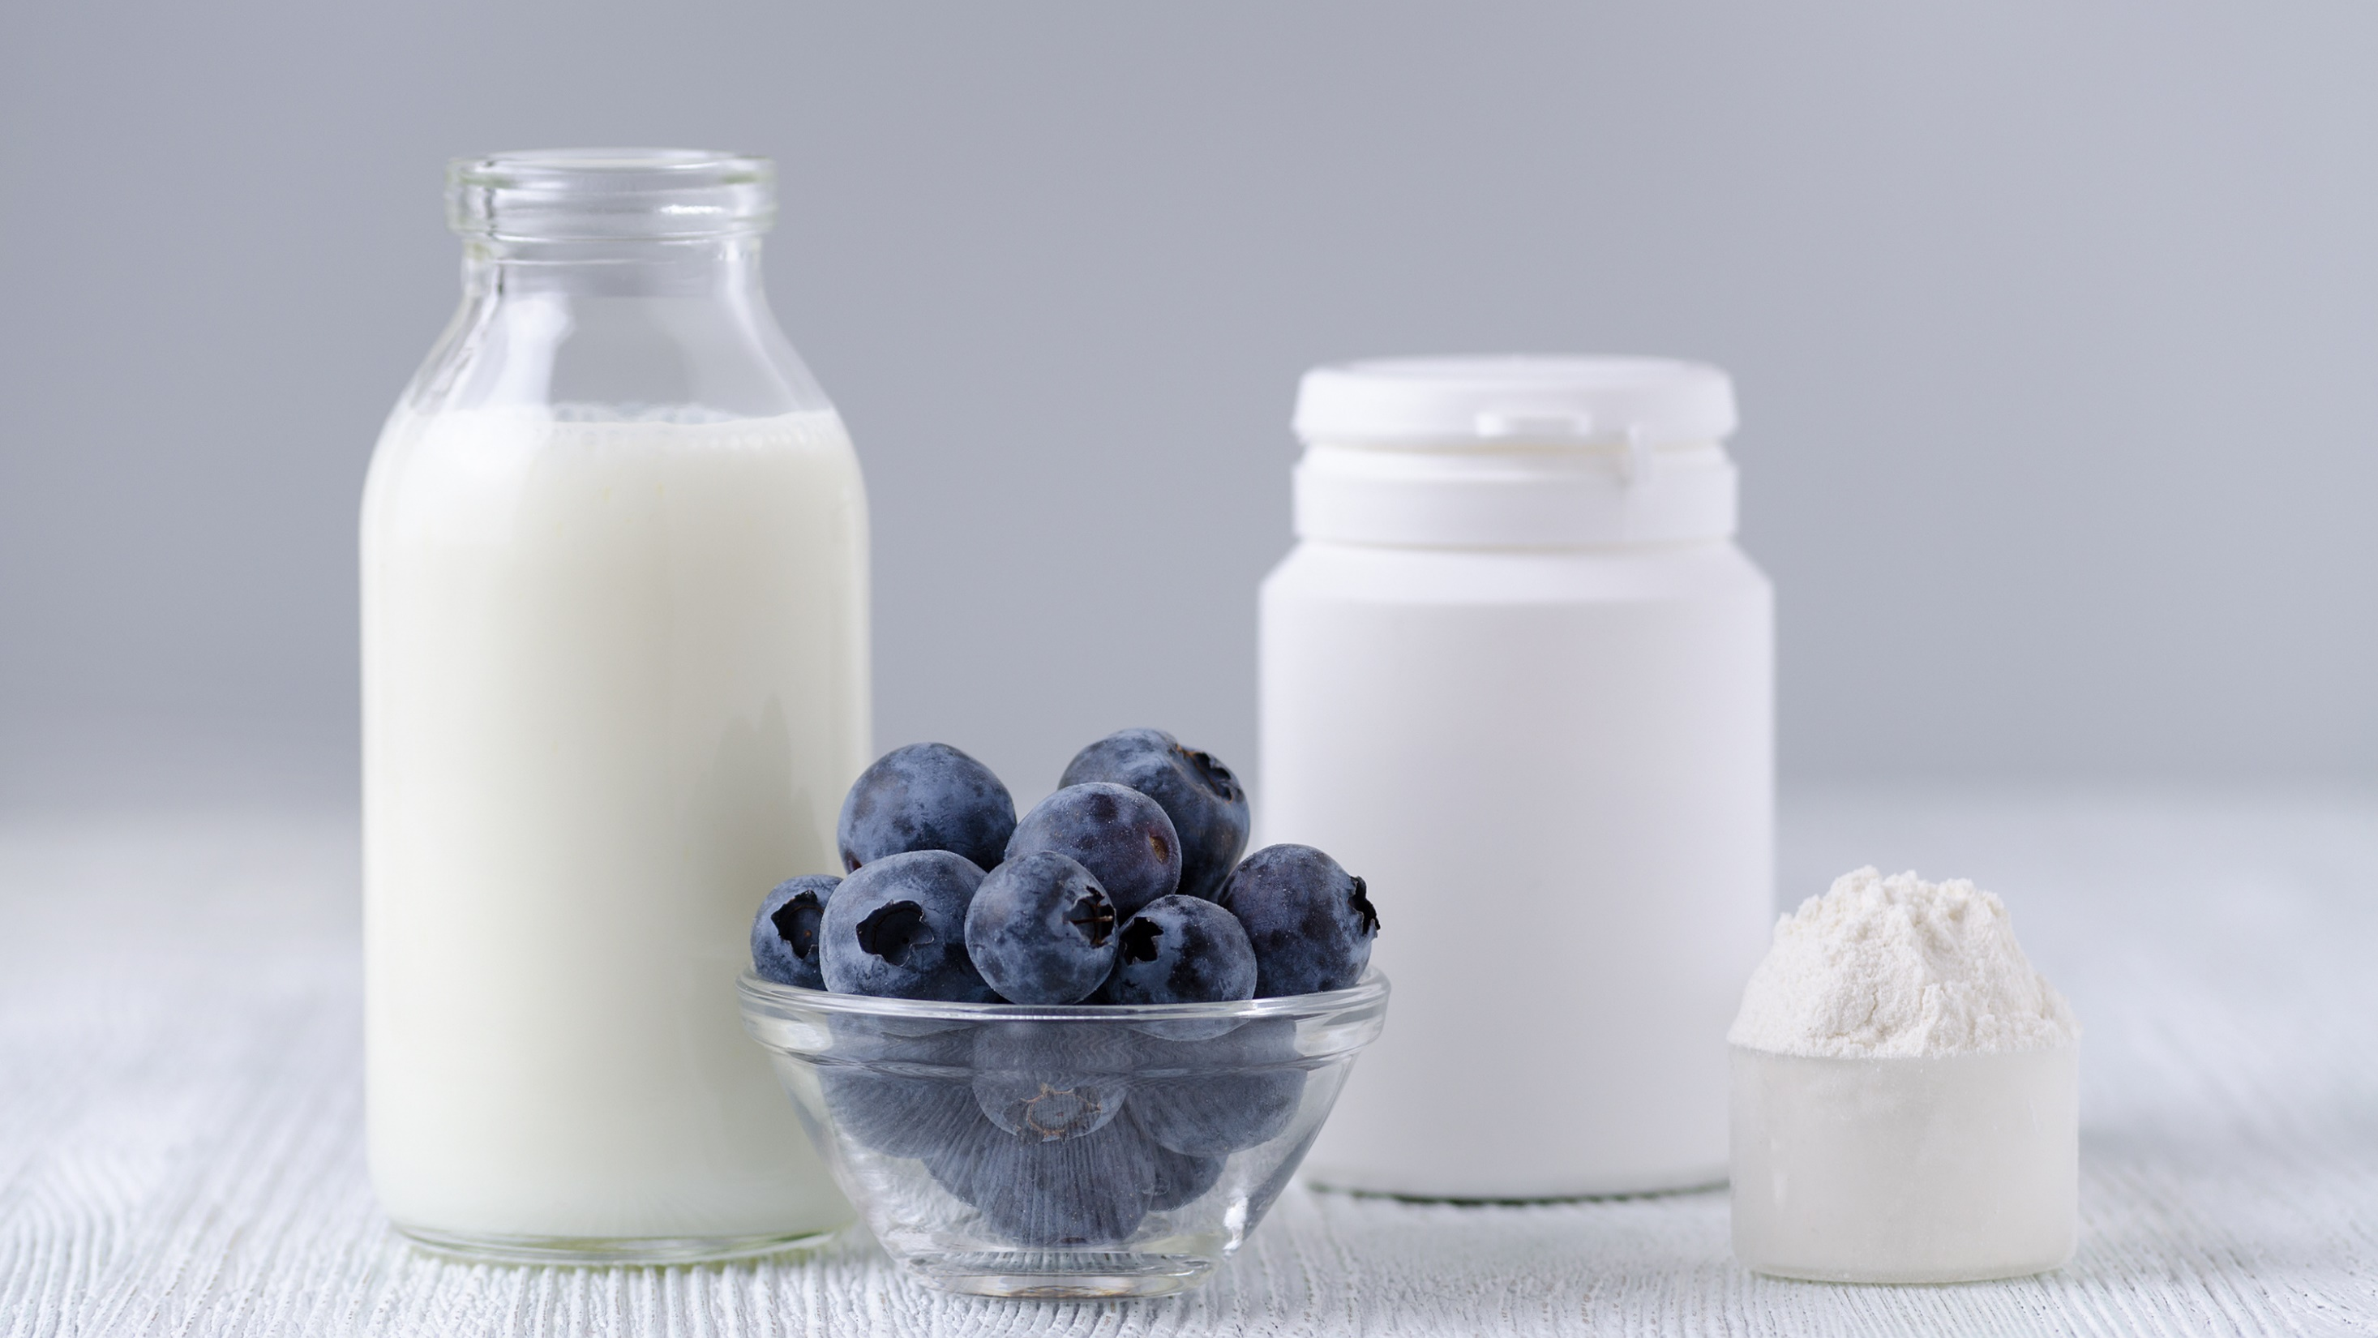
Questions?
Morgan Johnston
Communications Director
Global Prebiotic Association
morgan@itcstrategy.com
Tim Mizones
Project Specialist
Global Prebiotic Association
tim@itcstrategy.com

