Slide 1
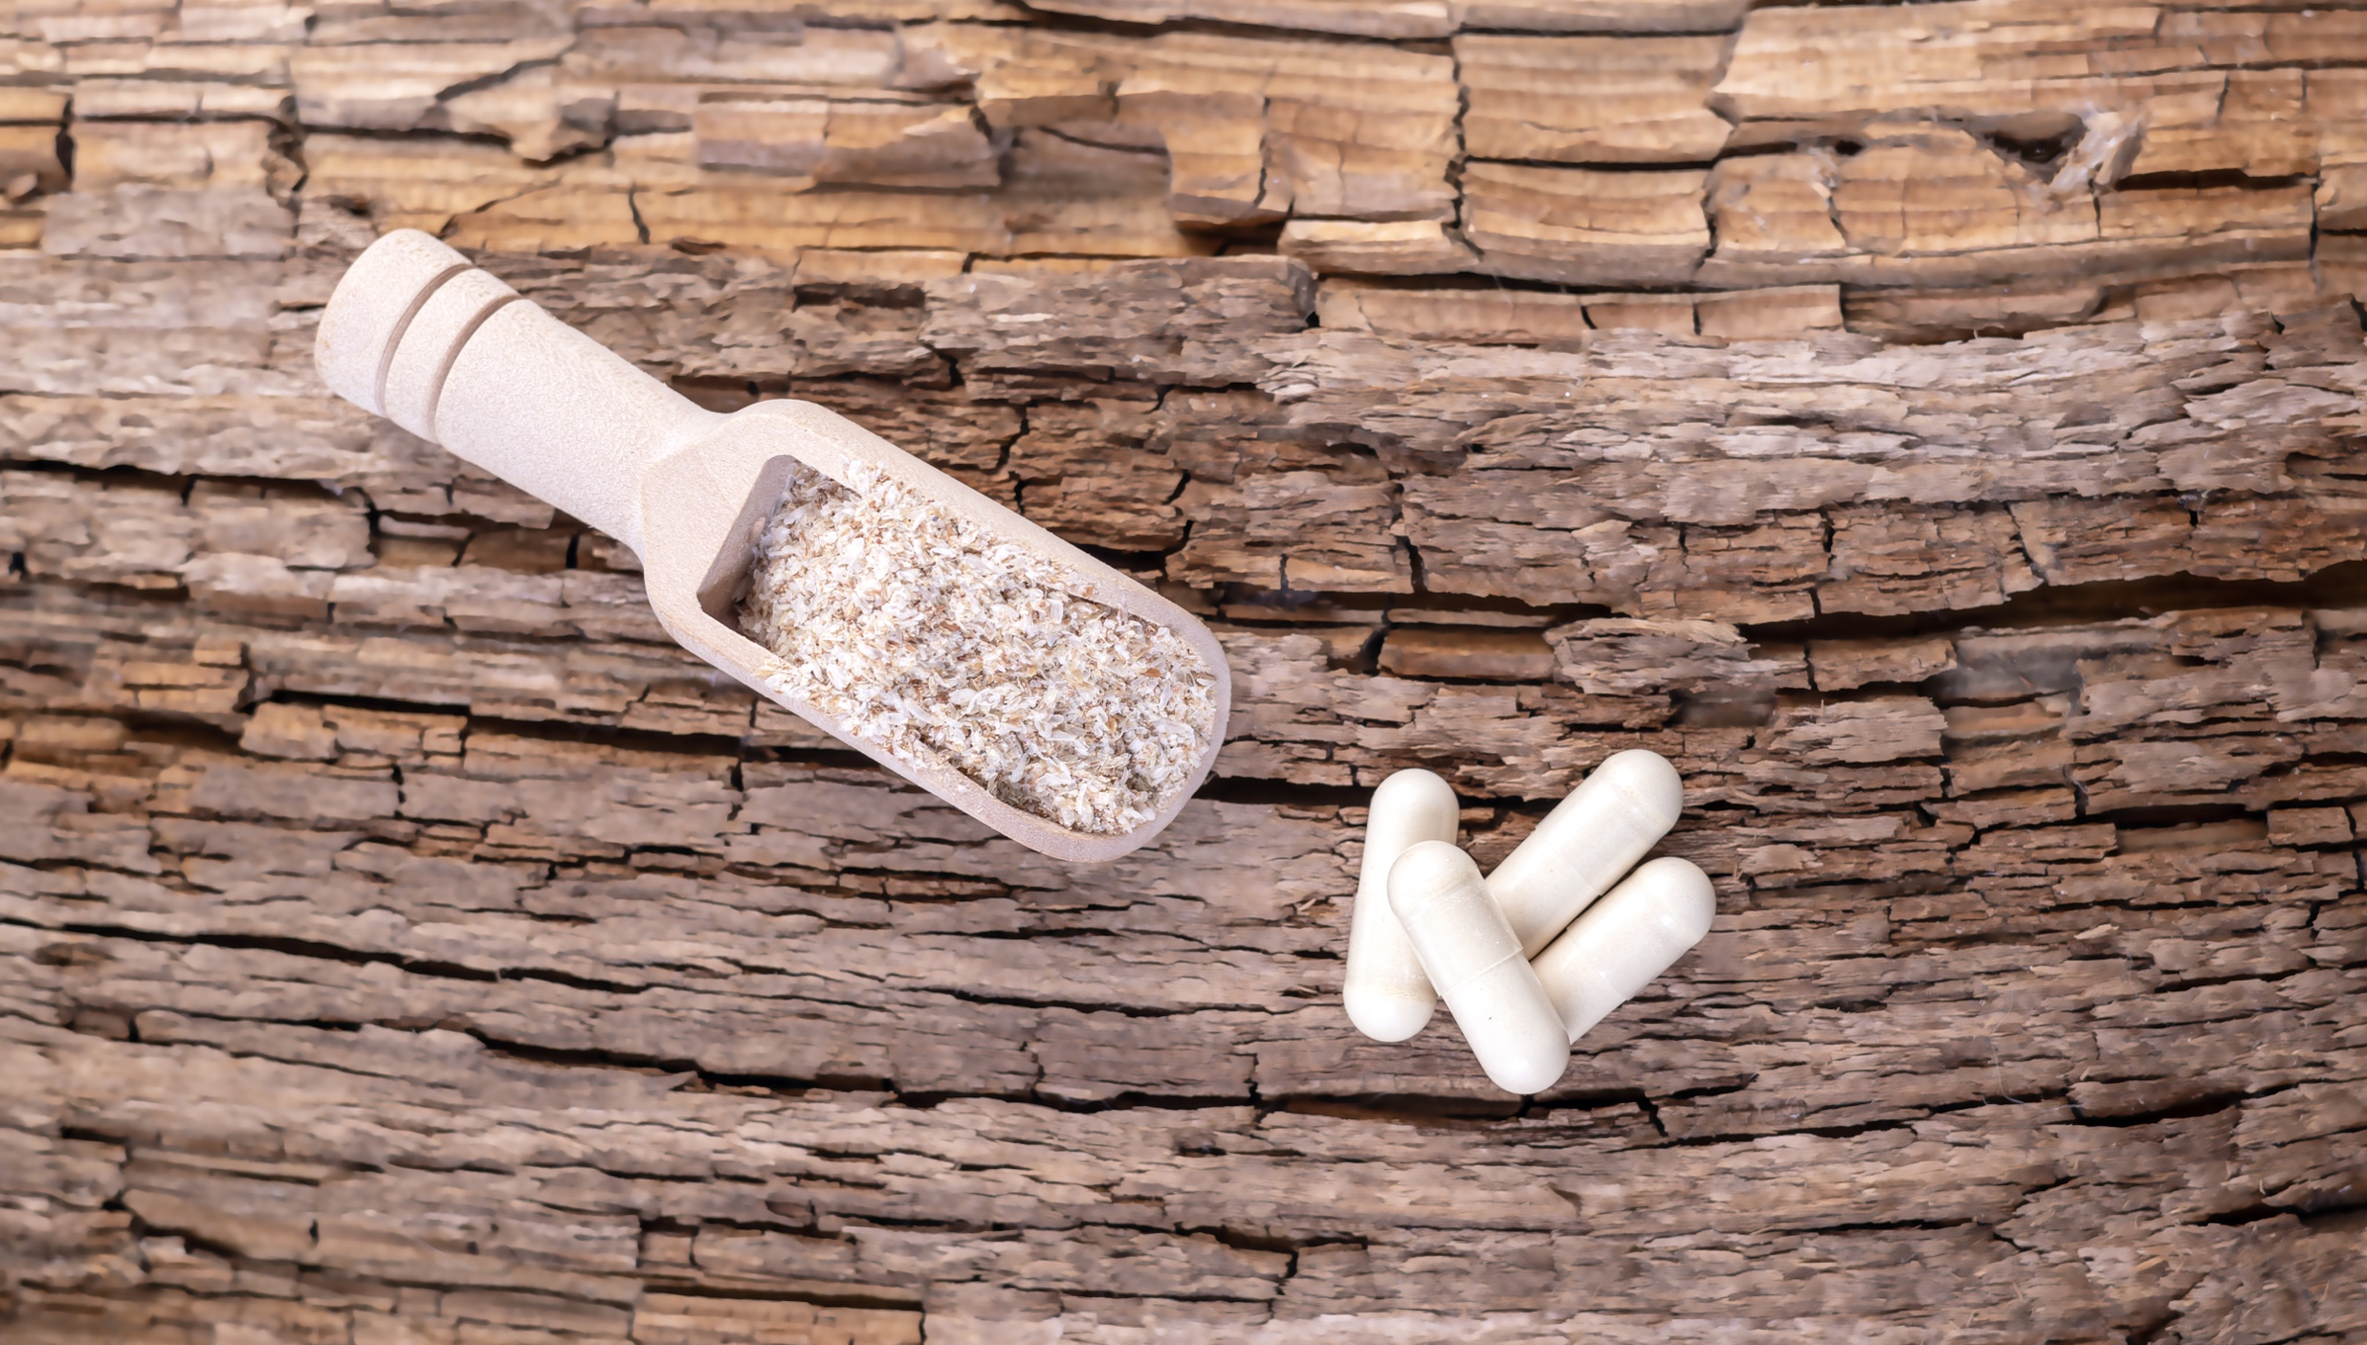
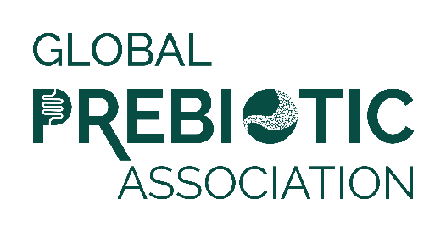
Media Insights Report
Q1 2022

Slide 2
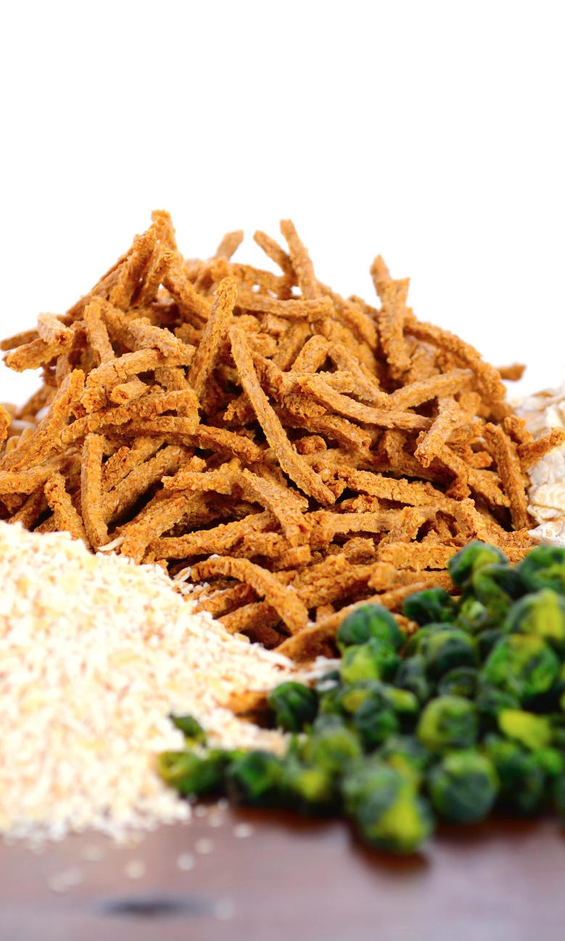
Data Summary
Data was pulled from Muck Rack insights for the period of January 1 to March 31, 2022.
Reports looked at traditional media and social media, with a heavy emphasis on consumer-reaching media.
Trade coverage and new product launches are also included.
Full text of articles may be accessed by clicking the article image on each slide.

Slide 3
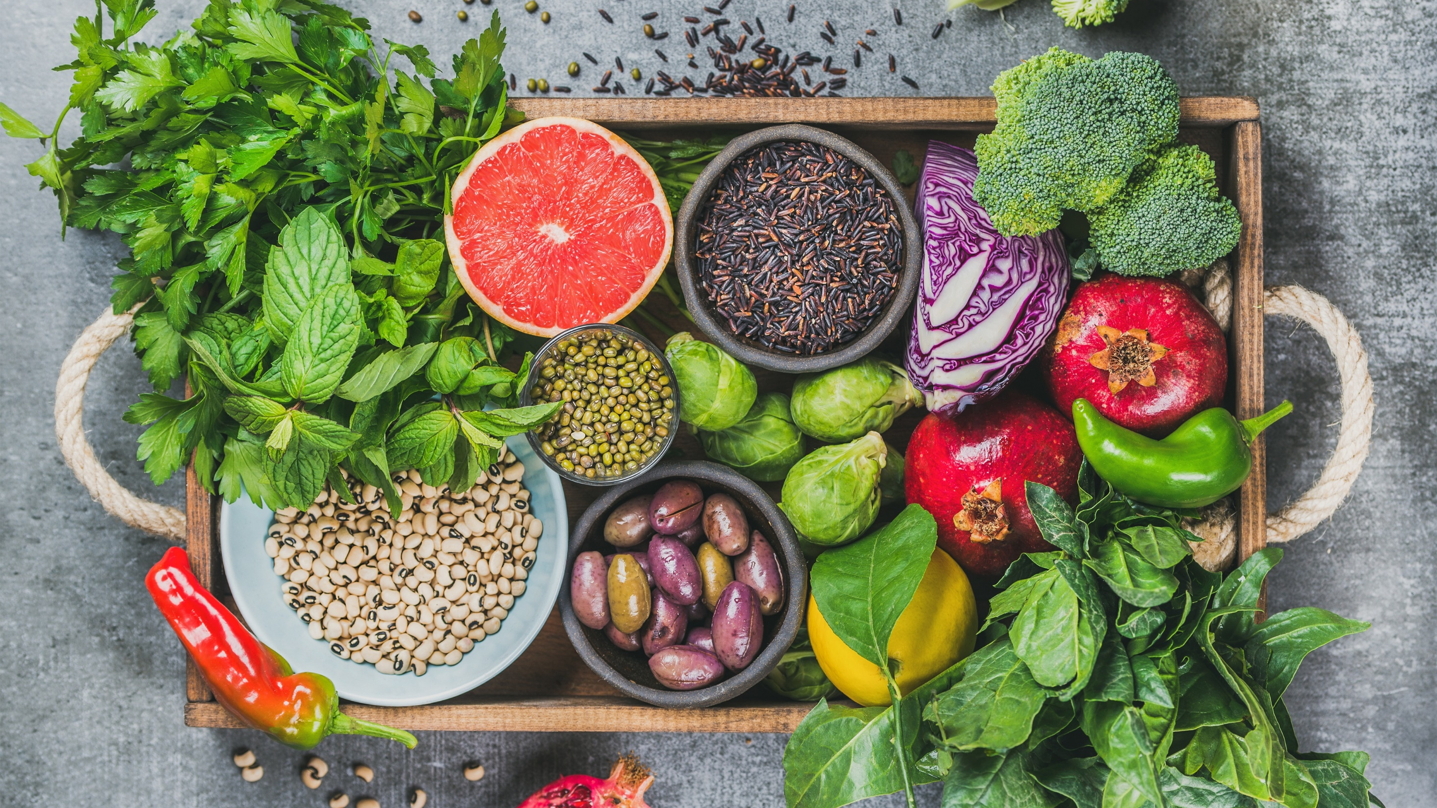
Media
Coverage

Slide 4
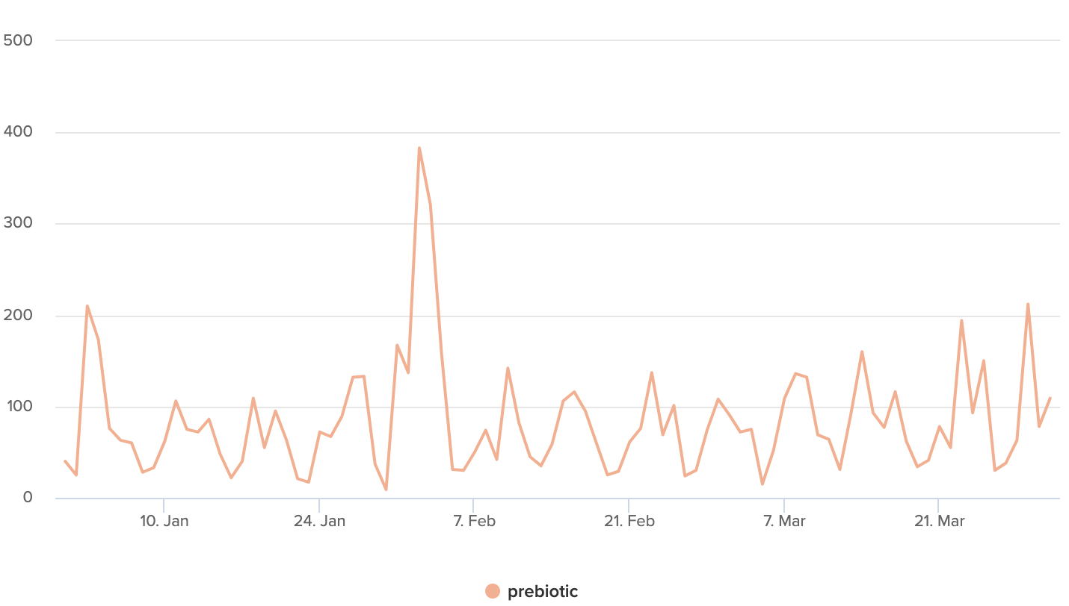
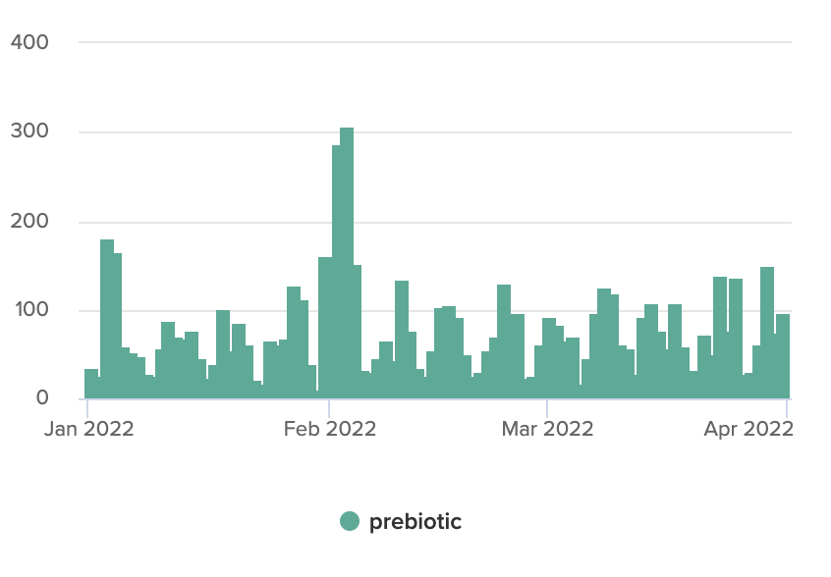

Articles Over Time
Unique Outlets
Coverage drivers are listed on the following slides.

Slide 5
Product Launches
ByHeart announces the launch of its new infant formula, including organic prebiotic fiber.
The Supplant Company debuts Supplant™ Chocolate Chips.
Wellbeing Nutrition and Disney partner to launch India’s first organic kids' nutrition, with one product having prebiotic fiber.
Lil' Goodness launches India’s first ready-to-serve prebiotic milkshake.
Melbourne couple lands $1m Coles deal with Sorted. prebiotic drink.
DeepCell Industries awarded groundbreaking patent for prebiotic cannabis formulation.
Dr. Tobias launches digestive enzymes with prebiotics and probiotics to support gut health.

Slide 6
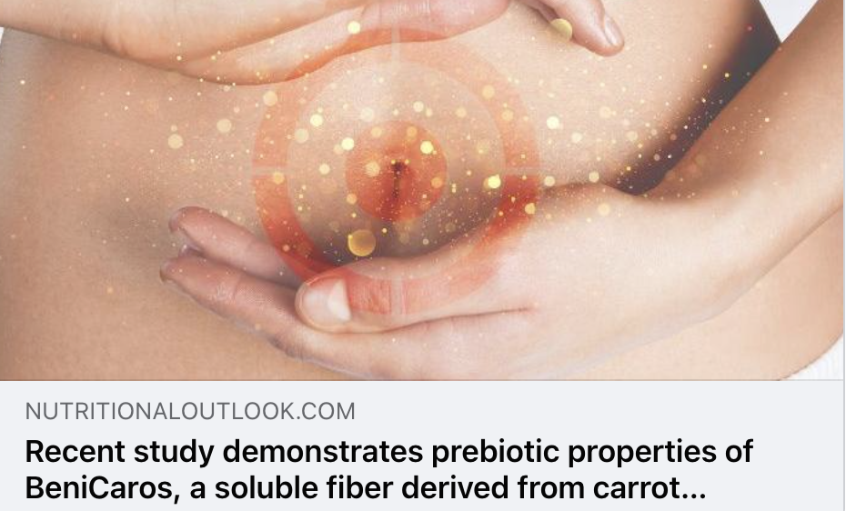
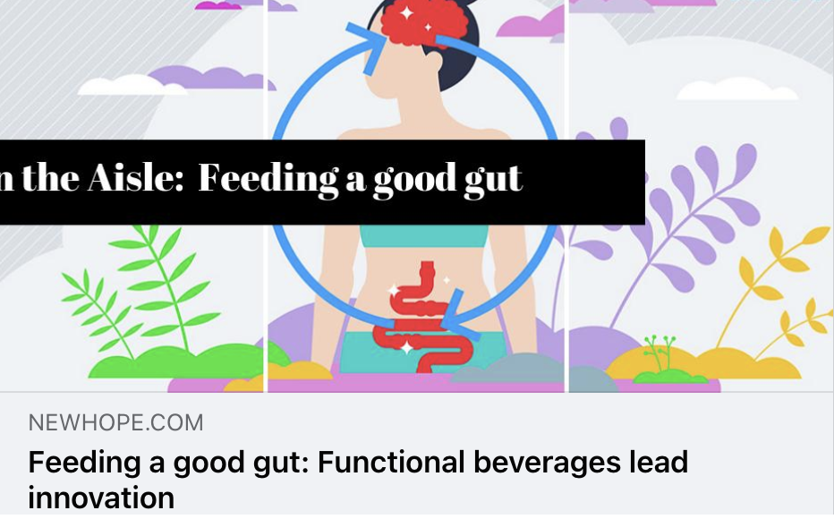

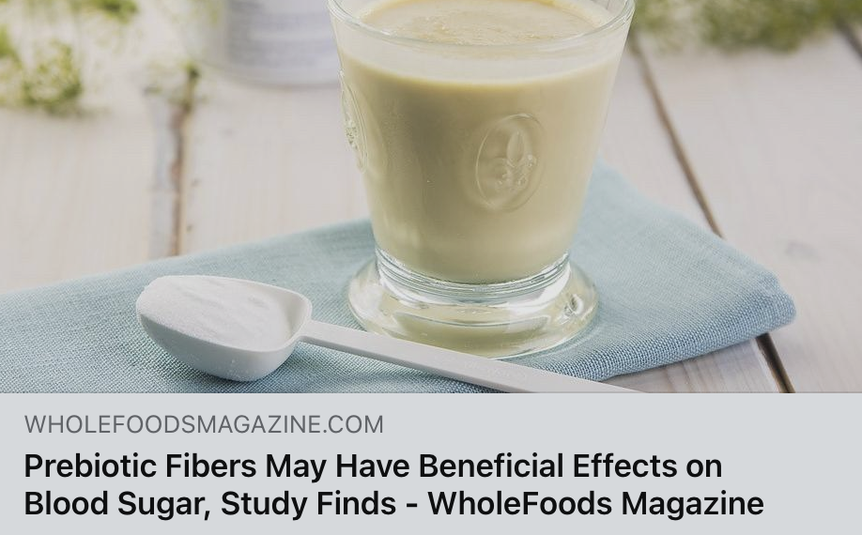
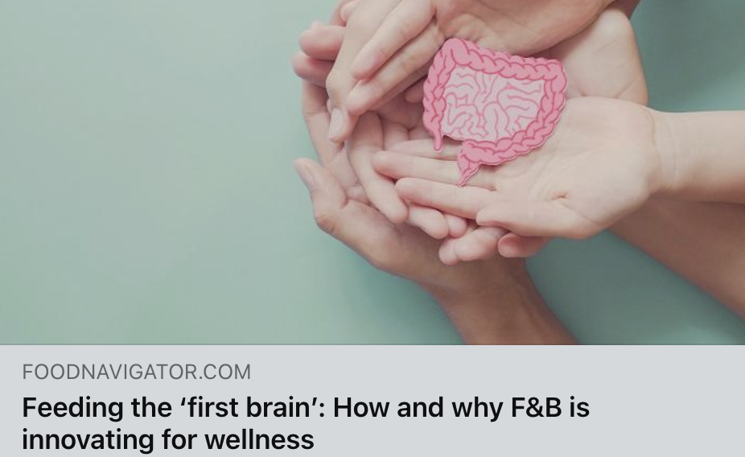

Trade Coverage

Slide 7
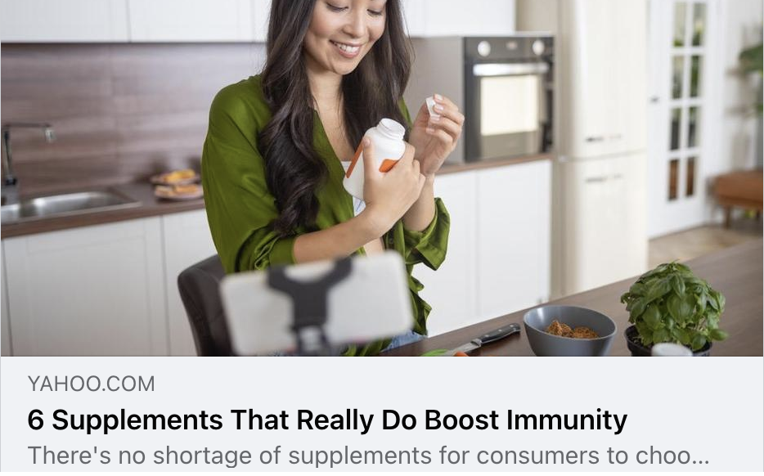
Yahoo!
UVM 457,656,248
"If you don't get proper nutrients and vitamins, your immune system won't be as strong. It's important to ensure your diet includes plenty of vegetables and prebiotics/probiotics (like yogurt) to maintain a balanced gut microbiome. I also take a multivitamin every single morning, and a baby aspirin (81mg) every night before bed.”

Slide 8
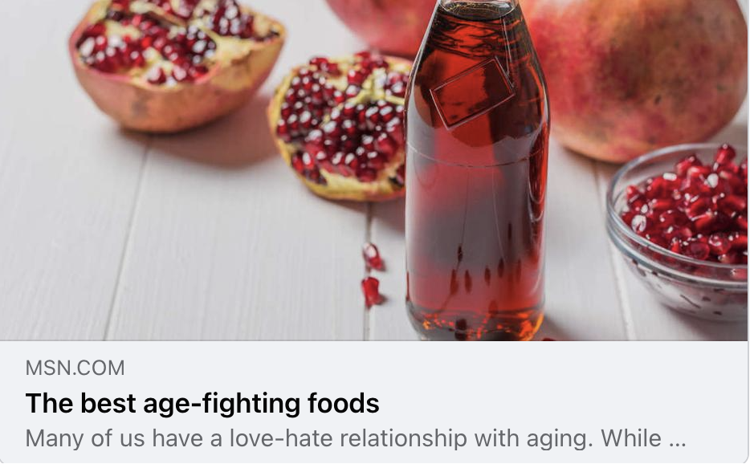
MSN
UVM 71,111,047
A great GF source of protein, potassium, B-12 and folates, lentils are not only a powerhouse of the bean family, but also are lower in fiber, making them a touch easier to digest than other beans. Their combo of high potassium and low sodium makes them a great protector against heart disease, and what’s more, lentils also contain prebiotics, contributing to gut health.

Slide 9
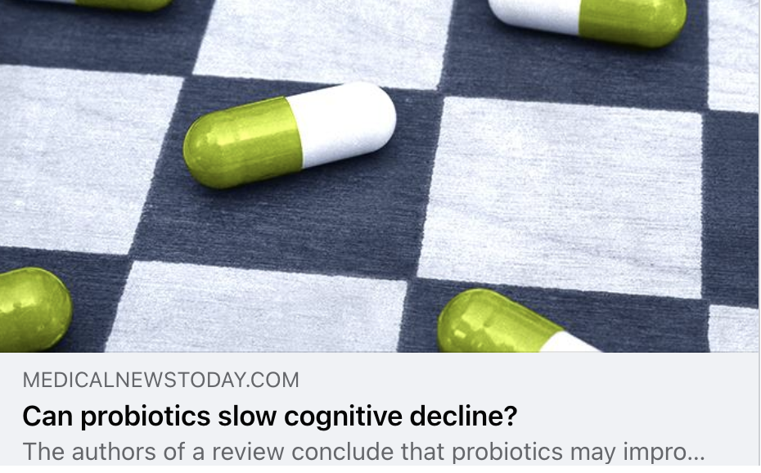
Medical News Today
UVM 72,332,768
“This gives us something that we can do to stem the rising tide of […] dementia. Hopefully, [it] can be a key target of something that we can affect, either through lifestyle changes — what we eat and what we don’t eat — or through supplementation with different prebiotics, probiotics, and synbiotics,” he concluded.

Slide 10
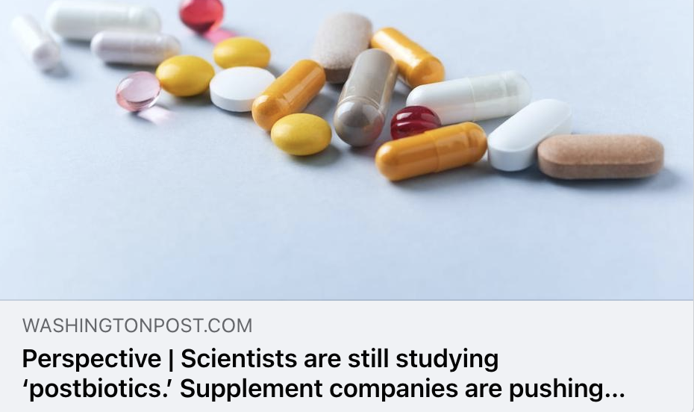
Washington Post
UVM 58,312,632
These newer supplements are said to help with weight loss, digestive health or immunity. There are even new combination supplements that contain prebiotics, probiotics and postbiotics in one capsule.

Slide 11
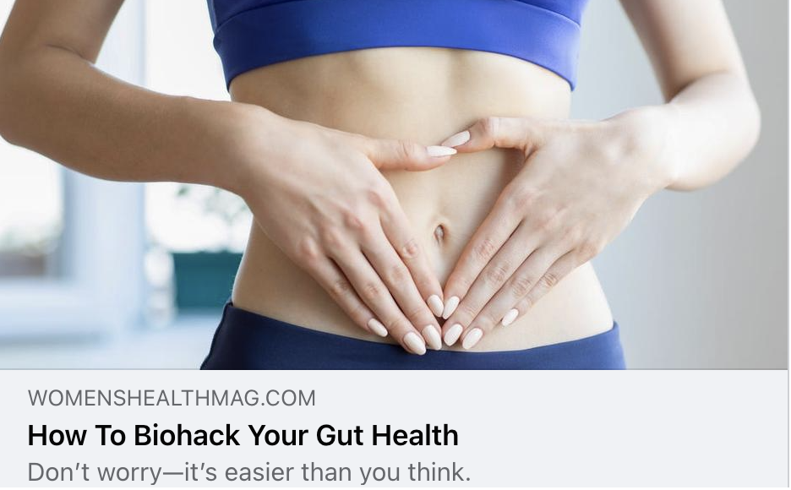
Women’s Health
UVM 23,228,626
Everyone needs to eat, right? That includes the bacteria in your microbiome. Prebiotics are compounds that serve as a food source for probiotics, and you can find them in walnuts, oats, red lentils, apples, and other fiber-rich foods. Basically, prebiotics feed your good gut bacteria.

Slide 12
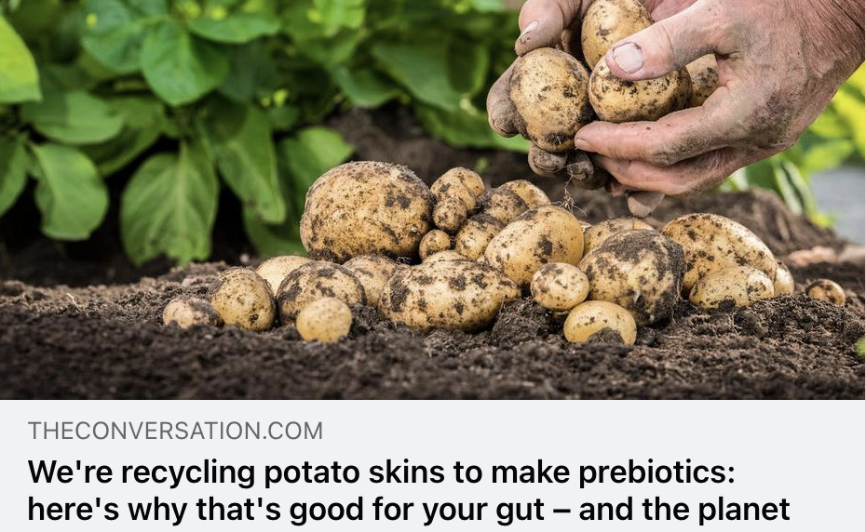
The Conversation
UVM 17,541,464
It has been shown that consuming prebiotics boosts overall digestive health by improving the absorption of micronutrients such as calcium, changing the rate at which certain foods lead to spikes in blood sugar, and improving the barrier function of the gut.

Slide 13
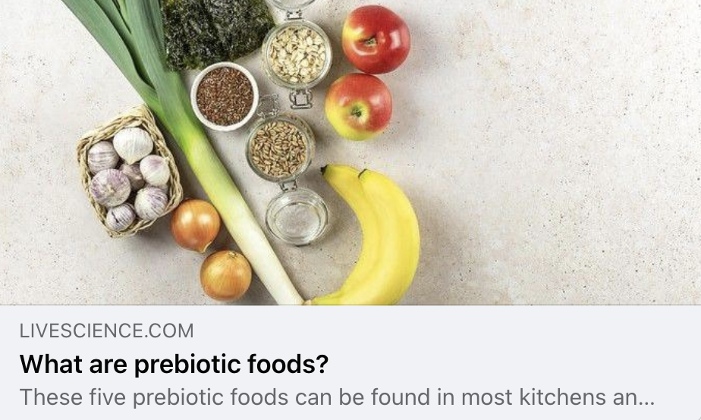
Live Science
UVM 12,235,740
Prebiotics are types of fiber that are beneficial for the functioning of our gut microbes. But what are some prebiotic foods you can eat and which ones are best for your gut health?

Slide 14
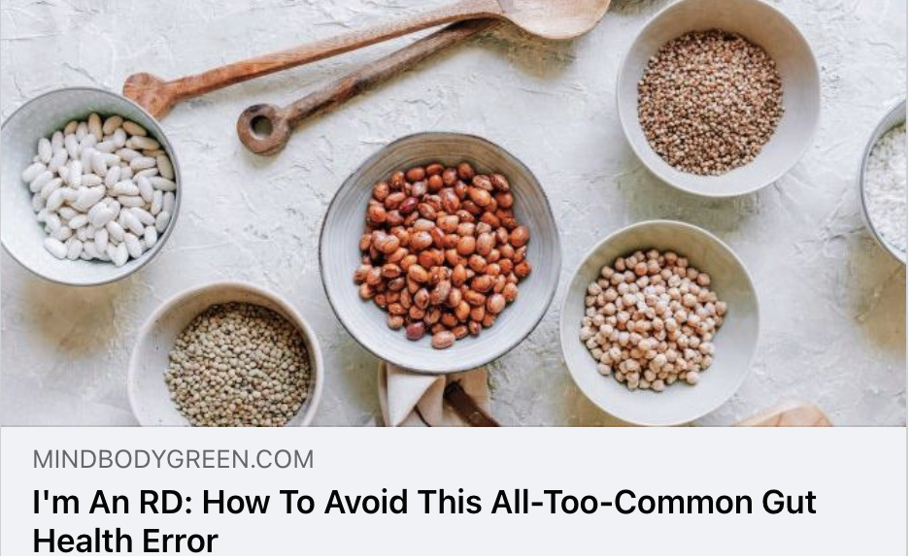
Mind Body Green
UVM 5,771,083
Prebiotics, not to be confused with probiotics, are a type of fiber that feed your good gut bacteria and help increase your gut bacterial diversity.* Just like us, the bacteria in the gut need fuel in order to survive, and their preferred source is prebiotic fiber.

Slide 15
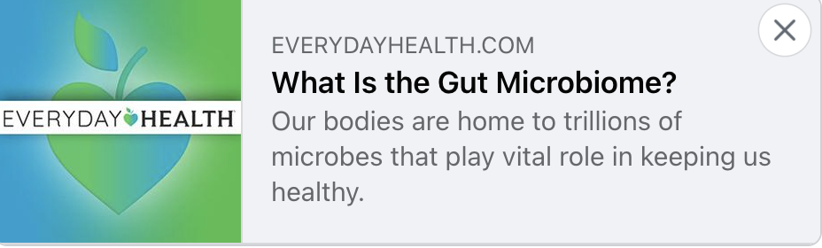
Everyday Health
UVM 15,756,189
Foods that promote increased levels of SCFAs (sometimes called prebiotics) are raw forms of garlic, onions, leeks, asparagus, bananas, seaweed, dandelion greens, and Jerusalem artichokes. It’s important to introduce prebiotic foods slowly into your diet, as doing so suddenly can lead to an increase in gas and bloating.

Slide 16
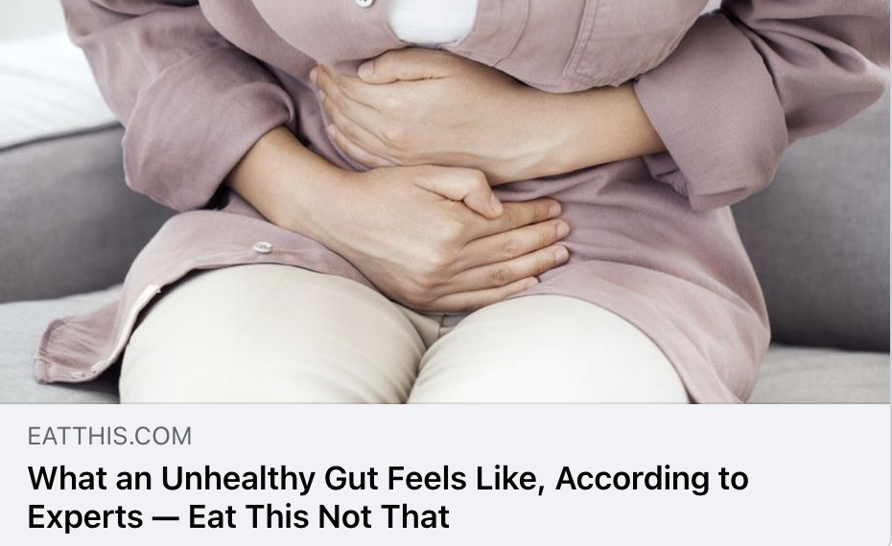
Eat This, Not That
UVM 19,929,098
Introduce gut health supplements packed with healthy prebiotics, probiotics and postbiotics to give your gut the support it needs.

Slide 17

Insights
Insights

Slide 18
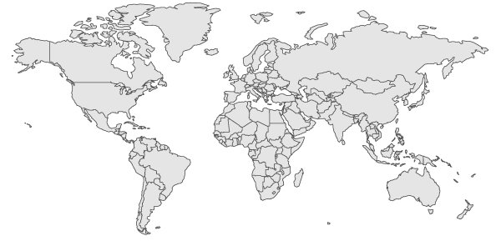
Top Countries Online + Print
Canada
3%
Germany
1%
USA
75%
UK
10%
India
5%
Australia
5%

Slide 19
Gut Health
Anxiety
Snacks
Synbiotics
Skincare
Microbiome
Pet Food
Trending Topics

Slide 20

Sentiment
Positive
%
Neutral
%
Negative
%
Coverage was positive, but we continue to see a need for education on the different types of prebiotics, as many still refer to prebiotics simply as food for probiotics or fiber.

Slide 21
Experts & Influencers
Tula Skincare founder Dr. Roshini Raj on America’s gut health problem, the microbiome and turning back the biological clock
Dr. Michael Mosley speaks on prebiotics being good for your brain and mood.
Registered dietitian Gail Cresci, PhD, RD, shares some secrets behind prebiotics.
Dr. Hodzovic suggests utilizing supplements or replacing with gut-healthy items such as prebiotic foods.
BRITTANY XAVIER

Slide 22
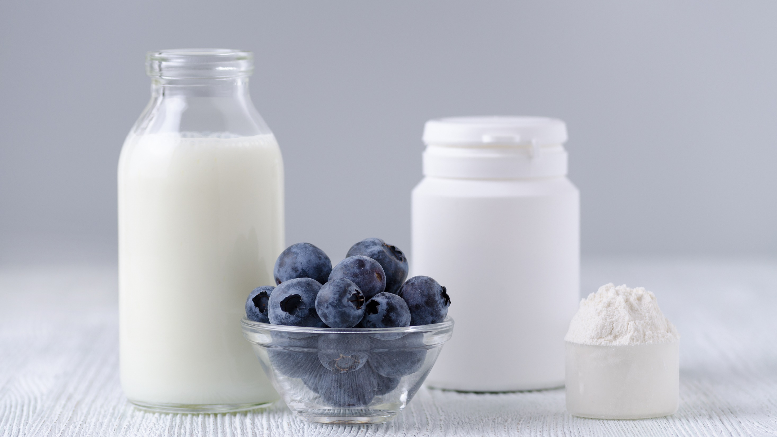
Questions?
Traci Kantowski
Communications Director
Global Prebiotic Association
+1 630.923.0211
traci@prebioticassociation.org

