Slide 1
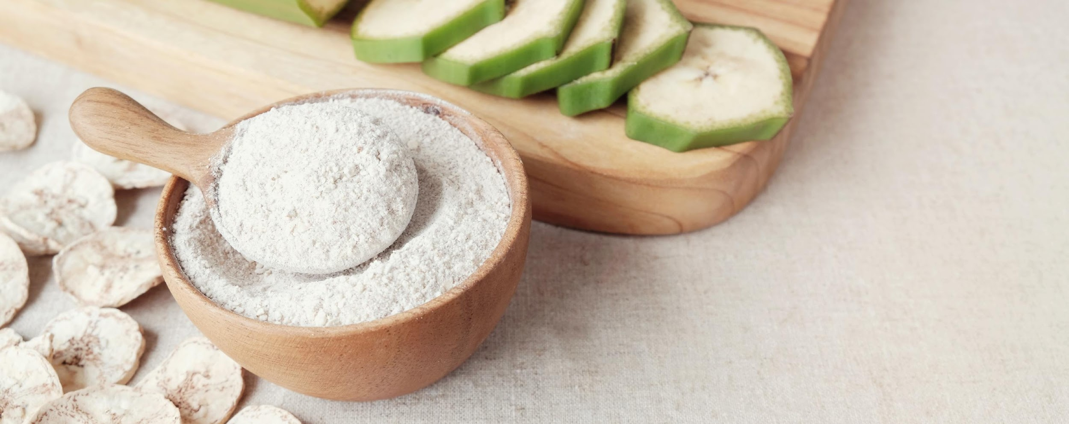

The Prebiotic Market & Its Consumers - Opportunities and Gaps
April 21, 2026

Slide 2




Mission
Champion the prebiotics category by increasing public awareness and understanding of the science supporting both
well-known and newfound benefits and create needed transparency about prebiotics and their interaction with the microbiome.

Slide 3











































Our Members:

Slide 4
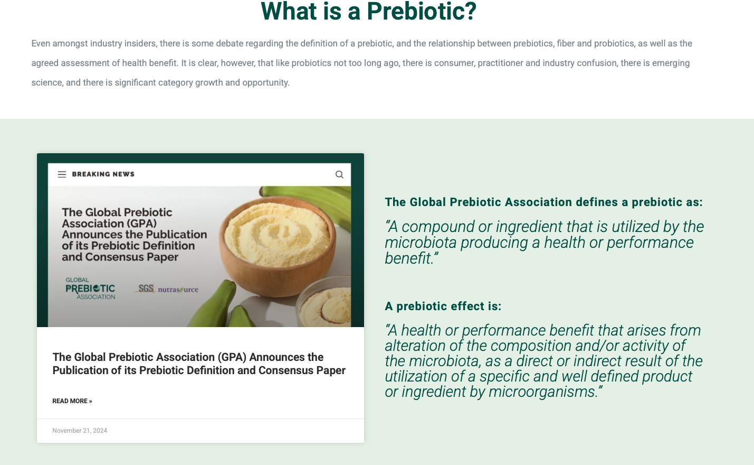

Slide 5

A Certification to Elevate Efficacious Prebiotics

Slide 6









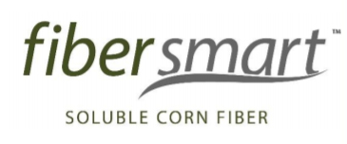
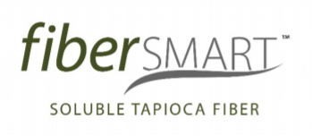





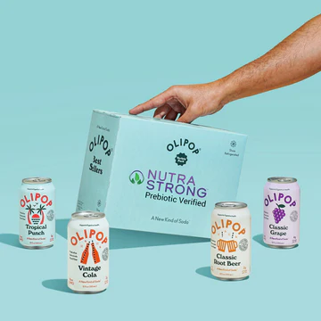
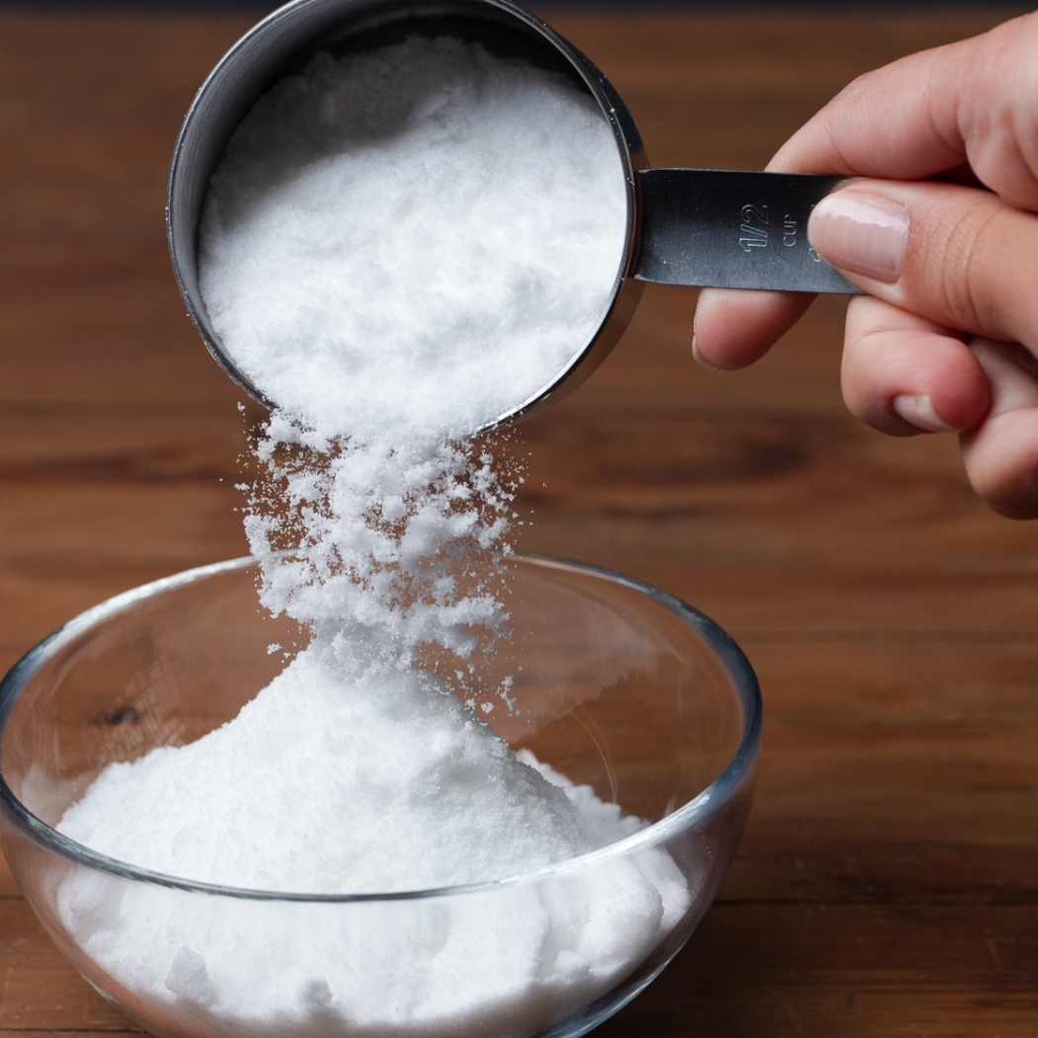
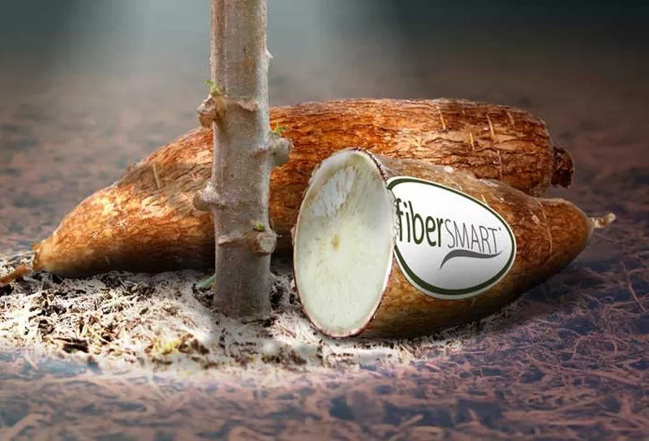
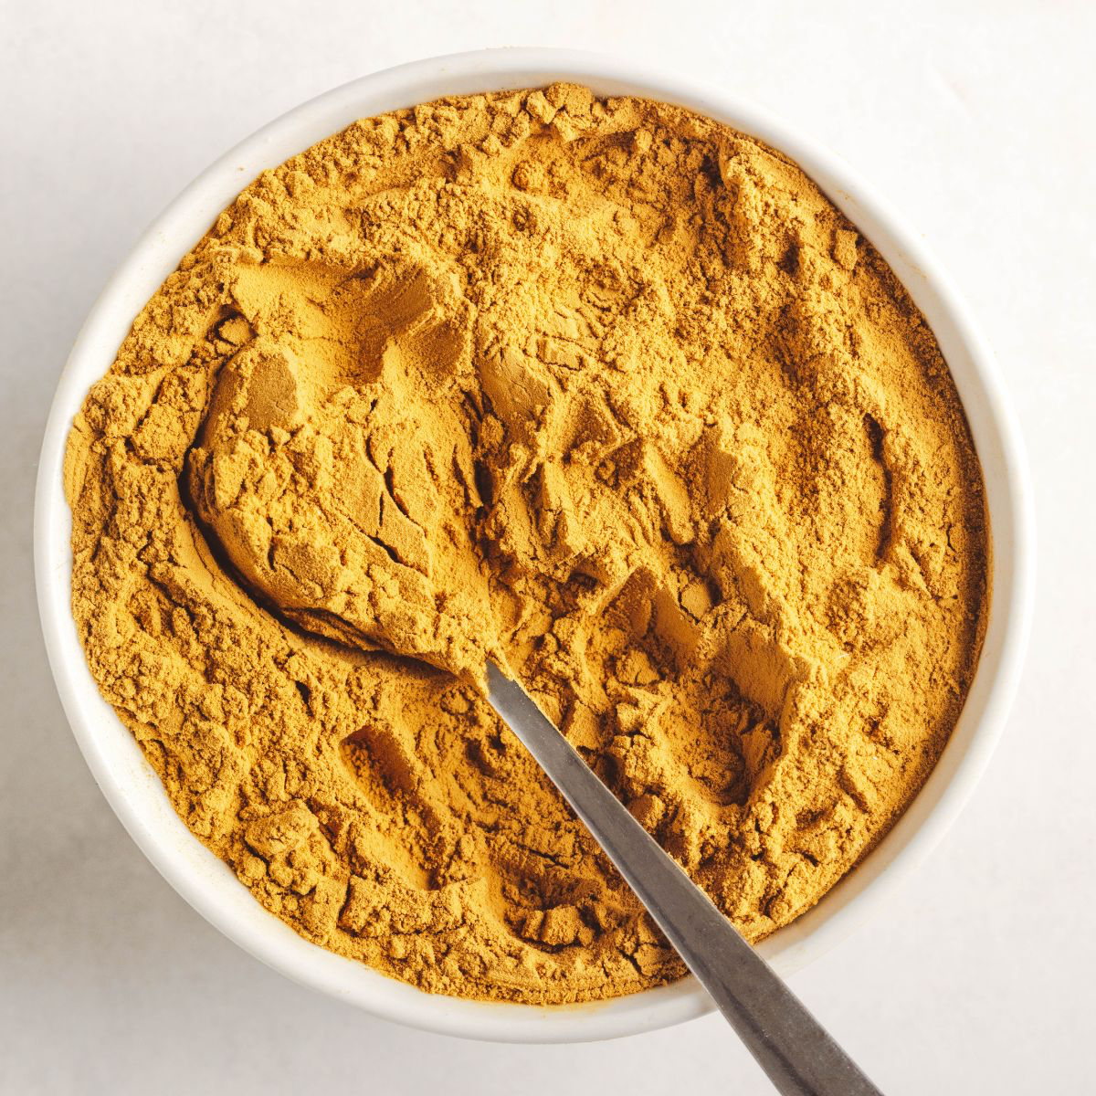
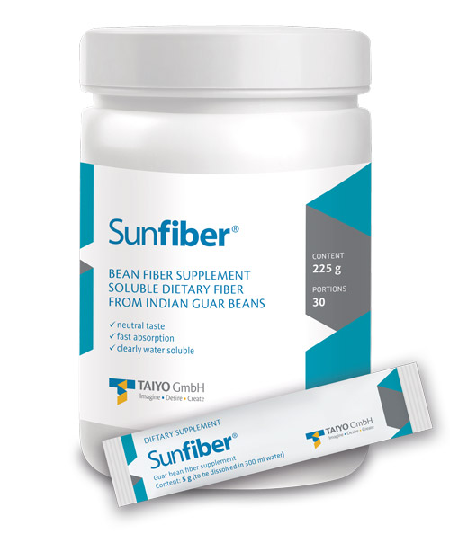
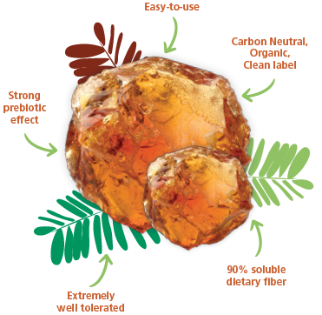
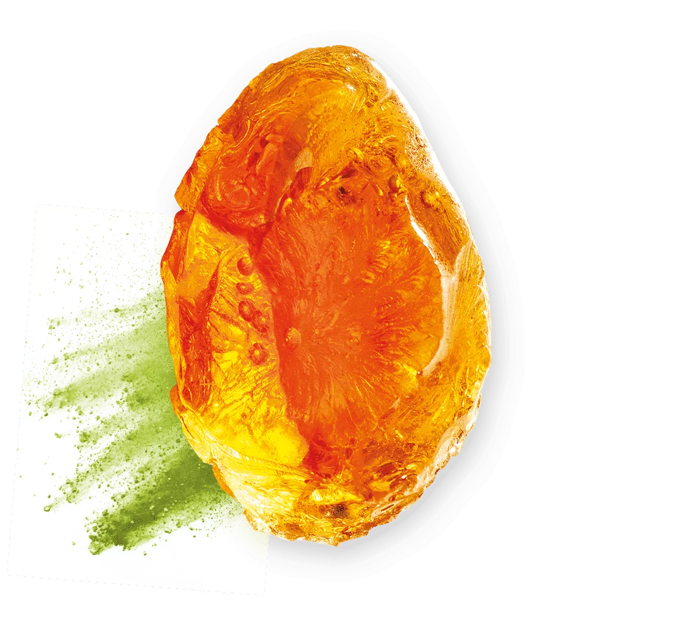

Prebiotic Verified Brands / Ingredients

Slide 7
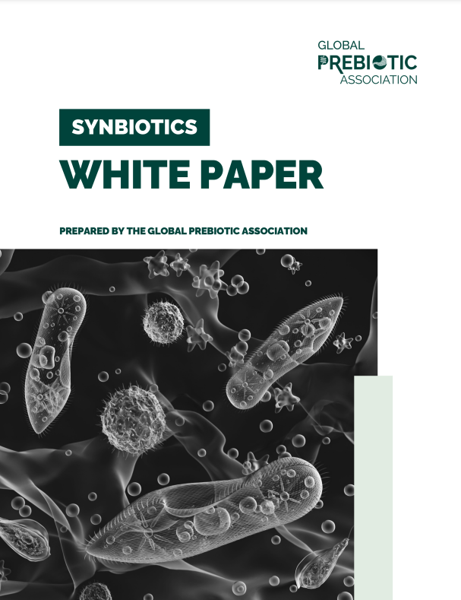
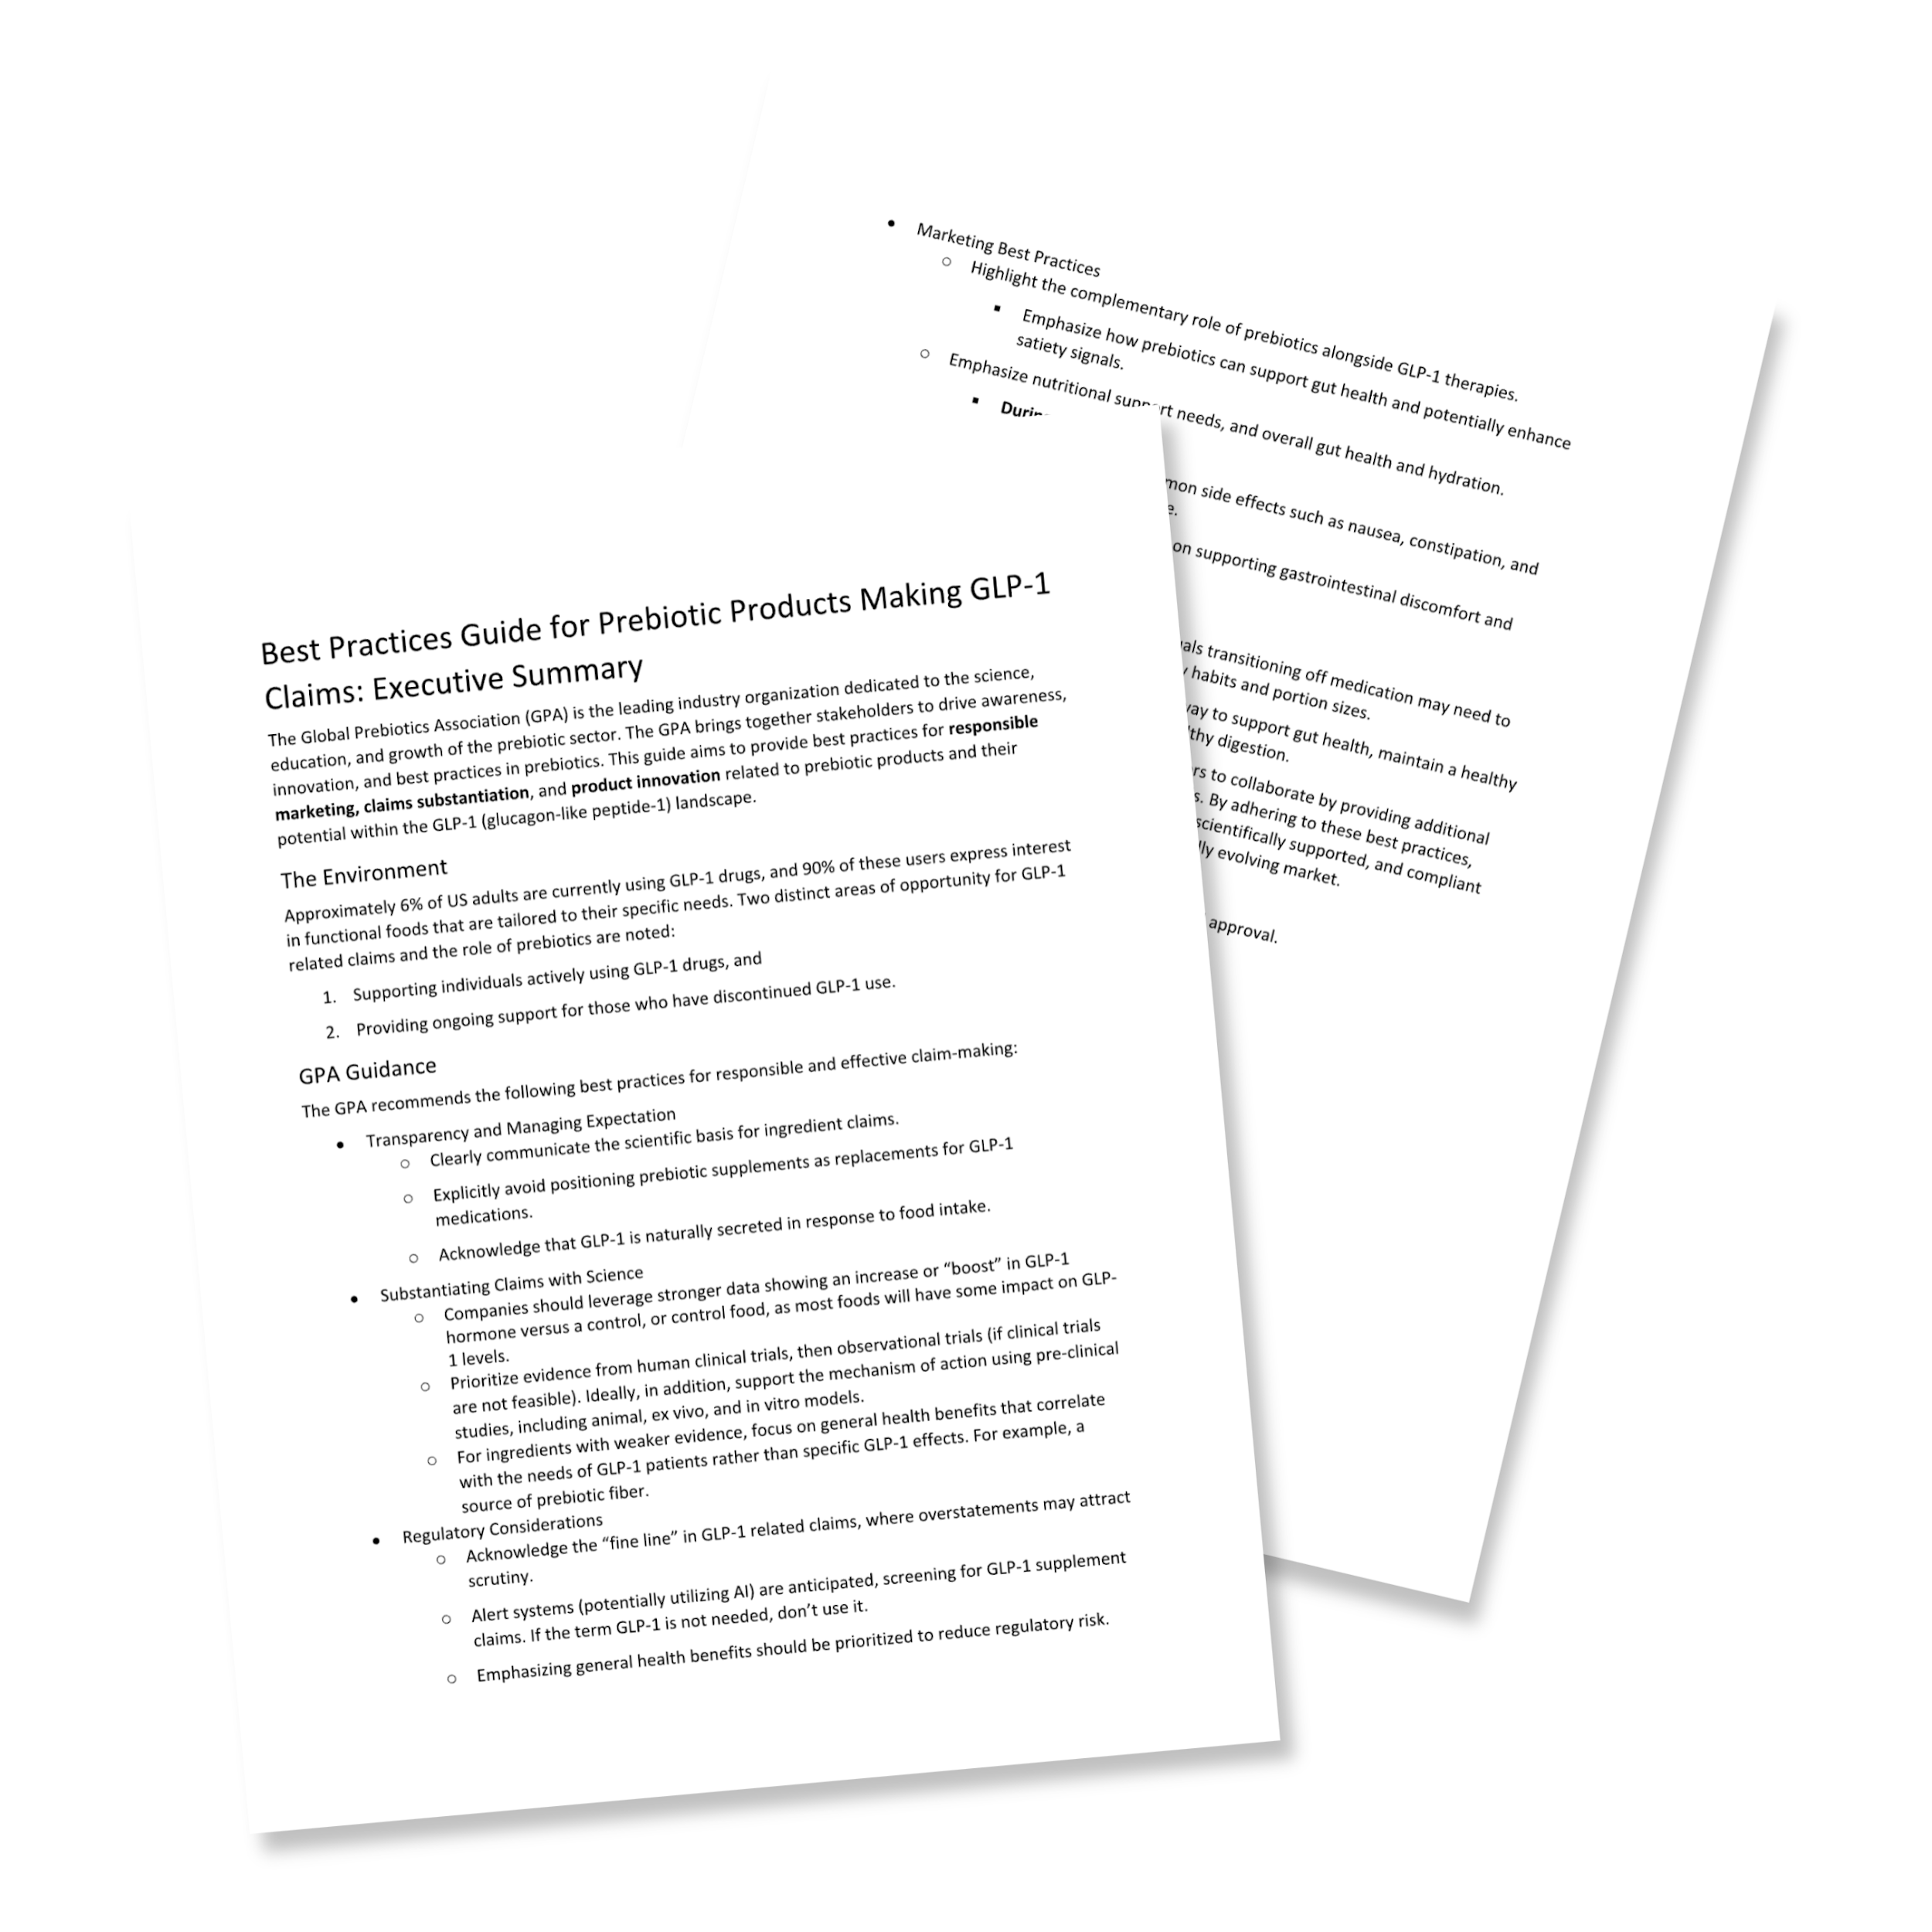
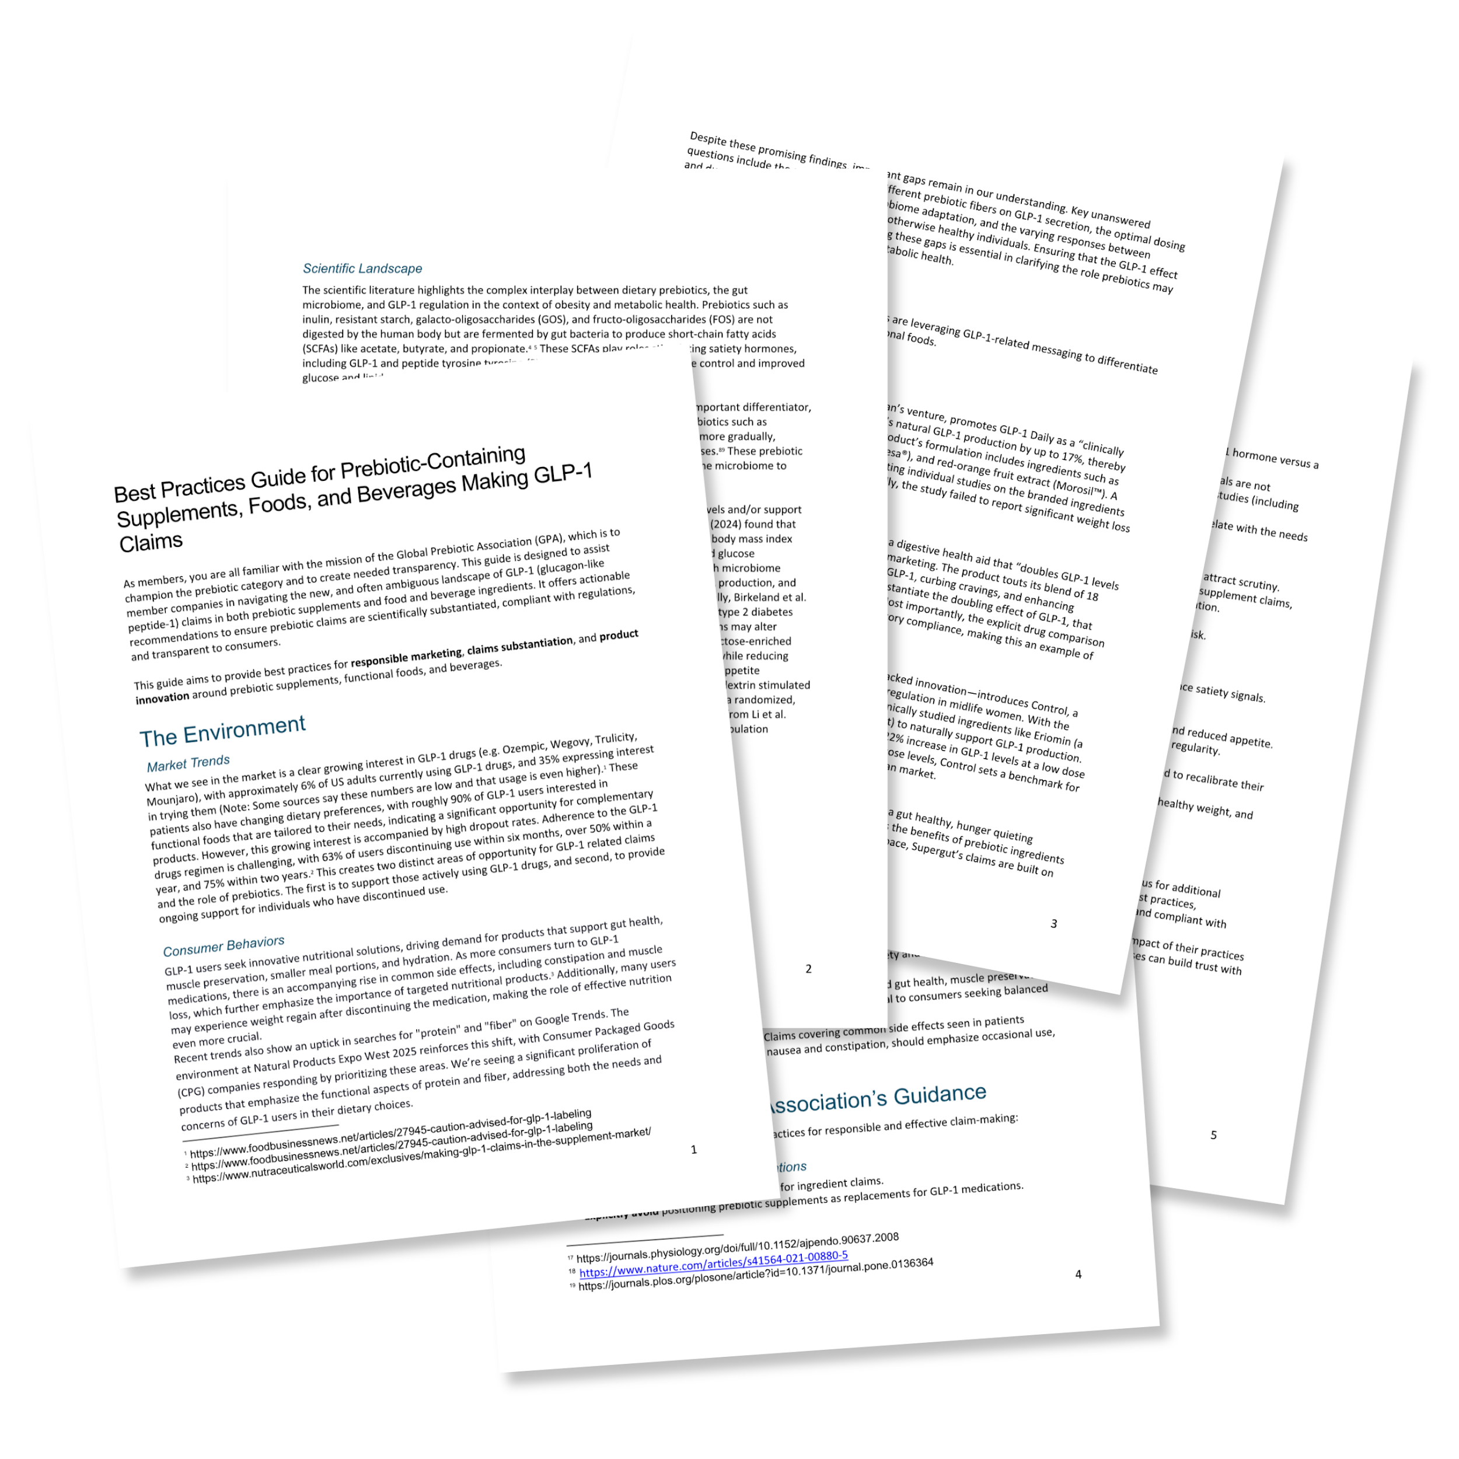
Efforts from GLP-1 & Synbiotics Task Forces:
Best Practices Guide, White Papers, & Prepared Responses
With more work to be published in 2026.

Slide 8
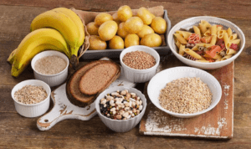
Prebiotics in the News

Slide 9
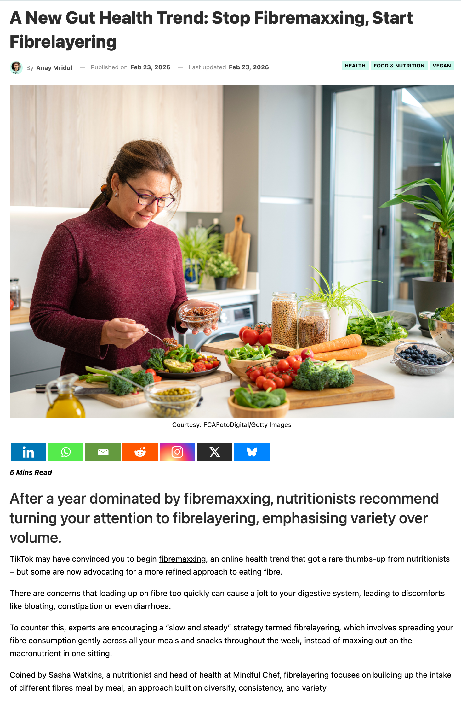
A New Gut Health Trend:
Fibermaxxing and Fiber layering
With all the hype, buoyed by the new US dietary guidelines, the focus on fiber in the wake of widespread GLP-1 drug adoption and nutritional fallout, fiber is having a rebirth.
Like any rebirth, this one is tricky as on the one hand, who wouldn’t want to try to make fiber sexy and address nutritional gaps. On the other hand, be careful what you wish for…

Slide 10
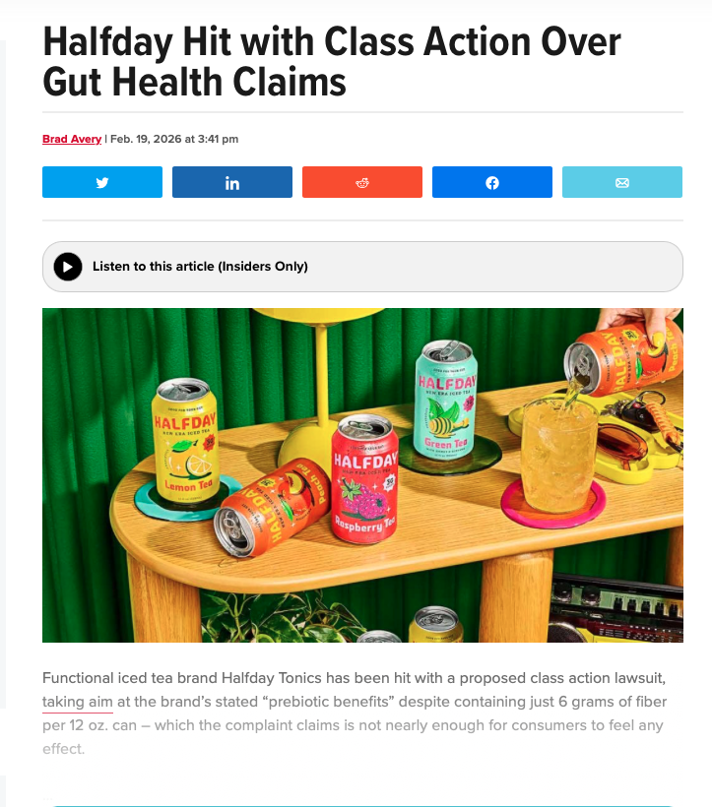
Prebiotic Beverages on Center Stage
As the popularity of prebiotic products increases, especially in the functional beverage category, expect to see more call for transparency, calling out of inconsistency and general overall scrutiny.

Slide 11
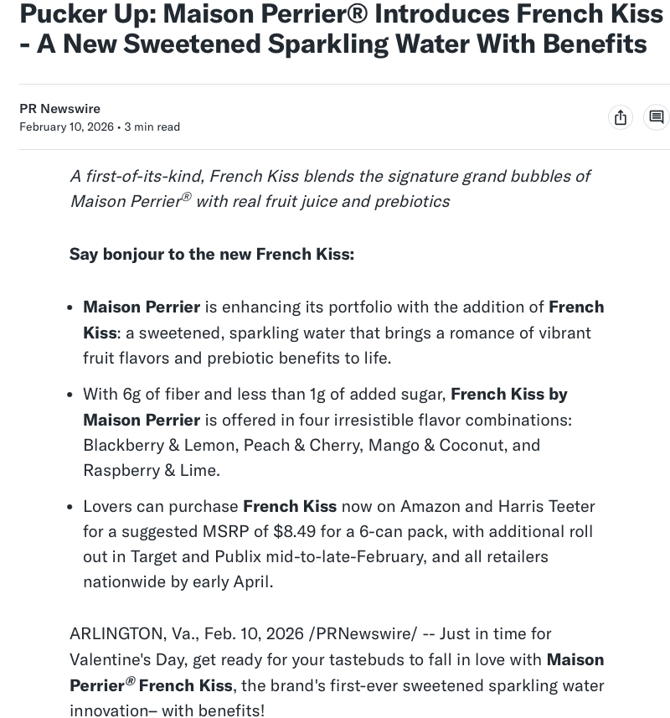

Prebiotic Beverages on Center Stage
It’s a global trend. Watch this space!

Slide 12
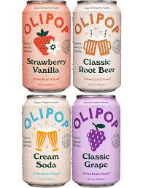
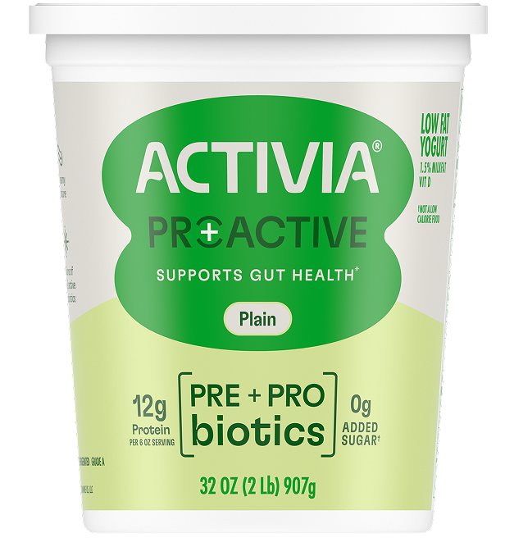

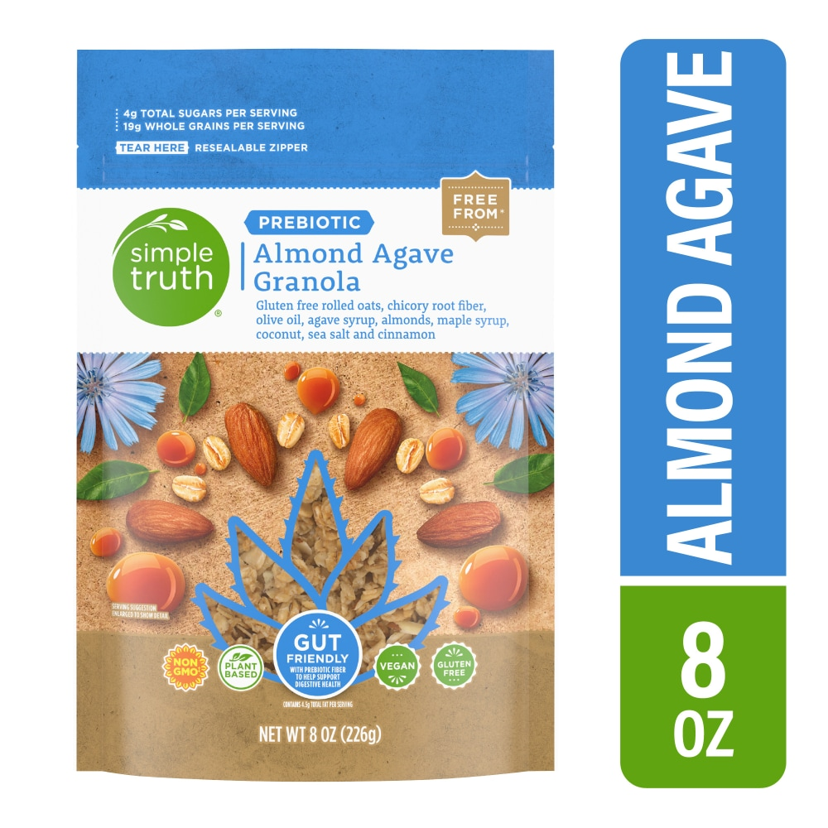
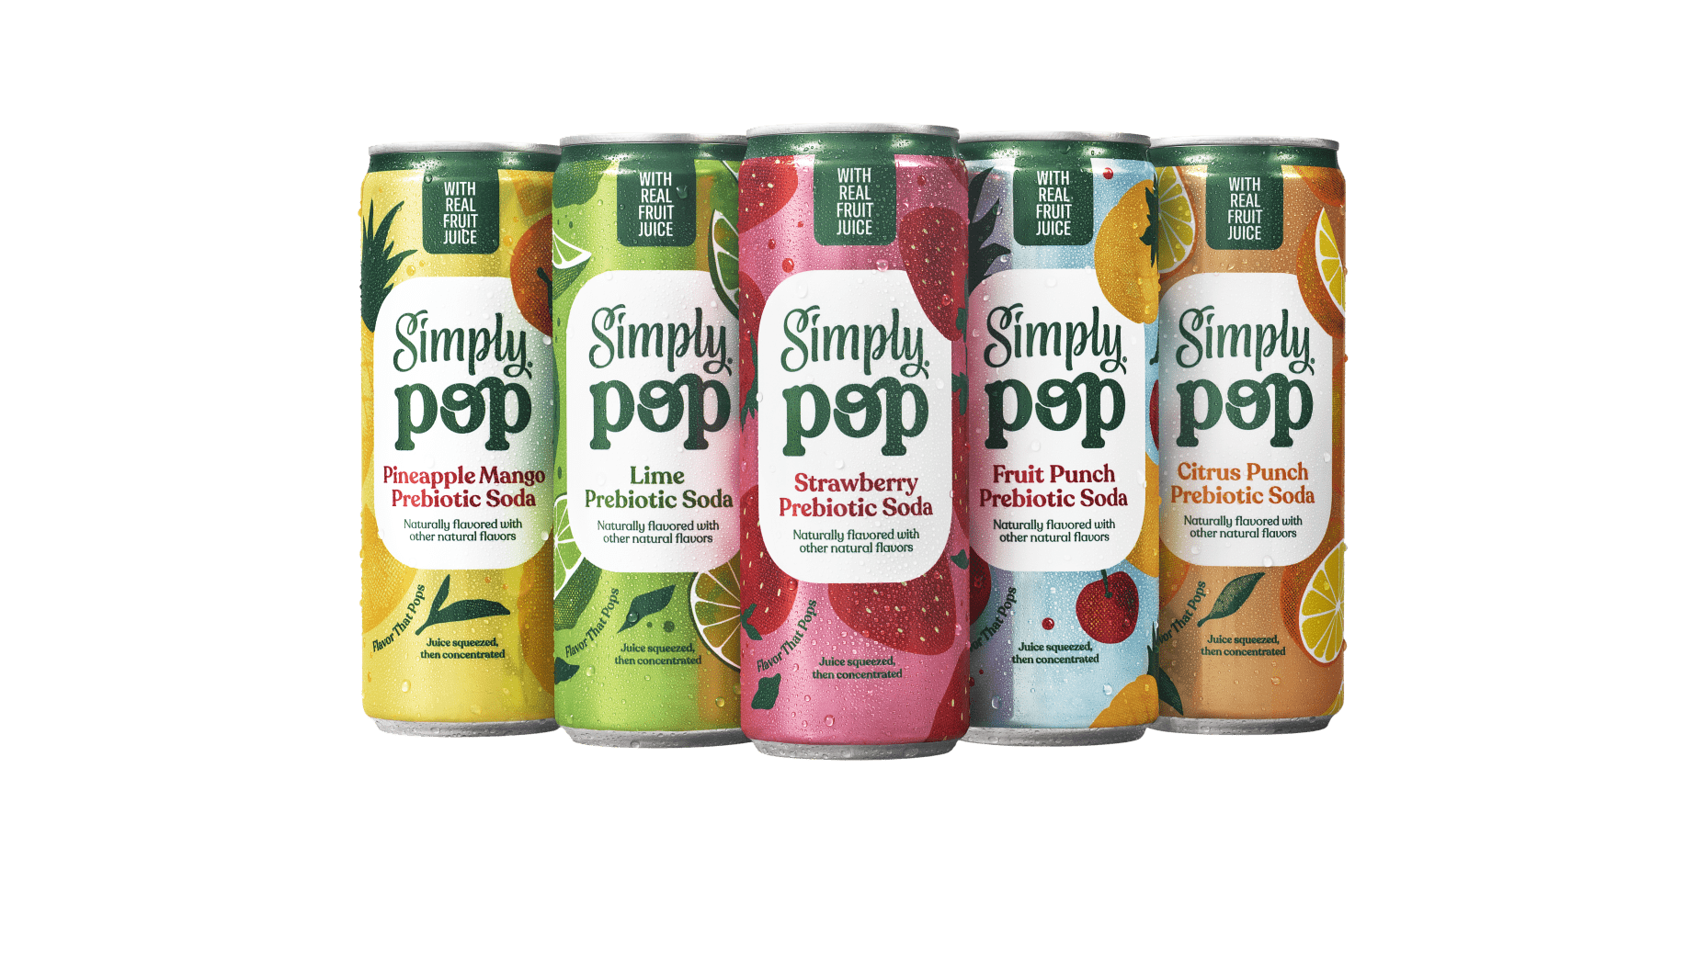
Prebiotics Are No Longer Niche - Mainstream

Slide 13
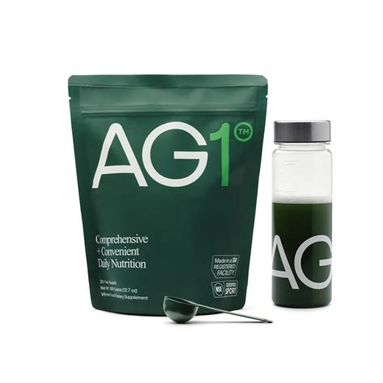
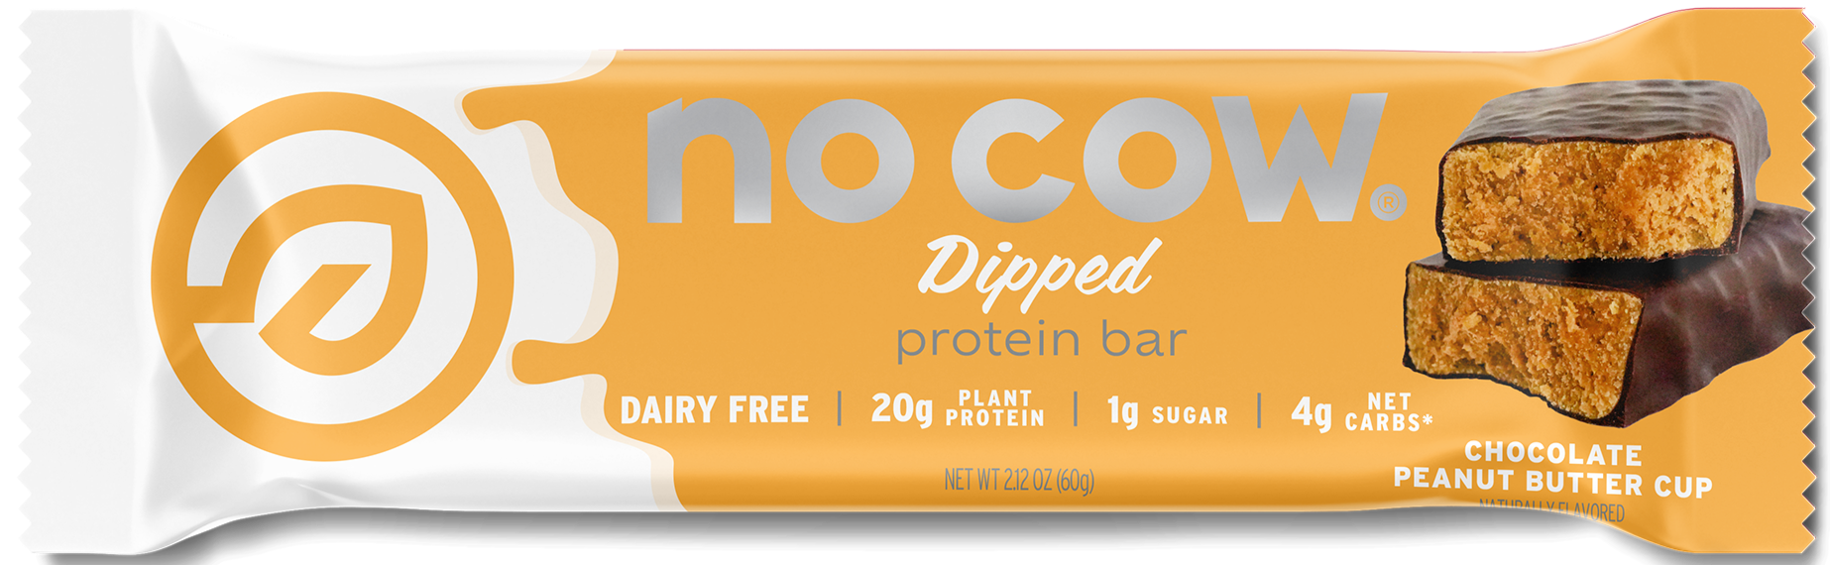

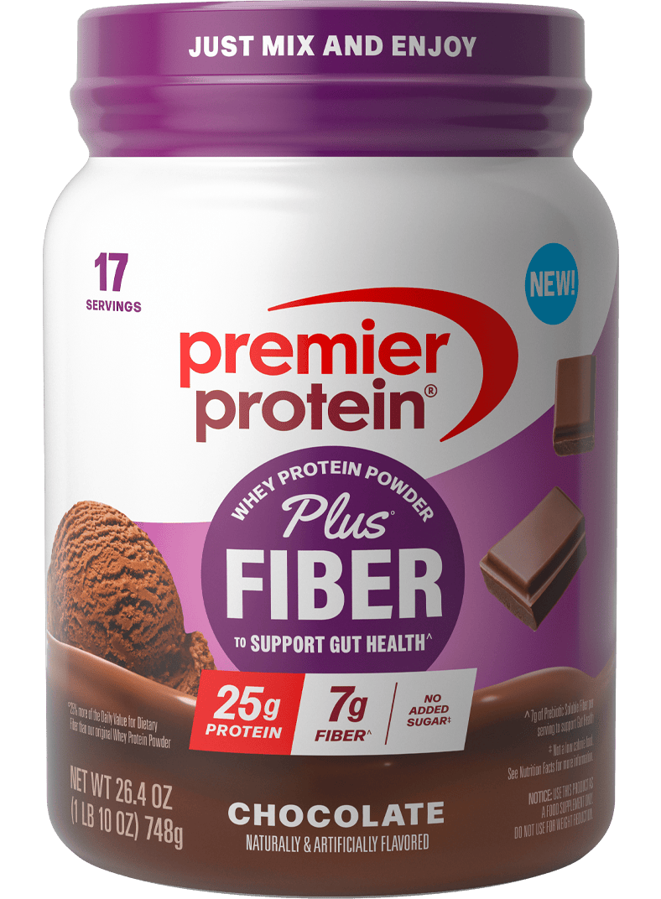

Prebiotics Are No Longer Niche – Wellness

Slide 14
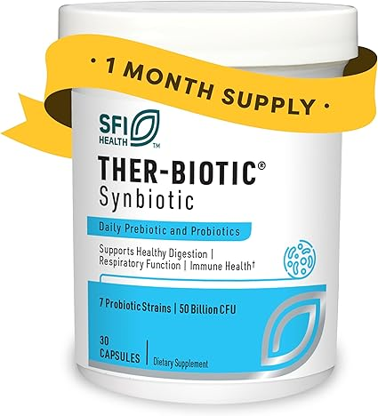
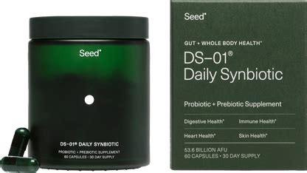
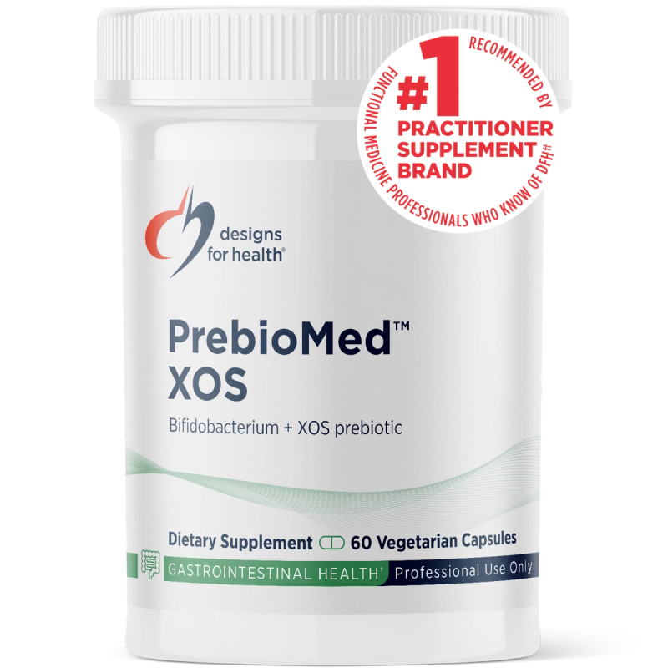
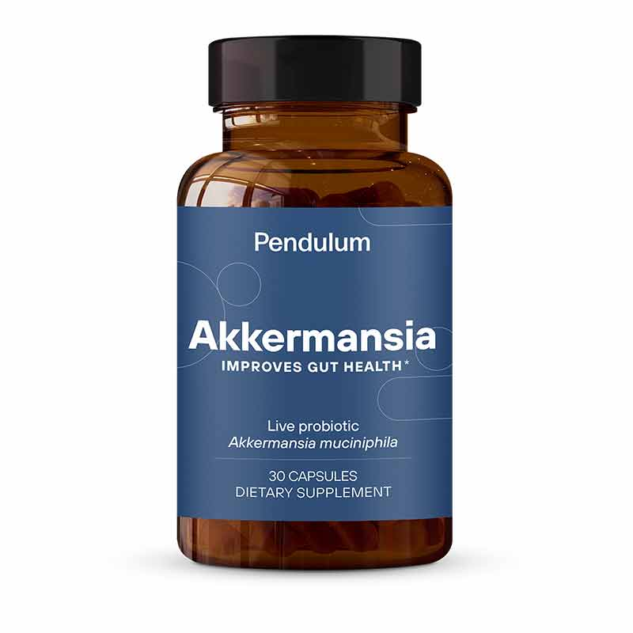
Prebiotics Are No Longer Niche - Synbiotics

Slide 15
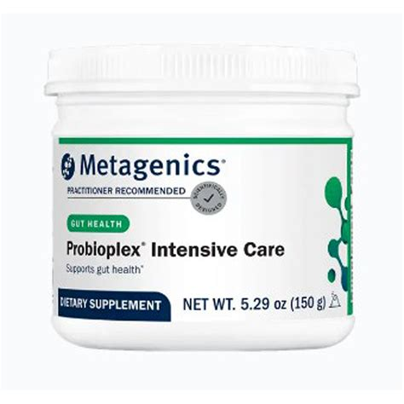
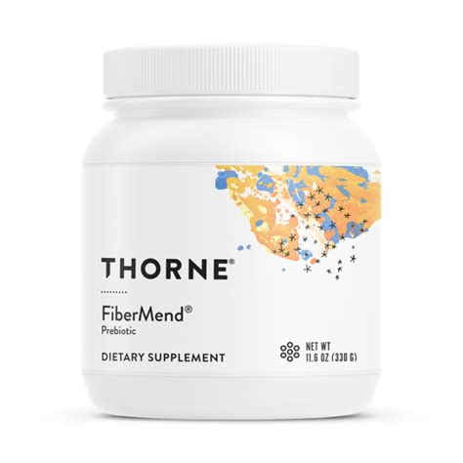
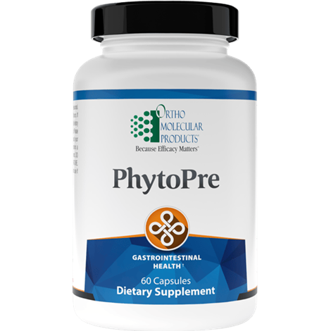
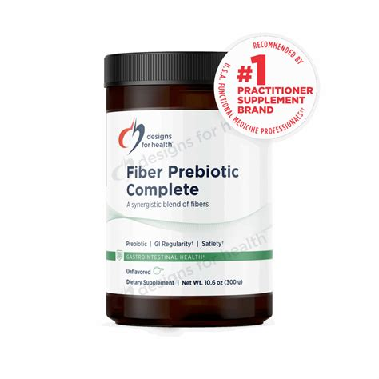
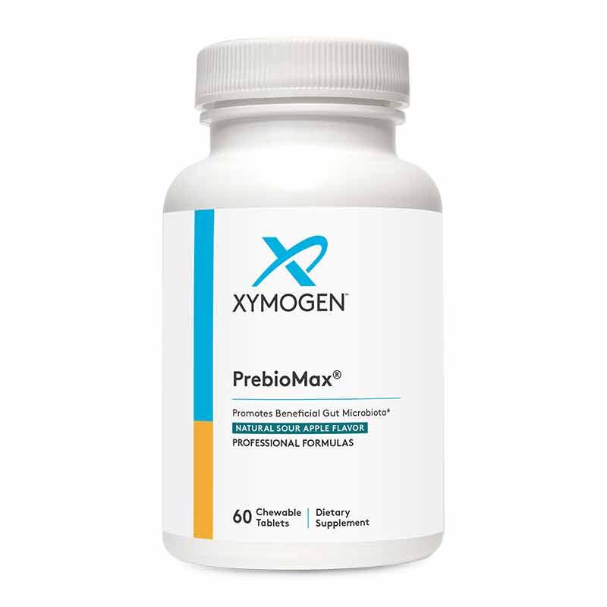
Prebiotics Are No Longer Niche – Clinical Use

Slide 16

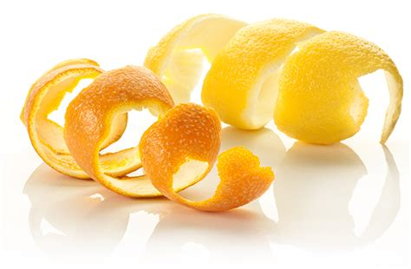
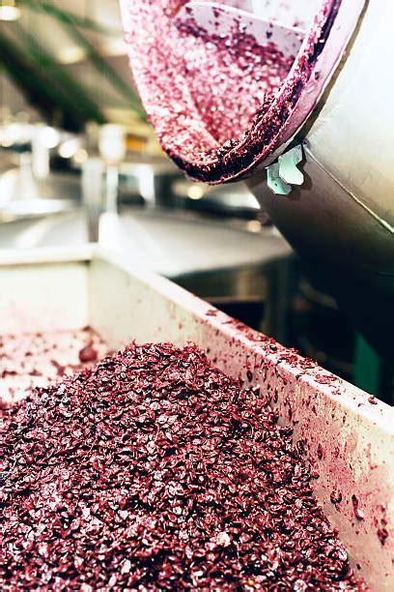
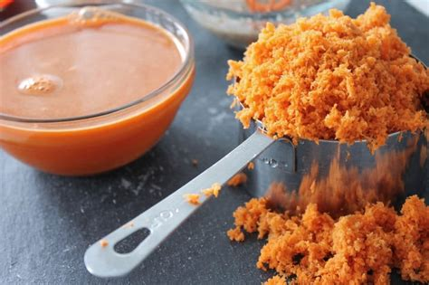
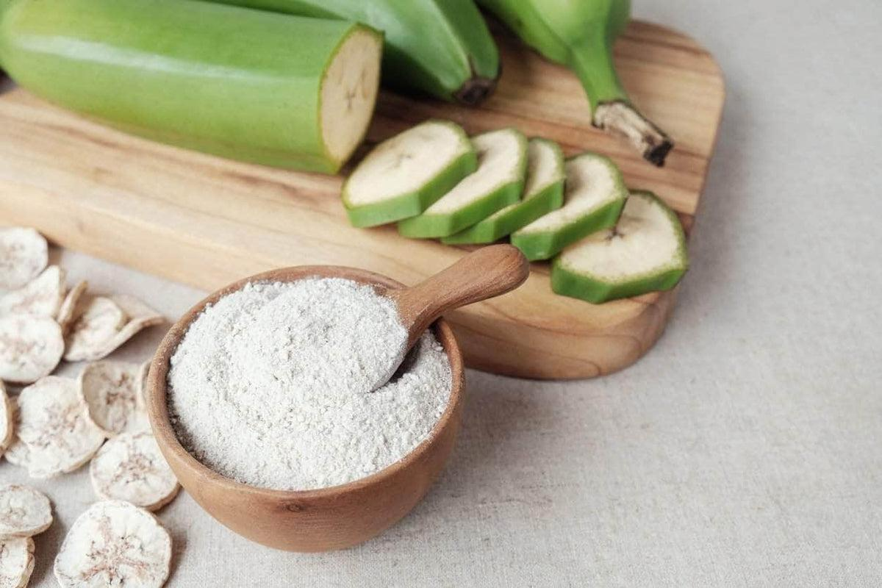
Macro Trends A Driving Theme– Upcycling, Plant-based, Whole Foods

Slide 17

FAMILIARITY: ALL USERS
Key Insight:
For all supplement users, familiarity with prebiotics continues to rise, now at 20% for top familiarity and 47% for top-two familiarity, up from 20% and 35%, respectively.
Note: All Respondents=4029. Question: “How familiar would you consider yourself regarding the use of these supplements?”

Slide 18
HEALTH CONCERNS AND WHAT THEY TAKE SUPPLEMENT FOR (TOP 10)
Key Insights:
Examining the white space between those who have consumed and those willing to consume for the top 10 concerns for all prebiotic users reveals opportunities for addressing anxiety or stress, insomnia/sleep problems, and hair loss.
Similarly, analyzing the ‘education’ opportunity space between all those with a concern and those willing to consume for a concern shows gaps in addressing anxiety or stress, skin health, hair loss, and insomnia/sleep problems.
Note: n=2525. Results shown top 10 health concerns. Health Concerns Question: “Which of the following health conditions or concerns currently impact or impacted you within the past year?”

Slide 19
WHY THEY TAKE PREBIOTICS: COUNTRY
Key Insights:
Gut health/digestion, overall nutrition support, and immunity health are the top three responses by a significant margin, with the former being the top response for most respondents except those from India, who instead rank immunity as number one.
It is notable to watch the emergence of weight management, stress/mood, brain health, inflammation and overall microbiome health.
Note: US n=637, UK n=265, DE n=253, IT n=295, KR n=344, AU n=325, IN n=406, All Respondents n=4029. Question: “Why do you take a prebiotic supplement?”

Slide 20
IMPORTANT LABEL CHARACTERISTICS:
US, AGE & GENDER
Key Insights:
In the US, overall, gut-friendly also is strong, especially among those aged 45-54 and 55+, roughly matching the global data. Females and males aged 18-25 prefer ‘prebiotic fiber’, with the former also favoring the term 'plant-based.' There is a notable increase among males aged 55+ for ‘labelled as a prebiotic,’ while males 26-34 and females 35-44 mainly choose a probiotic/prebiotic combination as their top response.
Note: US Female 18-25 n=38, US Male 18-25 n=47, US Female 26-34 n=79, US Male 26-34 n=85, US Female 35-44 n=73, US Male 35-44 n=113, US Female 45-54 n=75, US Male 45-54 n=56, US Female 55+ n=39, US Male 55+ n=31. Question: “When you select what prebiotic to purchase, what characteristics do you look for on the label?”

Slide 21

Female Prebiotic User · Ages 18–25
GUT-CURIOUS
WELLNESS STARTER
New to prebiotics and motivated by gut health and skin health — discovered through her HCP and social channels.
30%
Daily Supplement Use
$20–$40/mo
Avg. Monthly Spend
42% GLP-1
GLP-1 Usage

Slide 22

Male Prebiotic User · Ages 18–25
PERFORMANCE & IMMUNITY BUILDER
Immunity-first prebiotic motivation, performance-stack mindset, and the highest influencer sensitivity of any male cohort
28%
Daily Supplement Use
$40–$60/mo
Avg. Monthly Spend
40% GLP-1
GLP-1 Usage

Slide 23

Female Prebiotic User · Ages 26-34
INFORMED GUT OPTIMIZER
High supplement sophistication and the broadest prebiotic reason-set of any female cohort — driven by research, not trends.
39%
Daily Supplement Use
$30–$60/mo
Avg. Monthly Spend
29% GLP-1
GLP-1 Usage

Slide 24

Male Prebiotic User · Ages 26-34
DATA-DRIVEN MICROBIOME INVESTOR
The highest-spending male prebiotic cohort — analytically motivated, branded-ingredient aware, and the highest GLP-1 rate of any cohort
34%
Daily Supplement Use
$40–$80/mo
Avg. Monthly Spend
44% GLP-1
GLP-1 Usage

Slide 25

Female Prebiotic User · Ages 35-44
MICROBIOME SYSTEMS MANAGER
The highest total supplement usage of any female cohort and the strongest transparency sensitivity — research-driven and prevention-focused.
44%
Daily Supplement Use
$20–$40/mo
Avg. Monthly Spend
27% GLP-1
GLP-1 Usage

Slide 26

Male Prebiotic User · Ages 35-44
PERFORMANCE & PREVENTION OPTIMIZER
The highest transparency sensitivity for any prebiotic cohort globally (57%) — analytically engaged and optimizing for both performance and the long term.
37%
Daily Supplement Use
$30–$60/mo
Avg. Monthly Spend
40% GLP-1
GLP-1 Usage

Slide 27

Female Prebiotic User · Ages 45-54
COMMITTED GUT HEALTH MANAGER
Peak daily supplement consistency — HCP-guided, condition-motivated, and the most condition-specific prebiotic adopter of any female cohort.
48%
Daily Supplement Use
$30–$60/mo
Avg. Monthly Spend
22% GLP-1
GLP-1 Usage

Slide 28

Male Prebiotic User · Ages 45-54
PREVENTION-
FOCUSED GUT STRATEGIST
Establishing gut health as a core prevention tool — HCP-guided, cardiovascular-aware, and building long-term systemic health.
36%
Daily Supplement Use
$30–$60/mo
Avg. Monthly Spend
27% GLP-1
GLP-1 Usage

Slide 29

Female Prebiotic User · Ages 55+
LOYAL GUT HEALTH GUARDIAN
The most consistent daily supplement user of any female prebiotic cohort — HCP-anchored, gut-and-immunity focused, and deeply brand-loyal
62%
Daily Supplement Use
$30–$60/mo
Avg. Monthly Spend
16% GLP-1
GLP-1 Usage

Slide 30

Male Prebiotic User · Ages 55+
GUT-ANCHORED LONGEVITY SEEKER
The most HCP-reliant prebiotic cohort globally — gut health and immunity drive deep daily habits with strongest brand loyalty of any group.
48%
Daily Supplement Use
$20–$40/mo
Avg. Monthly Spend
17% GLP-1
GLP-1 Usage

Slide 31
What we’re watching…..
Smaller doses, precision interactions (pre and pro)
Playing in plant-based, leveraging the ‘right’ fiber story (pre)
Capitalizing on whole food/ circular, up-cycling (pre)
More than the gut (pre, pro, post)
Multi-microbiomes (pre, pro, post)
Smart synbiotics (pre, pro, post)
Integration with diagnostic tools (pre, pro, post)
Pet markets *pre, pro, post)
Reduction/elimination of non-responders >> will it colonize? (pre, pro, post)
Beverages and more (pre, pro)
Structural and physical aspects – multidimensional (pre, post)
    Watch this space!

Slide 32



Thank you!
Len Monheit
Executive Director
len@itcstrategy.com
Paula Guerra
Science & Technical Lead
pguerra@nutrasource.ca
Steve Imgrund
Communications Director
steve@itcstrategy.com
Maggie Feikes
Project Specialist
maggie@itcstrategy.com

Slide 33

Prebiotic Resistant Starch:
Science, Benefits & Applications
Rhonda S. Witwer
Executive Director
www.ResistantStarchResearch.com
April 21, 2026

Slide 34
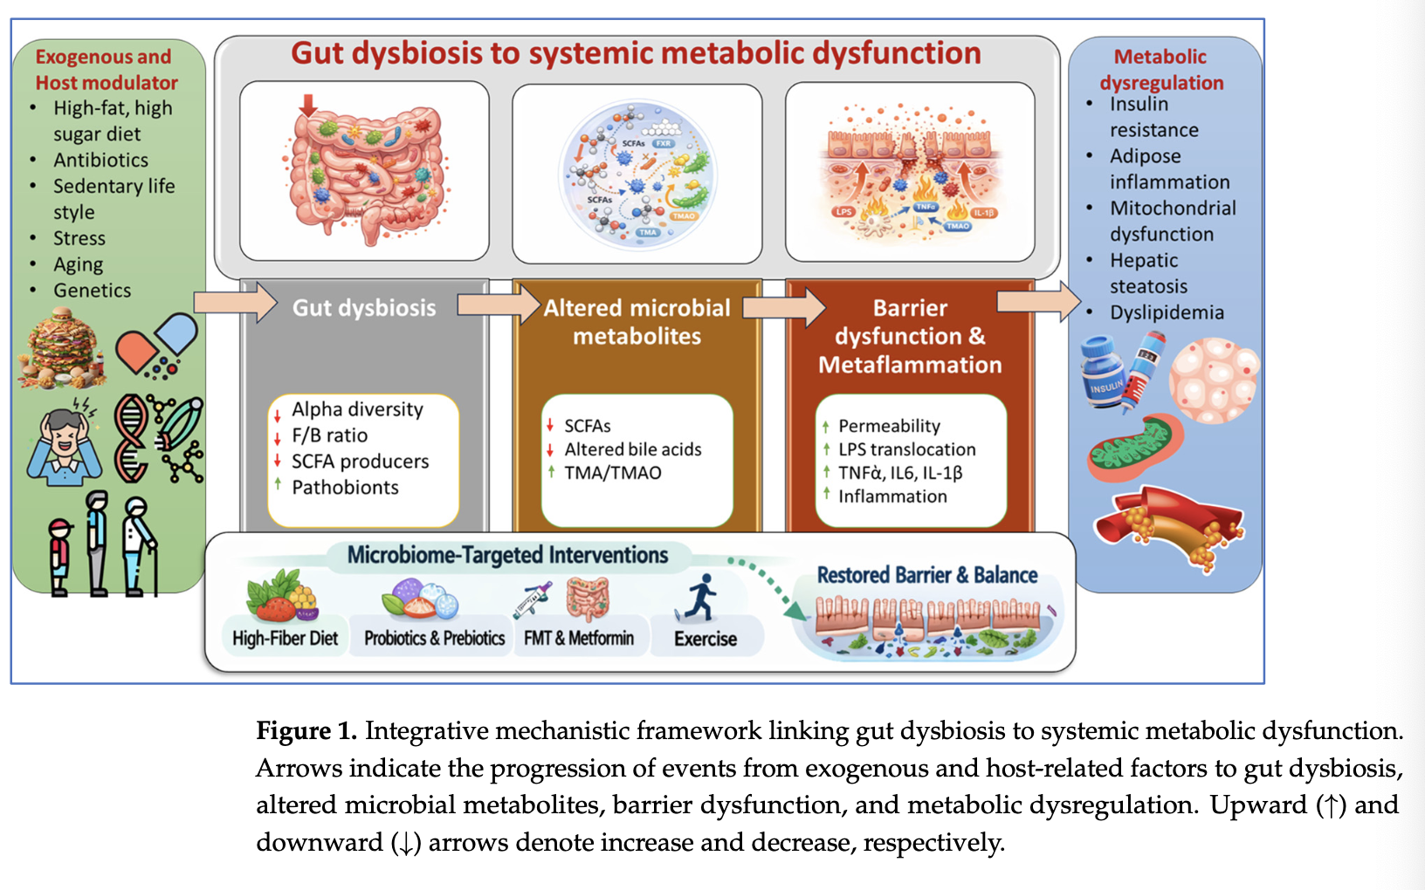
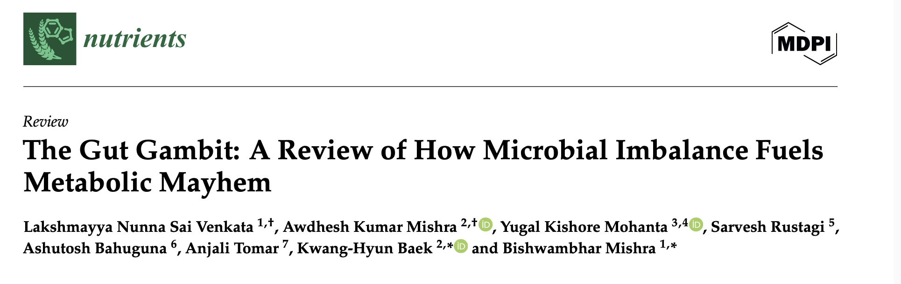

Gut Dysbiosis ➔ Metabolic Dysfunction
“Therapeutic strategies targeting the gut microbiota, such as prebiotics, probiotics, postbiotics and fecal microbiota transplantation, hold promise for mitigating oxidative stress and inflammation associated with metabolic syndrome.”

Slide 35
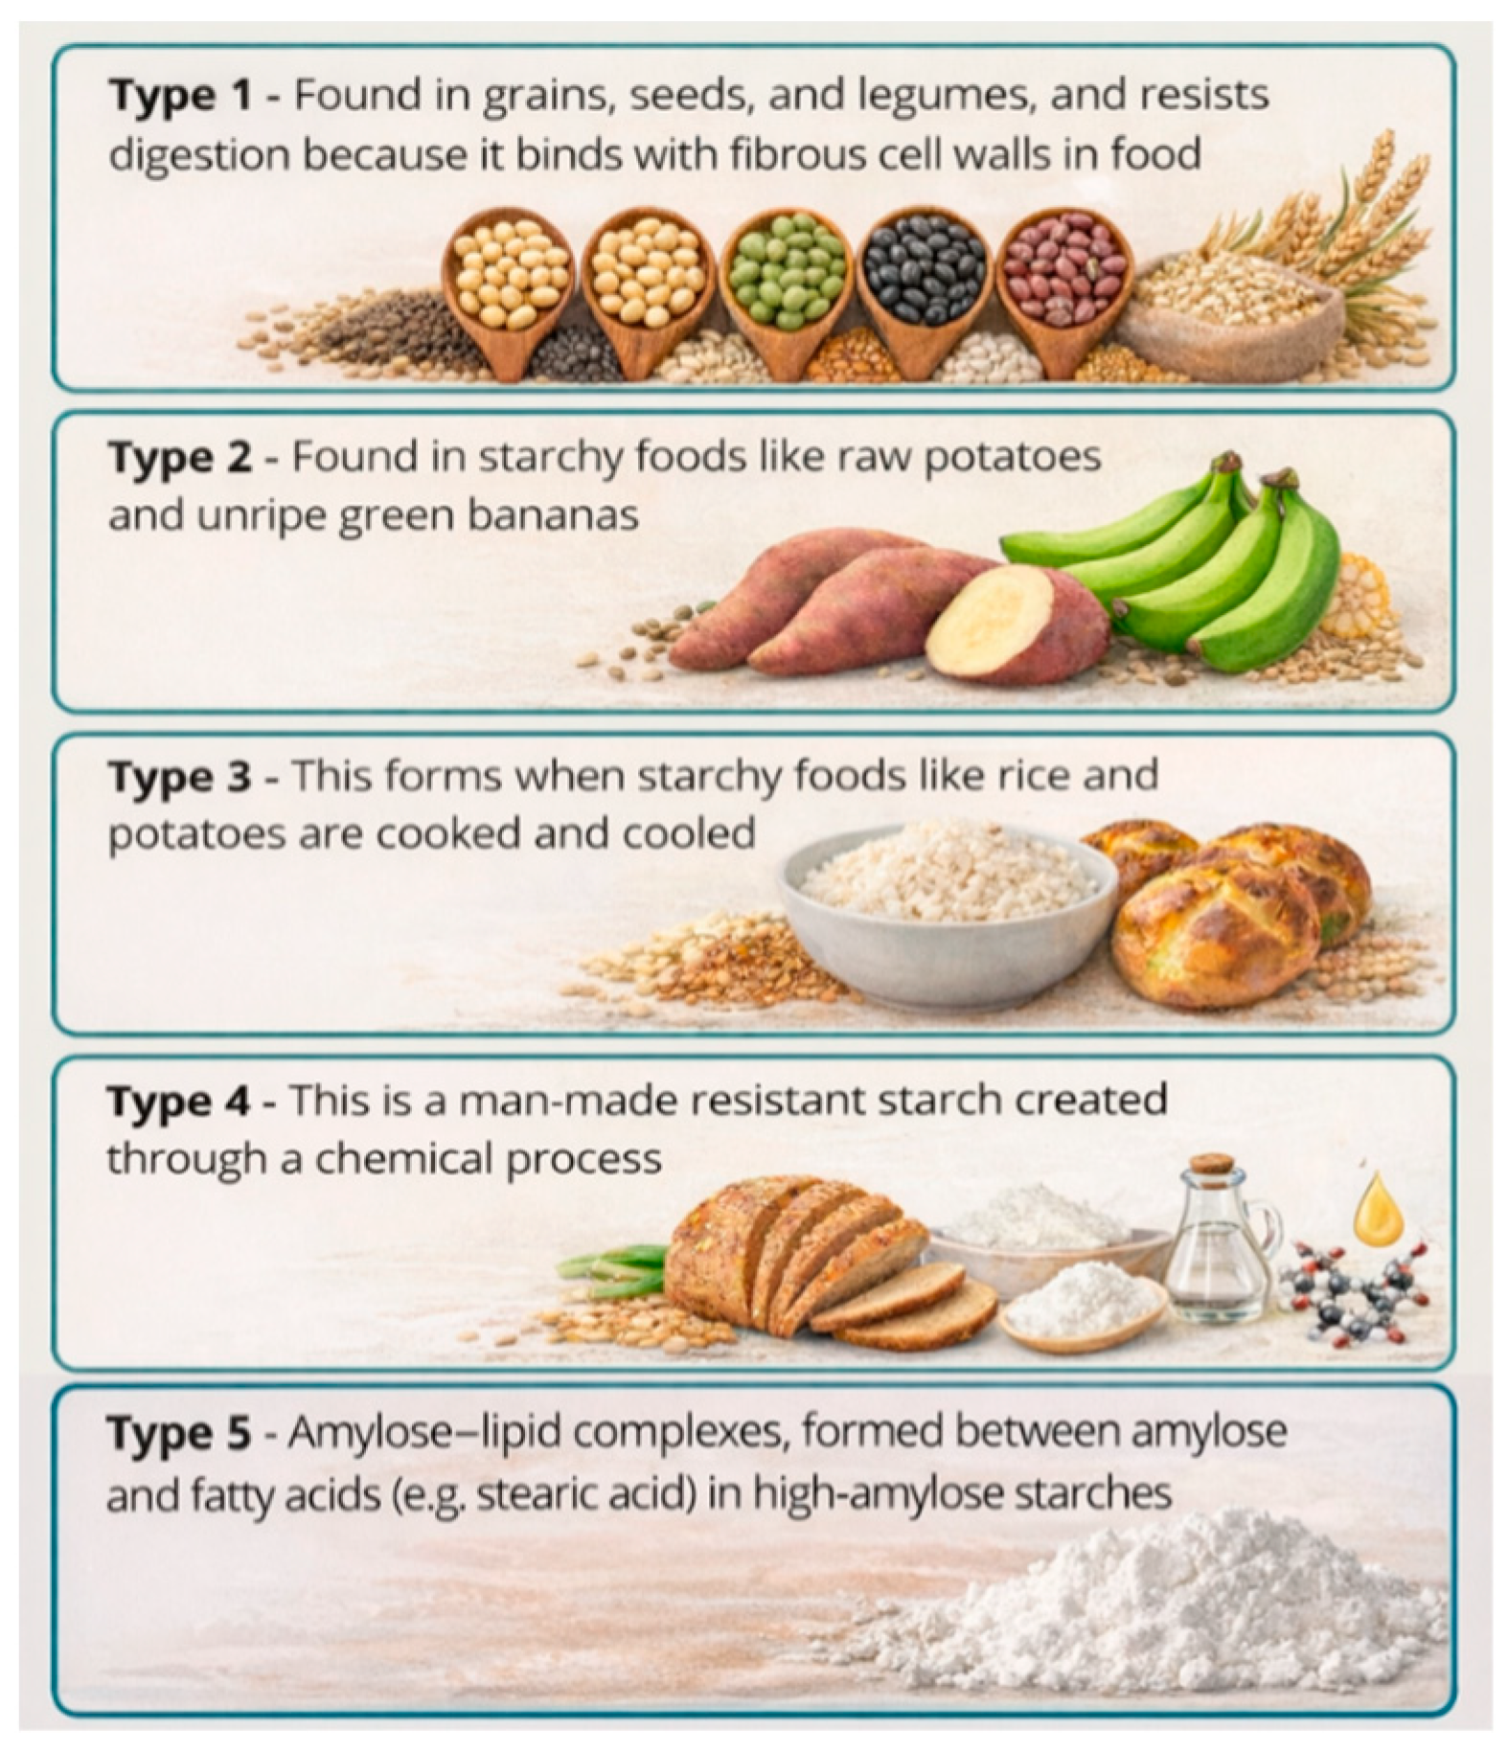
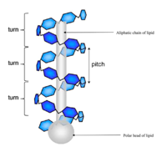
Resistant Starch: A Category with 5 Different Types
Occurrence
+
RS 1: Physically inaccessible
Recognized Prebiotic
RS 2: Resistant granules
RS 3: Retrograded starch
RS 4: Chemically modified starch
RS 5: Starch/lipid complexes
Vilela A. et al., Foods, 2026; 15(2): 277.

Slide 36

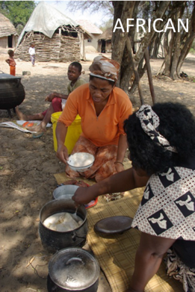
Resistant Starch is Missing in Processed Food
Dr. Stephen O’Keefe
University of Pittsburgh
Unprocessed foods are rich in resistant starch (RS)
  Traditional African diet contained 28 g fiber + 38 g RS
  Intact whole grains, bananas, beans, seeds, potatoes and other tubers deliver RS1 and RS2. Cooked & cooled foods deliver RS3.
American ultra-processed foods are missing RS
  African American diets contained an avg. 14 g fiber + 5 g RS
  RS from cooked & cooled foods (bread crust, cereal, baked goods), vegetables, bananas, legumes
Lack of resistant starch is linked to many metabolic diseases -
Restoring it into foods improves metabolic health.
O’Keefe S. et al, “Fat, fibre and cancer risk in African Americans and rural Africans. Nat Commun, 2015:6:6342. Doi: 10.1038/ncomms7342.

Slide 37
Fermentable Fiber’s Metabolic Pathway
Insoluble RS is fermented slowly & well tolerated at higher doses
  Remodels Microbiome
Gut Function
& Barrier
Improves Metabolism
02
04
06
P
Gut
M
G
SCFA
Genes
01
03
05
Low Glycemic
Short-Chain Fatty Acids & Other
Metabolites
Nutrigenomics
www.ResistantStarchResearch.com

Slide 38
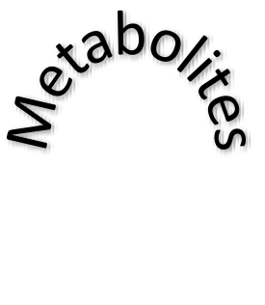
Prebiotic Resistant Starch Improves Gut Health
Healthy Populations
Increases fecal bulk and SCFAs, reduces pH
Remodels gut microbiome
Promotes regularity
Shifts microbiome in elderly toward that of younger adults
Improves hydration and performance (SCFA-RS4)
Maternal
Gut
Gut Health
Immune
Brain
Diseased Populations
Reduces diarrhea, treats constipation
Malnourished children gained more weight with RS
(formulation included green banana powder & chickpea flour)
Alleviates IBD and Crohn’s diseases
Reduced upper GI cancer in people with Lynch Syndrome
(high genetic risk for cancer)
Intestinal permeability - Improves/strengthens
the intestinal barrier in autoimmune diseases
RS
Insulin Pancreas
CV
Kidney, Liver, etc.
Weight

Slide 39

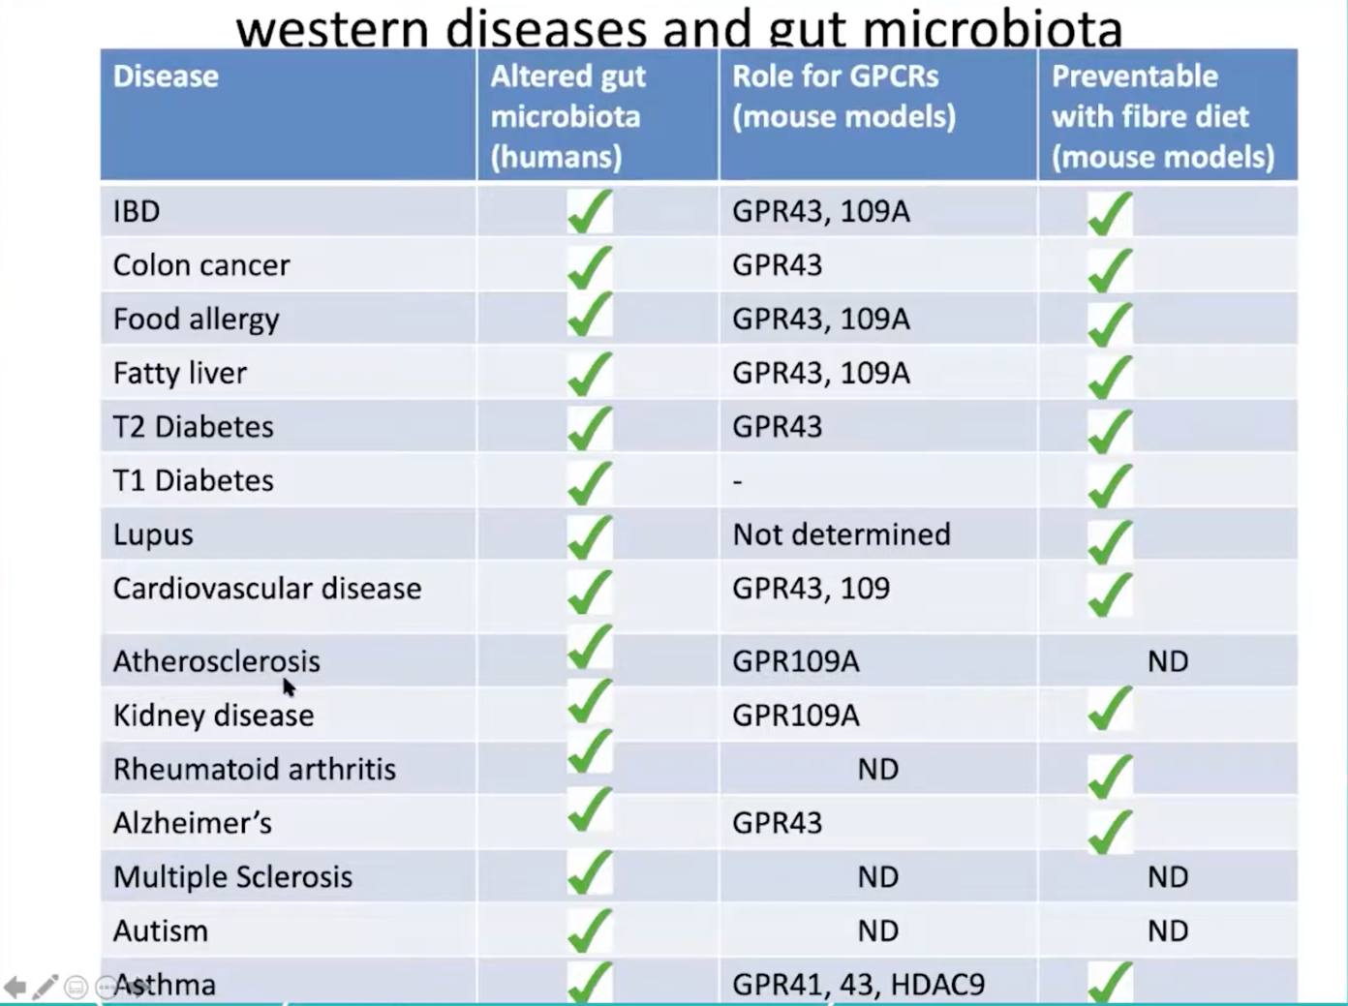
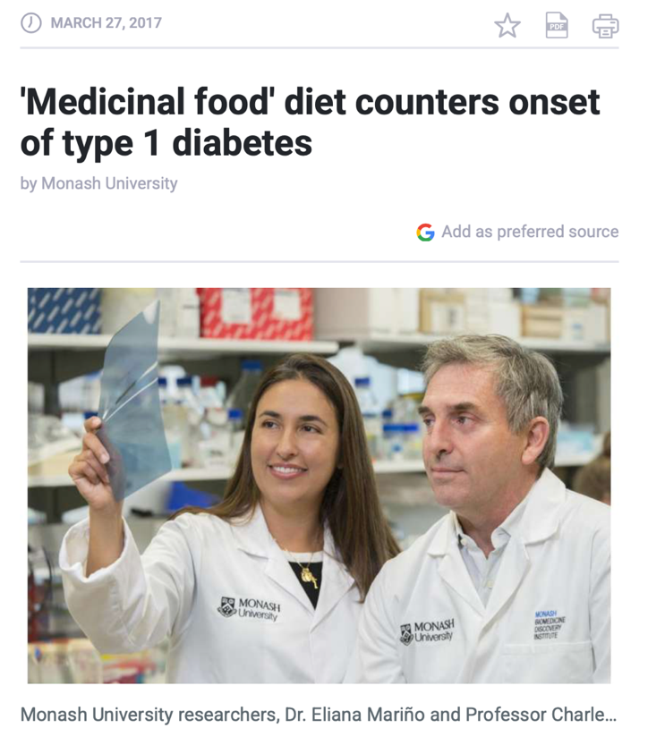

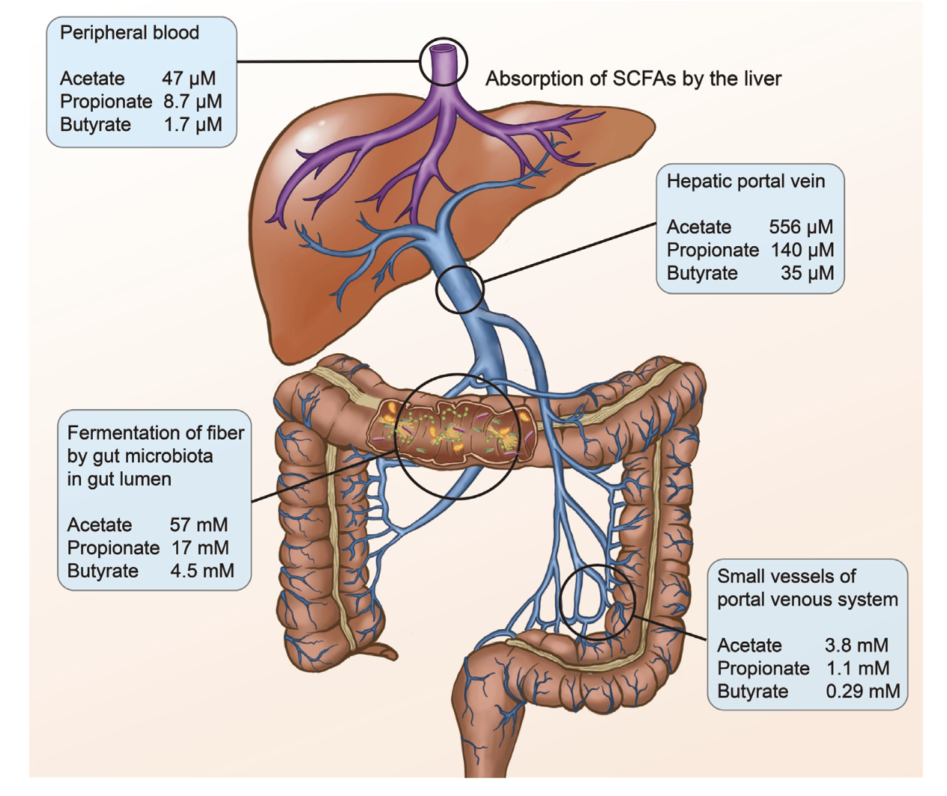

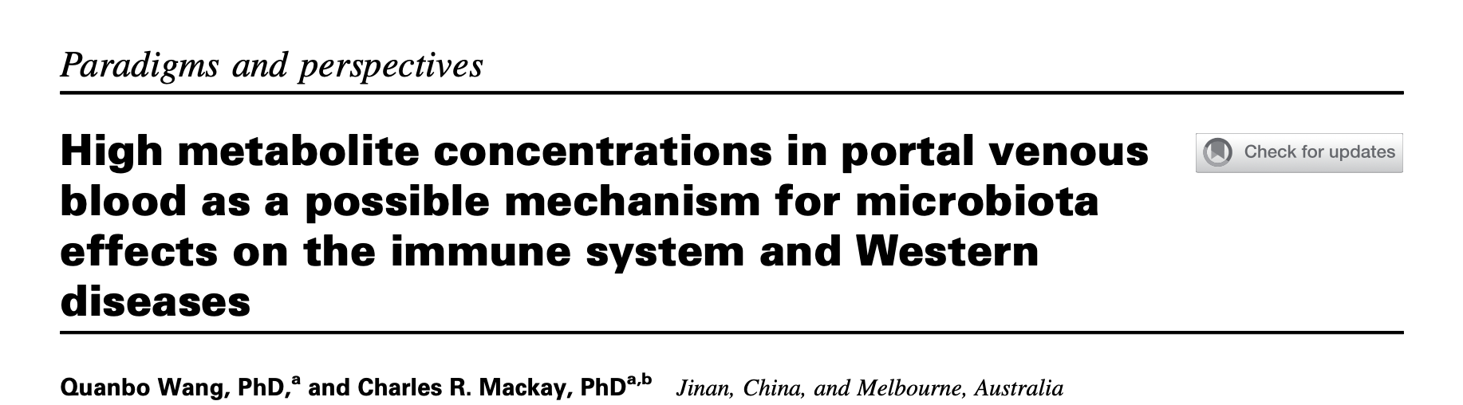
Microbial Metabolic Activity (SCFAs) and Gut pH
Modulate Immune Tone
Dr. Charles Mackay
Monash University
Bacterial metabolites, short-chain fatty acids, are present at exceptionally high concentrations in the portal vein circulation…Deficiency of SCFAs would lead to proinflammatory immune cell skewing through insufficient G-protein coupled receptor (GPCR) signaling, or lack of histone deacetylase (HDAC) inhibition. This model helps explain how the gut microbiome may be affecting peripheral immune cells, and consequently Western lifestyle diseases, most of which are immune based.
➔ His research uses resistant starches engineered to release high levels of short-chain fatty acids (SCFA-RS4: HAMSAB, HAMSA, HAMSB, HAMSP).
Notes:
G-protein-coupled receptor, also known as FFAR2 (Free Fatty Acid Receptor 2) plays a crucial role in energy homeostasis. It regulates inflammatory responses, including neutrophil migration, and influences metabolic processes like fat accumulation. It is physically located on immune cells and metabolic tissues (i.e., adipocyes and the intestine epithelial cells)

Slide 40
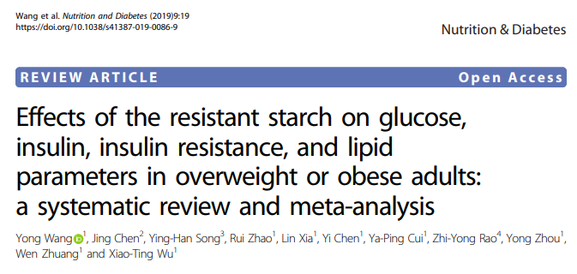
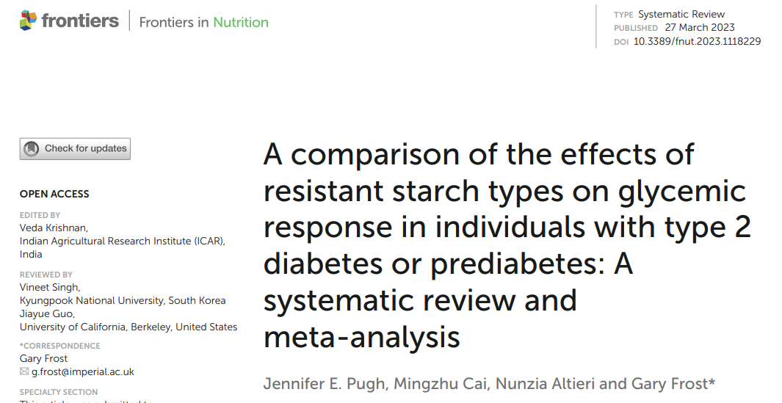
Prebiotic Resistant Starch Helps Maintain Insulin Sensitivity, Reduces Risk of T2D & Reduces LDL-Cholesterol
2016: the FDA approved a qualified health claim: limited evidence suggests that (RS2) resistant corn starch reduces the risk of type 2 diabetes
  8 clinicals in healthy, overweight or insulin resistant populations
2019: 13 case-control clinical studies analyzed (428 subjects with BMI ≥ 25)
RS2/RS3 ↓ fasting insulin in overall and stratified (diabetics and nondiabetics)
RS2/RS3 ↓ fasting glucose in overall and stratified analysis for diabetic trials
RS2/RS3 ↑ HOMA-S% (peripheral insulin sensitivity)
RS2/RS3 ↓ HbA1c, HOMA-B (beta-cell function) and LDL-C concentration
2023: 36 randomized clinical trials analyzed in March 2023 (982 people). 31 clinical trials in the meta-analysis.
RS1/ RS2 ↓ acute & chronic postprandial blood glucose
RS2 improved acute postprandial insulin response and improved
chronic fasting glucose and insulin
Benefits in individuals with T2D surpassed those seen with prediabetes

Slide 41



SCFA-RS4 ↓ Blood Pressure in People with Hypertension
Dr. Francine Marques
Monash Univ.
R, PC, DB, CO Clinical Trial
  20 adults with untreated hypertension
  40 g/day of ingredients for 3-weeks (3-week washout)
    SCFA-RS4 acetylated and butyrylated high amylose cornstarch (HAMSAB)
    Placebo = digestible maize starch
  Baked into foods (muffins, Arancini balls, frittata, tuna burger)
Results
  ↓ Systolic blood pressure (mean difference -6.1 mmHg);
  Non-significant ↓ in Diastolic blood pressure (-2.4 mmHg at day 14)
  ↑ levels of plasma acetate and butyrate
  Shifted the microbial ecosystem
    Expanded prevalence of SCFA producers
  Underlying Diet was Important!
    Responders (n=16) ate more refined grain servings;
    Non-responders (n=6) ate more wholegrains
R = Randomized, PC = Placebo Controlled, DB = Double Blind, CO = Crossover
https://www.youtube.com/watch?v=PalzRXC-YVo

Slide 42



High Amylose Corn RS2/RS3 Reduced Upper GI Tract Cancer in People with Lynch Syndrome by 60%
R, DB, PC Multi-center intervention in Lynch Syndrome
adults (CAPP2)
  30 g/day high amylose corn RS2:RS3 (n=463)
  Placebo = digestible cornstarch (n=455 people)
Consumed for 29 months (mean)
10-year follow-up (after ending supplement):
  60% fewer upper GI cancers (stomach, duodenal, bile duct and
  pancreatic cancers)
    These cancers are detected later and kill more people than
    colorectal cancer
  No impact on colorectal cancer
  “The supplement used in CAPP2 delivered a daily dose of RS
  equivalent to eating a green tipped banana. Thus, the potential health
  benefits observed in this intervention study might be achievable in the wider
  population of LS gene carriers with a modest dietary change.”
Dr. John Mathers,
Newcastle University
R = Randomized, DB = Double Blind, PC = Placebo Controlled, CAPP = Concerted Action Polyp Prevention
Notes:
CAPP – Colorectal Adenoma/carcinoma Prevention Programme

Slide 43



Tapioca RS3 Improved Parkinson’s Disease
Open label, single-center, R, PC, parallel, longitudinal trial
  74 adults with Parkinson’s Disease, aged 40-85 years old
  Three arms – Mixed diet control (26), RS supplement group (25), high-fiber group (23)
  Two-week short-term intervention with all meals provided by in-house kitchen
  48-week Long-term intervention for 10 in RS supplement group
  40 week treatment + 8 week post-intervention wash-out:
    SymbioIntest® containing 5 g tapioca RS3, and the 60 microns of biotin. One sachet of SymbioIntest stirred into a glass of non-sparkling water and drunk with main meals three times/day = 15 g RS3/day.
Results
ST intervention – modifications in microbiome and metabolic activity
LT RS intervention
  Remodeled gut microbiome
  ↑ fecal levels of total SCFAs and acetate
  ↑ blood levels of anti-inflammatory APOA4 and chaperone HSPA5 proteins
  Recovered intracommunity signaling, starch and sucrose metabolism
  Beneficial effect on both motor & non-motor symptoms
Dr. Brit Mollenauer
University Medical Center Gottingen
Michael J. Fox Foundation

Slide 44

Metabolic Benefits of Prebiotic Resistant Starch*
*RS2 & RS3 only,
(Phospyorylated RS4 needs data)
Offspring Benefits
Gut
Prebiotic
Improves organ formation to reduce metabolic diseases later in life
Maternal
Gut health & function (regularity, constipation), strengthens barrier
Immune
Brain
Cognition, aging
Brain
Immune Support
RS
Reduces inflammation
Modulates GPR43 & GPR109A
Insulin Pancreas
Cardiovascular
CV
Glycemic Control
Blood pressure, lipids
Kidney, Liver, etc.
Improves peripheral insulin sensitivity, pancreatic insulin production
Weight
Weight
Internal organs
Reduces fat in NAFLD, metabolites harmful to the kidneys, etc.
Satiety & Reduces visceral and subcutaneous fat

Slide 45
Resistant Starch Ingredients & Applications
Insoluble, replaces flour in many food formulations
High amylose varieties of corn, wheat, barley
  Higher gelatinization temperature helps maintain RS2 content in processing
Applications
  Baked Goods,
  i.e., bread, crackers, cakes, muffins, cookies, tortillas, pizza crust, pretzels, pastries…
  Bakery mixes
  Pasta
  Snacks
  Prepared Meals
  Breakfast cereals (lightly processed)

Slide 46
Conclusion – Improve Metabolism in Carbohydrate-Rich Foods with Prebiotic Resistant Starch
Feed the Gut
Maintain Blood Sugar Metabolism
Support the Heart
Protect the Brain & Kidneys
Resistant Starch was abundant in food but has been lost in processing
Natural RS Improves Metabolism
  10-30 grams RS/day drives metabolic benefits in clinical trials
  RS’s fermentation shifts nutrigenomic gene expression
  SCFAs in portal vein shifts systemic immunity
Opportunity to Promote Metabolic Health in Processed
Foods with Prebiotic Resistant Starch
  Natural resistant starch has published scientific data
  Well designed clinical studies in processed foods with natural RS can help defend refined carbohydrates as part of healthy diet
  Promote resistant starch as beneficial dietary component
    Quantity for benefits > quantity in serving
Resistant
Starch
Metabolic
Matrix

Slide 47
ITC 2025 Functional Food and Beverage Survey
Prebiotic Users Expected Benefits by Country (Top 10)
Key Insights:
The top responses in both countries are gut health followed by immune health then a healthy metabolism; UK responses are higher than US responses for the first two.
Source of fiber is next in the US, while in the UK, the next response is overall nutritional support followed by mental wellbeing.
Note: US n=661, UK n=620, All Prebiotic Users=1281.
Question: “What benefits are you looking for when you choose to consume foods/beverages that contain prebiotics?”
Notes:
ITC = Industry Transparency Center

Slide 48
Thank you!
Contact Information
Rhonda S. Witwer
Executive Director
www.ResistantStarchResearch.com
Email: rhondawitwer@gmail.com

Slide 49
Complex Dietary Fibers: Structure, Function, and Microbiome Impact
Tianming Yao
Assistant Professor, Rutgers University
04/21/2026
Notes:
Good evening everyone. thanks Doctor Tan for the introduction. I'm glad to have the opportunity to connect to the CAFS community and present the research from our group! And today my topic is about Cold plasma assisted polysaccharide extraction for enhanced microbiome function. My talk will be a little bit different compared to the previous speakers. Since I'm trying to utilize these emerging food processing methods and connected with the application in food and human health

Slide 50


Gut microbiome and health
Notes:
Before move on to the effect of CP on pectin structure modification, I’d like to give another background in gut microbiome and structural features of polysaccharides.

Slide 51

Nature Reviews Microbiology, 2024, 1-14.
Notes:
This slides is just a recap of the plant-derived dietary fibers, and how complicate their chemical structures are.
Of most higher plant, the cell wall is composed by cellulose fibril. Other molecules are tied up around the fibril, including pectin and hemicellulose. They are very complicated molecular structures, since they are composed by different monomeric sugar units and linked by diverse linkage bonds. Most of these dietary fiber molecules have the branched structures. Remember that arabinoxylan has ...
Cellulose are not fermentable in human gut!

Slide 52

Polysaccharide as a gut microbiome modulator
Porter, N. T., & Martens, E. C. (2017) Annual review of microbiology, 71(1), 349-369
Nat. Rev. Microbiol , 2012, 10(5):323-335
Notes:
Not all fibers are equal
starch vs non-starch polysaccharide.
So many different types of fiber in food.
Simple structure vs complex branching structure – their different ecological role in gut
The current guideline is more on the quantity recommandation 28-35 g/day, but lack the information on which type of fiber to intake.

Slide 53




Effect of fiber molecular structure
Carbohydrate active enzymes (CAZymes)
GH: Glycoside Hydrolase
Lindemann. (2020) Current opinion in Chemical Engineering
Martens, E. C. et al. (2014) J. Mol. Biol., 426(23), 3851-3865

Slide 54







Dietary fiber and gut microbiome
Fiber structures and gut microbiome
Complex dietary fiber (AX) maintain a more diverse microbial community than simple fiber (Inulin) and with higher metabolic outputs.
FEMS microbiology ecology, 2020. 96(9), fiaa158.
Notes:
The molecular complexity of dietary fiber and their role in maintain the diversity of the community.

Slide 55



Dietary fiber and gut microbiome
Inulin/FOS – concerns
Bloating effect, rapid fermentation.
Promotion of Proteobacteria, which is not a beneficial microbial phylotype.
FEMS microbiology ecology, 2020. 96(9), fiaa158.
Cell, 2018. 175(3), 679-694.
Notes:
Inulin diet promote Proteobacteria. and induced liver damage.

Slide 56



How does the fine complex fiber linkage structure shape distinct fecal microbial communities?
Arabinoxylan 1 isolated from red sorghum bran (RSAX)
Slightly more complicated side-chain regions
Arabinoxylan 2 from white sorghum bran (WSAX)
With less complicated linkages but more simple side-chain structures
Yao et al. (2023)
Carbohydr. Polym.
Notes:
The next question I want to study is how fine fiber structures would shape distinct microbial community, and also test whether our in vitro model could resolve different microbial responses when growing on a same type of substrates with small differences.
Here I used ...

Slide 57

Yao et al. (2023) Carbohydr. Polym.
Notes:
The result clearly showed different community evolution trajectories over 7 days. RSAX maintain a microbiota with ...
Besides the selection of different microorganisms, we also found distinct microbial functions in terms of different metabolites detected in RSAX and WSAX cultures.

Slide 58


Fiber-rich foods
Vegetables and fruits are emphasized in the new guideline
(Maisonnier et. al. 2002)
Notes:
Polysaccharides are quite rich in Byproducts include those pomace from juice and beverage production, such as apple pomace. Other fruit pomace include cranberry and blueberry, and all of these fruit derived pomace are rich in dietary fiber called pectin. pomace is widely applied in food industry as stabler, thickener and gelling agents and can be just a source of supplementary of dietary fiber. There are different pecin rich byproducts as just mentioned in fruit and vegetables. Some other By products such as. wheat bran. These are cereal grains by-products from the milling industry. They are rich in hemicellulose. One example is arabinoxylan which is abundant in corn bran, wheat bran and it's being considered as the next generation prebiotic fiber because it has a much stronger microbiome selection effect compares to the current widely applied prebiotic fibers such as inulin or FOS.

Slide 59


Impact of Food Processing on Polysaccharide Structure
RG
HG
Changes of esterification on pectin backbone
Modify the ratios of domain components (HG/RG ratio; monosaccharide composition)
Regulate the branching complexity
Nature Reviews Microbiology, 2024, 1-14.
Notes:
Back to our apple pectin extracted from pomace. Apple pectin is known to have the most complex structure among the natural food fiber source.
We would expect CP modify the structure of 1, 2, 3, ... and therefore exert different gut microbiome modulation effect, such as ...

Slide 60




Changes of soluble fiber composition after food processing
Schematic of a single-screw extruder
High temp
High mechanical shearing force
Alters fermentable fiber structures
(Yao et al., unpublished data)

Slide 61
Take home messages
Dietary fibers exhibit complex molecular structures.
Greater structural complexity in dietary fiber is associated with increased gut microbiota diversity.
Subtle variations in molecular structure can significantly influence gut microbiome responses.
Future efforts should focus on optimizing food systems to preserve or enhance microbiome-modulating functionality through controlled processing.

