Slide 1
Complex Dietary Fibers: Structure, Function, and Microbiome Impact
Tianming Yao
Assistant Professor, Rutgers University
04/21/2026
Notes:
Good evening everyone. thanks Doctor Tan for the introduction. I'm glad to have the opportunity to connect to the CAFS community and present the research from our group! And today my topic is about Cold plasma assisted polysaccharide extraction for enhanced microbiome function. My talk will be a little bit different compared to the previous speakers. Since I'm trying to utilize these emerging food processing methods and connected with the application in food and human health

Slide 2
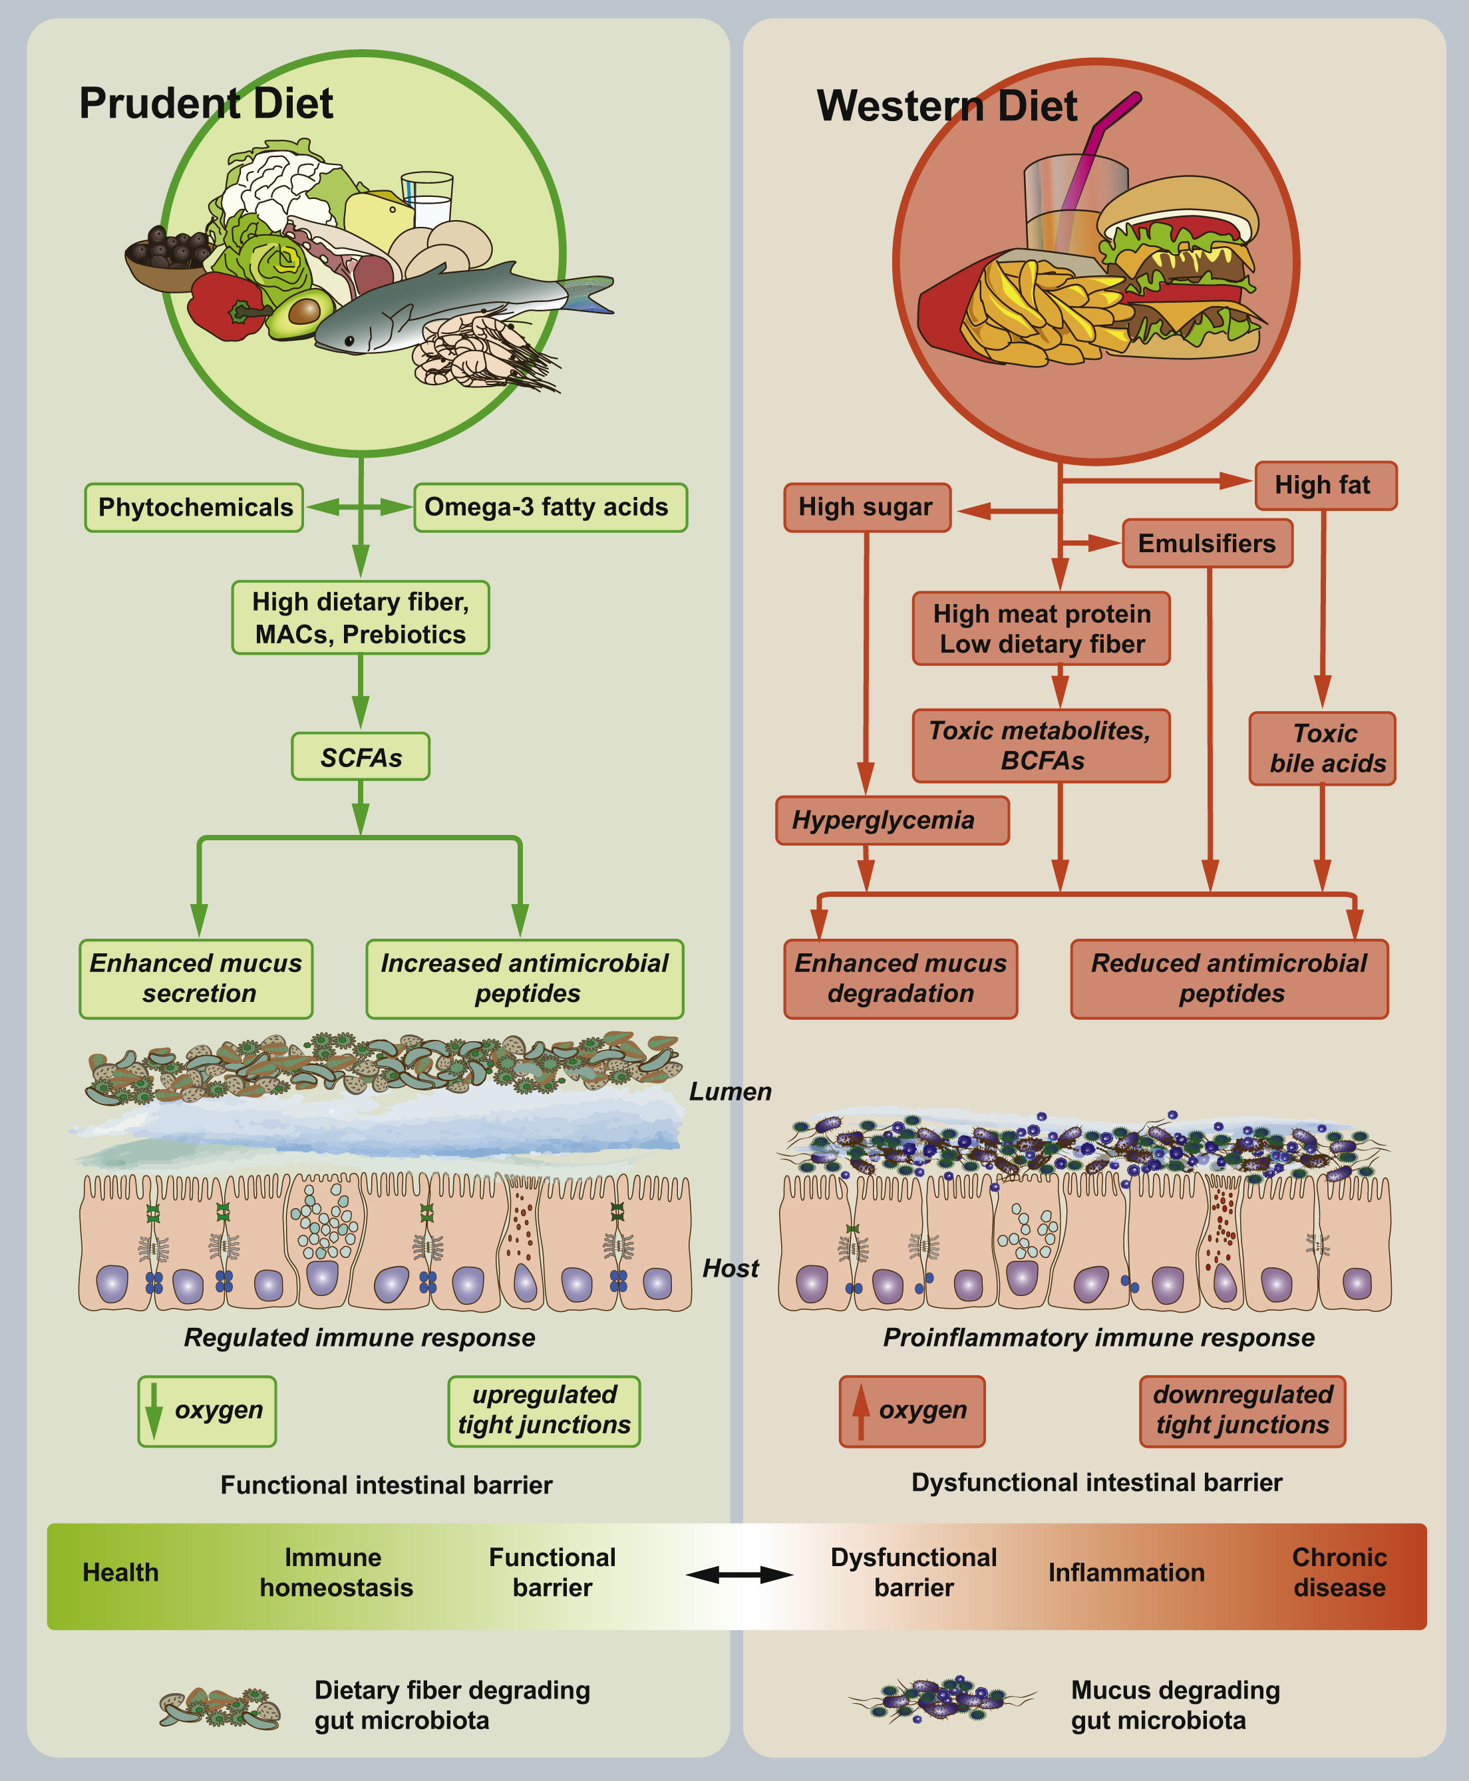
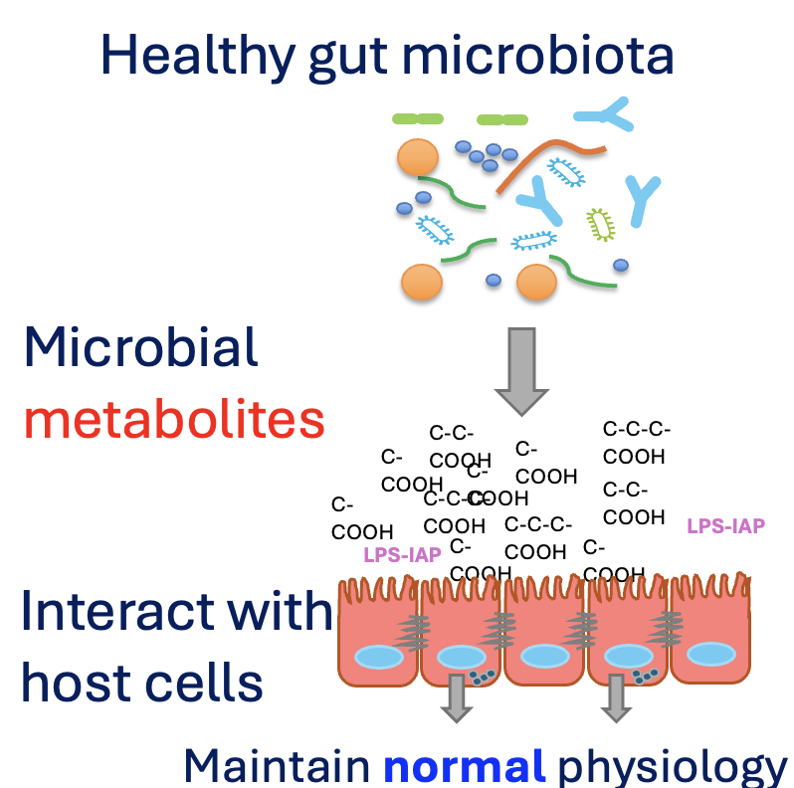
Gut microbiome and health
Notes:
Before move on to the effect of CP on pectin structure modification, I’d like to give another background in gut microbiome and structural features of polysaccharides.

Slide 3
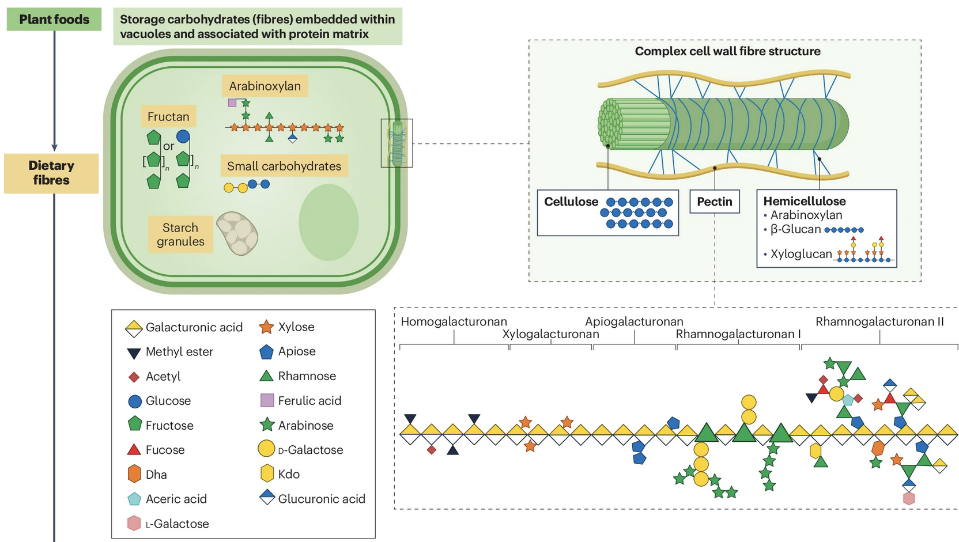
Nature Reviews Microbiology, 2024, 1-14.
Notes:
This slides is just a recap of the plant-derived dietary fibers, and how complicate their chemical structures are.
Of most higher plant, the cell wall is composed by cellulose fibril. Other molecules are tied up around the fibril, including pectin and hemicellulose. They are very complicated molecular structures, since they are composed by different monomeric sugar units and linked by diverse linkage bonds. Most of these dietary fiber molecules have the branched structures. Remember that arabinoxylan has ...
Cellulose are not fermentable in human gut!

Slide 4
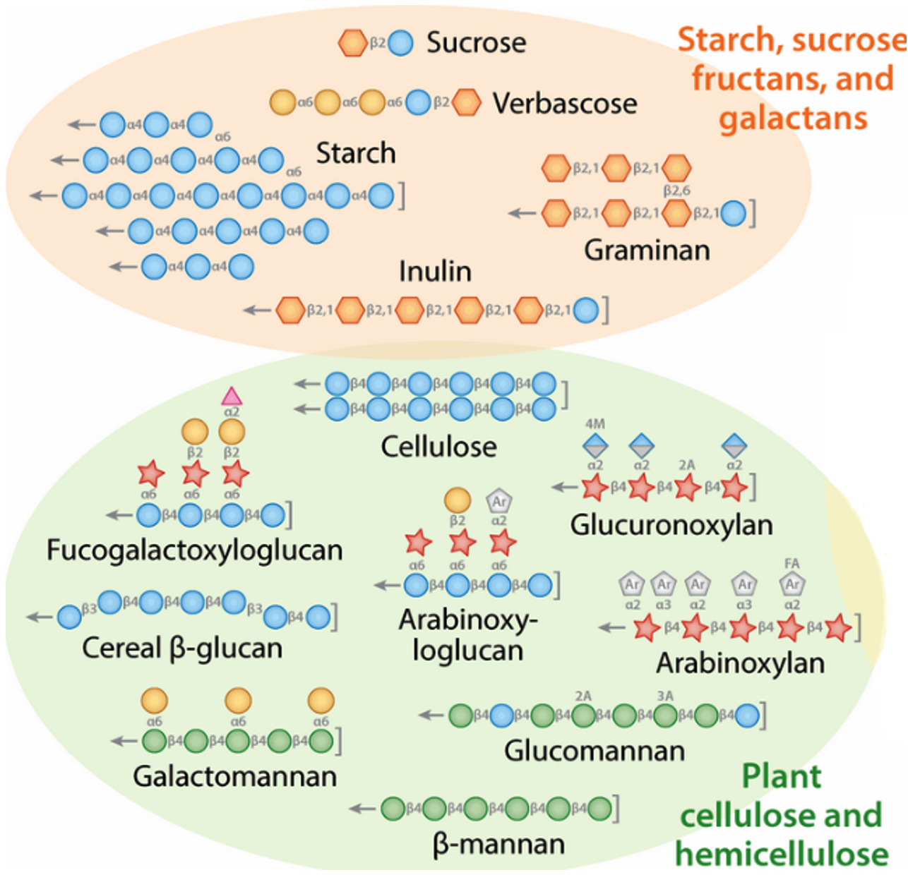
Polysaccharide as a gut microbiome modulator
Porter, N. T., & Martens, E. C. (2017) Annual review of microbiology, 71(1), 349-369
Nat. Rev. Microbiol , 2012, 10(5):323-335
Notes:
Not all fibers are equal
starch vs non-starch polysaccharide.
So many different types of fiber in food.
Simple structure vs complex branching structure – their different ecological role in gut
The current guideline is more on the quantity recommandation 28-35 g/day, but lack the information on which type of fiber to intake.

Slide 5
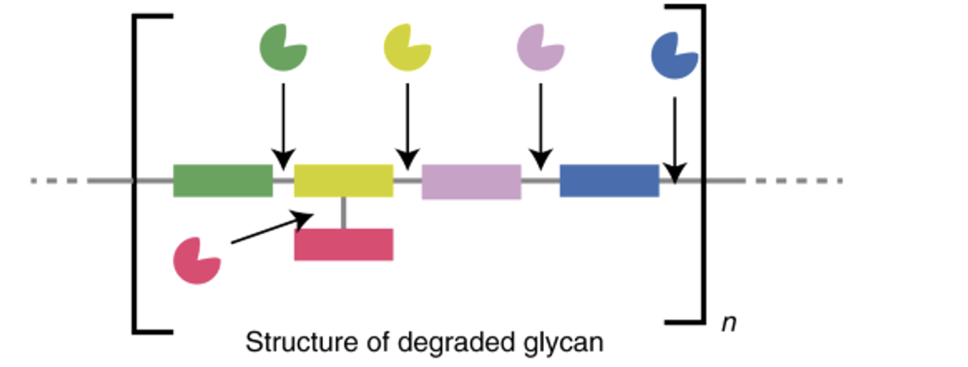
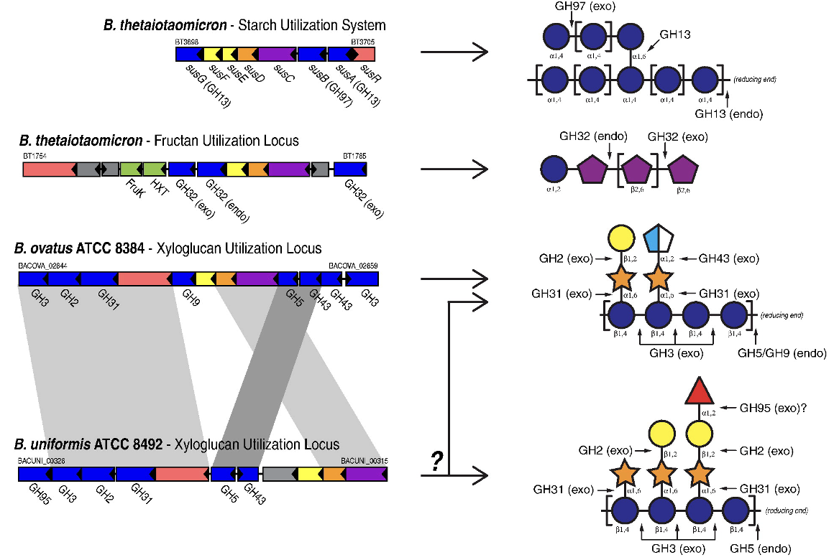
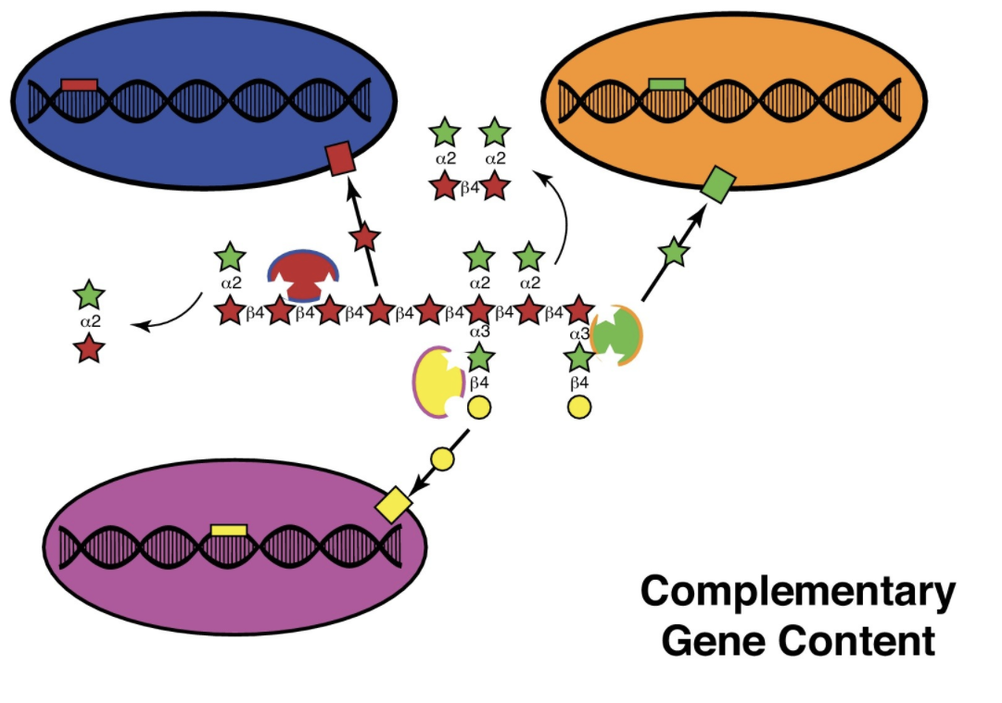
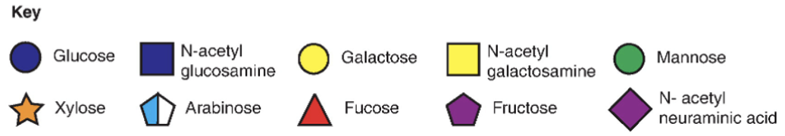
Effect of fiber molecular structure
Carbohydrate active enzymes (CAZymes)
GH: Glycoside Hydrolase
Lindemann. (2020) Current opinion in Chemical Engineering
Martens, E. C. et al. (2014) J. Mol. Biol., 426(23), 3851-3865

Slide 6
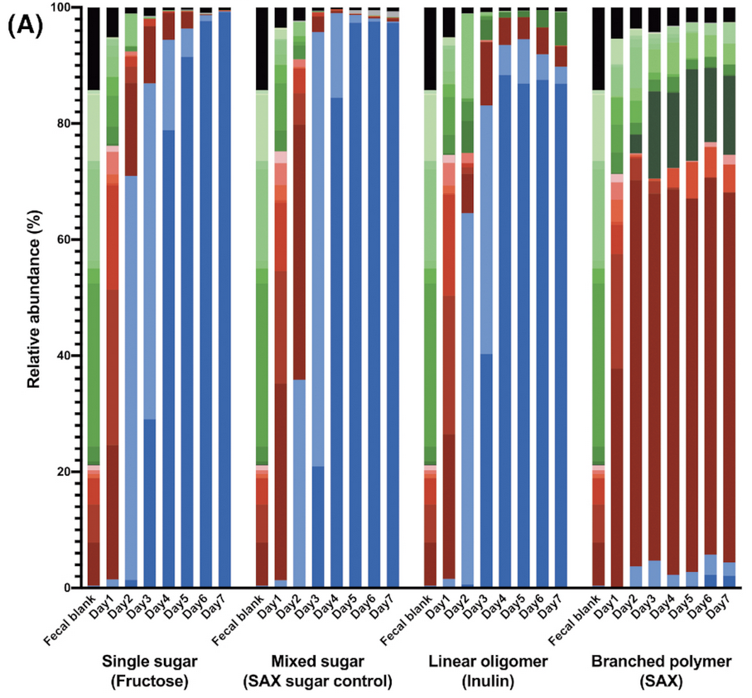
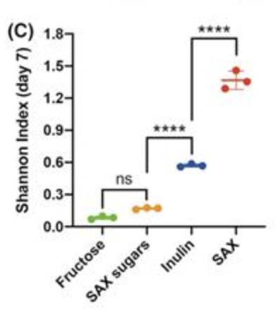
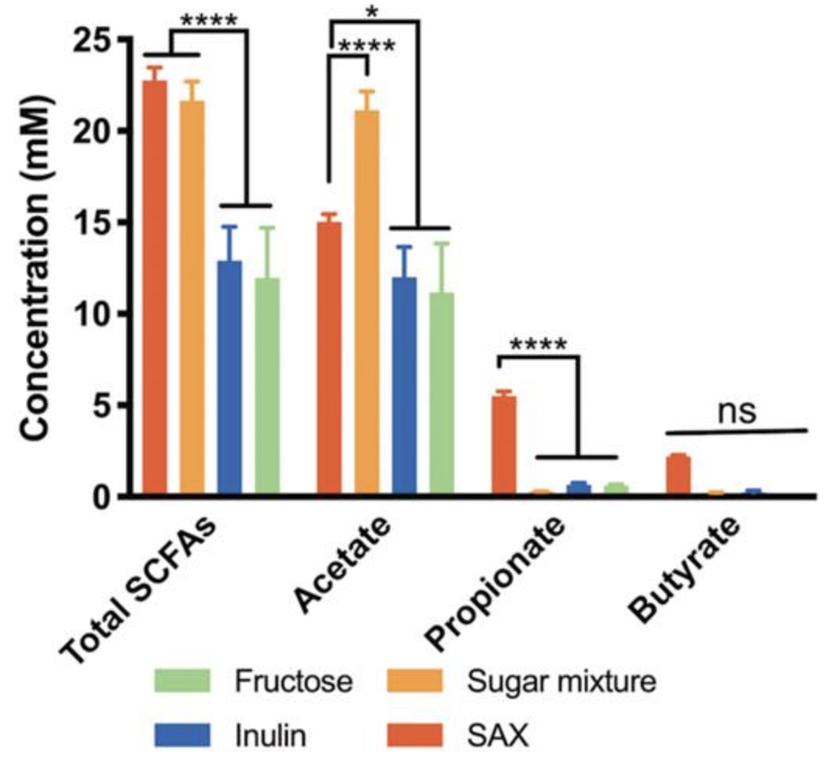




Dietary fiber and gut microbiome
Fiber structures and gut microbiome
Complex dietary fiber (AX) maintain a more diverse microbial community than simple fiber (Inulin) and with higher metabolic outputs.
FEMS microbiology ecology, 2020. 96(9), fiaa158.
Notes:
The molecular complexity of dietary fiber and their role in maintain the diversity of the community.

Slide 7
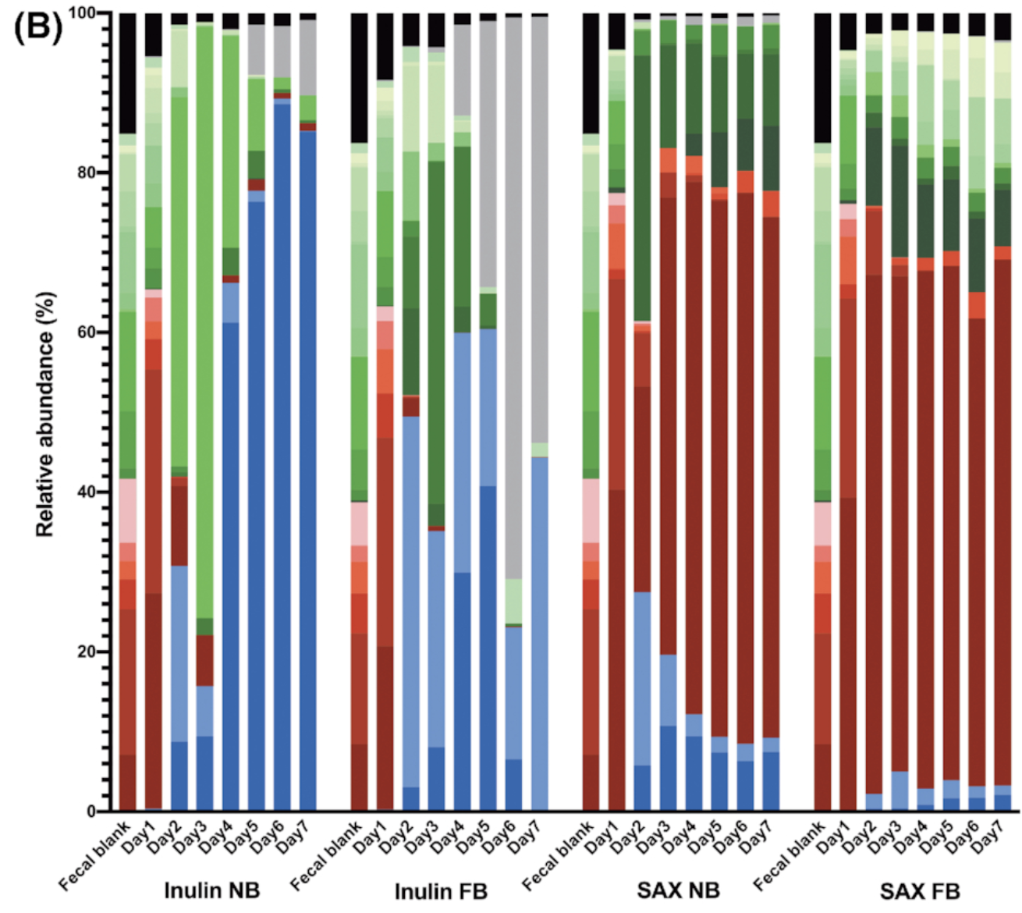
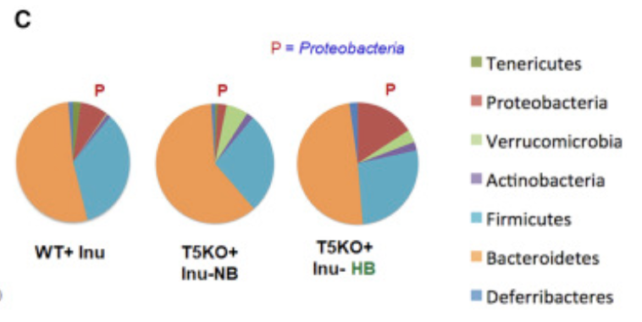
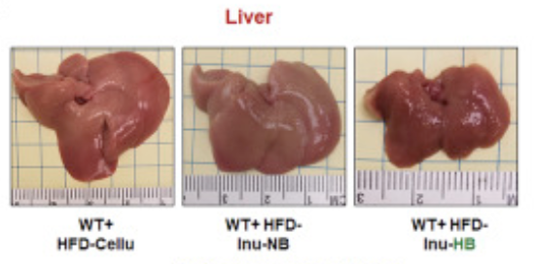
Dietary fiber and gut microbiome
Inulin/FOS – concerns
Bloating effect, rapid fermentation.
Promotion of Proteobacteria, which is not a beneficial microbial phylotype.
FEMS microbiology ecology, 2020. 96(9), fiaa158.
Cell, 2018. 175(3), 679-694.
Notes:
Inulin diet promote Proteobacteria. and induced liver damage.

Slide 8
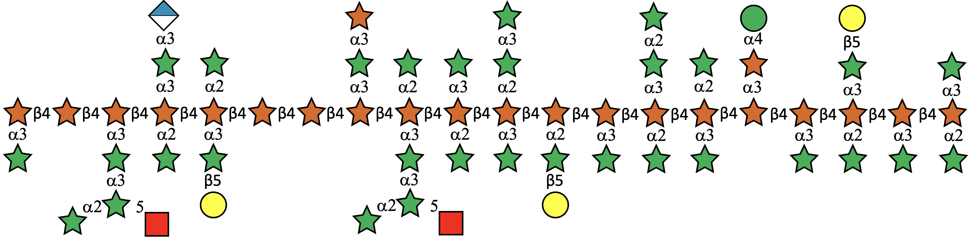
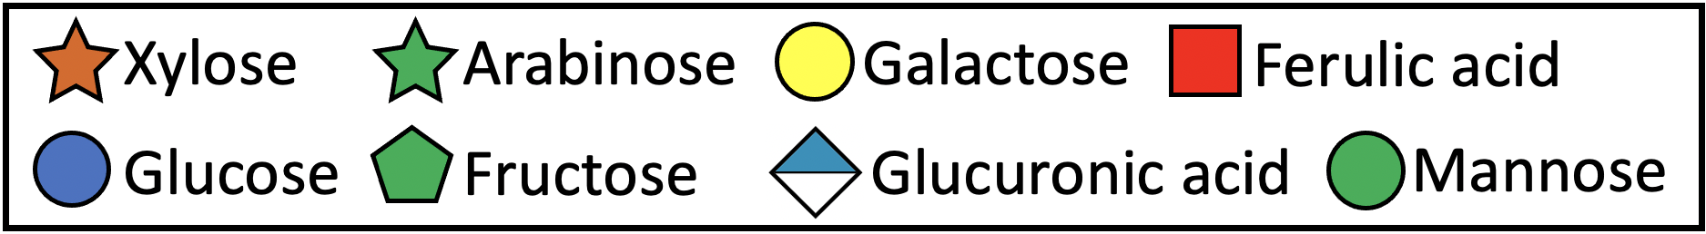
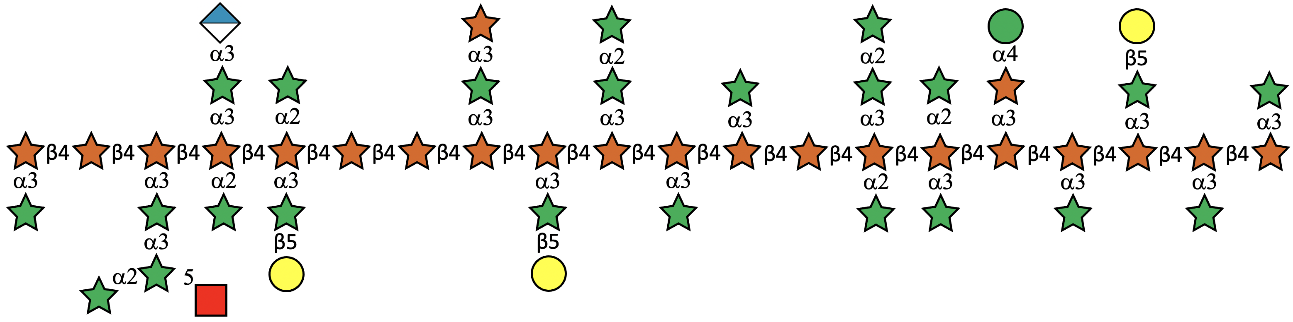
How does the fine complex fiber linkage structure shape distinct fecal microbial communities?
Arabinoxylan 1 isolated from red sorghum bran (RSAX)
Slightly more complicated side-chain regions
Arabinoxylan 2 from white sorghum bran (WSAX)
With less complicated linkages but more simple side-chain structures
Yao et al. (2023)
Carbohydr. Polym.
Notes:
The next question I want to study is how fine fiber structures would shape distinct microbial community, and also test whether our in vitro model could resolve different microbial responses when growing on a same type of substrates with small differences.
Here I used ...

Slide 9
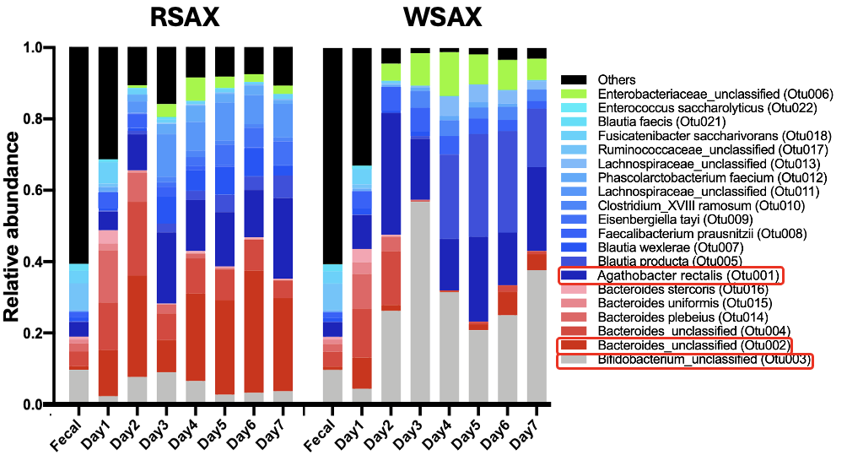
Yao et al. (2023) Carbohydr. Polym.
Notes:
The result clearly showed different community evolution trajectories over 7 days. RSAX maintain a microbiota with ...
Besides the selection of different microorganisms, we also found distinct microbial functions in terms of different metabolites detected in RSAX and WSAX cultures.

Slide 10
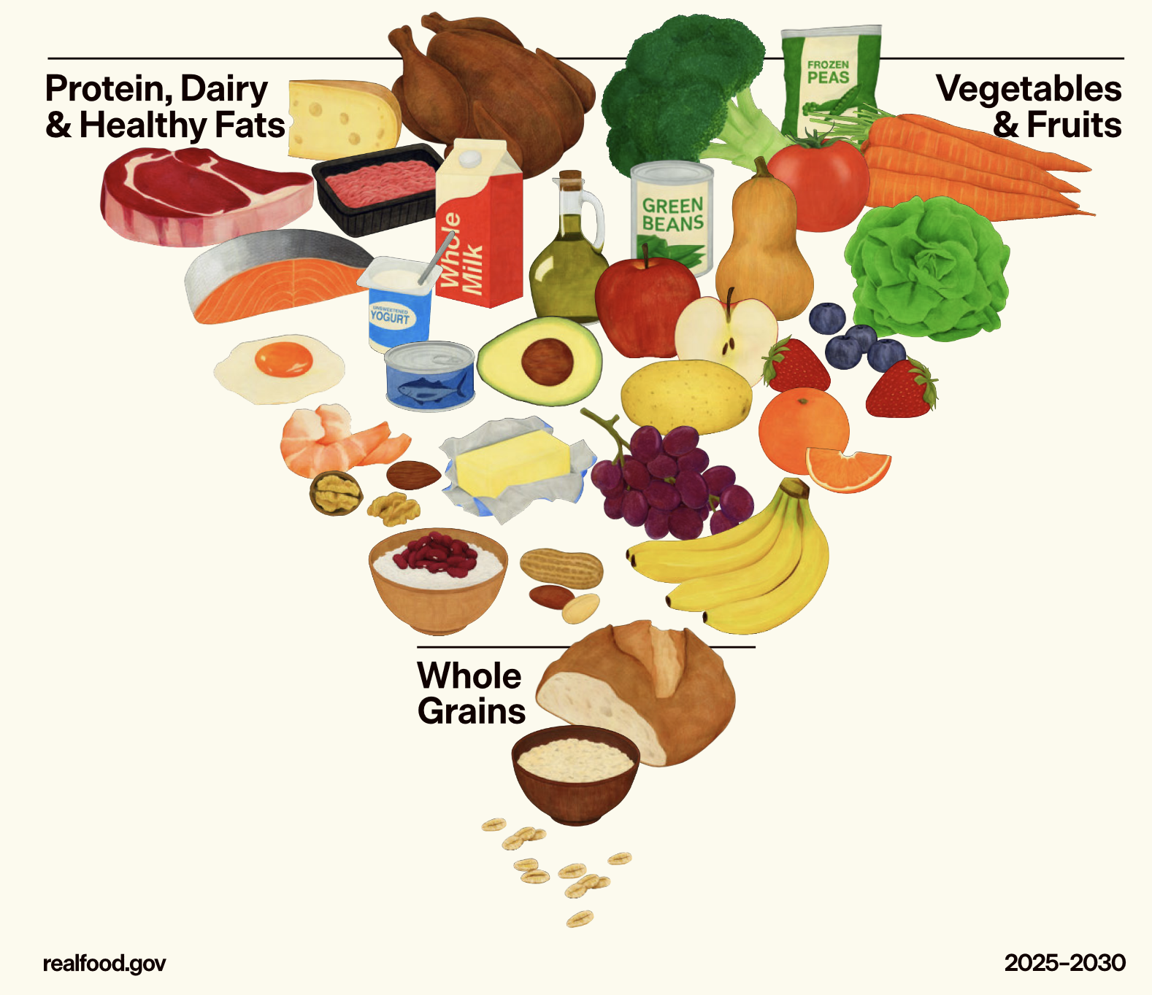
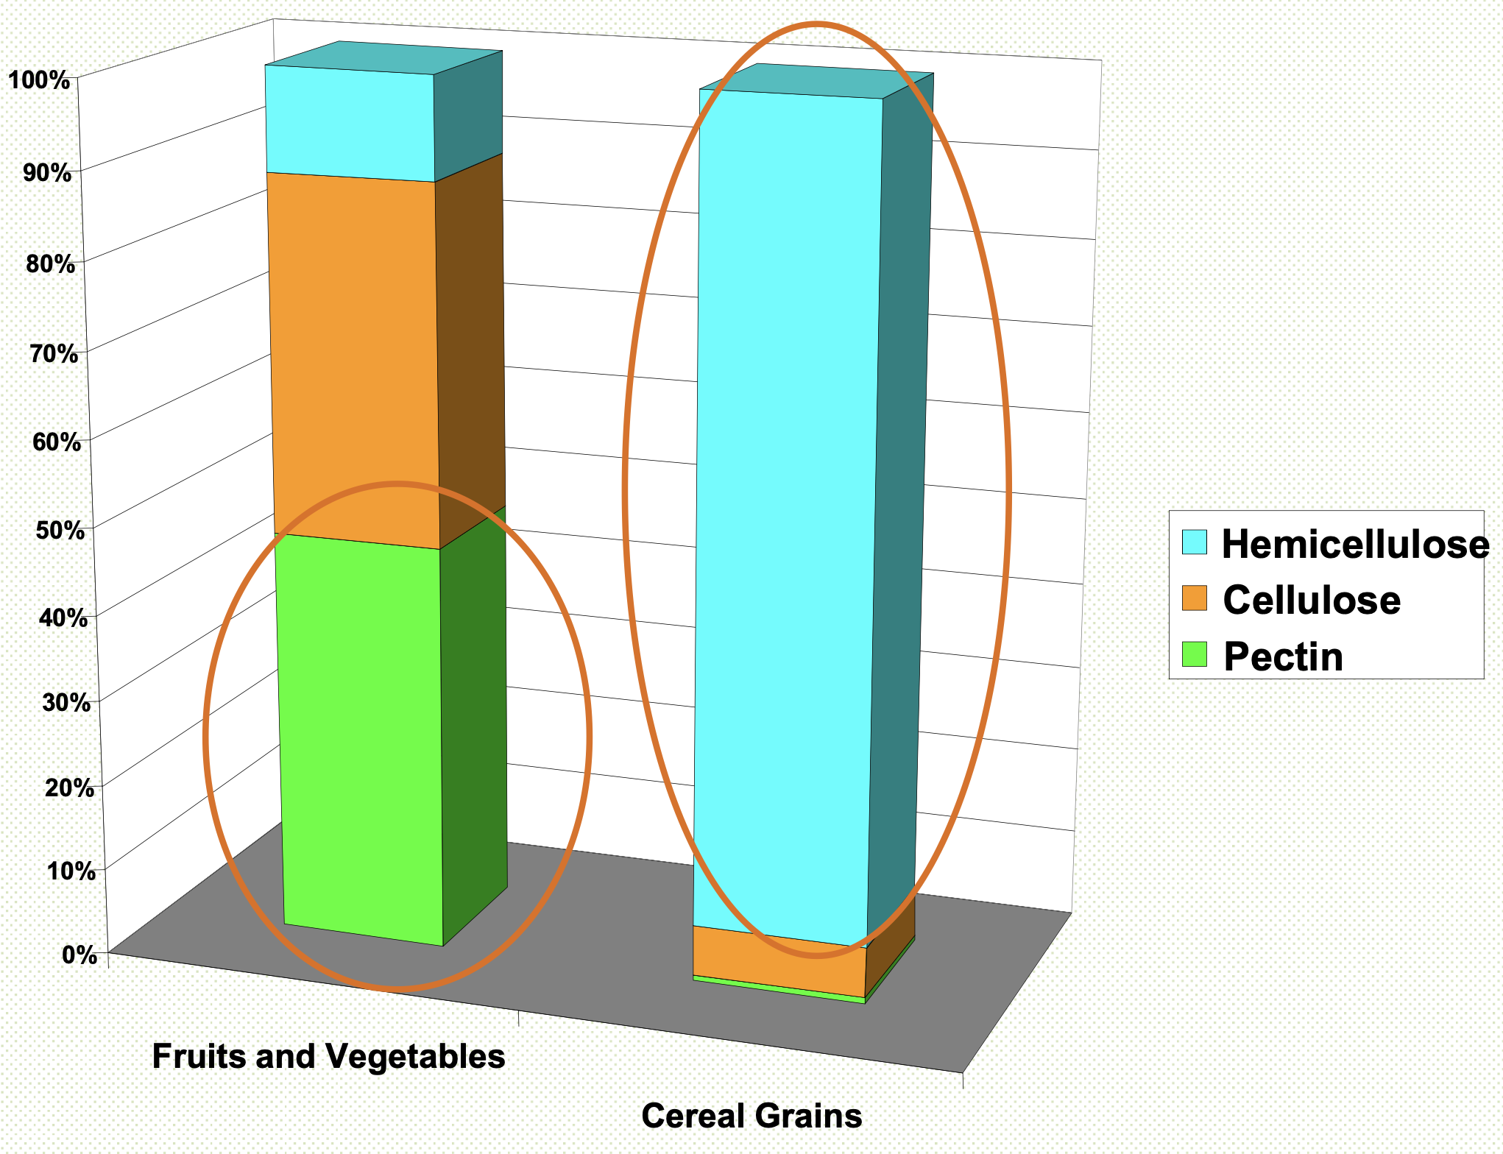
Fiber-rich foods
Vegetables and fruits are emphasized in the new guideline
(Maisonnier et. al. 2002)
Notes:
Polysaccharides are quite rich in Byproducts include those pomace from juice and beverage production, such as apple pomace. Other fruit pomace include cranberry and blueberry, and all of these fruit derived pomace are rich in dietary fiber called pectin. pomace is widely applied in food industry as stabler, thickener and gelling agents and can be just a source of supplementary of dietary fiber. There are different pecin rich byproducts as just mentioned in fruit and vegetables. Some other By products such as. wheat bran. These are cereal grains by-products from the milling industry. They are rich in hemicellulose. One example is arabinoxylan which is abundant in corn bran, wheat bran and it's being considered as the next generation prebiotic fiber because it has a much stronger microbiome selection effect compares to the current widely applied prebiotic fibers such as inulin or FOS.

Slide 11
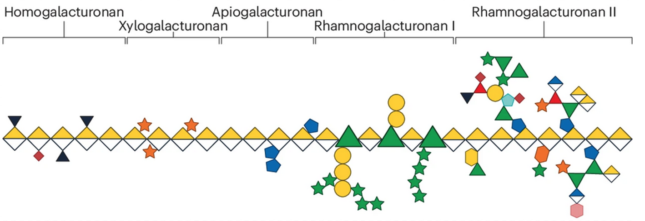
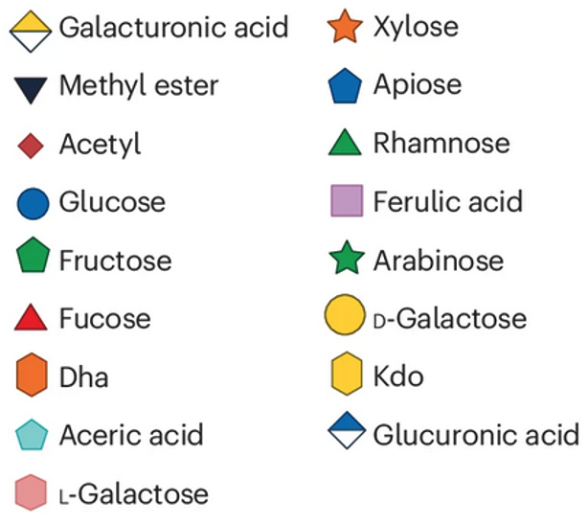
Impact of Food Processing on Polysaccharide Structure
RG
HG
Changes of esterification on pectin backbone
Modify the ratios of domain components (HG/RG ratio; monosaccharide composition)
Regulate the branching complexity
Nature Reviews Microbiology, 2024, 1-14.
Notes:
Back to our apple pectin extracted from pomace. Apple pectin is known to have the most complex structure among the natural food fiber source.
We would expect CP modify the structure of 1, 2, 3, ... and therefore exert different gut microbiome modulation effect, such as ...

Slide 12
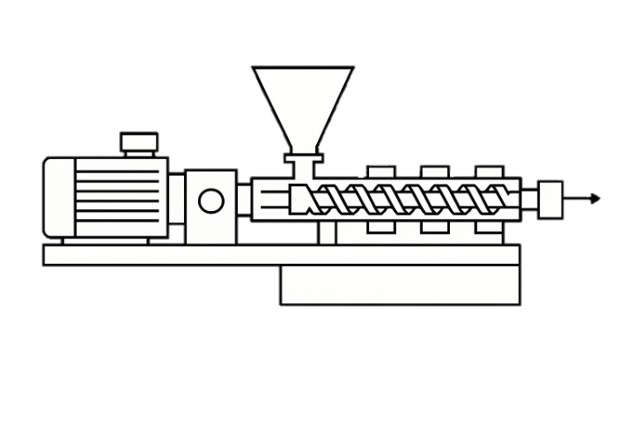
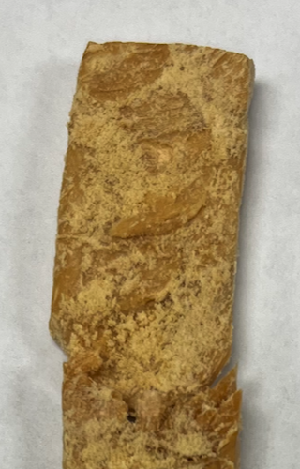
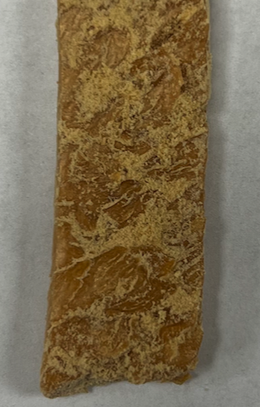
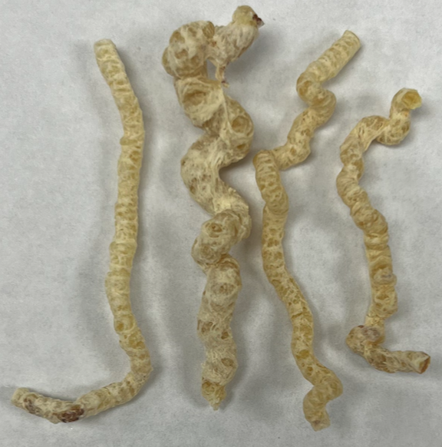
Changes of soluble fiber composition after food processing
Schematic of a single-screw extruder
High temp
High mechanical shearing force
Alters fermentable fiber structures
(Yao et al., unpublished data)

Slide 13
Take home messages
Dietary fibers exhibit complex molecular structures.
Greater structural complexity in dietary fiber is associated with increased gut microbiota diversity.
Subtle variations in molecular structure can significantly influence gut microbiome responses.
Future efforts should focus on optimizing food systems to preserve or enhance microbiome-modulating functionality through controlled processing.

